Slide 1
Approach to Patients with UTI

Slide 2
Case scenario
A 25-year-old lady, who works as a teacher in a secondary school, has presented to the clinic today with the complaint of painful and burning micturition, lower abdominal pain and increased frequency of urination.
These complaints initiated for last 2 days. She has got married just a week ago. Bowel movements are normal. No history of fever, chills or rigor.
On examination:
She look well, not in pain, not pale or jaundiced. Temperature is 37.2 0C.
Systematic examination revealed normal, apart from tenderness in the lower abdomen in the pubic area.
Summarize the case

Slide 3
Objectives:
Identify Differential Diagnosis DD of a case of UTI
Differentiate between the upper and lower UTI.
Discuss briefly about the acute cystitis (lower tract UTI) and honeymoon cystitis.
Discuss briefly about pyelonephritis (Upper UTI).
Investigate appropriately a patient with UTI.
Advice initial management plan for a patient with acute cystitis.
Identify preventive measures for acute cystitis.

Slide 4
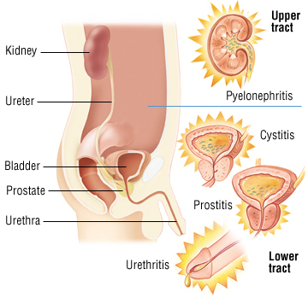
Definition of UTI
A urinary tract infection (UTI) is an infection of the kidneys, bladder, or urethra.
Infectious cystitis is the most common type of UTI, which is caused by a bacterial infection of the bladder.
Pyelonephritis is an infection of the kidney that often occurs via bacterial ascent.
Urethritis is an infection causing an inflammation of the urethra.

Slide 5
DD
lower urinary tract infection (LUTI).
upper urinary tract infection (UUTI).
Urethritis.
Urinary tract stones or foreign bodies.
Sexually transmitted diseases (STDs).
Vulvovaginitis.
Lithium and heavy metal toxicity.
Notes:
If vaginal discharge is present, the probability of bacteriuria (UTI) falls, usually due to candida

Slide 6
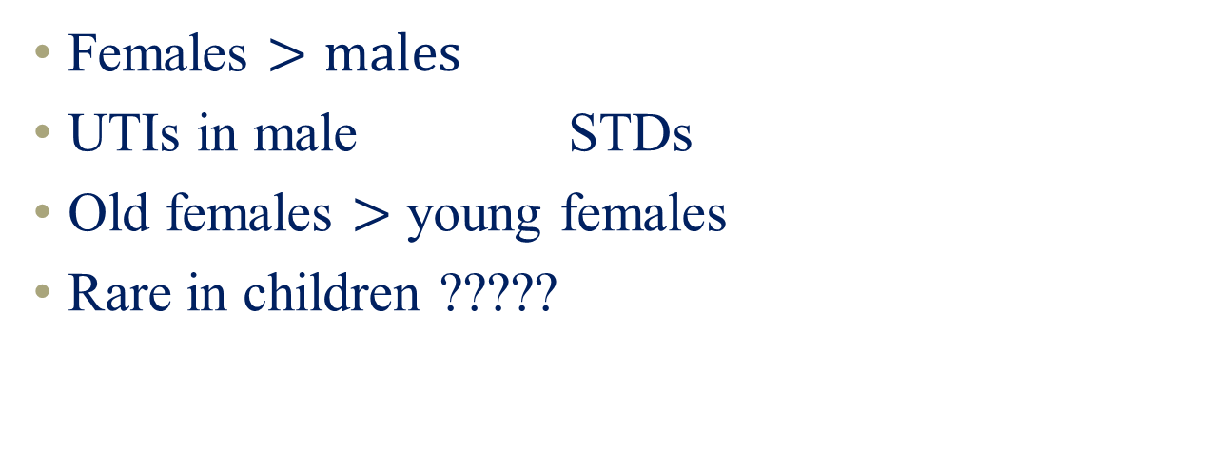
Clinical tips
Females $>males$
UTIs in male STDs
Old females $>$ young females
Rare in children ?????

Slide 7
Lower and Upper UTI
Lower urinary tract infection (LUTI):
Symptoms suggestive of cystitis (dysuria or frequency without fever, chills or back pain).
Upper urinary tract infection (UUTI):
Symptoms suggestive of pyelonephritis (loin pain, flank tenderness, fever, rigors or other manifestations of systemic inflammatory response).

Slide 9
Urinary tract Infection:
UTI most common bacterial infection.
Women are more likely to experience UTI than men.
Up to 50% of women had UTI at some time during their life.
Recurrent infections are serious. It can cause severe renal disease even end-stage renal failure.
Notes:
The majority of urinary tract infections are caused by ascending infection from Urethra.

Slide 10
Urinary tract Infection (Cont..)
The condition is rare in boys and young men.
Invasion and multiplication of microorganisms in UT.
Microorganisms reach urinary tract via either:
The urethra “Ascending infection” or
Bloodstream from a distant source “Hematogenous”.
Notes:
The majority of urinary tract infections are caused by ascending infection from Urethra.

Slide 11
Risk Factors:
Aging
Females: short urethra, having sexual intercourse, use of contraceptives .
Males: prostatic hypertrophy, bacterial prostatitis .
Urinary tract obstruction: tumor .

Slide 12
Risk Factors:
Sexual activity,
Spermicide use Spermicides,
Post-menopause The absence of oestrogen (consistent with urogenital atrophy, vaginal atrophy),
Positive family history of UTIs,
History of recurrent UTI,
Presence of a foreign body.

Slide 13
Classification
Uncomplicated or complicated.
- Uncomplicated UTIs include acute cystitis occurring in otherwise healthy, non-pregnant women without functional or anatomical urinary tract abnormalities.
- Complicated UTIs include infections in patients with functional or structural impairments that reduce the efficacy of antimicrobial therapy.
- The involvement of the kidneys (pyelonephritis) or UTIs occurring in pregnancy are also considered complicated UTIs.

Slide 14
Classification
- Acute UTIs are infections causing acute symptoms in the presence of infected urine.
- Recurrent UTI is defined as two separate culture-proven episodes of acute UTIs and associated symptoms within 6 months, or more than three UTIs in 12 months.

Slide 15
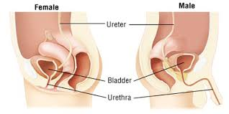

Slide 16
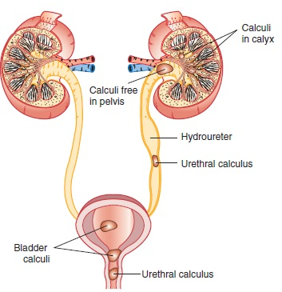

Slide 17
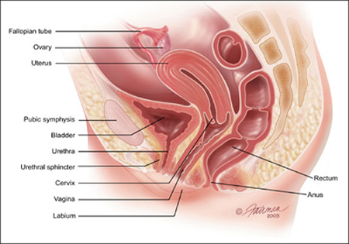
The Risk Factors For Acute Cystitis In Female
Short urethra.
Age.
sexual activity.
Pregnancy.
Contraceptive pills.
Diabetes mellitus.
Poor hygiene.
Wipe from back to front.

Slide 18
Acute cystitis:
Acute inflammatory signs are present of the inner lining of the bladder and it becomes red, congested and swollen.
It’s most common by E.coli (75-95%) .
It cause by Proteus, Klebsiella but less common.
Women have a higher incidence of infection.

Slide 19

Cystitis:
Sign and symptoms
Suprapubic pain
Dysuria
Un-complicated (simple) cystitis
Healthy, non-pregnant women without functional or anatomical urinary tract abnormalities.
No fever, nausea, vomiting or flank pain.
Complicated
cystitis
Hesitancy
Urinary frequency and urgency
Infections in patients with functional or structural abnormalities that reduce the efficacy of antimicrobial therapy.
If in male patients or in pregnant women, also considered as complicated.
If the kidney was involved (pyelonephritis).
Notes:
bladder infection. Occurs when the Bladder which is normally sterile (microbe free) become infected by bacteria
hesitancy - difficulty in beginning of urination
frequency, is the need to urinate more often than usual.
Urgency is a symptom where you get a sudden urgent desire to pass urine.

Slide 20
Table 1
Approximate frequency (%) | Organism
68% | E coli and other ‘coliforms’
12% | Proteus mirabilis
10% | Staph, saprophyticus.
6% | Enterococcus faecalis
4% | Klebsiella aerogenes

Slide 21
Honeymoon cystitis
It’s a term for UTI that often occurs after Sexual activity.
Sexual activity can push infecting bacteria Into the urethra resulting in an infection .
Women with a diaphragm placed for birth control are at a higher risk for UTIs .

Slide 22
Complicated UTI
DM
Pregnancy
kidney transplant
stones
anatomic abnormality
catheterization
recent antibiotics
recent hospitalization
UTI in males

Slide 23
Pyelonephritis

Slide 24
Pyelonephritis:
Severe infectious inflammatory disease of the renal parenchyma, calyces and pelvis.
Signs and symptoms:
Fever (> 38 °C) and chills.
Unilateral or bilateral flank or angle pain and tenderness.
Nausea and/or vomiting.
Anorexia.

Slide 25
Pyelonephritis
Acute pyelonephritis
Chronic pyelonephritis
long standing infection that doesn't clear and can result in kidney scarring .
Occurs only in patients with major anatomic abnormalities .
chronic pyelonephritis that occur in obstruction due to infected or renal stones.
≥2 infections in six months or ≥3 infections in one year.
Xanthogranulomatous pyelonephritis
Recurrent pyelonephritis
Sudden development of kidney infection.
Affected patients usually have massive destruction of the kidney .( confused with renal malignancy )
Notes:
Xanthogranulomatous pyelonephritis:
is an unusual variant of chronic pyelonephritis that occur in the setting of obstruction due to infected renal stones.
Affected patients usually have massive destruction of the kidney due to granulomatous tissue containing lipid-laden macrophages; the appearance may be confused with renal malignancy. with a history of recurrent urinary tract infections. The typical presenting symptoms include flank pain, fever, malaise, anorexia and weight loss. A unilateral renal mass can usually be palpated on physical examination. The most common organisms associated with XPN are E. coli, Proteus mirabilis, Pseudomonas, Enterococcus faecalis and Klebsiella

Slide 26
Cystitis vs Pyelonephritis:
 | Cystitis | Pyelonephritis
Site | Lower UT | Upper UT
Fever | NO | Yes
Pain | suprapubic | flank

Slide 27
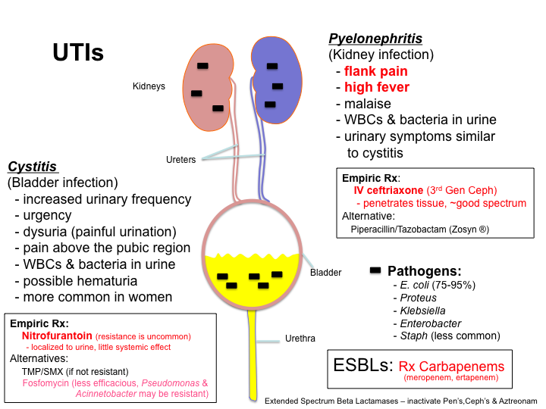
Clinical Picture

Slide 28
Investigations

Slide 29
Laboratory:
Dipstick urinalysis
Microscopic urinalysis (clean catch midstream specimen).
Urine Culture

Slide 30
Urine dipstick
Perform a urine dipstick test as the first diagnostic test in women aged under 65 years with urinary tract symptoms where they have:
- Only 1 of the 3 key signs or symptoms (dysuria, nocturia, or cloudy-looking urine, OR
- None of the 3 key signs or symptoms but other severe symptoms of urgency, frequency, visible haematuria, or suprapubic tenderness).

Slide 31
Laboratory:
Dipstick urinalysis
Positive leukocyte esterase. Can detect bacteria equalent to 100,000 colony forming unit/ml
Positive Nitrites.
Positive RBCs.

Slide 32
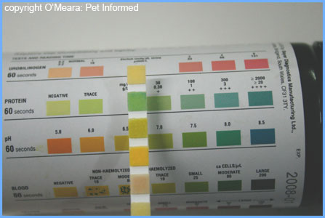
Work up (urine dipstick)
Presence of leukocyte esterase (an enzyme released by leukocytes, reflecting pyuria)
Nitrite (reflecting the presence of Enterobacteriaceae which convert urinary nitrate to nitrite)
Positive for RBCs

Slide 33
Cont ..Laboratory:
Microscopic urinalysis (clean catch midstream specimen).
Look for pyuria, bacteriuria, and leukocyte castes.
Hematuria and proteinuria may be present.
Urine culture recommended in complicated and upper UTI

Slide 34
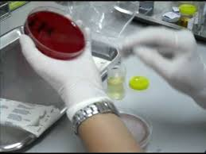
Urine culture:
Should always be performed in:
Men
Suspected upper UTI,
With complicating factors:
Pregnancy
Diabetes.
It’s not required for symptomatic
lower UTI in non-pregnant women.

Slide 35
Indications for culture
Has none of the 3 key diagnostic symptoms but has other urinary symptoms, and the urine has positive leukocytes and negative nitrites.
Is pregnant
Is aged over 65 years and is symptomatic and is being started on antibiotics for a UTI
Has suspected sepsis or pyelonephritis
Has persistent symptoms or antibiotic treatment has failed
Has recurrent UTIs (2 in 6 months or 3 in 12 months)
Has a urinary catheter and will receive antibiotics for a UTI
Has a risk of antimicrobial resistance.

Slide 36
Criteria for diagnosis
3 key signs or symptoms (dysuria, nocturia, or cloudy-looking urine).
Only 1 of the 3 key signs or symptoms plus positive nitrites and leuco-esterase in urine dipstick.
Only 1 of the 3 key signs or symptoms plus pus cells in microscopic urine analysis.
Symptoms plus growth in urine culture.

Slide 37
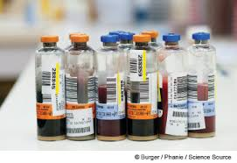
Blood culture:
Only indicated in ill-patient and if urosepsis is suspected.

Slide 38
Role of imaging
In complicated UTI
Renal stones or obstruction
Hydronephrosis or abscess
Poor bladder emptying
Illness despite 3 days of treatment
Urinary tract congenital anomalies
Visualization for biopsy
Plain x-ray
Ultrasonography
CT
Intravenous pyelography (IVP)
Micturating cystourethrography
Cystoscopy

Slide 39
Management
Non-pregnant women <65 Ys without a catheter.
- Give immediate antibiotics for women with severe symptoms who have:
2 or 3 of the key diagnostic signs and symptoms for UTI (dysuria, new nocturia, cloudy-looking urine) OR
1 key diagnostic sign or symptom AND
- A urine dipstick positive for nitrite OR
- A urine dipstick positive for leukocytes and negative for nitrite OR
- A urine dipstick positive for both leukocytes and red blood cells.
Watch and wait and provide a back-up prescription for antibiotics for women with mild symptoms.

Slide 40
SIGN guideline recommends considering NSAIDs as a first-line treatment in women aged under 65 with mild symptoms.
This offers an alternative to antibiotics in order to reduce antibiotic prescribing.
Consider and discuss with the patient the risks and benefits if considering this approach.
Limit the duration to 3 days and ask the patient to make contact if the symptoms do not resolve or worsen in this time

Slide 41
Back-up prescriptions
for women with acute uncomplicated UTI seem to be as effective as immediate prescriptions (measured by severity of symptoms, duration of symptoms, and time to reconsultation) and reduce the number of women using antibiotics.
- Do not give immediate or back-up antibiotics to women with no key diagnostic signs or symptoms and a dipstick test negative for nitrites, leukocytes, and red blood cells.
- Do not send a urine culture. Do not treat non-pregnant women who have asymptomatic bacteriuria

Slide 42
Choice of antibiotic
• Nitrofurantoin if estimated glomerular filtration rate (eGFR) ≥45 mL/minute
• Nitrofurantoin is effective against Escherichia coli , the most common causative pathogen in uncomplicated UTIs (70%-95% of patients)
• Trimethoprim if low risk of resistance
Duration of treatment - NICE recommends a 3-day course.

Slide 43
Women ≥65 years (without a catheter).
Give immediate antibiotics, ideally after sending urine for culture, for women aged ≥65 years with severe symptoms and a likely UTI.
Watch and wait and give a back-up prescription for antibiotics, ideally after sending urine for culture, for women aged ≥65 years with mild symptoms and a likely UTI.
For first-choice antibiotic,
Nitrofurantoin (nitrofurantoin: 100 mg orally (modified release) twice daily; 50 mg orally (immediate release) four times daily).
Trimethoprim if low risk of resistance (200 mg orally twice daily).

Slide 44
Pregnant women (without a catheter)
Initial management Prescribe an immediate antibiotic, after sending urine for culture, for all pregnant women with symptoms of a UTI.
First-choice antibiotic in women with symptoms of a UTI,
Nitrofurantoin if eGFR ≥45 mL/minute.
second-choice antibiotic,
Amoxicillin
Cefalexin
- For women with asymptomatic bacteriuria prescribe nitrofurantoin, amoxicillin, or cefalexin.
Duration of treatment is 7-days.

Slide 45
Women (any age) with a catheter
Send a urine sample for culture and susceptibility testing, noting a suspected catheter-associated infection, before prescribing any antibiotic.
Prescribe at least a 7-day course of antibiotics to ensure complete cure.
- Nitrofurantoin
- Trimethoprim if low risk of resistance.
Pregnant women with catheter-associated UTI:-
- Prescribe cefalexin.
- For first-choice intravenous antibiotic, in patients who are vomiting, are unable to take oral antibiotics, or are severely unwell, prescribe cefuroxime

Slide 46
Special Circumstances
Older women
Need longer duration of antibiotics (7-10 days)
In men of 15-50 years, incidence very low
Risk factors: homosexuality, lack of circumcision
Need 7-10 days duration
In pregnancy
Cephalexin 250/125mg 6-hourly.
Amoxicillin 250mg 3 times daily.
(Trimethoprim and Quinolons to be avoided)

Slide 47
Follow-up:
Patients with acute cystitis or pyelonephritis who have persistent symptoms after 48 to 72 hours of appropriate antimicrobial therapy or recurrent symptoms within a few weeks of treatment
Should have urine culture repeated and empiric treatment should be initiated with another antimicrobial agent.

Slide 48


Slide 49



Fluid intake of at least 2 L/day.
Timed voiding (regular complete emptying of bladder).
Good personal hygiene especially during sexual intercourse.
Females, should wipe from front to back after voiding to prevent contaminating the urethra with bacteria from the anal area.
Cranberry juice may be effective.

Slide 50
Prophylactic therapy:
In recurrent infections
Treatment for 6–12 months
low-dose prophylaxis:
Trimethoprim 100 mg,
Co-Trimoxazole 480 mg,
Cefalexin 125 mg at night)

Slide 51
In Summary:
UTI is a common problem.
Female are more prone for this problem.
Empiric treatment of short duration is OK
Be aware of Upper UTI, and UTI in male
Non-pharmacological and good hygienic habits are the corner stones to reduce the recurrent attacks

Slide 52
A 23-year-old sexually active woman visits a free clinic, reporting a sudden onset of dysuria that began 2 days ago. On further questioning, she also reports urinary frequency, some back pain, and a pink discoloration to her urine. She denies vaginal discharge or irritation and has been afebrile. The clinic has no microscope or urine dip sticks available. Based on this history, what is her most likely diagnosis?
a. Acute bacterial cystitis
b. Urethritis
c. Pyelonephritis
d. Interstitial cystitis
e. Vulvovaginitis

Slide 53
An 18-year-old woman is seeing you for back pain, frequency, and dysuria. She has never had a urinary tract infection (UTI) in the past, and though she recently became sexually active, she denies vaginal discharge or risk for sexually transmitted infection. In this setting, when would a urine culture be necessary?
a. If a urine dipstick were negative
b. If a urine dipstick was positive for leukocyte esterase and blood
c. If a microscopic evaluation of her centrifuged urine revealed more than 5 white blood cells per high powered field
d. If a microscopic evaluation of her centrifuged urine revealed significant bacteriuria

Slide 54
A screening urinalysis in a female patient reveals asymptomatic bacteriuria. In which of the following patients would treatment be indicated?
a. A sexually active teenager
b. A pregnant 26-year-old
c. A 45-year-old with uncontrolled hypertension
d. A menopausal woman
e. An otherwise healthy 80-year-old woman

Slide 55
You are seeing a 34-year-old man with urinary symptoms. He reports frequency, urgency, and moderate back pain. He is febrile and acutely ill. He has no penile discharge. His urinalysis shows marked pyuria. He has never had an episode like this before and has no known urinary tract abnormalities. What is the most likely diagnosis?
a. Gonococcal urethritis
b. Nongonococcal urethritis
c. Acute bacterial cystitis
d. Pyelonephritis
e. Acute prostatitis

