Slide 1
Acute Visual Loss
Waleed alrashed

Slide 2
Definition
Sudden onset of blindness.
A disaster for most people and you should be able to evaluate such a patient and be able to recognize situations requiring urgent action.

Slide 3
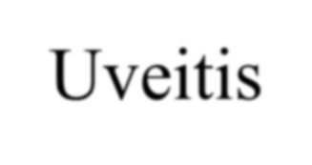
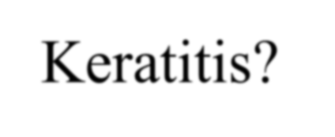
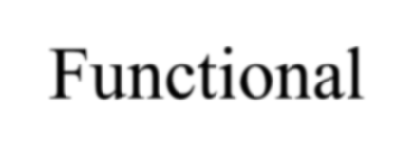
Causes of Acute Visual Loss
Painful
Acute A. C. glaucoma
Uveitis
Keratitis
Corneal abrasion and eye trauma
Endophthalmitis
Painless
Vitreous hem
RD
Retinal vascular Occlusions
Optic neuritis +
Ischemic optic neuropathy
CVA
Functional

Slide 4
ACUTE VISUAL LOSS
Examination:
Visual acuity testing
Confrontation visual fields
Pupillary reactions
Ophthalmoscopy
External examination of the eye with a pen light
Tonometry to measure the intraocular pressure

Slide 5
Media opacities
Cornea
Oedema
The cornea appears like a ground glass rather than its normal clear appearance.
The most common cause of corneal edema is increased intraocular pressure and occurs typically in angle closure glaucoma.
Infection
Any acute infection of the cornea by a corneal ulcer may mimic corneal edema.

Slide 6
Media opacities
Hyphema
Hyphema is blood in the anterior chamber
The hyphema is a direct consequence of blunt trauma to a normal eye.
However, it can occur with tumors, diabetes,intraocular surgery and chronic inflammation which all cause neovascularization.

Slide 7
Vitreous Hemorrhage
Not a diagnosis rather a sign of many diseases

Slide 8
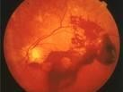
Media opacities
Vitreous hemorrhage
Any bleeding into vitreous will also reduce the visual acuity.
after trauma, seen in diabetics or after a retinal vein occlusion and it may also accompany subarachnoid hemorrhage.
If you cannot appreciate a red reflex with an ophthalmoscope and the lens appears clear, you should suspect a vitreous hemorrhage.
The diagnosis is confirmed with slit lamp examination through a dilated pupil.
B scan is important.

Slide 9
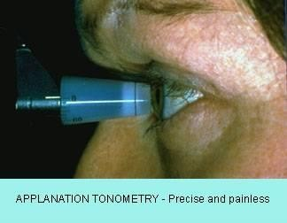
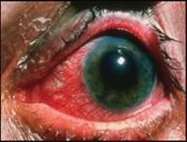
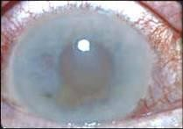
Acute Angle Closure Glaucoma

Slide 10
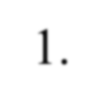
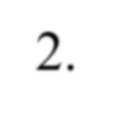
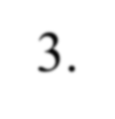
Retinal Detachment (RD)
Types:
Rhegmatogenous RD.
Traction RD.
Exudative RD.

Slide 11
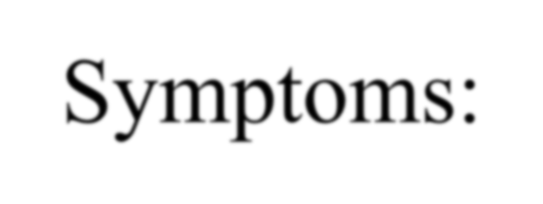
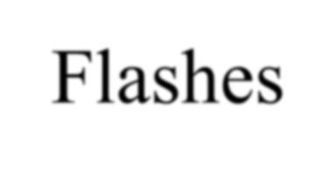
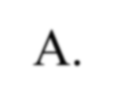
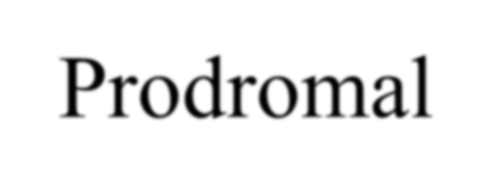
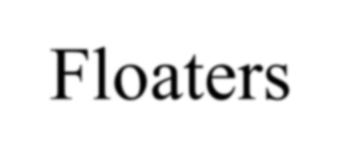
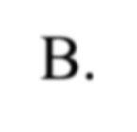
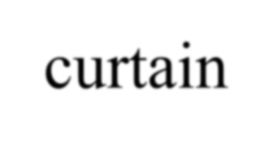
Retinal Detachment (RD)
Symptoms:
Flashes
Prodromal
Floaters
VF loss – curtain-like.
Sudden, painless loss of vision.

Slide 12
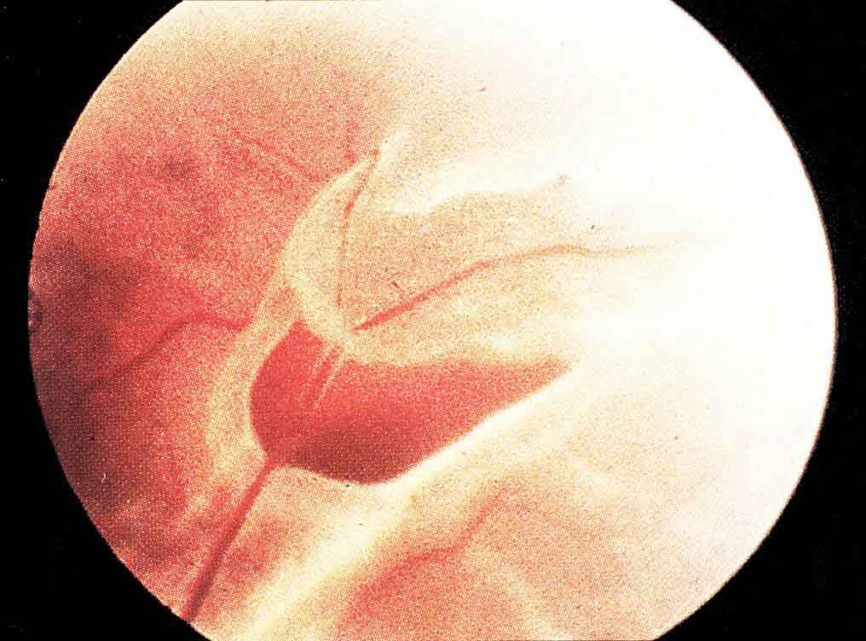

Slide 13
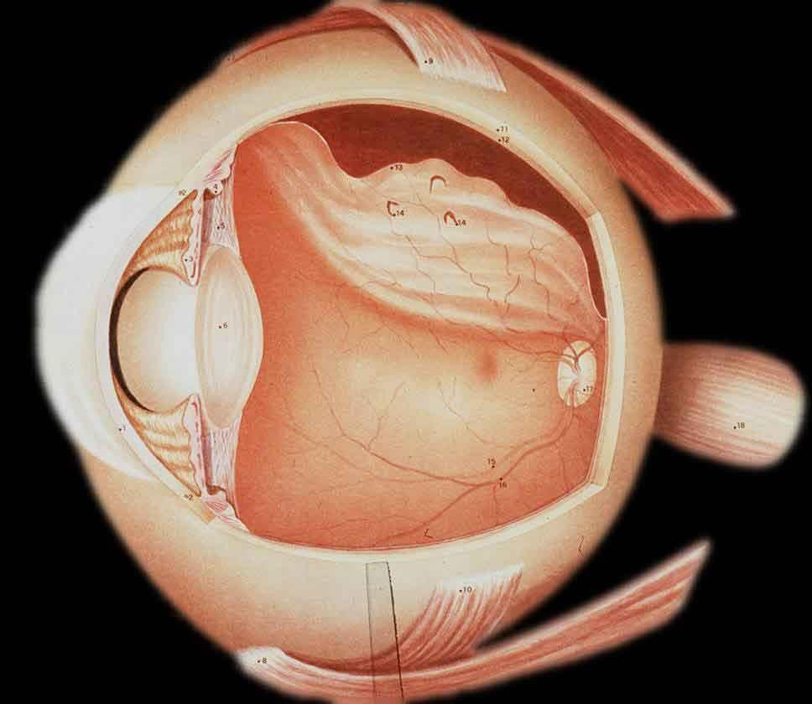

Slide 14
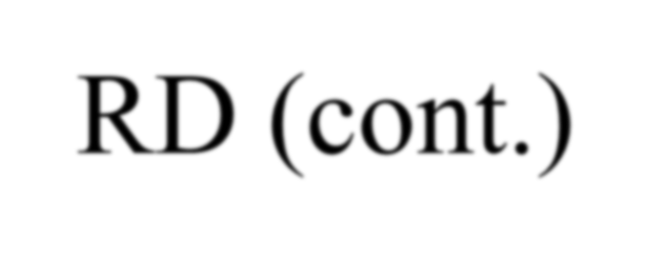
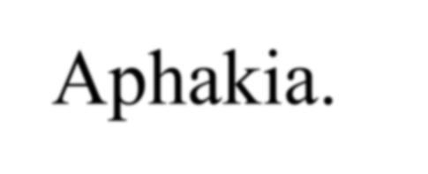
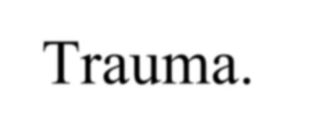
RD (cont.)
Risk Factors:
Peripheral retinal degenerations
- e.g. lattice degeneration, retinal tufts…etc.
High myopia.
Aphakia.
Trauma.
H/O RD.

Slide 15
Retinal vascular occlusion Retinal vein occlusion
ophthalmoscopes picture of disc swelling, venous engorgement, cotton wool spots and diffuse retinal hemorrhages like blood and thunder.
Loss of vision may be severe.
There is no generally accepted acute management. Central retinal vein occlusion is not a true ophthalmic emergency

Slide 16
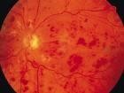

Slide 17
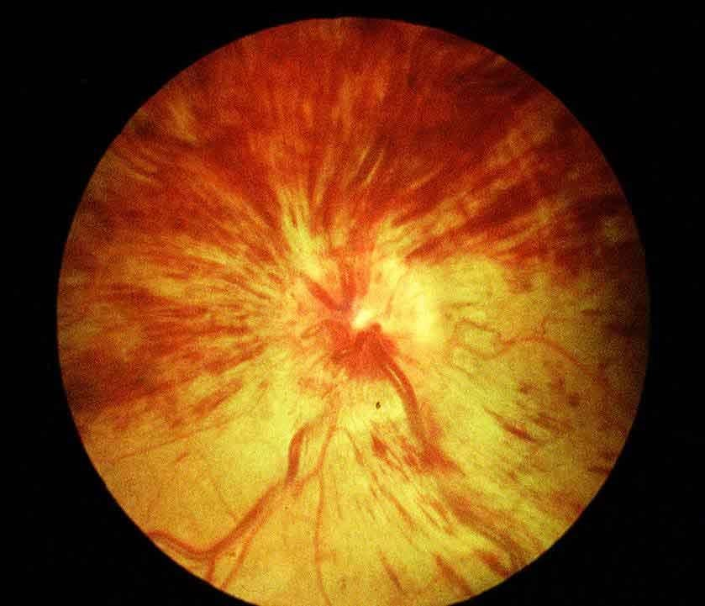

Slide 18
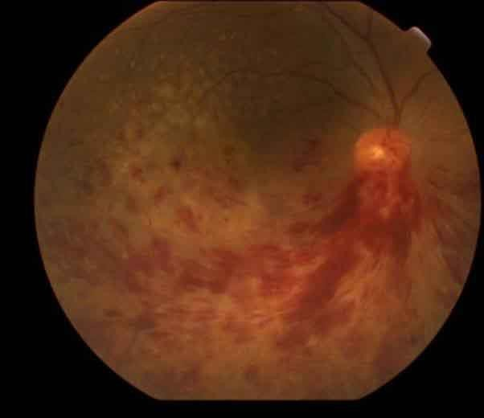
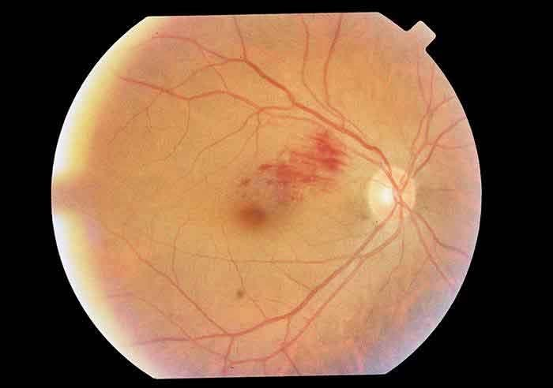

Slide 19
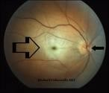
Retinal vascular occlusion
Central Retinal artery occlusion –
A sudden, painless and often complete visual loss may indicate central retinal artery occlusion.
Several hours after a central retinal artery occlusion, the inner layer of the retina becomes opalescent.
A cherry red spot is seen due to the pallor of the perifoveal retina in contrast to the normal color of the fovea.
A chronic cherry red spot is also a feature of the storage diseases such as Tay-Sachs Pick diseas disease and Niemann-Pick disease.

Slide 20
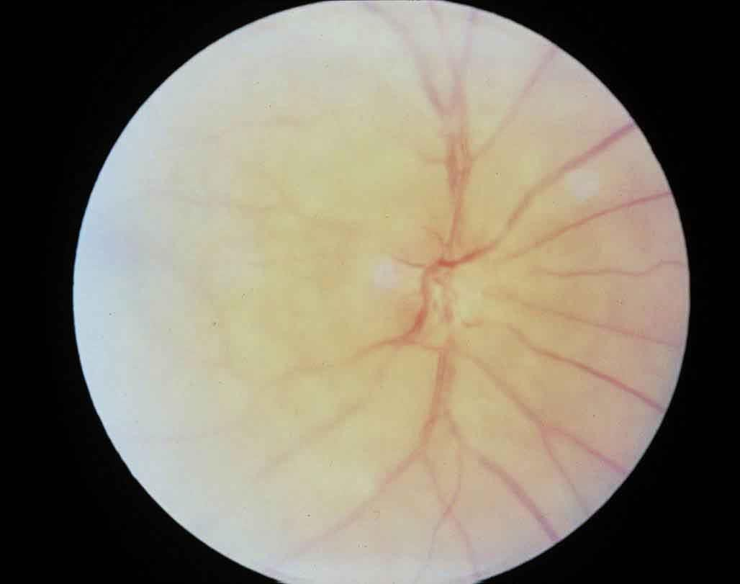

Slide 21
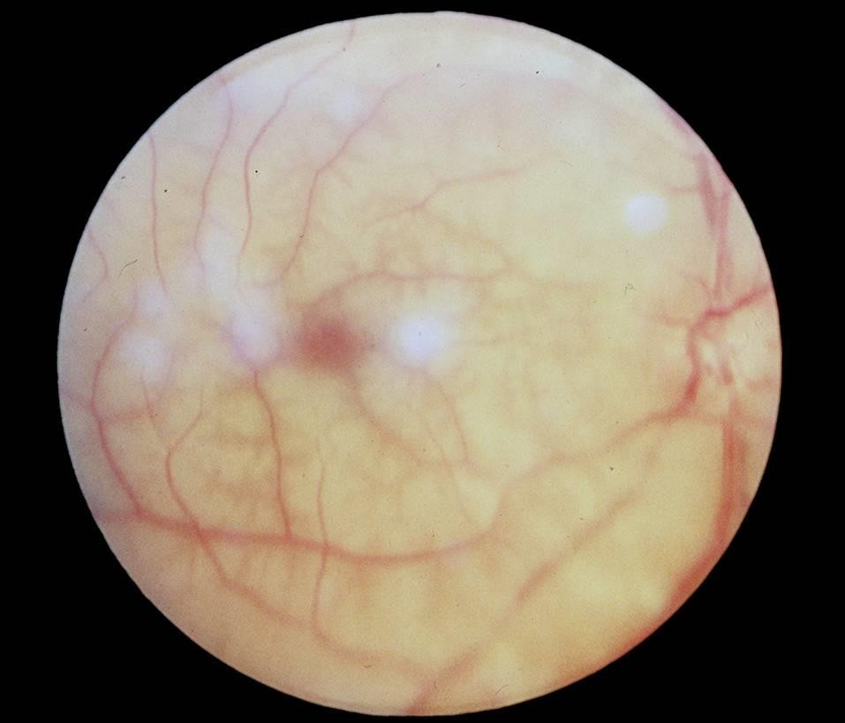

Slide 22
Retinal vascular occlusion
Branch Retinal Artery Occlusion
when only a branch of the central retinal artery is occluded, vision is only partially lost.
This is more likely to be the result of an emboli and the source of the emboli should be sought.
If the visual acuity is affected, attempts should be made to dislodge the emboli by ocular massage.

Slide 23
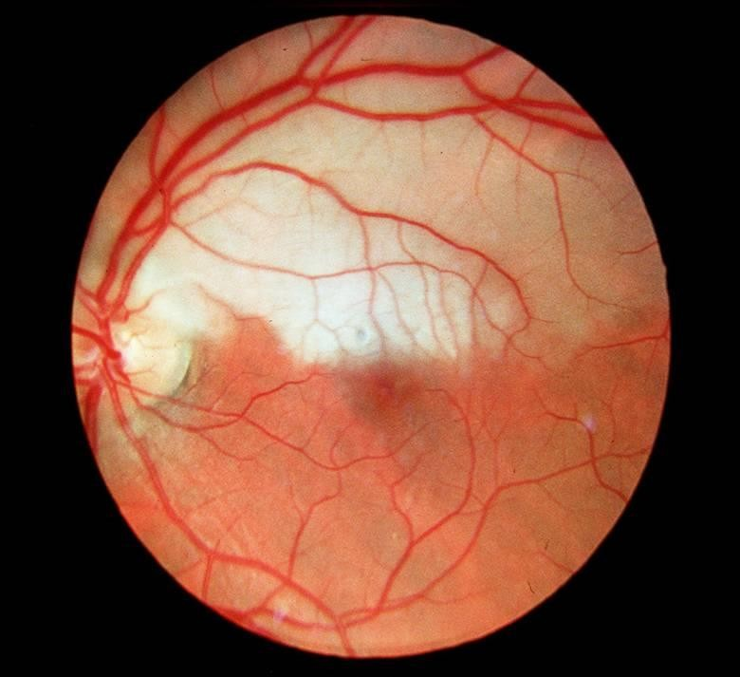

Slide 24
Optic Nerve Disease
Optic Neuritis:
Optic Neuritis is inflammation of the optic nerve and is usually idiopathic but maybe associated with multiple sclerosis in a significant number of cases.
The visual acuity is markedly reduced and an afferent pupillary defect is present.
The optic disc initially appears hyperemic and swollen. The visual acuity usually recovers;
however, repeated episodes of optic neuritis may lead to permanent loss of vision.

Slide 25
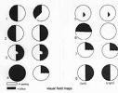
Visual Pathway Disorders
Homonymous hemianopia - is loss of vision on one side of both visual fields
and may result from occlusion of one of the posterior cerebral arteries with infarction of the occipital
lobe.
Other vascular abnormalities occurring in the middle cerebral artery distribution may produce a hemianopia, but usually other neurological signs
are prominent.
Any patient with a hemianopia needs at CT or MRI to localize and identify the cause.

Slide 26
Cortical Blindness
Cortical Blindness: A rare extensive bilateral damage to the cerebral visual pathways results in complete loss of Vision.
This condition is referred to as cortical, central or cerebral blindness.
As the pathways serving the pupillary lights reflex separate from those carrying visual information at the level of the optic tracts, a patient who is cortically blind has normal pupillary reactions.
Thus a patient with normal fundus examination along with normal pupillary reactions,most likely has cortical blindness..

Slide 27
Functional Disorders
A functional disorder is used in preference to hysterical or malingering to describe visual loss without organic basis.
A patient may report complete blindness in one eye and normal vision in the other eye,
and no relative afferent pupillary defect

Slide 28
Thank you

