Slide 1
بسم الله الرحمن الرحيم

Slide 2
Lacrimal Sac Lesion

Slide 3
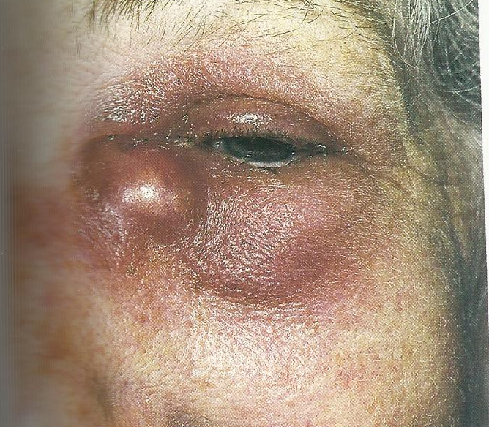
Lacrimal sac lesion
Diabetic retinopathy
A 60-year-old woman complained of tearing and pain in her right eye. She had no history of trauma or surgery of the eyelids, nose or sinuses. She had tearing and discharge for several months. Recently she had developed a painful red lump near the right inner canthus. Examination showed her vision to be 6/6 OU. There was an erythematous swelling over the right lacrimal sac.

Slide 4
Lacrimal sac lesion
Diabetic retinopathy

Slide 5
Discharge from punctum
Reg Test
Probing / Irrigation
Inv.
1- Reg test
2- Probing / Irregation only to adults Giving saline may aggreviate the condition in children
3- Fluroscsent stain test
Treatment
Adult: Probing and silicon tube incase of partial obstruction
In total obstruction – DCR
Children:
Less than 1 year – conservative treatment (ocular massage, topical antibiotic, hot compress) – after 1 year we can do probing twice

Slide 6
Lacrimal sac lesion
Diabetic retinopathy
Clinical features
Tearing
Discharge
Tender
Sex

Slide 7
Lacrimal sac lesion
Diabetic retinopathy
Diagnosis

Slide 8
Chronic dacryocystitis (mucocele)

Slide 9
Lacrimal sac lesion
Diabetic retinopathy
* Other causes of tearing
* Examination and testing
* ?? Probing
* CT
* Dacryocystography

Slide 10
Lacrimal sac lesion
Diabetic retinopathy
Differential diagnosis

Slide 11
Dacrocystocele
Pereceptal cellulitis
Acute ethmoid sinusitis
Frontal sinsitis

Slide 12
Lacrimal sac lesion
Diabetic retinopathy
Treatment

Slide 13
THANK YOU

