Slide 1
Chronic Visual Loss
Waleed alrashed

Slide 2
CHRONIC VISUAL LOSS
Measure intraocular pressure with a tonometer
Evaluate the nerve head
Evaluate the clarity of the lens
Evaluate the function and appearance of the macula
Do refraction (or VA with pinhole)

Slide 3
CHRONIC VISUAL LOSS
Causes of slowly progressive visual loss in an adult patient
Glaucoma
Cataract
Macular degeneration
Diabetic retinopathy
Keratoconus
Refractive errors (children and young adult )

Slide 4
GLAUCOMA
*A major cause of blindness. African Americans
*Often A symptomatic; in early stage (peripheral vision)
*Damage is irreversible
*Effective treatment is available

Slide 5
TYPES OF GLAUCOMA
Open Angle
Closed angle

Slide 6
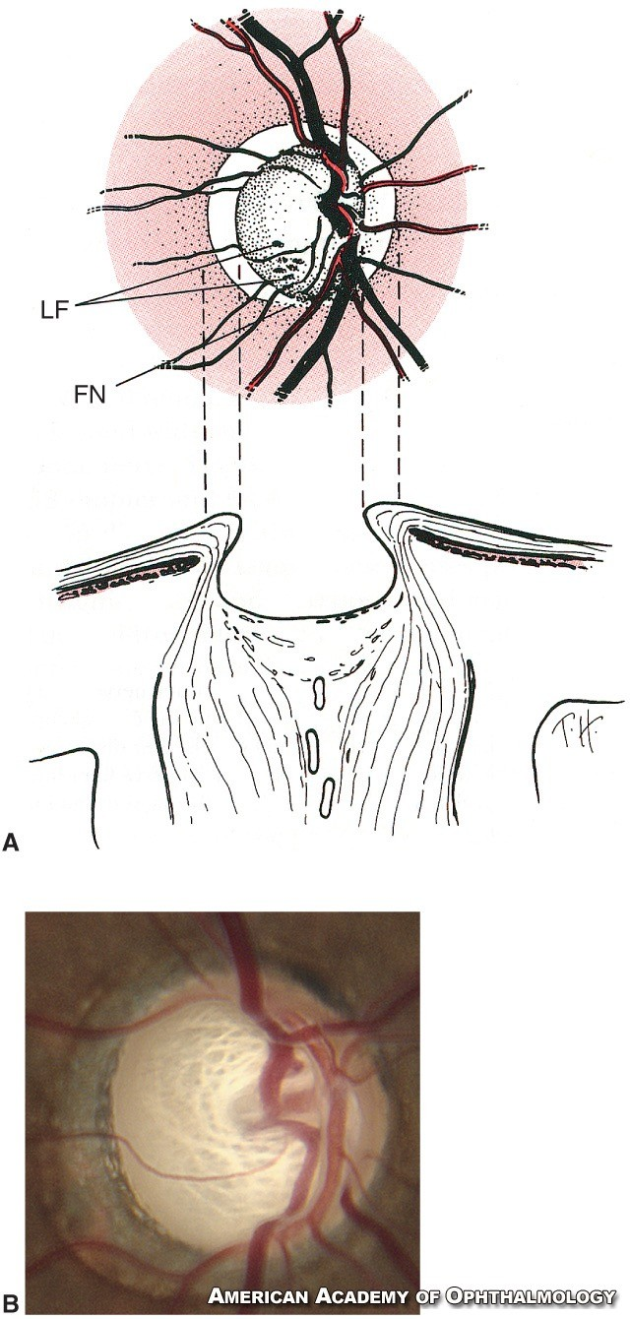

Slide 7
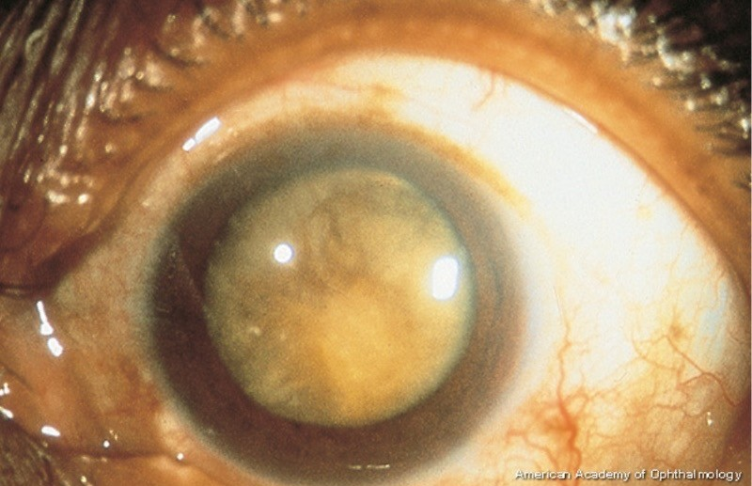
CATARACT
Opacity of the lens

Slide 8
CATARACT
Causes Age Trauma
Systemic diseases
Myotonic dystrophy
Medications
Steroids Chlorpromazine Miotics

Slide 9
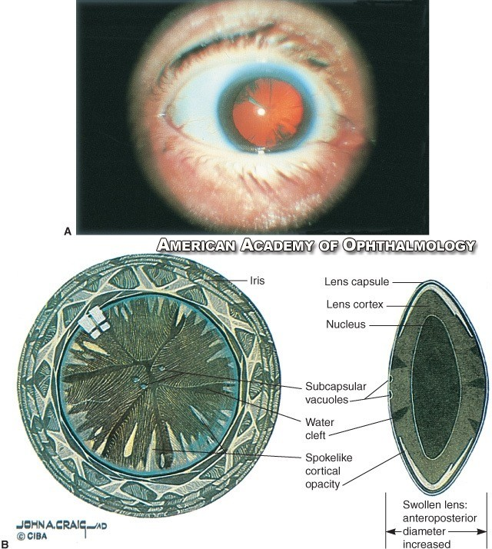

Slide 10
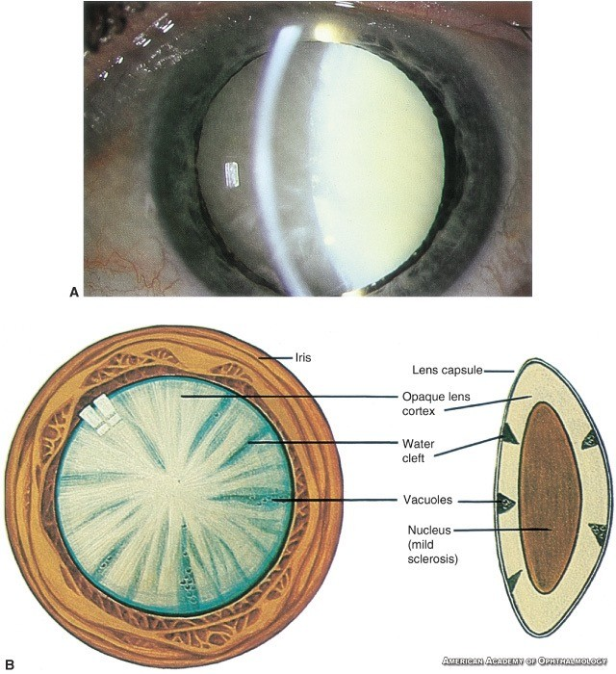

Slide 11
Macular Degeneration

Slide 12
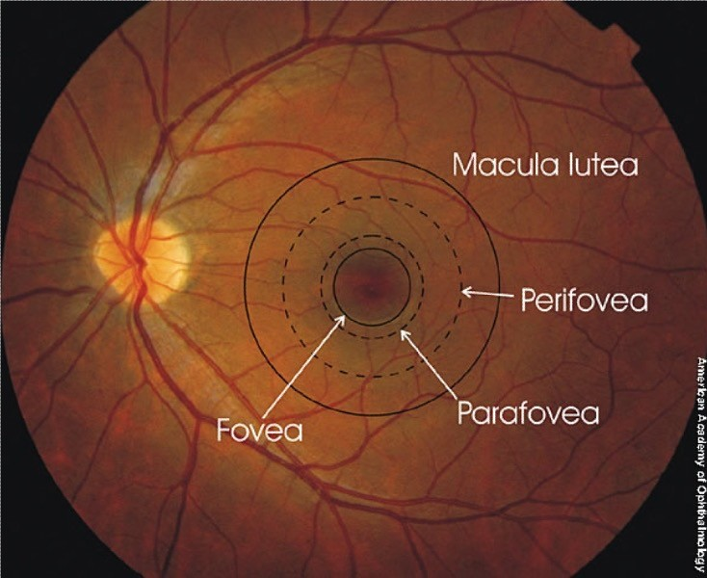
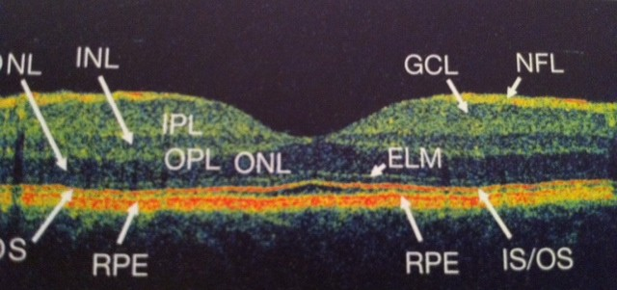

Slide 13
Macular Degeneration
Risk Factors
Age
Race
Gender
Genetics
Smoking
High Blood Pressure
High Cholesterol
Unhealthy diet and Obesity
Ultraviolet (UV)

Slide 14
Macular degeneration
Types
Dry type: slow progressive atrophy of RPE and photoreceptors
Wet type: RPE detachment and choroidal neovas.

Slide 15
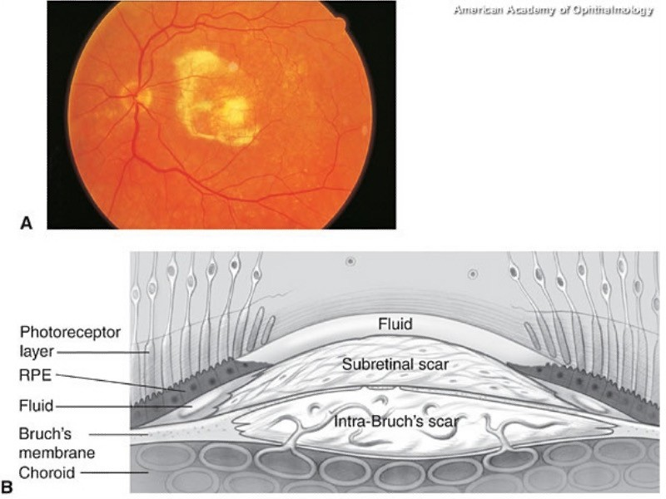

Slide 16
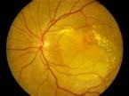
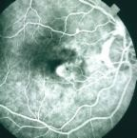
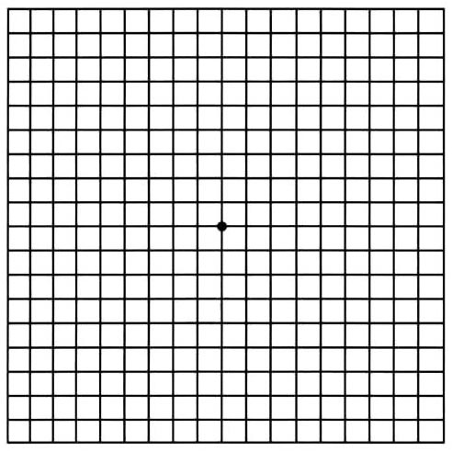
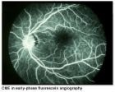
Macular degeneration
Tests for macular function Visual acuity Ophthalmoscopy
Amsler grid OCT
Fluorescein angiography

Slide 17
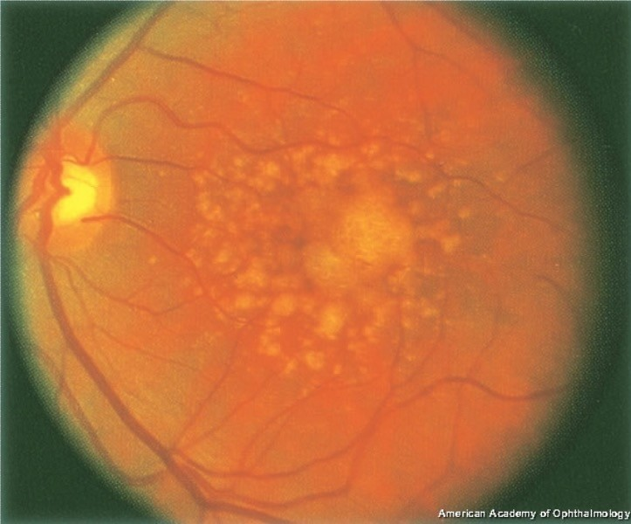

Slide 18
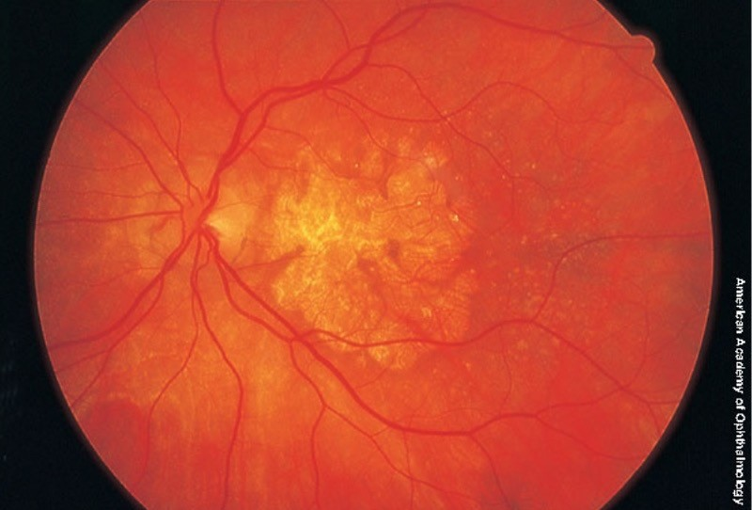

Slide 19
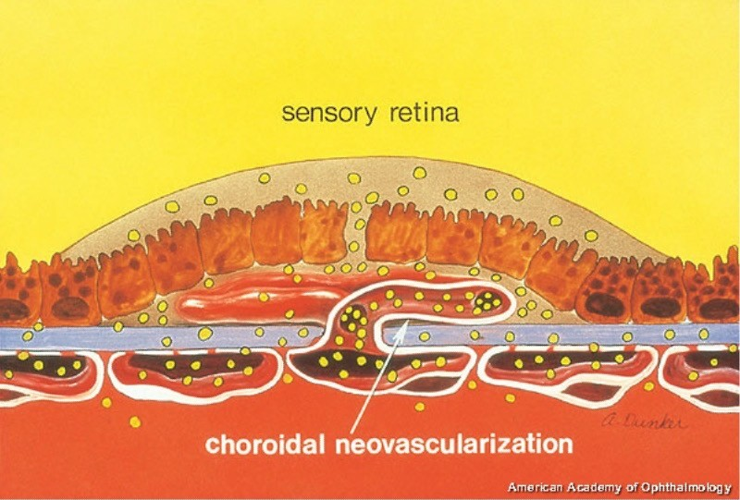

Slide 20
Thank you

