Slide 1
Neuro-ophthalmic examination
By
WALEED AL-RASHED

Slide 2
Neuro-ophthalmic examination
Objectives:
1- visual acuity testing.
2- visual field testing.
3- color perception and saturation.
4- pupillary examination.
5- ocular motility and alignment testing.
6- ophthalmoscopy.

Slide 3
VISUAL ACUITY:
20/20: you can see at 20 feet what should normally be seen at 20 feet
20/100: you can see at 20 feet what a normal person can see at 100 feet

Slide 4
VISUAL ACUITY

Slide 5
1- visual acuity testing.

Slide 6
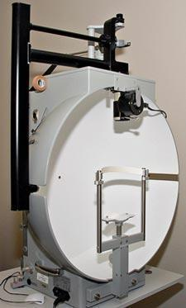
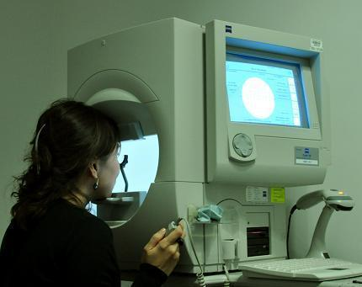
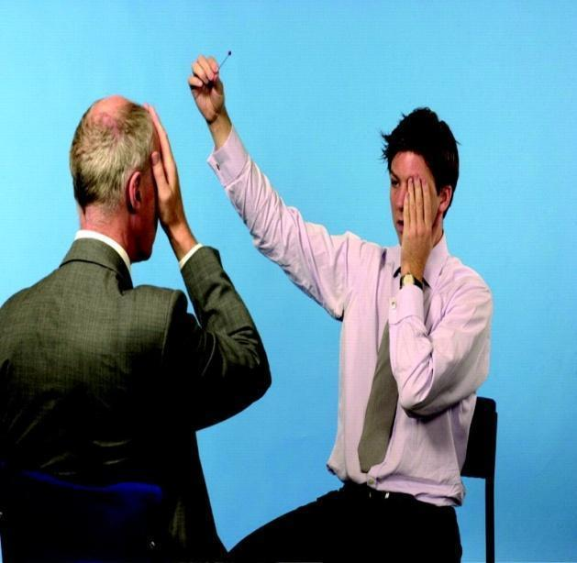
2- visual field testing.

Slide 7
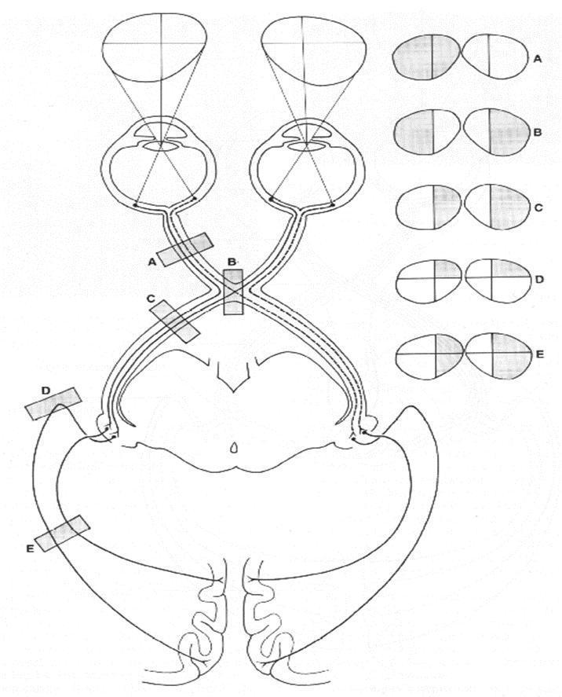
2- visual field testing.

Slide 8
2- visual field testing.
Confrontation visual field testing
Video

Slide 9
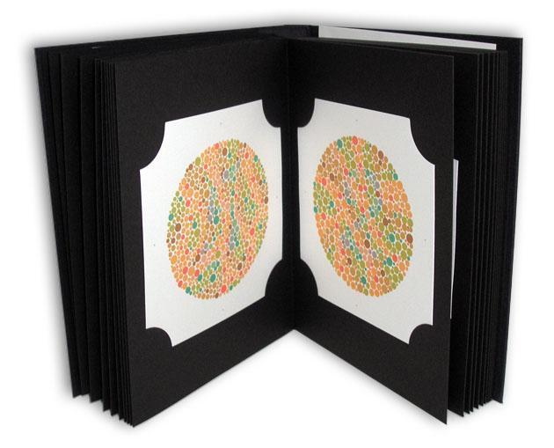
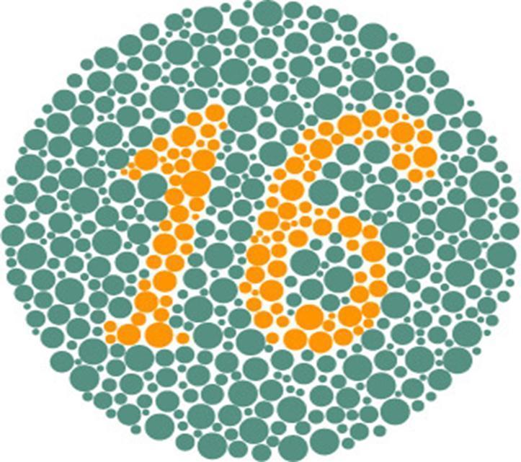
3- color perception and saturation.

Slide 10
4- pupillary examination.
This test should be done if the complaint is reduction of vision, ocular motility disorder or headache.
Size (Equal)
Shape (Round)
Reaction to light
Reaction to accommodation
Swinging-flash light test

Slide 11
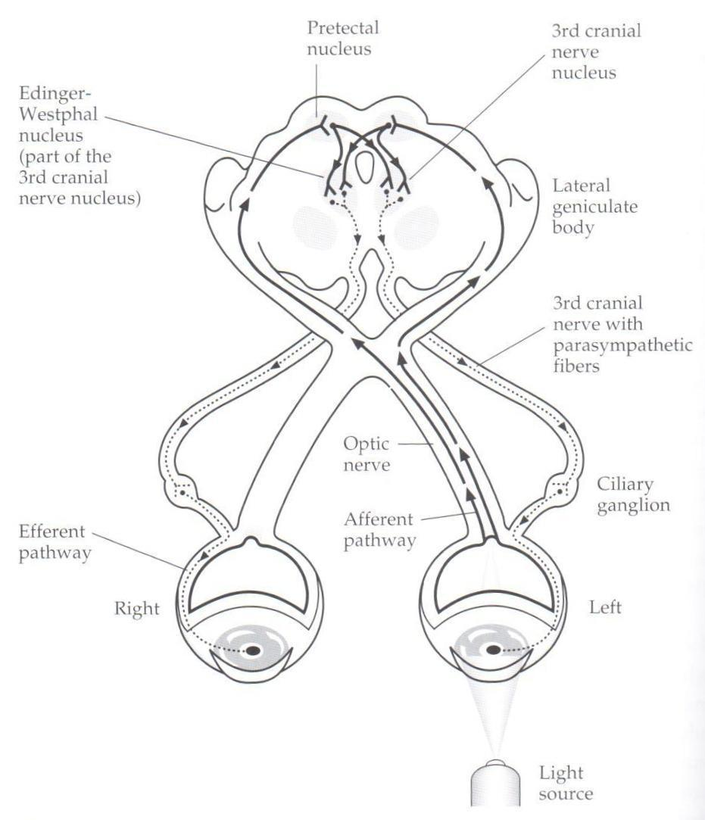
Pupillary pathway

Slide 12
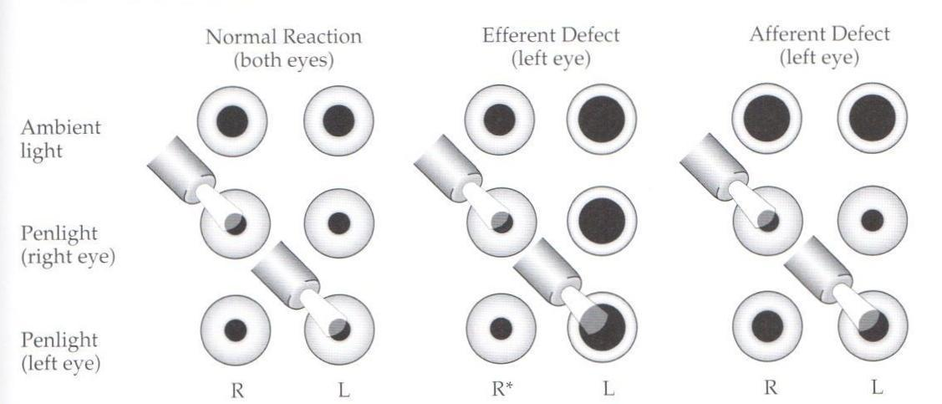
Light reflex of the pupil

Slide 13
Swinging-flash light test
Video1 1
Video 2
Video 3

Slide 14
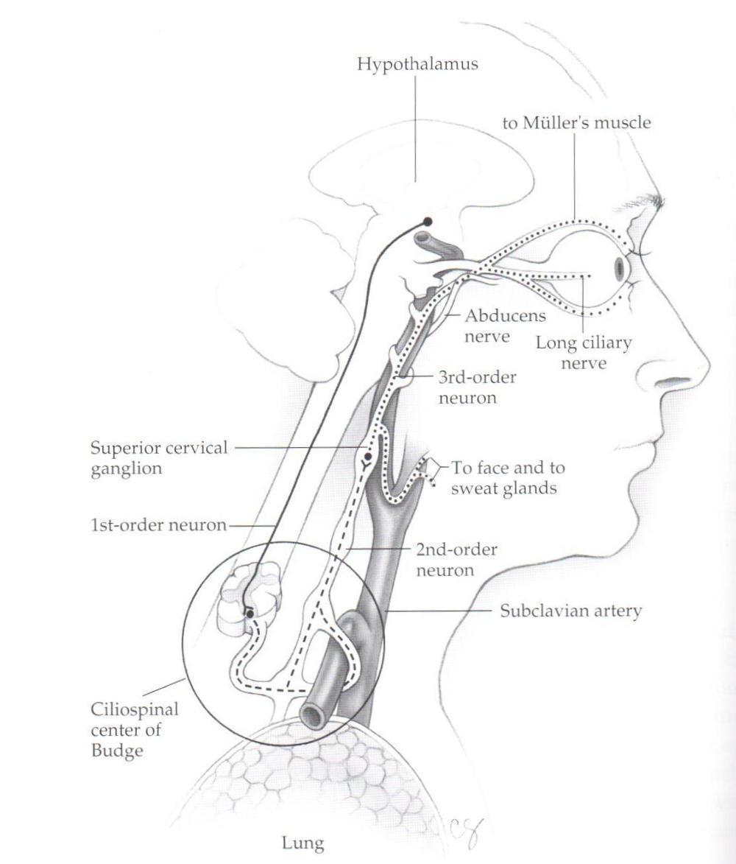
Horner syndrome - sympathetic pathway

Slide 15
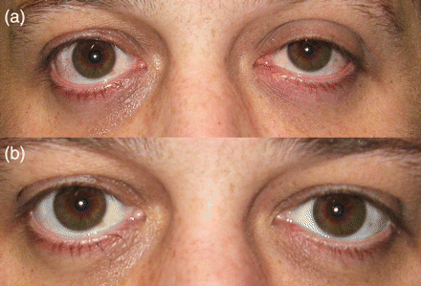
Anisocoria – horners syndrome acquired

Slide 16
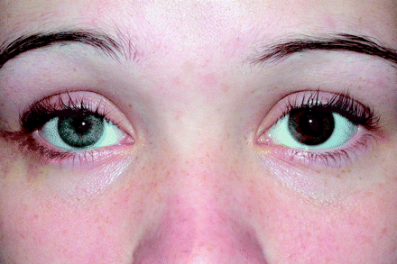
Anisocoria – horners syndrome conginetal

Slide 17
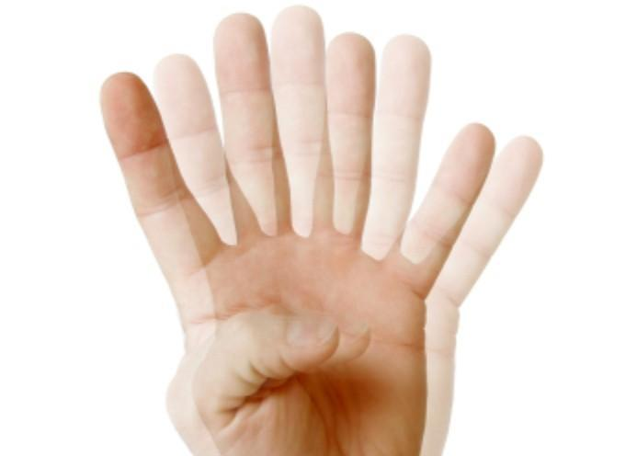
5- ocular motility and alignment testing.
This test to be preformed if the complaint is binocular diplopia.
Video 4

Slide 18
MUSCLE | PRIMARY ACTION
MR | ADDUCTION
LR | ABDUCTION
SR | ELEVATION
IR | DEPRESSION
SO | INTORSION
IO | EXTORSION

Slide 19
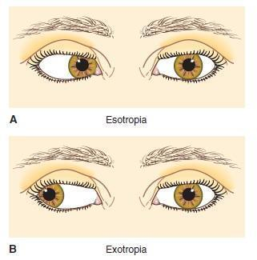

Slide 20
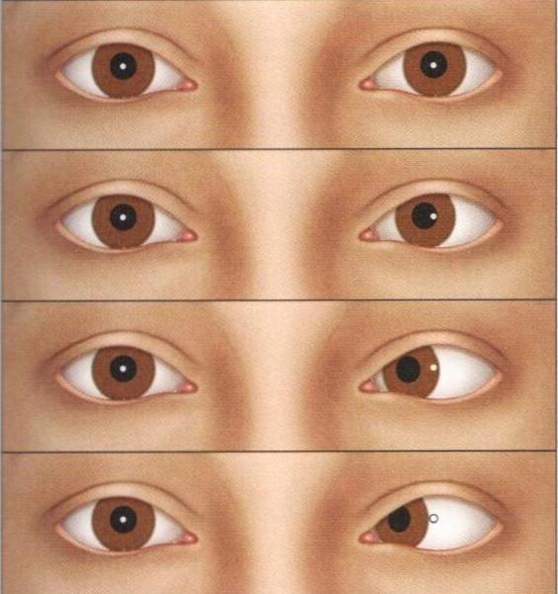
5- ocular motility and alignment testing.
Corneal light reflex position ( hirschberg’s method )

Slide 21
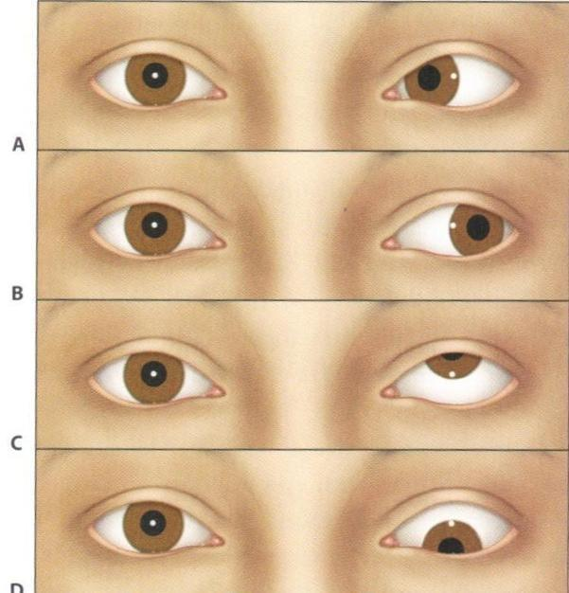
5- ocular motility and alignment testing.
Corneal light reflex position ( hirschberg’s method )

Slide 22
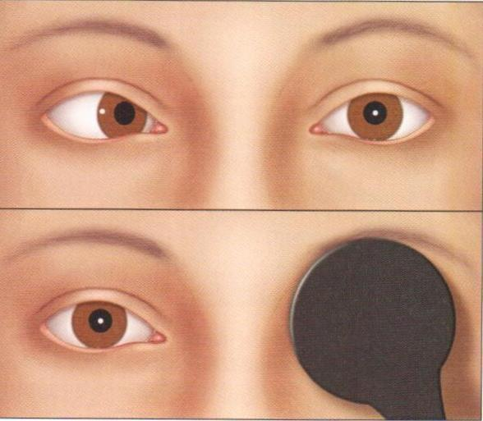
5- ocular motility and alignment testing.
The monocular cover-uncover test

Slide 23
Cranial nerves pulsies
Video 5
Video 6
Video 7

Slide 24
6th Nerve Palsy

Slide 25
3rd Nerve Palsy

Slide 26
4th Nerve Palsy

Slide 27
6- ophthalmoscopy.
Video

Slide 28
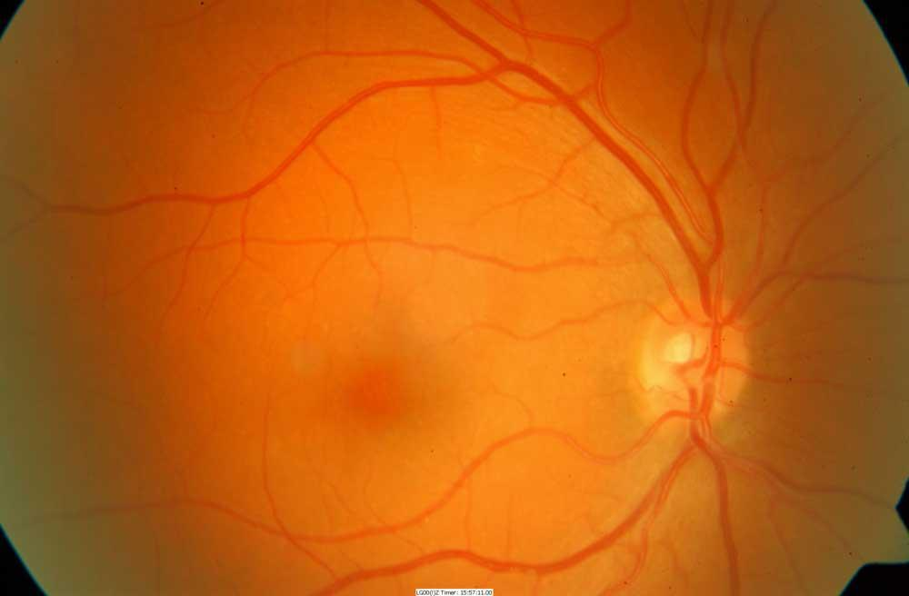
6- ophthalmoscopy.

Slide 29
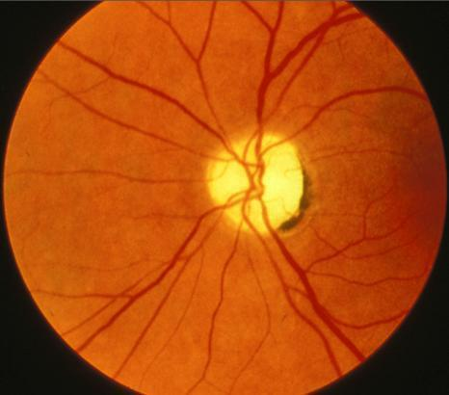
6- ophthalmoscopy.

Slide 30
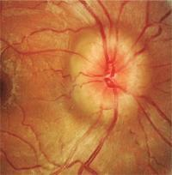
6- ophthalmoscopy.

Slide 31
www.ophthobook.com

Slide 32
Thank you

