Slide 1
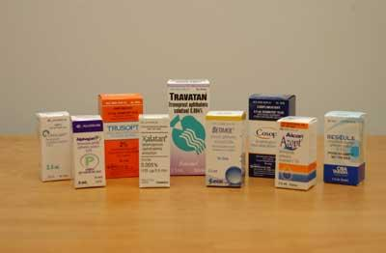
Ocular pharmacology and toxicology
Waleed alrashed

Slide 2
A drug can be delivered to ocular tissue as:
Locally:
Eye drop
Ointment
Periocular injection
Intraocular injection
Systemically:
Orally
IV

Slide 3
Measures to increase drop absorption:
-wait 5-10 minutes between drops
-keep eye lids closed for 5 minutes after instillation

Slide 4
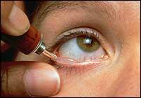
Ointments
Increase the contact time of ocular medication to ocular surface thus better effect
It has the disadvantage of vision blurring

Slide 5
Intraocular injections
Intracameral or intravitreal:
Intravitreal antibiotics in cases of endophthalmitis
Intravitreal steroids in macular edema
Intravitreal Anti-VEGF for DR or CRVO macular edema

Slide 6
MYDRIATICS

Slide 7
Cholinergic –blocking drugs
Anti-cholinergics
Cholinergic antagonists
Parasympatholytic agents
Muscarinic antagonists

Slide 8
Cholinergic antagonists
E.g. tropicamide, cyclopentolate, homatropine, scopolamine, atropine
Cause mydriasis (by paralyzing the iris sphincter muscle) with cycloplegia (by paralyzing the ciliary muscle)
Uses: fundoscopy, cycloplegic refraction, anterior uveitis
Side effects:
local: allergic reaction, blurred vision
Systemic: constipation, urinary retention, dry mouth dry skin dry eyes and confusion
specially in children they might cause flushing, fever, tachycardia, or delirium
Red as a beet Hot as a hare
Blind as a bat Dry as a bone
Mad as a hatter full as a flask

Slide 9
Adrenergic (sympathetic) Agonists
Alpha-1 agonists
E.g. phenylepherine
Uses: mydriasis (without cycloplegia), decongestant
Adverse effect:
Can cause significant increase in blood pressure specially in infant and susceptible adults
Rebound congestion
precipitation of acute angle-closure glaucoma in patients with narrow angles or myocardial infarction with higher concentration

Slide 10
Antiglaucoma medications

Slide 11
Adrenergic agonists
Alpha-2 agonists
E.g. brimonidine(alphagan), apraclonidine(Iopidine)
Uses: glaucoma treatment, prophylaxis against IOP spiking after glaucoma laser procedures,also in the diagnosis of Horner syndrome
Mechanism: decrease aqueous production, and increase uveoscleral outflow
Side effects:
local: allergic reaction, mydriasis, lid retraction, conjunctival blanching, dry eye
systemic: oral dryness, headache, fatigue, drowsiness, orthostatic hypotension, vasovagal attacks
Contraindications: infants (apnea,sever hypotention,somnolence and seizures)

Slide 12
Muscarinic stimulating cholinergic stimulating parasympathomimetic parasympathetic stimulating agents

Slide 13
Muscarinic stimulating agents
Pilocarpine:
Increase aqueous out flow via trabecular meshwork
Complication:
Spasm of accommodation, brow ache, miosis, sweating, bradycardia, gastrointestinal disturbance

Slide 14
Beta blockers
Beta 1 receptors: located in the heart when stimulated cause tachycardia
Beta 2 receptors: located in the bronchi and ciliary epithelium when stimulated cause bronchodilatation and increase in the aqueous production

Slide 15
Beta-adrenergic blockers
E.g.
non-selective: timolol, levobunolol
selective: betaxolol (beta 1 “cardioselective”)
Uses: glaucoma
Mechanism: reduce the formation of aqueous humor by the ciliary body
Side effects: bronchospasm (less with betaxolol), cardiac block

Slide 16
Beta blockers
Complication:
Dry eyes
Bradycardia
Hypotension
Bronchospasm (may be fatal in asthmatic pts and pts COPD)
Impotence, lethargy, depression, may mask hypoglycaemic attacks in diabetic pts.

Slide 17
Beta blockers
Contraindication
Asthma
COPD
2 and 3ed degree heart block
Congestive heart failure

Slide 18
Carbonic Anhydrase Inhibitors chemically related to sulfonamides
Systemic: Acetazolamide(Diamox), Methazolamide,
Topical: Dorzolamide(Trusopt), Brinzolamide (Azopt).
Uses: glaucoma, cystoid macular edema, pseudo-tumour cerebri
Mechanism: aqueous suppression
Side effects: paresthesia(extremities and mucocutaneous junction), anorexia, GI upset, headache, altered taste and smell
K depletion (hypokalemia), metabolic acidosis, renal stone, bone marrow suppression “aplastic anemia”, steven-johnsone syndrome
Contraindication: sulpha allergy, sickler pts , and pregnancy

Slide 19
Osmotic agents
Dehydrate vitreous body which reduce IOP significantly
E.G.
Glycerol 50% syrup (cause nausea, hyperglycemia)
Mannitol 20% IV (cause fluid overload and not used in pts with heart failure)

Slide 20
Prostaglandin Analogues PGF2 alpha agonist
E.g. latanoprost (Xalatan), bimatoprost (Lumigan),
travoprost (Travatan)
Uses: glaucoma
Mechanism: increase uveoscleral aqueous outflow
Side effects: darkening of the iris (heterochromia iridis),hyperpigmentation of periorbital and conjunctiva lengthening and thickening of eyelashes, intraocular inflammation, macular edema

Slide 21
Prostaglandine analgue
Contraindication:
Pregnancy(teratogenic, uterine contraction)
Active uveitis
Cystoid macular edema

Slide 22
Anti-inflammatory
Corticosteroid
NSAID

Slide 23
Corticosteroids
Topical
E.g. fluorometholone, prednisolone, dexamethasone, hydrocortisone
Uses: postoperatively, anterior uveitis, severe allergic conjunctivitis, vernal keratoconjunctivitis, prevention and suppression of corneal graft rejection, episcleritis, scleritis
Side effects: susceptibility to infections, glaucoma, and cataract (posterior subcapsular cataract)

Slide 24
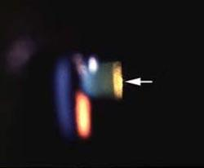
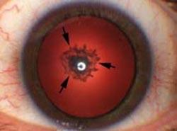
Corticosteroids
Systemic:
E.g. prednisolone, methylprednisolone
Uses: posterior uveitis, optic neuritis, temporal arteritis with artertic anterior ischemic optic neuropathy
Side effects:
Local: posterior subcapsular cataract, glaucoma
Systemic: suppression of pituitary-adrenal axis, hyperglycemia, osteoporosis, peptic ulcer, psychosis

Slide 25
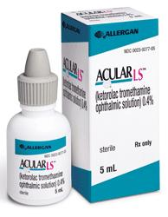
NSAIDs
E.g. ketorolac, diclofenac, nepafenac
Uses: post-operatively, episcleritis/scleritis, mild uveitis, cystoid macular edema, preoperatively to prevent miosis during surgery
Side effects: stinging and burning. Rarely: corneal melting

Slide 26
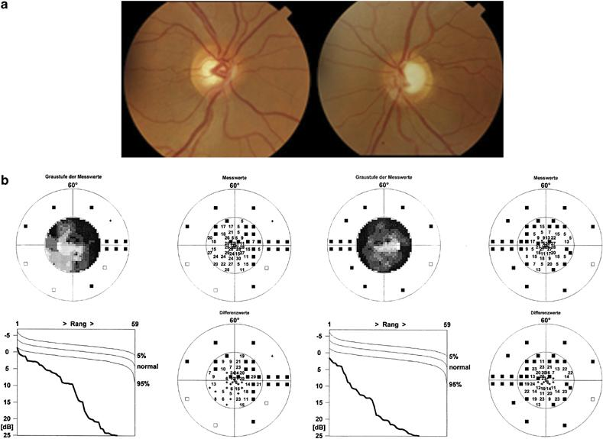
Anti-allergy
Avoidance of allergens, cold compress, lubrications
Antihistamines (e.g pheniramine, alopatadine, levocabastine)
Decongestants (e.g. naphazoline, phenylepherine, tetrahydrozaline)
Mast cell stabilizers (e.g. cromolyn, nedocromil,)
NSAID (e.g. ketorolac)
Steroids (e.g. fluorometholone, prednisolone)
Drug combinations

Slide 27
Antibiotics
Used topically in prophylaxis (pre and postoperatively) and treatment of ocular bacterial infections.
Used orally for the treatment of preseptal cellulitis
e.g. amoxycillin with clavulonate, cefaclor
Used intravenously for the treatment of orbital cellulitis
e.g. gentamicin, cephalosporin, vancomycin, flagyl
Can be injected intravitrally for the treatment of endophthalmitis

Slide 28
Antibiotics
Trachoma can be treated by topical and systemic tetracycline or erythromycin, or systemic azithromycin.
Bacterial keratitis (bacterial corneal ulcers) can be treated by topical fortified penicillins, cephalosporins, aminoglycosides, vancomycin or fluoroquinolones.
Bacterial conjunctivitis is usually self limited but topical erythromycin, aminoglycosides, fluoroquinolones, or chloramphenicol can be used

Slide 29
Antivirals
Acyclovir
Interact with viral thymidine kinase (selective)
Used in herpetic keratitis
Trifluridine
More corneal penetration
Can treat herpetic iritis
Ganciclovir
Used intravenously for CMV retinitis

Slide 30
Ocular diagnostic drugs
Fluorescein dye
Available as drops or strips
Uses: stain corneal abrasions, applanation tonometry, detecting wound leak, NLD obstruction (DDT), fluorescein angiography.

Slide 31
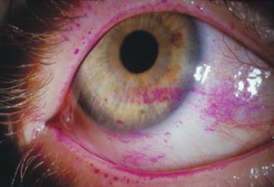
Ocular diagnostic drugs
Rose bengal stain
Stains devitalized epithelium
Uses: severe dry eye, herpetic keratitis

Slide 32
Local Anesthetics
Topical
E.g. propacaine, tetracaine
Uses: applanation tonometry, gonioscopy, removal of corneal foreign bodies, removal of sutures, examination of patients who cannot open eyes because of pain
Adverse effects: toxic to corneal epithelium, and rarely allergic reaction

Slide 33
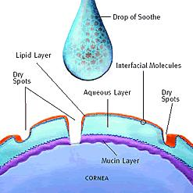
Other Ocular Preparations
Lubricants
Drops, jell or ointments
Polyvinyl alcohol, methylcellulose or hyaluronic acid
Preserved or preservative free

Slide 34
Ocular Toxicology

Slide 35
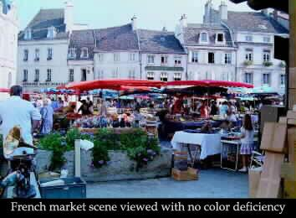
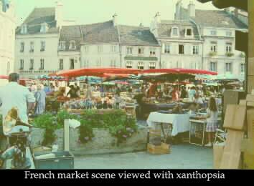
Digitalis
A cardiac failure drug
Causes chromatopsia (objects appear yellow) with overdose

Slide 36
Chloroquines
E.g. chloroquine, hydroxychloroquine
Used in malaria, rheumatoid arthritis & SLE
Cause vortex keratopathy (corneal verticillata) which is usually asymptomatic but can present with glare and photophobia
Also cause retinopathy (bull’s eye maculopathy)

Slide 37
Ethambutol
An anti-TB drug
Causes a dose-related optic neuropathy
Usually cause reversible but occasionally permanent visual damage

Slide 38
Other agents
methanol – optic atrophy and blindness
Contraceptive pills – pseudotumor cerebri (papilledema), and dryness (CL intolerance)
Hypervitaminosis A – yellow skin and conjunctiva, pseudotumor cerebri (papilledema)
Hypovitaminosis A – night blindness (nyctalopia), sterile corneal melting (keratomalacia), dry eyes (Xerophthalmia) and bitot’s spots.

Slide 40
Thank you

