Slide 1
Neuro-ophthalmology Review
Waleed Alrashed

Slide 2
Neuro-ophthalmology
Afferent
Efferent
Anatomy
Examination
Diagnoses
Tests

Slide 3
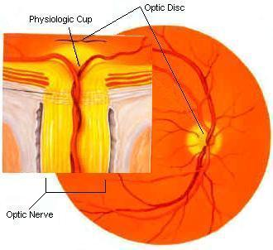
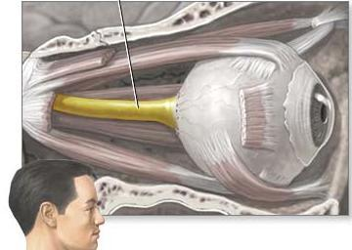
Optic Nerve Anatomy
Cranial nerve II, the second of twelve paired cranial nerves.
These fibers are axons of the retinal ganglion cells of one retina.

Slide 4
Optic Nerve Anatomy
The optic nerve is ensheathed in all three meningeal layers (dura, arachnoid, and pia mater).
It leaves the orbit (eye socket) via the optic canal, running postero-medially towards the optic chiasm.

Slide 6
Optic Nerve Anatomy
In optic chiasm there is a partial decussation (crossing) of fibers from the temporal visual fields (the nasal hemi-retina) of both eyes.

Slide 7
Optic Nerve Anatomy
From there, the nerve fibers become the optic tract.
Passing through the thalamus and turning into the optic radiation.
Until they reach the visual cortex in the occipital lobe at the back of the brain. This is where the visual center of the brain is located.

Slide 8
Optic Nerve Physiology
The eye's blind spot is a result of the absence of photoreceptors in the area of the retina where the optic nerve leaves the eye.

Slide 10
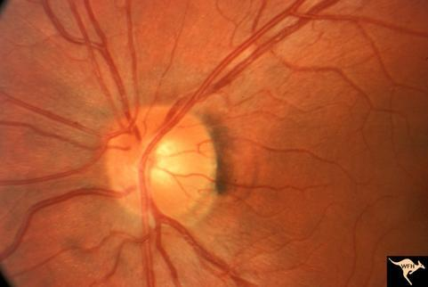
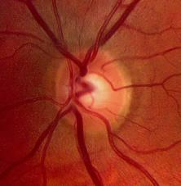
Optic Nerve Physiology
Fiber tracks of the mammalian central nervous system (as opposed to the peripheral nervous system) are incapable of regeneration, and, hence, optic nerve damage produces irreversible blindness.

Slide 11
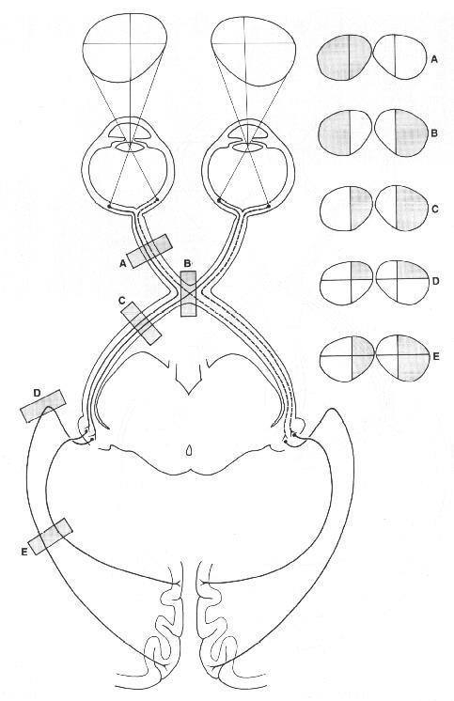
Afferent Anatomy

Slide 12
Examination
Visual acuity
Color vision
Visual field
Pupil examination
Fundoscopy

Slide 13
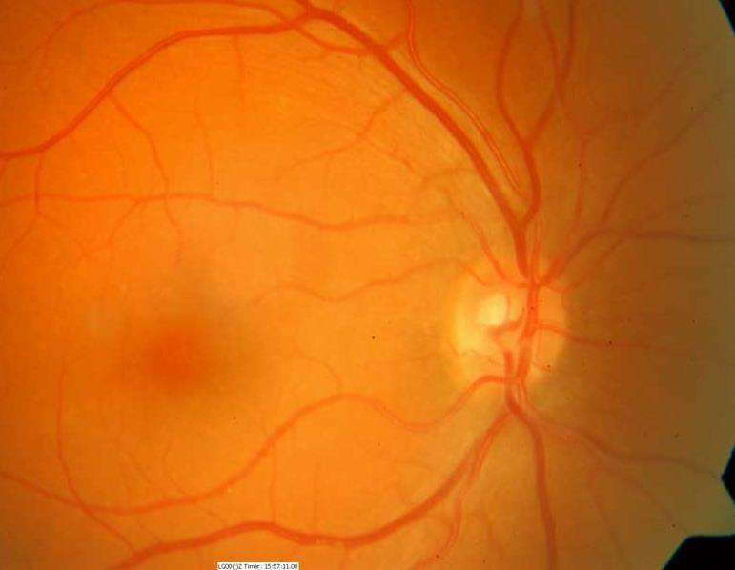
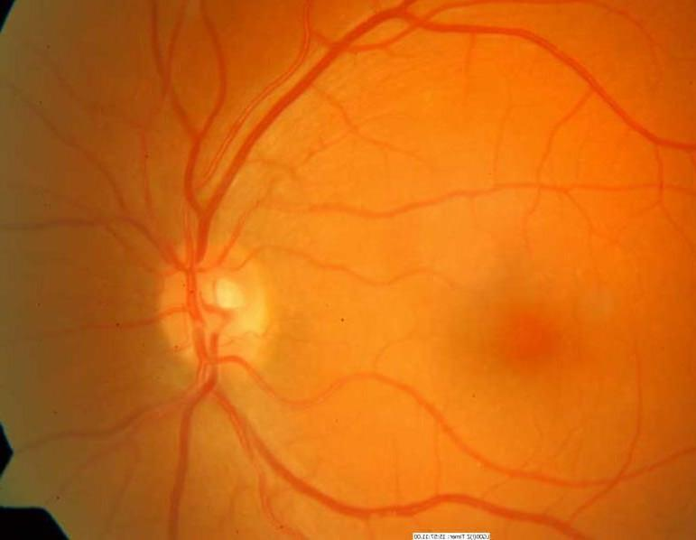
Fundus Exam

Slide 14
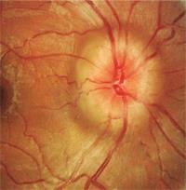
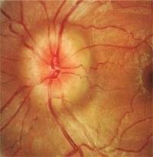

Slide 15
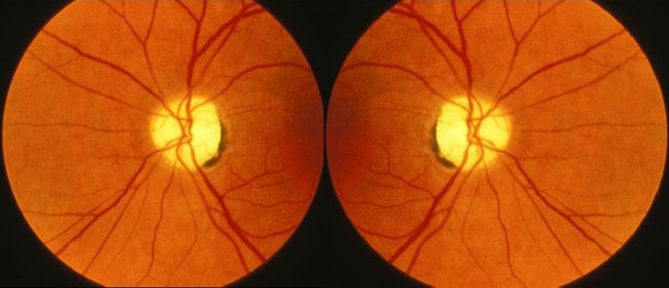

Slide 16
Optic Neuropathy

Slide 17
Classification of Optic Neuropathy
I. Glaucomatous optic neuropathy.
II. Non glaucomatous optic neuropathy:
Inflammatory optic neuropathy.
Ischemic optic neuropathy.
Infiltrative optic neuropathy.
Compressive optic neuropathy.
Traumatic optic neuropathy
III. Papilledema

Slide 18
NON-GLAUCOMATOUS OPTIC NEUROPATHY
CAUSES:
Inflammatory optic neuropathy.
Compressive optic neuropathy.
Ischemic optic neuropathy.
Infiltrative optic neuropathy.
Traumatic optic neuropathy

Slide 19
Inflammatory optic neuropathy ( Optic Neuritis)
It is caused by a number of underlying conditions:
Systemic infection.
Vaccination.
Autoimmune disease.
The most commonly associated cause of inflammatory optic neuropathy is demyelinating optic neuritis secondary to multiple sclerosis (MS).

Slide 20
Inflammatory optic neuropathy
A complex cascade of inflammatory events begins peripherally in the body.
Activation of T lymphocytes.
The activated cells cross the blood-brain barrier and gain access to the central nervous system.

Slide 21
Inflammatory optic neuropathy
The initial inflammatory cascade leads to phagocytosis of the myelin sheath.
As a result,gliotic tissue is laid down in place of missing myelin.
This substitutive tissue lacks the conduction properties of myelin, lead to nerve impulse interruption.

Slide 22
Inflammatory optic neuropathy
multiple sclerosis
Symptomatology:
Patient is typically female, white, age 20 to 40 years.
Typically present with mild to moderate ocular pain (exaggerated upon eye movement).
Noticeable changes in color vision in the affected eye.

Slide 23
Inflammatory optic neuropathy
Variable unilateral loss of vision, ranging from 20/30 to no light perception.
This is often accompanied by an afferent pupillary defect (APD).
Visual field defect in form of cecocentral scotomas

Slide 24
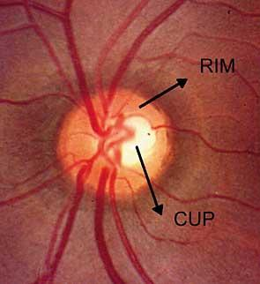
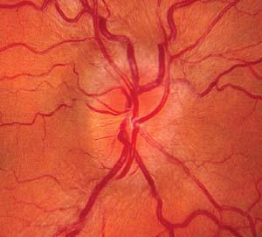
Inflammatory optic neuropathy
Signs:
In acute optic neuritis:
Disc edema
Disc hemorrhages
Segmental or diffuse optic disc pallor
2/3 of pts have normal appearance of optic disc.

Slide 25
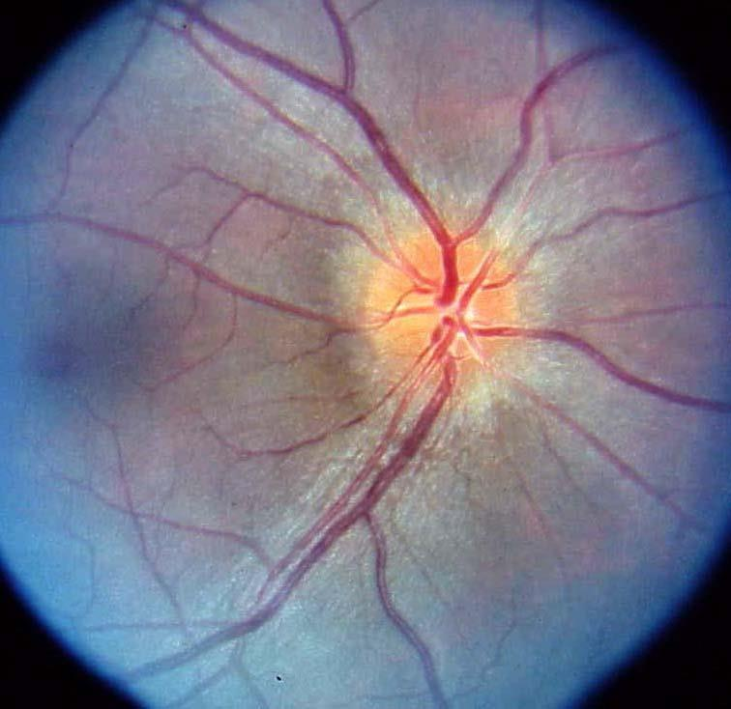
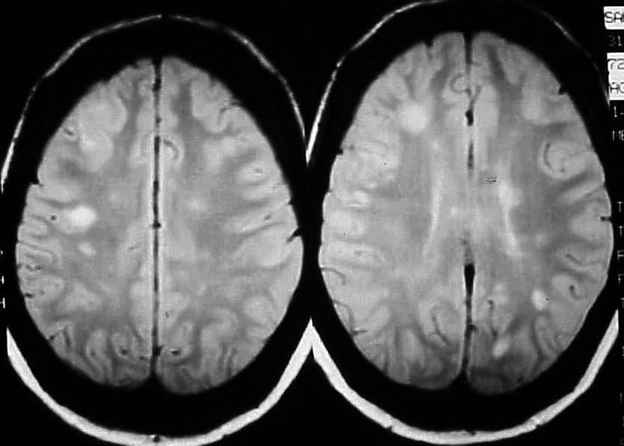
Inflammatory optic neuropathy
Dyschromatopsia, red color desaturation defects
APD

Slide 26
Inflammatory optic neuropathy
multiple sclerosis
Management:
Intravenous steroid ( methylprednisone ) , administered over the course of three days followed by an 11-day course of oral prednisone.

Slide 27
Compressive Optic Neuropathy
Results from mechanical mass effect secondary to:
Tumors ( Intracranial, Chiasmal, or Optic Nerve tumors)
non-neoplastic lesions :
Retrobulbar hemorrhage.
Aneurysm.
Mucocele.
Orbital apex syndrome(thyroid eye disease).

Slide 28
Compressive Optic Neuropathy
Symptomatology:
Slowly progressive process with changes or fluctuations in visual acuity or missing visual field that occur over several months to years.
Changes in color vision.
Diplopia ( double vision), results from interruption of any of the cranial nerves innervating the extraocular muscles (CN III, IV, VI).

Slide 29
Compressive Optic Neuropathy
The optic disc's appearance may vary greatly depending on the lesion's location.
Early in the compressive disease process, the optic disc may appear normal.

Slide 30
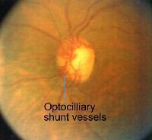
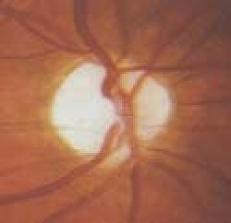
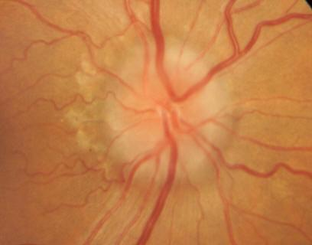
Compressive Optic Neuropathy
Optic disc edema.
Atrophic changes (most often due to chronic compression).
Presence of optocilliary shunt vessels.

Slide 31
Compressive Optic Neuropathy
Management:
Early and accurate diagnosis with prompt treatment of the underlying cause of the compression is vital to preserve the patient's vision.
Surgical and medical treatments directed at managing the underlying etiology may result in recovery of acuity, fields and symptoms.

Slide 32
ISCHEMIC OPTIC NEUROPATHY
Two forms of ischemic optic neuropathy are:
Non-Arteritic (NAION) 95%
Arteritic (AAION). 5%

Slide 33
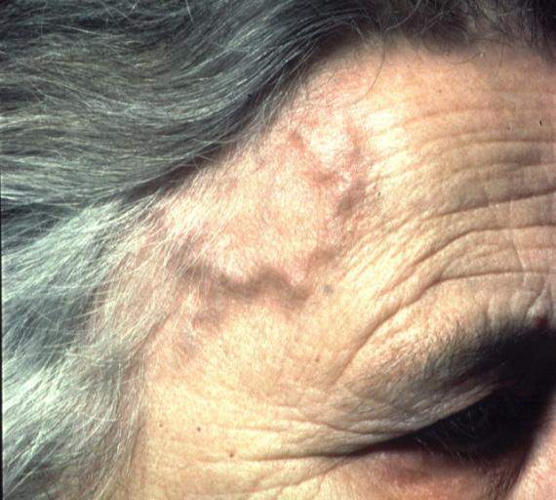
ISCHEMIC OPTIC NEUROPATHY
The main cause of AAION is vasculitis of the short posterior ciliary vessels supplying the optic nerve head.
large multinucleated monocytes infiltrate the small- and medium-sized arteries, causing obliteration of their lumen leading to ischemia.

Slide 34
ISCHEMIC OPTIC NEUROPATHY
Symptomatology:
AAION:
Mean age of onset: 70 years
Headache is the most common symptom.
Rheumatic myalgia(poly myalgia rheumatica)
Scalp tenderness
Jaw claudication
Malaise, anorexia, weight loss, low grade fever
Severe visual loss, developing over hours to days.

Slide 35
ISCHEMIC OPTIC NEUROPATHY
Signs: AAION:
Pallid disc edema ( chalky white appearance of the disc )
Disc of fellow eye: normal

Slide 36
ISCHEMIC OPTIC NEUROPATHY
Cause of NAION:
Hypoperfusion or Non-perfusion of the optic nerve head.
Risk factors of NAION:
Diabetes mellitus
Hypertension
Hypercholesterolemia.
Smoking.

Slide 37
ISCHEMIC OPTIC NEUROPATHY
Symptomatology:
NAION:
Mean age of onset: 60 years
Patients present with Painless vision loss developing over hours to days.
Visual loss is less severe than AAION.
No systemic symptoms .

Slide 38
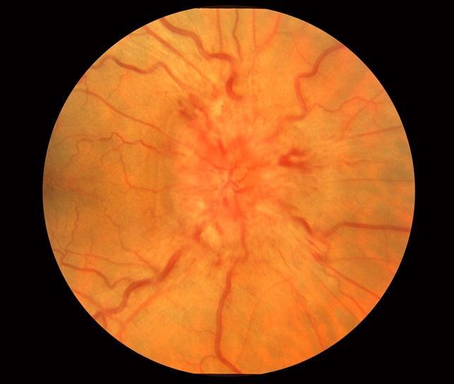
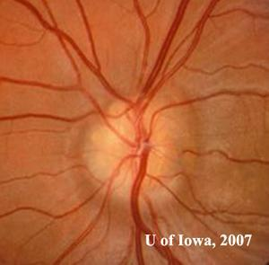
ISCHEMIC OPTIC NEUROPATHY
Signs:
NAION:
Segmental or diffuse disc swelling, hyperemic or pale.
Peripapillary retinal hemorrhages.
Disc in fellow eye “ disc at risk” : small, crowded, elevated with blurry margin

Slide 39
ISCHEMIC OPTIC NEUROPATHY
Management:
AAION
It is life and vision threatening.
High-dose ( steroid) oral prednisone or intravenous methyl-prednisolone followed by a course of oral prednisone.
NAION:
No proven treatment
Optimize the medical condition .

Slide 40
INFILTRATIVE OPTIC NEUROPATHY
Most commonly found in association with Sarcoidosis
Can result from:
Systemic infection.
Systemic lupus erythematosus.
Blood-borne cancers and metastatic disease.

Slide 41
Traumatic Optic Neuropathy:
Classically divided into:
Direct injury: external object penetrates the tissues and impact the optic nerve.
Indirect injury: collision to the skull and the energy is absorbed by the optic nerve.
Usually associated with mid-face trauma

Slide 42
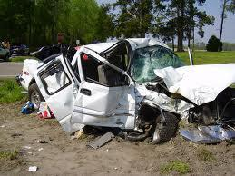
Traumatic Optic Neuropathy:
Causes:
Motor Vehicle Accident (MVA), most common cause.
Falls
Assault

Slide 43
Traumatic Optic Neuropathy:
Symptomatology:
History of trauma
Loss of vision after the trauma
Commonly associated with loss of consciousness.

Slide 44
Traumatic Optic Neuropathy:
Signs:
Vision: is often significantly reduced.
Afferent pupillary defect
Associated ocular injury.
Fundoscopy:
Acutely the optic nerve appears normal.
Weeks later, optic nerve pallor develops.
Vitreous hemorrhage
Retinal hemorrhage

Slide 45
Papilledema
Definition
Bilateral optic disc swelling due to increased intracranial pressure.

Slide 46
Papilledema
Causes:
Intracranial tumors.
Hydrocephalus.
Pseudotumor cerebri: Often occurs in young, overweight females.
Subarachnoid hemorrhage: Severe headache, may have preretinal hemorrhages (i.e., Terson syndrome).

Slide 47
Cont’d
Arteriovenous malformation.
Brain abscess: Often associated with fever.
Meningitis: Fever, stiff neck, headache
Encephalitis: Often produces mental status abnormalities.
Cerebral venous sinus thrombosis.

Slide 48
Papilledema
Symptoms
Episodes of transient, often bilateral visual loss (lasting seconds), related to change in position (altering intracranial pressure)
Headache
Double vision
Nausea
Vomiting

Slide 49
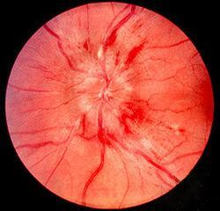
Papilledema
Signs
Bilaterally swollen, hyperemic discs
Papillary or peripapillary retinal hemorrhages
Dilated, tortuous retinal veins;

Slide 50
Papilledema
Signs
Normal pupillary response and color vision;
Enlarged physiologic blind spot by formal visual field testing.

Slide 51
Papilledema
Treatment
Treatment should be directed at the underlying cause of the increased intracranial pressure.

Slide 52
Thank you

