Slide 1
Depressive disorder and suicide
Med 2017

Slide 2
Objectives
Recognize depression symptoms and burden
Recognize the systemic effects of depression and its relation to other medical problems
Assess suicide risk
Planning management of depression

Slide 3
Causes of Global
Burden of Disease
2004
LRTIs
Diarrheal diseases
Unipolar depression
Ischemic heart disease
HIV/AIDS
2030
Unipolar depression
Ischemic heart disease
Road traffic accidents
Cerebrovascular disease
COPD
MDD:
2004: #3 cause of global burden of disease
2020: #2 cause of global burden of disease
2030: #1 cause of global burden of disease
MDD = major depressive disorder; LRTI = lower respiratory tract infection; HIV = human immunodeficiency virus; AIDS = acquired immunodeficiency syndrome; COPD = chronic obstructive pulmonary disease
1. World Health Organization. The Global Burden of Disease: 2004 Update. WHO; 2004.
2. World Health Organization. World Health Organization Website. Mental Health. Depression. What is depression? Available at: http://www.who.int/mental_health/management/depression/definition/en/index.html,
Accessed October 28, 2011.
Notes:
#1 cause of years lost to disability worldwide
Currently ranked third leading cause of global burden of disease and the leading cause for women
Projected to be leading cause of global burden of disease by 2030
Most (75-85%) persons with mental and psychosocial disabilities in low and middle income countries do not have access
to treatment.
REFERENCES:
Ref #1 = WHO, The Global Burden of Disease, 2004 Update. Available at http://www.who.int/healthinfo/global_burden_disease/GBD_report_2004update_full.pdf. Accessed 19 December, 2011.
Ref #2 = WHO, Mental Health, Depression. What Is Depression? Available at http://www.who.int/mental_health/management/depression/definition/en/index.html#. Accessed December 19, 2011.
Ref # 3. WHO World Mental Health Survey Consortium. Prevalence, severity and unmet need for treatment of mental disorders in the World Health Organization World Mental Health Surveys. Journal of the American Medical Association, 2004,291:2581-2590.

Slide 4
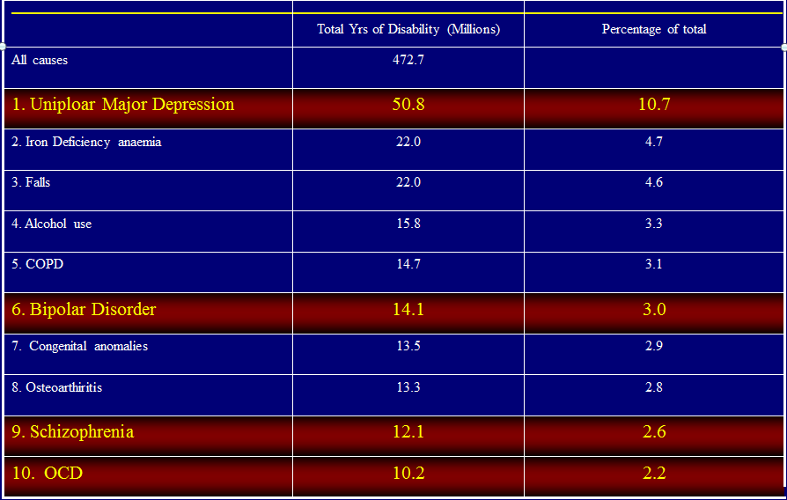
THE LEADING CAUSES OF DISABILITY WORLDWIDE

Slide 5
WHAT IS DEPRESSION?
Depression is not:
“Weakness of character”
“Madness”
“Something that will pass”
Incurable
Inevitable

Slide 6
Depression is …
Persistent low mood for at least two weeks plus at least 5 of the following:
poor appetite or weight loss or increased appetite or weight gain..
Loss of energy or tiredness to the point of being unable to make the simplest everyday decisions.
An observable slowing down or agitation.

Slide 7
Depression is …
A markedly diminished loss of interest or pleasure in activities that were once enjoyed.
Feelings of self-reproach or excessive or inappropriate guilt over real or imagined misdeeds.
Complaints/evidence of diminished ability to think or concentrate.
Recurrent thoughts of death, suicide, suicidal thoughts without a specific plan, or a suicide attempt or plan.

Slide 8
DEPRESSION: A SAD FACE (S)
A - Appetite
S - Sleep
A - Anhedonia
D - Depressed mood
F - Fatigue
A - Agitation
C - Concentration
E - Esteem
S - Suicidal
Montano, J Clin Psych 1994
Notes:
An alternative mnemonic to SIGE CAPS

Slide 9
DEPRESSION: RISK FACTORS
Age: peak age of onset 20-40 yrs
Gender: female 2 X higher
Family history: 1.5 to 3 X higher
Marital status: divorced, separated, widowed
married vs. unmarried???

Slide 10
DEPRESSION: RISK FACTORS
Personal history of depression
1 episode - 50% relapse
2 episodes - 75% relapse
3 episodes - 90% relapse
Postpartum: up to 1 in 10 women
Chronic medical illness

Slide 11

Functional Impairment in MDD
MDD impairs occupational and social functioning^{1,2}
  87% exhibit at least moderate impairment³
  59% exhibit severe or very severe impairment³
MDD is associated with¹:
  Increased number of disability days
  Decreased work productivity, psychosocial disability
MDD and work productivity¹
  Impact on function at work is substantially higher than missed work days
  Absenteeism represents only a small fraction of
  workplace cost
Druss BG et al. Am J Psychiatry. 2001;731-34.
Judd LL, et al. Arch Gen Psychiatry. 2000;57:375-80.
Kessler RC et al. JAMA. 2003;289:3095-105.
Notes:
Major depressive disorder (MDD) is associated with significant psychosocial and occupational disability. In a study, nearly all (96.9%) respondents with 12-month MDD reported at least some role impairment associated with their depression in at least 1 of the 4 SDS role domains, with 87.4% describing this impairment as at least moderate, 59.3% as either severe or very severe, and 19.1% as very severe.³
Psychosocial disability associated with unipolar MDD is pervasive and chronic, affecting most areas of everyday function; disability varies directly with the level of depressive symptom severity during the course of illness; disability is state dependent—when depressive symptoms are present, disability is present; when the same patients are asymptomatic, disability decreases significantly and psychosocial function is good or very good.²
Depressive illness is associated with persistent difficulties in workplace functioning. Depressive disorders in the workplace persist over time and have a major effect on work performance/productivity, most notably on “presenteeism,” or reduced effectiveness in the workplace. The impact of depression on function at work was substantially higher than its association with missed days at work.¹
REFERENCES:
1. Druss BG, Schlesinger M, Allen HM Jr. Depressive symptoms, satisfaction with health care, and 2-year work outcomes in an employed population. Am J Psychiatry. 2001 May;158(5):731-4.
2. Judd LL, Akiskal HS, Zeller PJ, Paulus M, Leon AC, Maser JD, Endicott J, Coryell W, Kunovac JL, Mueller TI, Rice JP, Keller MB. Psychosocial disability during the long-term course of unipolar major depressive disorder. Arch Gen Psychiatry. 2000 Apr;57(4):375-80.
3. Kessler RC, Berglund P, Demler O, Jin R, Koretz D, Merikangas KR, Rush AJ, Walters EE, Wang PS; National Comorbidity Survey Replication. The epidemiology of major depressive disorder: results from the National Comorbidity Survey Replication (NCS-R). JAMA. 2003 Jun 18;289(23):3095-105.

Slide 12
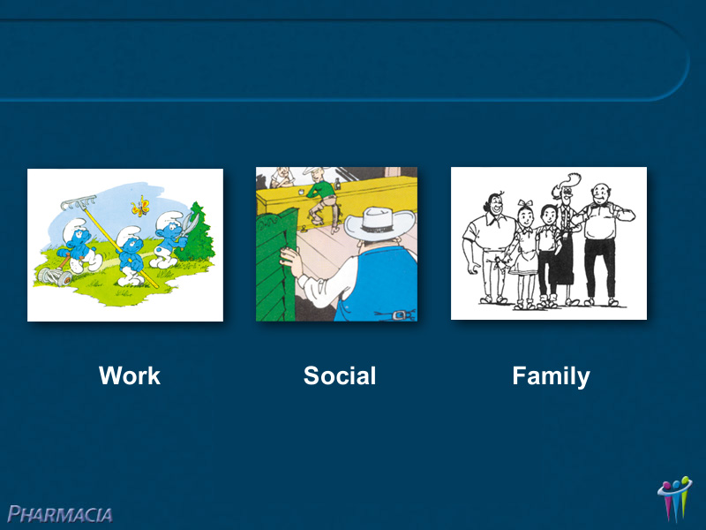

Slide 13
Etiology and Pathogenesis of Depressive Disorders
Biochemical: a deficit of specific neurotransmitters in the brain mainly Serotonin, Noradrenaline and Dopamine
Psychosocial : factors like low self steem and dependant personalities
Social: life events and stress
Developmental factors: genetic and hereditary factors
Integrative: involves all previous factors
Notes:
Many hypotheses attempt to explain the etiology and pathogenesis of depressive disorders. All of them recognize the roles of:
Neurobiologic factors: family, twin, and adoption studies indicate that the risk for depressive disorders is familial, and that norepinephrine, serotonin, and dopamine have important roles in depressive disorders.
Psychosocial factors: their involvement is exemplified by the effects of social support ("buffering” effect), which appears to protect individuals from the deleterious effects of stressful life events.
Developmental factors: a relationship exists between stressful events and the development of a disorder.
WPA/PTD Educational Program on Depressive Disorders

Slide 14
Areas in Brain Affected by Depression
Limbic System
Hypothalamus

Slide 15
DSM qualifiers of mood states ( coded with main diagnosis)
Atypical features | Overeating, oversleeping while depressed; preserved reactivity to reward.
Catatonic Features | Detachment from the environment while awake; negativism including immobility, mutism, refusal to eat or drink. May be life-threatening.
Melancholic Features | Dense anhedonia, lack of response to reward, terminal insomnia (early morning awakening), diurnal variation (mornings worse).
Postpartum onset | Depressive episode within 1 month of childbirth by definition. Clinically, this period of markedly increased risk may be > 3 months. Often includes marked anxiety.
Psychotic features | Mood congruent in depression: Delusions of poverty, guilt, nihilism, illness, self-disgust; derogatory auditory hallucinations. Mood congruent in mania: Delusions of special powers or unlimited resources, paranoia, auditory hallucinations.

Slide 16
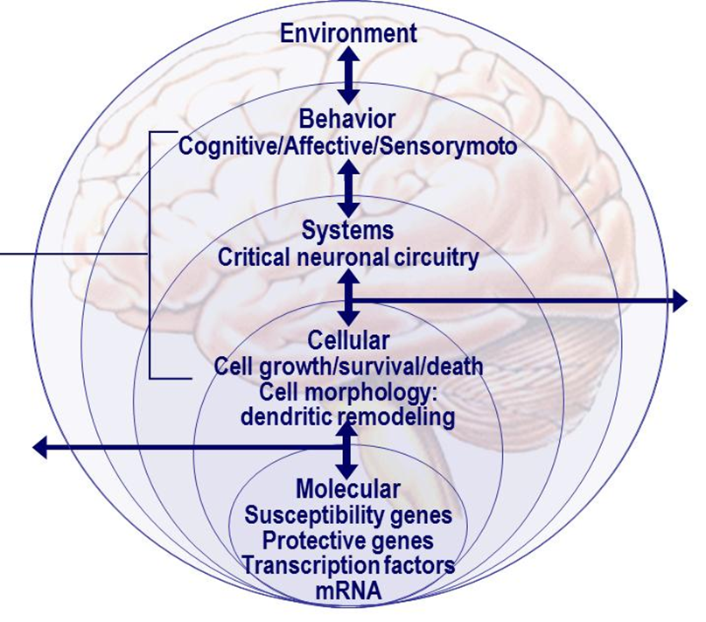
A 21st Century View of Depression
Early Life Adverse Events
r
Environmental factors
(including external environment:
psychosocial stressors, sleep deprivation, internal environment: gonadal/HPA steroids)
Neurotransmission:
neurotransmitters and
Neuropeptides and synaptic connectivity
BDNF, CREB, PKC, and other regulatory proteins
BDNF = brain-derived neurotrophic factor; CREB = cAMP responsive element binding;
HPA = hypothalamic-pituitary-adrenal; mRNA = messenger ribonucleic acid; PKC = protein kinase C;
Schloesser RJ et al. 2008. Neuropsychopharmacol Rev. 2008;33:110-33.
Notes:
Key message:
Depression can affect multiple areas of a patient’s life − emotionally, physically
and functionally.
Key message:
From the neurobiological perspective, a new clinical outlook of depression encompasses the understanding of molecular, cellular, chemical, behavioral and environmental factors of depression.

Slide 17
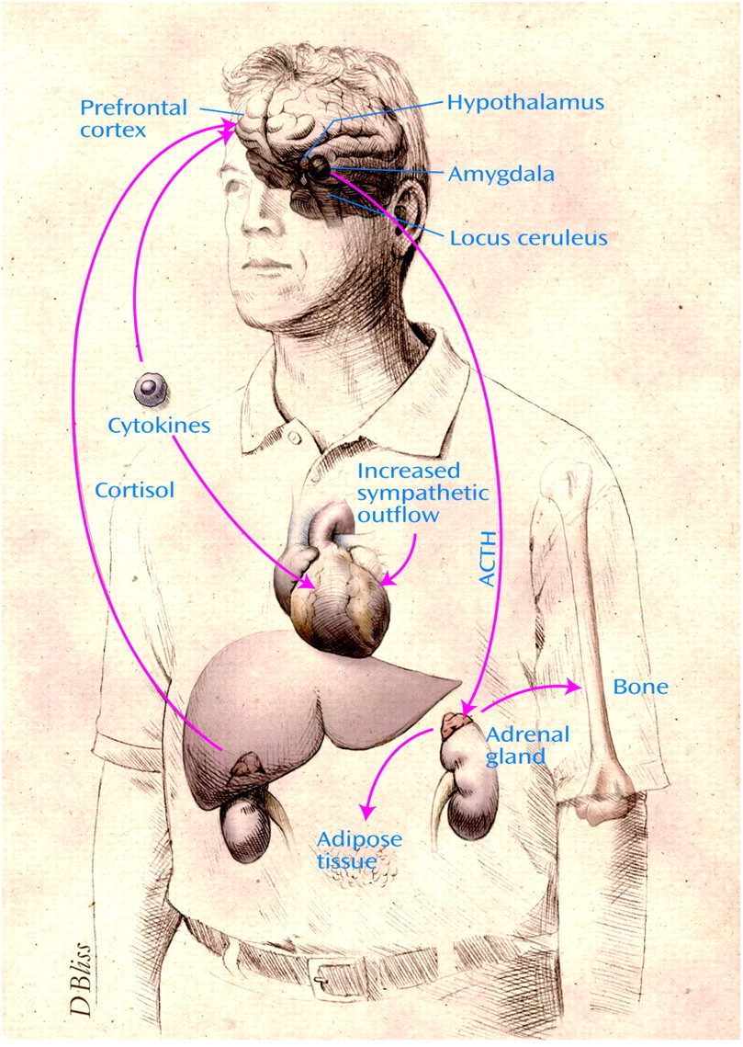
Depression: A Disease of the Mind, Brain, and Body
Gold PW, Charney DS. Am J Psychiatry. 2002;159(11):1826.
Notes:
It is known that depression is an illness that affects the mind and mood of a sufferer, altering that person’s core experience of others and the world around them. There is emerging evidence that depressed patients have a significant loss of cells in the prefrontal cortex. An increase in cortisol and norepinephrine secretion represents a highly adverse biochemical environment, a condition that is likely to contribute to many different adverse outcomes, including increased
visceral fat, insulin resistance, increased inflammation, enhanced blood coagulation, deficient fibrinolysis, decreased bone formation, and increased bone resorption. These changes support the concept of depression as a systemic disease that may have primary medical manifestations. Moreover, depression has adverse
effects on co-morbid medical diagnoses as well, such as coronary artery disease, diabetes, and osteoporosis.
REFERENCE:
Gold PW, Charney DS. Diseases of the mind and brain: depression: a disease of the mind, brain, and body. Am J Psychiatry. 2002 Nov;159(11):1826.

Slide 18
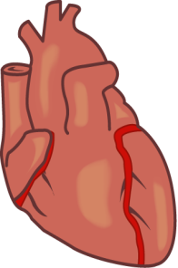
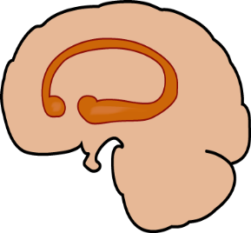
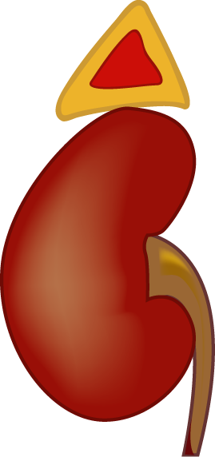
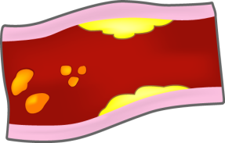
Major Depressive Disorder May
Have Systemic Consequences
2
Adrenal gland releases excessive amounts of catecholamines and cortisol
3
Increase in catecholamines can lead to myocardial ischemia, diminished heart rate variability, and can contribute to ventricular arrhythmias
ACTH
4
Increase in catecholamines causes platelet activation; increase in cytokines and interleukins may also contribute to atherosclerosis and eventual hypertension
1
Hypothalamus stimulates pituitary gland to release excessive ACTH, continuously driving the adrenal gland
5
Cortisol antagonizes insulin and contributes to dyslipidemia
ACTH=Adrenocorticotropic hormone
Adapted from Musselman DL et al. Arch Gen Psychiatry 1998;55(7):580-92.

Slide 19
Depression and Chronic Disease
Chronic illness has been associated with increased prevalence of depression
Diseases include:
  Diabetes
  Hypertension
  Cardiovascular diseases
  Mild cognitive impairment prior to onset of dementia
  Cancer
  HIV
  COPD
  Rheumatoid arthritis
HIV = human immunodeficiency virus; COPD = chronic obstructive pulmonary disease
Simon GE. West J Med 2001;175:292-3; de Groot et al., Diabetes Spectrum 2010;23:15-8; Scalco AZ et al. Clinics 2005;60:241-50; Barnes DE et al. Arch Gen Psychiatry 2006;63:273-80; Lin HB et al. Ann Fam Med 2009;7:414-21.

Slide 20
Prevalence Rates of Depression in Chronic Medical Disorder

Slide 21
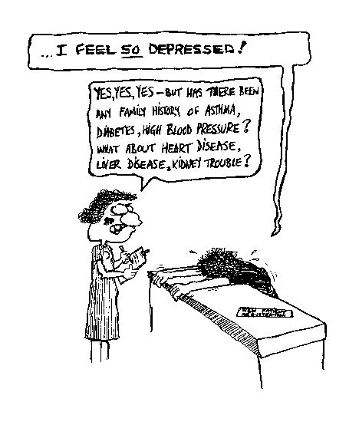
Martin Davis 1997

Slide 22
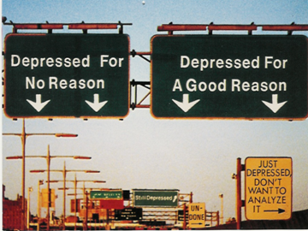

Slide 23
Structural changes in brain in depression
2000s
Depression
Decrease in neurogenesis
Cellular
atrophy
Decrease in hippocampal volume
Frodl et al. Am J Psych. 2002; McKittrick et al. Synapse. 2000; Duman R. CNS Spectrum, 2002.

Slide 24
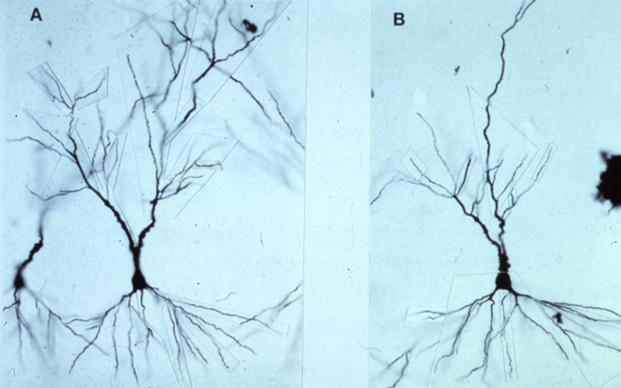
Cellular Atrophy in Depression
Rat hippocampal neurone before (A) and after (B)
3-week repeated stress

Slide 25
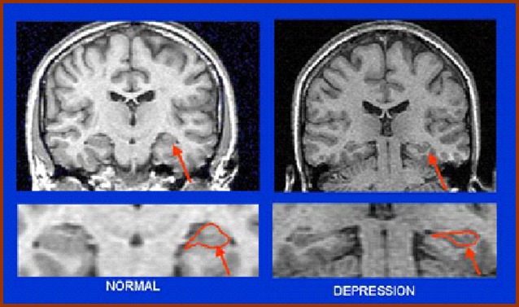
Evidence of Hippocampal Atrophy and Loss in Patients With MDD
Compared to controls, patients with depression had smaller hippocampal volumes (n=16)¹
Decreased hippocampal volume may be related to the duration of depression²⁻⁴
Bremner JD, et al. Am J Psychiatry. 2000;157(1):115-118.
Sheline YI, et al. J Neurosci. 1999;19(12):5034-5043.
Sheline YI, et al. Proc Natl Acad Sci USA. 1996;93(9):3908-3913.
Sheline YI, et al. Am J Psychiatry. 2003;160(8):1516-1518.
Images courtesy of JD Bremner.
Notes:
25
PURPOSE OF THE SLIDE
Atrophy of the hippocampus, a region of the brain involved in conscious memory, may be associated with depression.
SPEAKER DIRECTION
Molecular and cellular studies of stress, depression, and antidepressants have moved the field of mood disorder research beyond the monoamine hypothesis of depression. These studies demonstrated that stress and antidepressant treatment may exert opposing actions on the expression of specific neurotrophic factors in limbic brain regions involved in the regulation of mood and cognition.¹
Most notable are studies of BDNF. The functional significance of altered neurotrophic factor expression was highlighted by studies demonstrating that stress and depression can lead to neuronal atrophy and cell loss in key limbic brain regions implicated in depression, including the amygdala, prefrontal cortex, and hippocampus (which expresses high levels of receptors for glucocorticoids, the major stress reactive adrenal steroid).¹
Several studies have associated depression with decreased hippocampal volume.^{2,3} Furthermore, this reduction in volume has been related to the duration of depression.³⁻⁵
BACKGROUND
The hippocampus is one of several limbic structures that have been implicated in mood disorders. Included in the functions of hippocampal circuitry are control of learning and memory and regulation of the hypothalamic-pituitary-adrenal (HPA) axis, both of which are altered in depression. The hippocampus has connections with the amygdala and prefrontal cortex, regions that are more directly involved in emotion and cognition and thereby contribute to other major symptoms of depression.¹
Bremner et al studied 16 patients with a history of depression based on the Structured Interview for DSM-IV, finding hippocampal volume loss and memory deficits.²
In a sample of 24 women age 23 to 86 years with histories of recurrent major depression, Sheline et al found that post-depressives scored lower in verbal memory, suggesting that the hippocampal volume loss was related to an aspect of cognitive functioning. The study also found duration of depressive episode to be a predictor of hippocampal volume loss.³
REFERENCES
Duman RS, Monteggia LM. A neurotrophic model for stress-related mood disorders. Biol Psychiatry. 2006;59:1116-1127.
Bremner JD, Narayan M, Anderson ER, et al. Hippocampal volume reduction in major depression. Am J Psychiatry. 2000;157(1):115-118.
Sheline YI, Sanghavi M, Mintun MA, et al. Depression duration but not age predicts hippocampal volume loss in medically healthy women with recurrent major depression. Neurosci. 1999;19:5034-5043.
Sheline YI, Wang PW, Gado MH, et al. Hippocampal atrophy in recurrent major depression. Proc Natl Acad Sci USA. 1996;93:3908-3913.
Sheline YI, Gado MH, Kraemer HC, et al. Untreated depression and hippocampal volume loss. Am J Psychiatry. 2003;160:
1516-1518.

Slide 26
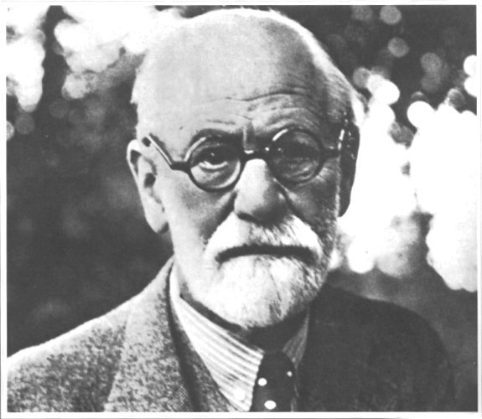

Slide 27
Barriers to Diagnosis and Treatment in the Arab countries
Lack of education about depression
Lack of availability of appropriate therapies
Competing clinical demands
Social issues
Lack of patient acceptance of the diagnosis
Nasir LS, A-Qutob R. J Am Board Fam Pract 2005;18(2):125-31.
Notes:
Depression is one of the most common causes of morbidity in developing countries. It is believed that there are many barriers to diagnosis and treatment in the primary care setting. Through a sample of 50 primary health care providers working in the public health clinics of the Jordanian Ministry of Health (MOH), it was identified that the lack of education about depression, lack of availability of appropriate therapies, competing clinical demands, social issues, and the lack of patient acceptance of the diagnosis were among the most important barriers to the identification, diagnosis, and treatment of patients with depression in this population.
REFERENCE:
Nasir LS, Al-Qutob R. Barriers to the diagnosis and treatment of depression in Jordan. A nationwide qualitative study. Am Board Fam Pract. 2005 Mar-Apr;18(2):125-31.

Slide 28
Freud
“ Melancholia, whose definition fluctuates even in descriptive psychiatry, takes on various clinical forms the grouping together of which into a single unity does not seem to be established with certainty; and some of these forms suggest somatic rather than psychogenic affections.”
Mourning and Melancholia (1917)

Slide 29
Are Depressed patients more likely to be medically ill?
1500 Depressed Patients were evaluated for General Medical Conditions
Total prevalence was 53%
Those with older age, Lower income, unemployment, limited education and longer duration of depression were at higher risk
Disease/ System | Prevalence %
Musculo skeletal | 43%
Respiratory | 32%
Heart | 29%
Upper GI | 26%
Neurological | 25%
Endocrine | 24%
Yates et al, Gen Hosp Psych 2004 STAR-D Study

Slide 30
Likelihood of Depression Increases with No. of Physical Symptoms at Presentation
Kroenke K, et al. Arch Fam Med 1994
Notes:
Out patient data. High utilizers are ususally depressed, anxious or somatization d/o or substance abuser

Slide 31
Medical screening for mood episodes should include:
- review of systems, physical exam, blood count and chemistries, thyroid function tests, and tests for auto-immune factors. Other studies ( EKG, neuroimaging) should be obtained only if indicated by specific symptoms, not just abnormal mood.

Slide 32
Differential diagnosis of Depression
Grief
Medical causes
Other psychiatric disorders

Slide 33
What is Grief?
Grief is the physical, emotional, somatic, cognitive and spiritual response to actual or threatened loss of a person, thing or place to which we are emotionally attached. We grieve because we are biologically willed to attach. (John Bowlby, Father of Attachment Theory)

Slide 34
DEPRESSION MANAGEMENT
Pharmacotherapy:
50 to 70% effective
Selection factors:
prior response to agent
anticipated side effects
concomitant illness
potential for drug interactions
family history of response
patient desire
cost
Notes:
Patients coming in with information from TV, radio, magazine, and the Internet.

Slide 35
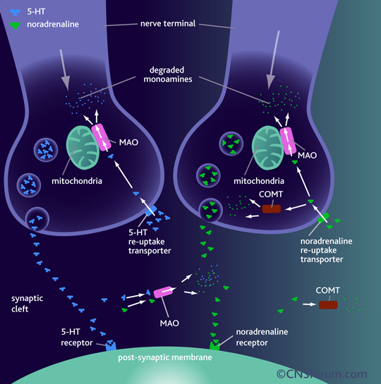

Slide 36
SSRI
A class of drugs that inhibit the uptake of serotonin so increases synaptic serotonin levels.
Many SSRI affect other receptors especially at higher doses.
Several serotonin (5-HT) receptors subtypes.
The different response we notice in some patients with one antidepressant versus another because they are structurally unrelated and different response related to different morphology of serotonin transport protein.
Middleton et al: BMJ (2005)

Slide 37
SSRI
Fluoxetine : 1988
Sertraline : 1992
Paroxetine : 1993
Fluvoxamine : 1994
Citalopram : 1998
S. Citalopram : 2002

Slide 38
SNRIs
Desvenlafaxine, duloxetine, venlafaxine

Slide 39
Norepinephrine-serotonin modulator
NASA
Mirtazapine

Slide 40
Antidepressants: Guidelines
 | CANMAT (first-line recommendations) | APA (Level 1= recommended with substantial clinical confidence)
SNRIs | Desvenlafaxine, duloxetine, venlafaxine | Desvenlafaxine, duloxetine, venlafaxine
SSRIs | Citalopram, escitalopram, fluoxetine, fluvoxamine, paroxetine, sertraline | Citalopram, escitalopram, fluoxetine, fluvoxamine, paroxetine, sertraline
TCAs | N/A | Amitriptyline, doxepin, imipramine, nortriptyline, protriptyline, maprotiline trimipramine
Serotonin modulators | N/A | Nefadozone, trazodone
Norepinephrine-serotonin modulator | Mirtazapine | Mirtazapine
MAOIs | Moclobemide | Isocarboxazid, moclobemide, phenelzine, selegiline, tranylcypromine
DNRI | Bupropion | Bupropion
APA = American Psychiatric Association; CANMAT = Canadian Network for Mood and Anxiety Treatments; TCA = tricyclic antidepressant; N/A = not applicable; MAOI = monoamine axidase inhibitor; DNRI = dopamine norepinephrine reuptake inhibitor
Gelenberg et al., 2010. Practice Guideline for the Treatment of Patients with Major Depressive Disorder. Third Edition. Available at http://www.psych.org/guidelines/mdd2010; Lam RW et al. J Affect Disord. 2009;117(Suppl 1):S26-S43.

Slide 41
Principles of prescribing in depression
Discuss with the patient choice of drug and utility/availability of other, non-pharmacological treatments.
Discuss with the patient likely outcomes, such as gradual relief from depressive symptoms over several weeks.
Prescribe a dose of antidepressant (after titration, if necessary) that is likely to be effective.
For a single episode, continue treatment for at least 6-9 months after resolution of symptoms (multiple episodes may require longer).
Withdraw antidepressants gradually; always inform patients of the risk and nature of discontinuation symptoms.

Slide 42
Summary of NICE guidance: treatment for depression
Antidepressants are not recommended as a first-line treatment in recent-onset, mild depression; active monitoring, individual guided self-help, CBT and/or exercise are preferred. Antidepressants are recommended for the treatment of moderate-to-severe depression and for dysthymia. When an antidepressant is prescribed, a selective serotonin reuptake inhibitor (SSRI) is recommended. All patients should be informed about the withdrawal (discontinuation) effects of antidepressants. For treatment-resistant depression, recommended strategies include augmentation with lithium or an antipsychotic or the addition of a second antidepressant . Patients with two prior episodes and functional impairment should be treated for at least 2 years. The use of ECT is supported in severe and treatment-resistant depression.

Slide 43
Selective serotonin reuptake inhibitors: summary of suggested treatment
Use of the lowest possible dose Monitor closely in early stages for restlessness, agitation and suicidality. This is particularly important in young people (<30 years). Doses should be tapered gradually on stopping.

Slide 44
Key points that patients should know about depression
A single episode of depression should be treated for at least 6-9 months after remission. The risk of recurrence of depressive illness is high and increases with each episode. Those who have had multiple episodes may require treatment for many years. The chances of staying well are greatly increased by taking antidepressants. Antidepressants are: - effective - not addictive - not known to lose their efficacy over time - not known to cause a new long-term side-effects. Medications needs to be continued at the treatment dose. If side-effects are intolerable, it may be possible to find a more suitable alternative. If patients decide to stop their medication, this must not be done abruptly, as this may lead to unpleasant discontinuation effects and confers a higher risk of relapse. The medication needs to be reduced slowly under the supervision of a doctor.

Slide 45
MORTALITY RATES - SUICIDE
300,000 people die from AIDS
850,000 people die from car accidents
920,000 people die from malaria
970,000 people die from lung cancer
820,000 people die from suicide
World Health Organisation (1997)
Notes:
The World Health Organisation figures from 1997 show that the number of reported deaths from suicide is high compared to more high-profile causes of death. The actual figure is likely to be much higher as many suicides are not reported. According to the WHO figures for some countries, such as Mexico, do not even report death by suicides. This indicates a discrepancy in the way mortality figures are reported.

Slide 46
POSYCHIATRIC DIAGNOSIS
Of 6,003 cases of suicide, the cause was
  organic brain syndrome - 5%
  substance abuse - 16%
  schizophrenia - 10%
  affective disorders - 24%
  neurotic and personality disorders - 22%
  other mental disorders - 21%
  no diagnosis - 2%
World Health Organisation (1997)
Notes:
The presence of a psychiatric disorder (including alcohol and drug abuse) is the strongest risk factor for suicide, so that the prevention and treatment of psychiatric disorders would undoubtedly have a significant effect on the number of suicides. It is widely accepted that over 90% of those in the USA and Europe who succeed in committing suicide have a psychiatric illness at the time of death.

Slide 47
Assessing Suicide Risk
Factors to Consider in Evaluating Suicide Risk
Lifetime history of attempts | Psychiatric hospitalization
Suicidal ideation | Disabling medical illness
Access to means for suicide | Demographic features
Hopelessness/self-esteem | Psychosocial stressors
Anxiety | Absence of psychosocial support
Impulsivity | History of childhood traumas
Aggression and violence | Family history of or recent exposure to suicide
Cognition | Absence of protective factors
Psychotic symptoms | Alcohol or other substance abuse
Comorbid psychiatric disorders
Re-evaluate risk periodically as treatment proceeds
Numerous false negatives and false positives complicate risk assessment

Slide 48
SUICIDE: A MULTI-FACTORIAL EVENT
Psychiatric Illness
Co-morbidity
Personality
Disorder/Traits
Neurobiology
Impulsiveness
Substance
Use/Abuse
Hopelessness
Severe Medical
Illness
Suicide
Family History
Access To Weapons
Psychodynamics/
Psychological Vulnerability
Life Stressors
Suicidal
Behavior

Slide 49
Suicide (risk) Assessment refers to the establishment of a clinical judgment of risk in the very near future, based on the weighing of a very large mass of available clinical detail. Risk assessment carried out in a systematic, disciplined way is more than a guess or intuition – it is a reasoned, inductive process, and a necessary exercise in estimating probability over short periods

Slide 50
COMPONENTS OF SUICIDE ASSESSMENT
Appreciate the complexity of suicide / multiple contributing factors
Conduct a thorough psychiatric examination, identifying risk factors and protective factors and distinguishing risk factors which can be modified from those which cannot

Slide 51
Ask directly about suicide; The Specific Suicide Inquiry
Determine level of suicide risk:
low, moderate, high
Determine treatment setting and plan
Document assessments

Slide 52
CHARACTERISTICS OF A SUICIDE PLAN
Risk / Rescue Issues:
  Method
  Time
  Place
  Available means
  Arranging sequence of events
Jacobs (1998)

Slide 53
SUICIDE RISKS IN SPECIFIC DISORDERS
Condition RR %/y %-Lifetime
Prior suicide attempt 38.4 0.549 27.5
Eating disorders 23.1
Bipolar disorder 21.7 0.310 15.5
Major depression 20.4 0.292 14.6
Mixed drug abuse 19.2 0.275 14.7
Dysthymia 12.1 0.173 8.6
Obsessive-compulsive 11.5 0.143 8.2
Panic disorder 10.0 0.160 7.2
Schizophrenia 8.45 0.121 6.0
Personality disorders 7.08 0.101 5.1
Alcohol abuse 5.86 0.084 4.2
Cancer 1.80 0.026 1.3
General population 1.00 0.014 0.72
Adapted from A.P.A. Guidelines, part A, p. 16

Slide 54
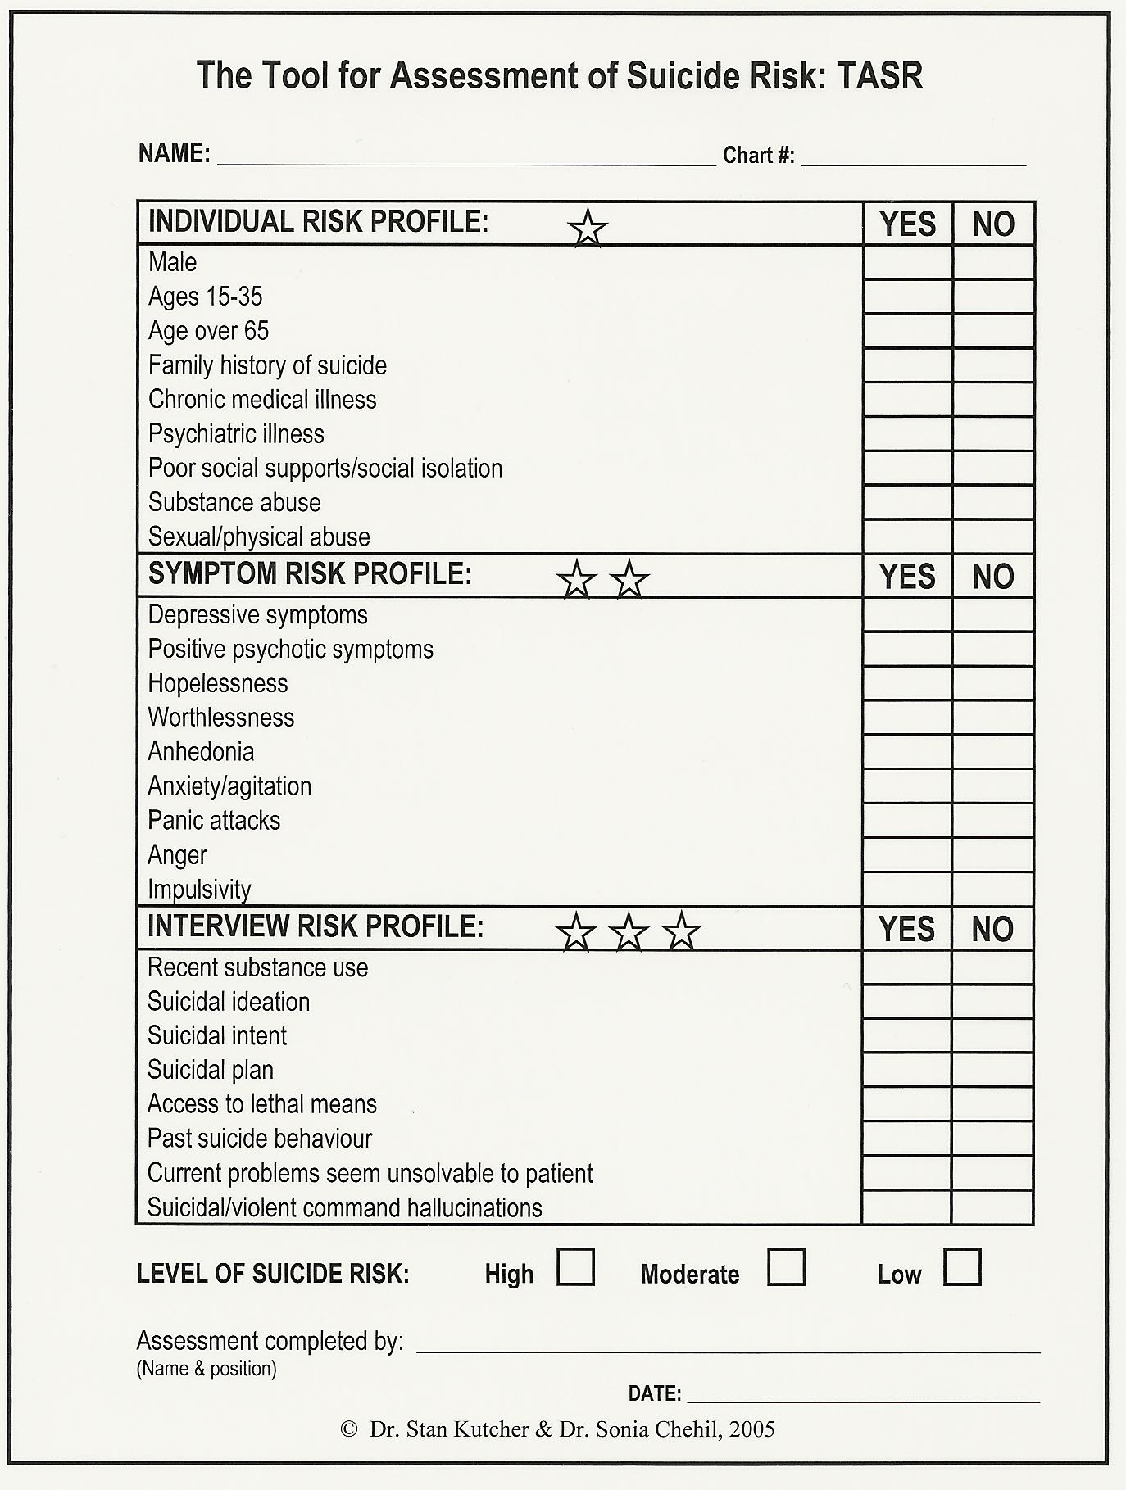

Slide 55
WHEN TO DOCUMENT
SUICIDE RISK ASSESSMENTS
At first psychiatric assessment or admission.
With occurrence of any suicidal behavior or ideation.
Whenever there is any noteworthy clinical change.
For inpatients:
    Before increasing privileges/giving passes
    Before discharge
The issue of firearms:
    If present - document instructions
    If absent - document as pertinent negative

Slide 56
SUICIDE ASSESSMENT
Competency
Document:
  The risk level
  The basis for the risk level
  The treatment plan for reducing the risk
Example:
This 62 y.o., recently separated man with recent stroke is experiencing his first episode of major depressive disorder. He is denying having death wishes or current suicidal ideation. He had serious suicide attempt 5 years ago and he has continued anxiety and hopelessness.

Slide 57


