Slide 1


Slide 2
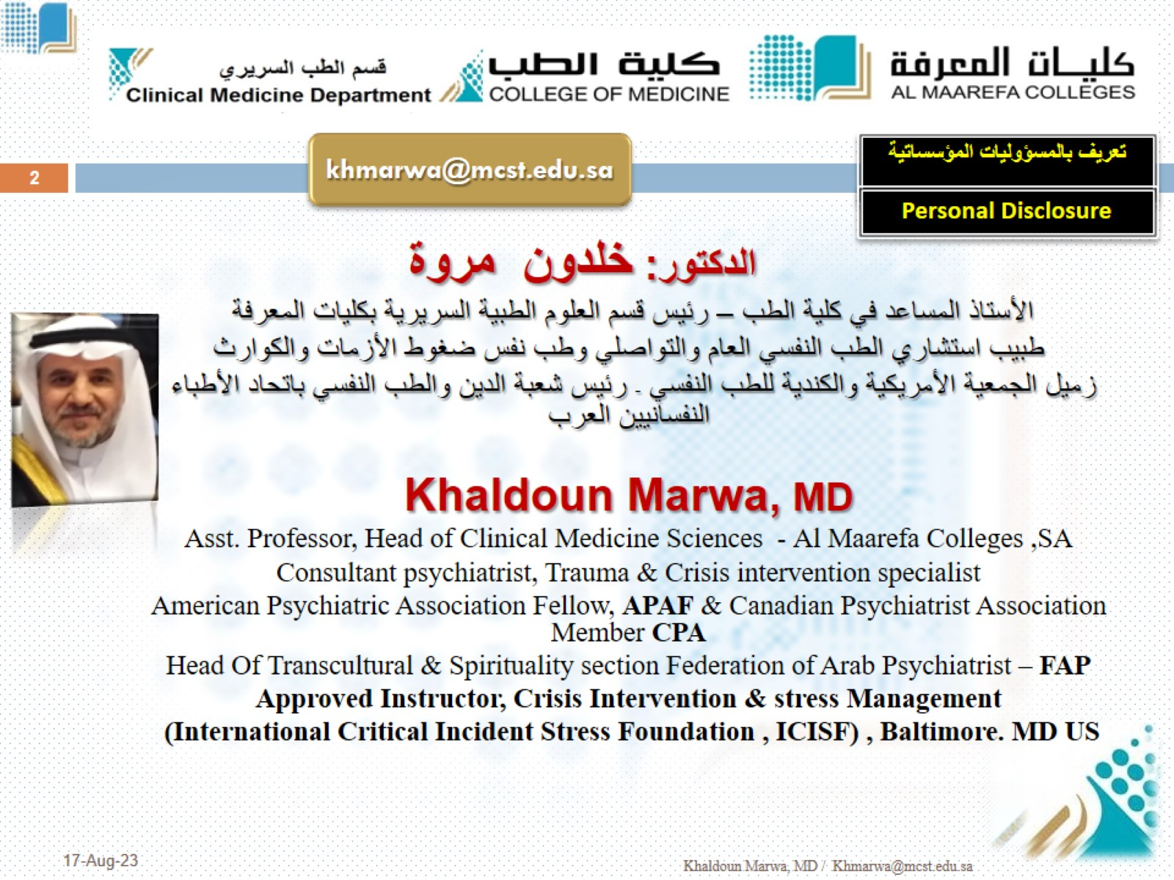

Slide 3
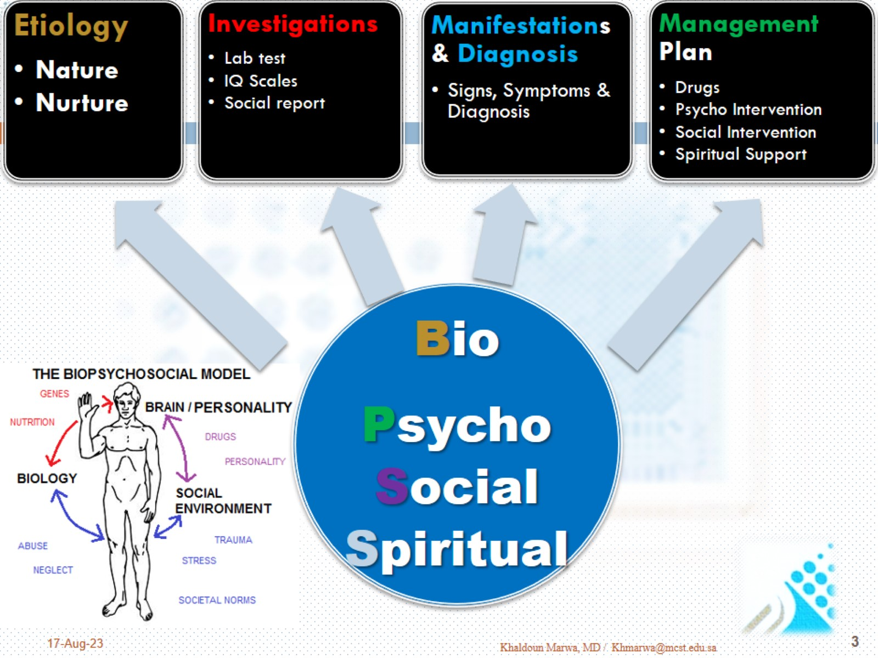

Slide 4

Etiology in Psychiatry

Slide 5
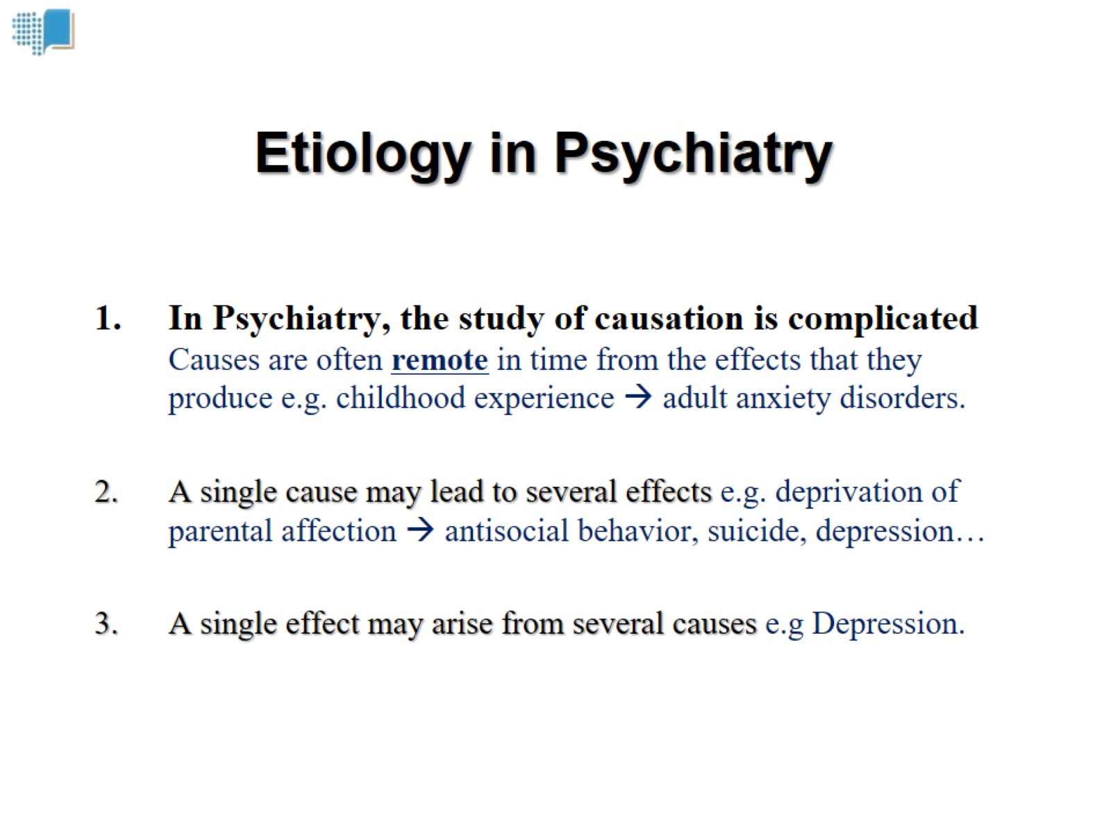

Slide 6
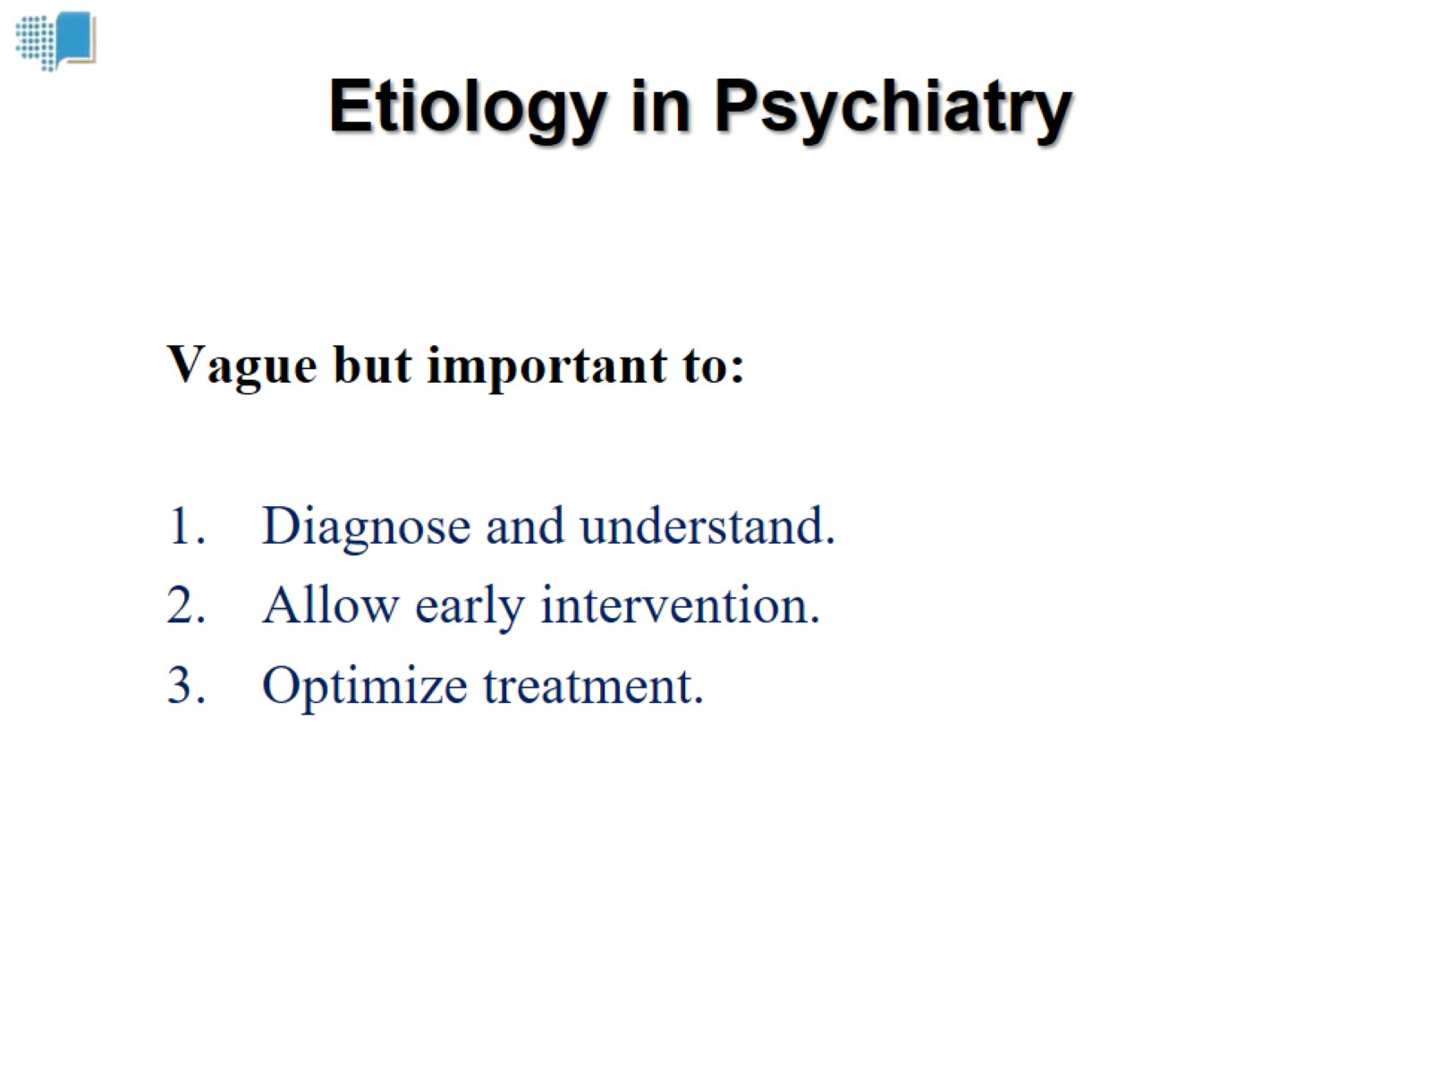
Etiology in Psychiatry

Slide 7
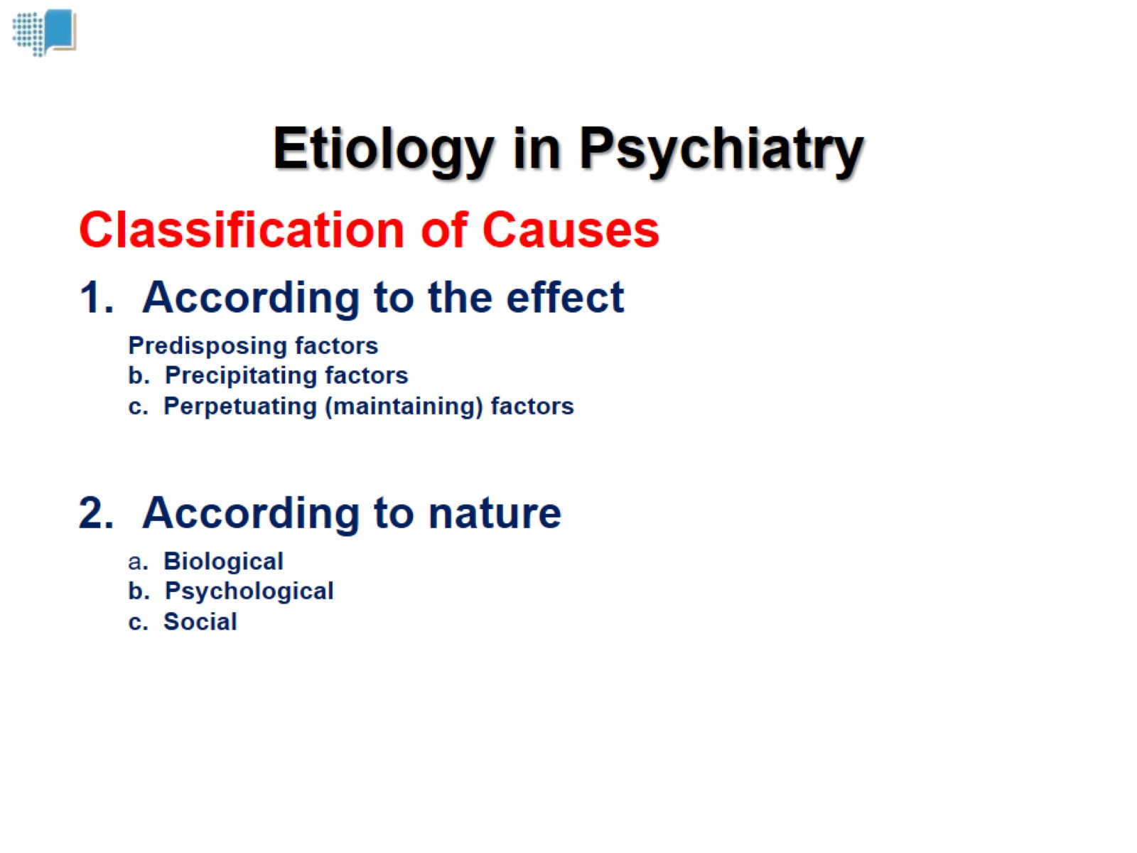
Etiology in Psychiatry

Slide 8
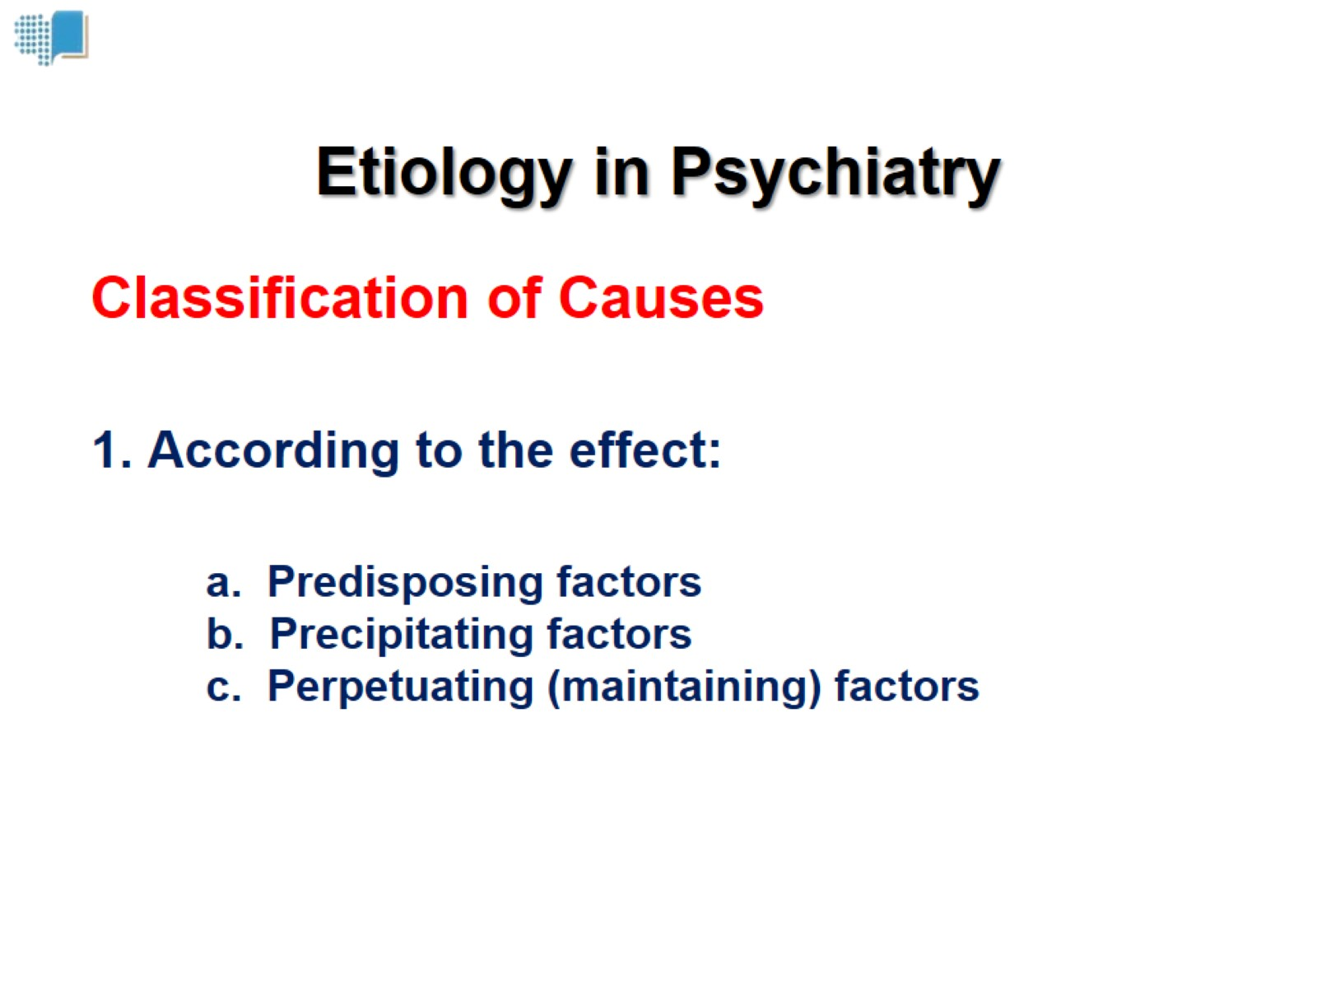
Etiology in Psychiatry

Slide 9
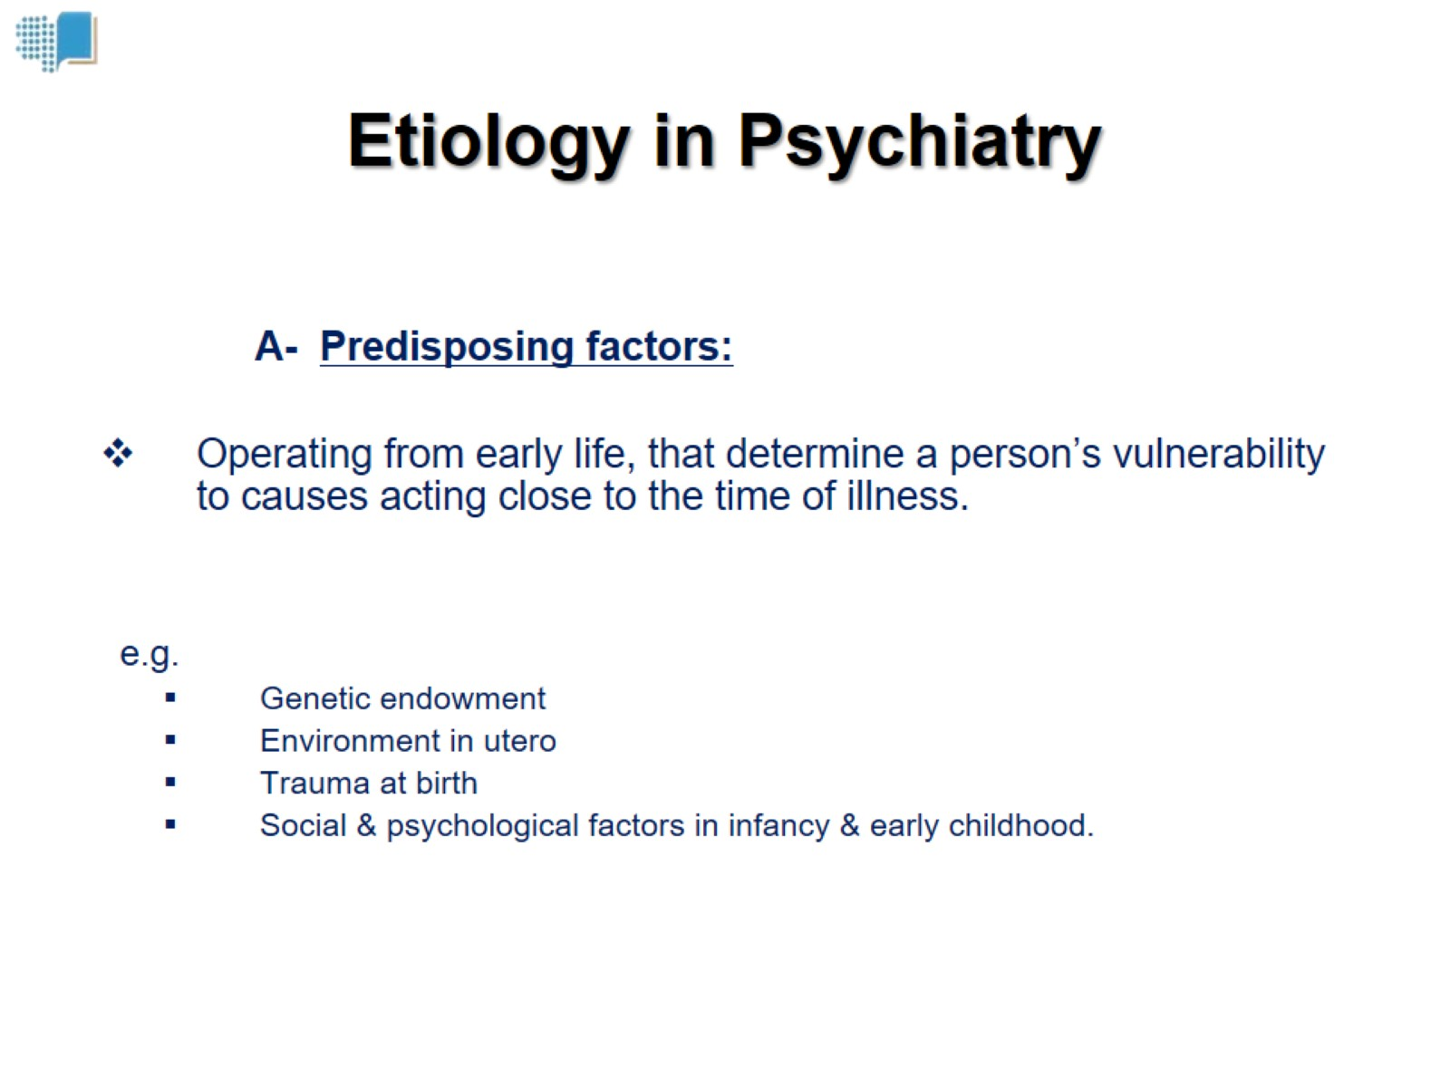
Etiology in Psychiatry

Slide 10
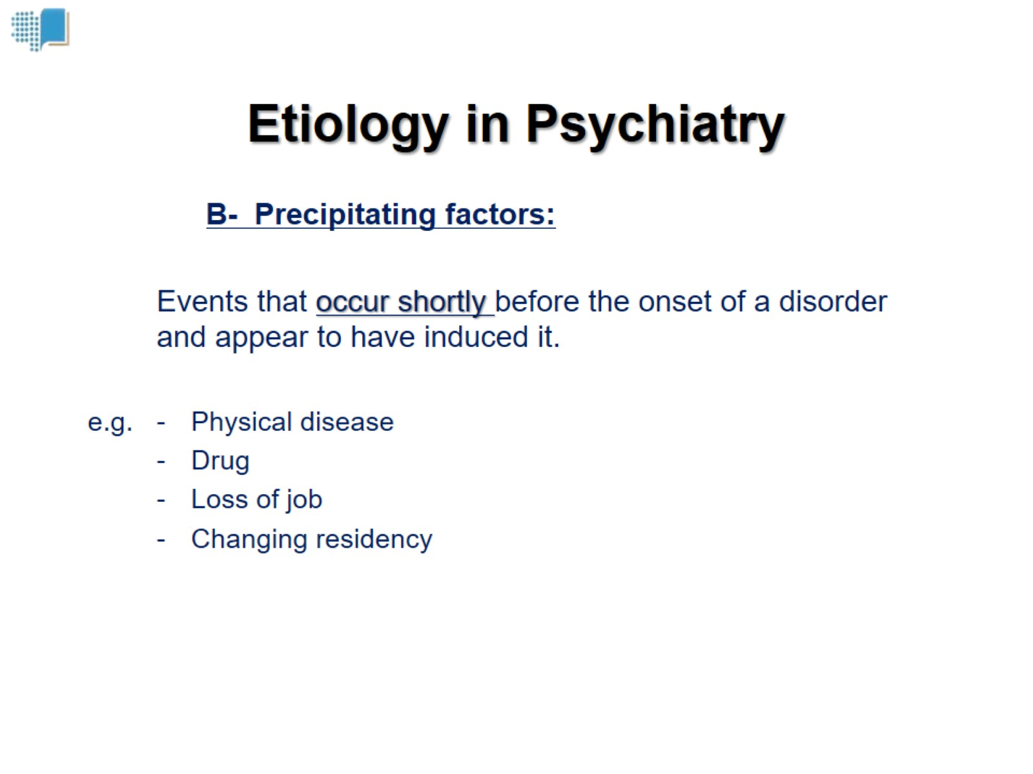
Etiology in Psychiatry

Slide 11
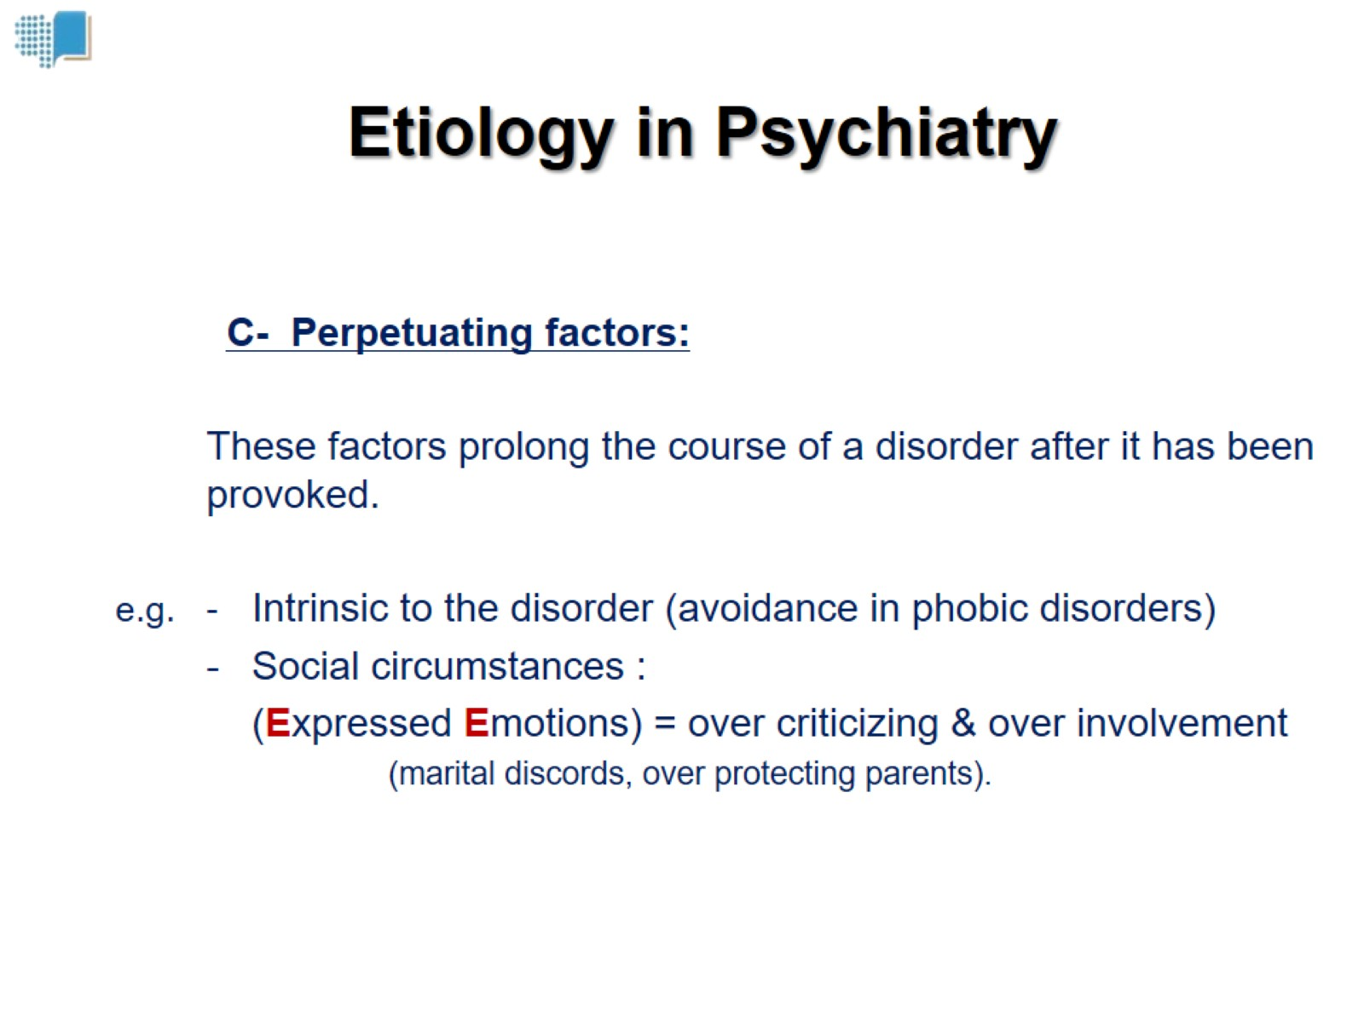
Etiology in Psychiatry

Slide 12
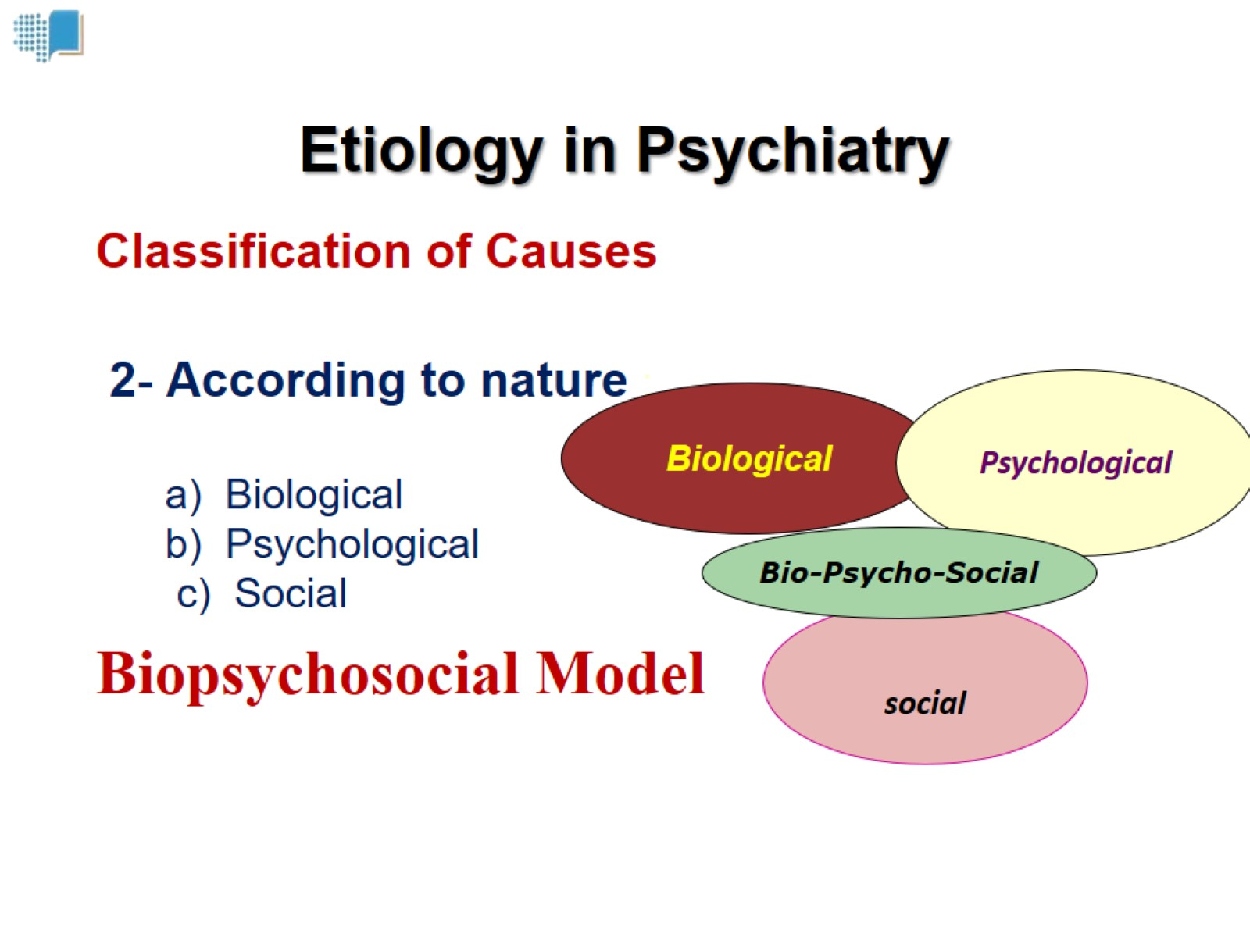
Etiology in Psychiatry

Slide 13
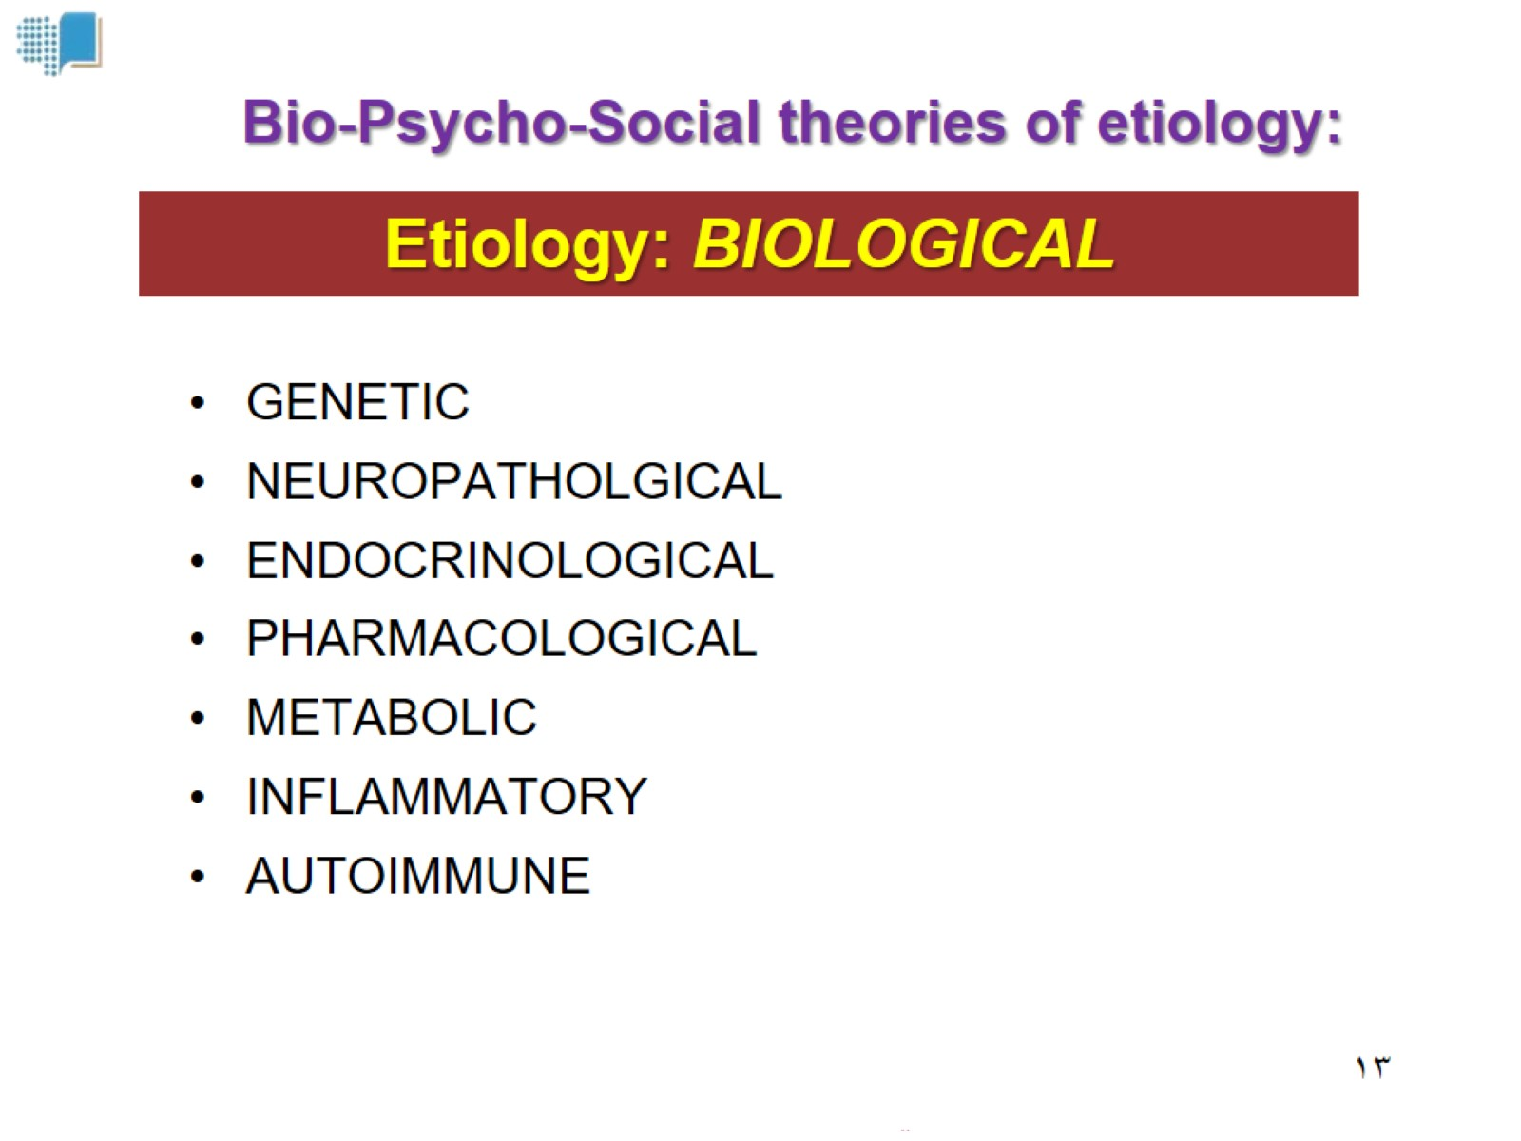
Etiology: BIOLOGICAL

Slide 14
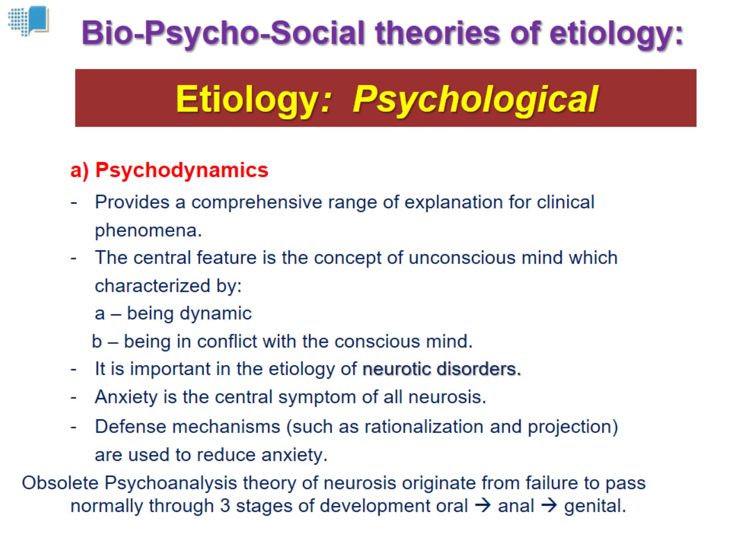
Etiology: Psychological

Slide 15
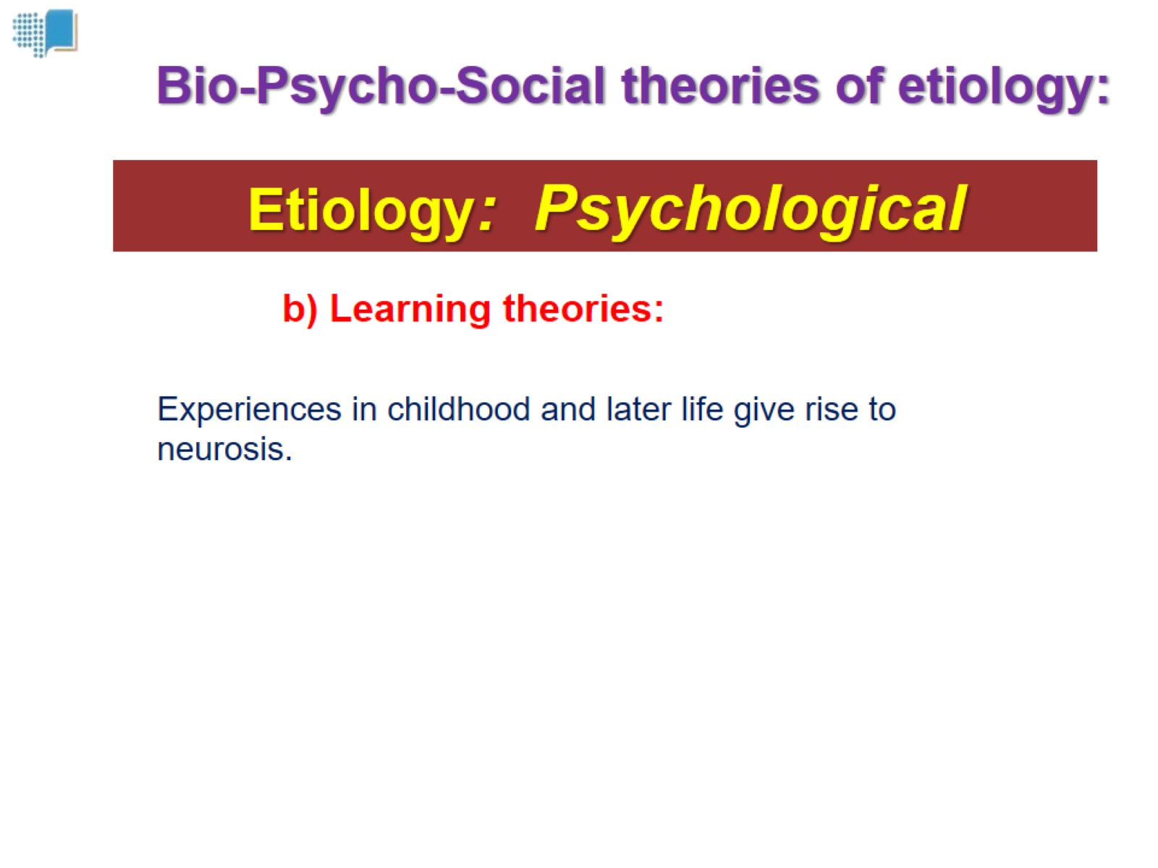
Etiology: Psychological

Slide 16
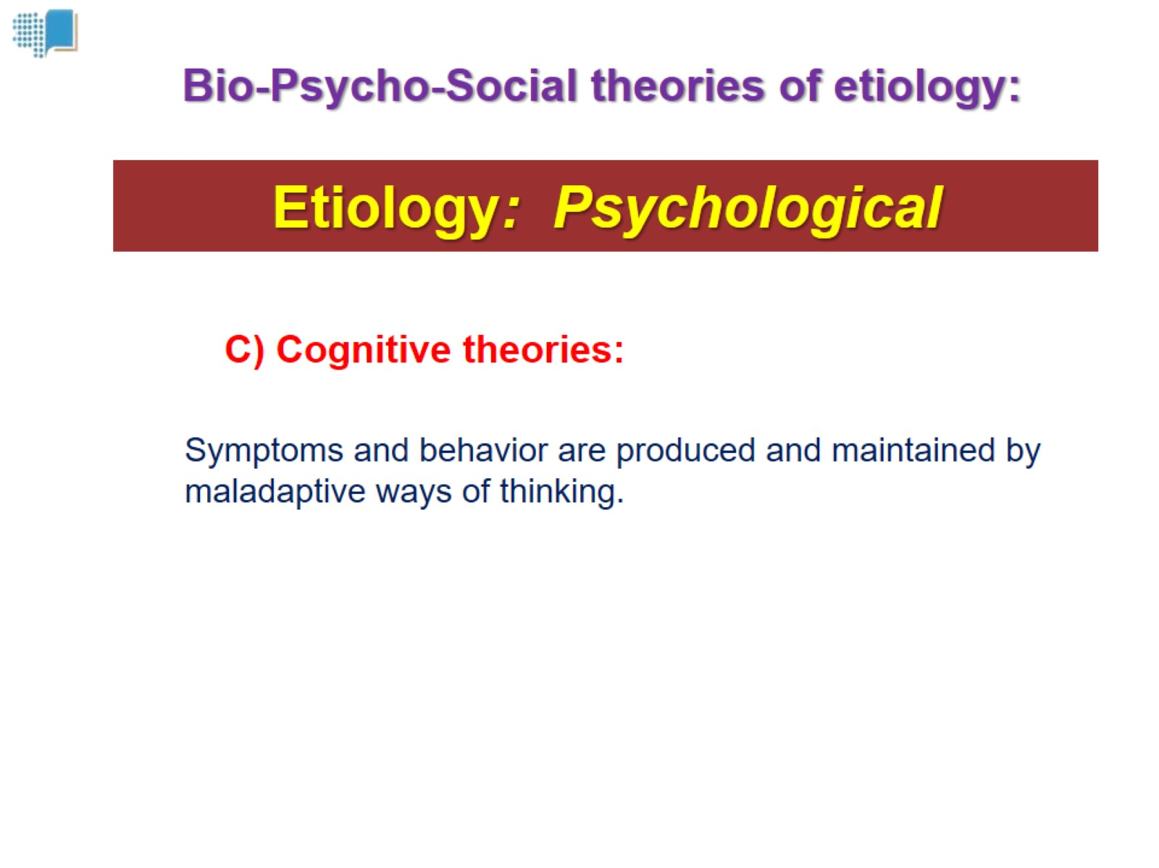
Etiology: Psychological

Slide 17
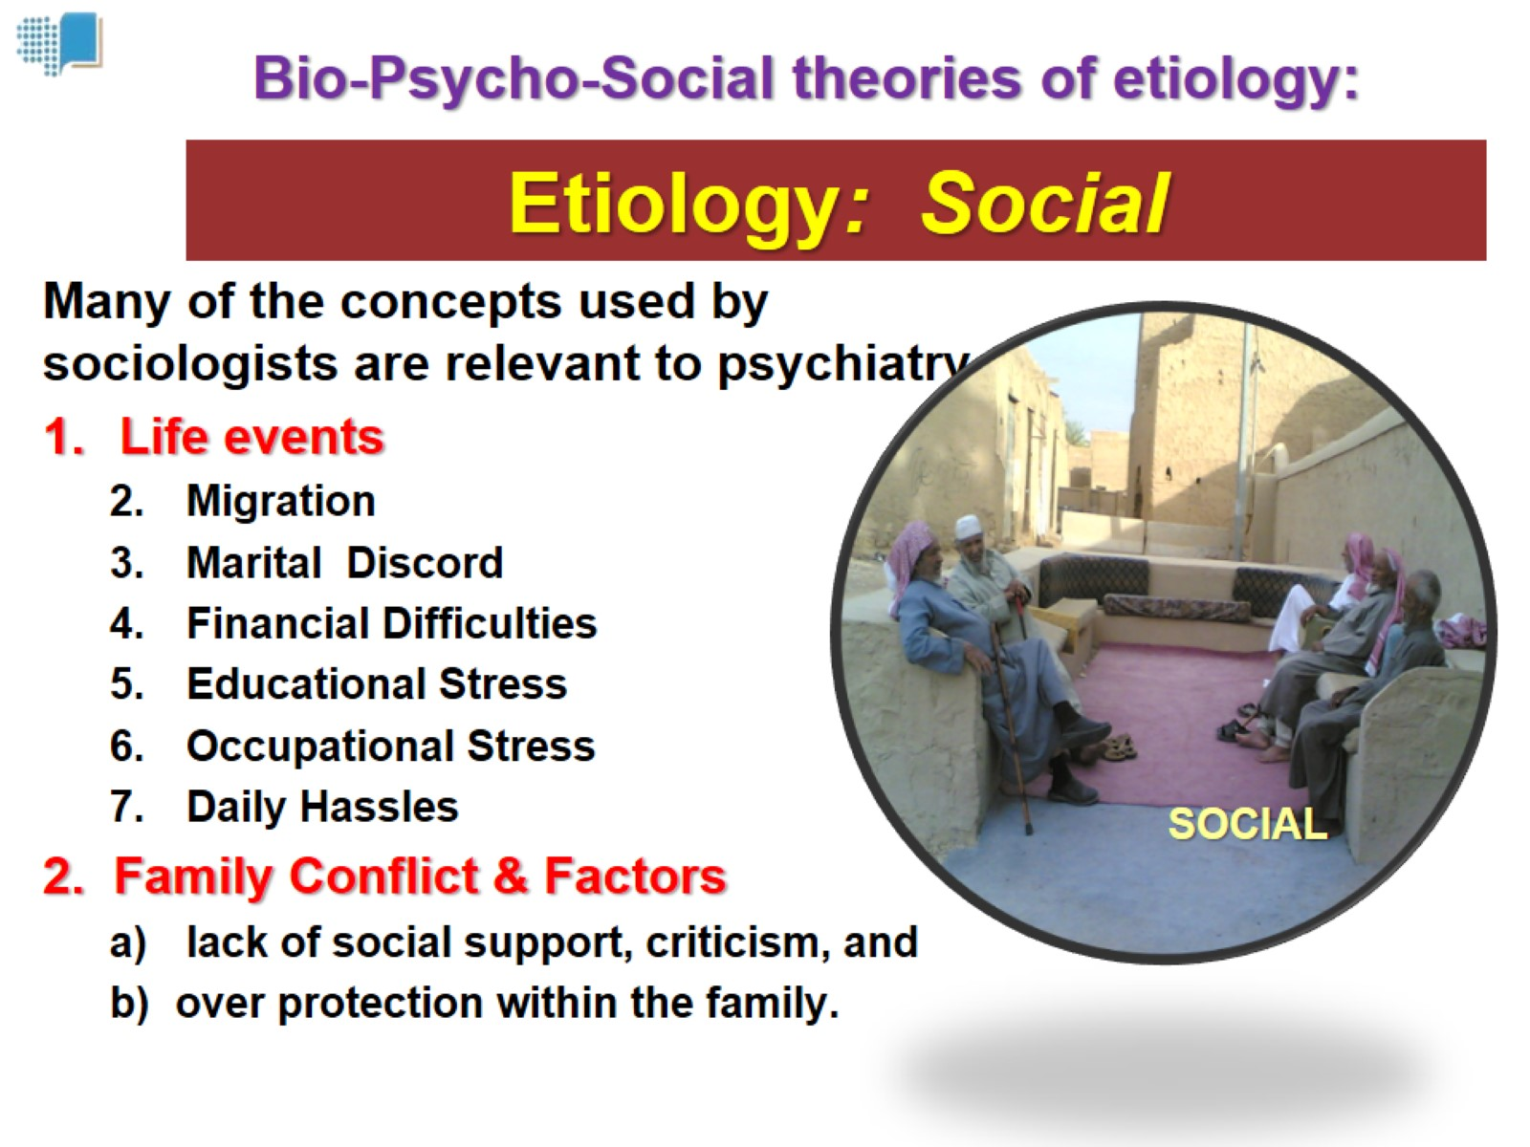

Slide 18
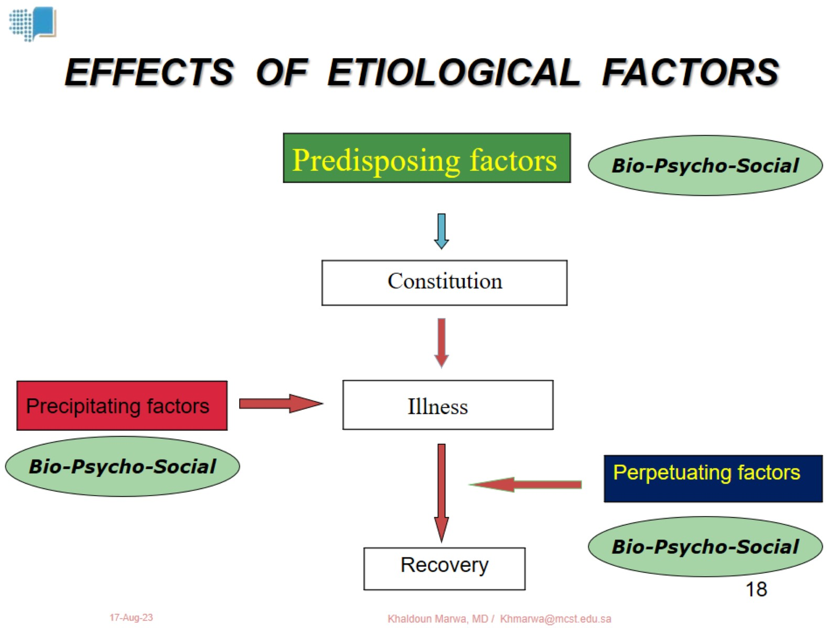

Slide 19

Investigation & Psychiatry

Slide 20
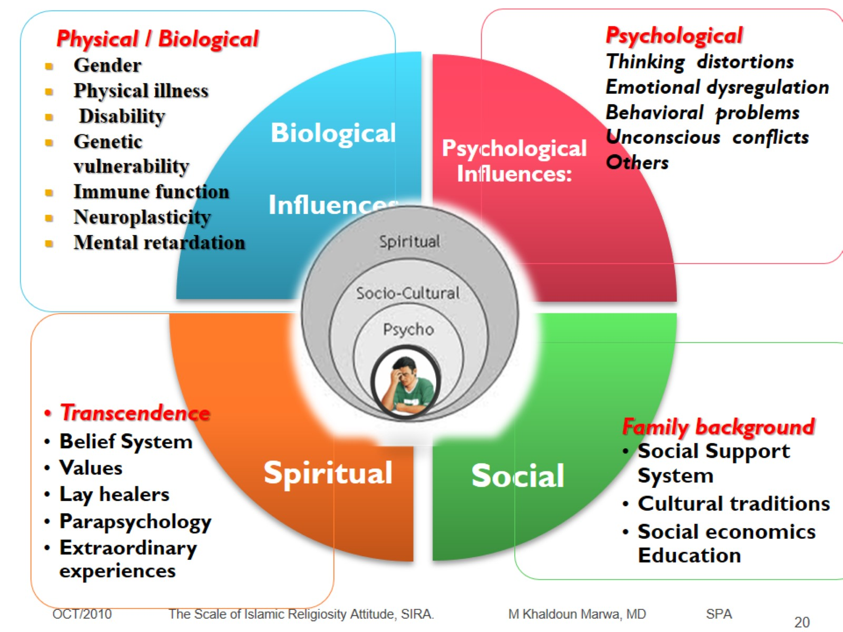

Slide 21
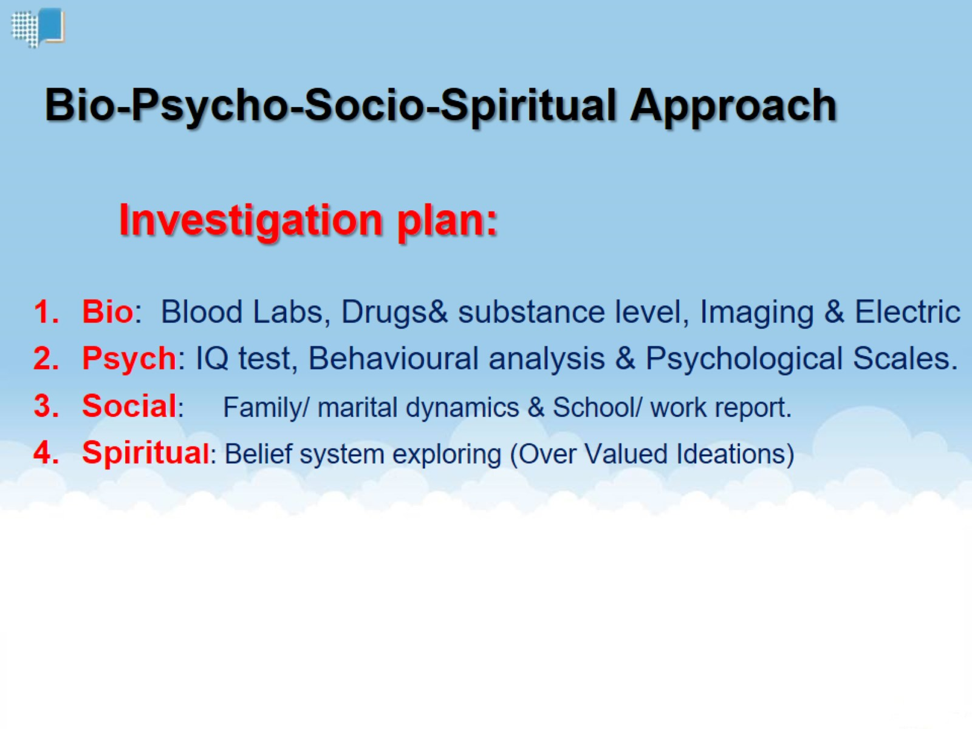
Bio-Psycho-Socio-Spiritual Approach

Slide 22
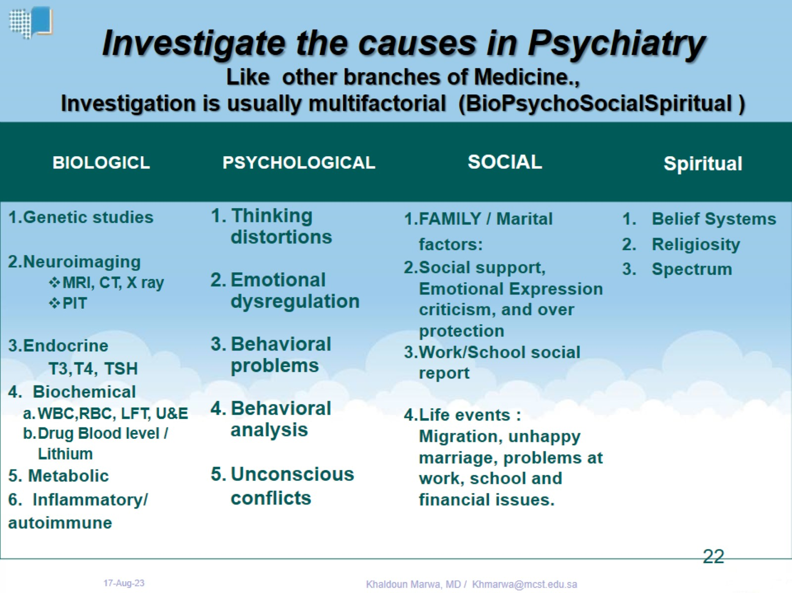
Investigate the causes in Psychiatry Like other branches of Medicine., Investigation is usually multifactorial (BioPsychoSocialSpiritual )

