Slide 1


Slide 2
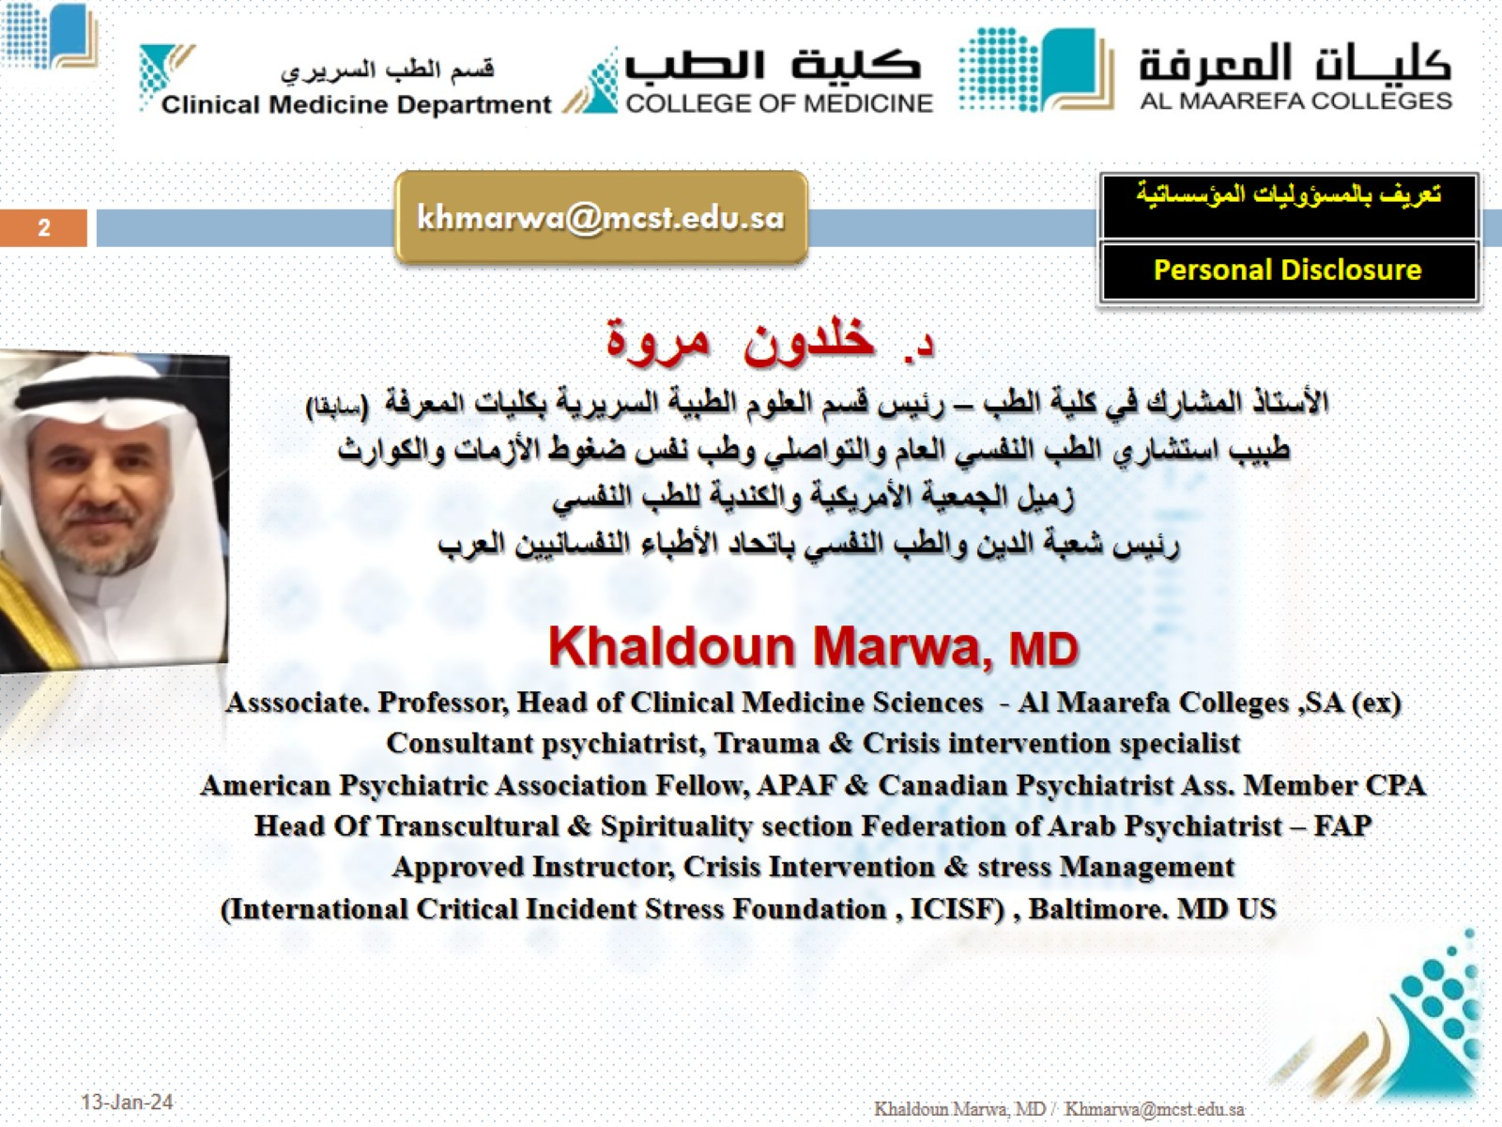

Slide 3
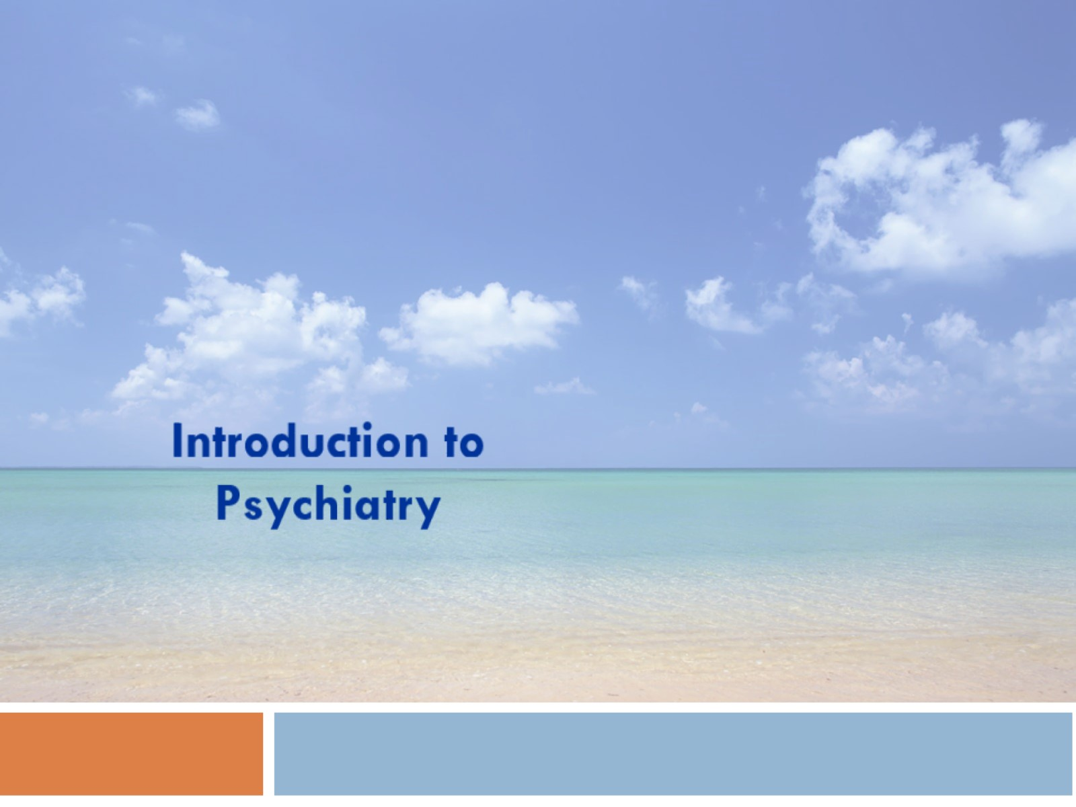

Slide 4
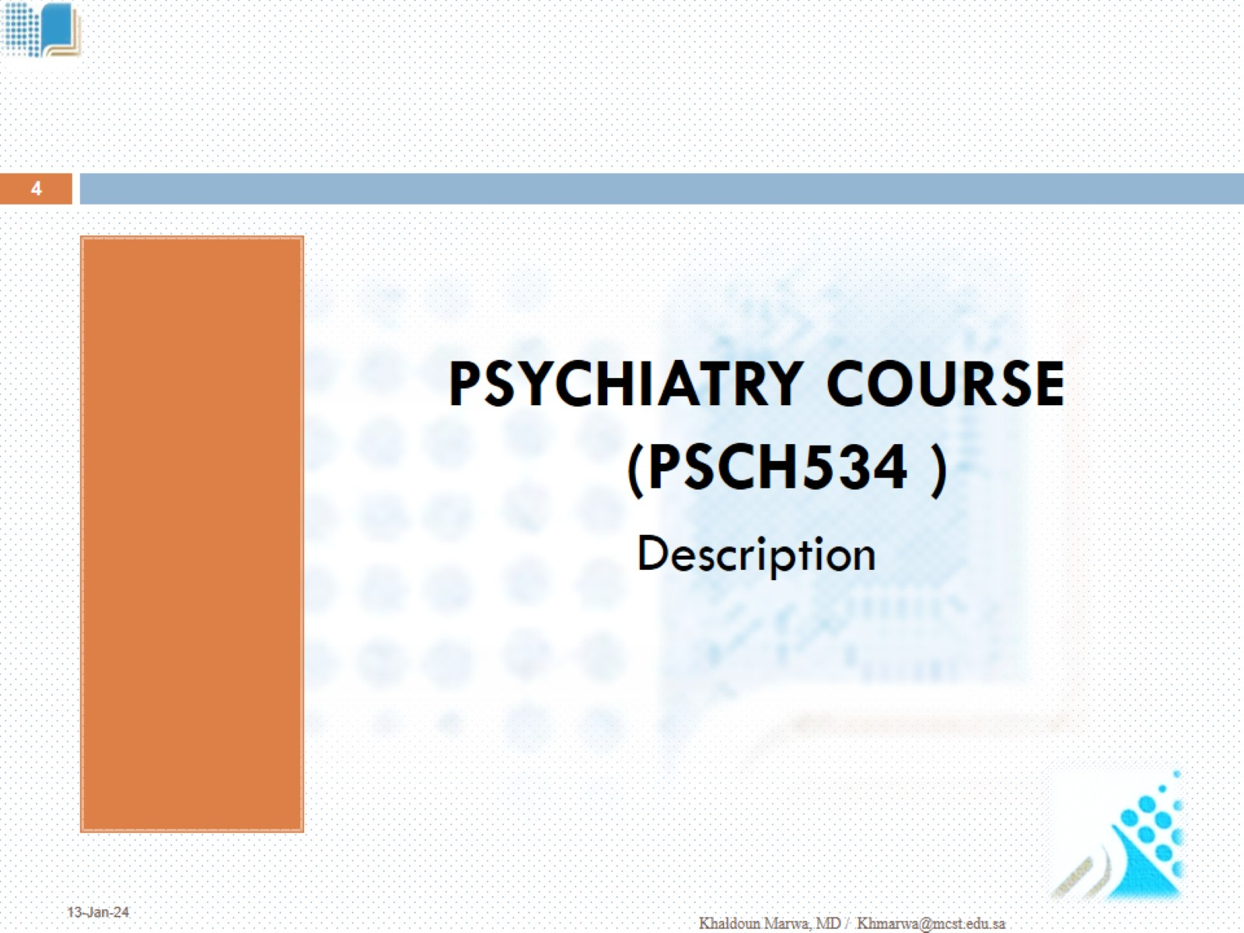

Slide 5
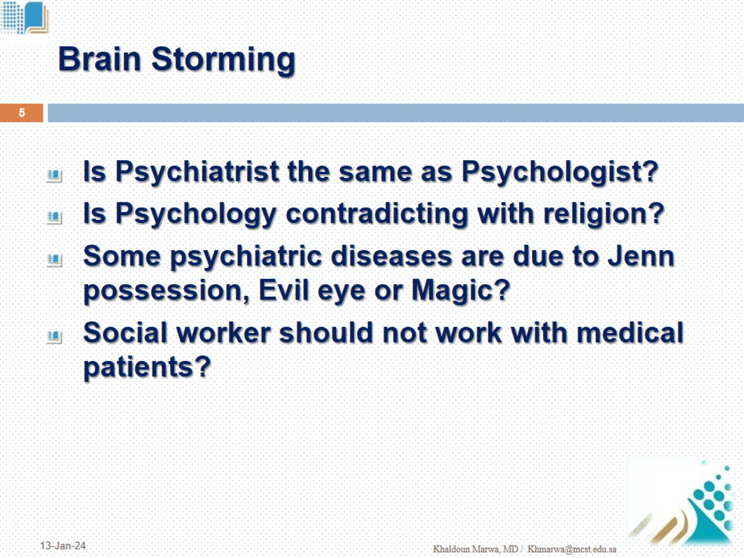
Brain Storming

Slide 6
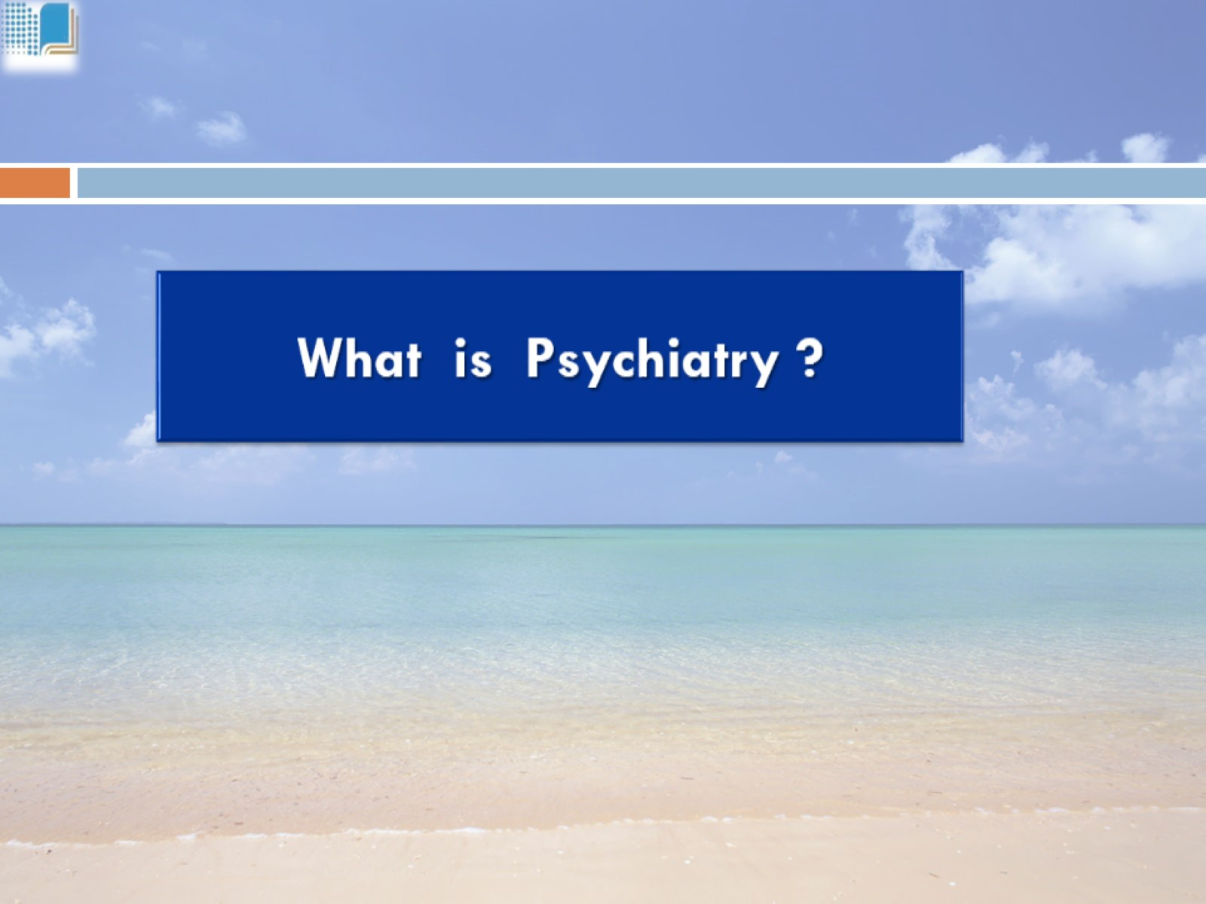

Slide 7
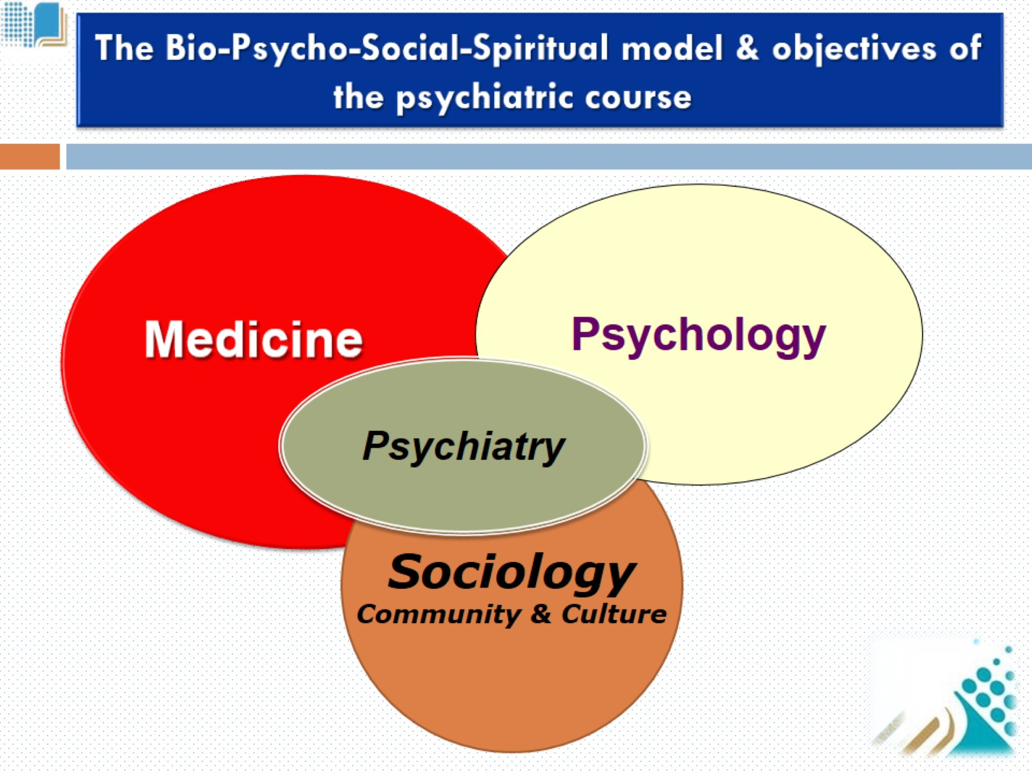

Slide 8
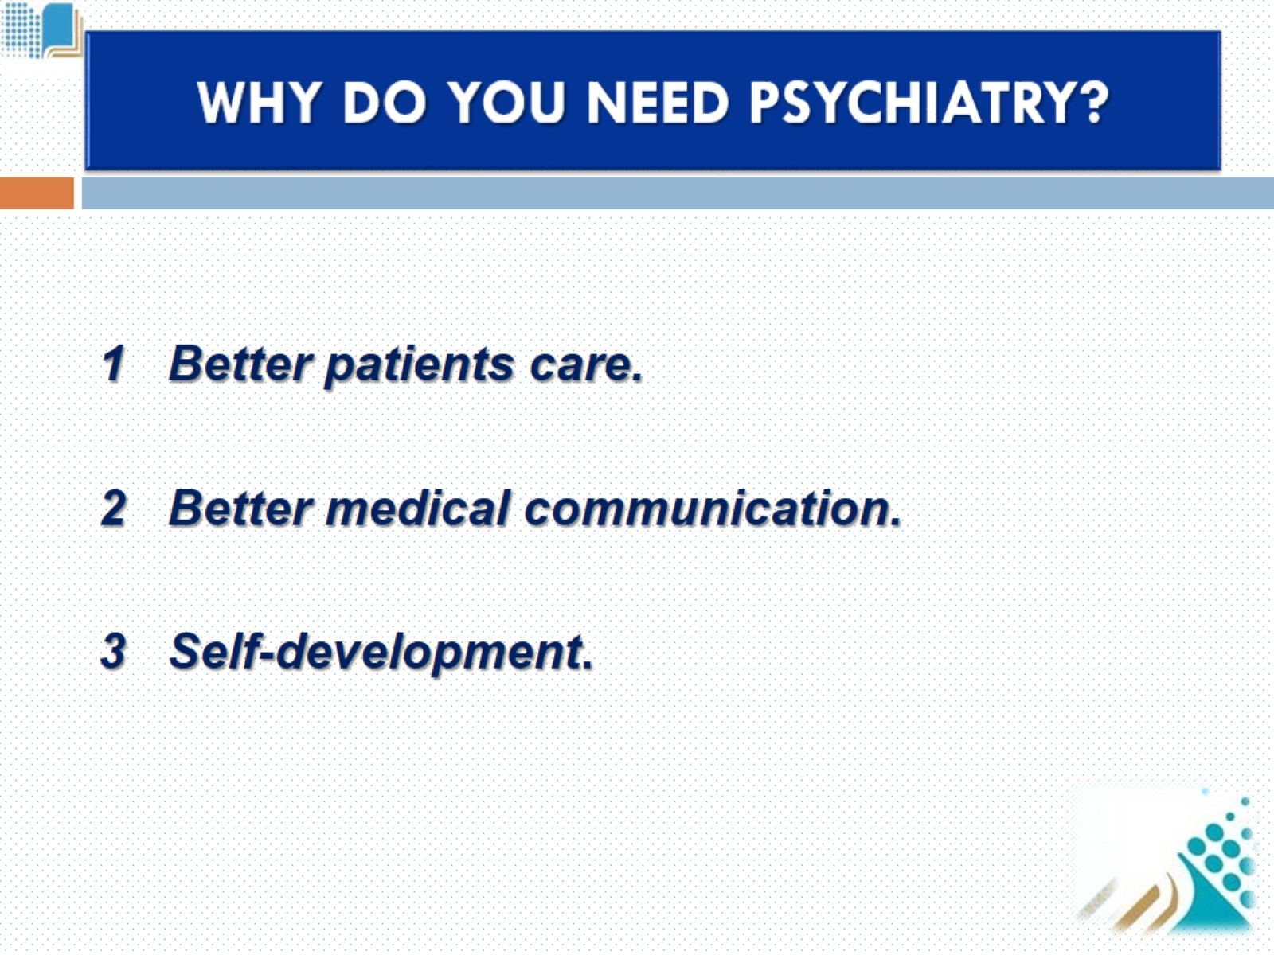
WHY DO YOU NEED PSYCHIATRY?

Slide 9
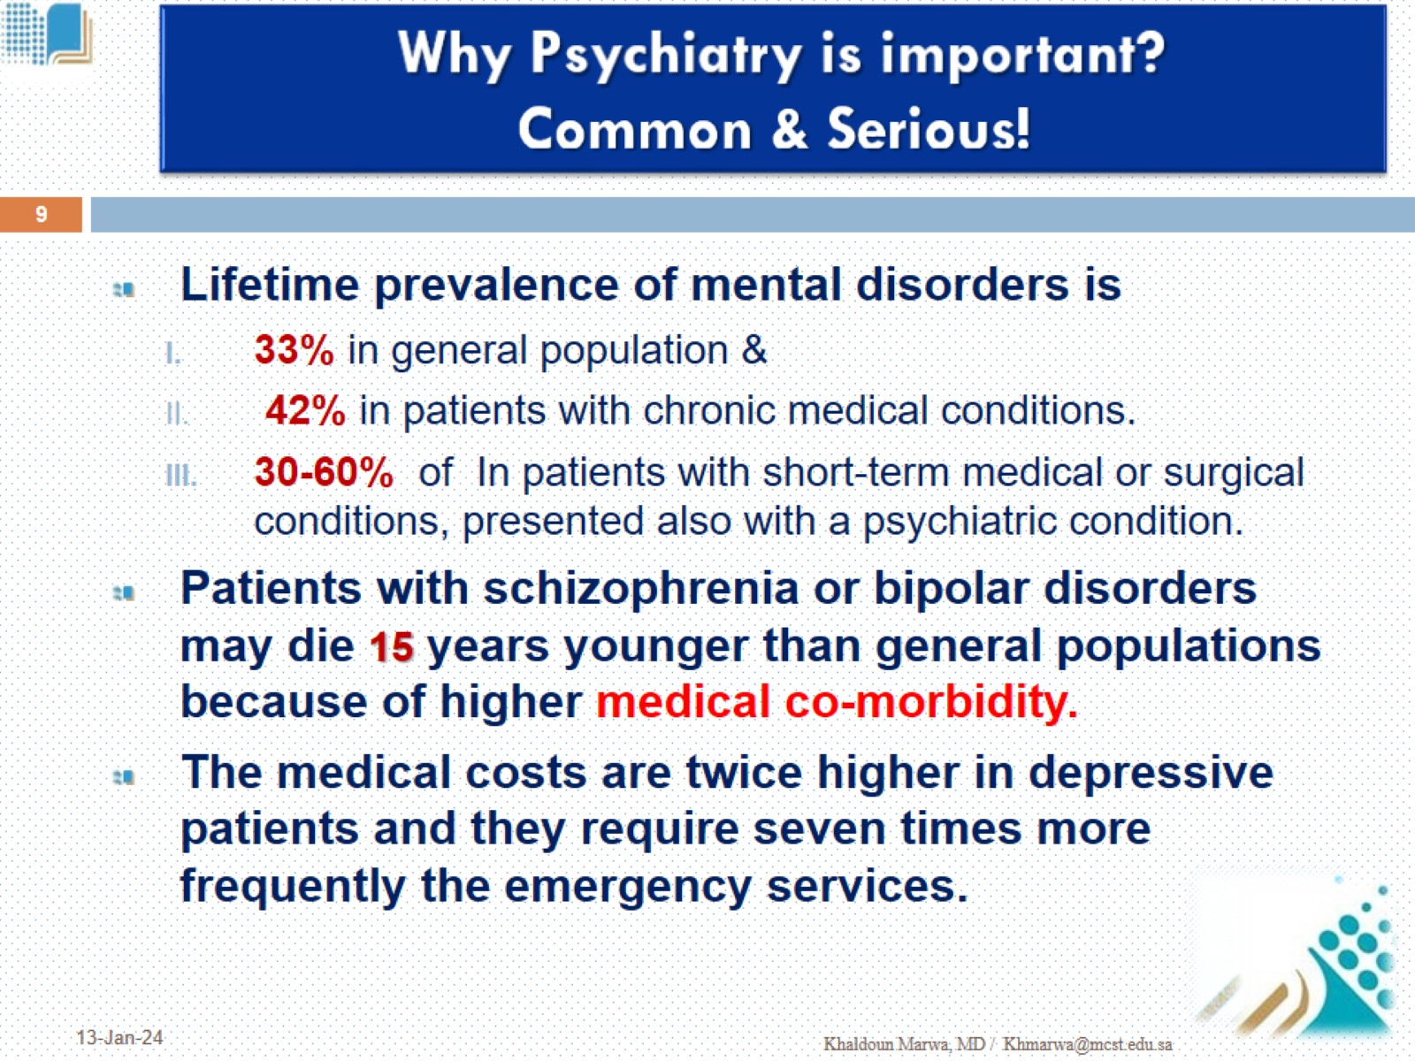
Why Psychiatry is important?
Common & Serious!

Slide 10
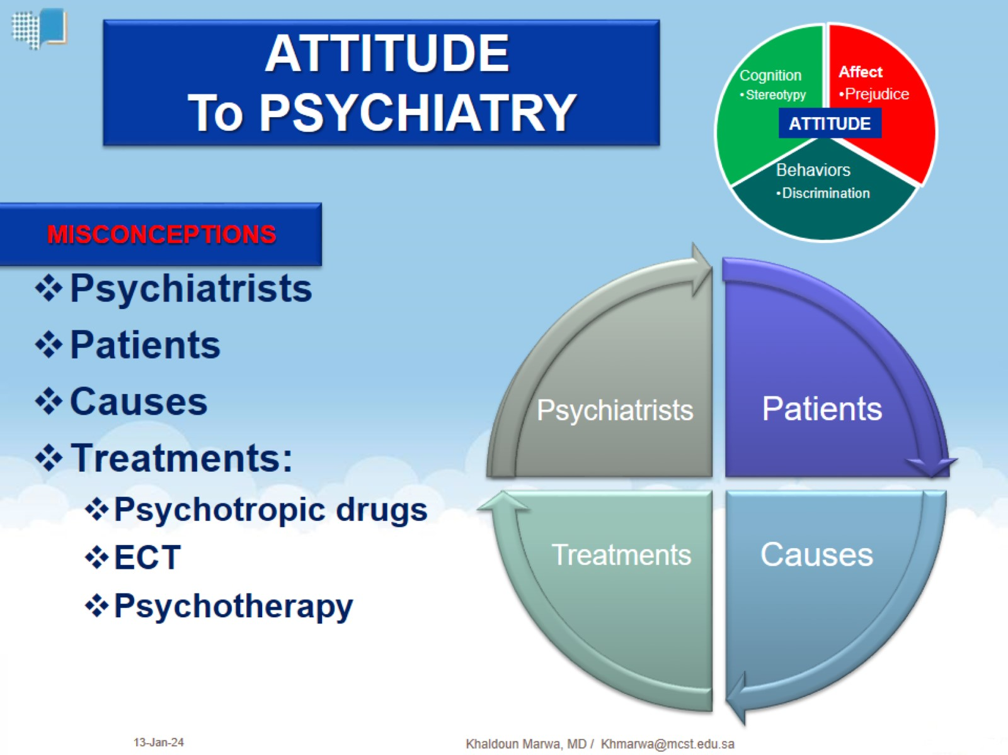
MISCONCEPTIONS

Slide 11
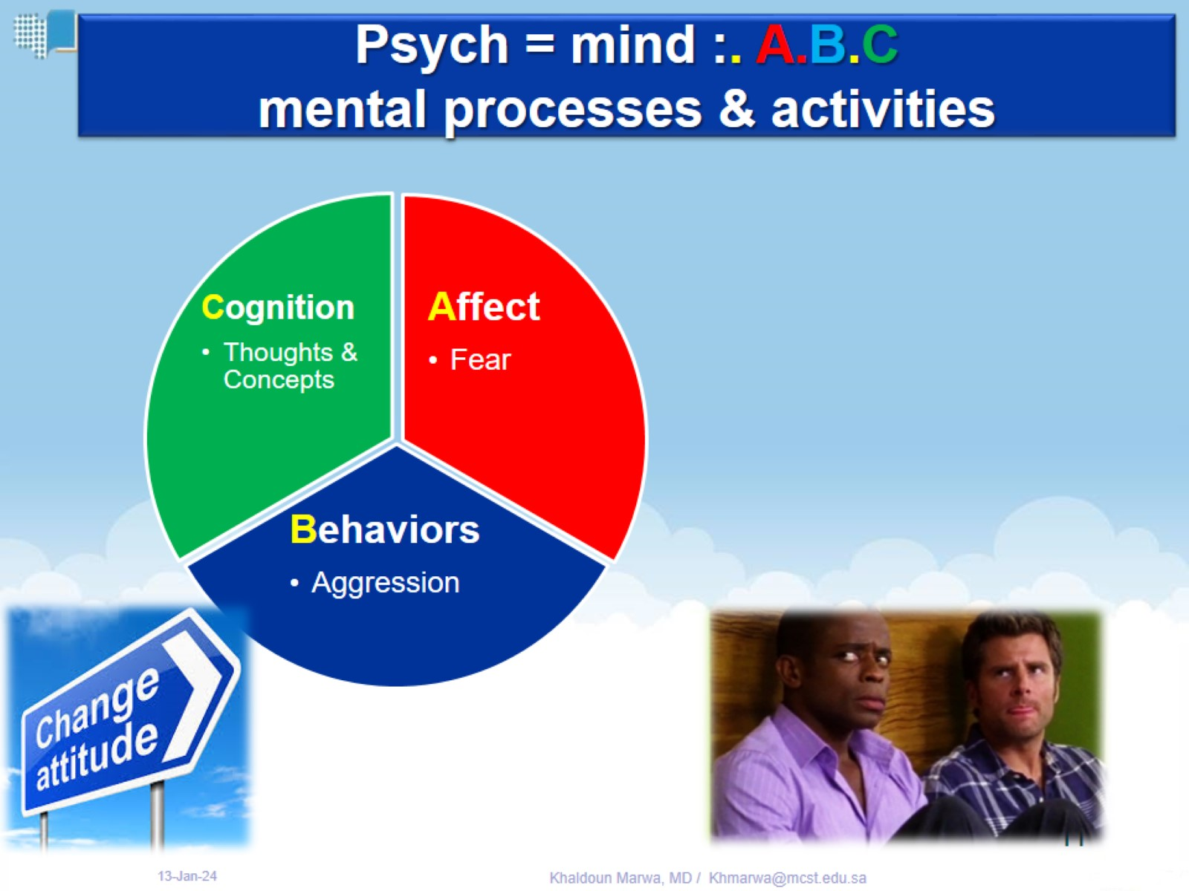
Psych = mind :. A.B.C mental processes & activities

Slide 12
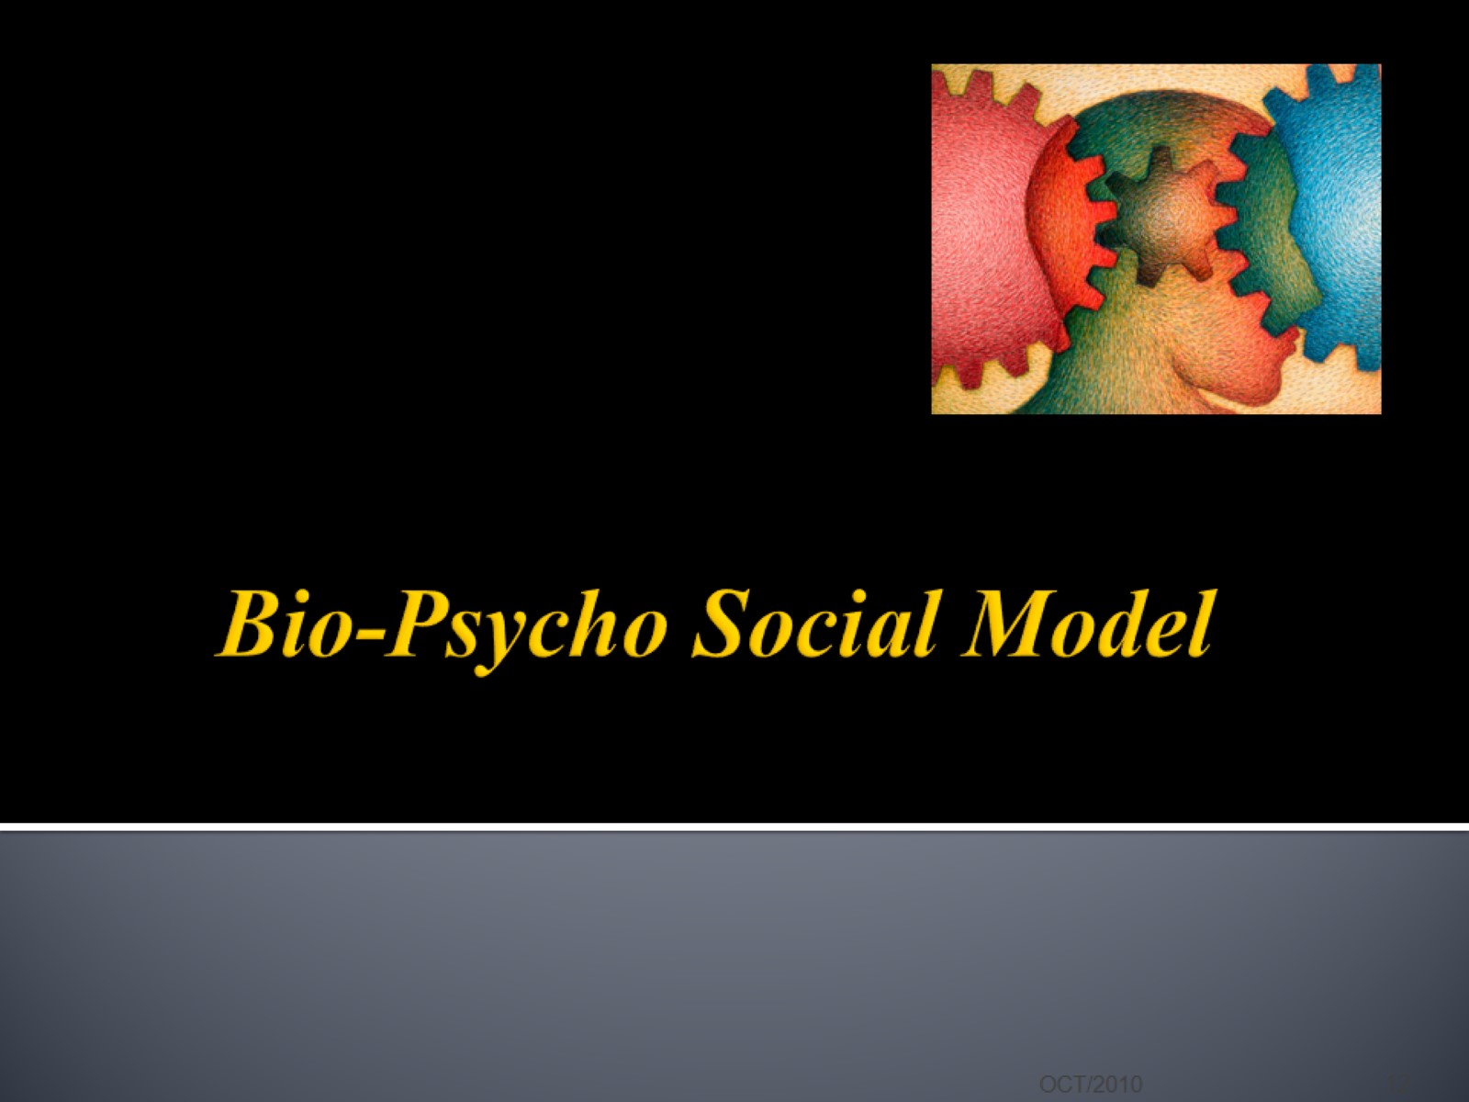
Bio-Psycho Social Model

Slide 13
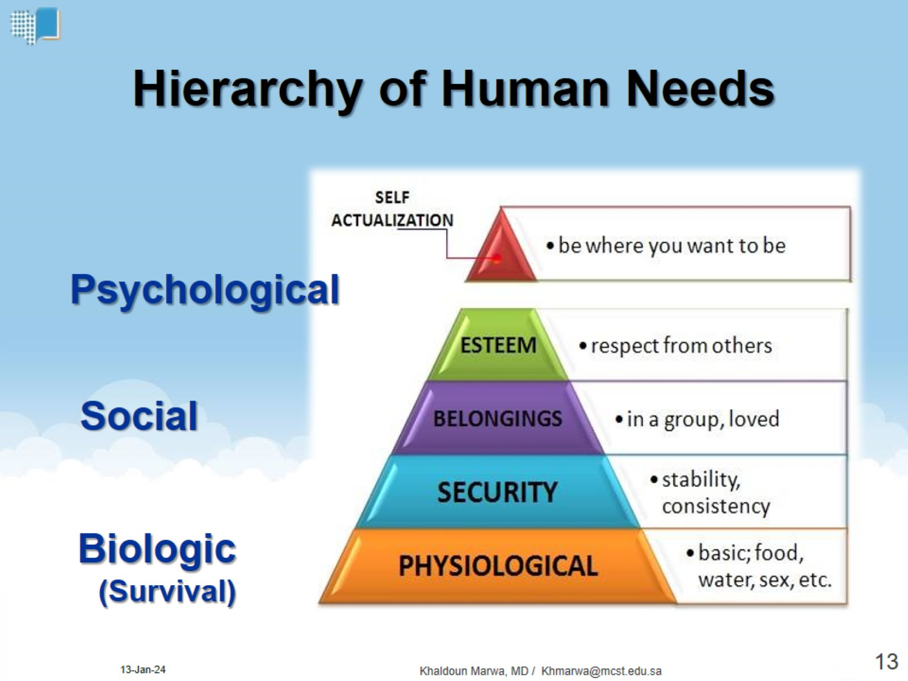
Hierarchy of Human Needs

Slide 14
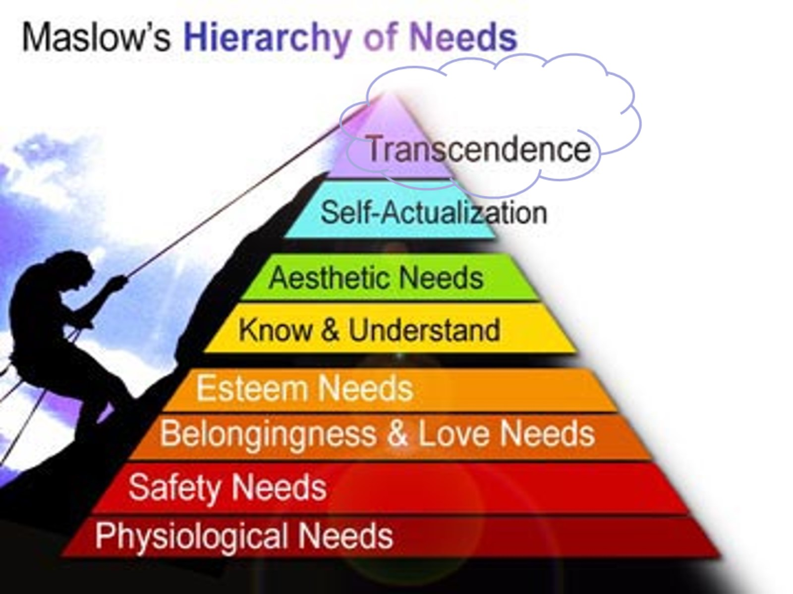

Slide 15
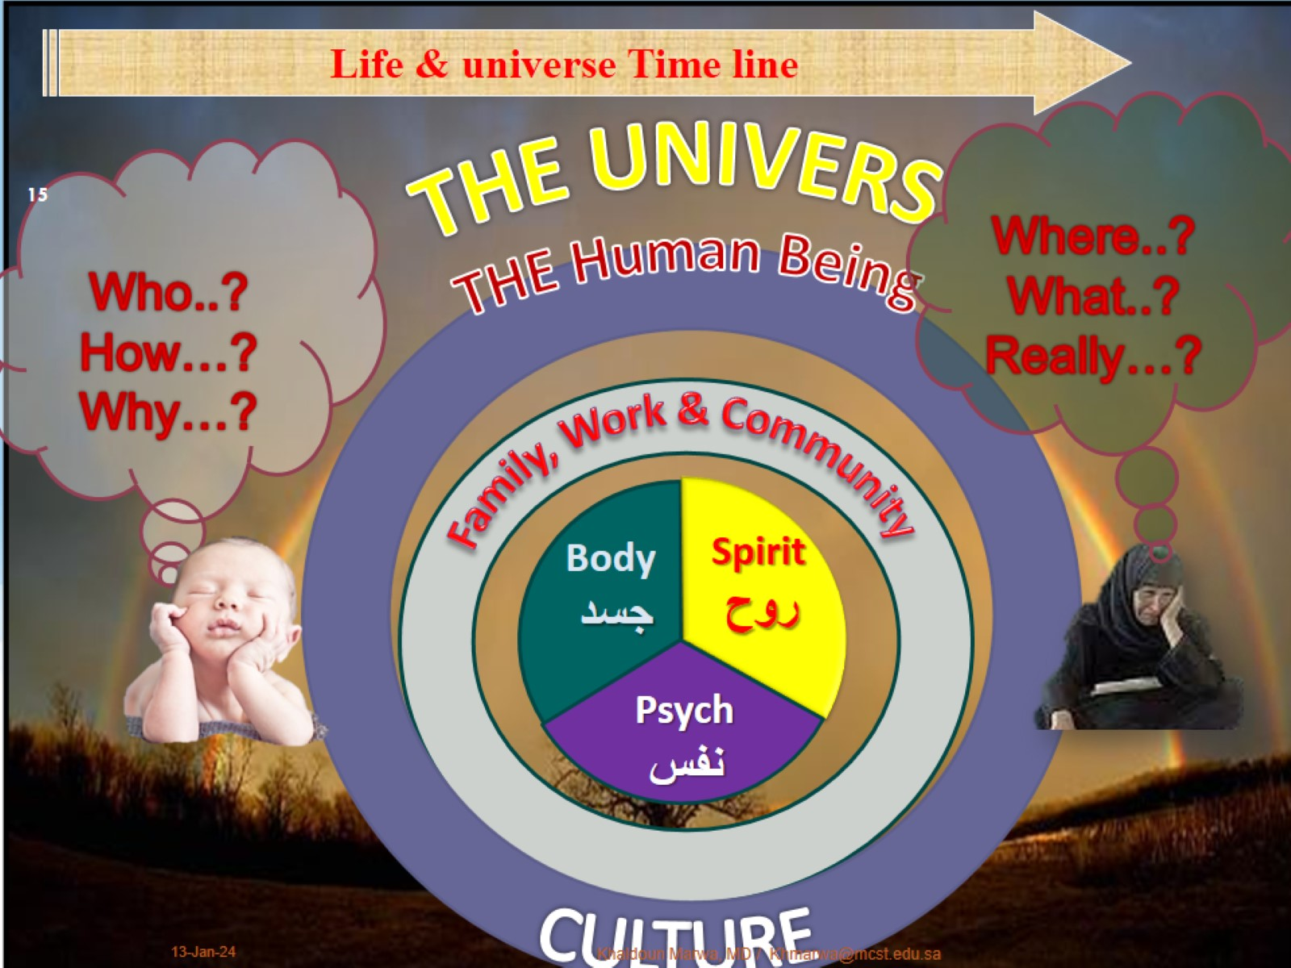

Slide 16
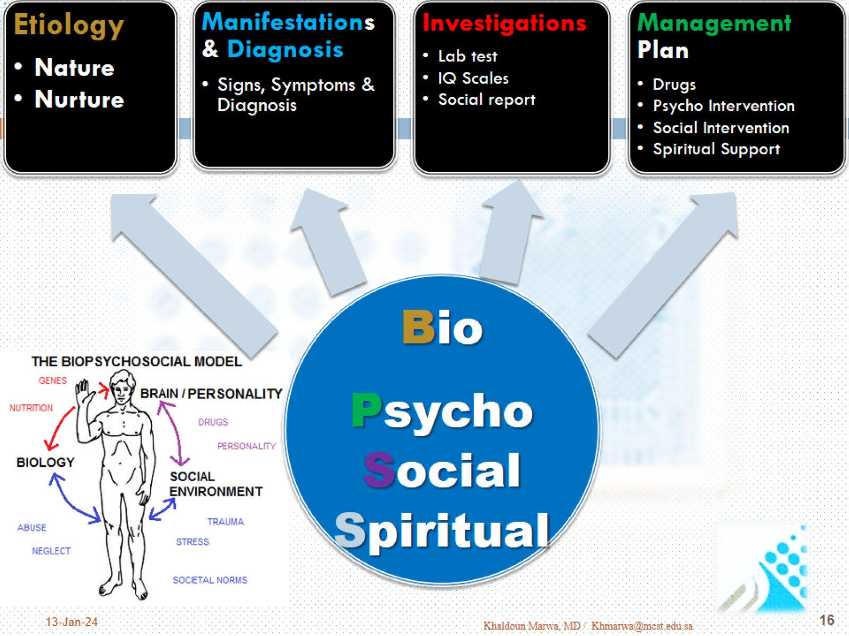

Slide 17
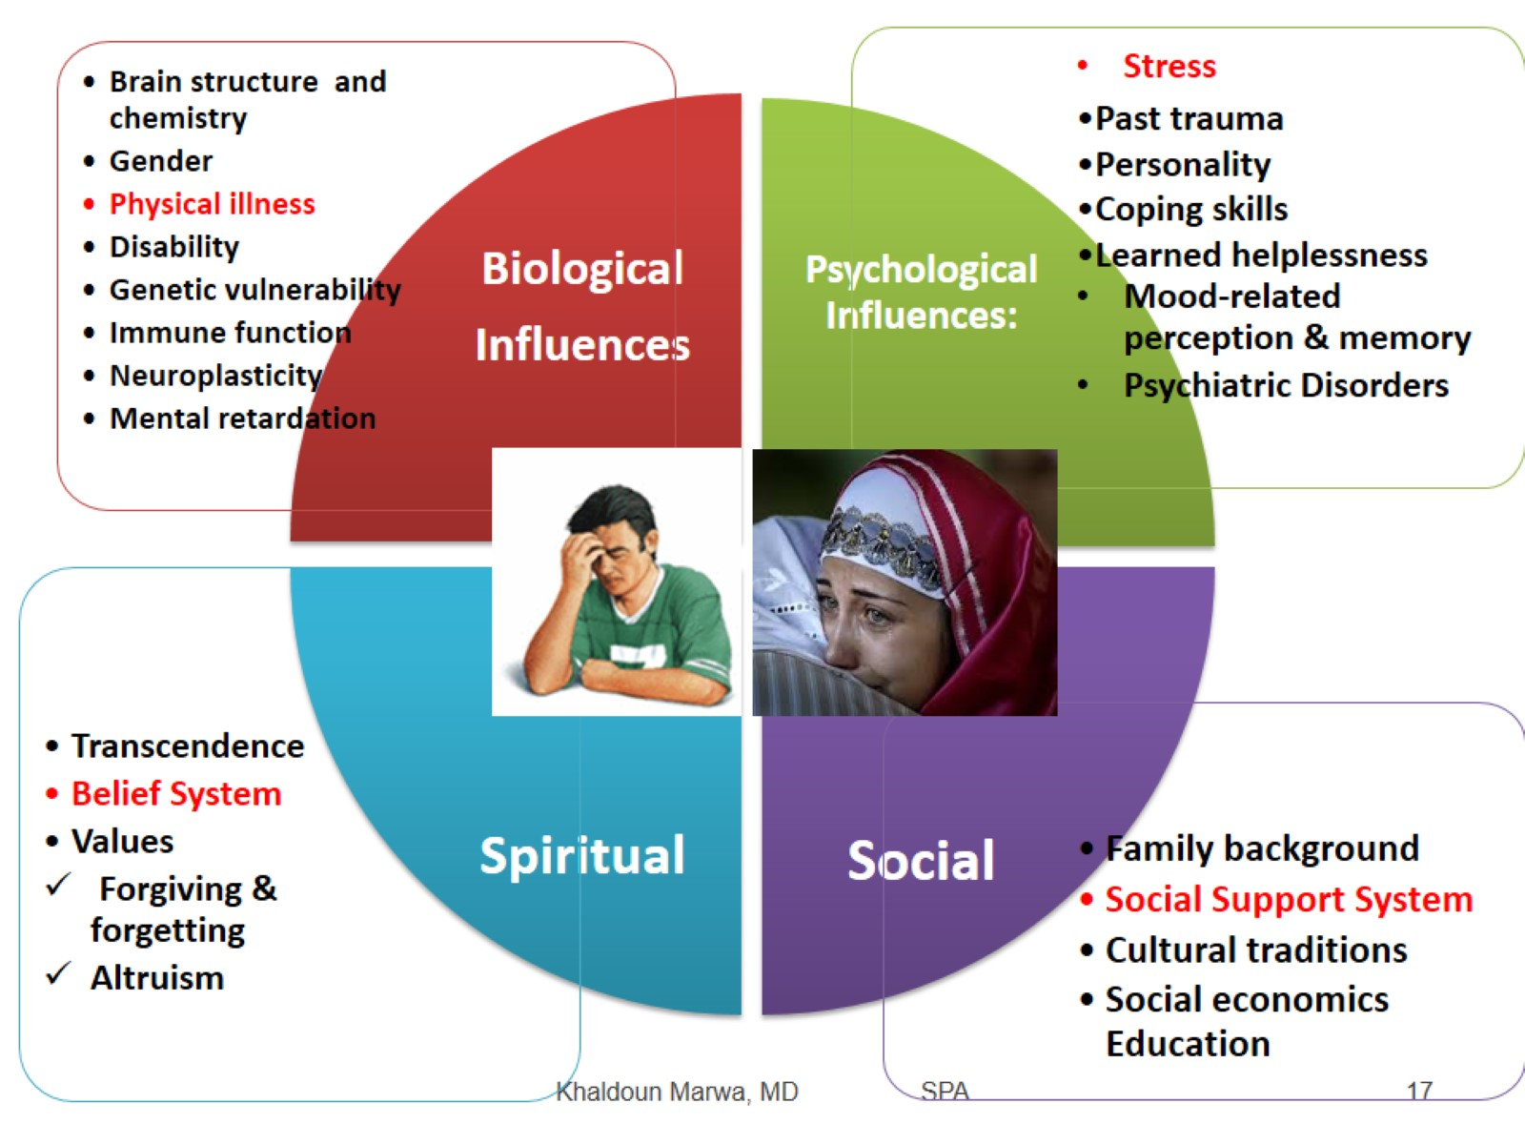

Slide 18
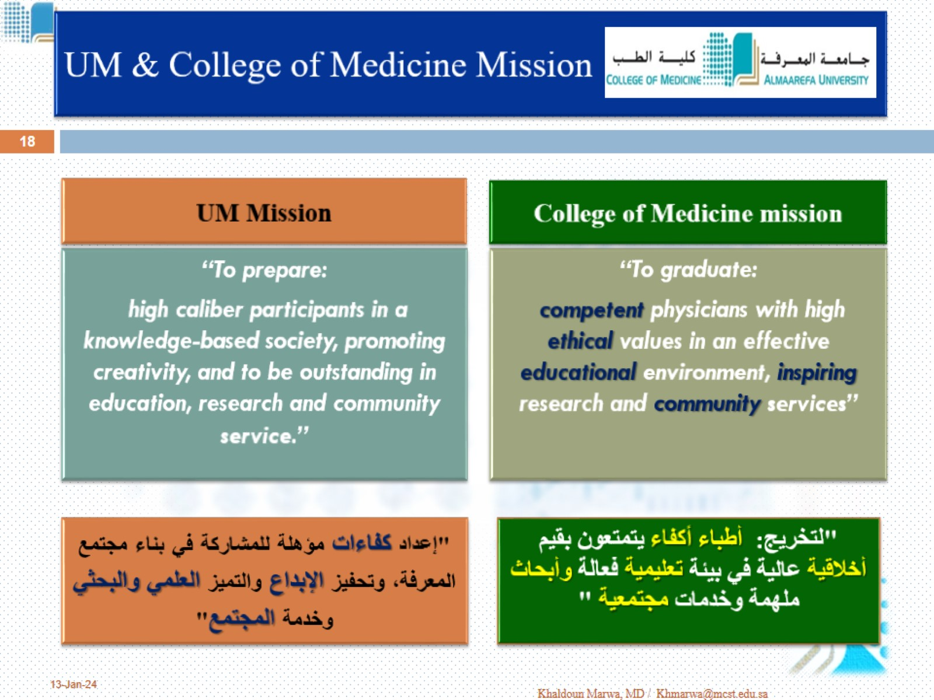
UM & College of Medicine Mission

Slide 19
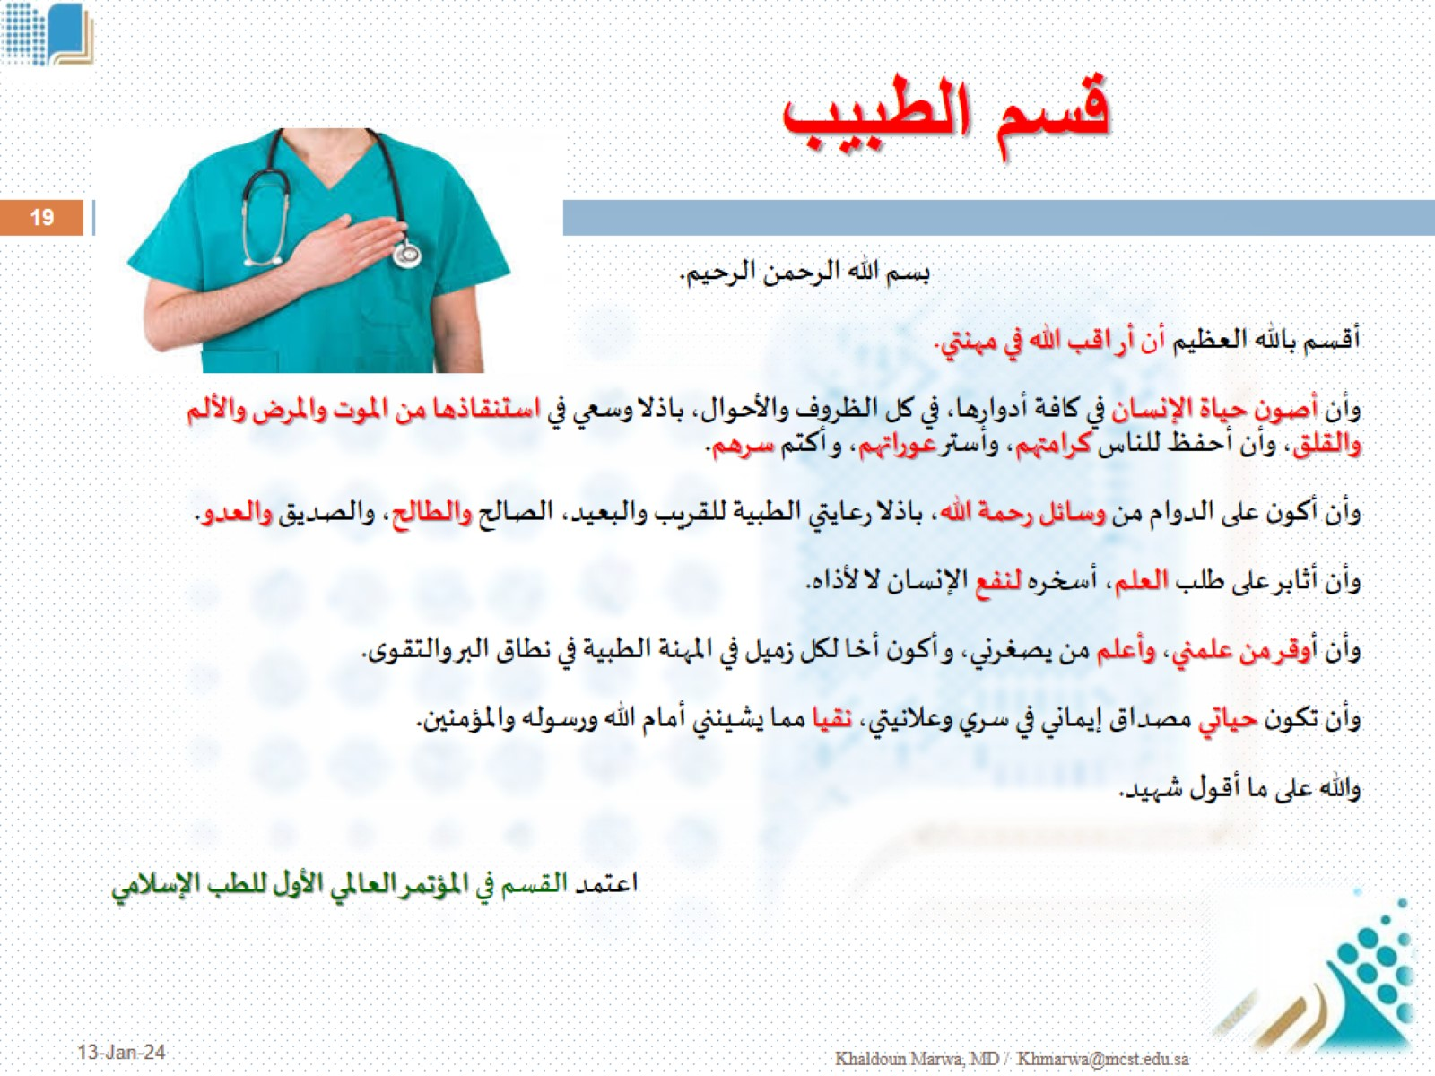
قسم الطبيب

Slide 20
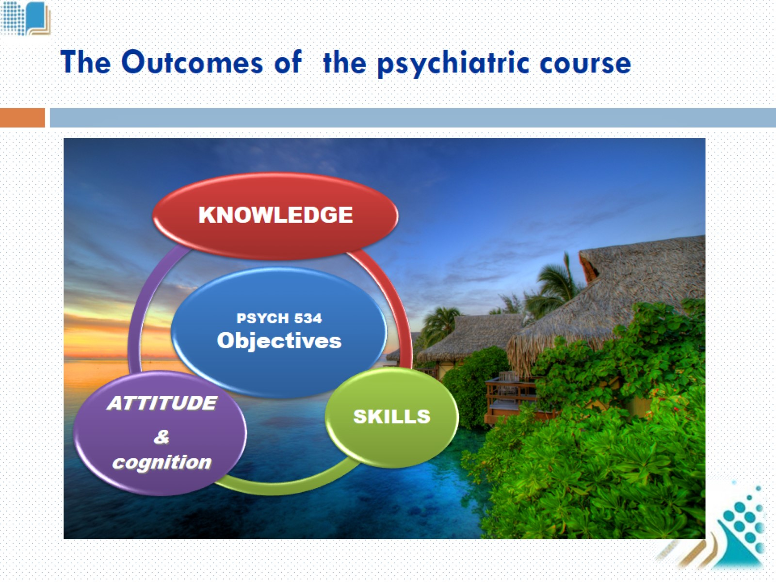
The Outcomes of the psychiatric course

Slide 21
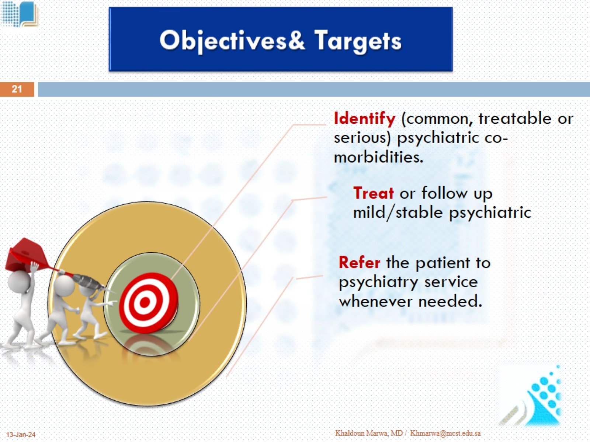
Objectives& Targets

Slide 22
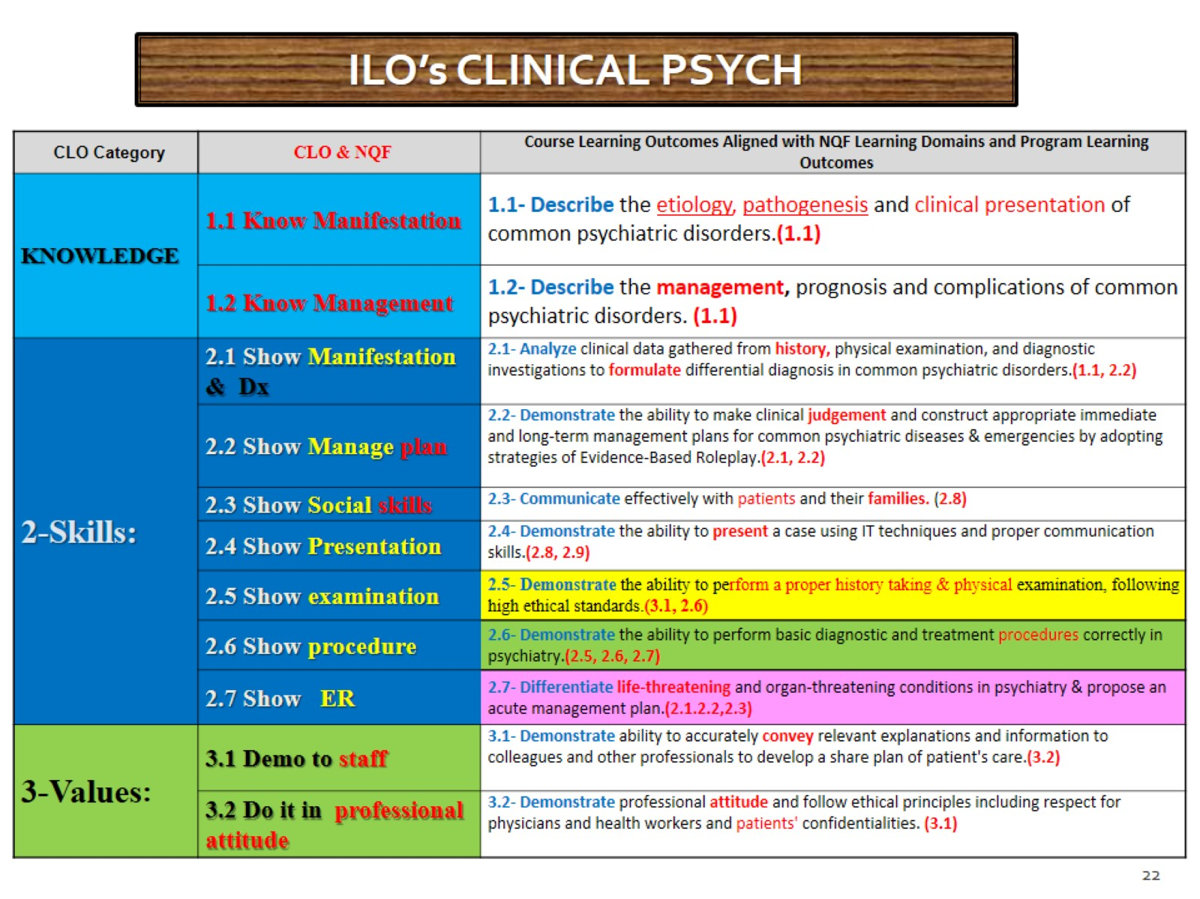

Slide 23
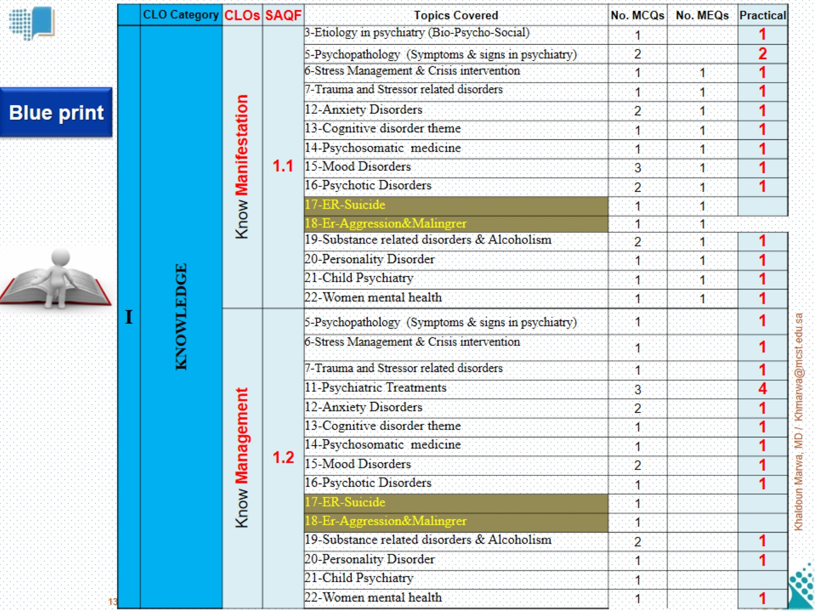

Slide 24
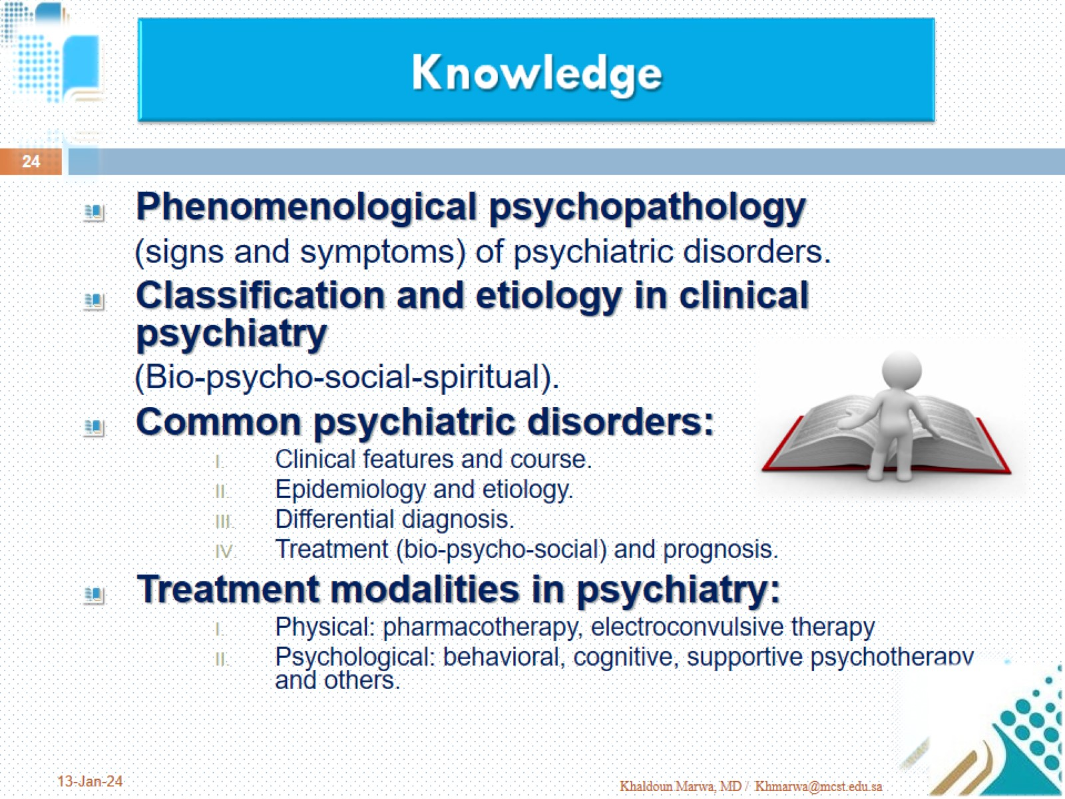

Slide 25
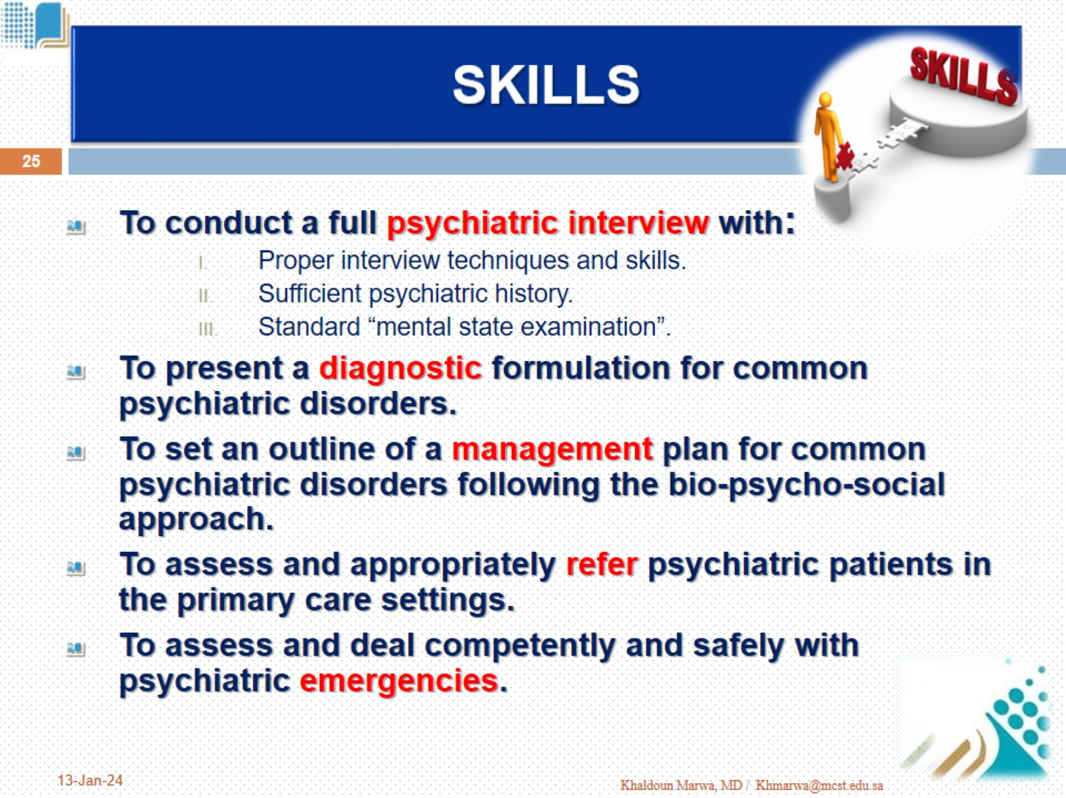
SKILLS

Slide 26
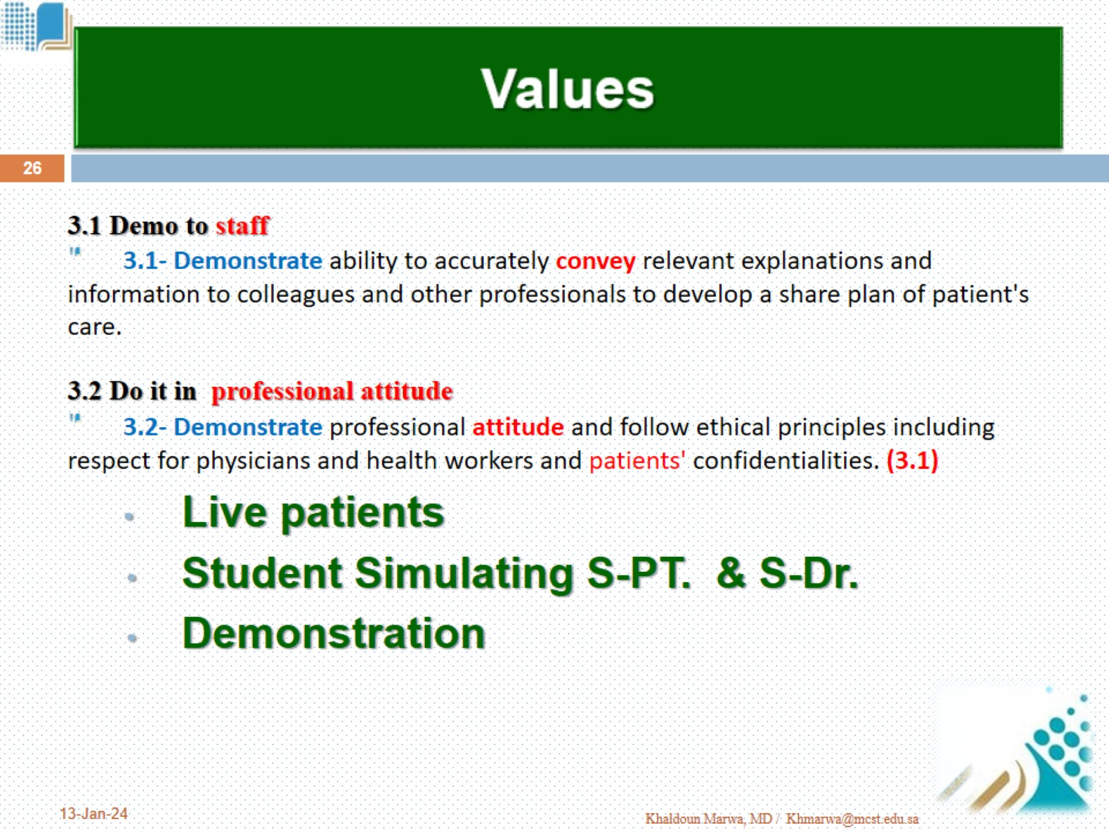
Values

Slide 27
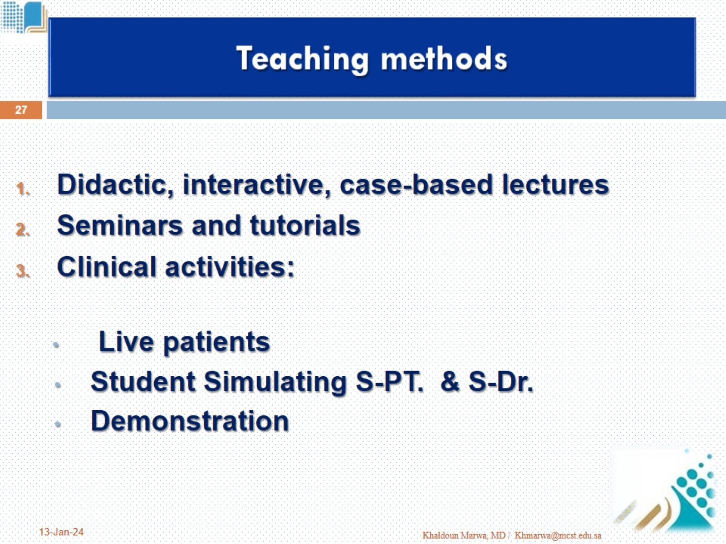
Teaching methods

Slide 28
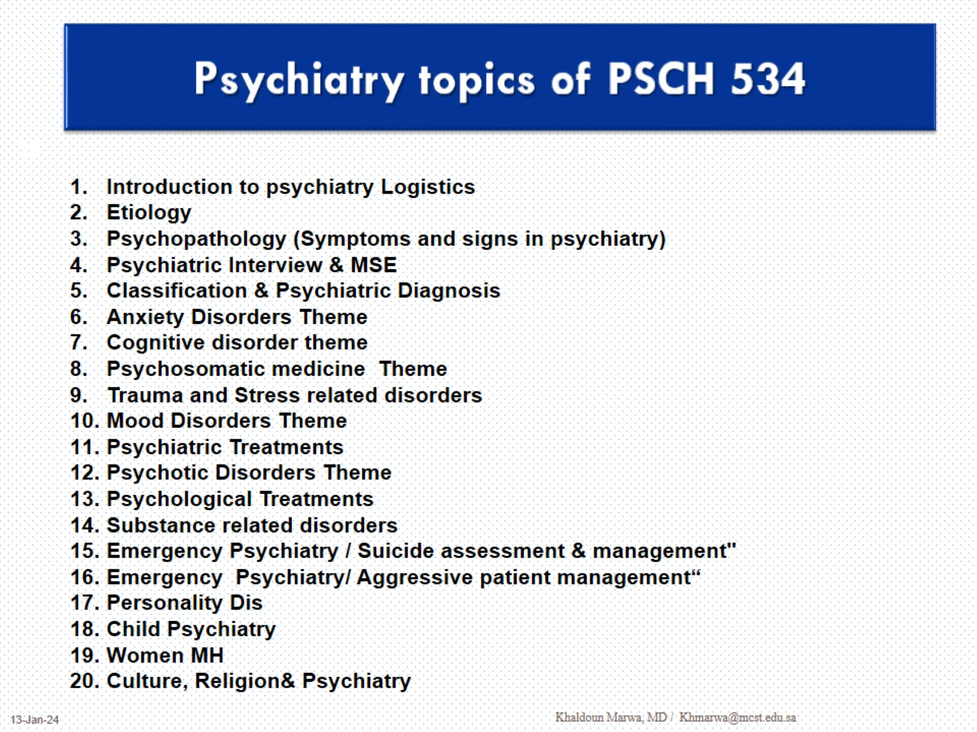
Psychiatry topics of PSCH 534

Slide 29
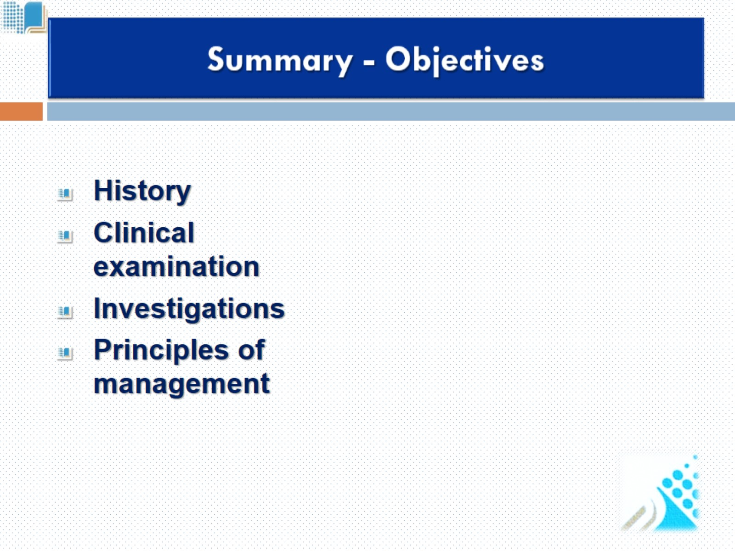
Summary - Objectives

Slide 30
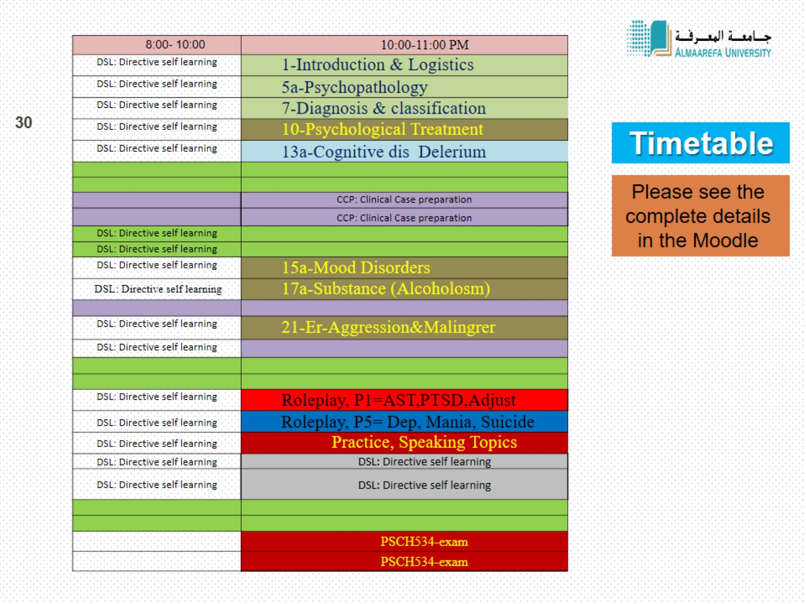
Timetable

Slide 31
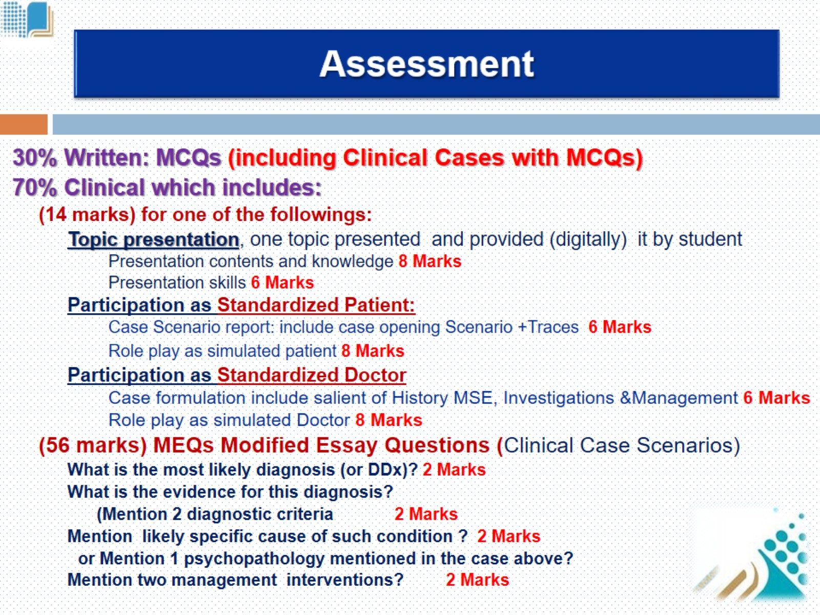
Assessment

Slide 32
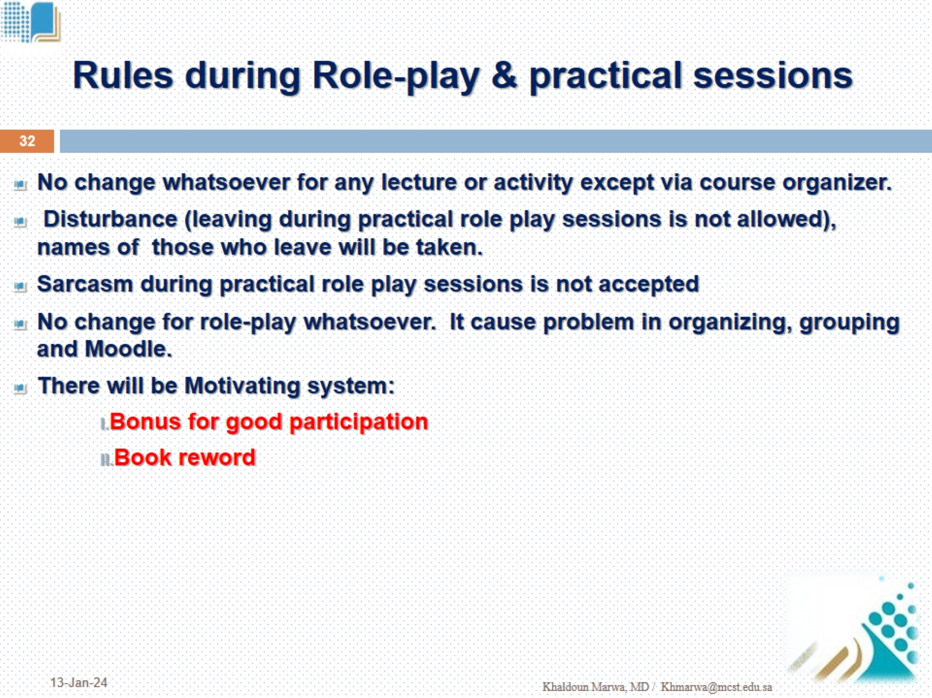
Rules during Role-play & practical sessions

Slide 33
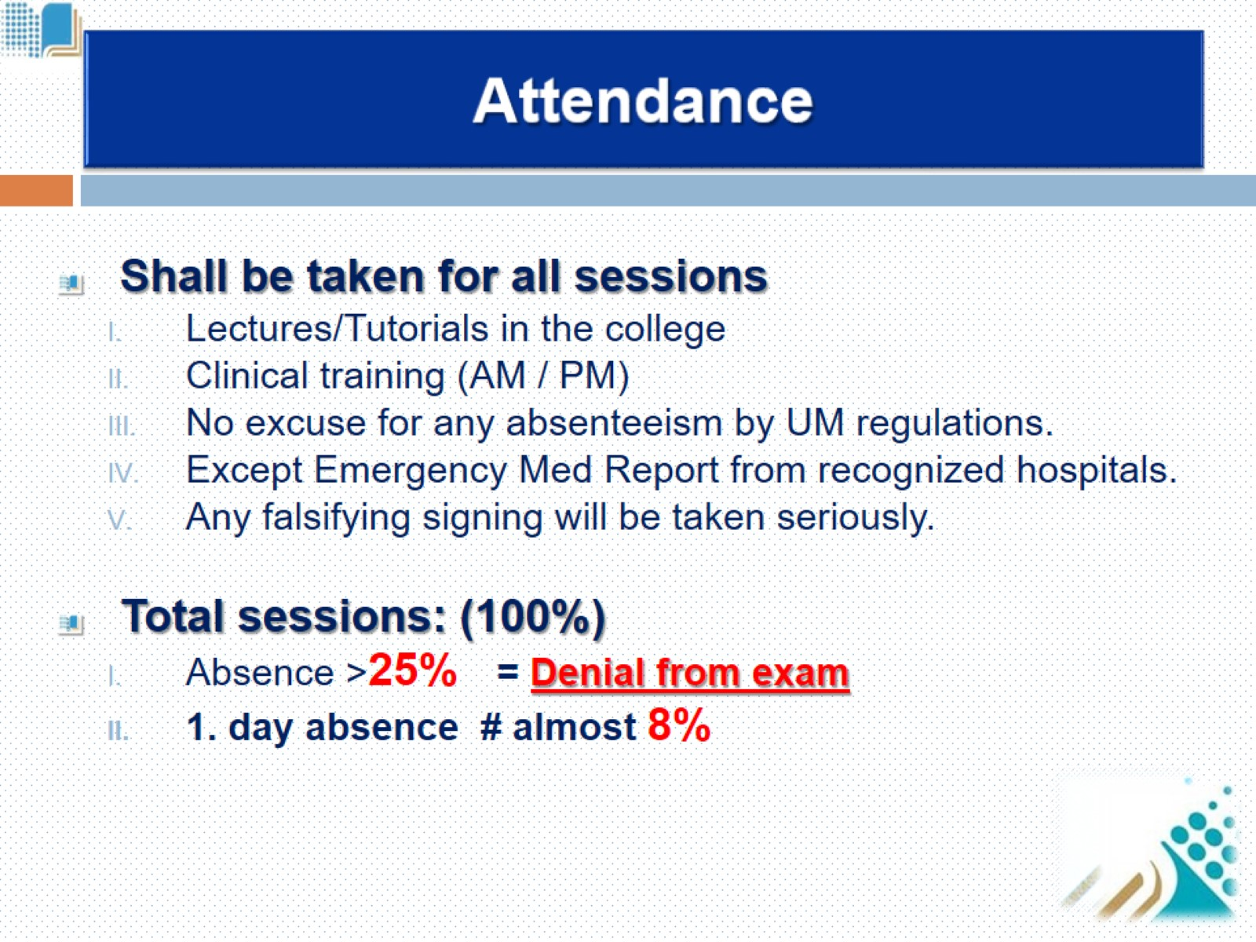
Attendance

Slide 34
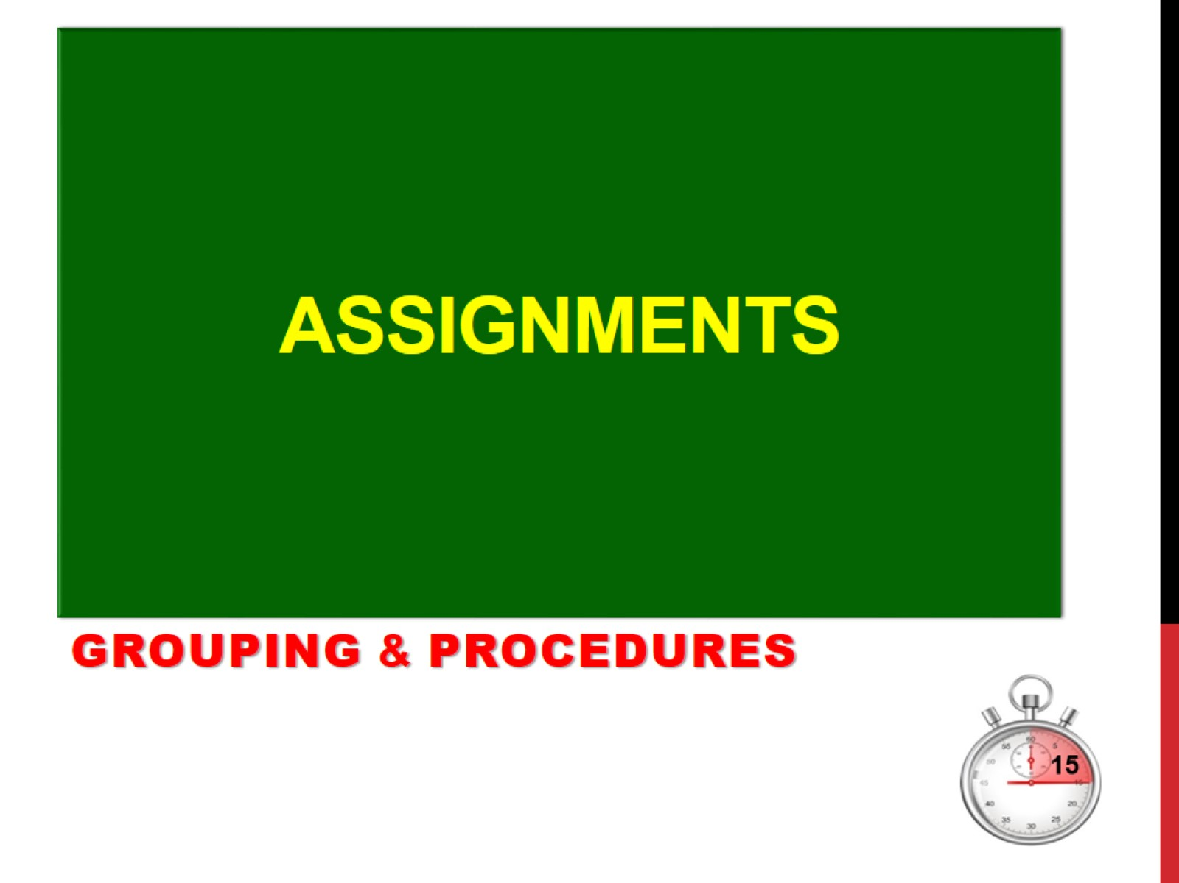
assignments

Slide 35
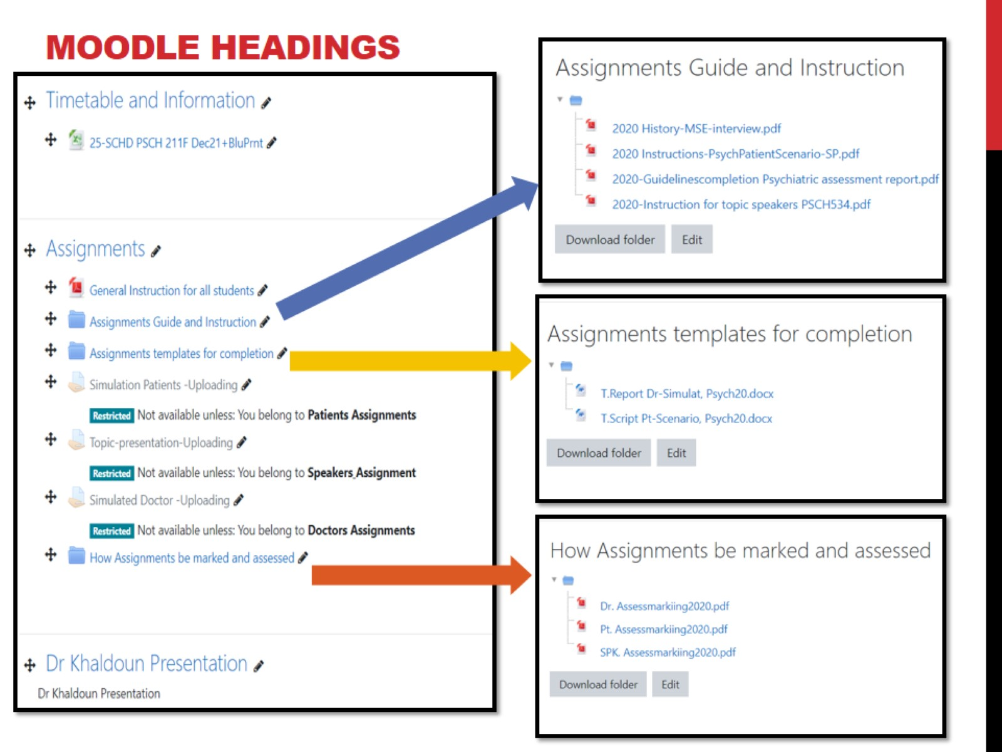
Moodle Headings

Slide 36
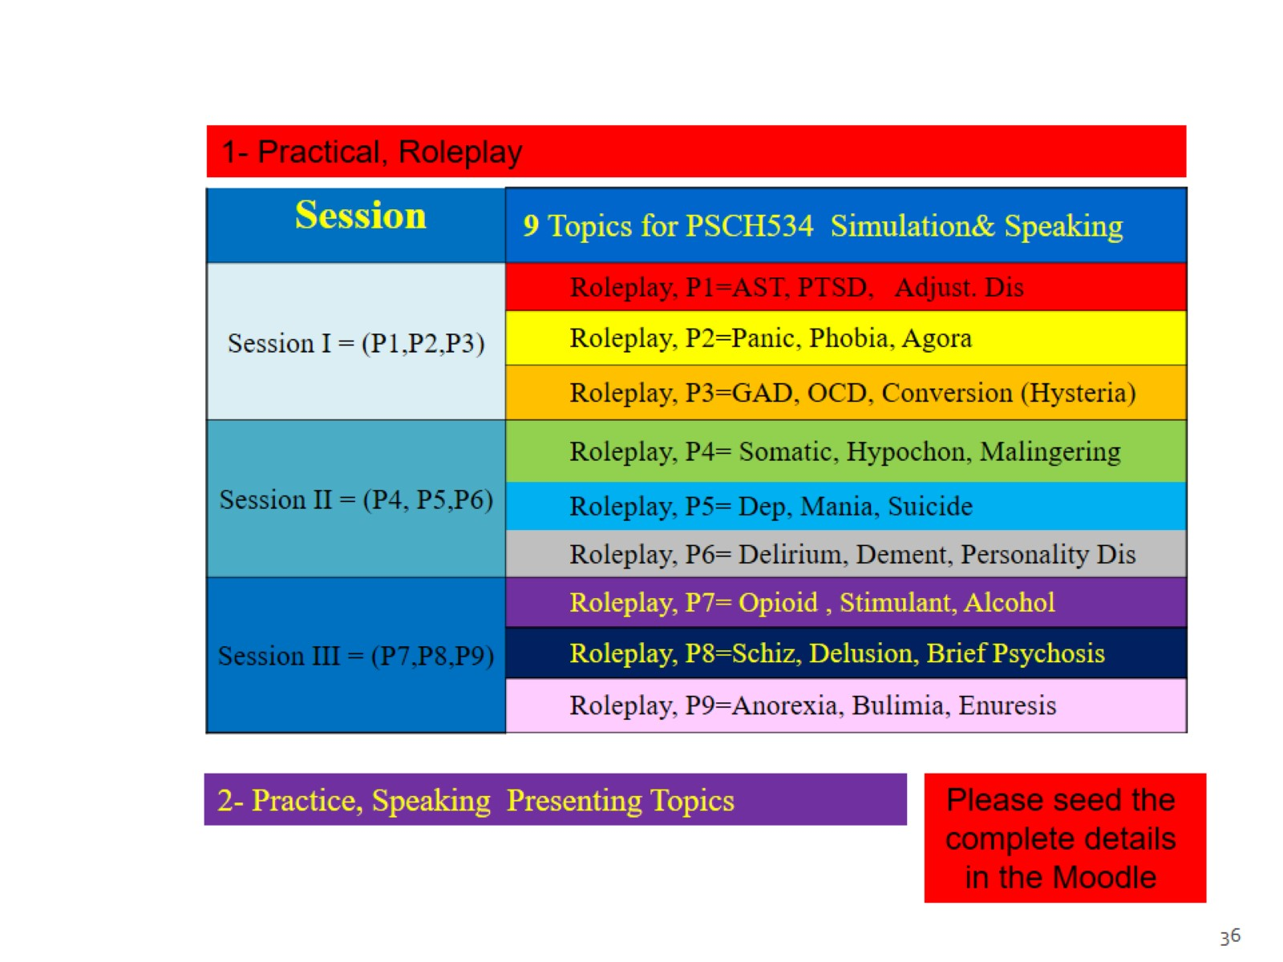

Slide 37
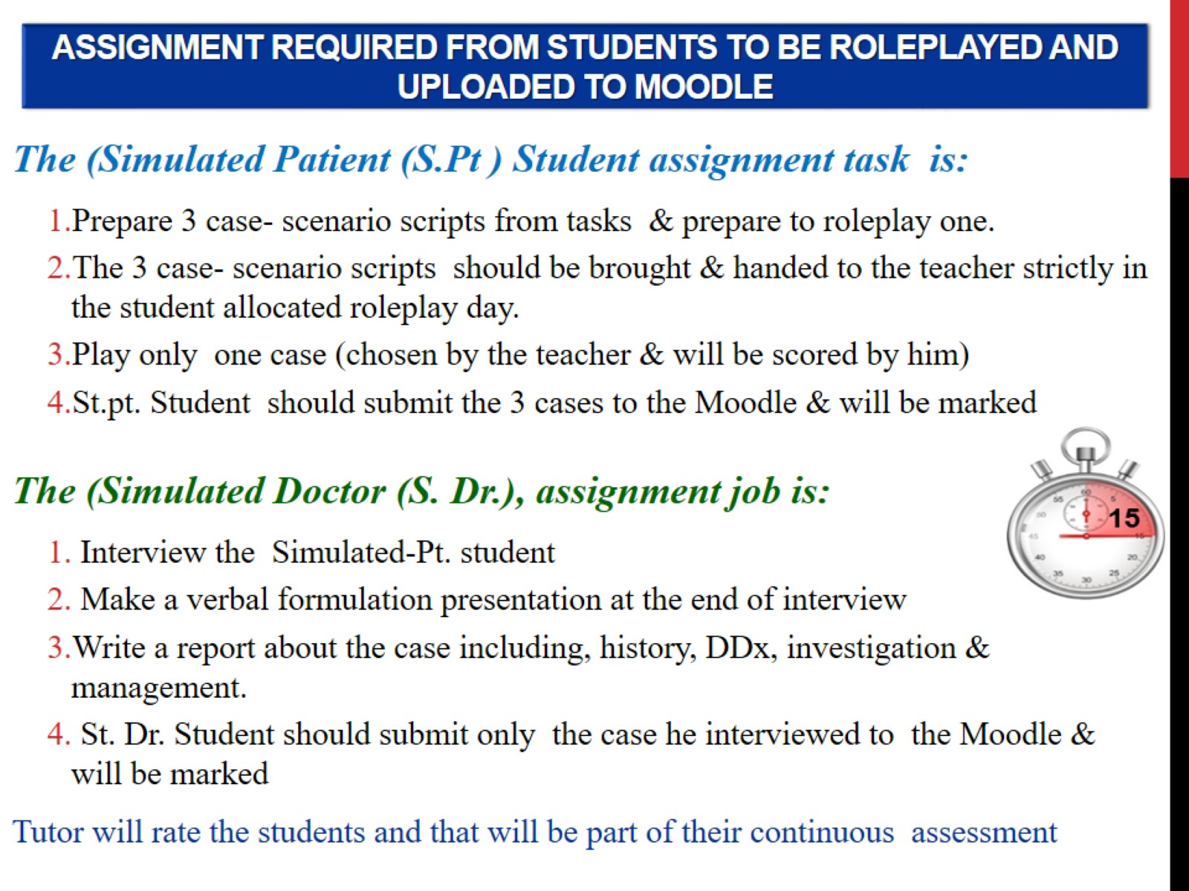
Assignment Required from students to be Roleplayed and uploaded to Moodle

Slide 38
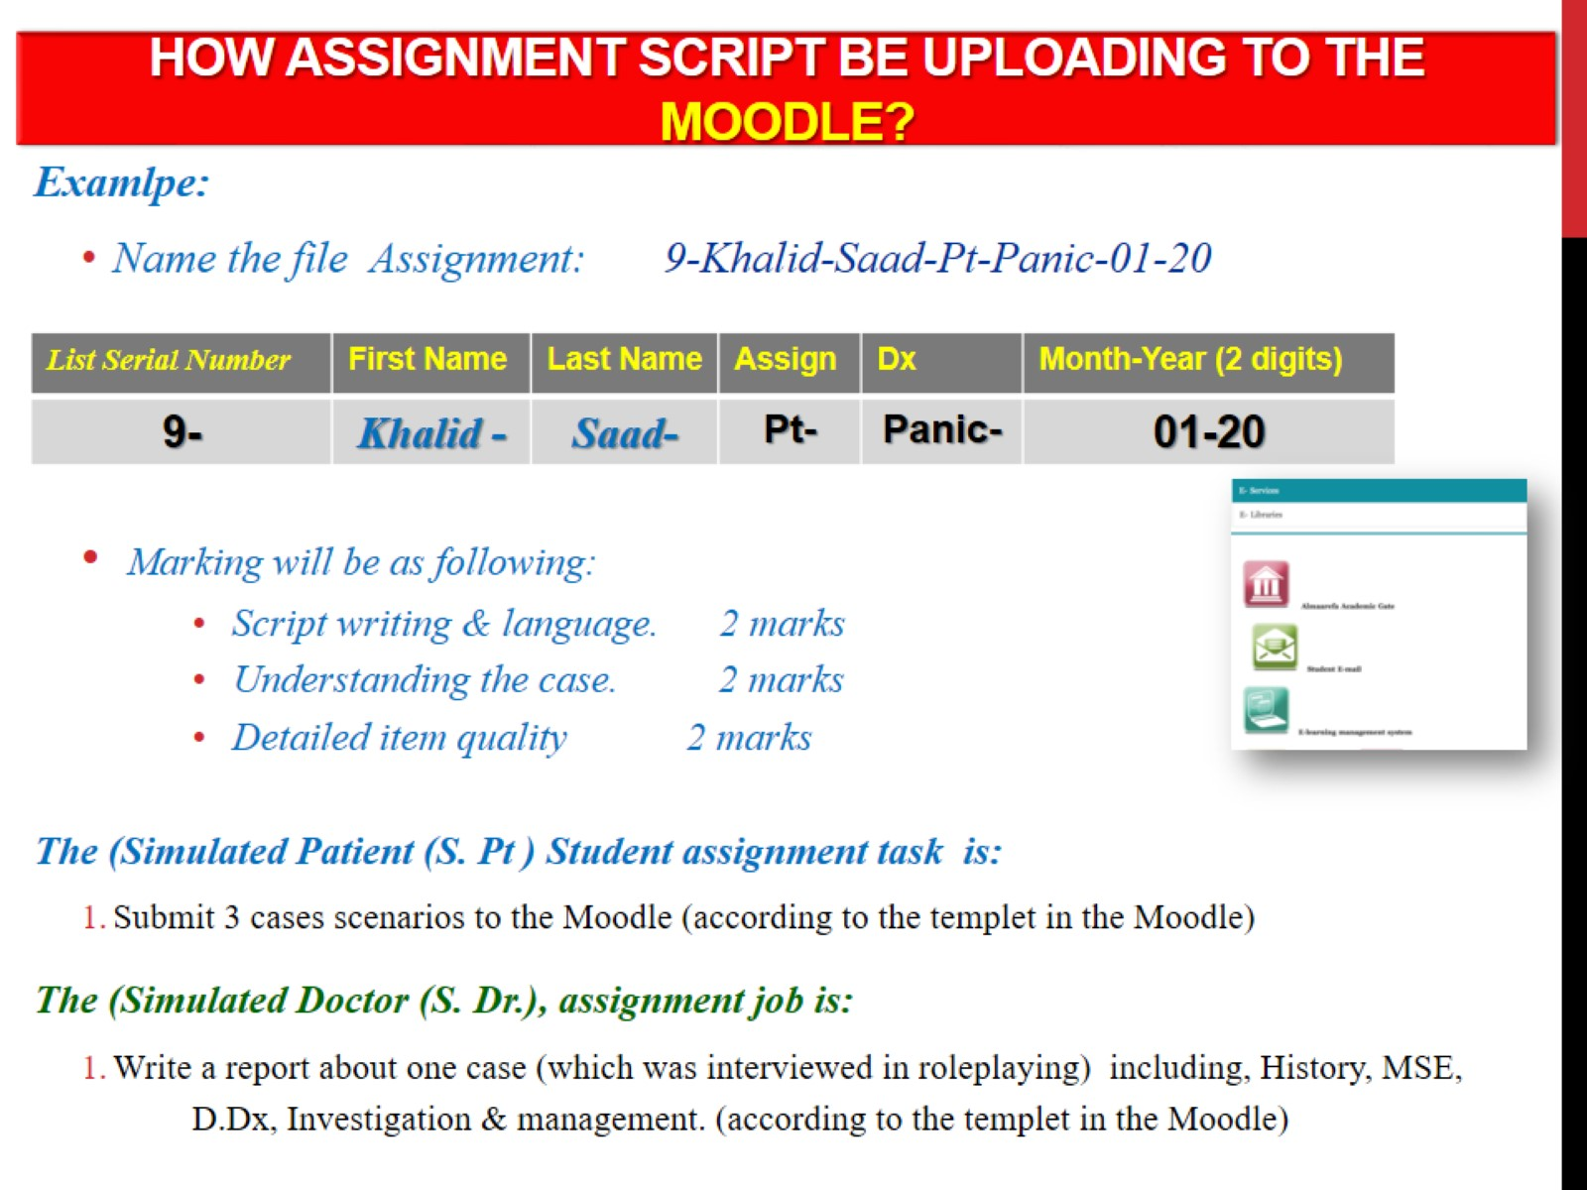
How Assignment script be uploading to the Moodle?

Slide 39
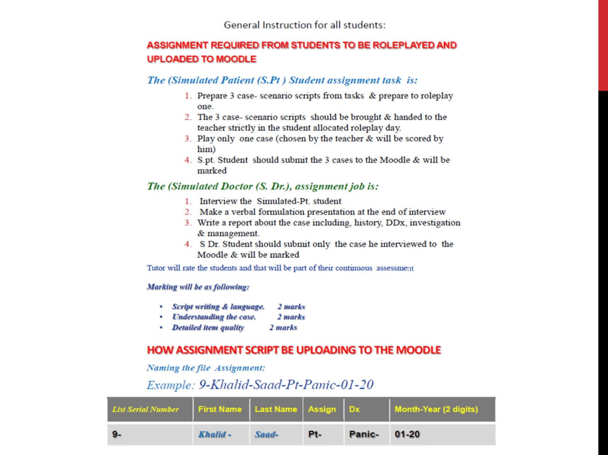

Slide 40
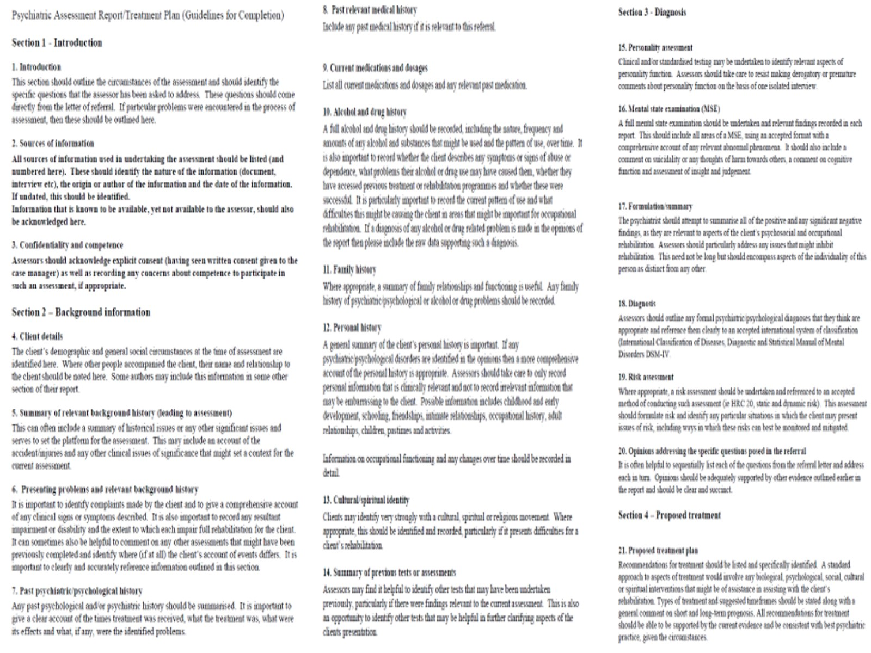

Slide 41
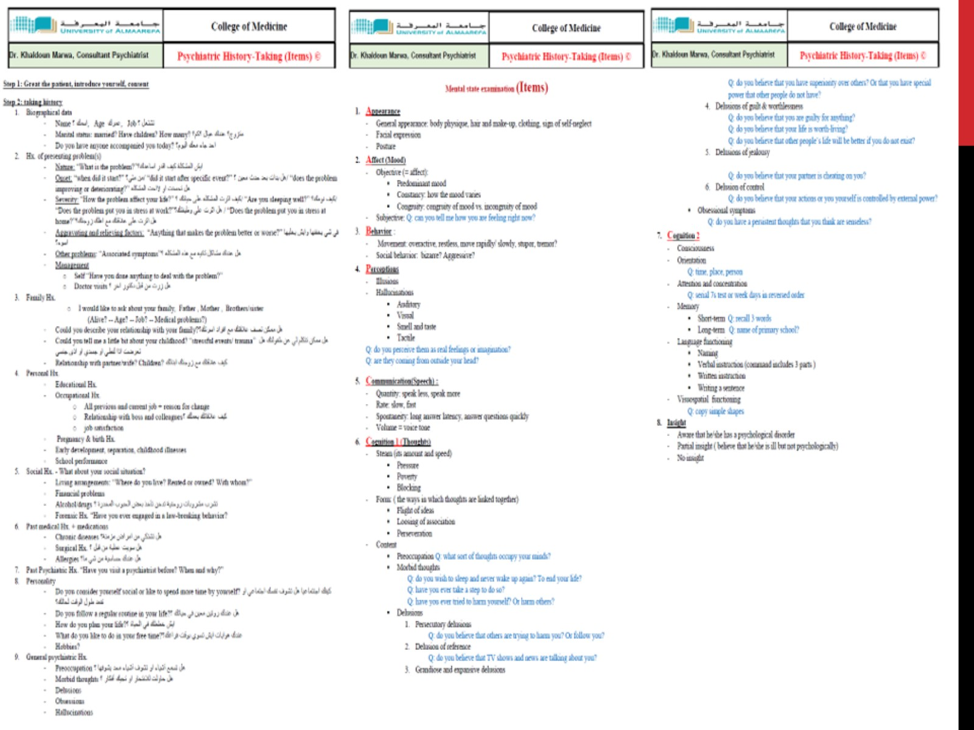

Slide 42
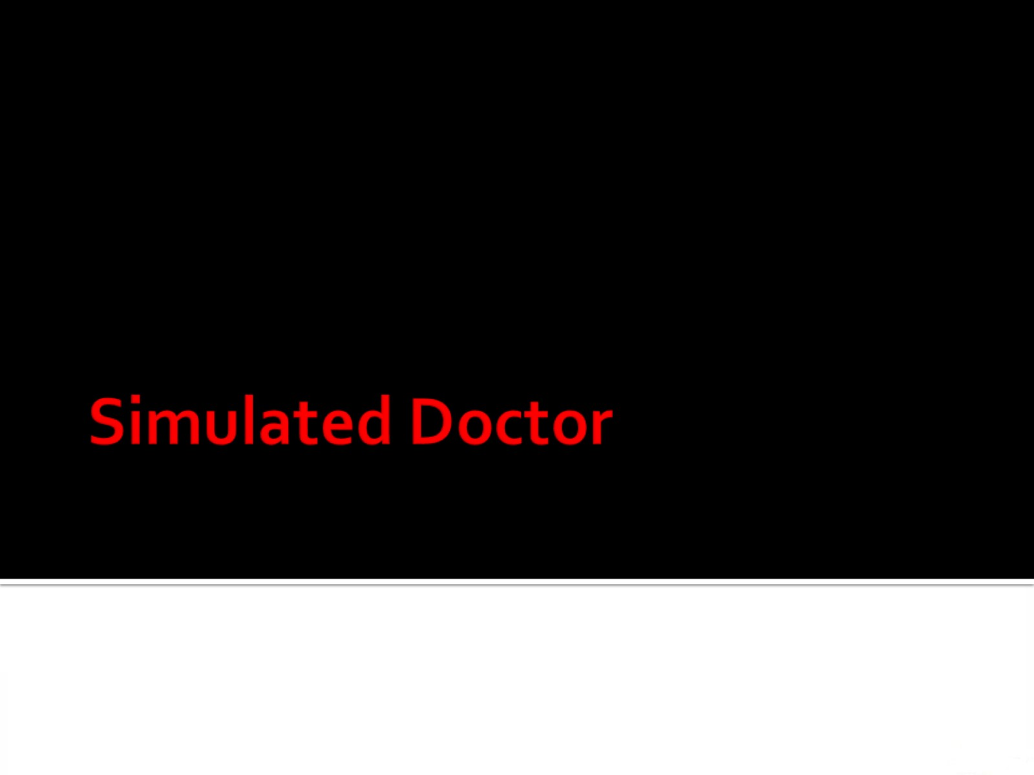
Simulated Doctor

Slide 43
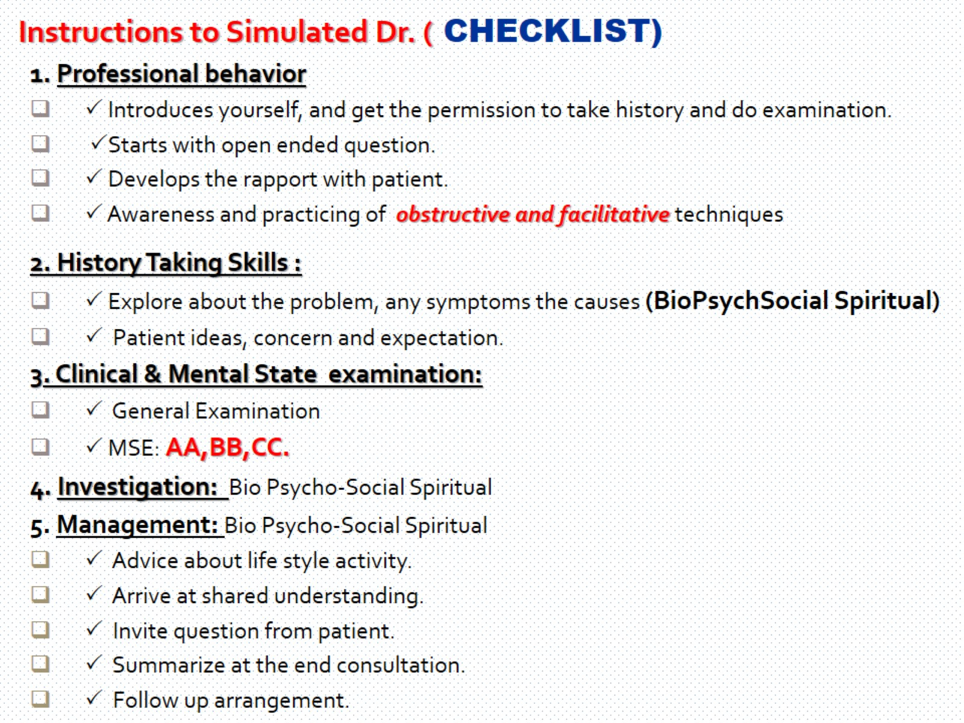

Slide 44
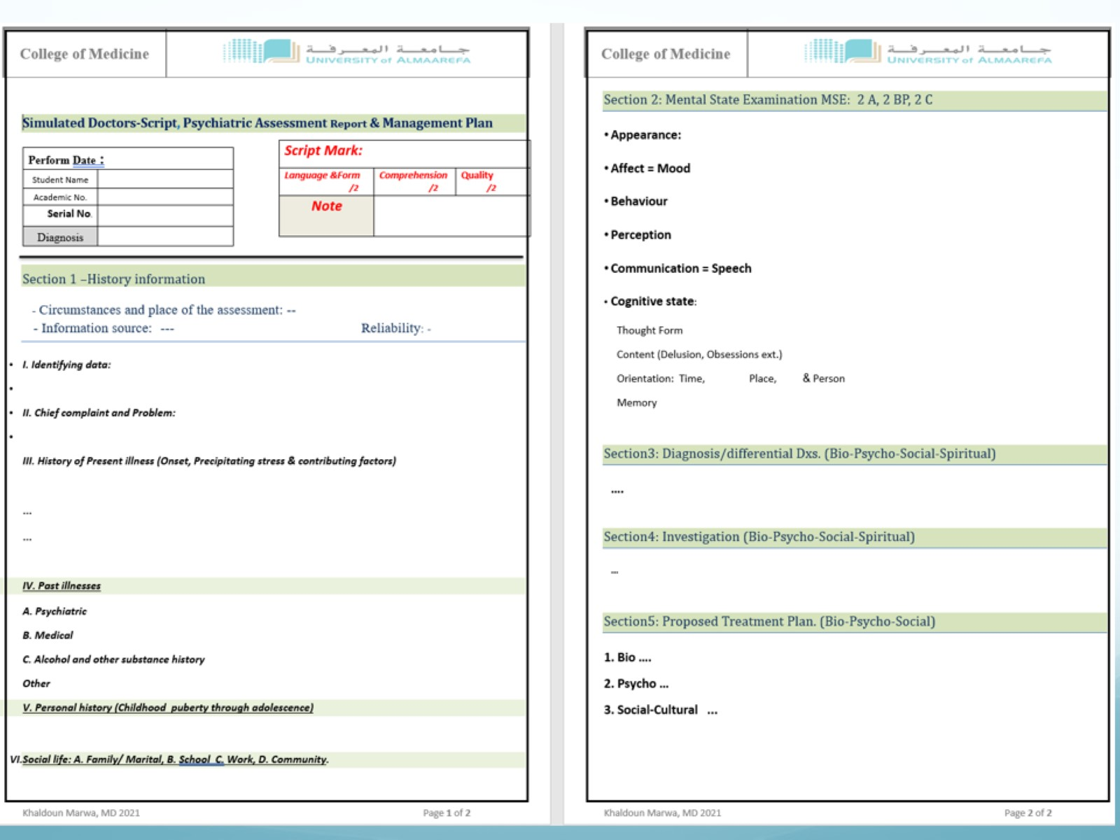

Slide 45
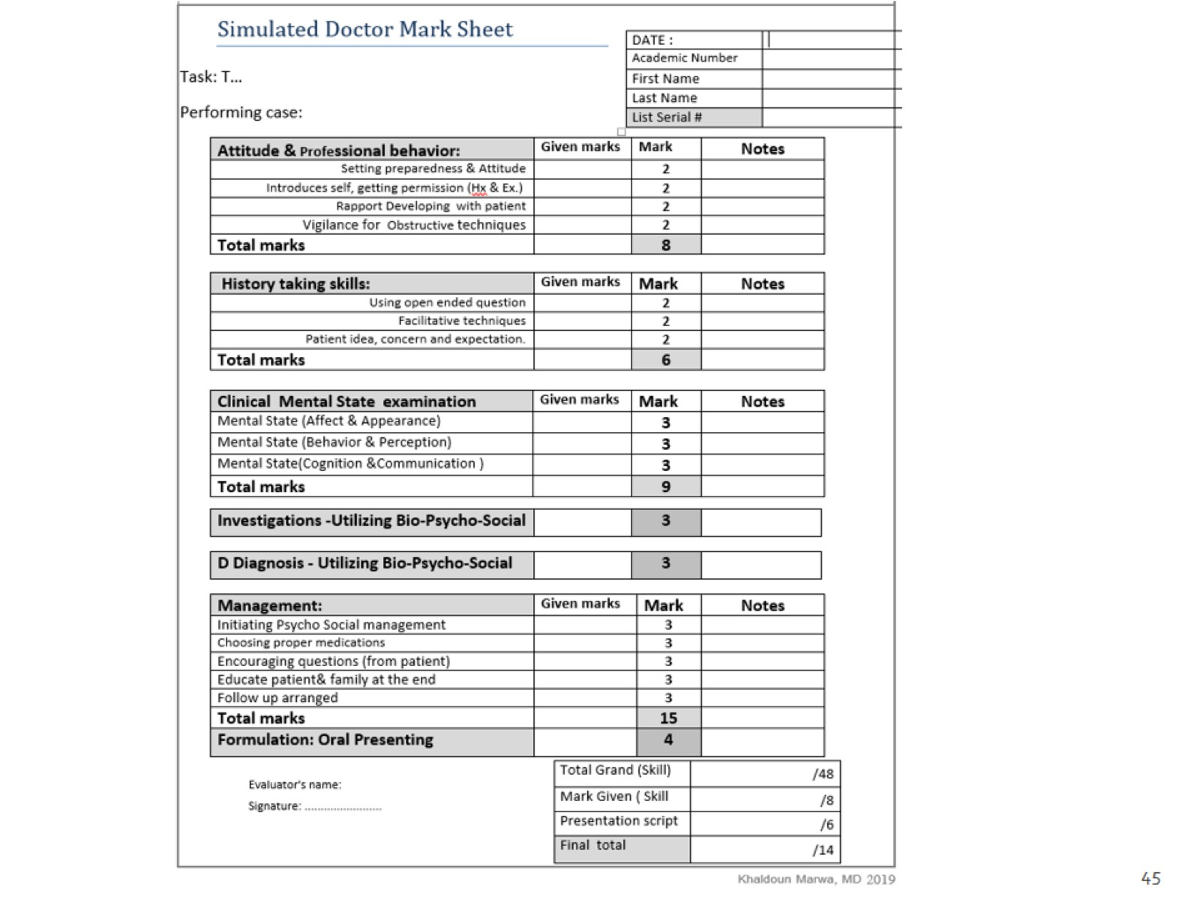

Slide 46
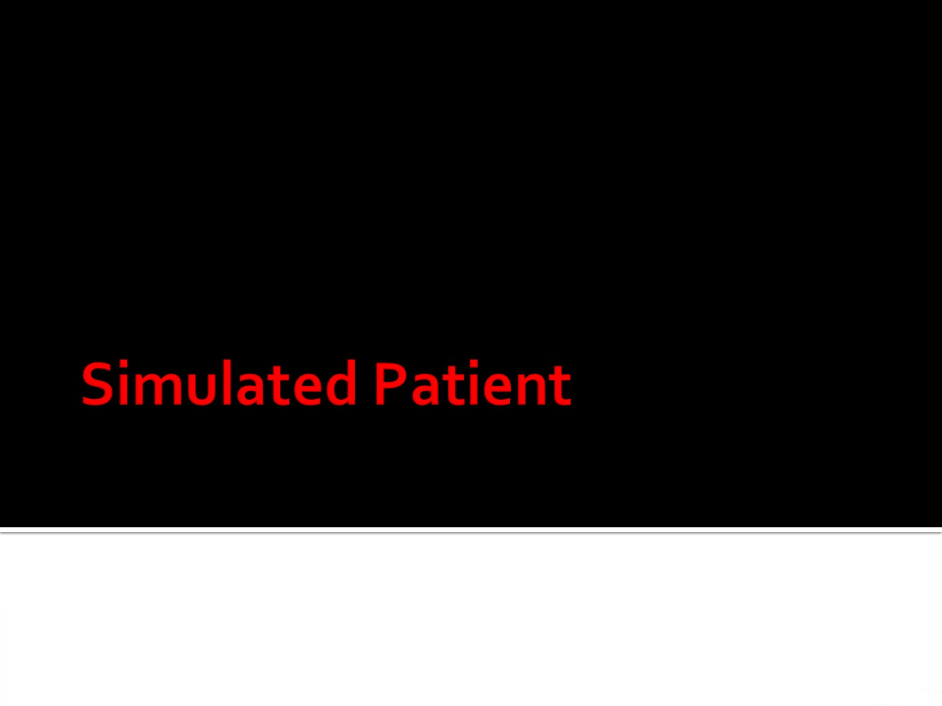
Simulated Patient

Slide 47
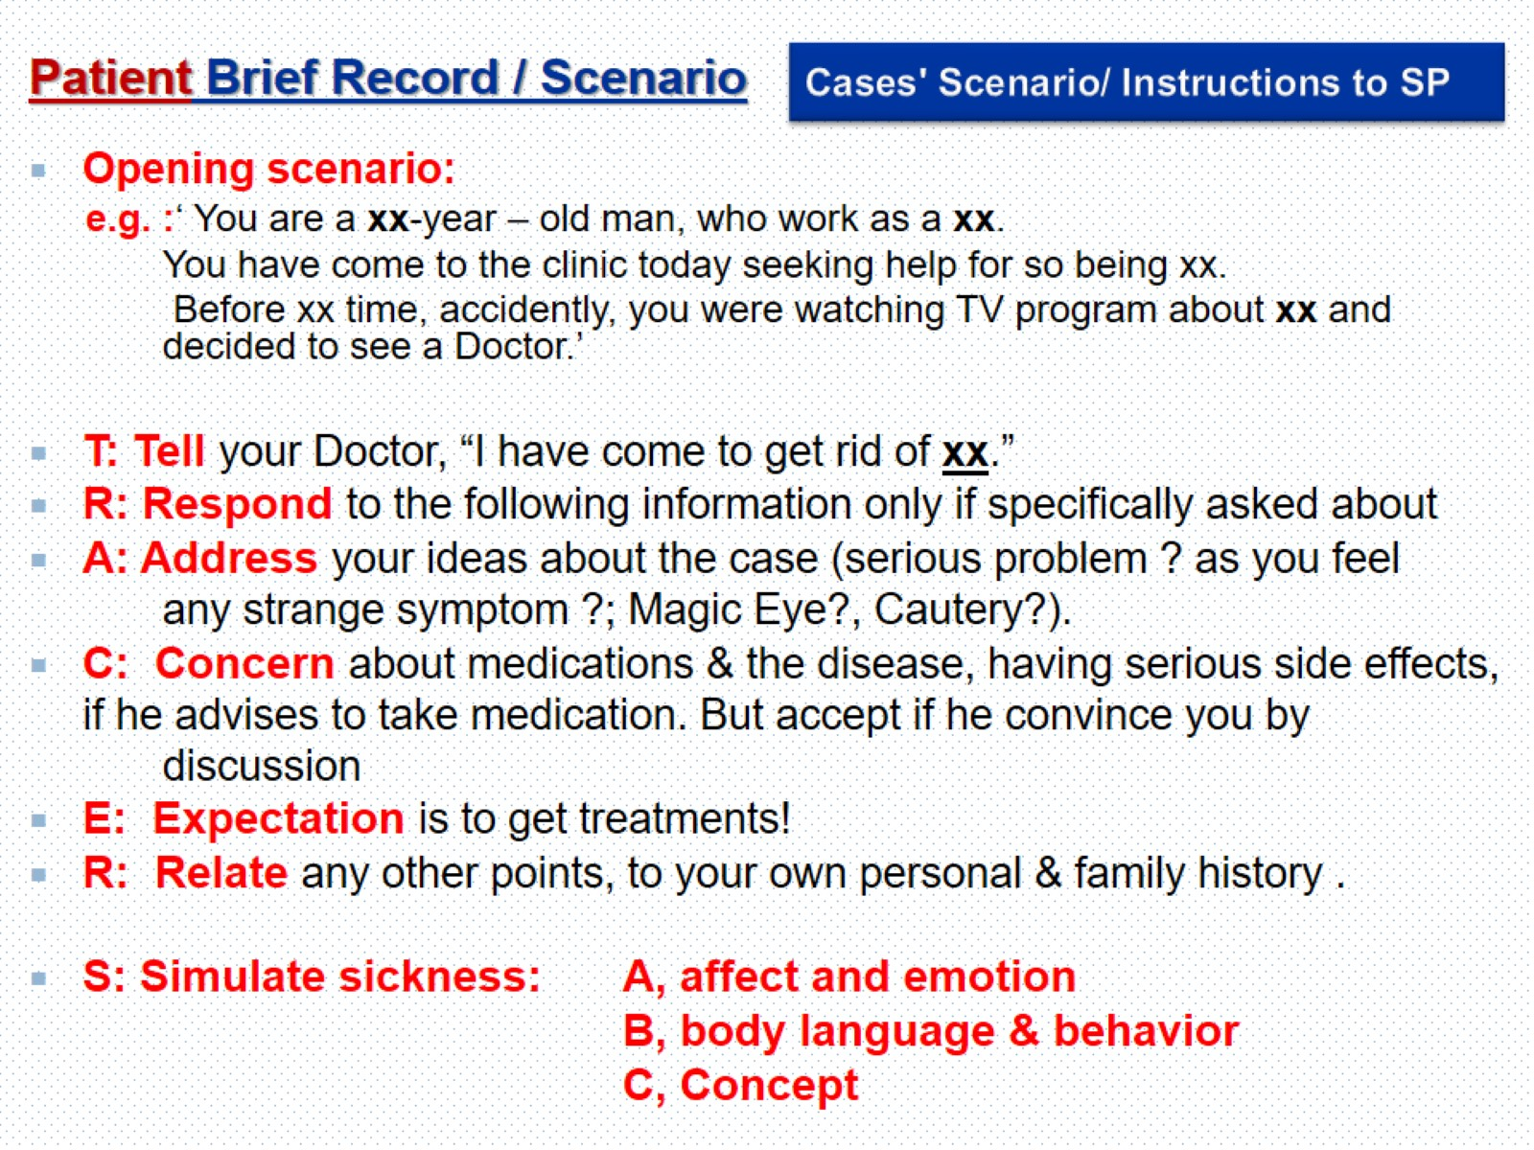
Cases' Scenario/ Instructions to SP

Slide 48
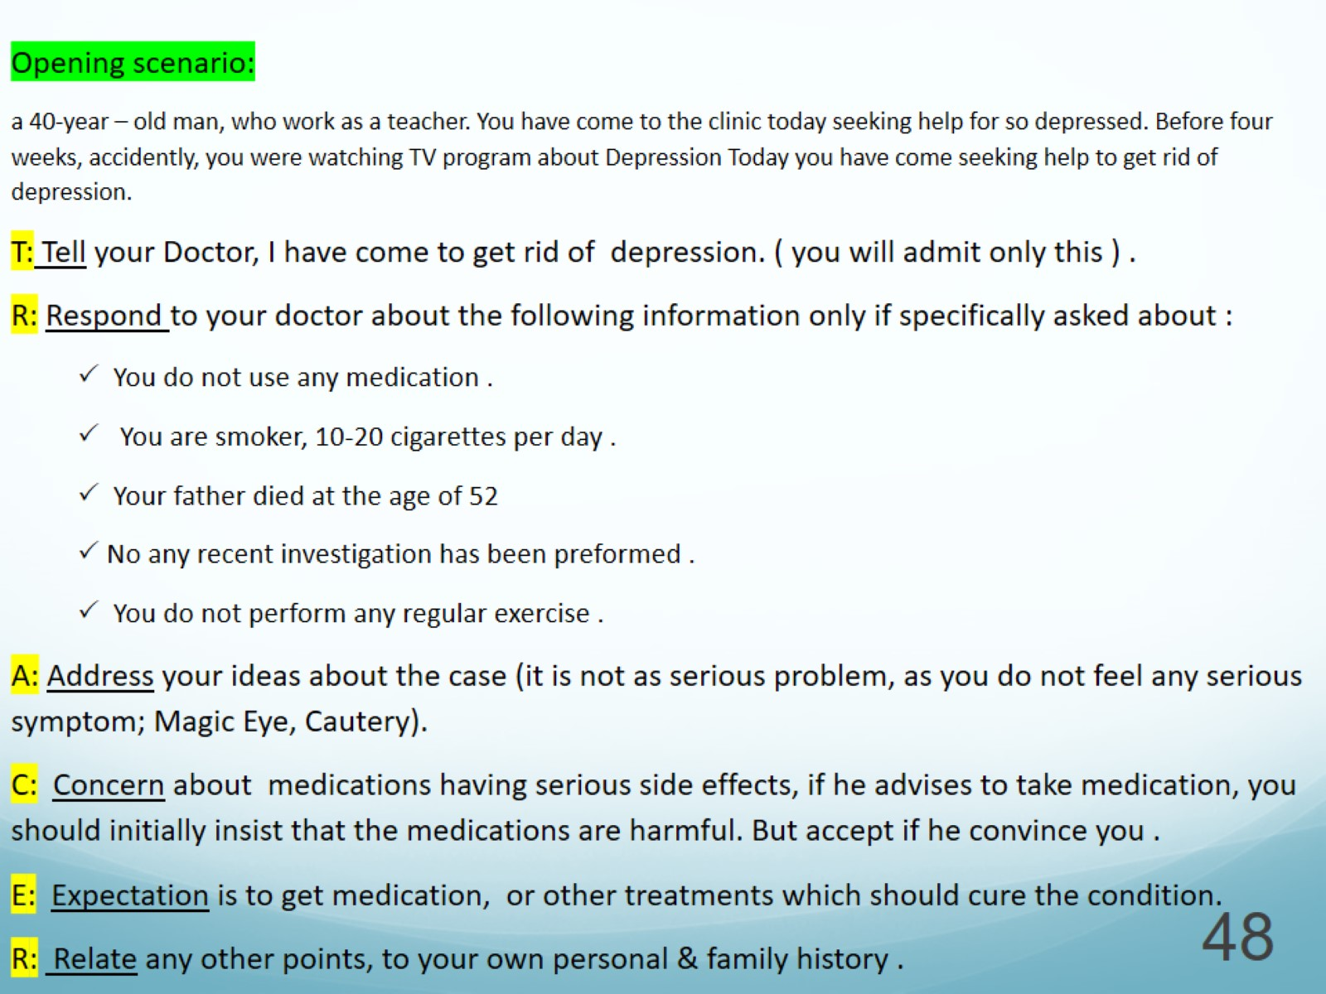

Slide 49
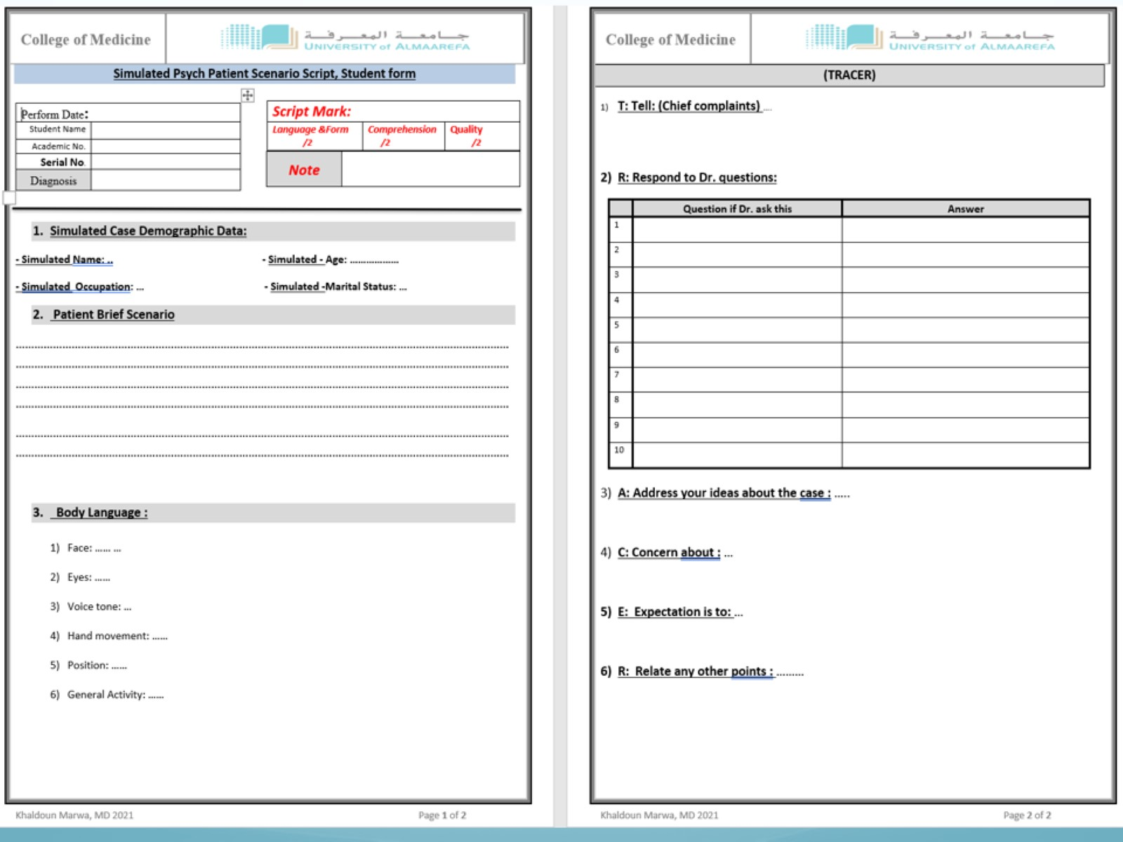

Slide 50
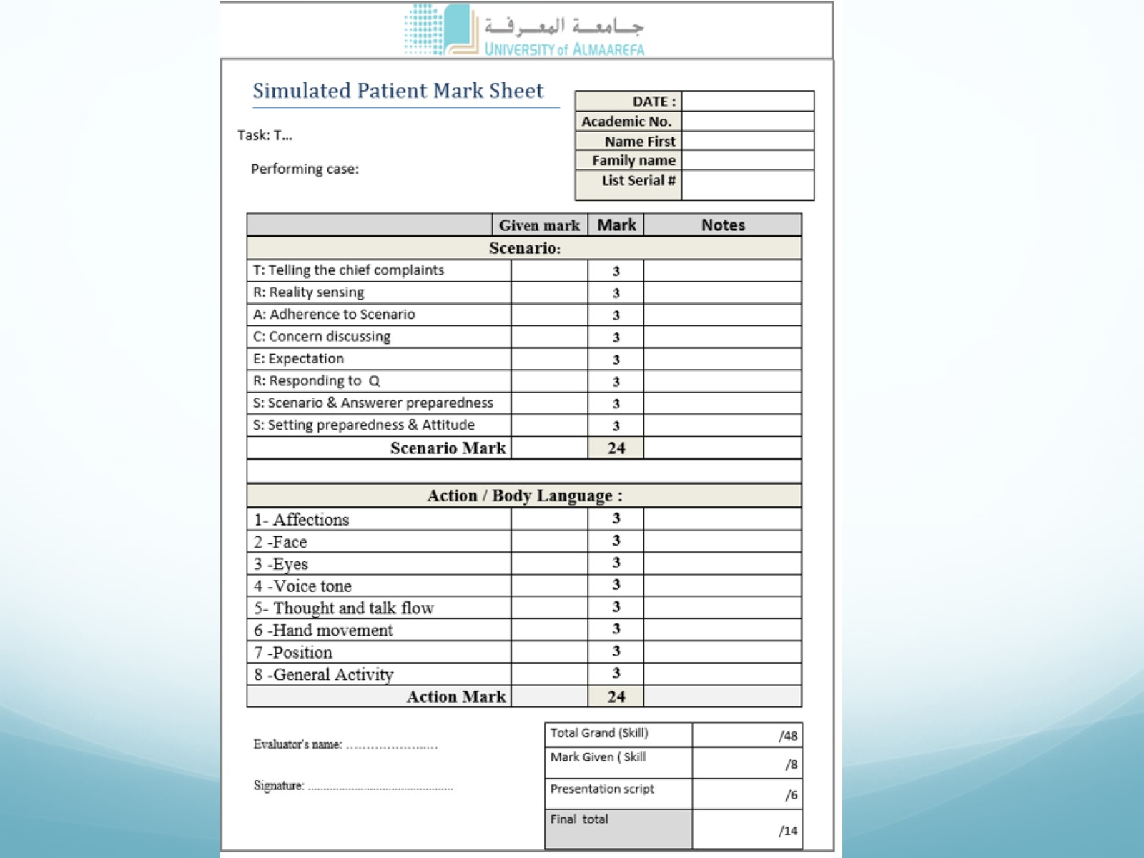

Slide 51
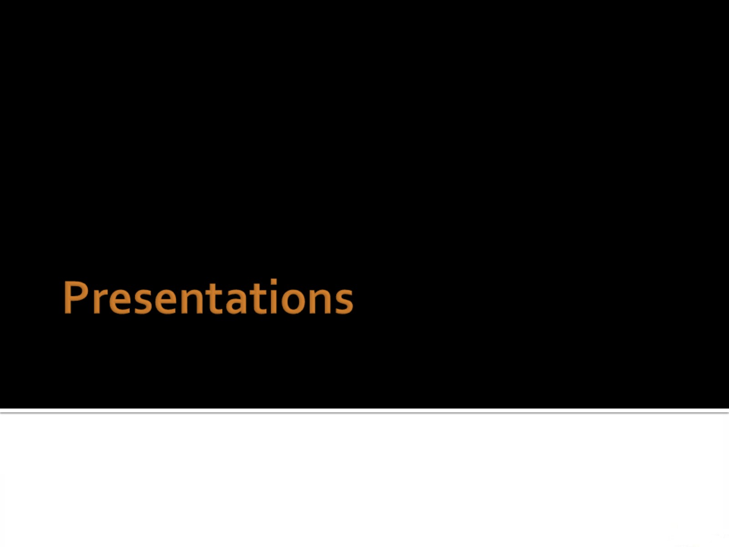
Presentations

Slide 52

Presentation Mark

Slide 53


Slide 54

PSYCHIATRY REFERENCES (Basic)

Slide 55

PSYCHIATRY REFERENCES (Advanced)

Slide 56

PSYCHIATRY REFERENCES (Basic)

Slide 57

PSYCHIATRY REFERENCES (Basic)

Slide 58

PSYCHIATRY REFERENCES

Slide 59

PSYCHIATRY REFERENCES (Advanced)

Slide 60

Required

Slide 61

COURSE EVALUATION

Slide 62

Sincere Psychological Advice !

Slide 63

Course Material

Slide 64

Questions?

Slide 65

Psychiatric training problem & solution

Slide 66

Al Maarefa Simulation Centre

Slide 67

Medical Students as Simulated Patients and Doctors: a Novel Strategy for Clinical Psychiatric Skills Training

Slide 68

Medical Students as Simulated Patients and Doctors: a Novel Strategy for Clinical Psychiatric Skills Training

Slide 69

Medical Students as Simulated Patients and Doctors: a Novel Strategy for Clinical Psychiatric Skills Training

Slide 70

Medical Students as Simulated Patients and Doctors: a Novel Strategy for Clinical Psychiatric Skills Training

