Slide 1
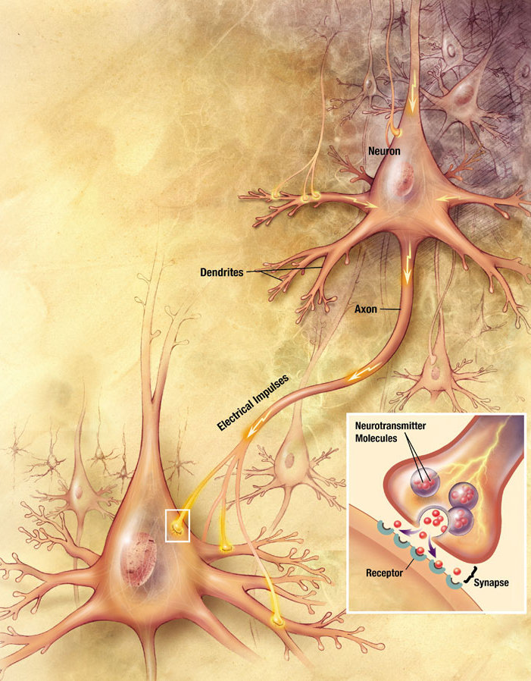
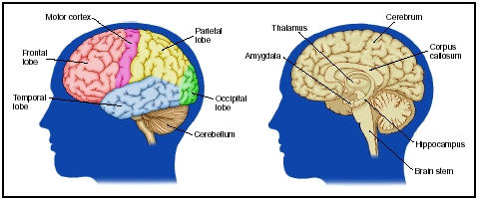

Slide 2
Evolutionary Development
If you examine the brain in an evolutionary perspective, this can help to understand the interlinks between form and function. The brain can be divided anatomically and functionally into three basic components.

Slide 3
Reptilian Brain
Corresponds to the brainstem
Consists of the medulla, pons, midbrain and basal ganglia
Not only responsible for vegetative functions but also for many volitional behaviours directed towards individual preservation and propagation such as feeding, drinking and sexual aggression.

Slide 4
Paleomammalian Brain
The primitive cortex of the limbic lobe
Subserves primitive (but distinctly mammalian behaviours) such as hoarding and parental care of offspring.

Slide 5
Neomammalian
Paleomammalian
Reptilian

Slide 6
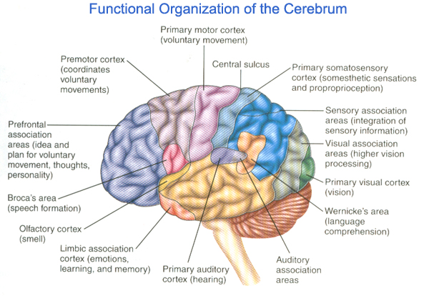

Slide 7
The limbic system
Amygdala :response to fear
Prefrontal cortex : integrates this emotion with conscious sources of information and plans our physiological and behavioral responses to the situation.
Hippocampus : consolidation of conscious memories and cognitive navigation
Cingulate gyrus : error detection, determining the focus of our attention, the personal sense of urgency and social interactions

Slide 8
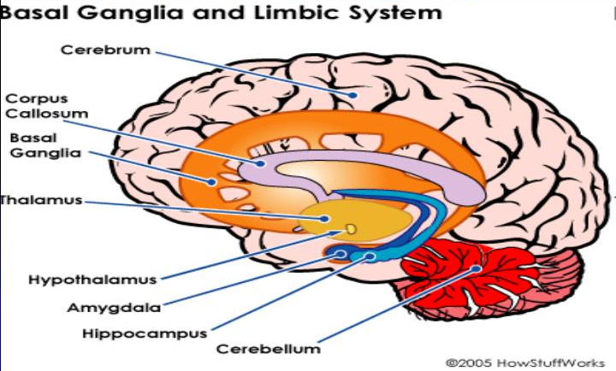
Basal Ganglia and Limbic System

Slide 9
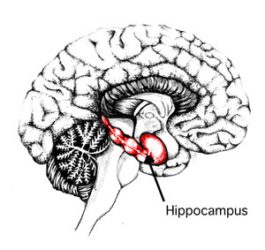

Slide 10
Hippocampal Formation & Amygdala
Hippocampal Formation
Dentate gyrus + the hippocampus proper + Subiculum
Memory, spatial navigation and attention
Amygdala
Via hypothalamus activates the ANS
Activation of Neurotransmitters
Emotional Learning – Conditioning
Memory modulation
Kluver Bucy Syndrome – Docility: diminished fear responses,
dietary changes, Hyperorality, Hypersexuality, Visual Agnosia
Hypermetamorphosis: irrresistable impulse to notice and react to everything, memory loss

Slide 11
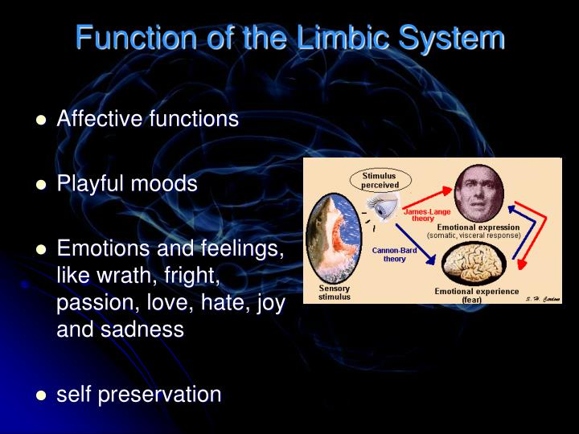
Function of the Limbic System
Affective Functions
Playful moods
Emotions and feelings,
Like wrath, fright, passion,
Love, hate, joy and sadness
Self preservation

Slide 12
Prefrontal cortex
Dorsolateral cortex(DLC) :Attention, planning, decision making, inhibition, and initiation of goal-directed behavior, working memory
The orbitofrontal cortex (OFC) :inhibit the emotional and autonomic reactivity of subcortical structures such as the amygdala.

Slide 13
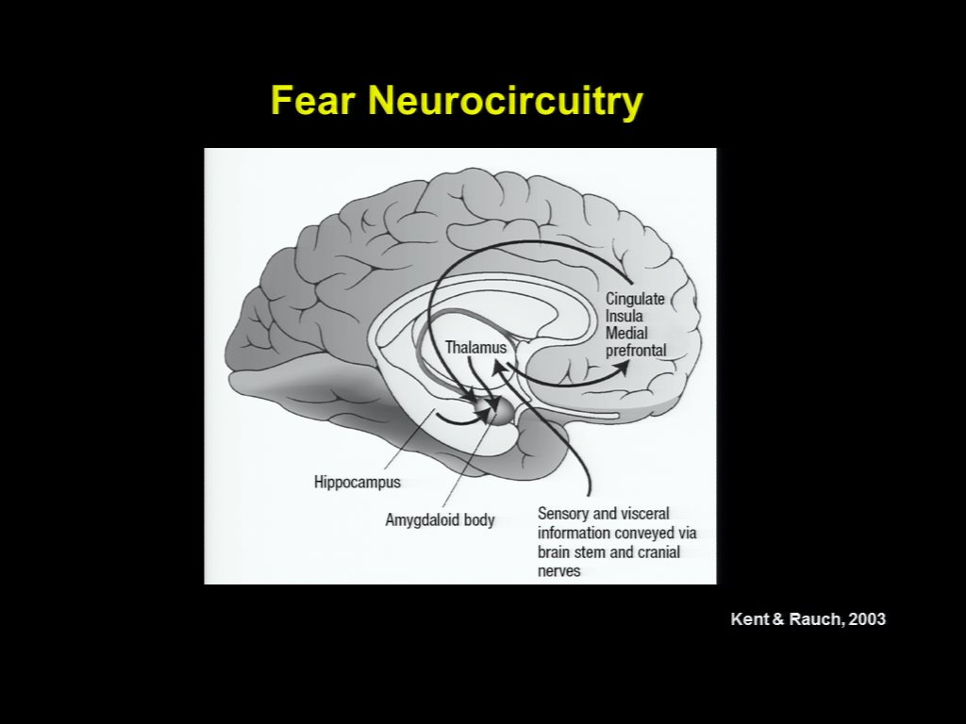
Fear Neurocircuitry

Slide 14
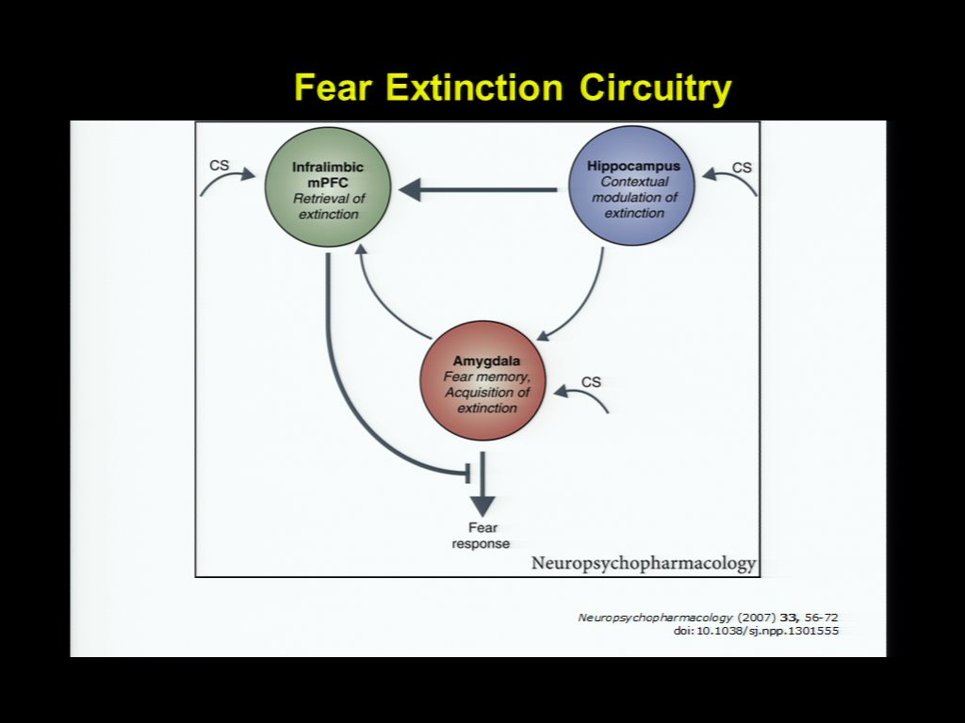
Fear Extinction Circuitry

Slide 15
Frontal Lobe Dysfunction
The Primary motor cortex
Contra lateral motor control
The medial frontal cortex
Arousal and motivation – Abulic (Apathy & inattention
The orbital frontal cortex
Modulate Behaiour – Labile, euphoric, facetious, vulgar
The left postero-inferior frontal cortex (Broca’s)
Language – expressive Aphasia
The dorsolateral frontal cortex
Working memory & dysexecutive syndrome

Slide 16
Disorders that affect the forebrain
Region | Disorder
Cerebral cortex | depression, Huntington's disease, mania
Cerebrum | epilepsy, stroke
frontal lobe | Alzheimer's disease, depression, mania,schizophrenia
parietal lobe | Alzheimer's diseasea
temporal lobe | Alzheimer's disease, depression, mania
Limbic system | mania
amygdala | depression
hippocampus | Alzheimer's disease, mania

Slide 17
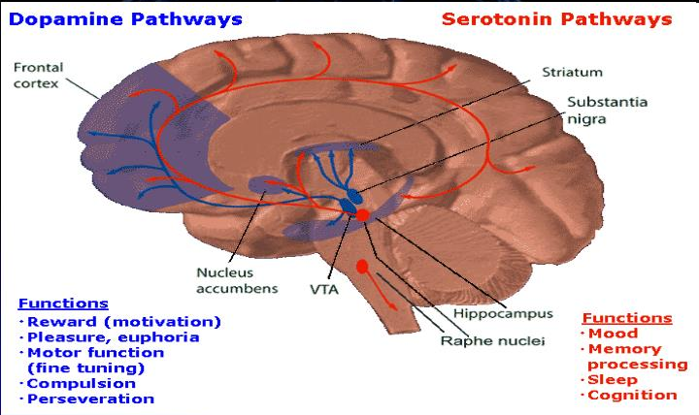
Serotonin Pathways

Slide 18
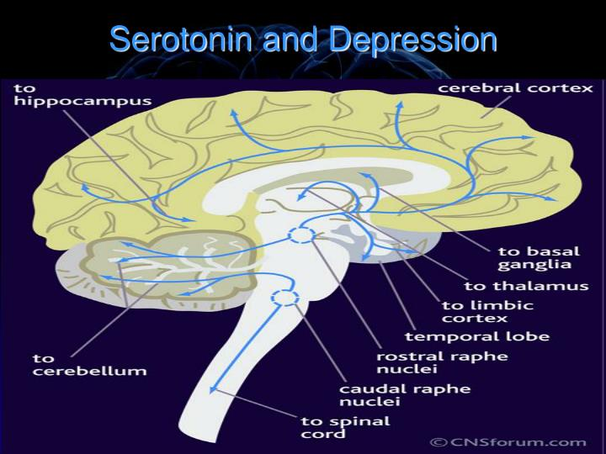
Serotonin and Depression

Slide 19
Serotonin and Depression
Serotonin transmission – Caudal raphe nuclei and Rostal raphe nuclei is reduced in depression
Increasing the levels of serotonin in these pathways, by reducing serotonin reuptake = treatment

Slide 20
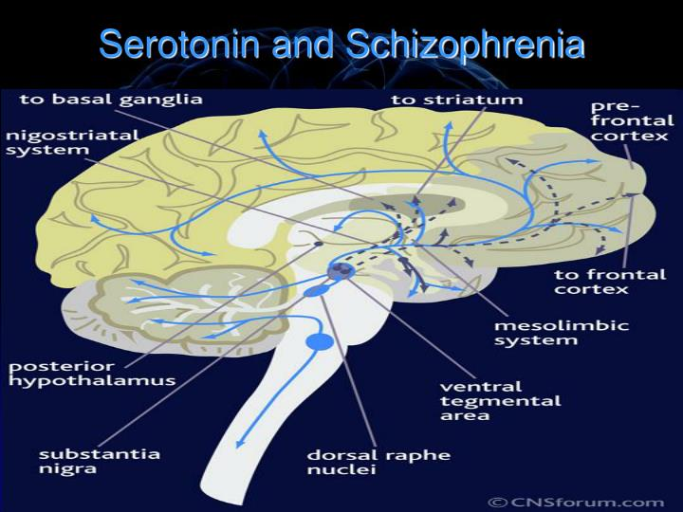
Serotonin and Schizophrenia

Slide 21
Serotonin in Schizophrenia
Dorsal raphe nuclei – Substantia Nigra
Rostal raphe nuclei – cerebral cortex, limbic regions and basal ganglia
The up-regulation of Serotonin pathways leads to the hypofunction dopamine pathways = negative symptoms
The serotonergic nuclei in the brainstem that give rise to descending serotonergic axons remains unaffected in schizophrenia

Slide 22
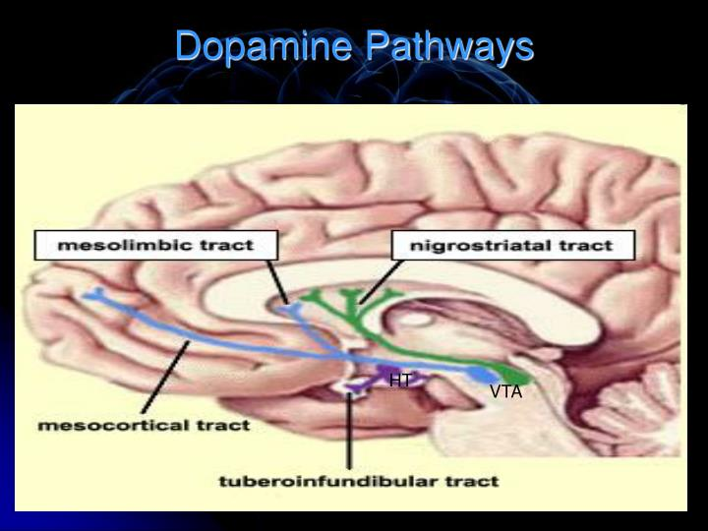
Dopamine pathways

Slide 23
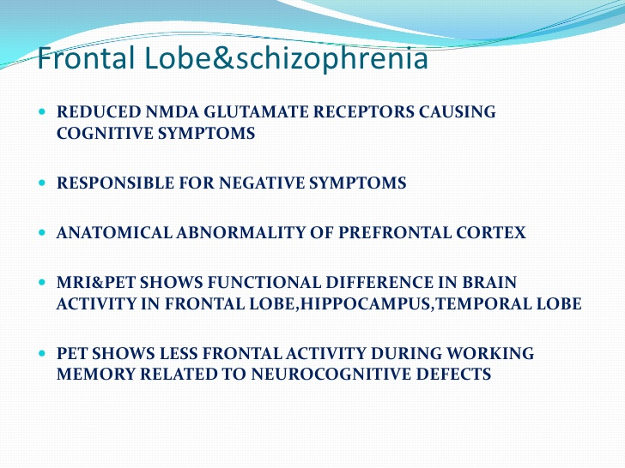

Slide 24
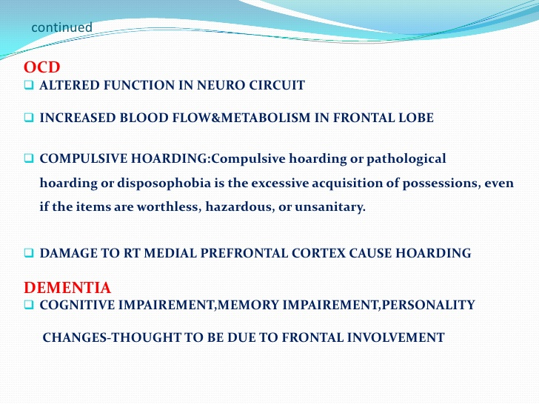

Slide 25
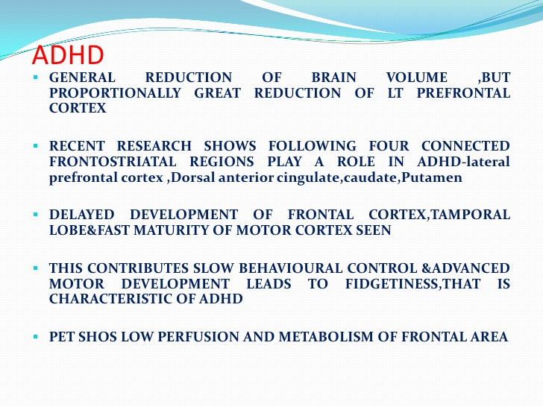

Slide 26
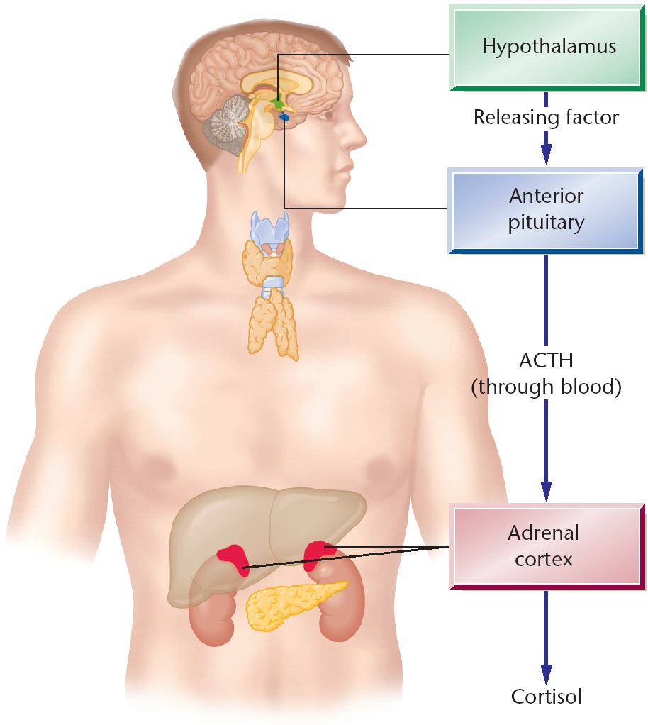

Slide 27
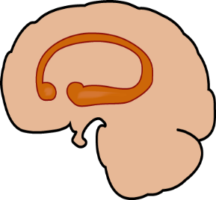
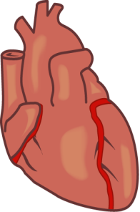
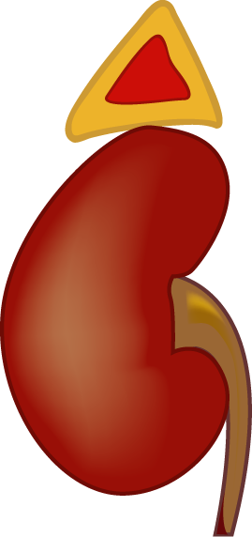
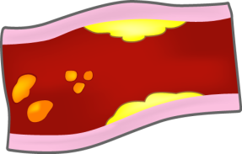
Depression may have systemic health consequences
2. The adrenal gland releases excessive amounts of catecholamines and cortisol
3. Increase in catecholamines can lead to myocardial ischemia,
diminished heart rate variability, and can contribute to ventricular arrhythmias
ACTH
4. Increase in catecholamines causes platelet activation; increase in cytokines and interleukins may also contribute to atherosclerosis and eventual hypertension
Hypothalamus stimulates the pituitary gland to release excessive ACTH, continuously driving the adrenal gland
5. Cortisol antagonizes insulin and contributes to dyslipidemia, type 2 diabetes, and obesity; increases in cortisol also suppress the immune system
Adapted from: Musselman DL, et al. Arch Gen Psychiatry. 1998;55(7):580-592.
Notes:
27
KEY POINTS
MDD may not only be a “psychiatric disease,” as there is evidence of widespread systemic consequences. Neuroendocrine dysregulation and elevated sympathetic tone may result in cardiovascular morbidity and increased risk of metabolic syndrome. Immune response may be compromised in MDD.
Major depression and depressive symptoms, although commonly encountered in medical populations, are frequently underdiagnosed and undertreated in patients with cardiovascular disease (CVD).
This is of particular importance because several studies have shown depression and its associated symptoms to be a major risk factor for both the development of CVD and death after an index myocardial infarction.
Treatment of depression in patients with CVD may be able to improve their dysphoria and other signs and symptoms of depression and improve quality of life.
BACKGROUND
“This review of the extant literature is derived from MEDLINE searches (1966-1997) using the search terms “major depression,” “psychiatry,” “cardiovascular disease,” and “pathophysiology.”
“Studies investigating pathophysiological alterations related to CVD in patients with depression are reviewed.”
“The few studies on treatment of depression in patients with CVD are also described.”
REFERENCE
Musselman DL, Evans DL, Nemeroff CB. The relationship of depression to cardiovascular
disease: epidemiology, biology, and treatment. Arch Gen Psychiatry. 1998;55(7):580-592.

Slide 28
Normal Stress Response: HPA Axis
Stressor
CRF released from hypothalamus
Glucocorticoids provide negative feedback to hypothalamus
ACTH released from pituitary
Glucocorticoids released from adrenal cortex

Slide 29
Stress sensitization and Brain Atrophy
Prolonged Stress
Prolonged Glucocorticoid Release
Disinhibition of HPA Axis by Hippocampus
Hippocampal Atrophy

Slide 30
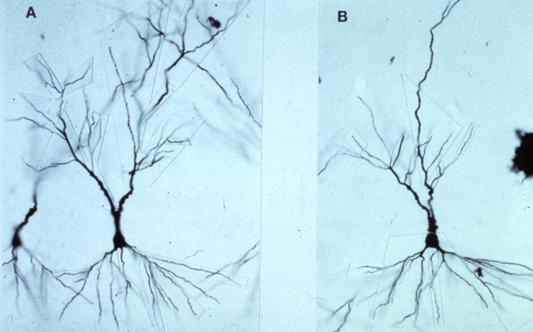
Cellular atrophy after stress
Rat hippocampal neurone before (A) and after (B)
3-week repeated stress

Slide 31


Slide 32
Structural changes in brain in depression
Stress
Decrease in neurogenesis
Cellular atrophy
Decrease in hippocampal volume
Frodl et al. Am J Psych. 2002; McKittrick et al. Synapse. 2000; Duman R. CNS Spectrum, 2002.

Slide 33
Neuroplasticity
The brain's natural ability to form new connections in order to compensate for injury or changes in one's environment.

Slide 34
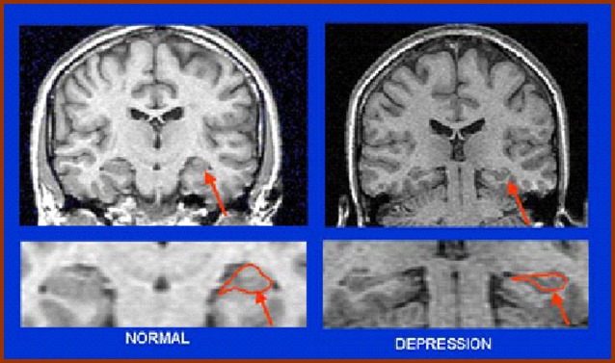
Evidence of Hippocampal Atrophy and Loss in Patients With MDD
Compared to controls, patients with depression had smaller hippocampal volumes (n=16)¹
Decreased hippocampal volume may be related to the duration of depression²⁻⁴
Bremner JD, et al. Am J Psychiatry. 2000;157(1):115-118.
Sheline YI, et al. J Neurosci. 1999;19(12):5034-5043.
Sheline YI, et al. Proc Natl Acad Sci USA. 1996;93(9):3908-3913.
Sheline YI, et al. Am J Psychiatry. 2003;160(8):1516-1518.
Images courtesy of JD Bremner.
Notes:
34
PURPOSE OF THE SLIDE
Atrophy of the hippocampus, a region of the brain involved in conscious memory, may be associated with depression.
SPEAKER DIRECTION
Molecular and cellular studies of stress, depression, and antidepressants have moved the field of mood disorder research beyond the monoamine hypothesis of depression. These studies demonstrated that stress and antidepressant treatment may exert opposing actions on the expression of specific neurotrophic factors in limbic brain regions involved in the regulation of mood and cognition.¹
Most notable are studies of BDNF. The functional significance of altered neurotrophic factor expression was highlighted by studies demonstrating that stress and depression can lead to neuronal atrophy and cell loss in key limbic brain regions implicated in depression, including the amygdala, prefrontal cortex, and hippocampus (which expresses high levels of receptors for glucocorticoids, the major stress reactive adrenal steroid).¹
Several studies have associated depression with decreased hippocampal volume.^{2,3} Furthermore, this reduction in volume has been related to the duration of depression.³⁻⁵
BACKGROUND
The hippocampus is one of several limbic structures that have been implicated in mood disorders. Included in the functions of hippocampal circuitry are control of learning and memory and regulation of the hypothalamic-pituitary-adrenal (HPA) axis, both of which are altered in depression. The hippocampus has connections with the amygdala and prefrontal cortex, regions that are more directly involved in emotion and cognition and thereby contribute to other major symptoms of depression.¹
Bremner et al studied 16 patients with a history of depression based on the Structured Interview for DSM-IV, finding hippocampal volume loss and memory deficits.²
In a sample of 24 women age 23 to 86 years with histories of recurrent major depression, Sheline et al found that post-depressives scored lower in verbal memory, suggesting that the hippocampal volume loss was related to an aspect of cognitive functioning. The study also found duration of depressive episode to be a predictor of hippocampal volume loss.³
REFERENCES
Duman RS, Monteggia LM. A neurotrophic model for stress-related mood disorders. Biol Psychiatry. 2006;59:1116-1127.
Bremner JD, Narayan M, Anderson ER, et al. Hippocampal volume reduction in major depression. Am J Psychiatry. 2000;157(1):115-118.
Sheline YI, Sanghavi M, Mintun MA, et al. Depression duration but not age predicts hippocampal volume loss in medically healthy women with recurrent major depression. Neurosci. 1999;19:5034-5043.
Sheline YI, Wang PW, Gado MH, et al. Hippocampal atrophy in recurrent major depression. Proc Natl Acad Sci USA. 1996;93:3908-3913.
Sheline YI, Gado MH, Kraemer HC, et al. Untreated depression and hippocampal volume loss. Am J Psychiatry. 2003;160: 1516-1518.

Slide 35
Correlation Between Hippocampal Volume and Duration of Untreated Depression
38 Female Outpatients With Recurrent Depression in Remission
6000
R²=.28
p=.0006
N=38
5500
5000
Total Hippocampal Volume (mm³)
4500
4000
3500
3000
0
1000
2000
3000
4000
Days of Untreated Depression
There was a significant inverse relationship between total hippocampal volume and the length of time depression went untreated
Reprinted with permission from APA.
Sheline YI, et al. Am J Psychiatry. 2003;160(8):1516-1518.
Notes:
PURPOSE OF THE SLIDE
Illustrate the potential correlation between the duration of untreated depression and changes in hippocampal volume.
Emphasize the urgency to treat depression early.
SPEAKER DIRECTION
In this study, depression that had gone untreated was found to have deleterious effects on overall neuronal health.
The duration of time that depression was untreated was significantly inversely related to hippocampal volume, with longer periods of untreated depression correlated with lower total hippocampal volume.
BACKGROUND
38 outpatient female subjects with recurrent depression in remission were recruited for this study.
Subjects were screened for medical problems and were specifically screened for incipient dementia.
DSM-IV criteria were used to determine past episodes of major depression as well as for exclusion of other psychiatric diagnoses.
Hippocampal volumes were measured using MRI scans.
Total time treated was not found to be correlated with hippocampal volume.
REFERENCE
Sheline YI, Gado MH, Kraemer HC. Untreated depression and hippocampal volume loss. Am J Psychiatry. 2003;160:1516-1518.

Slide 36
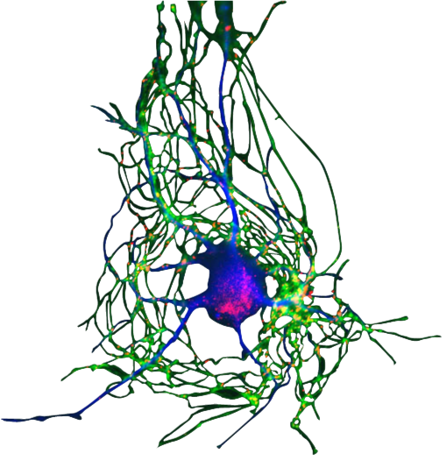
Beyond the Synapse: Brain-derived Neurotrophic Factor (BDNF), Depression, and Antidepressants
Neurogenesis (the birth of new neurons) continues postnatally and into adulthood
BDNF is associated with production of new neurons and their growth and development¹
Data suggest that neurogenesis occurs in the hippocampus²
The hippocampi appear to have important functions related to both mood and memory
Data from depressed patients have shown reduced hippocampal volume³
BDNF may influence regulation of mood⁴
BDNF is downregulated in MDD and increased with successful antidepressant treatment^{4,5}
Both serotonin (5-HT) and norepinephrine (NE) are believed to play roles in the modulation of BDNF^{1,5}
1. Duman RS, et al. Arch Gen Psychiatry. 1997;54(7):597-606.
2. Gould E, et al. Biol Psychiatry. 2000;48(8):715-720.
3. Sheline YI, et al. Proc Natl Acad Sci USA. 1996;93(9):3908-3913.
4. Shimizu E, et al. Biol Psychiatry. 2003;54(1):70-75.
5. Maletic V, et al. Int J Clin Pract. 2007;61(12):2030-2040.
Image courtesy of Society for Neuroscience.
Notes:
36
PURPOSE OF THE SLIDE
Stress the importance of BDNF in depression and connect depression and antidepressants with neuronal health through interaction with BDNF.
SPEAKER DIRECTION
Neurogenesis (the birth of new neurons) continues postnatally and into adulthood in the brains of many animal species, including humans. One specific area where neurons continue to be born throughout life is in the dentate gyrus of the hippocampus.^{1,2}
Neurogenesis is regulated by growth factors, including brain derived neurotrophic factor (BDNF), that can lead to the development of new cells and help keep them alive.
The hippocampi appear to have important functions related to both mood and memory.
Sheline compared hippocampal volumes of subjects with a history of major depressive episodes but currently in remission and with no known medical comorbidity (n=10) to matched normal controls (n=10) by using volumetric magnetic resonance imaging.³
BDNF is expressed throughout the brain in glia, monoamine neurons including monoaminergic, GABA, and glutamate neurons.⁴
Neurotrophic factors such as BDNF are critical for growth and guidance of the developing nervous system, the survival and function of the adult learning system, learning, and memory.⁴
Depression, in part, results from a loss of neurotrophic support, which leads to atrophy and loss of neurons in the brain. This suggests a role for structural and neurochemical changes in depression.
BDNF has been shown to be associated with regulation of mood,⁵ and in preclinical studies, to be influenced by stress and perception of pain.⁶
In one study, patients with major depressive disorder (MDD) had significantly lower levels of BDNF compared to control subjects.⁵
Antidepressant treatment was shown to raise BDNF levels back to normal levels.
Both 5-HT and NE are believed to play roles in the modulation of BDNF.¹
Antidepressants act in part by inducing neurotrophic effects that reverse the structural changes that may have occurred.⁴
Antidepressants increase the synaptic levels of NE and 5-HT over the course of weeks or months, suggesting that adaptation or plasticity is necessary for therapeutic response.
BACKGROUND
Most neurons in the mammalian brain and spinal cord are generated during the pre- and perinatal periods of development. Nevertheless, neurons continue to be born throughout life in the olfactory bulb, which processes scents, and in the dentate gyrus of the hippocampus.¹
Most existing neurons in the adult brain cannot divide. Some progenitor cells, however, remain, and they retain the capability for further division into new neurons. Apparently, in most parts of the adult brain, something inhibits progenitor cells from dividing to produce new neurons. No one knows exactly why neurogenesis continues in some areas and not others.
In a study of 33 patients with MDD, patients who had not received antidepressant treatment (n=16) had significantly lower BDNF levels than treated patients (n=17) as well as control subjects (n=50).⁵
In an animal study, both stress as well as acute and chronic pain states significantly lowered levels of BDNF mRNA in the rat hippocampus.⁵
5-HT and/or NE activate intracellular cascades that can independently lead to activation of transcription factor (CREB) and eventual synthesis of BDNF. BDNF interacts with TrkB receptor to enhance neuroplasticity and neurogenesis. By facilitating synthesis of a neuroprotective factor, Bcl-2, BDNF helps improve cellular resilience.^{7,8}
REFERENCES
Duman RS, Heninger GR, Nestler EJ. A molecular and cellular theory of depression. Arch Gen Psychiatry. 1997;54(7):597-606.
Gould E, Tanapat P, Rydel T, Hastings N. Regulation of hippocampal neurogenesis in adulthood. Biol Psychiatry. 2000;48(8):715-720.
Sheline YI, Wang PW, Gado MH, Csernansky JG, Vannier MW. Hippocampal atrophy in recurrent major depression. Proc Natl Acad Sci USA. 1996;93(9):3908-3913.
Duman RS. Role of neurotrophic factors in the etiology and treatment of mood disorders. Neuromol Med. 2004;5:11-25.
Shimizu E, Hashimoto K, Okamura N, et al. Alterations of serum levels of brain-derived neurotrophic factor (BDNF) in depressed patients with or without antidepressants. Biol Psychiatry. 2003;54(1):70-75.
Duric V, McCarson KE. Hippocampal neurokinin-1 receptor and brain-derived neurotrophic factor gene expression is decreased in rat models of pain and stress. Neuroscience. 2005;133(4):999-1006.
Maletic V, Robinson M, Oakes T, et al. Neurobiology of depression: an integrated view of key findings. Int J Clin Pract. 2007;61:2030-2040.
Manji HK, Quiroz JA, Sporn J, et al. Enhancing neuronal plasticity and cellular resilience to develop novel, improved therapeutics for difficult-to-treat depression. Biol Psychiatry. 2003;53:707-742.

Slide 37
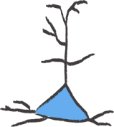
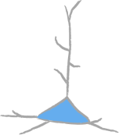
The Role of BDNF in Neuronal Changes in stress¹⁻⁴
Stress
Production of Inflammatory Cytokines and Catecholamines
Increased Activity of HPA Axis
Increased Secretion of
Glucocorticoids
BDNF
Decreased Dendritic Branching
Atrophy/Death of Neurons
Normal Survival and Growth
HPA = hypothalamic pituitary adrenal
1. Duman RS, et al. Biol Psychiatry. 2000;48(8):732-739.
2. Sapolsky RM. Arch Gen Psychiatry. 2000;57(10);925-935.
3. Maletic V, et al. Int J Clin Pract. 2007;61(12):2030-2040.
4. Musselman DL, et al. Arch Gen Psychiatry. 1998;55(7):580-592.
Notes:
37
PURPOSE OF THE SLIDE
Show the importance of the HPA axis and BDNF in some of the neuronal changes that may be involved in depression.
SPEAKER DIRECTION
Molecular and cellular studies of stress, depression, and antidepressants have moved the field of mood disorder research beyond the monoamine hypothesis of depression.
Stress has been shown to decrease levels of BDNF in the hippocampus, as well as produce neuronal atrophy and decrease neurogenesis, which may contribute to a depression-like state.^{1,2}
A mechanism by which the brain reacts to stress and depression is activation of the hypothalamic-pituitary-adrenal (HPA) axis.³ Sustained elevations of glucocorticoids may be seen under conditions of prolonged, severe stress and possibly in patients with depression, hippocampal neurons may be damaged and reduction of neurogenesis may occur.
Patients with major depression who are otherwise medically healthy have also been observed to have activated inflammatory pathways. Activation of macrophages due to inflammatory challenges (infection, tissue damage, or destruction) may cause release of proinflammatory cytokines. These cytokines enter several areas of the afferent sensory systems and can lead to increased activity. Once in the brain, cytokines can cause altered metabolism of serotonin (5-HT) and dopamine (DA), activation of corticotrophin-releasing hormone (CRH) leading to increased serum glucocorticoid levels, and disruption of synaptic plasticity through changes in growth factors such as BDNF.⁴
Severe stress can cause several changes in these neurons, including a reduction in their dendritic branching, and a reduction in BDNF expression (which could be one of the factors mediating the dendritic effects). The reduction in BDNF is thought to be mediated partly by excessive glucocorticoids, which could interfere with the normal transcriptional mechanisms that control BDNF expression and therefore damage hippocampal pyramidal neurons.²
BACKGROUND
The requirement for long-term, chronic antidepressant treatment has led to the hypothesis that alterations in functional and structural plasticity may be necessary for a therapeutic response.¹
Antidepressants are thought to produce the opposite effects: they increase dendritic branching and BDNF expression of these hippocampal neurons. By these actions, antidepressants may reverse and prevent the actions of stress on the hippocampus, and therefore may ameliorate certain symptoms of depression.⁵
Antidepressants have been shown to increase levels of BDNF (as well as other neurotrophic/growth factors).
The reversal of neuronal atrophy, increased neurogenesis, and antidepressant response may potentially be regulated by increases in growth factors such as BDNF.
REFERENCES
Duman RS, Monteggia LM. A neurotrophic model for stress-related mood disorders. Biol Psychiatry. 2006;59:1116-1127.
Sapolsky RM Glucocorticoids and hippocampal atrophy in neuropsychiatric disorders. Arch Gen Psychiatry. 2000;57;925-935.
Musselman DL, Evans DL, Nemeroff CB. The relationship of depression to cardiovascular disease. Arch Gen Psychiatry. 1998;55:580-592.
Raison CL, Capuron L, Miller AH. Cytokines sing the blues: inflammation and the pathogenesis of depression. Trends in Immunol. 2006;27:24-31.
Nestler EJ, Barrot M, DiLeone RJ, et al. Neurobiology of depression. Neuron. 2002;34(1):13-25.

Slide 38
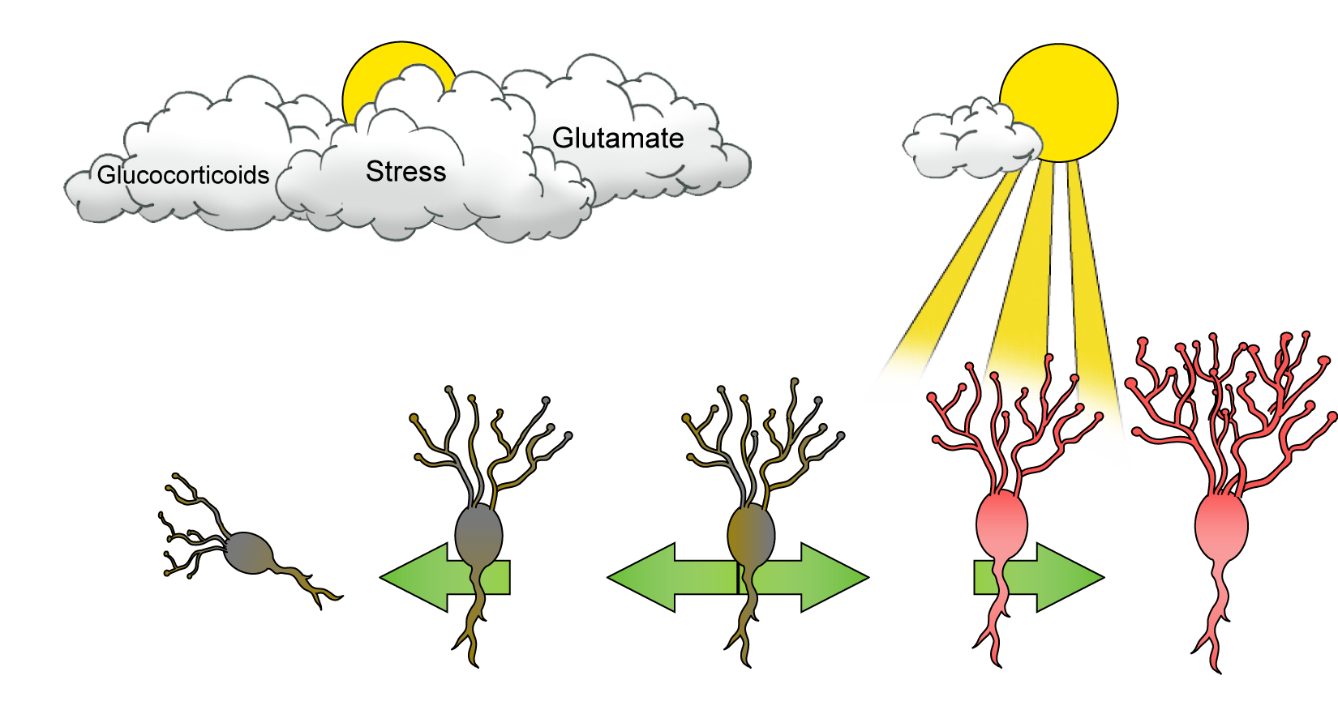
The monoamine hypothesis of gene action: The impact of stress on BDNF
Adapted from: Stahl SM. Essential Psychopharmacology: Neuroscientific Basis and Practical Applications; 2000:187.
Notes:
38
KEY POINTS
This slide uses the simple idea of a plant that needs sunlight to survive, the absence of which means withering and death.
“One candidate mechanism that has been proposed as the site for a possible flaw in signal transduction from monoamine receptors is the target gene for BDNF.”
“Normally, BDNF sustains the viability of brain neurons. Shown here, however, is the gene for BDNF under situations of stress. In this case, the gene for BDNF is repressed, and BDNF is not being synthesized. If BDNF is no longer made in appropriate amounts, instead of the neuron prospering and developing more and more synapses, stress can cause vulnerable neurons in the hippocampus to atrophy and possibly undergo apoptosis when their neurotrophic factor is cut off.”
“This, in turn, can lead to depression and to the consequences of repeated episodes and less and less responsiveness to treatment. This may explain why hippocampal neurons seem decreased in size and impaired in function during depression, on the basis of recent neuroimaging studies.”
“These findings stress the importance of early detection and diagnosis of depression in order to provide patients the highest chances of optimal outcomes.”
REFERENCE
Stahl SM. Essential Psychopharmacology: Neuroscientific Basis and Practical Applications. 2nd ed.
New York, NY: Cambridge University Press; 2000:187.

