Slide 1


Slide 2


Slide 3
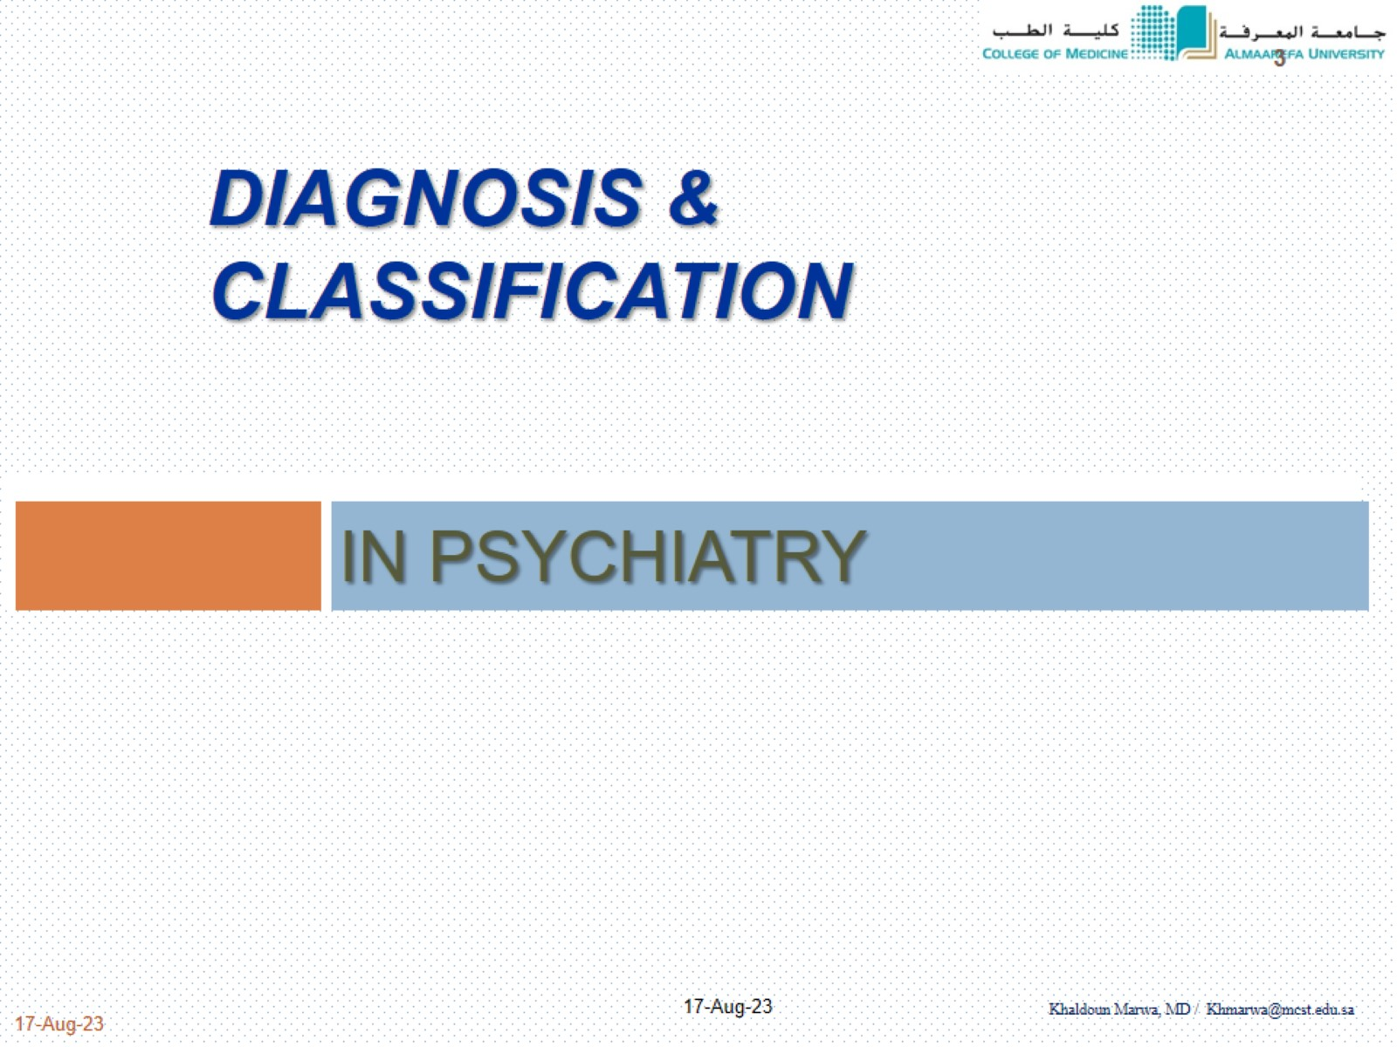
DIAGNOSIS & CLASSIFICATION

Slide 4
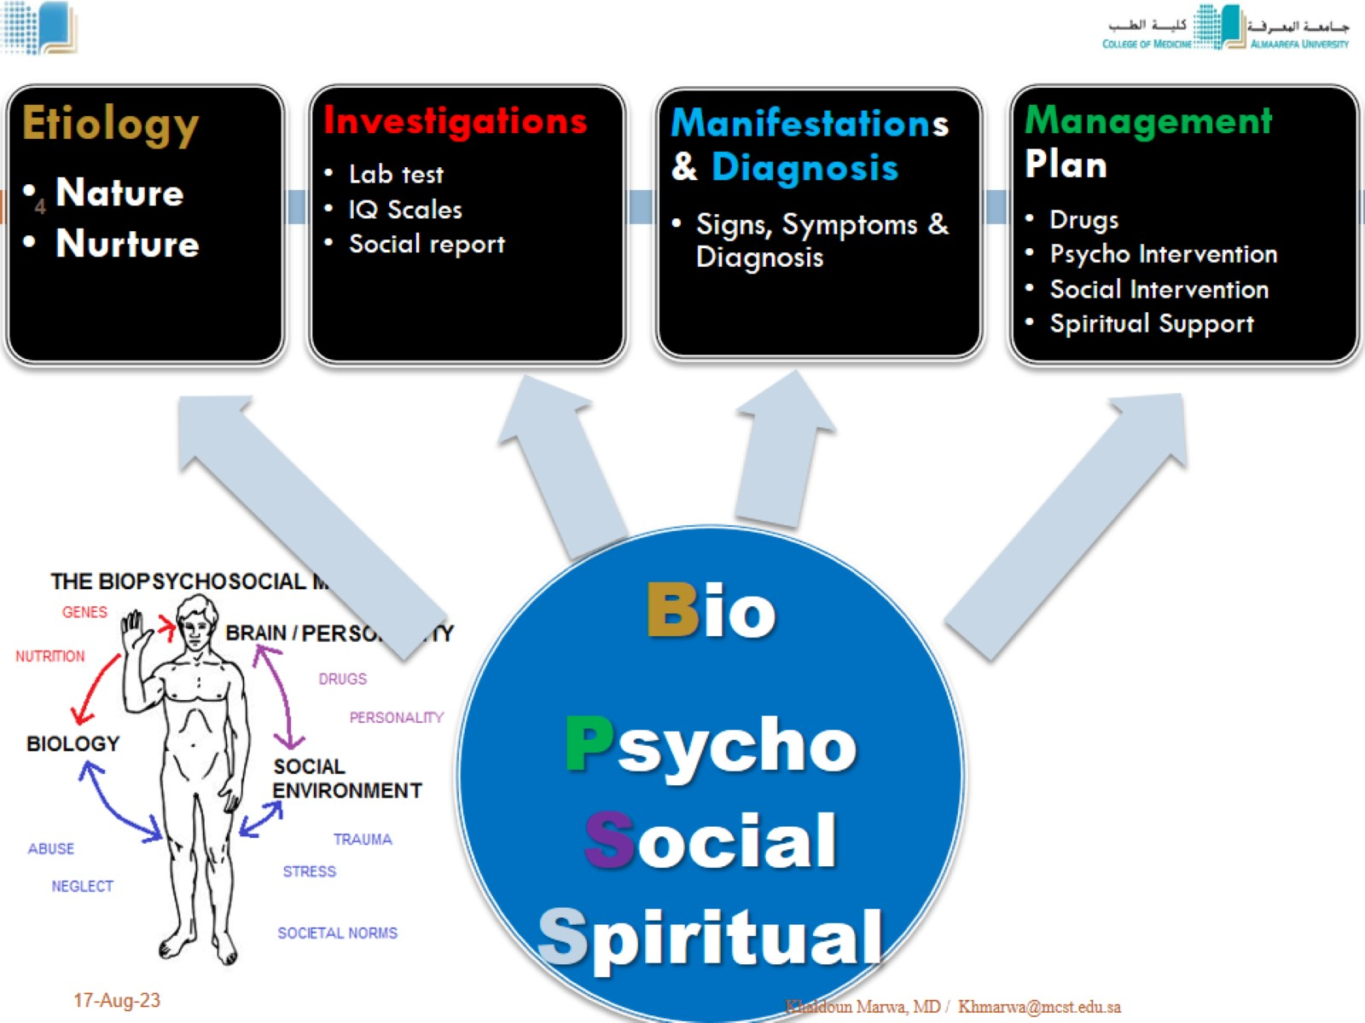

Slide 5
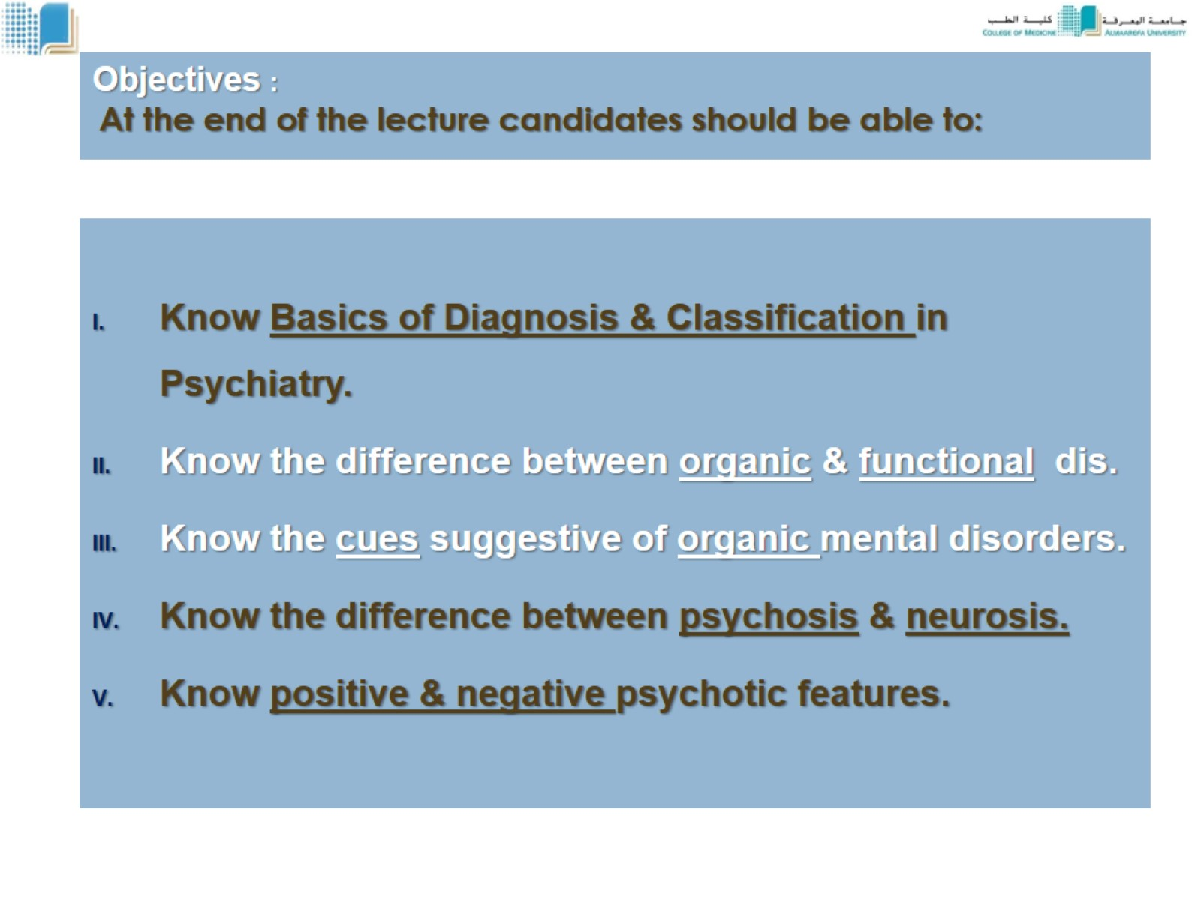
Objectives : At the end of the lecture candidates should be able to:

Slide 6
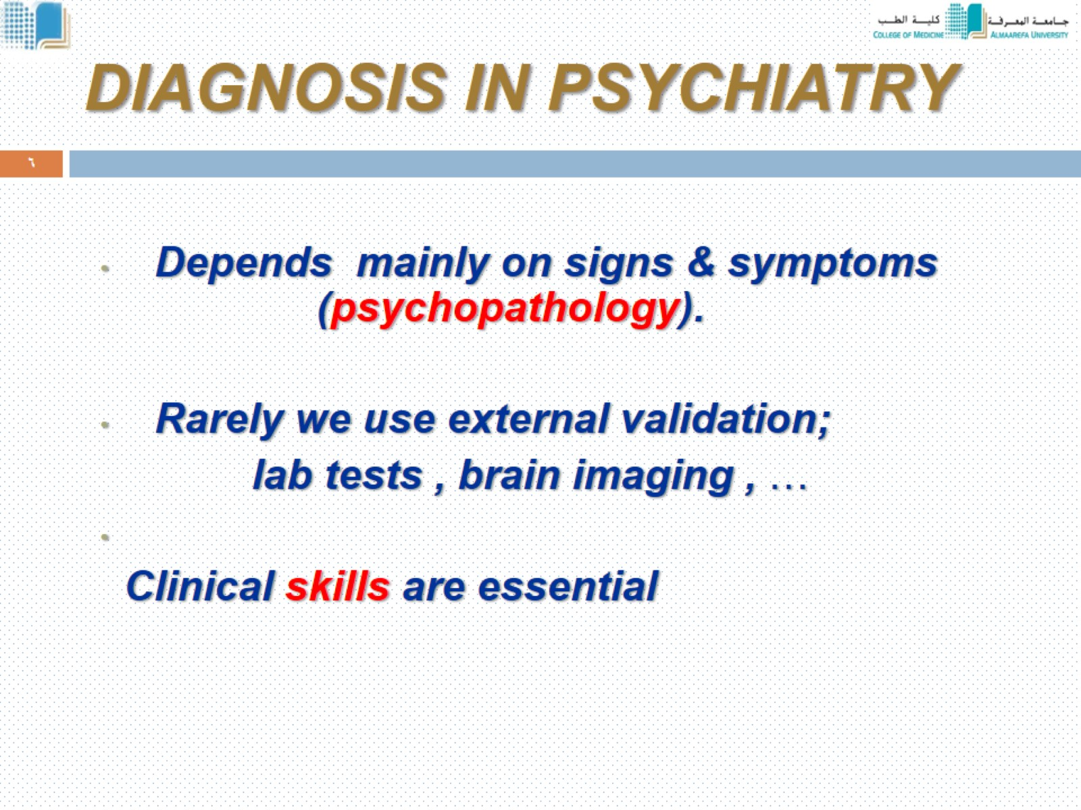
DIAGNOSIS IN PSYCHIATRY

Slide 7
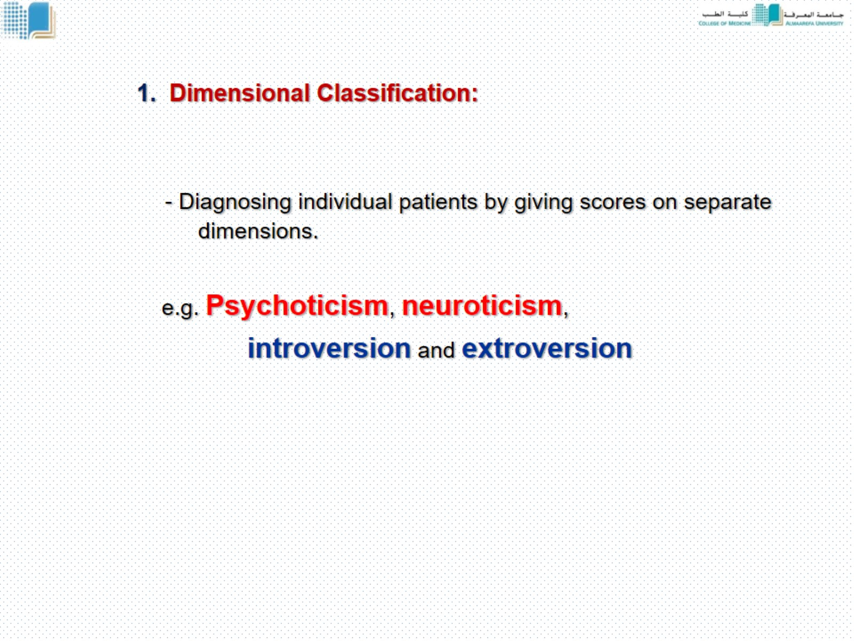
1. Dimensional Classification:

Slide 8
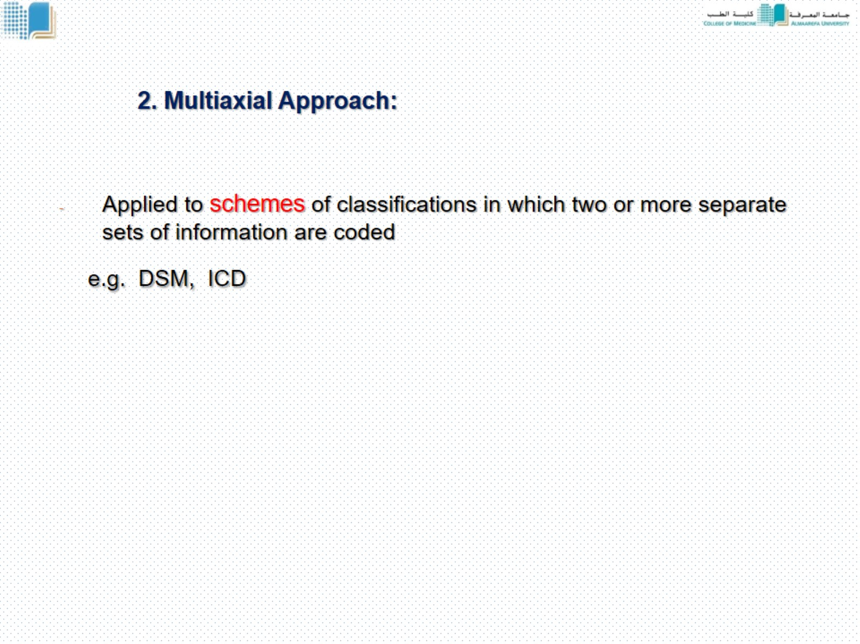
2. Multiaxial Approach:

Slide 9
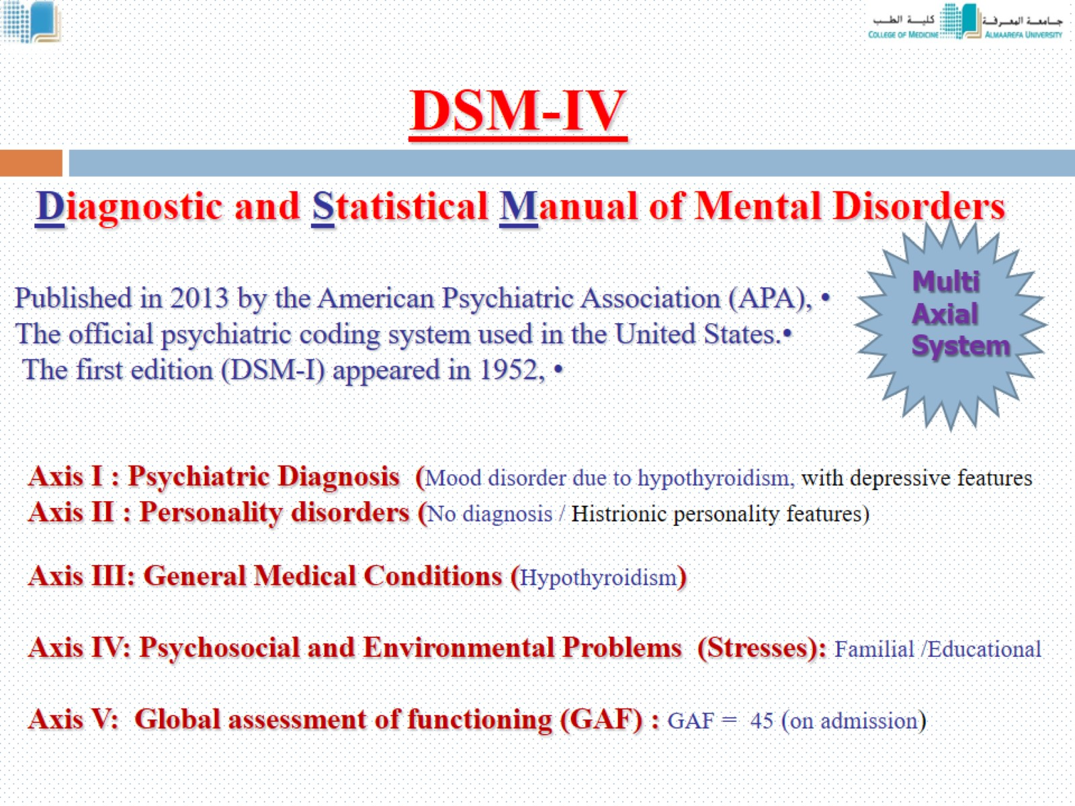

Slide 10
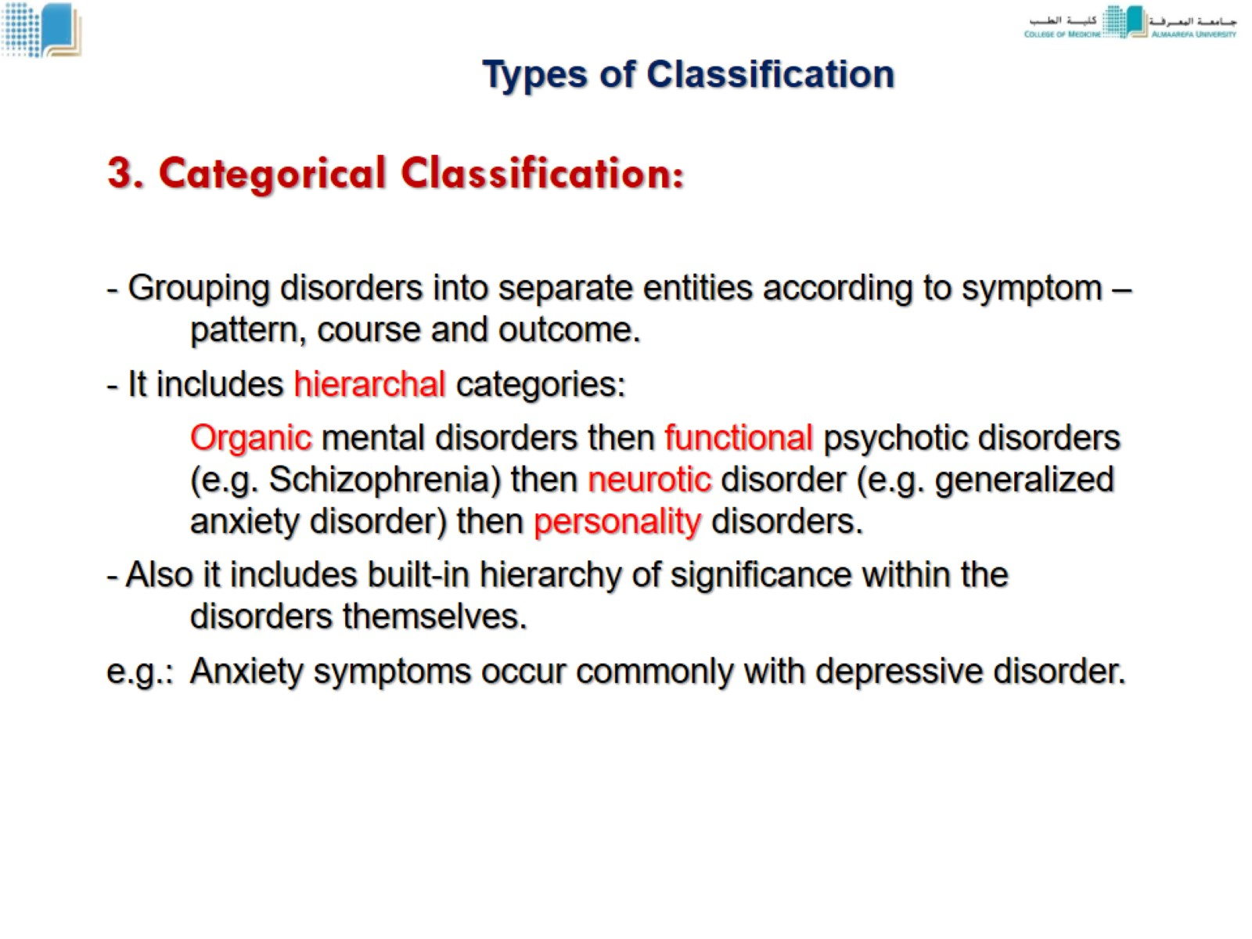
Types of Classification

Slide 11
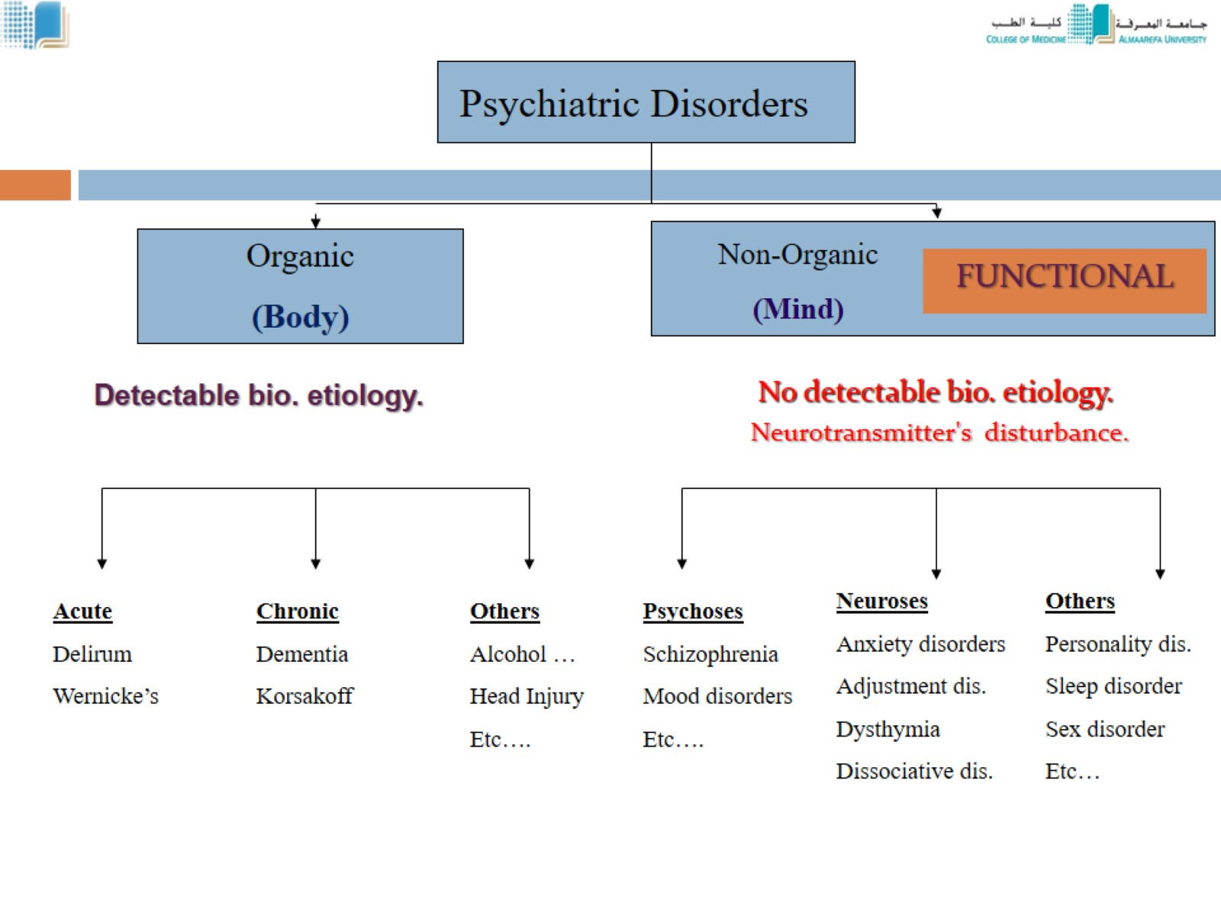

Slide 12
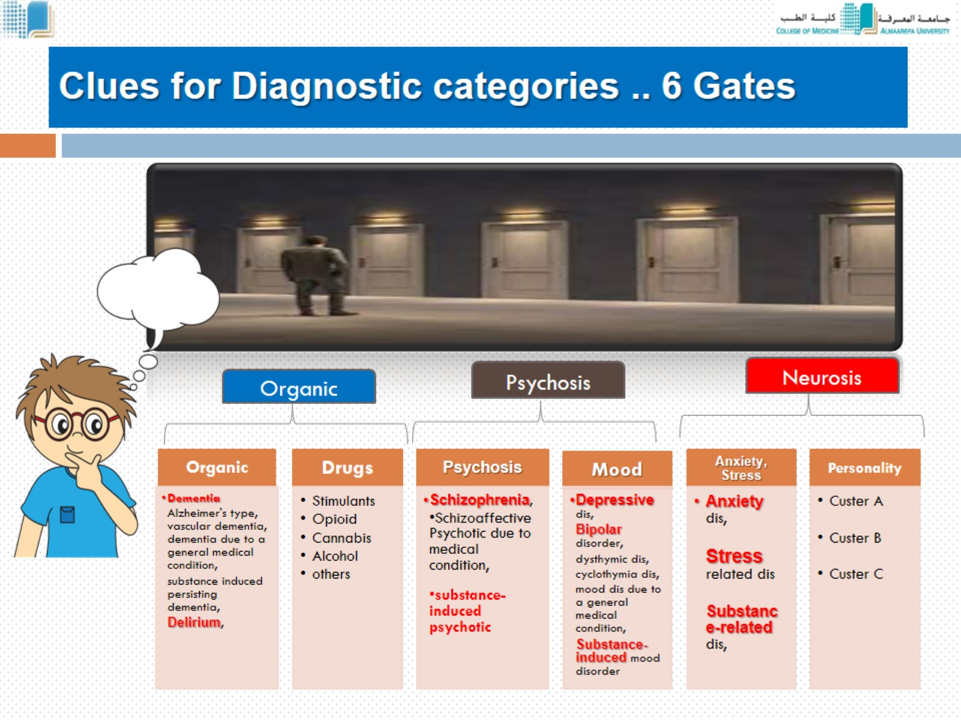
Clues for Diagnostic categories .. 6 Gates

Slide 13
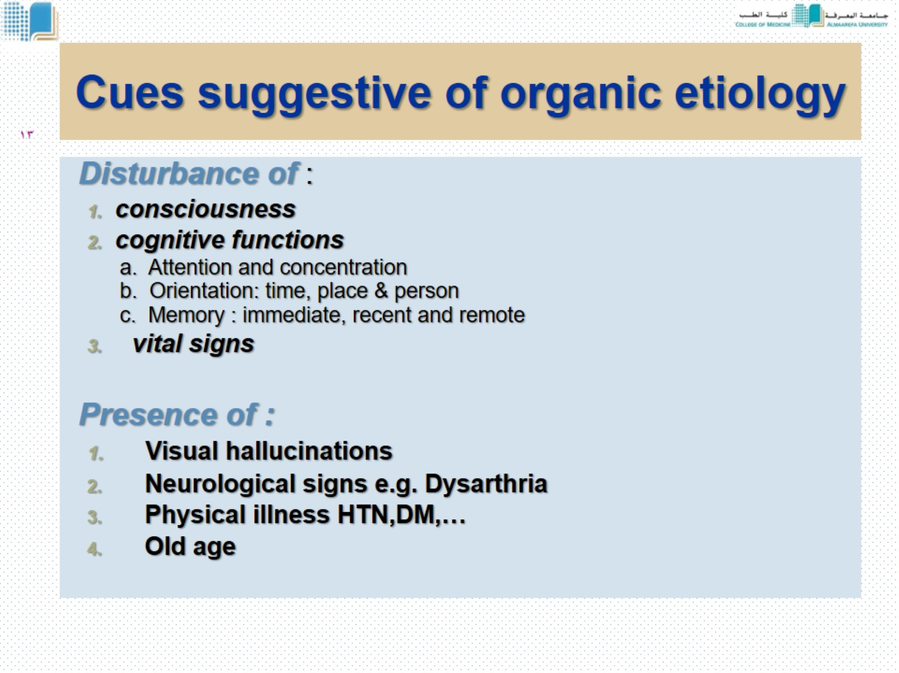
Cues suggestive of organic etiology

Slide 14
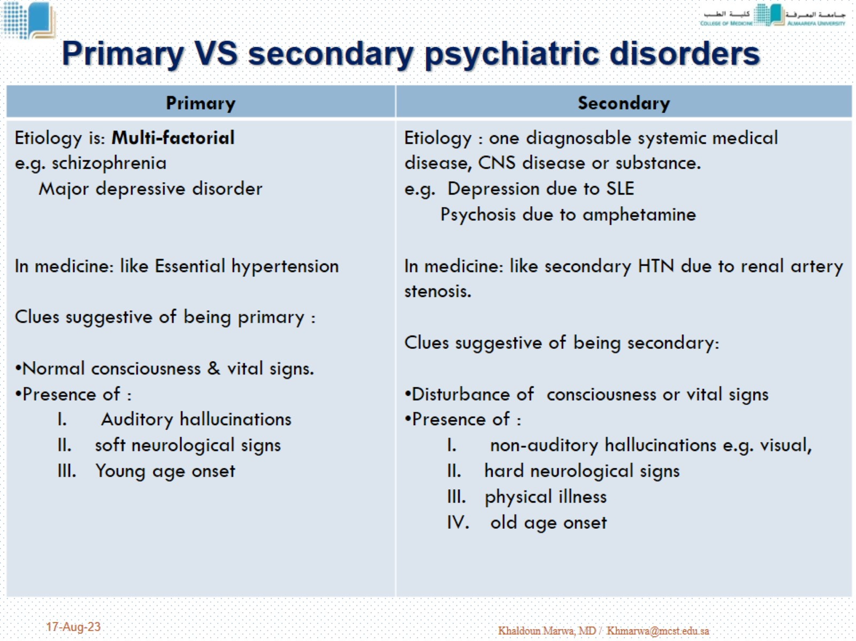
Primary VS secondary psychiatric disorders

Slide 15
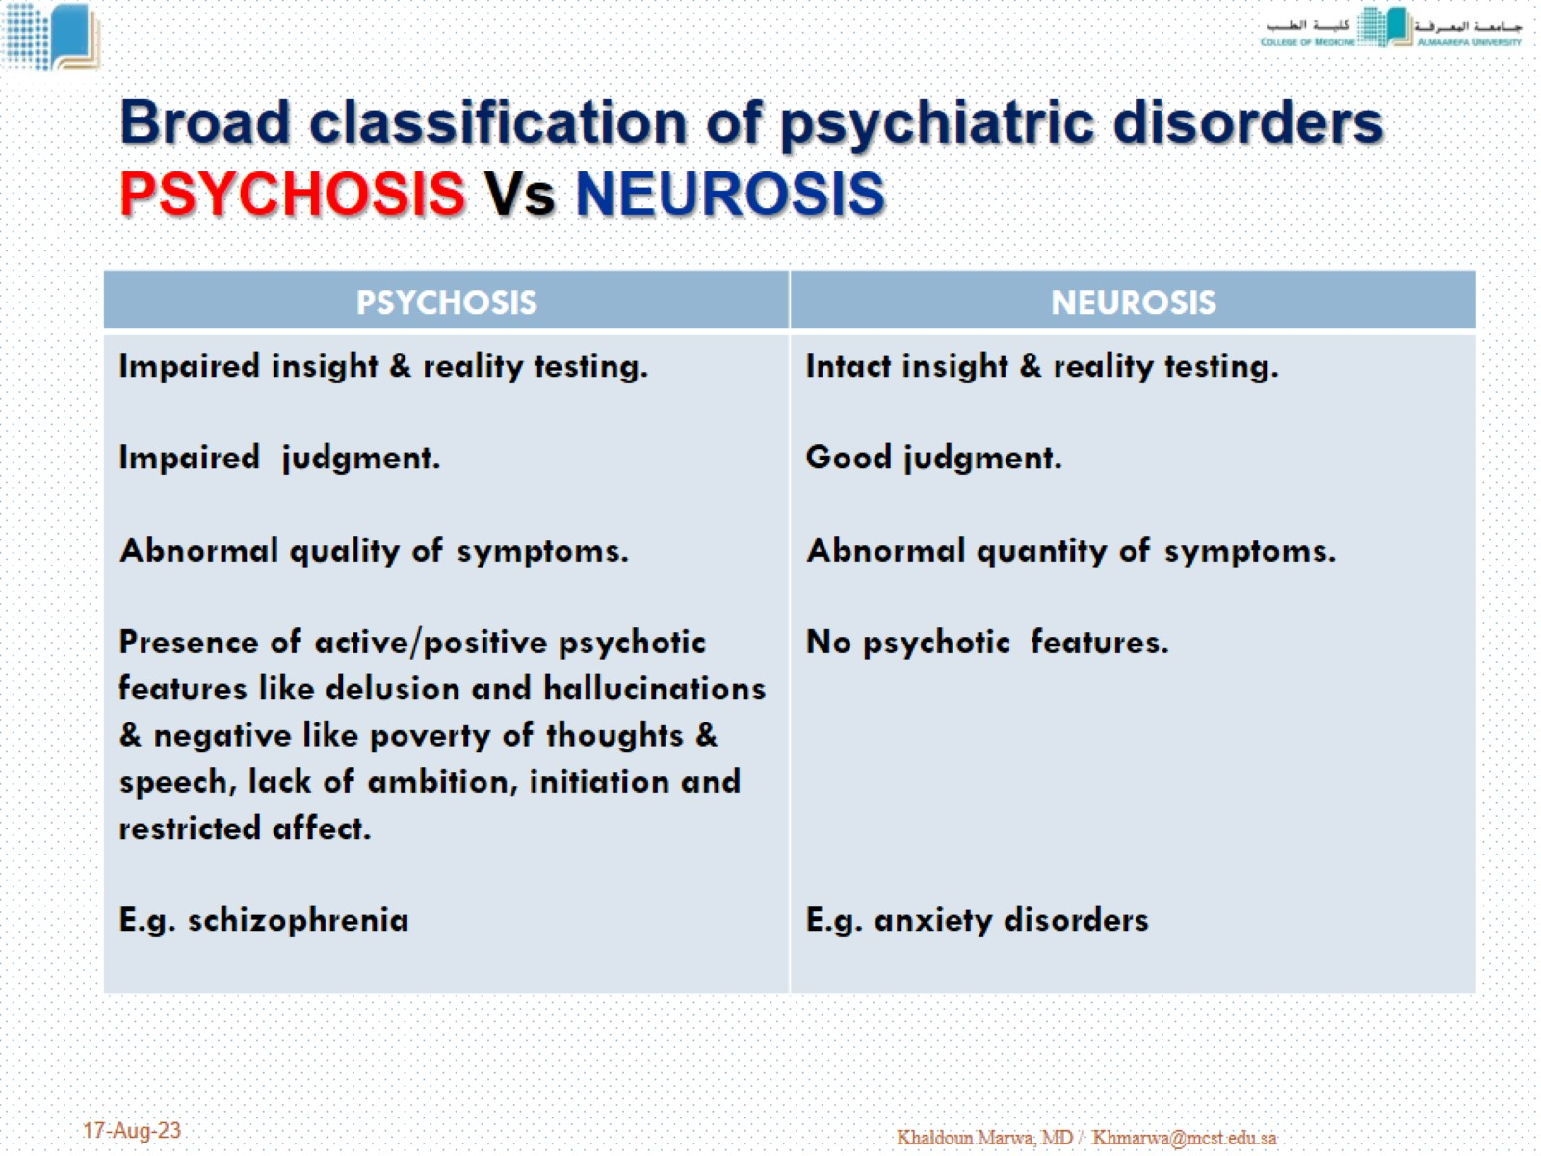
Broad classification of psychiatric disorders PSYCHOSIS Vs NEUROSIS

Slide 16
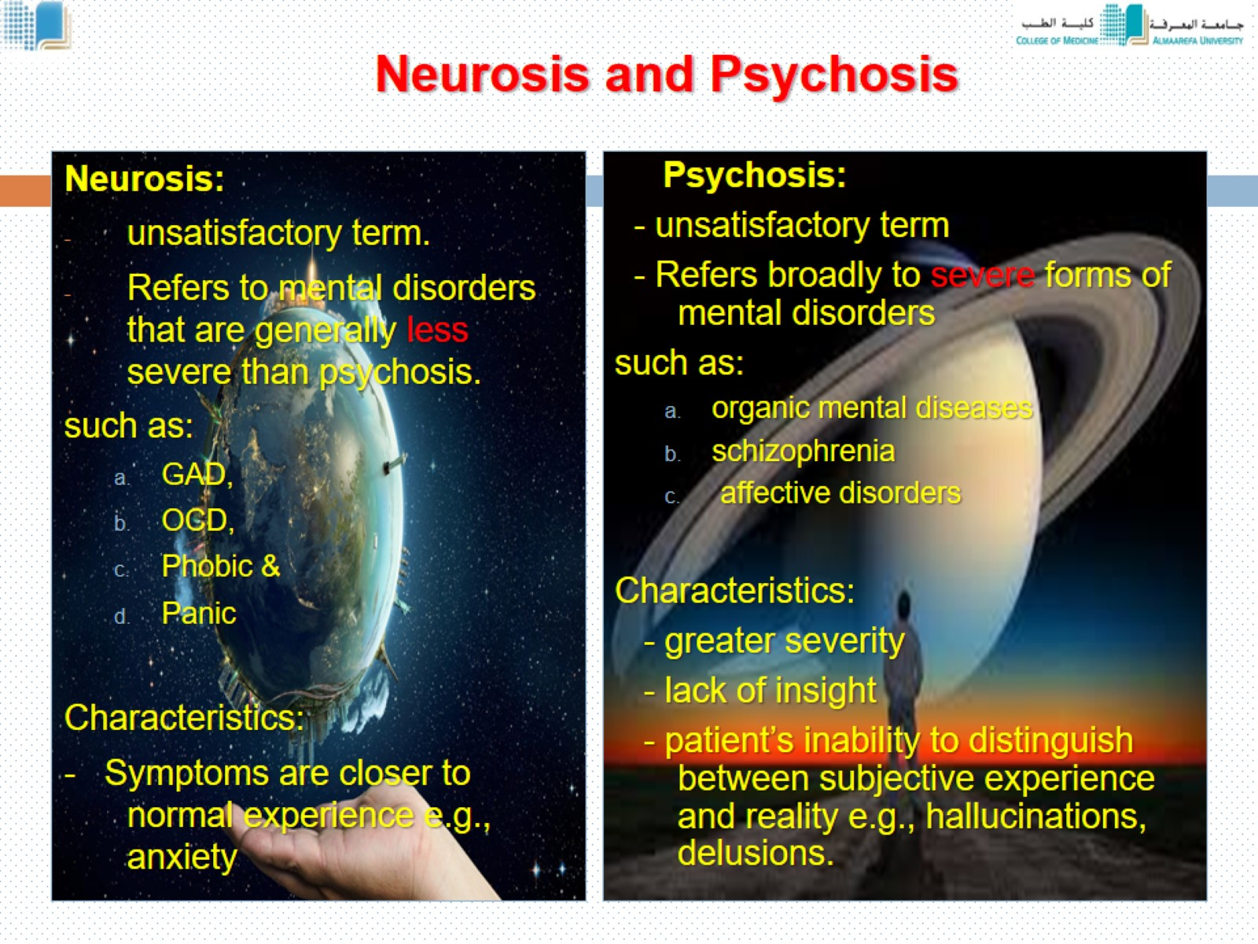
Neurosis and Psychosis

Slide 17
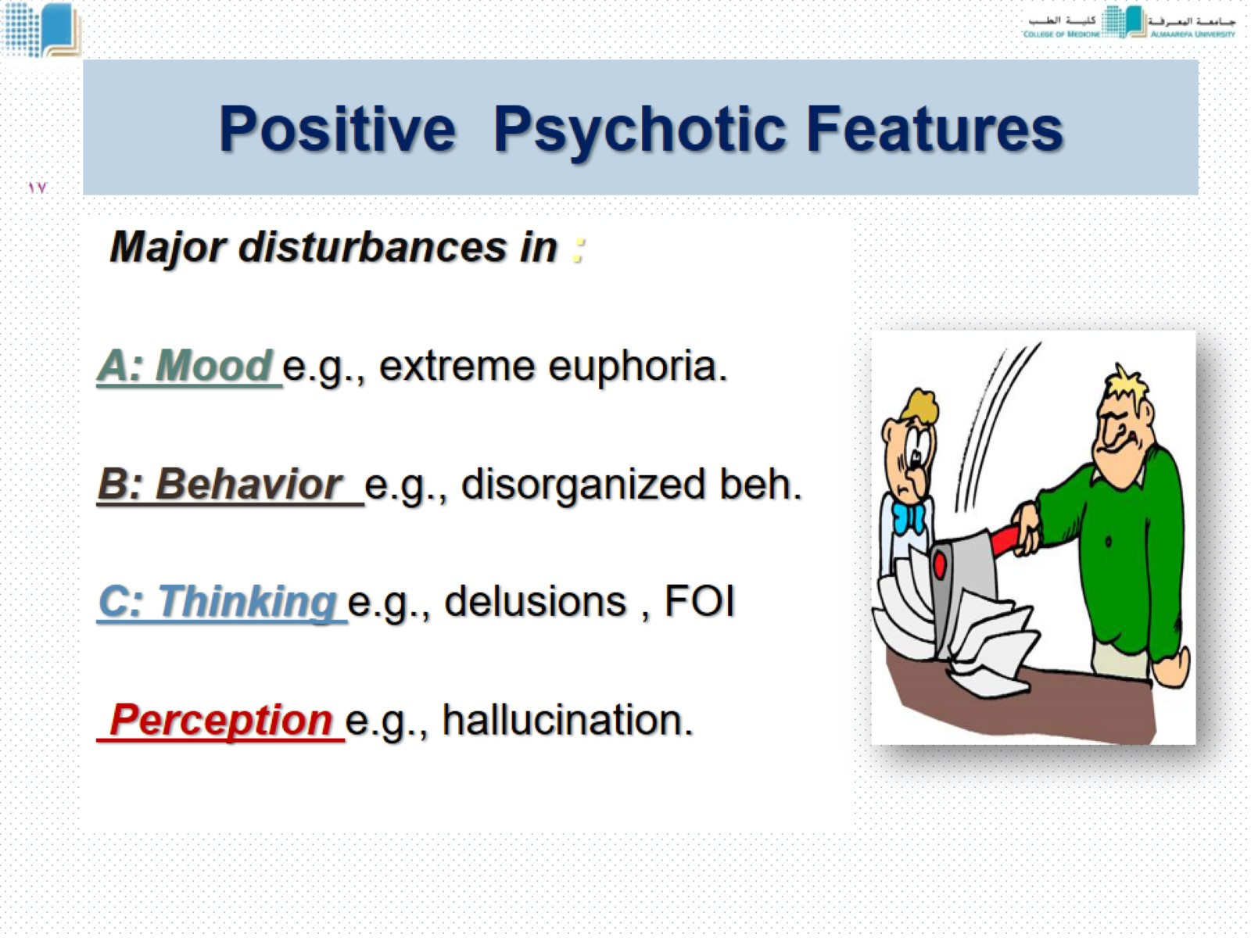
Positive Psychotic Features

Slide 18
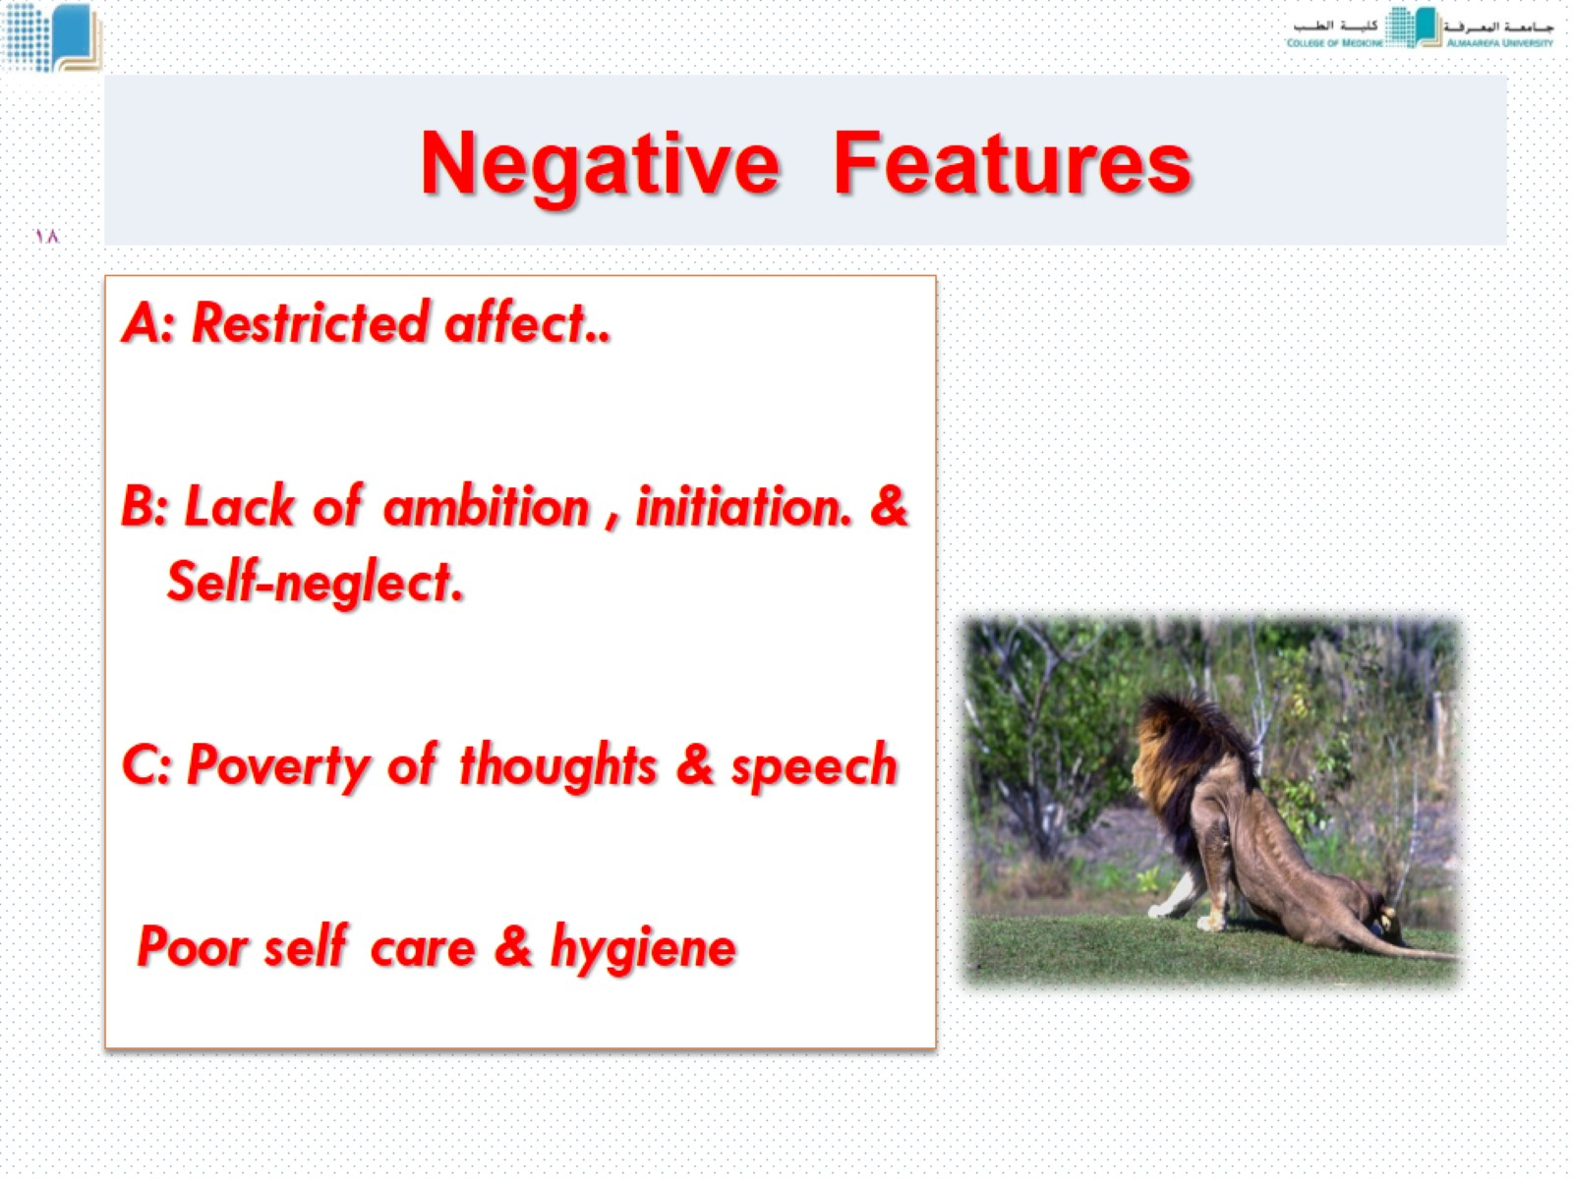
Negative Features

Slide 19
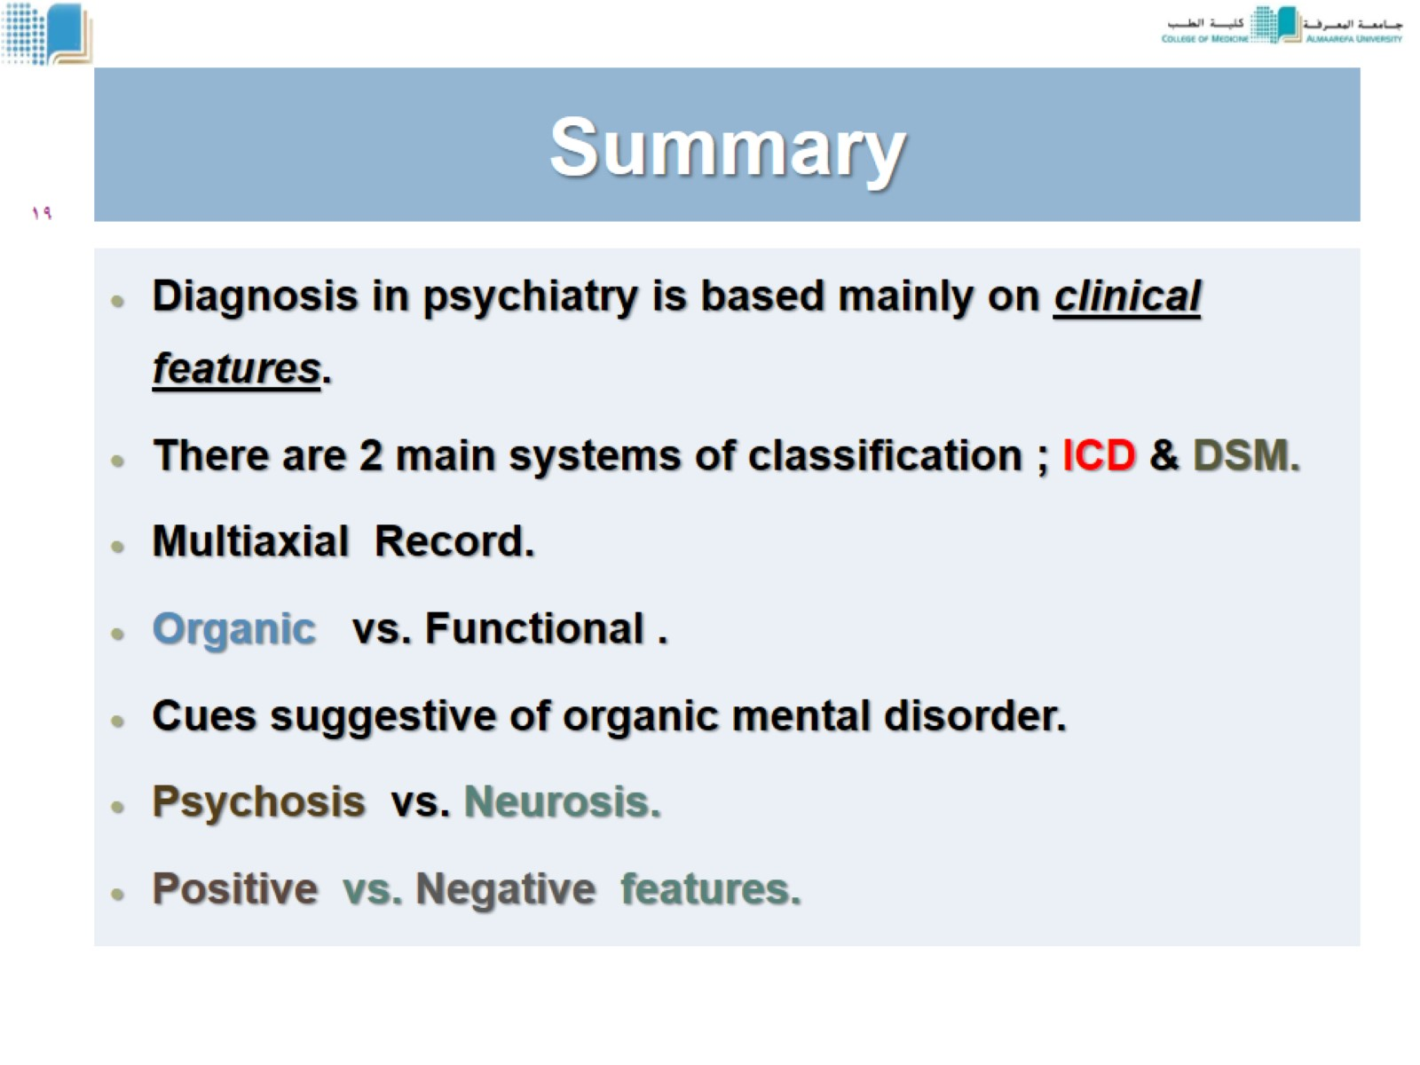
Summary

Slide 20
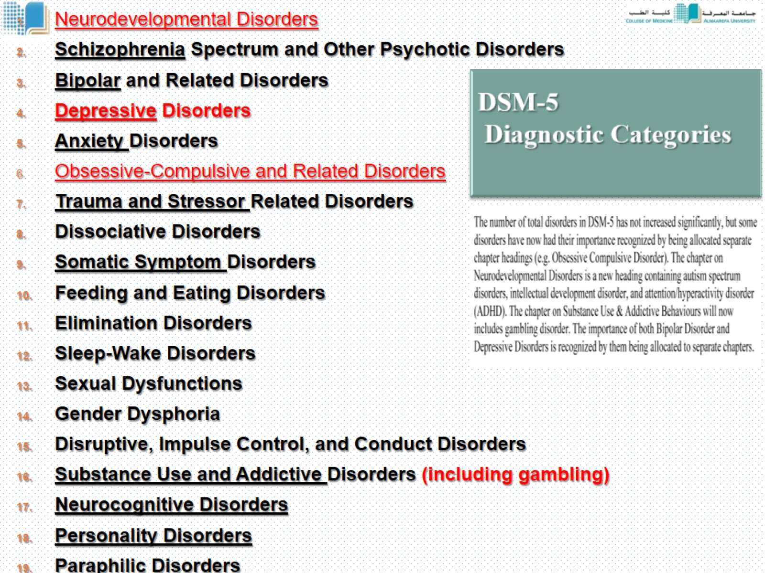
DSM-5 Diagnostic Categories

Slide 21
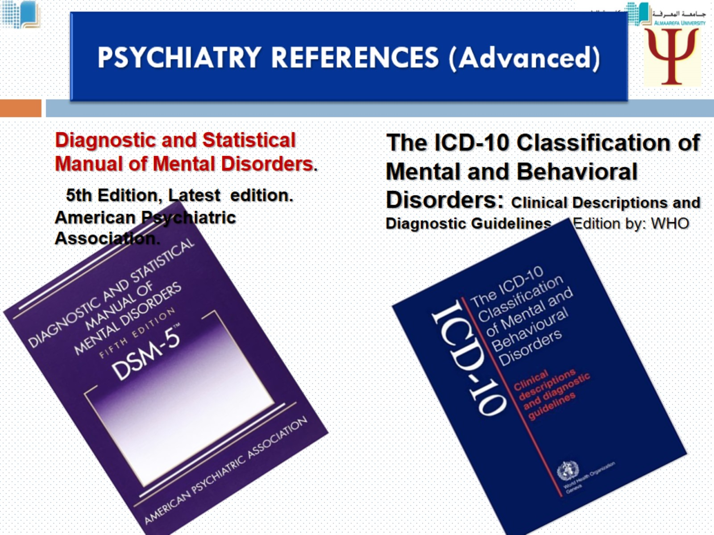
PSYCHIATRY REFERENCES (Advanced)

Slide 22
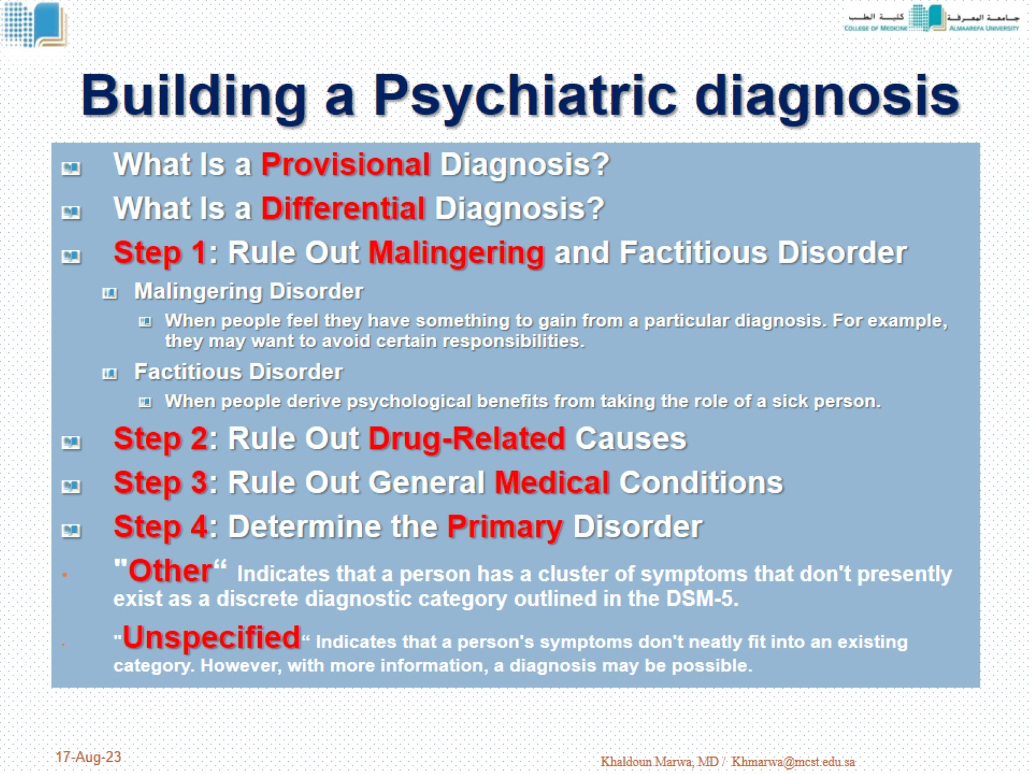
Building a Psychiatric diagnosis

Slide 23
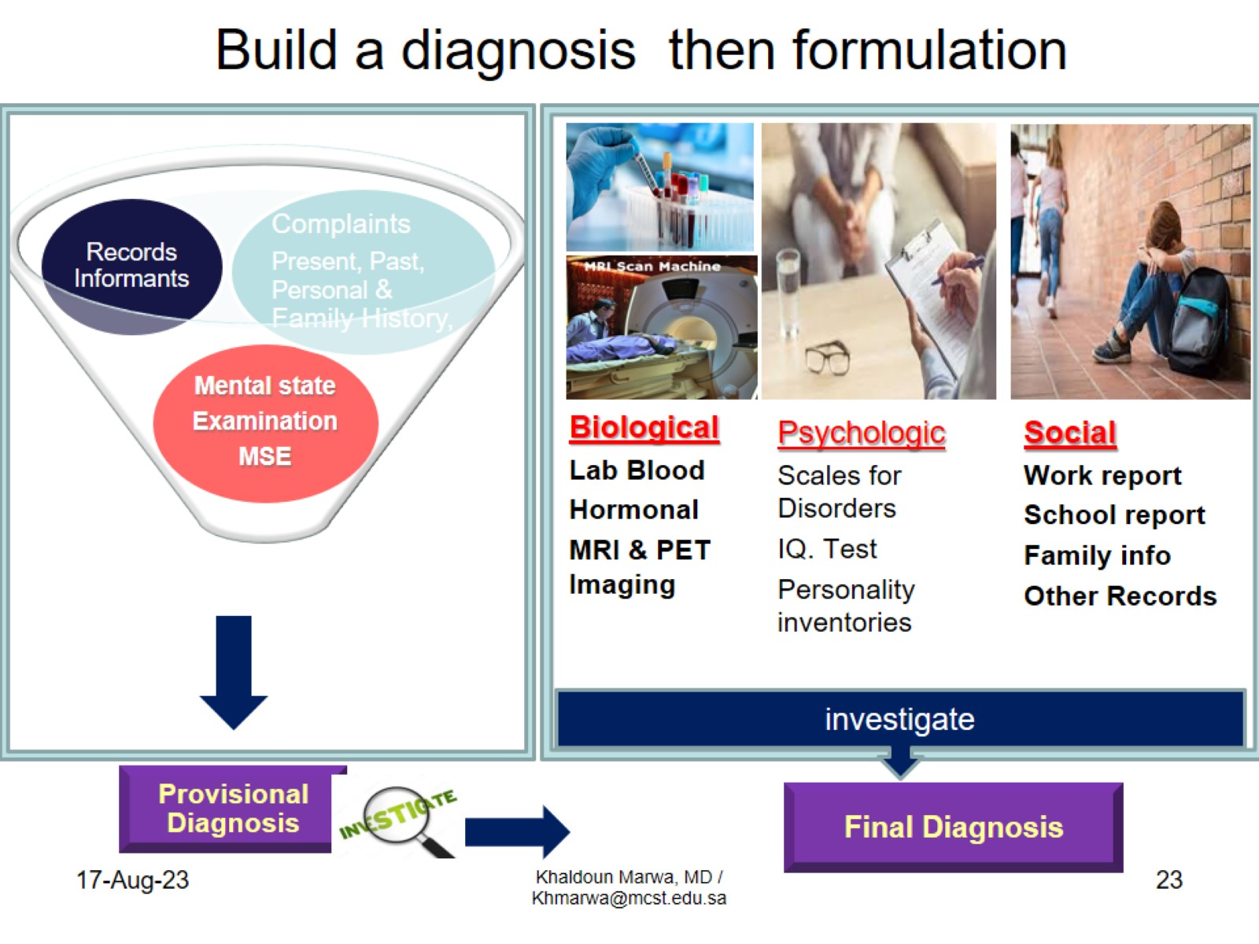
Build a diagnosis then formulation

Slide 24
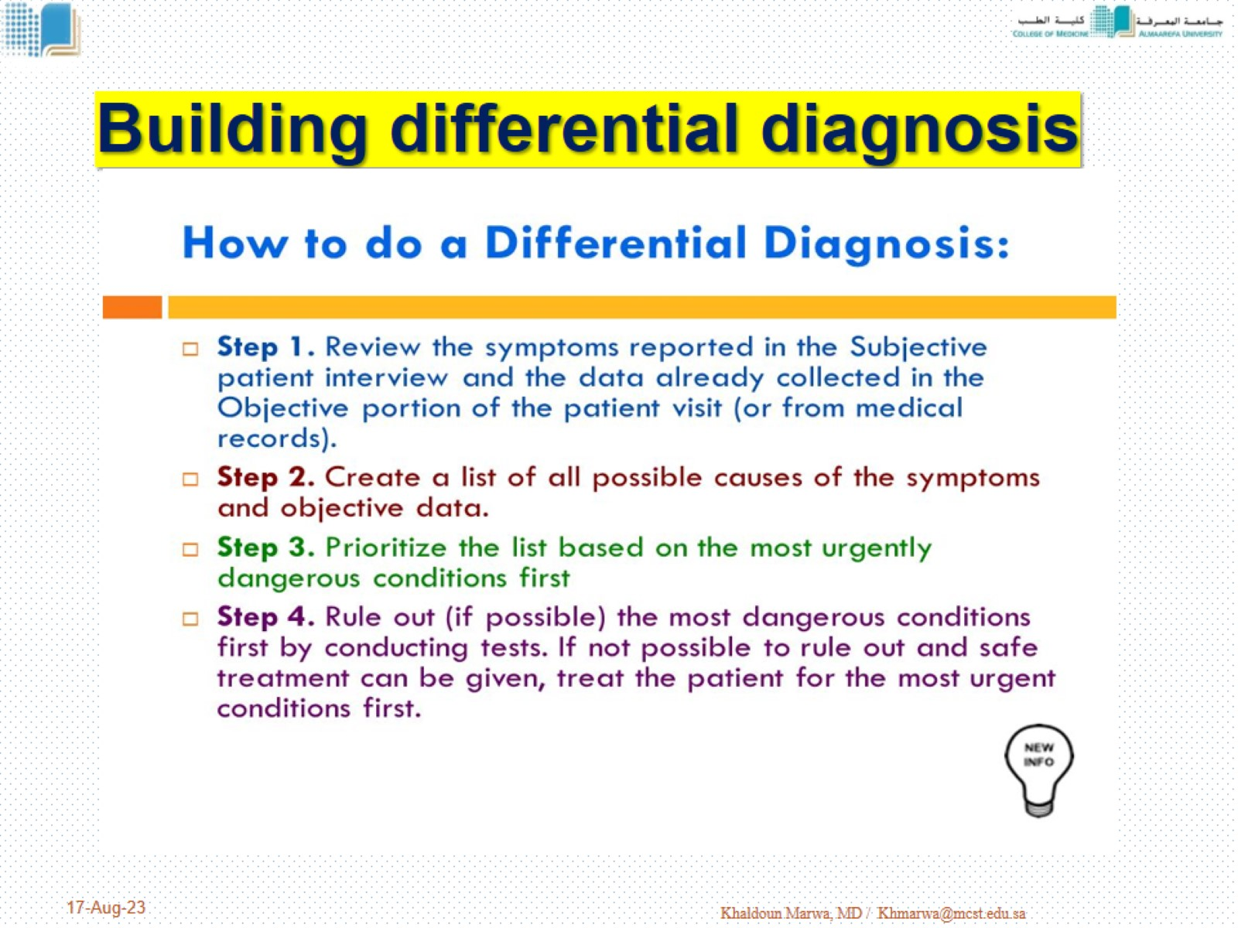
Building differential diagnosis

Slide 25
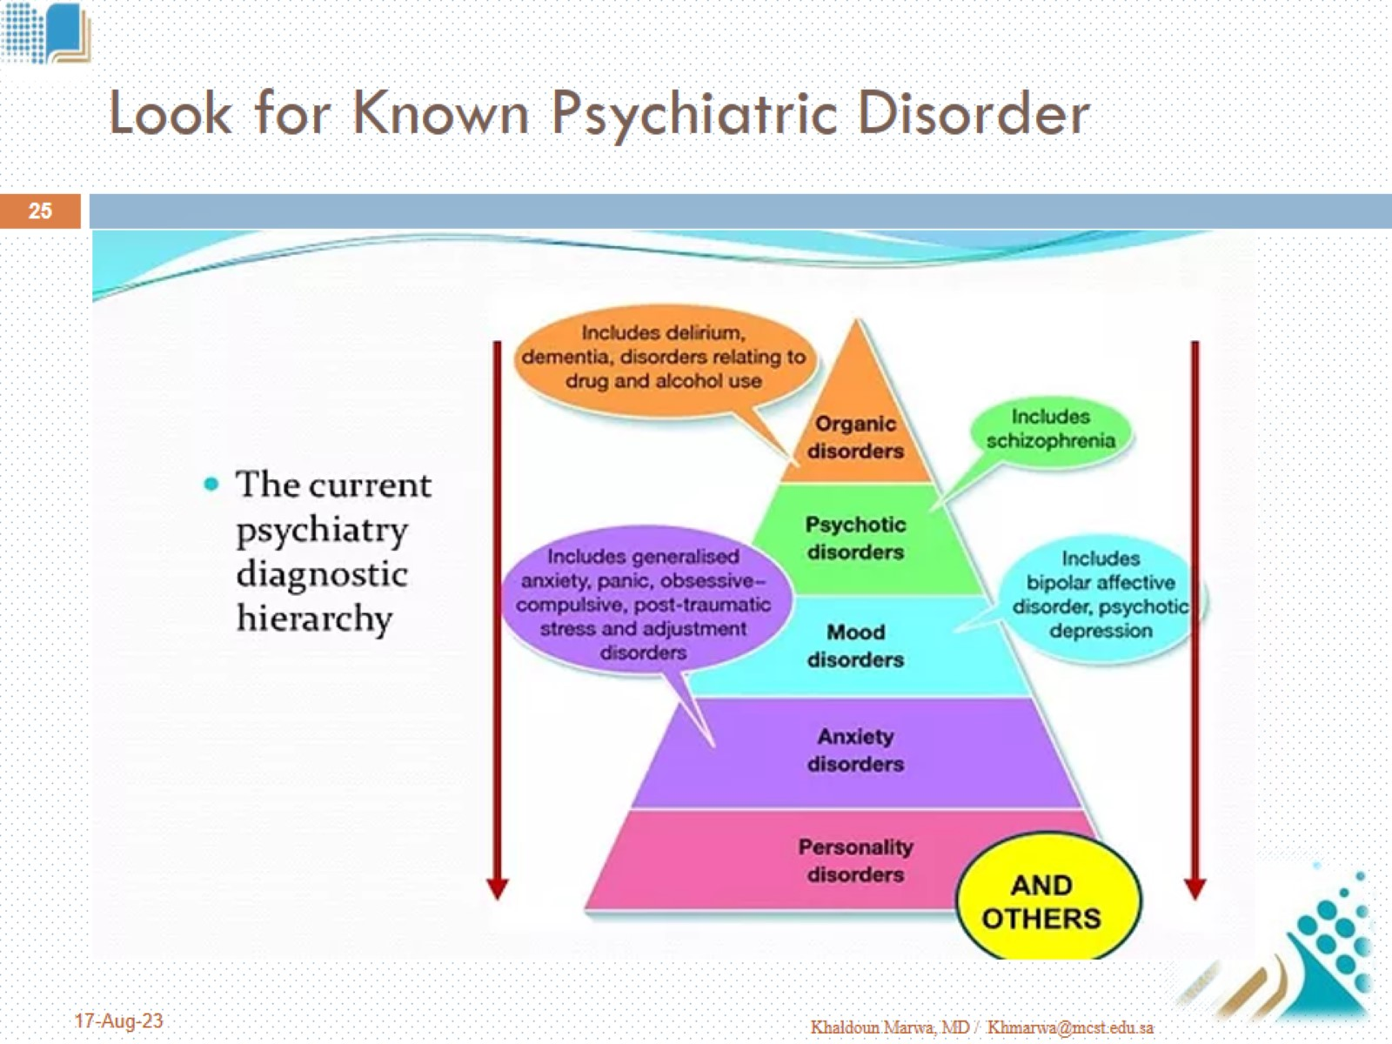
Look for Known Psychiatric Disorder

Slide 26
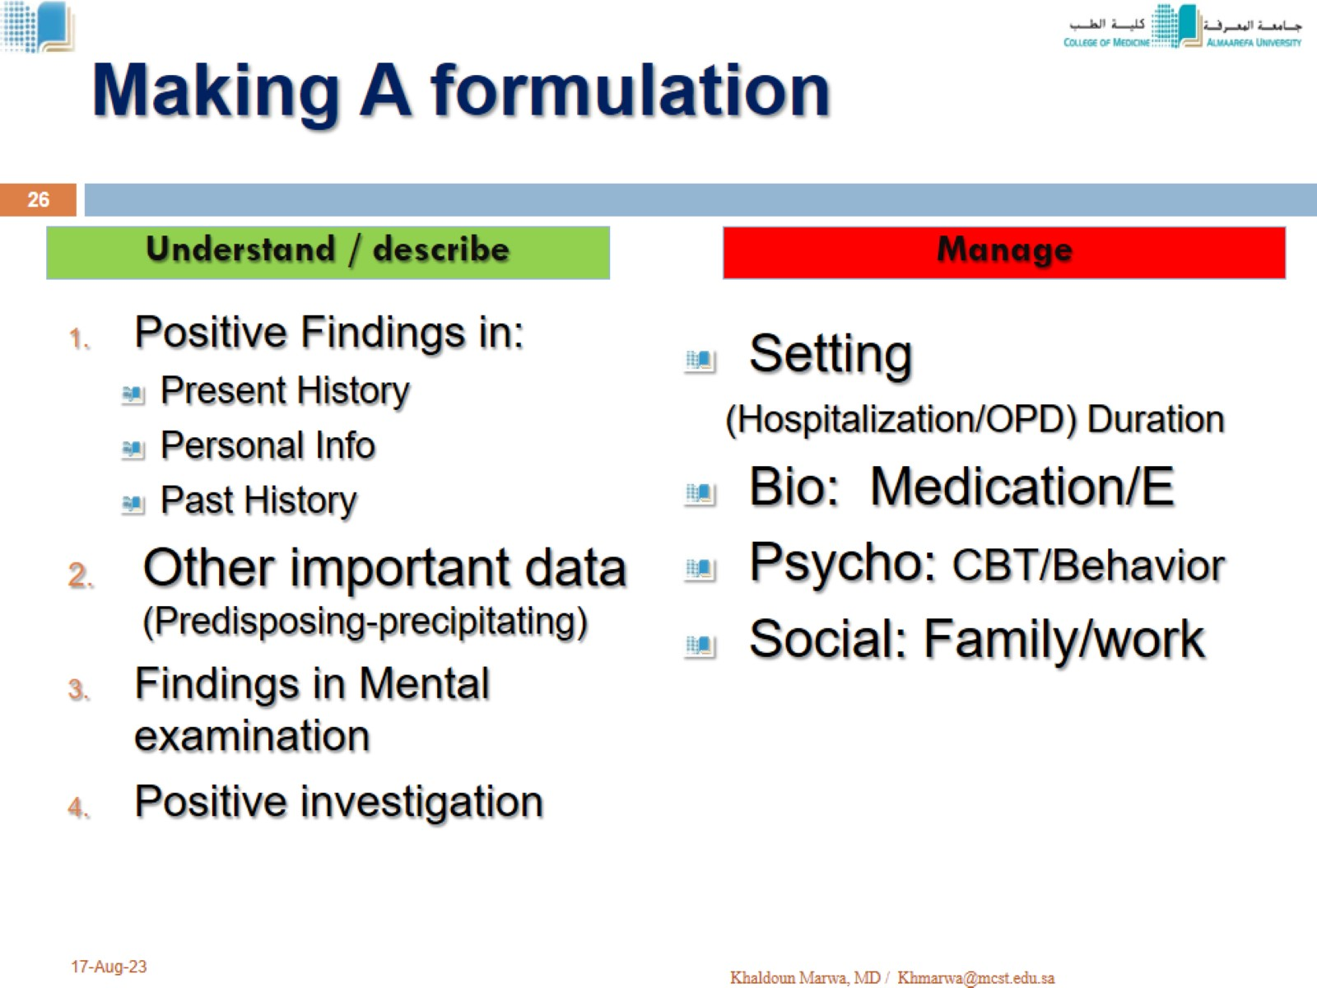
Making A formulation

Slide 27

Resilience

