Slide 1


Slide 2
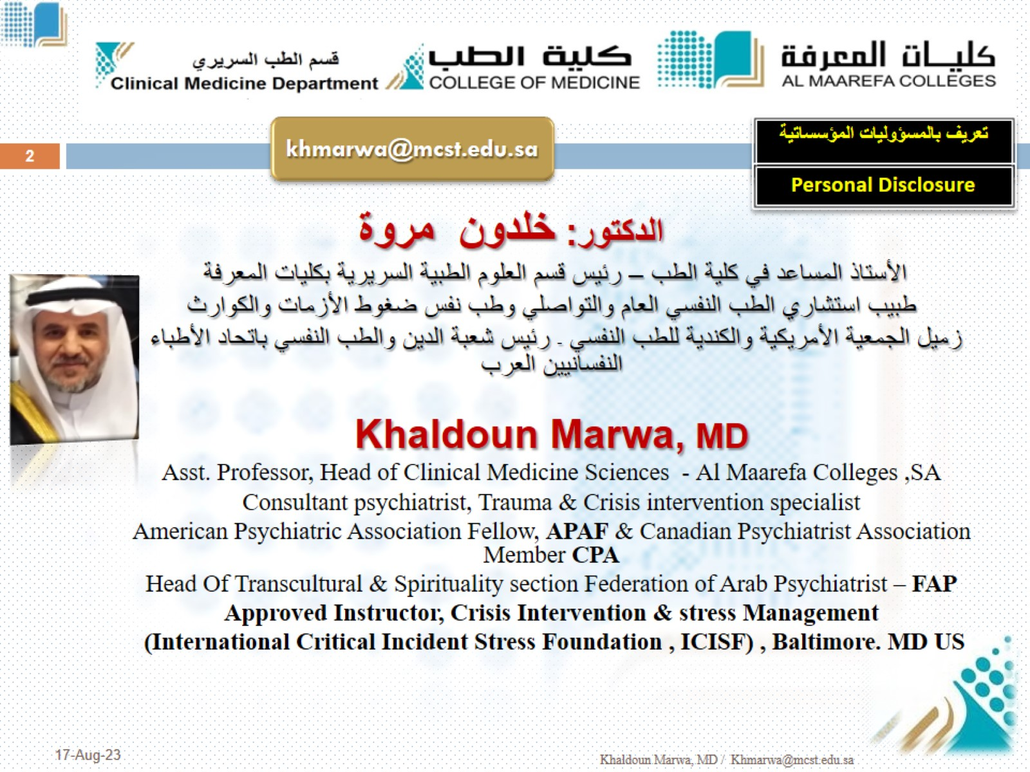

Slide 3

Psychiatric Interview, History, and Mental Status Examination

Slide 4
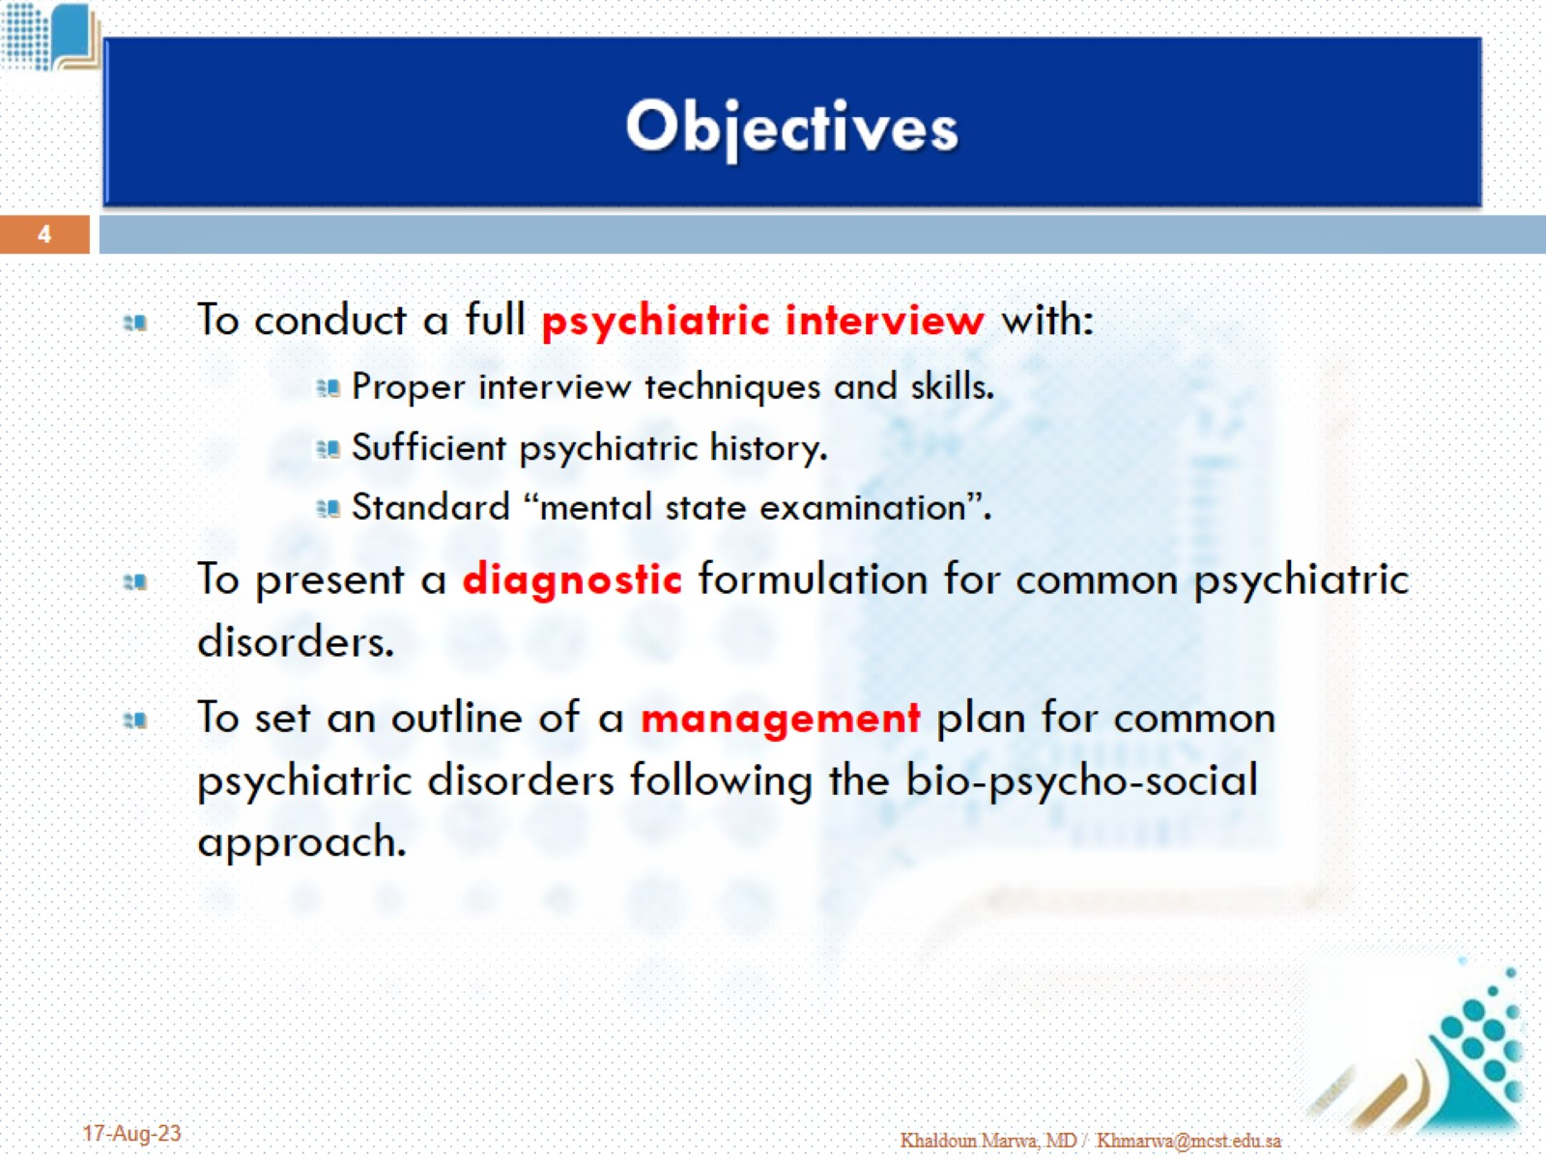
Objectives

Slide 5


Slide 6
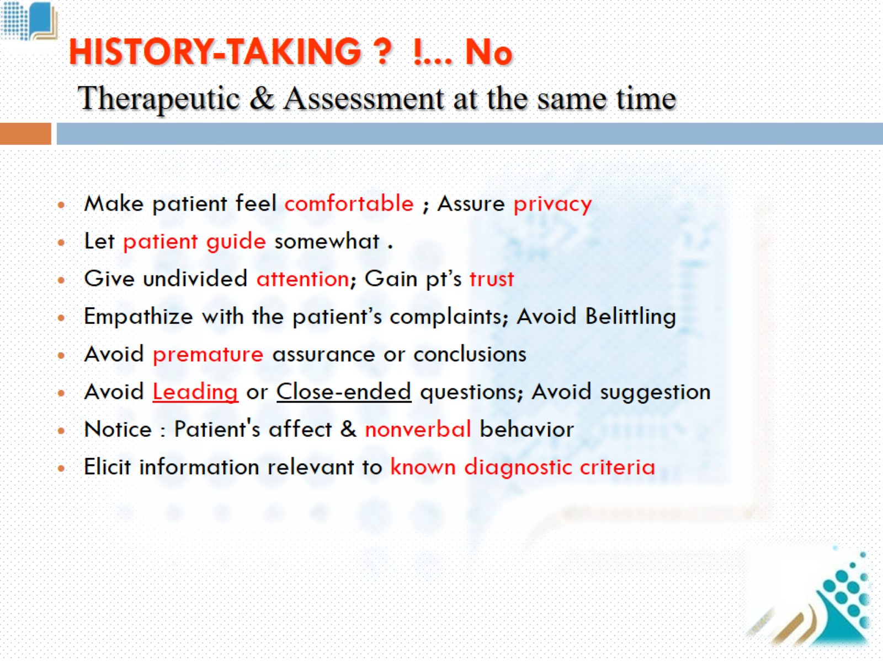
HISTORY-TAKING ? !... No

Slide 7
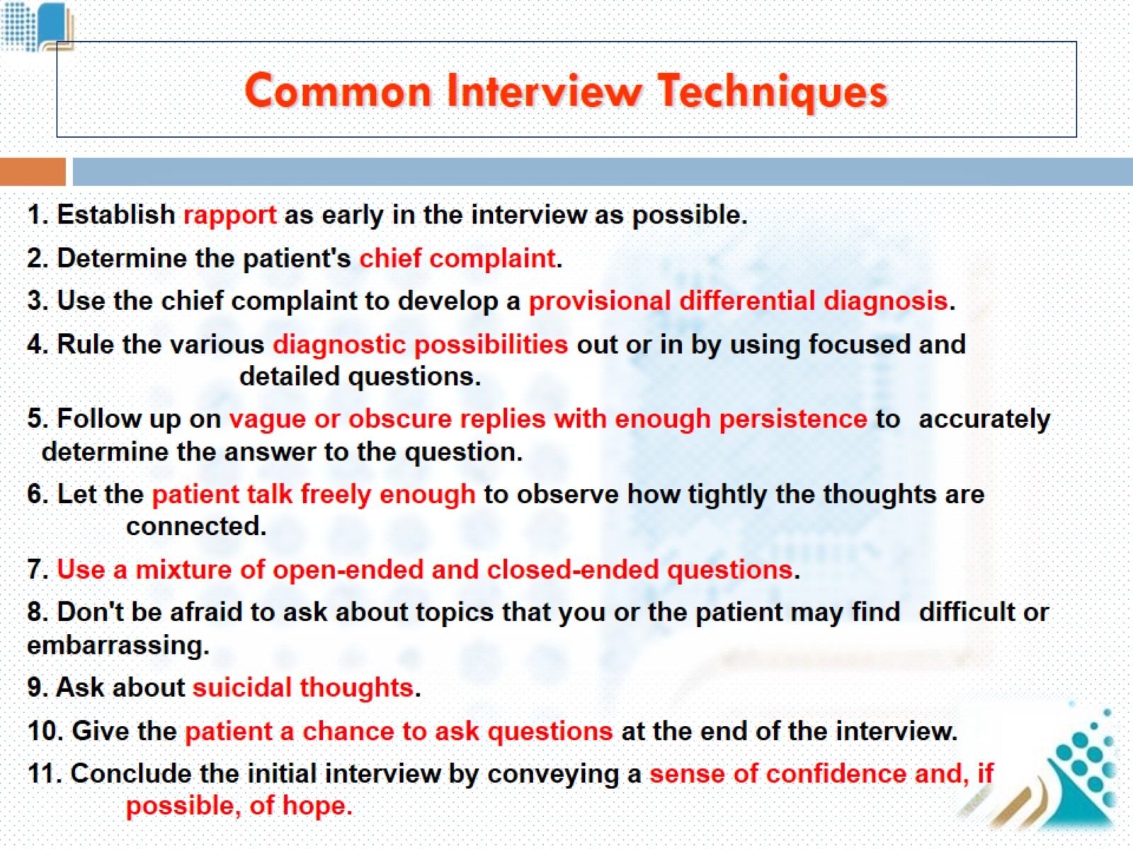
Common Interview Techniques

Slide 8
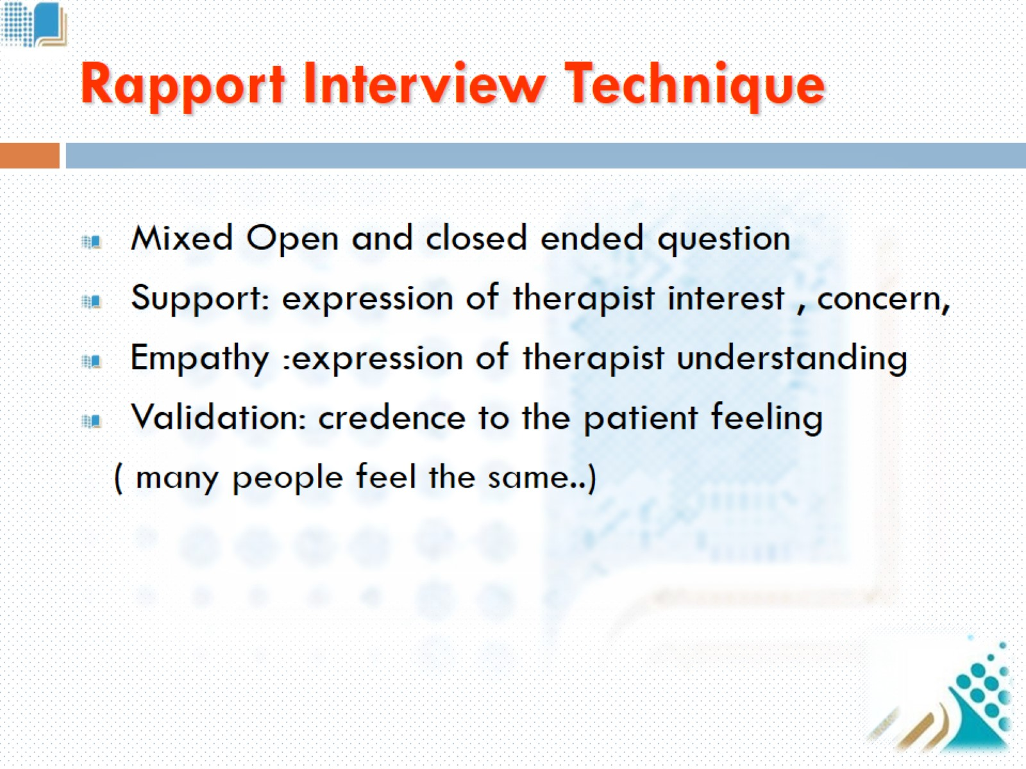
Rapport Interview Technique

Slide 9
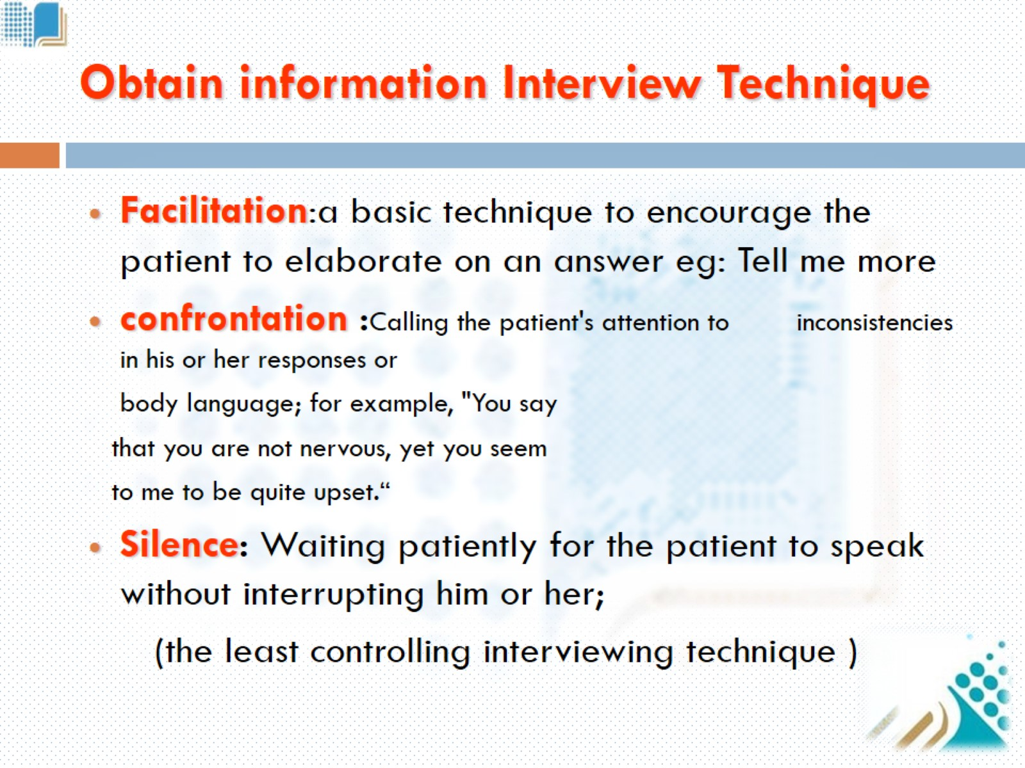
Obtain information Interview Technique

Slide 10
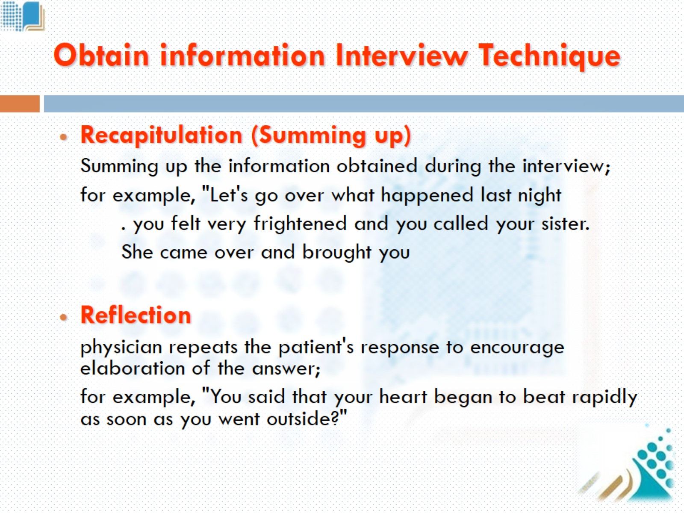
Obtain information Interview Technique

Slide 11
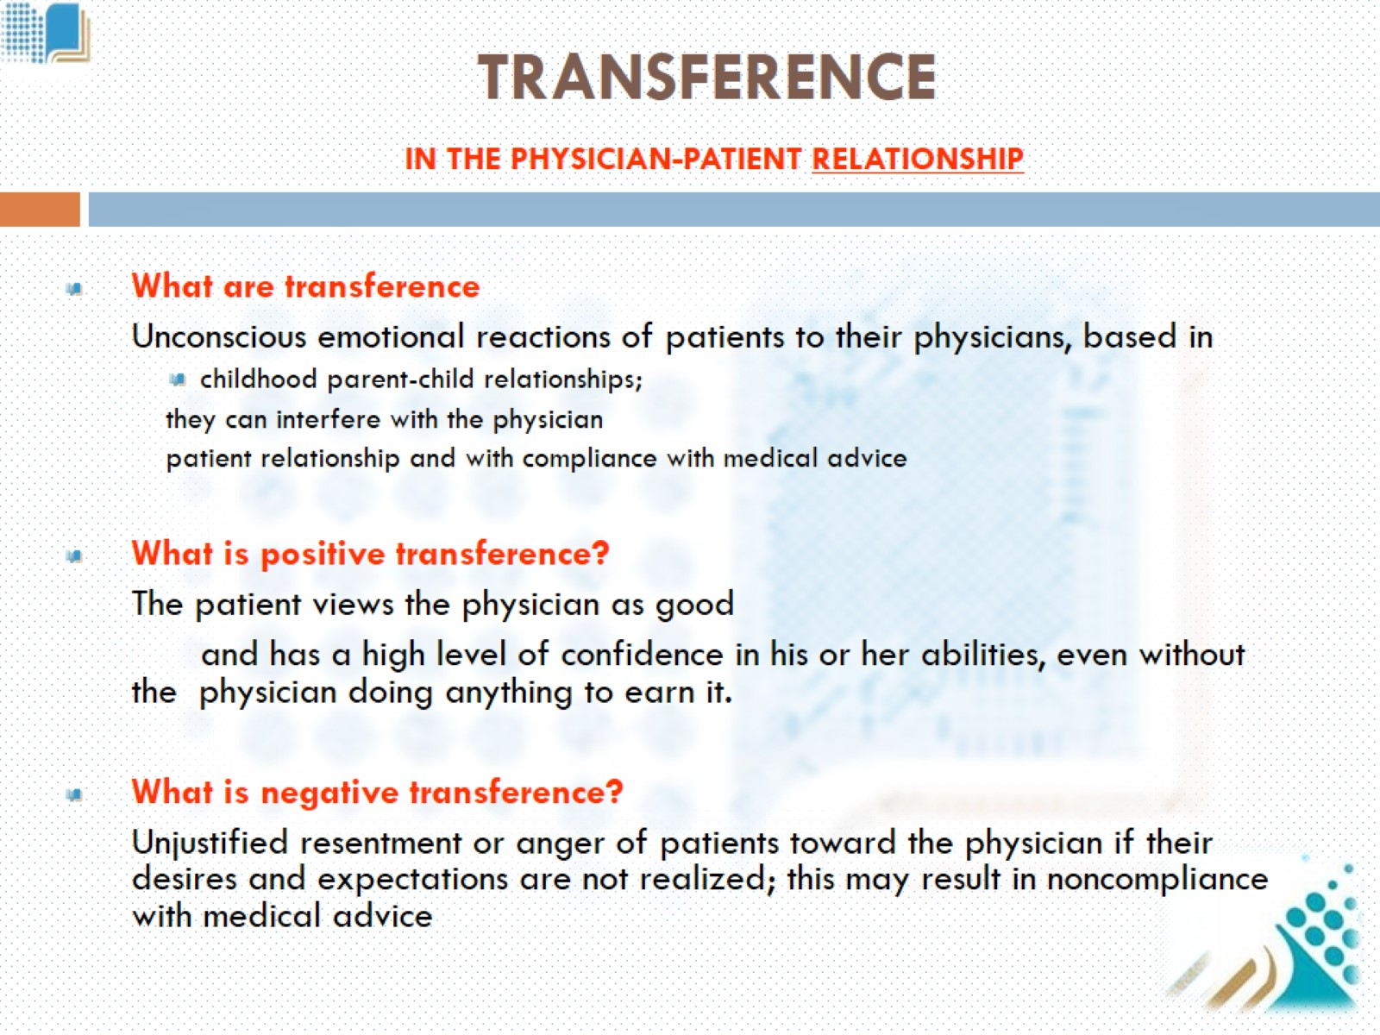
TRANSFERENCE IN THE PHYSICIAN-PATIENT RELATIONSHIP

Slide 12
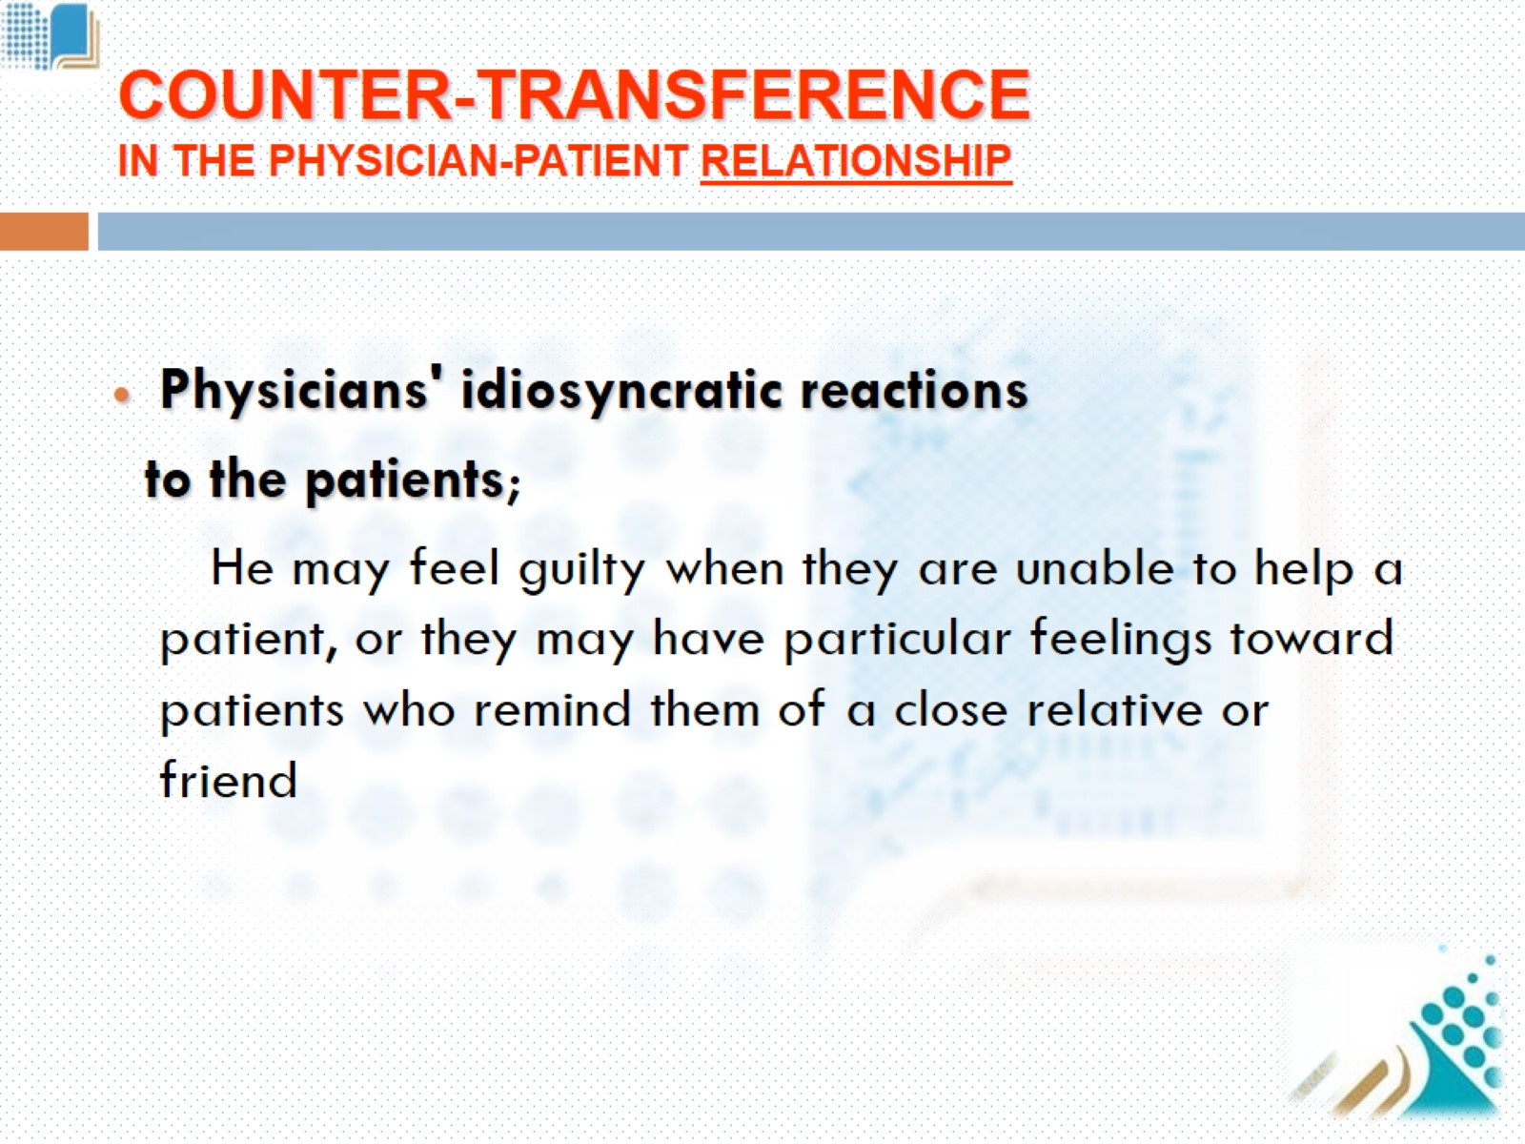
COUNTER-TRANSFERENCE IN THE PHYSICIAN-PATIENT RELATIONSHIP

Slide 13
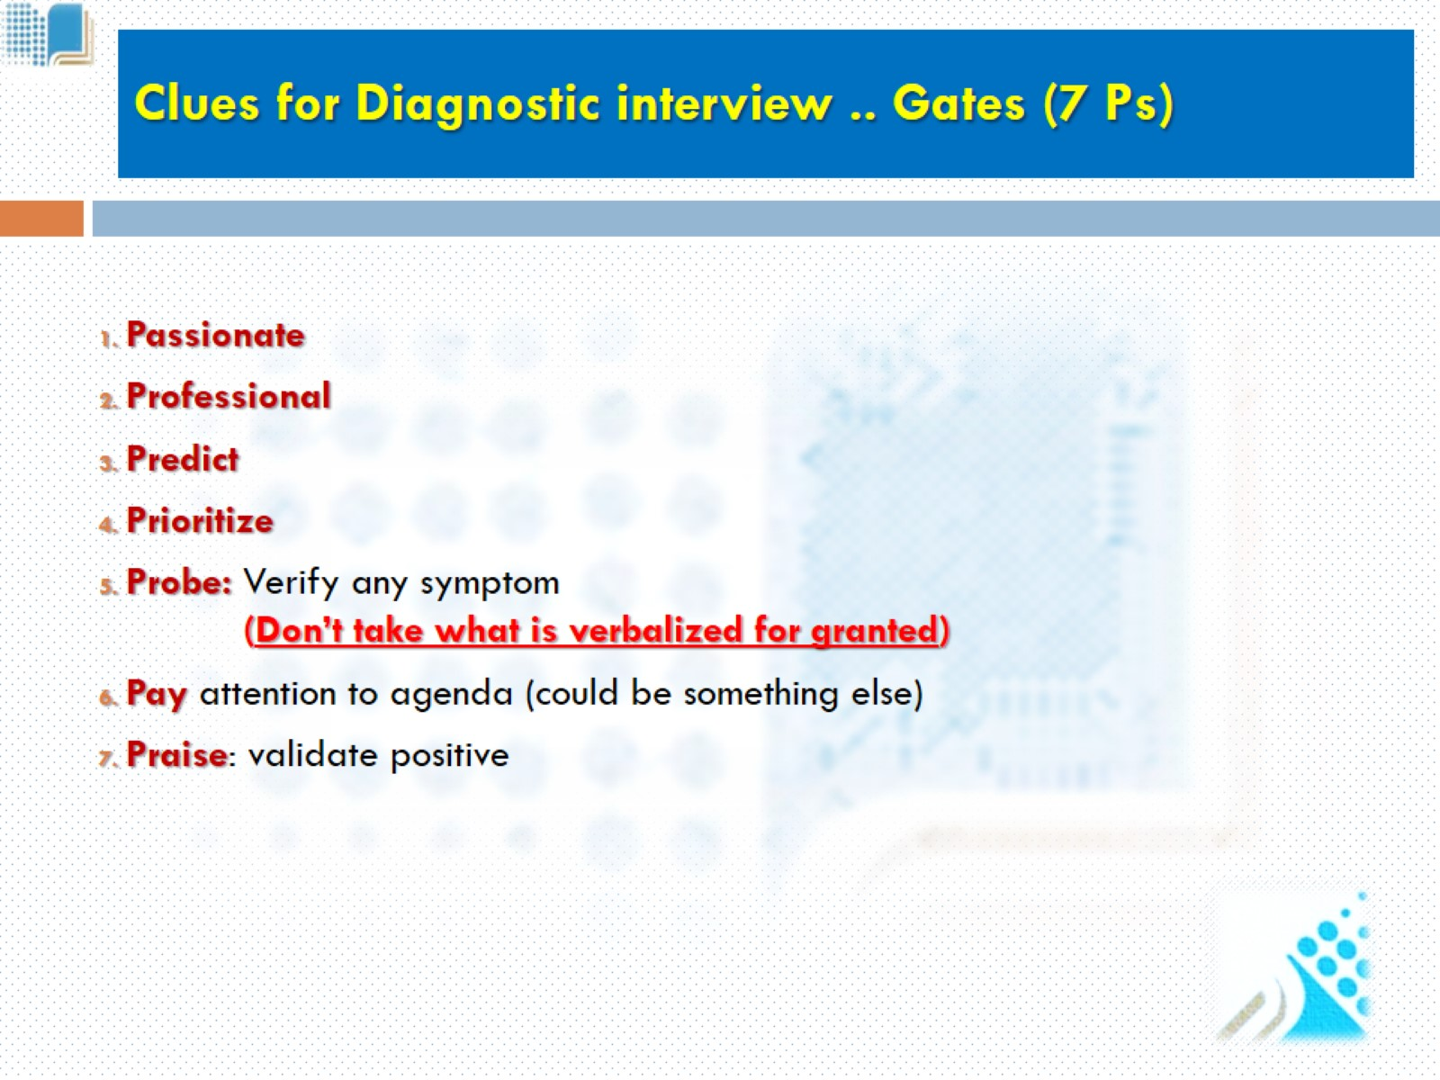
Clues for Diagnostic interview .. Gates (7 Ps)

Slide 14
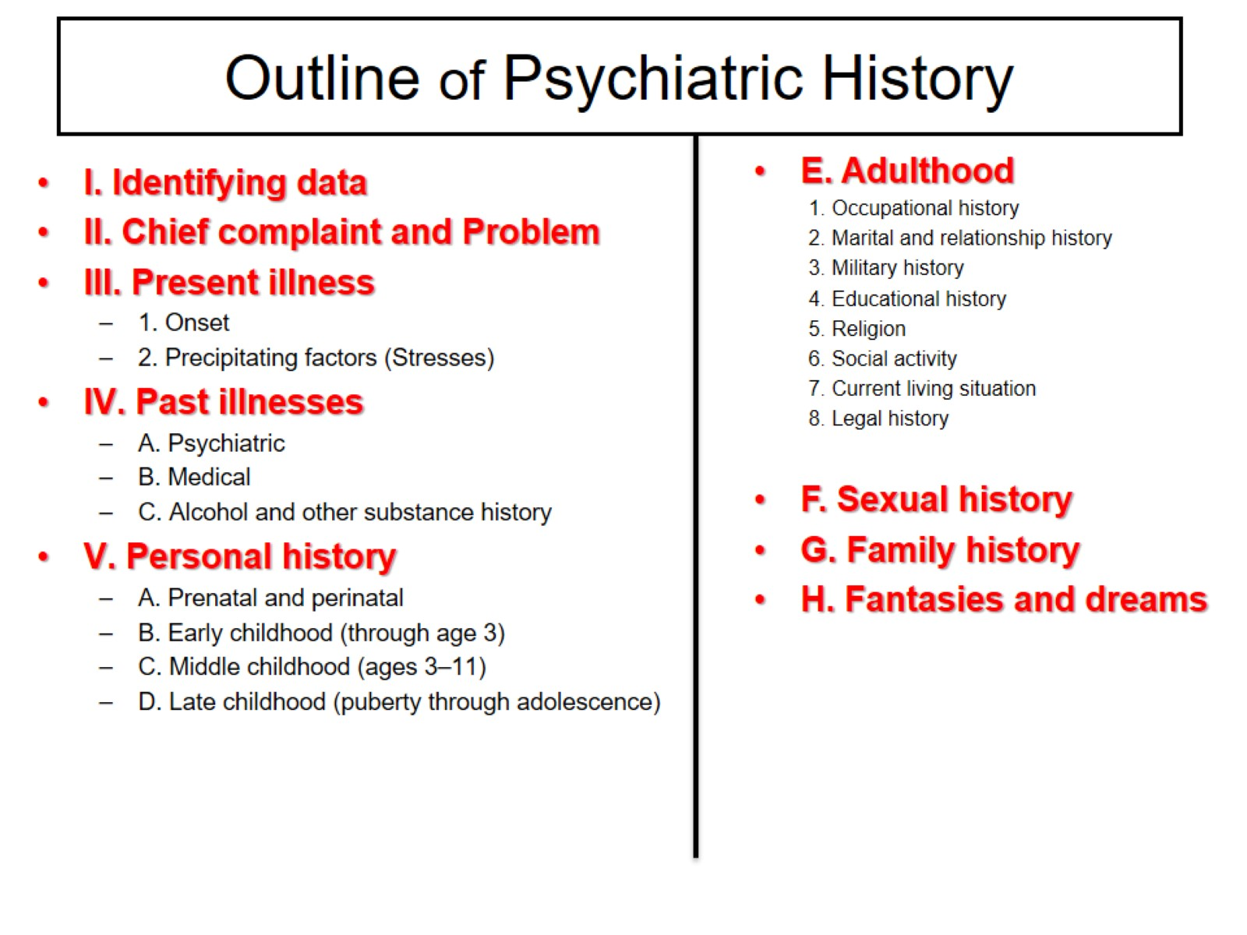
Outline of Psychiatric History

Slide 15
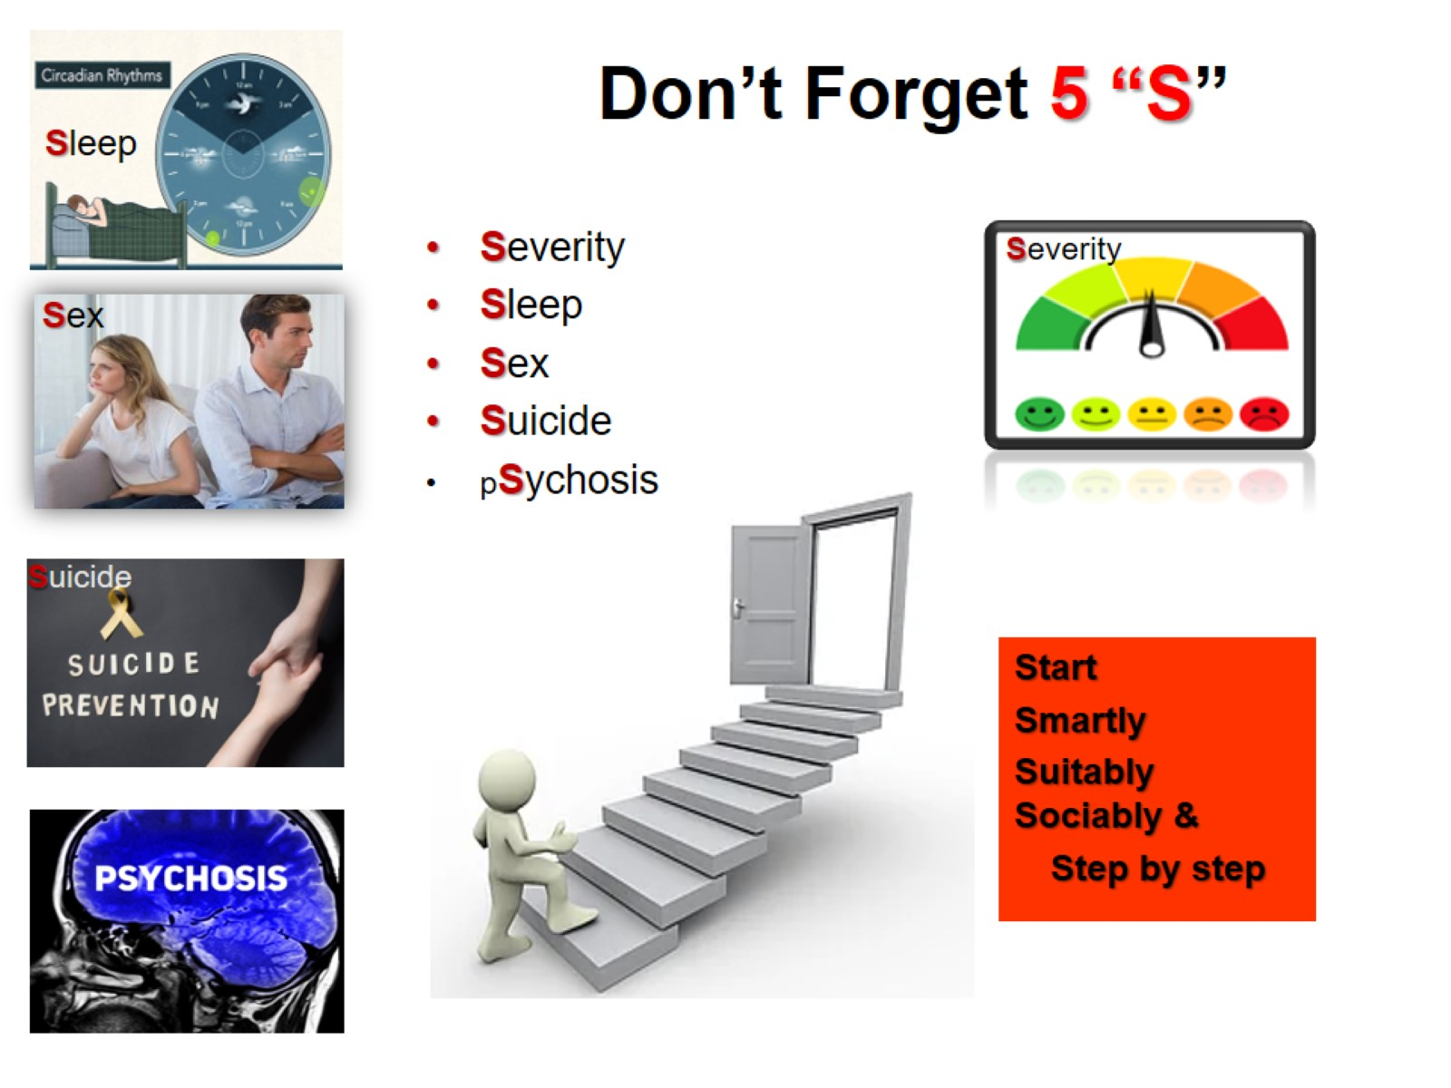
Don’t Forget 5 “S”

Slide 16
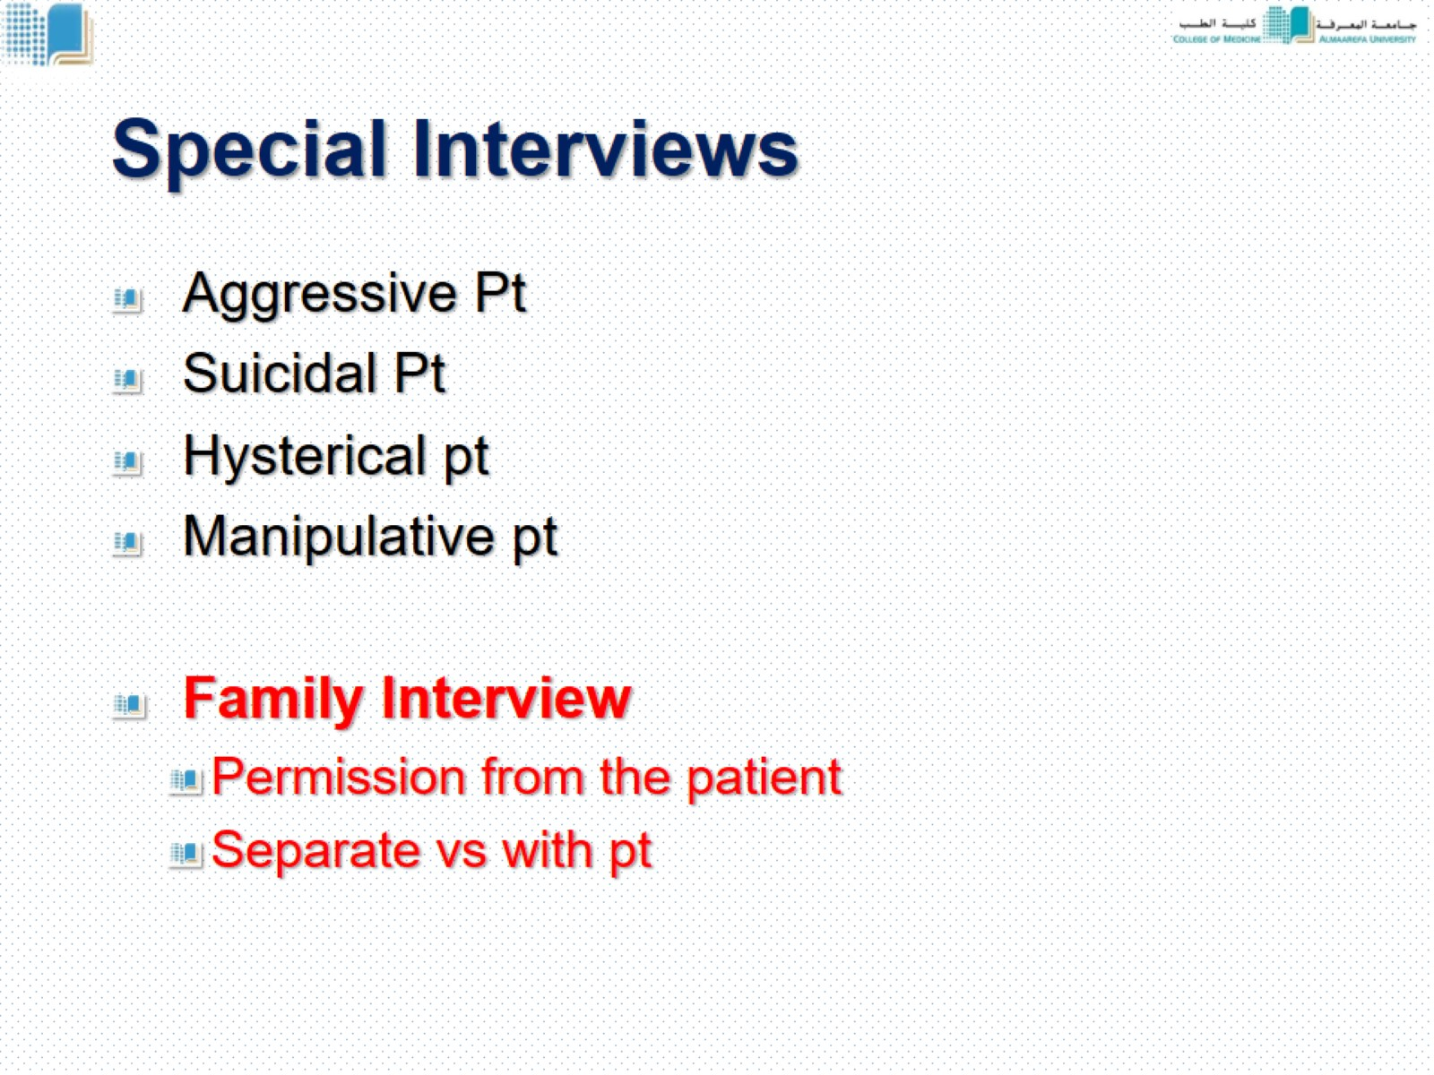
Special Interviews

Slide 17
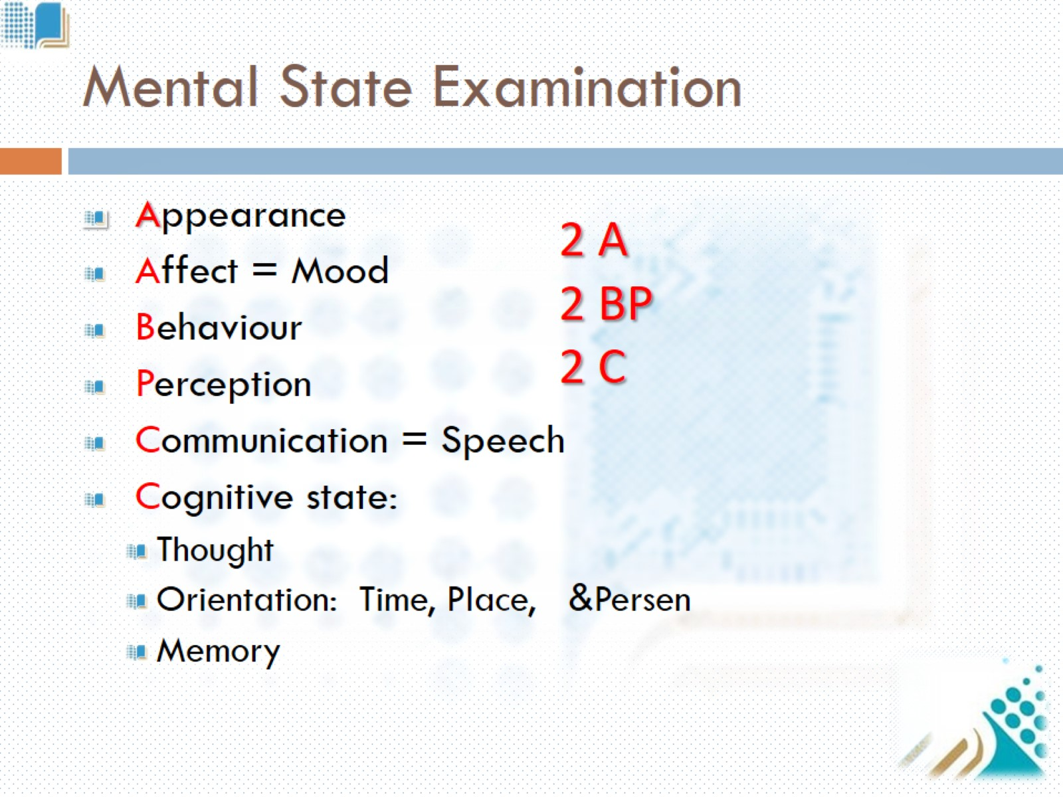
Mental State Examination

Slide 18
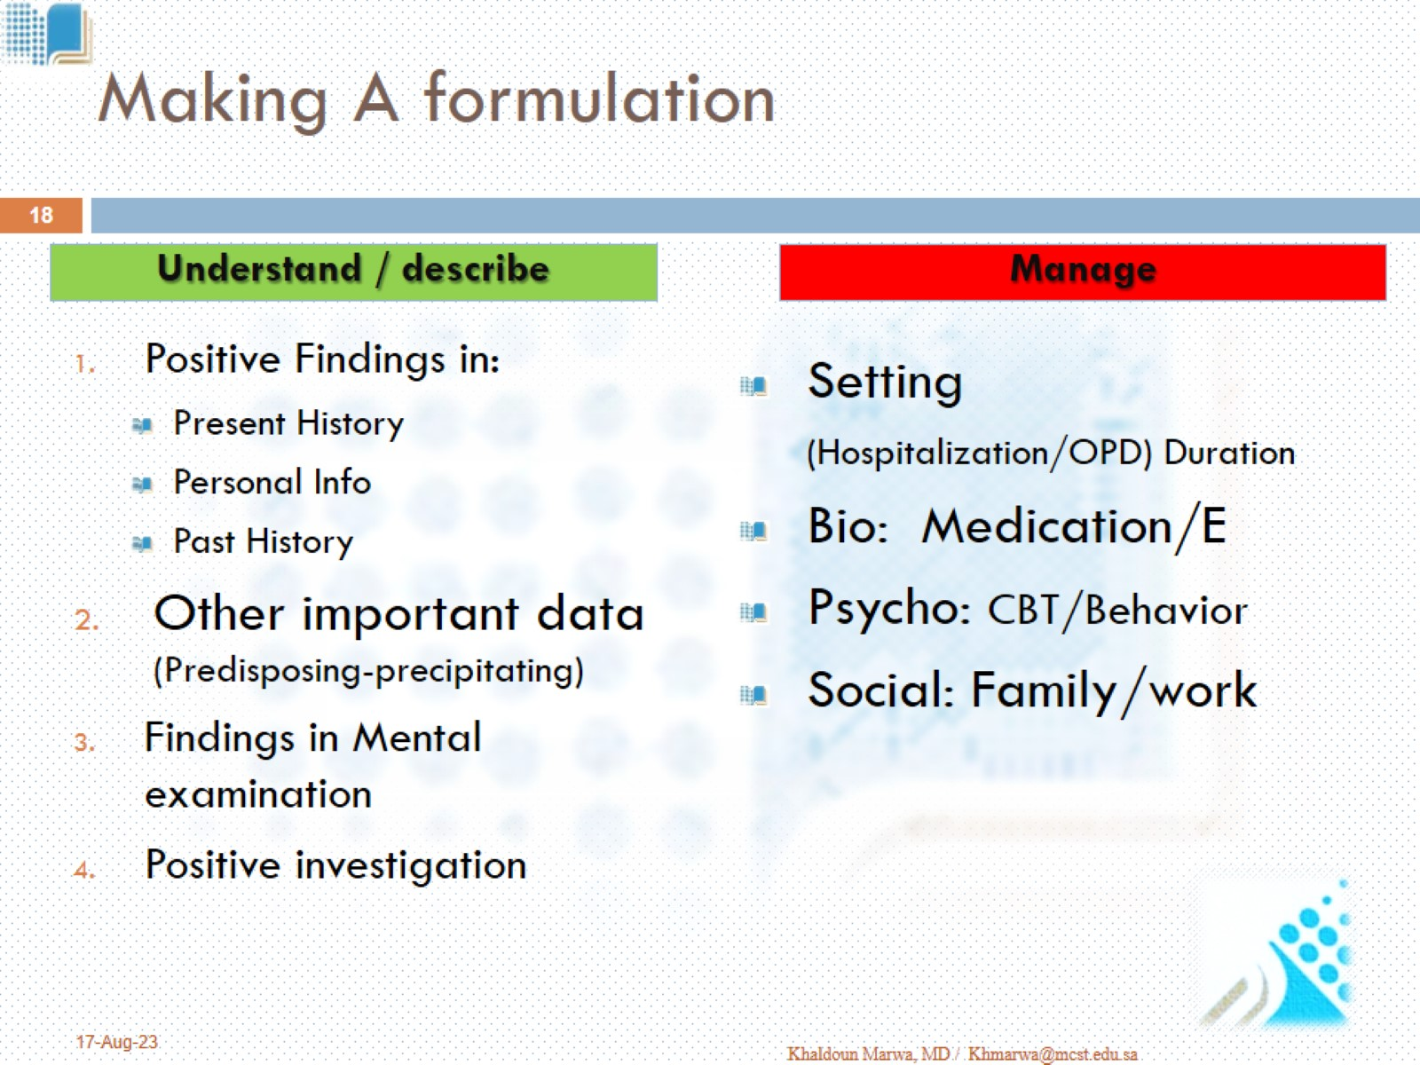
Making A formulation

Slide 19
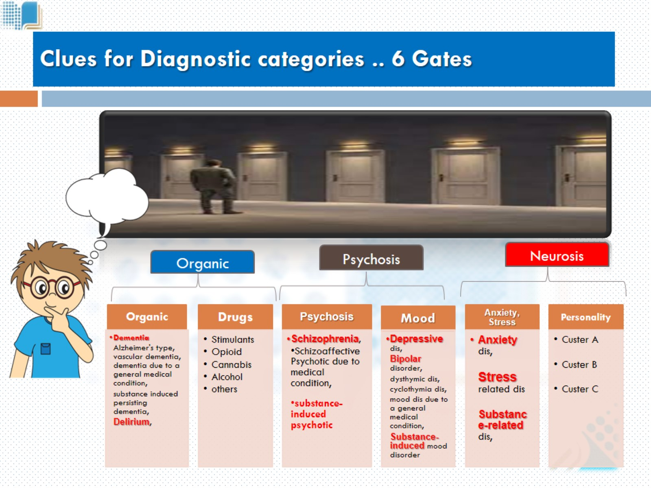
Clues for Diagnostic categories .. 6 Gates

Slide 20
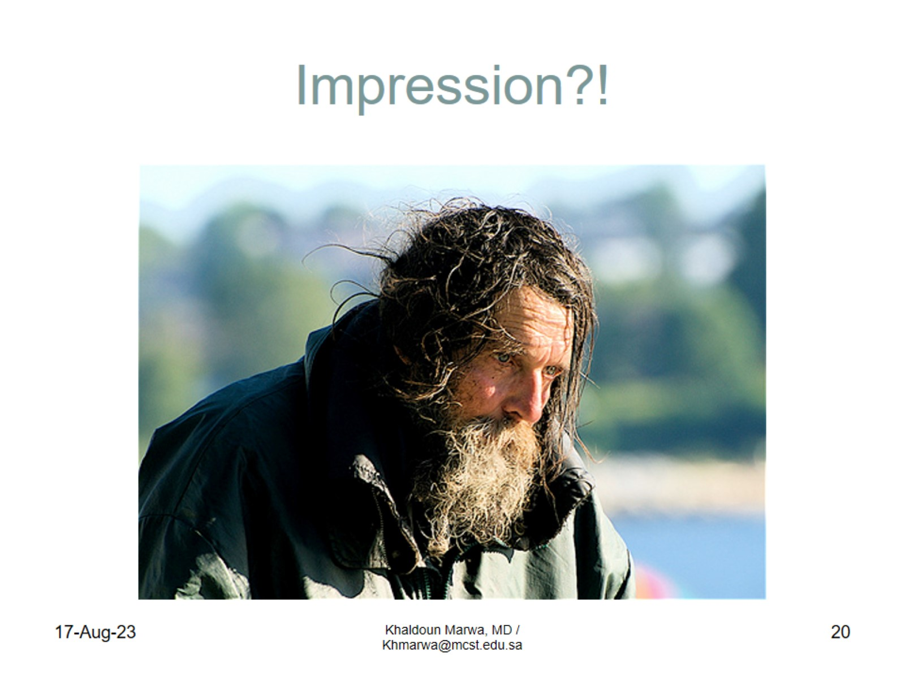
Impression?!

Slide 21
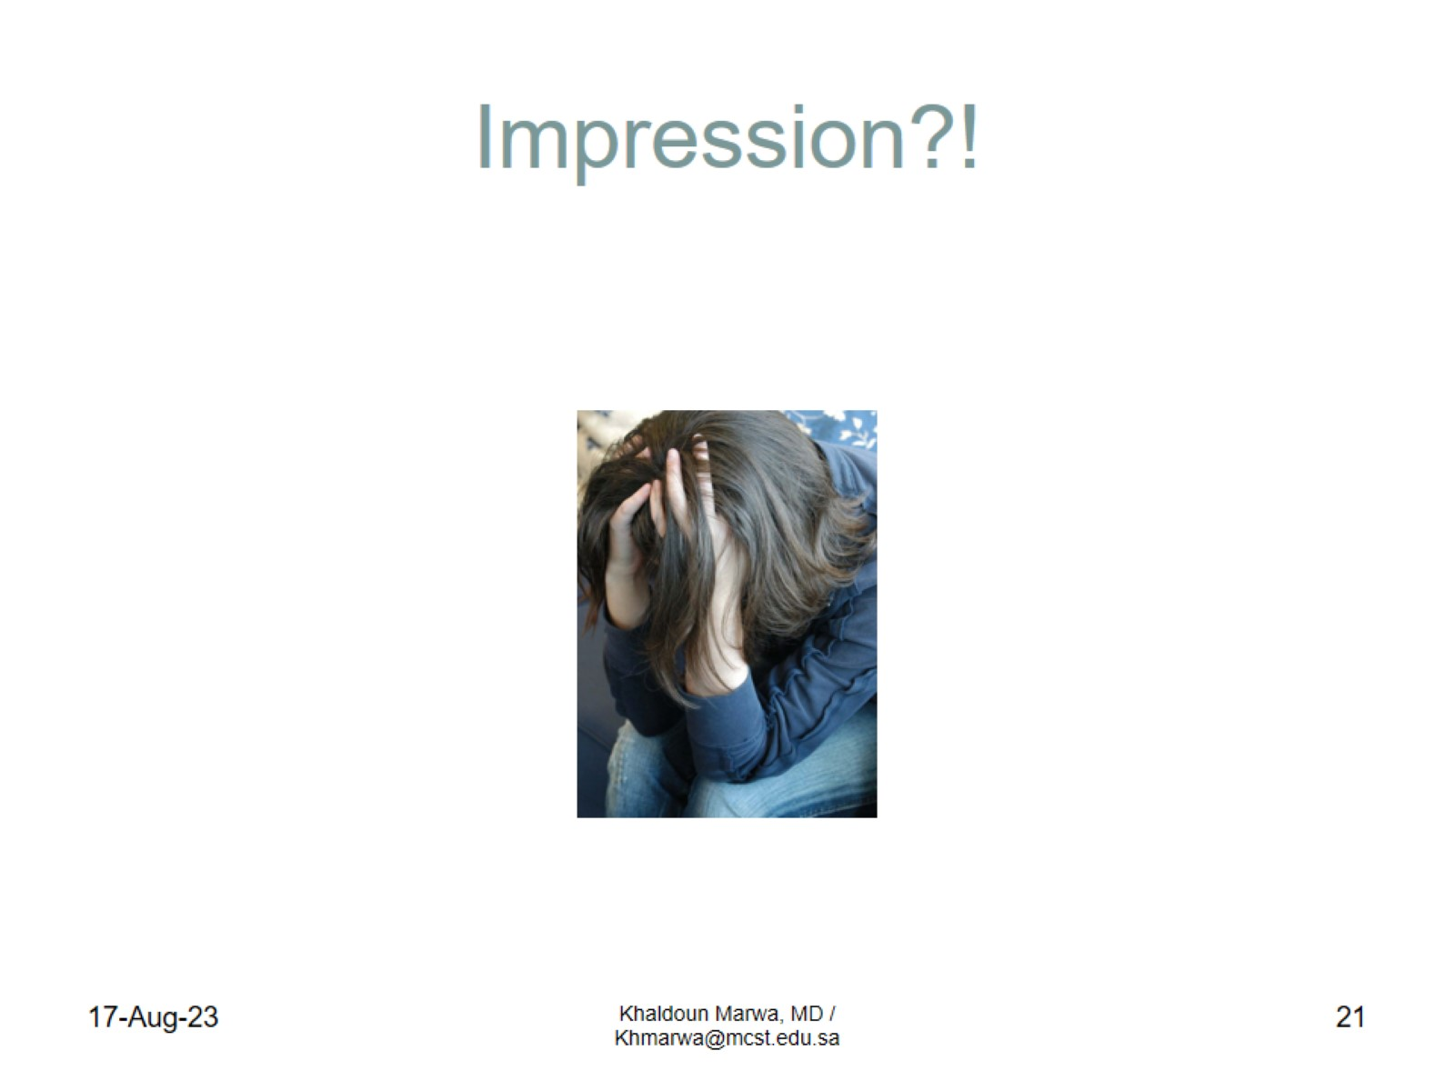
Impression?!

Slide 22
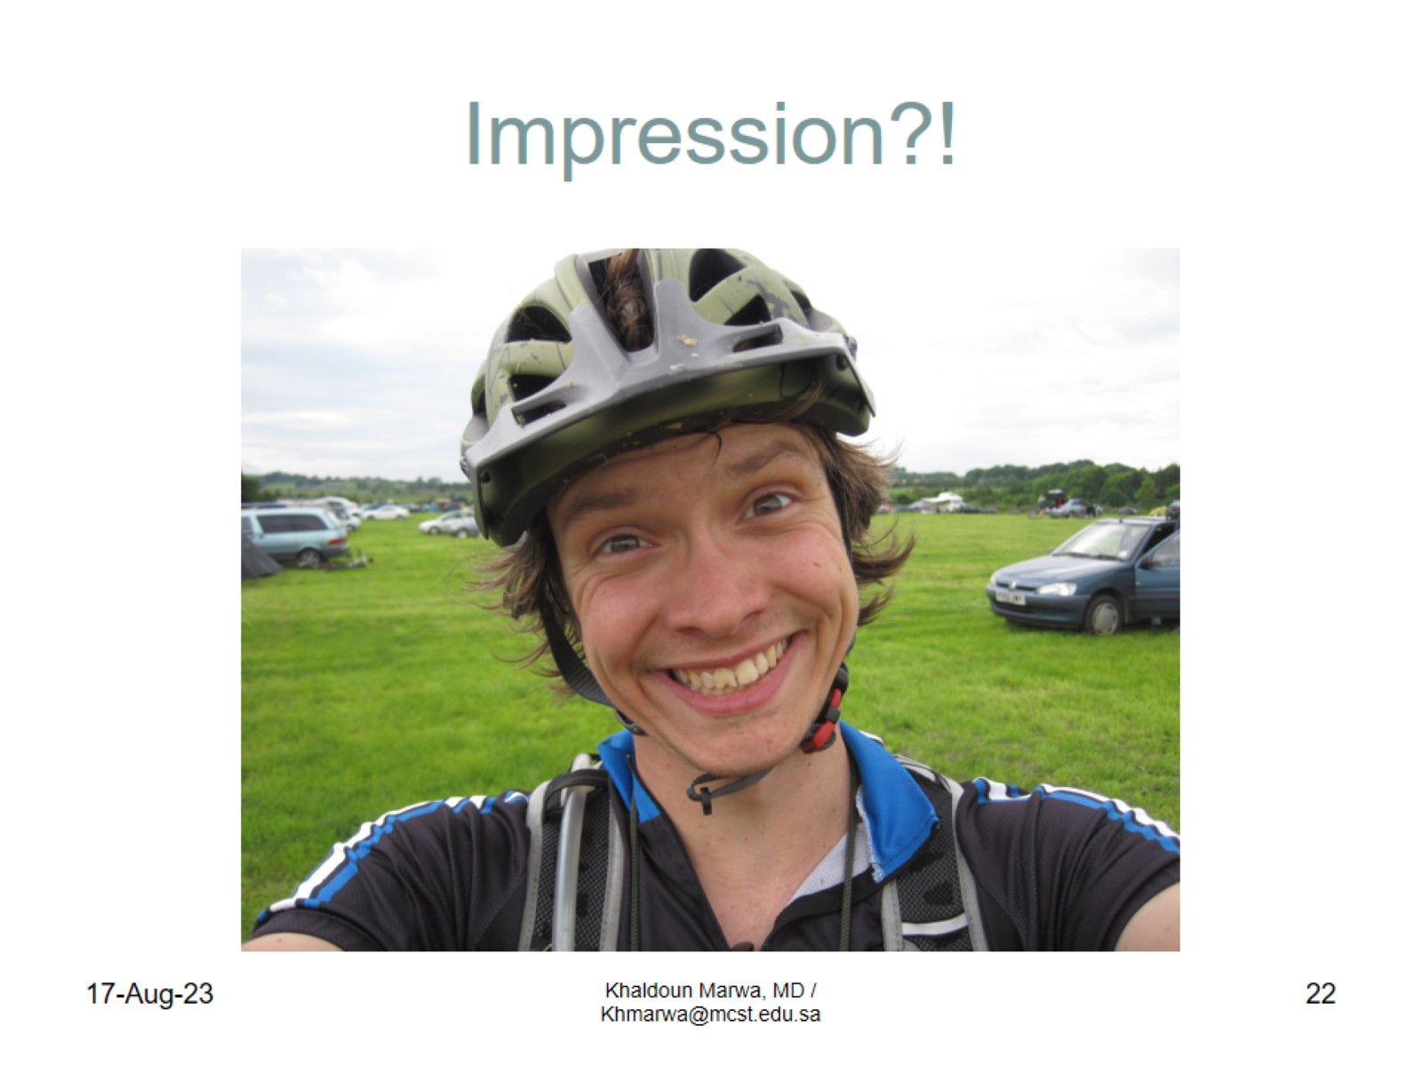
Impression?!

Slide 23
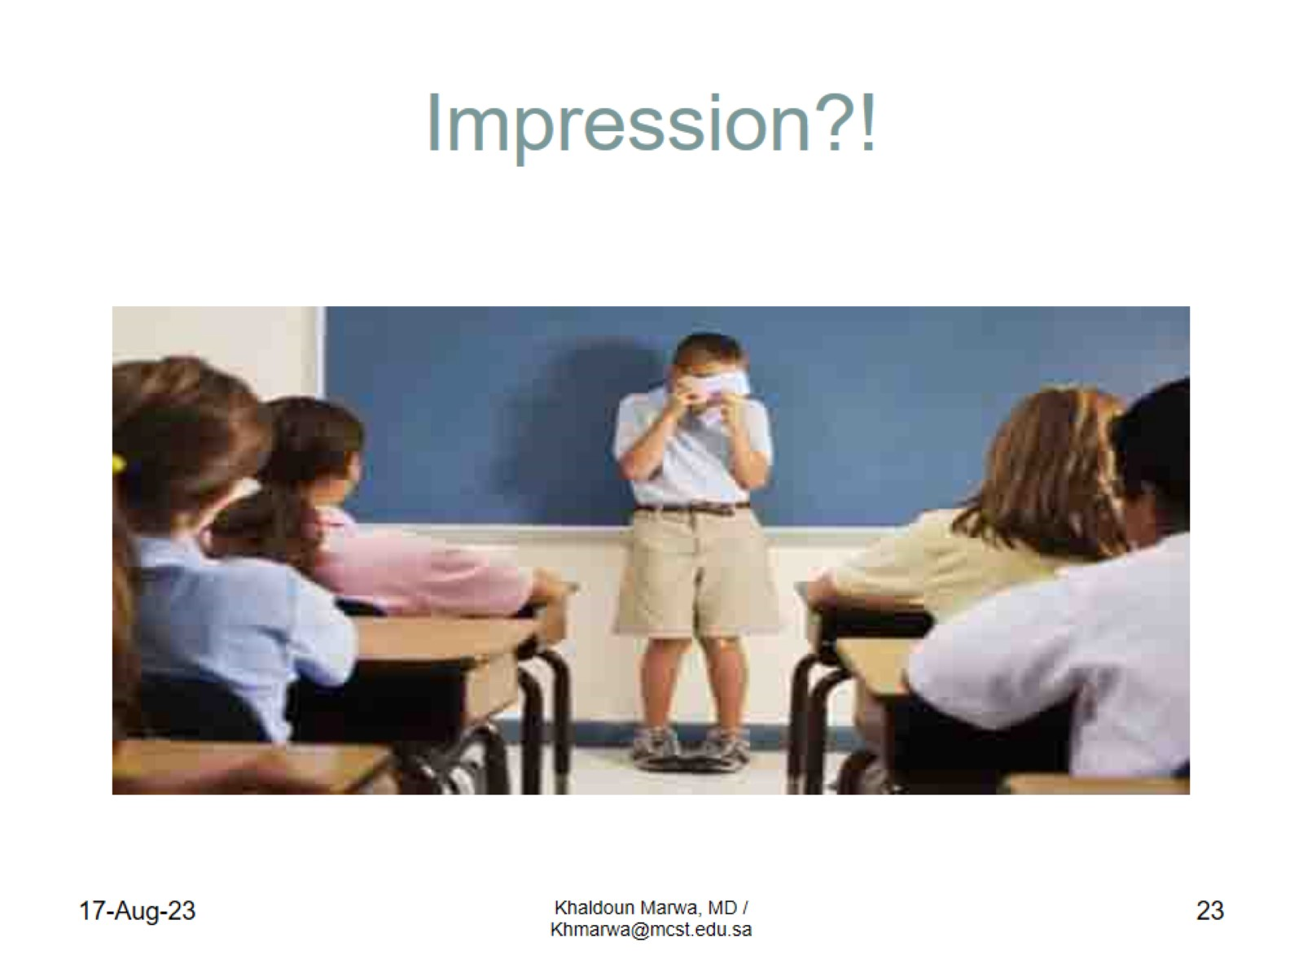
Impression?!

Slide 24


Slide 25
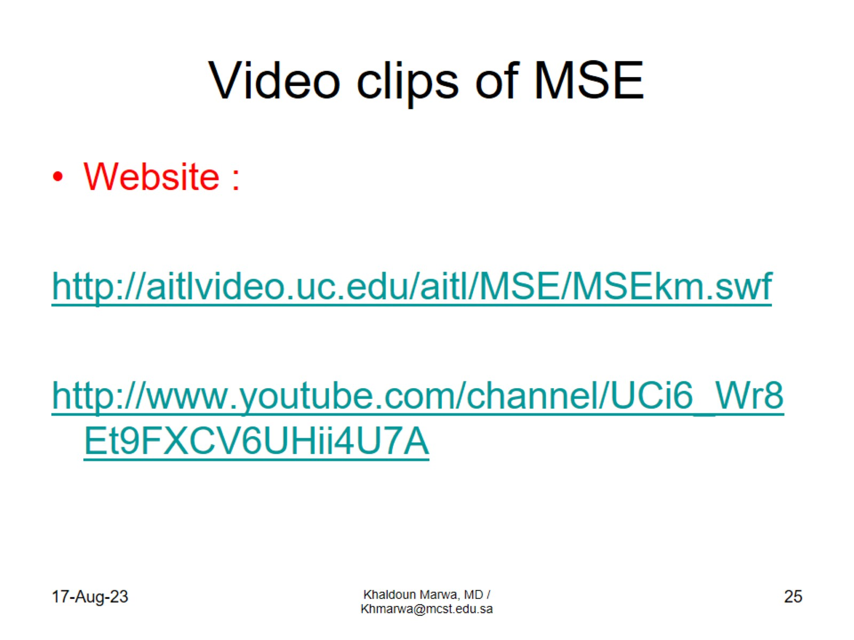
Video clips of MSE

