Slide 1
Psychotic disorders
Med 2017

Slide 2
Objectives:
Appreciating the prevalence of various psychotic illnesses
Describing the key features of various psychotic illnesses
Understanding how to differentiate between psychotic illnesses
Selecting psychopharmacologic treatment for various psychotic illnesses
Applying general principles on how to approach a patient with psychosis

Slide 3
Terminology
Psychosis
disorder of thinking and perception where typically patients do not ascribe their symptoms to a mental disorder
Positive symptoms
Delusions, hallucinations, thought disorder
Negative symptoms
A deficit state – what is not there
Delusion
False unshakeable belief out of keeping with the patients cultural educational and social background

Slide 4
Terminology
Hallucination
A sensory perception experienced in the absence of a real stimulus
Prodrome
A definable period before the onset of psychotic symptoms during which functioning becomes impaired.

Slide 5
Frequency
1 yr prevalence of non organic psychosis is 4.5/1000 community residents.
Commonest age of presentation men < 30 women < 35 and people >60.
Schizophrenia has a 1 yr prevalence of 3.3/1000 and life time morbidity of 7.2/1000
Psychotic symptoms have a 10.1% prevalence in non demented community > 85yrs

Slide 6
Differential Diagnoses for psychotic disorders
Mood Disorders with Psychotic Features
Schizophrenia and Schizophreniform Disorder
Substance-Induced Psychotic Disorder
Delusional Disorder
Psychotic Disorder due to General Medical Condition
Shared Psychotic disorder (Folie a’ Deux)
Psychotic Disorder NOS

Slide 7
Other diagnoses that can masquerade as psychotic illnesses
Delirium- pts often have paranoia, visual hallucinations
Paranoid personality disorder and schizotypal personality disorder can dance very near the edge of psychosis
Obsessive compulsive disorder- at times obsessions can be difficult to discern from psychosis

Slide 8

So how do you figure out how to identify the diagnosis?

Slide 9
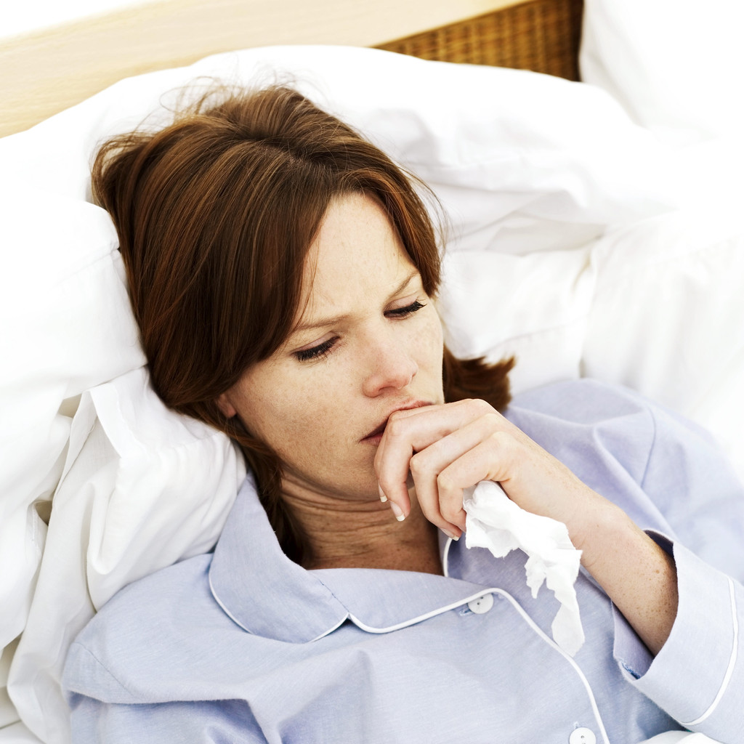
?
Are psychotic sx only present when mood symptoms present?
Does the patient have a medical condition that can cause psychosis?

Slide 10


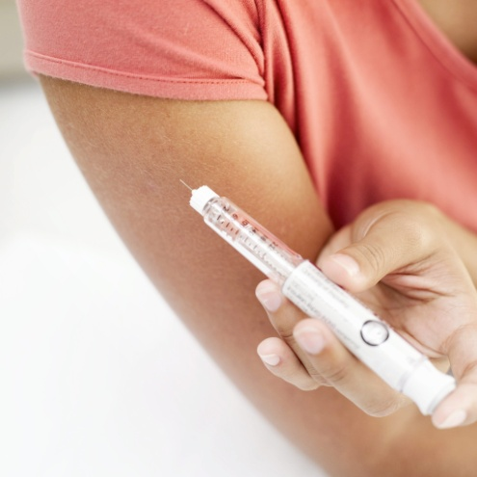
?
Is the patient using drugs/ETOH- if yes need to have sx present after at least a month of sobriety otherwise is attributed to substance(s)

Slide 11
?
Does the patient have prominent negative symptoms?
Is the patient delusional or psychotic?
What is the nature of the psychotic symptoms? Are they mood congruent (depressive themes associated with the psychosis) or incongruent?

Slide 12
A word about hallucinations
Hallucinations are defined as false sensory perceptions not associated with real external stimuli.

Slide 13
A word about delusions
Delusions are defined as a false believe based on incorrect inference about external reality that is firmly held despite what most everyone else believes and despite what constitutes incontrovertible and obvious proof of evidenced to the contrary.
Always keep in mind cultural norms

Slide 14
?
Mood incongruent
Mood congruent
Mood incongruent themes include delusions of control, persecution, thought broadcasting and thought insertion.
Delusions or hallucinations consistent with themes of a depressed mood such as personal inadequacy, guilt, disease, death, deserved punishment. For manic mood themes of worth, power, knowledge, special relationship to a deity.

Slide 15

Psychotic illnesses

Slide 16
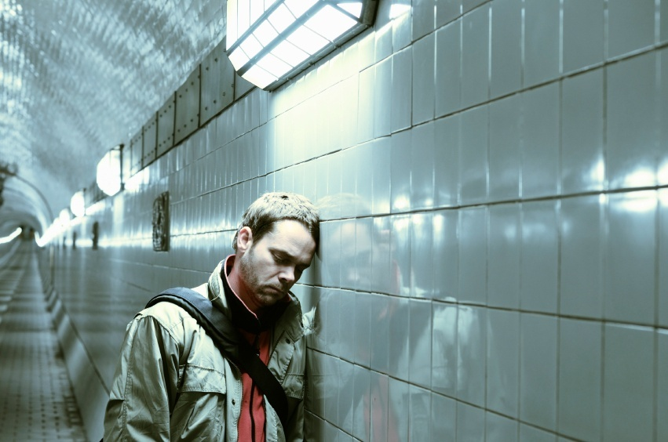
Mood disorders with psychotic features
Major depressive disorder with psychotic features
Bipolar disorder, manic or mixed
Schizoaffective disorders

Slide 17
Major depressive disorder (MDD) with psychotic features
Patient meets criteria for major depressive episode and also has psychotic symptoms while depressed
Does not have psychotic symptoms during times of euthymia
Psychotic features occur in ~18.5% of patients who are diagnosed with MDD

Slide 18
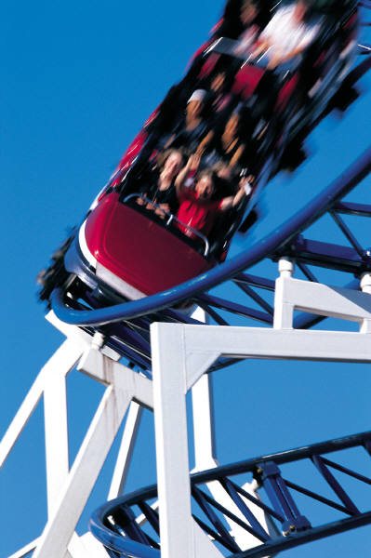
Bipolar I disorder, manic or mixed with psychotic features
Patient had bipolar disorder and is manic or mixed and exhibiting psychotic features
Estimated to occur in ~25% of Bipolar I patients

Slide 19

Schizophrenia

Slide 20
Schizophrenia
Two or more of the following present for a significant portion of the time during a 1 month period:
Delusions*
Hallucinations* (See link on website for examples)
disorganized speech*
grossly disorganized or catatonic behavior*
negative symptoms (affect flattening, alogia, avolition, apathy)

Slide 21
Schizophrenia
Only one criteria needed if delusions bizarre or hallucinations consist of a voice keeping a running commentary or two voices talking to each other
Must cause significant social/occupational dysfunction
Continuous signs of disturbance for 6 months
< 6 months = schizophreniform

Slide 22
Schizophrenia subtypes
Paranoid: preoccupation with one or more delusions or frequent auditory hallucinations
Disorganized: disorganized speech, behavior and flat or inappropriate affect are all present
Catatonic: motoric immobility or excessive activity, extreme negativism, peculiar movements, echolalia or echopraxia

Slide 23
Epidemiology
It affects 1-2% of the population
Onset symptoms in males peaks 17-27 yrs
Onset symptoms in females: 17-37 yrs
Only 10% new cases have onset after 45 years
Presence of proband with schizophrenia significantly increases the prevalence of schizoid and schizotypal personality disorders, schizoaffective disorder and delusional disorder

Slide 24
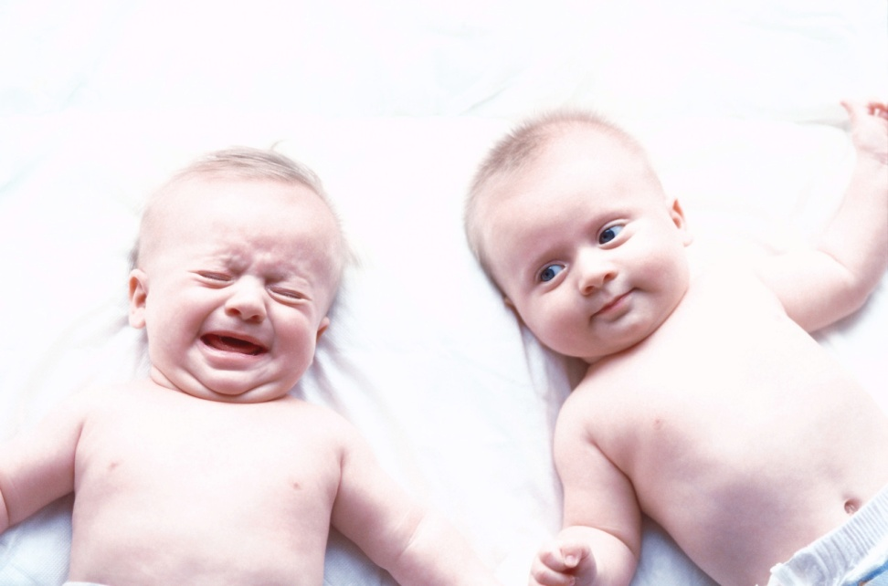
Etiology
Studies of monozygotic twins suggest approximately 50% schizophrenia risk genetic as there is 40-50% concordance
Estimated: the other 50% due to as of yet unidentified environmental factors including in utero exposure

Slide 25
Pathophysiology
Possibly due to aberrant neuro-developmental processes such as increase in normal age-associated pruning frontoparietal synapses that occur in adolescence and young adulthood
Excessive activity in mesocortical and mesolimbic dopamine pathways

Slide 26
Schizophrenia and addiction
47 percent have met criteria for some form of a drug/ETOH abuse/addiction.
The odds of having an alcohol or drug use disorder are 4.6 times greater for people with schizophrenia than the odds are for the rest of the population: the odds for alcohol use disorders are over three times higher, and the odds for other drug use disorders are six times higher

Slide 27
Schizophrenia illness course
Negative symptoms thought to be more debilitating in regards to social and occupational impairment
>90% of pts do not return to pre-illness level of social and vocational functioning
10% die by suicide

Slide 28
Schizophrenia illness course
Generally marked by chronic course with superimposed episodes of symptom exacerbation
1/3 have severe symptoms & social/vocational impairment and repeated hospitalizations
1/3 have moderate symptoms & social/vocational impairment and occasional hospitalizations
1/3 have no further hospitalizations but typically have residual symptoms, chronic interpersonal difficulties and most cannot maintain employment

Slide 29
Mental State Examination
Mood
Depressed or elevated
Affect
Normal or flat
Asses suicidal risk
Cognitive impairment
Grossly abnormal indicates learning disability or organic disorder

Slide 30
Mental status exam
Appearance: disheveled, anxious
Behavior: mild PMR, poor eye contact
Speech: soft, constricted prosody
Mood: “beyond terrible”
Affect: mood congruent, depressed
Thought process: perseverative on belief she must go to jail because of perceived wrong doing
Thought content: +delusions she has harmed someone, +paranoia, -AH, passive SI stating she deserves to die without plan, -HI, -TI, -TB, -IOR
Cognition: fully oriented
Insight/judgement: poor

Slide 31
Mental state examination
General behaviour
Disorganised speech indicates thought disorder
Stilted and difficult conversation occurs with negative symptoms
New words – neologisms best written down
Random changes in conversation
Fast or pressured speech suggests mania

Slide 32
Treatment
Positive symptoms respond better than negative Antipsychotics are mainstay of treatment.
Atypical antipsychotics: used first to reduced risk of Tardive Dyskinesia (TD) but can have weight gain, metabolic syndrome including elevated lipids and type 2 diabetes
Risk of TD approximately 3-5% per year for typical antipsychotics. Highest in older women with affective disorders
Risk of dystonic reaction highest in young males

Slide 33
Schizoaffective disorder
Uninterrupted period: either major depressive, episode or mixed episode while criterion for schizophrenia met
Periods where delusions or hallucinations present for >2 weeks without prominent mood symptoms
Symptoms that meet criteria for a mood disorder are present for a substantial portion of the illness
Lifetime prevalence rates is 0.7%

Slide 34
Schizoaffective disorder treatment
Antipsychotics are mainstay
If depressed type: add antidepressant
If Bipolar type: mood stabilizers as well

Slide 35
Substance induced psychotic disorder
Substances associated with psychosis include:
Alcohol The lifetime prevalence was 0.5%
Cocaine
Amphetamines
Cannabis
LSD, PCP, NMDA, Ketamine

Slide 37
Substance-induced psychotic disorder (SIMD)
A. Prominent hallucinations or delusions.
B. There is evidence from the history, physical examination, or laboratory findings of either (1) or (2):
(1) the symptoms in Criterion A developed during, or within a month of Substance Intoxication or Withdrawal
(2) substance use is etiologically related to the disturbance

Slide 38
The diagnosis cannot be made if the symptoms occurred before the substance or medication was ingested, or are more severe than could be reasonably caused by the amount of substance involved.
If the disorder persists for more than a month after the withdrawal of the substance, the diagnosis is less likely with the exception of methamphetamines.

Slide 39
Substances associated with inducing psychosis:
Alcohol
Cocaine
Amphetamines
Cannabis
LSD, PCP
NMDA, Ketamine
Inhalants
Opiods

Slide 40
Treatment
Stop the drug use
Chemical dependence treatment if indicated
Consider antipsychotics depending on how psychotic the patient is and how long the symptoms have been present

Slide 41
Psychotic disorders due to a General Medical Condition (GMC)
Brain tumors
Seizure disorders
Delirium
Huntington’s disease
Multiple Sclerosis
Cushing’s syndrome
Vitamin deficiencies
Electrolyte abnormalities
Thyroid disorders
Uremia
SLE
HIV
Wellbutrin
Anabolic steroids
Corticosteroids
Antimalarial drugs

Slide 42
Delusional disorder
Nonbizarre delusions (i.e. involving situations that occur in real life such as being poisoned, loved at a distance, deceived by a spouse) of at least one months duration.
Criterion A for Schizophrenia never met
Apart from impact of delusions functioning not markedly impaired
Not due to mood disorder or substance
Lifetime prevalence = 0.03%

Slide 43
Mean age of onset is ~40 years
Slightly higher in females compared to males

Slide 44
Delusional disorder subtypes
Erotomanic
Grandiose
Persecutory
Jealous
Somatic
Mixed
See erotomanic delusions more often in women
See persecutory delusions more often in men

Slide 45
Brief psychotic disorder
Presence of one or more of the following
delusions
Hallucinations
Disorganized speech
Disorganized or catatonic behavior
Duration of episode is <1 month with eventual return to premorbid level of functioning

Slide 46

Given just what you know what is the most likely dx?

Slide 47

Psychosis NOS
If pt has psychotic sx but does not meet criteria for any diagnosis they get the Psychosis NOS diagnosis

Slide 48
Getting back to our case
29 yo woman was brought to the emergency room by the police after she started screaming at Starbucks then threw coffee at the barista. In the emergency room she stated “I need to be taken to jail. I think I contaminated someone with a virus and I need to go to jail. Don’t get near me…I will make you sick too.”
PE, VS, lab work all unremarkable

Slide 49
Lets get back to our differential diagnoses for Psychotic disorders
Mood Disorders with Psychotic Features
Schizophrenia and Schizophreniform Disorder
Substance-Induced Psychotic Disorder
Delusional Disorder
Psychotic Disorder due to General Medical Condition
Shared Psychotic disorder (Folie a’ Deux)
Psychotic Disorder NOS
Look alikes: BPD, OCD, PPD, schizotypal pd

Slide 50
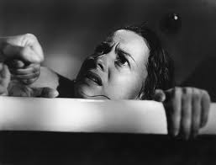
MDD with psychotic features
Leading diagnosis given depressive themes to psychosis, depressed mood, negative utox, no abnormalities in labs, normal PE and lack of negative sx

Slide 51

To rule in the DX
Pt needs to currently meet criteria for a major depressive episode and not have other reasons for psychosis for example

Slide 52
What information would you need to r/o other dx?
No history of manic episodes- r/o BAD
No drug/ETOH use in recent past- r/o SIPD
No medical issues such as hypothryoidism- r/o psychotic disorder due to a GMC
Does not meet criteria for schizophrenia

Slide 53
How to approach a psychotic pt
Acknowledge you believe they are experiencing what they are reporting
Try not to collude with the pt
Try to establish rapport before confronting psychotic beliefs
Don’t be overly friendly or it can feed into the paranoia

Slide 54
Take home points
Psychotic disorders can be primary or secondary
Cornerstone of treatment is antipsychotics if primary psychotic illness
If secondary psychotic illness treat underlying cause and often will also need to use antipsychotics
There are approaches as outlined earlier that can make interactions with patients more effective

