Slide 1
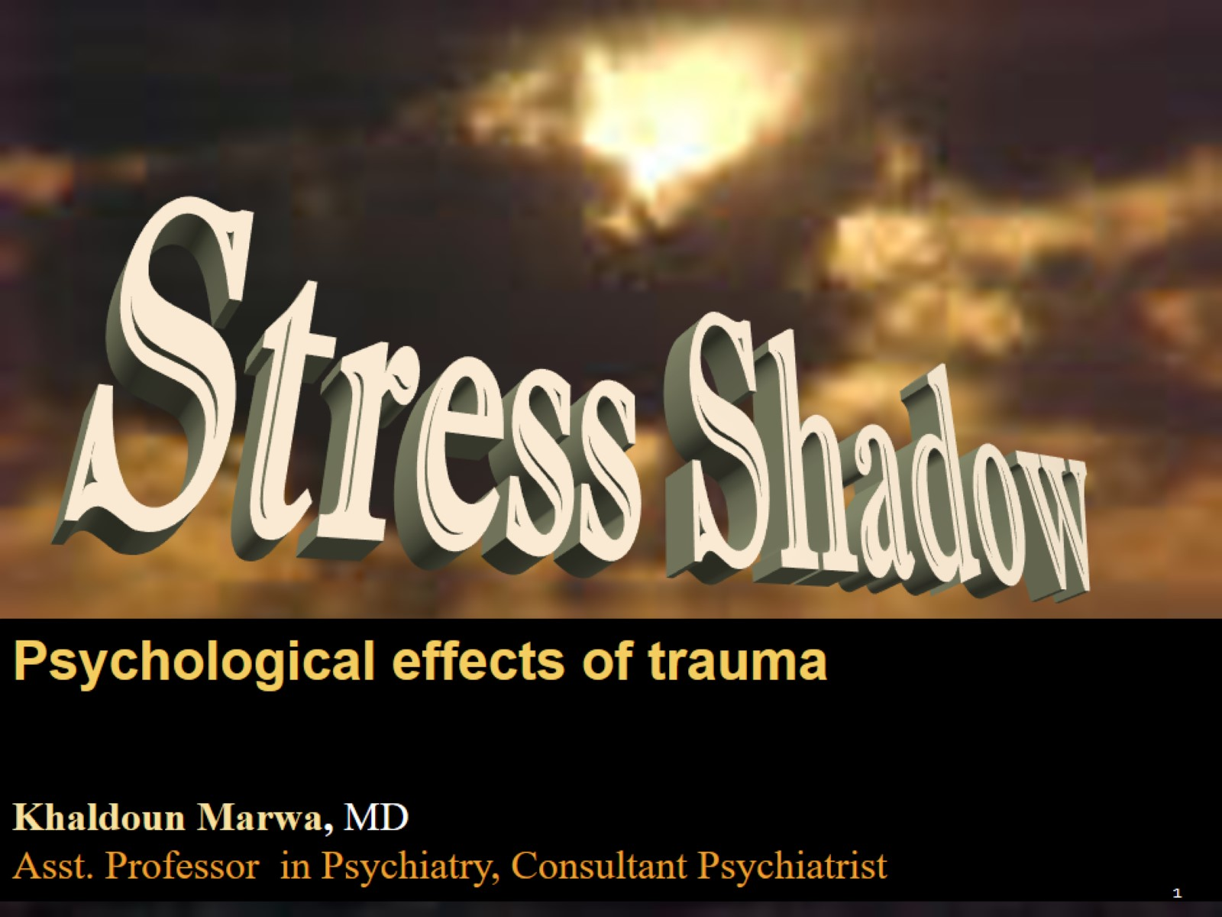

Slide 2
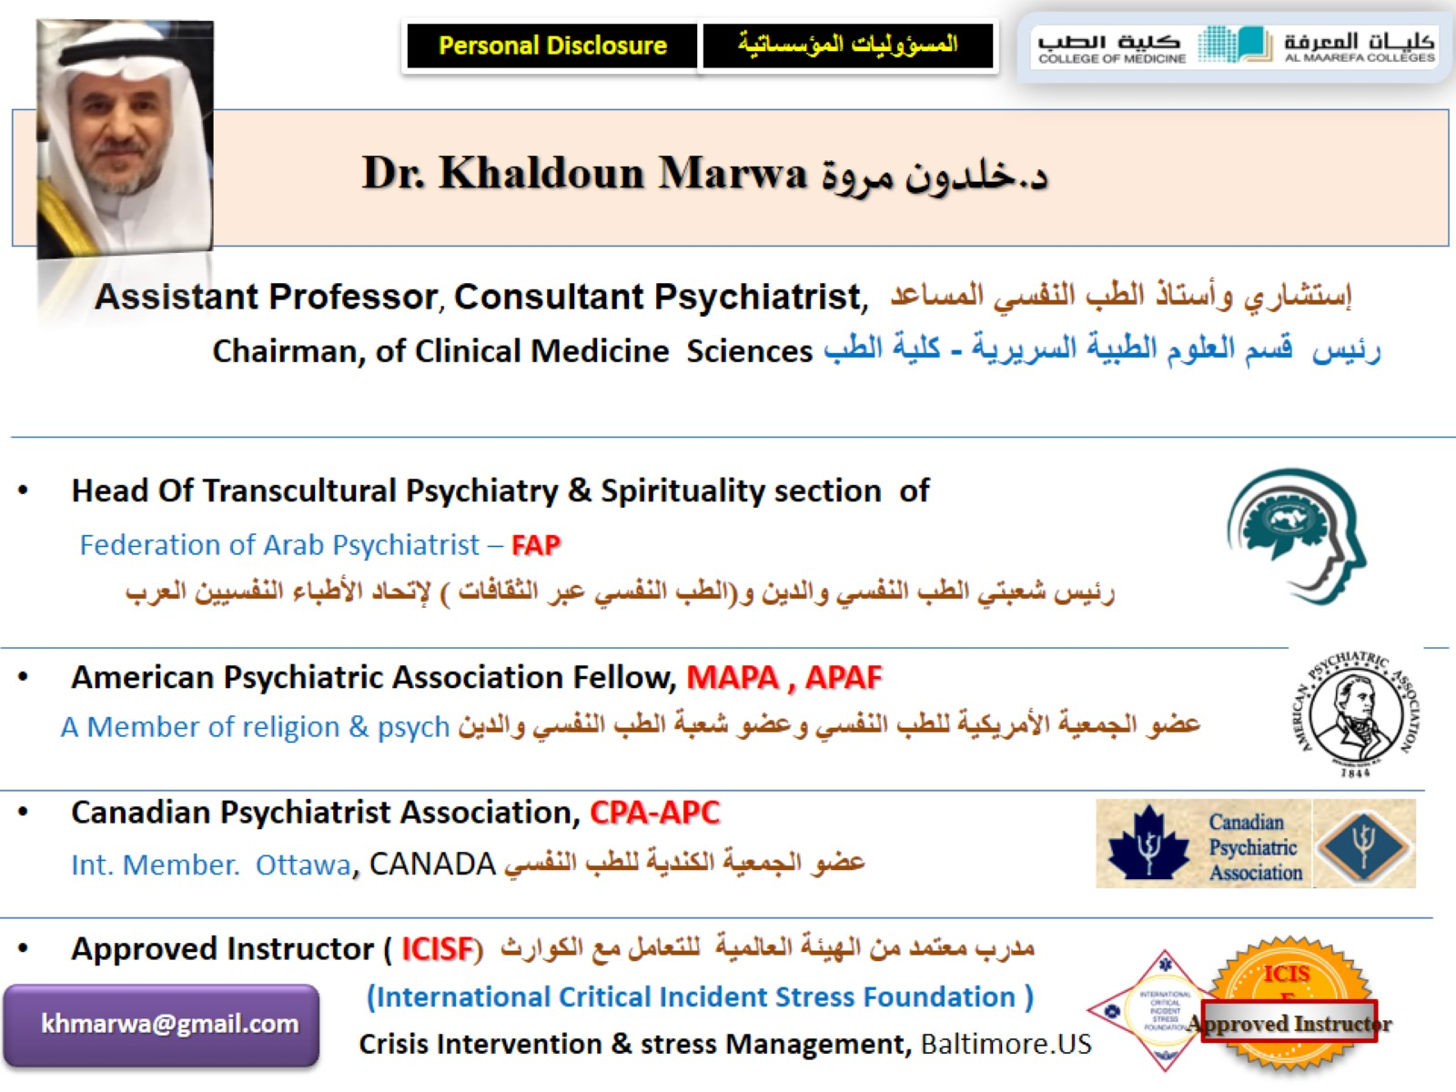

Slide 3
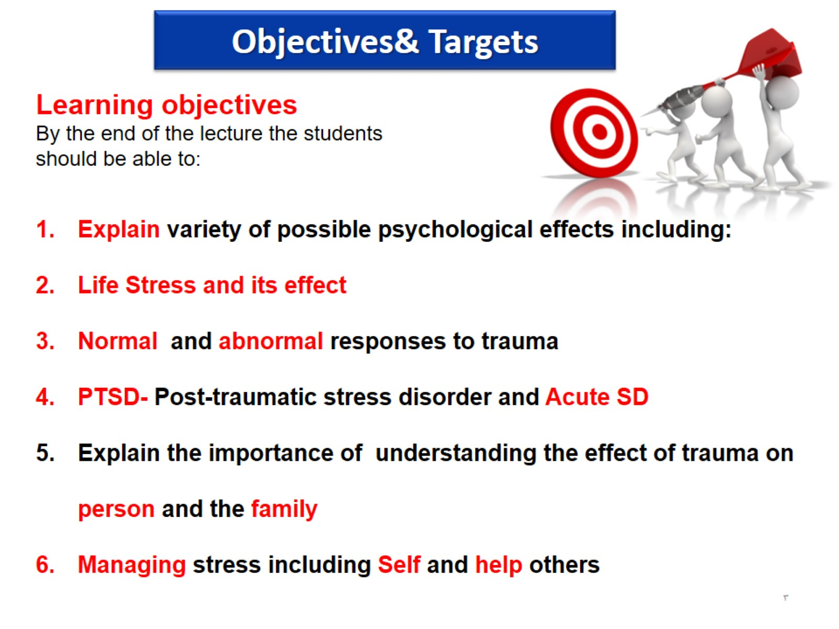

Slide 4
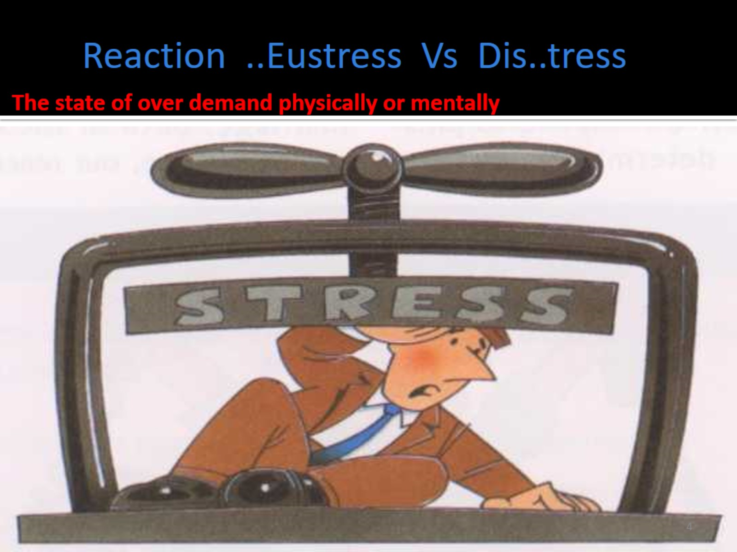
Reaction ..Eustress Vs Dis..tress

Slide 5
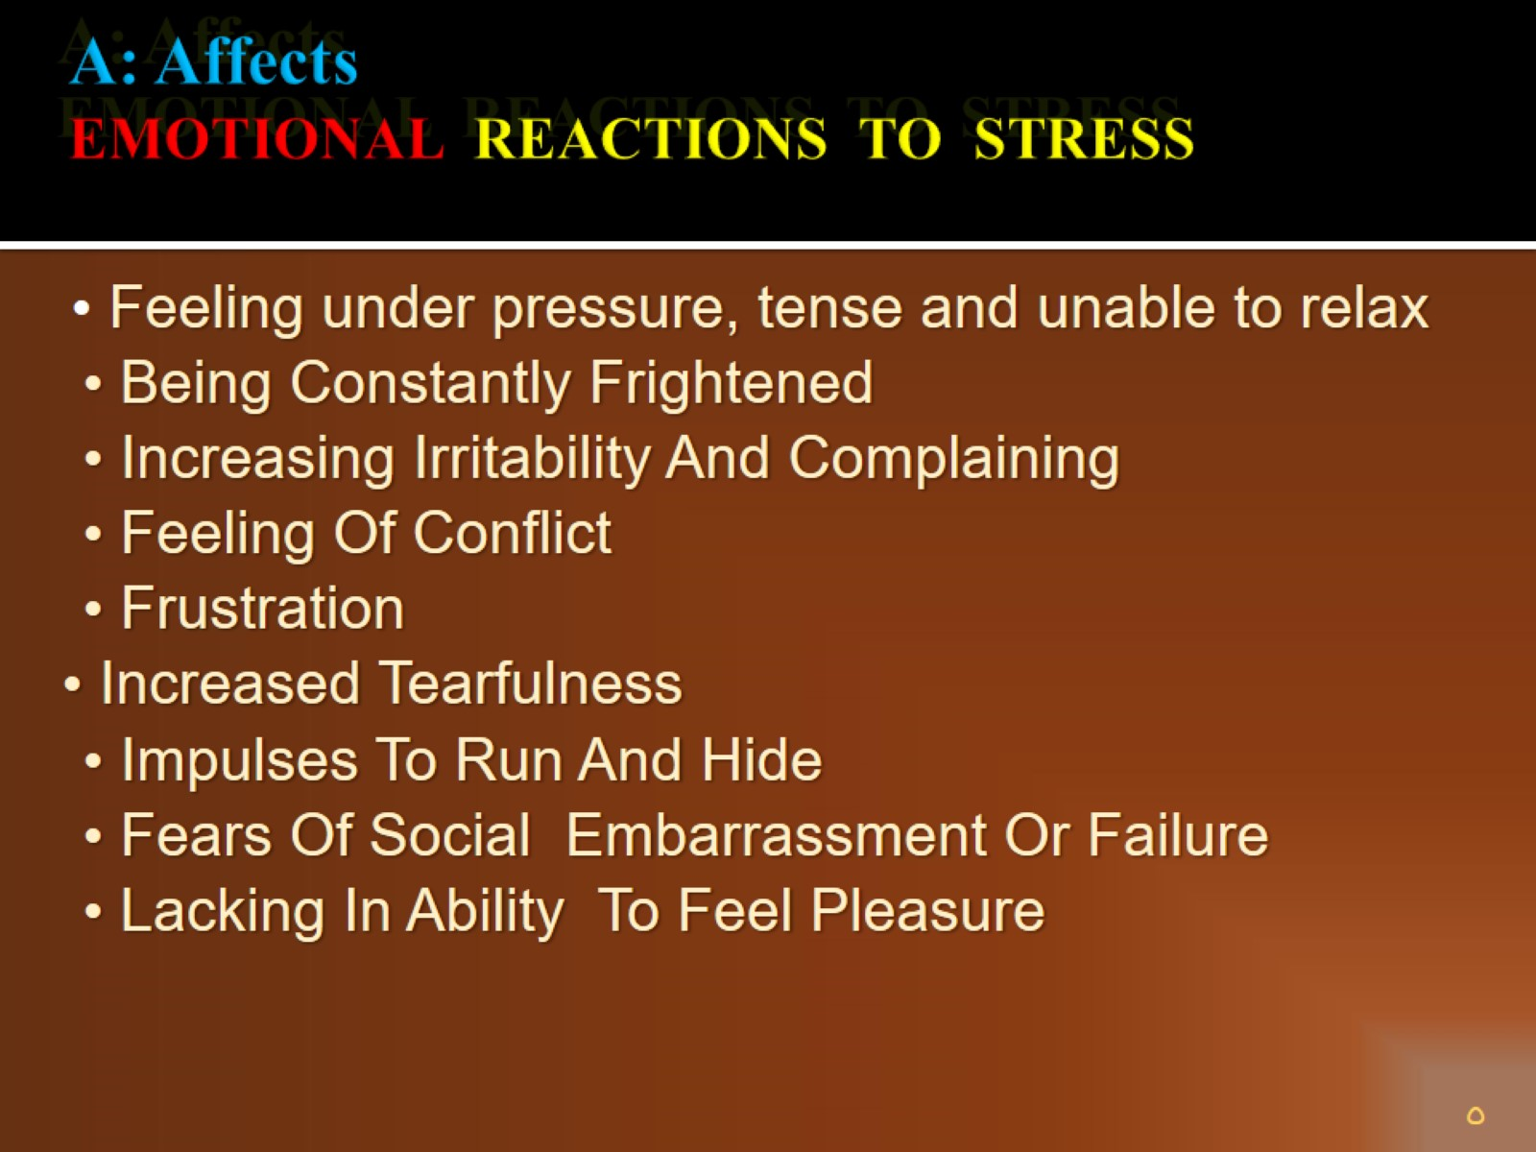
A: Affects EMOTIONAL REACTIONS TO STRESS

Slide 6
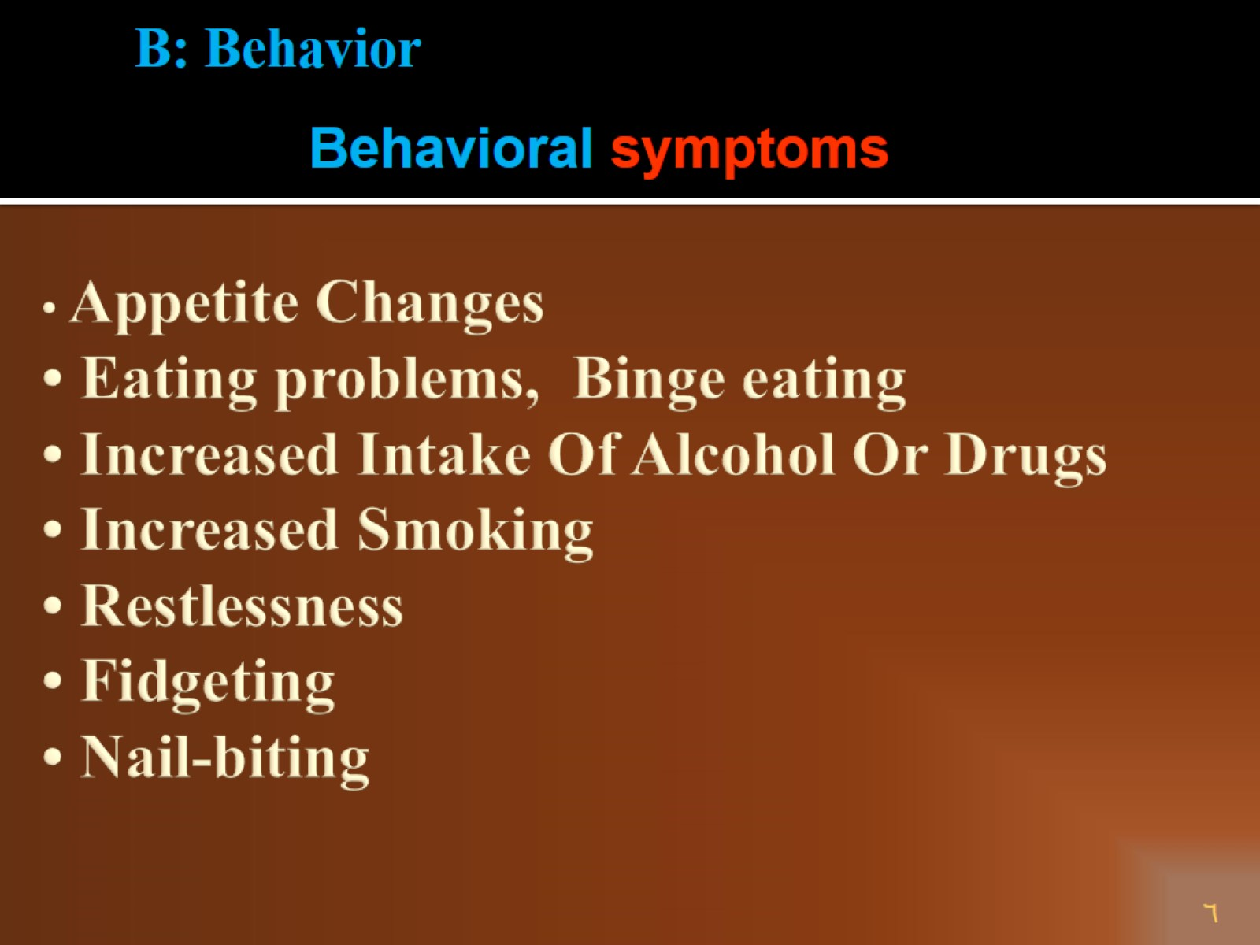
• Appetite Changes • Eating problems, Binge eating • Increased Intake Of Alcohol Or Drugs • Increased Smoking • Restlessness • Fidgeting • Nail-biting

Slide 7
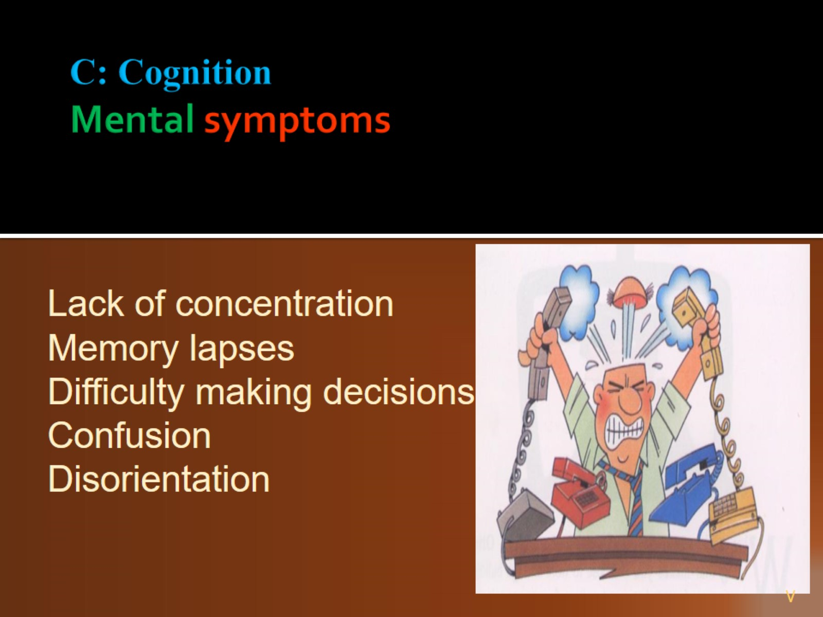
C: Cognition Mental symptoms

Slide 8
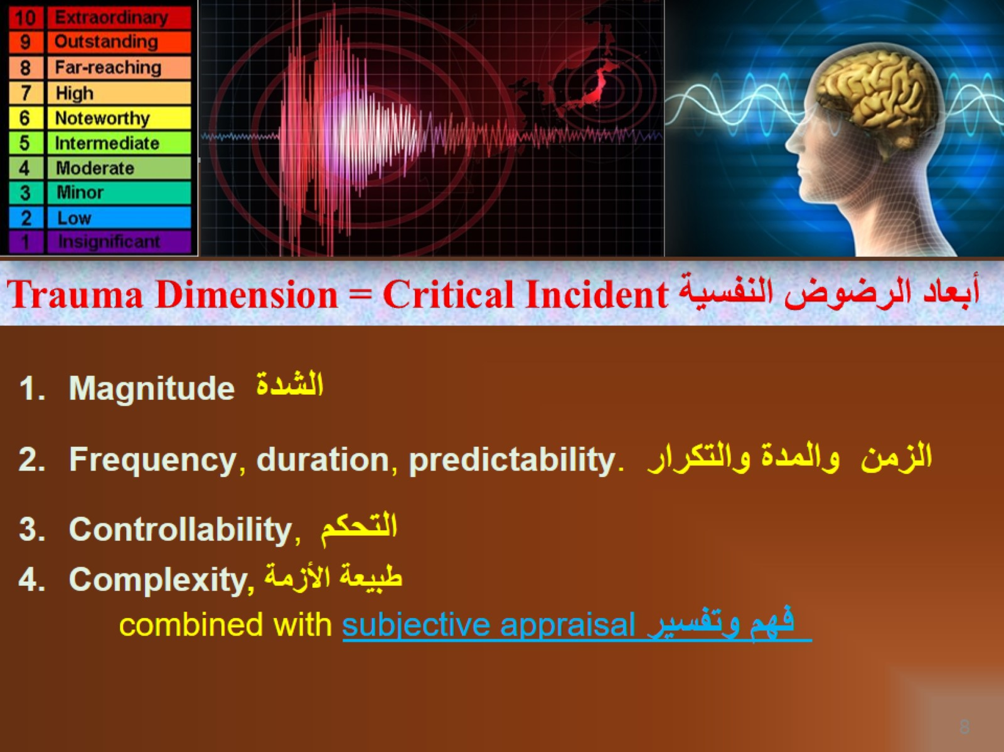
Trauma Dimension = Critical Incident أبعاد الرضوض النفسية

Slide 9
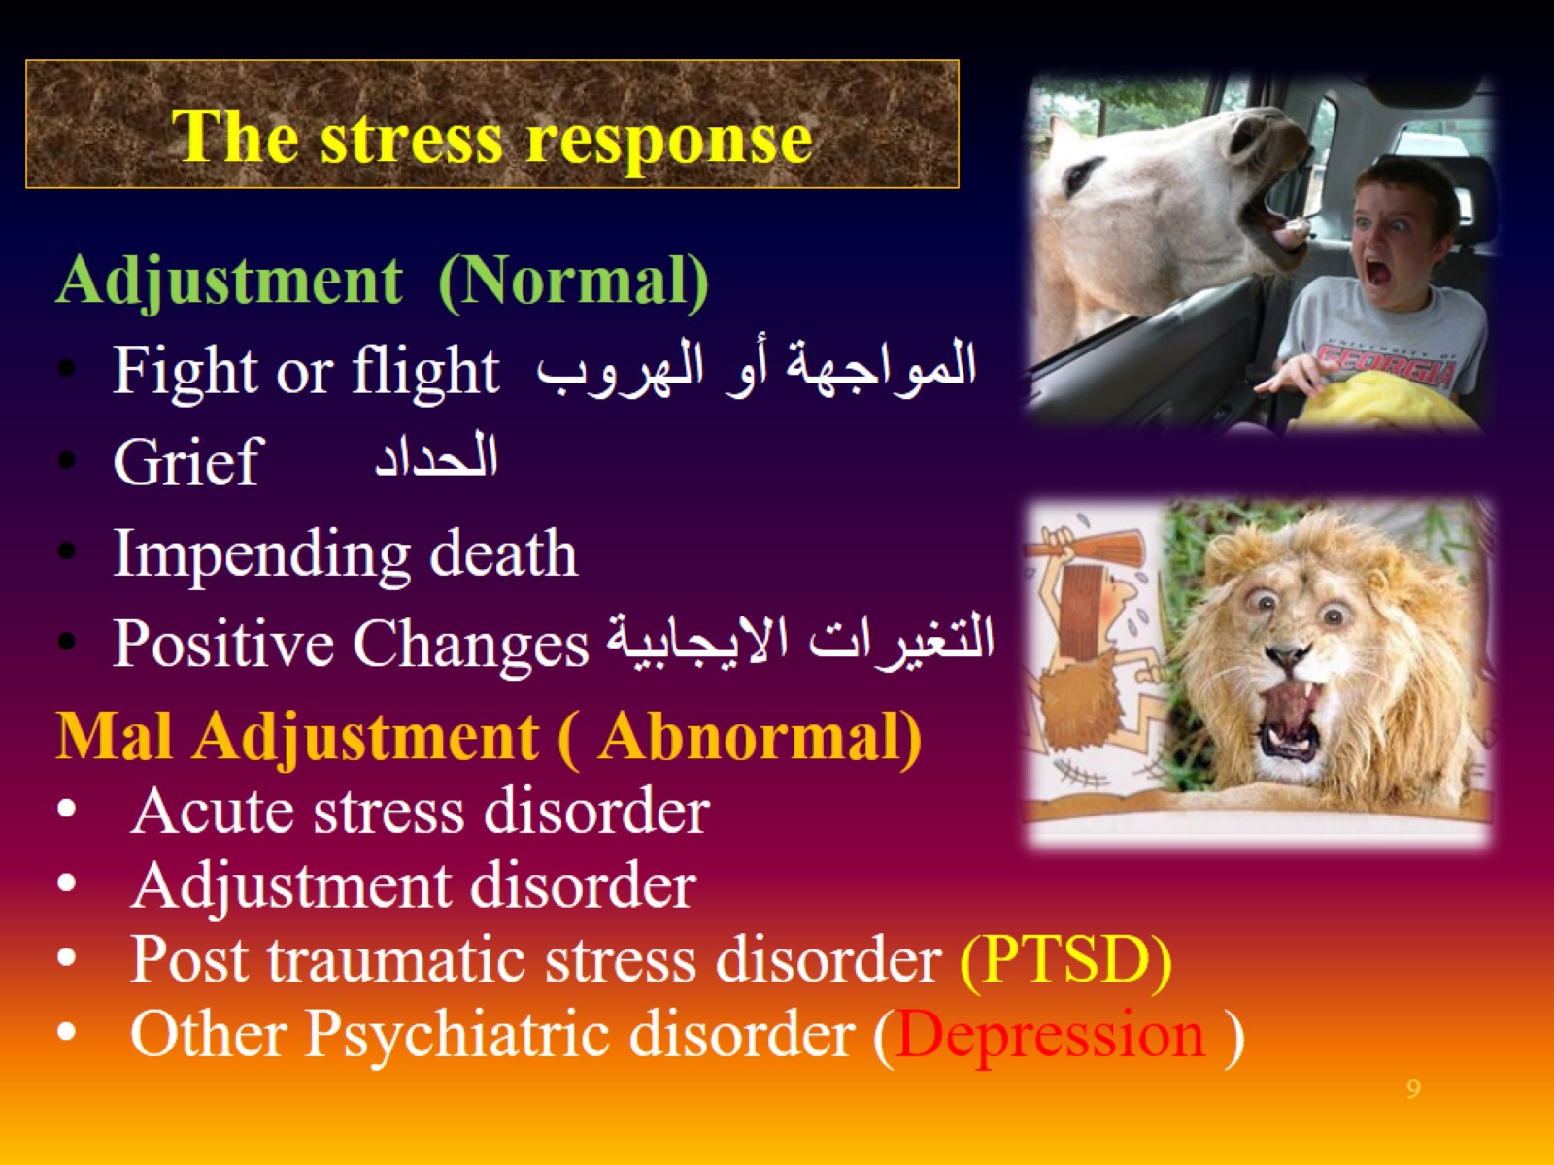
The stress response

Slide 10
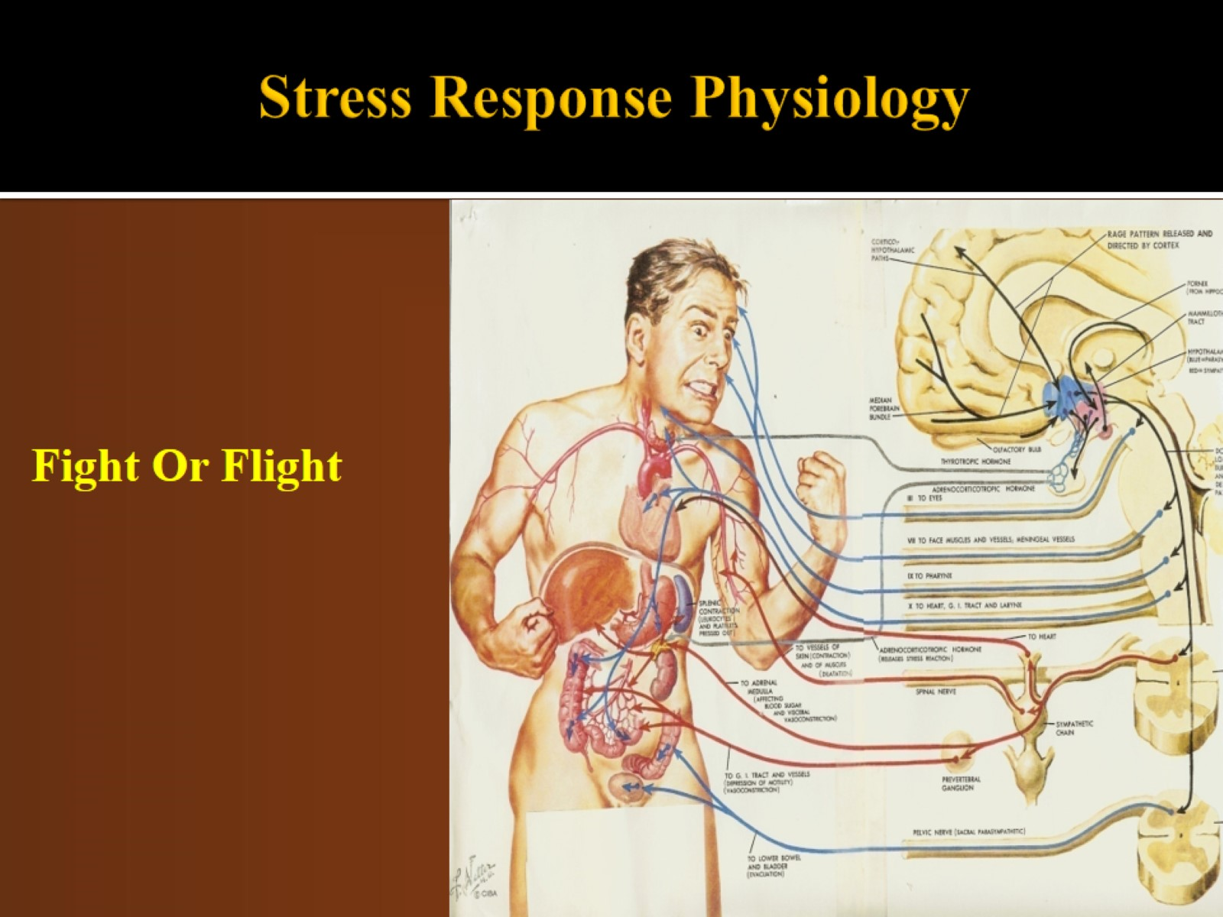
Stress Response Physiology

Slide 11
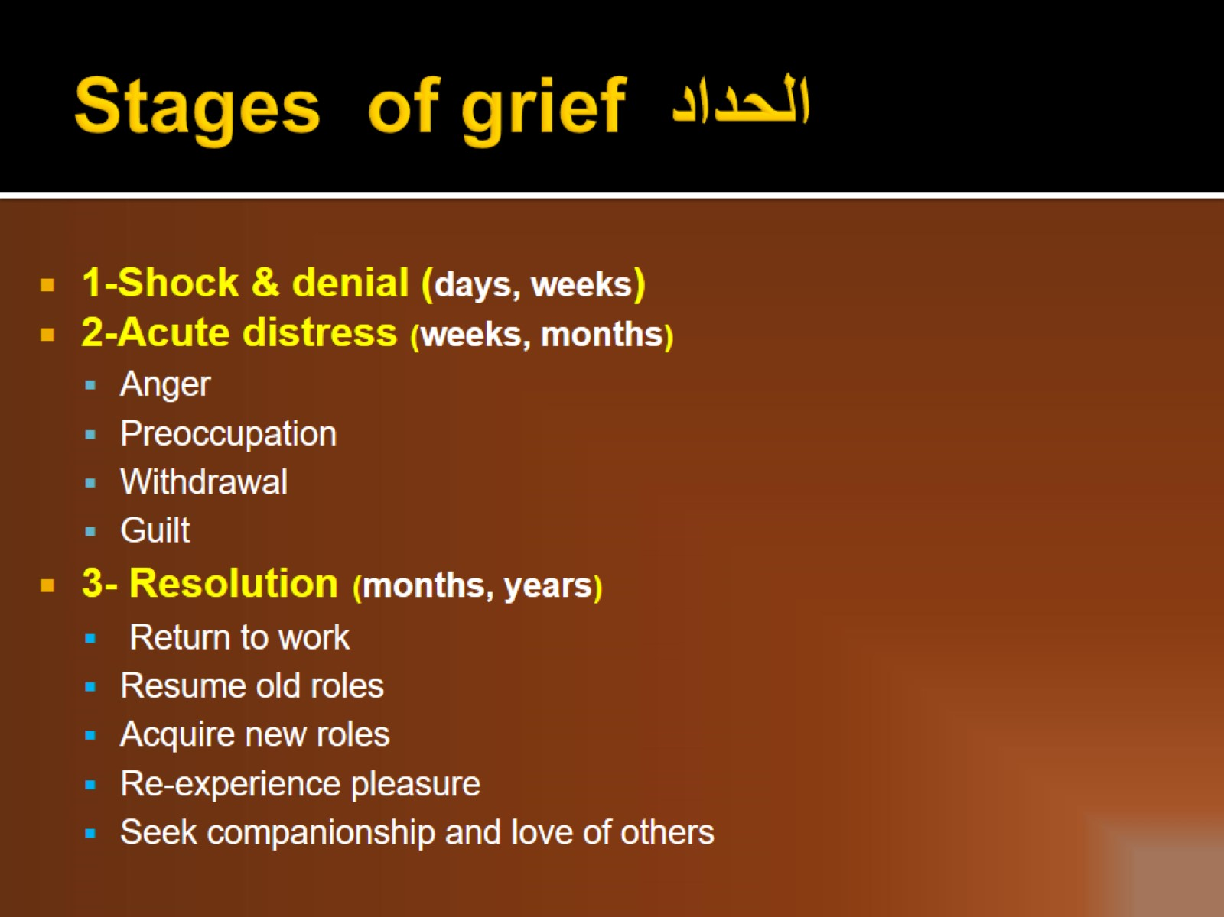
Stages of grief الحداد

Slide 12
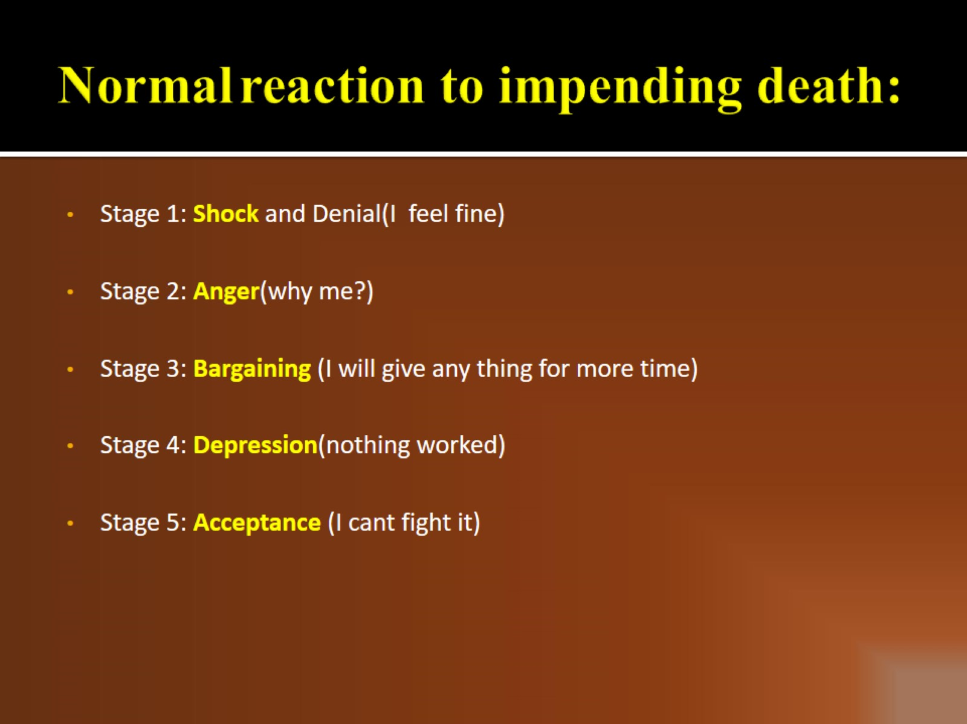
Normal reaction to impending death:

Slide 13
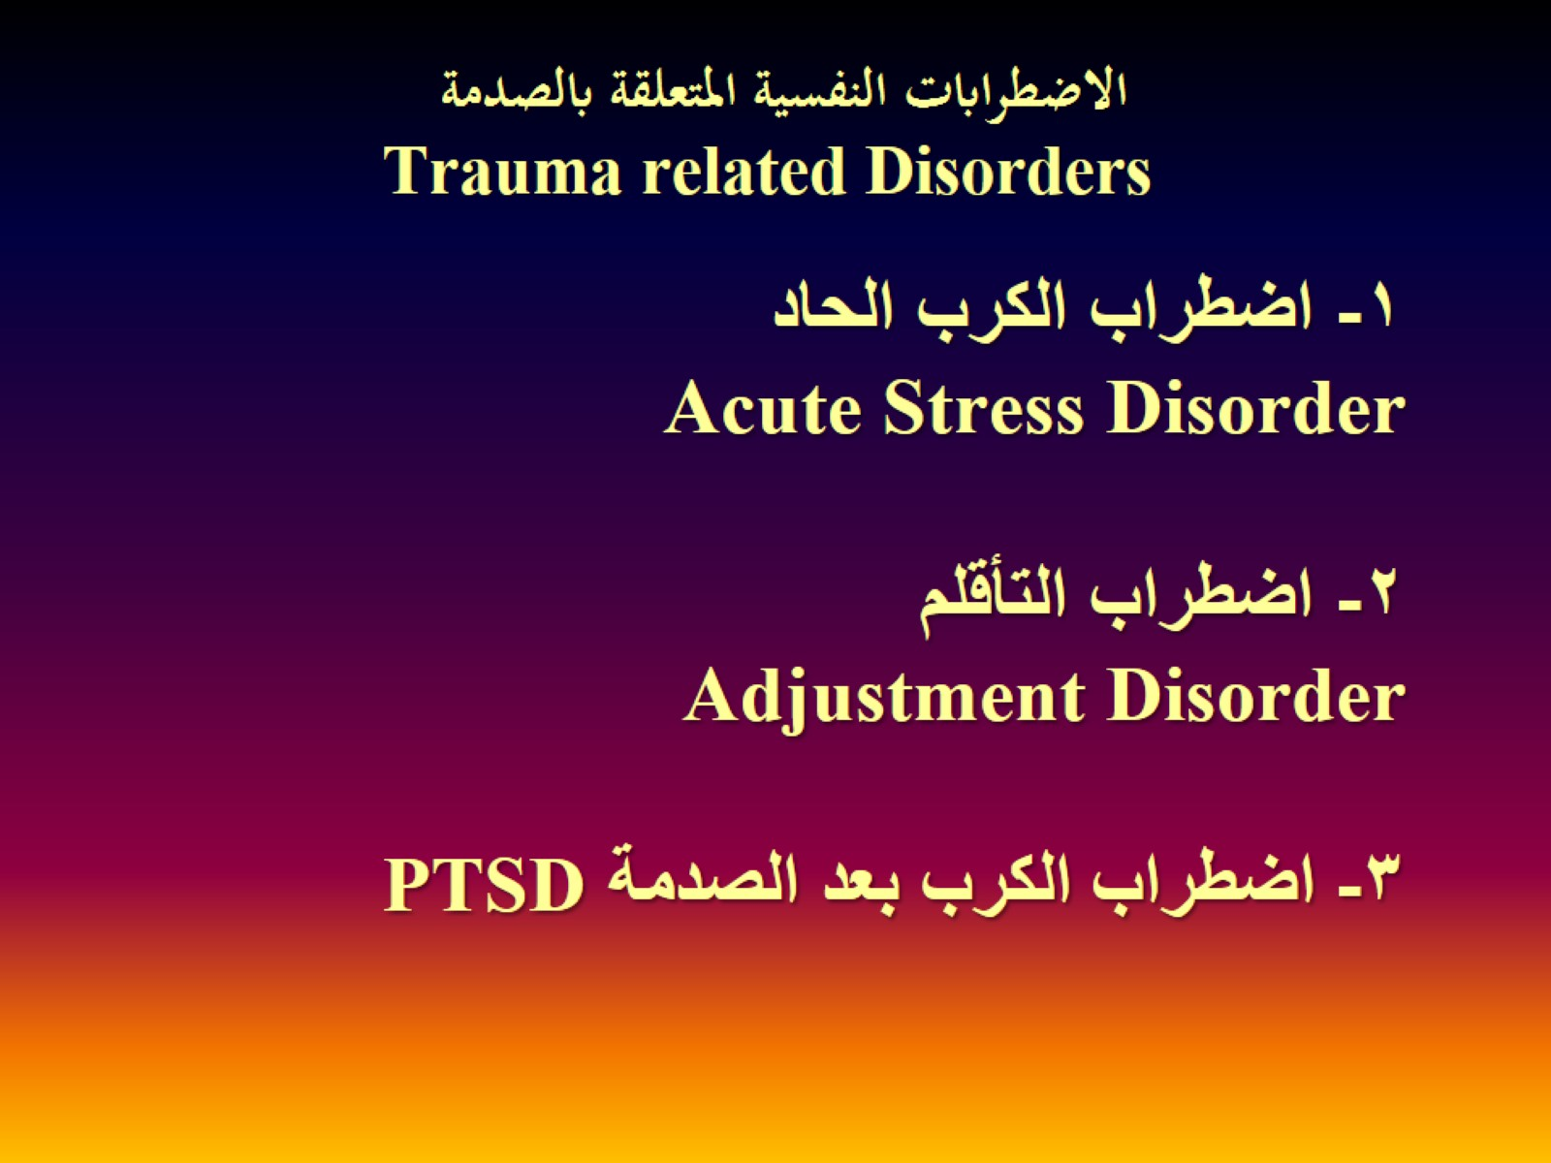
الاضطرابات النفسية المتعلقة بالصدمة Trauma related Disorders

Slide 14
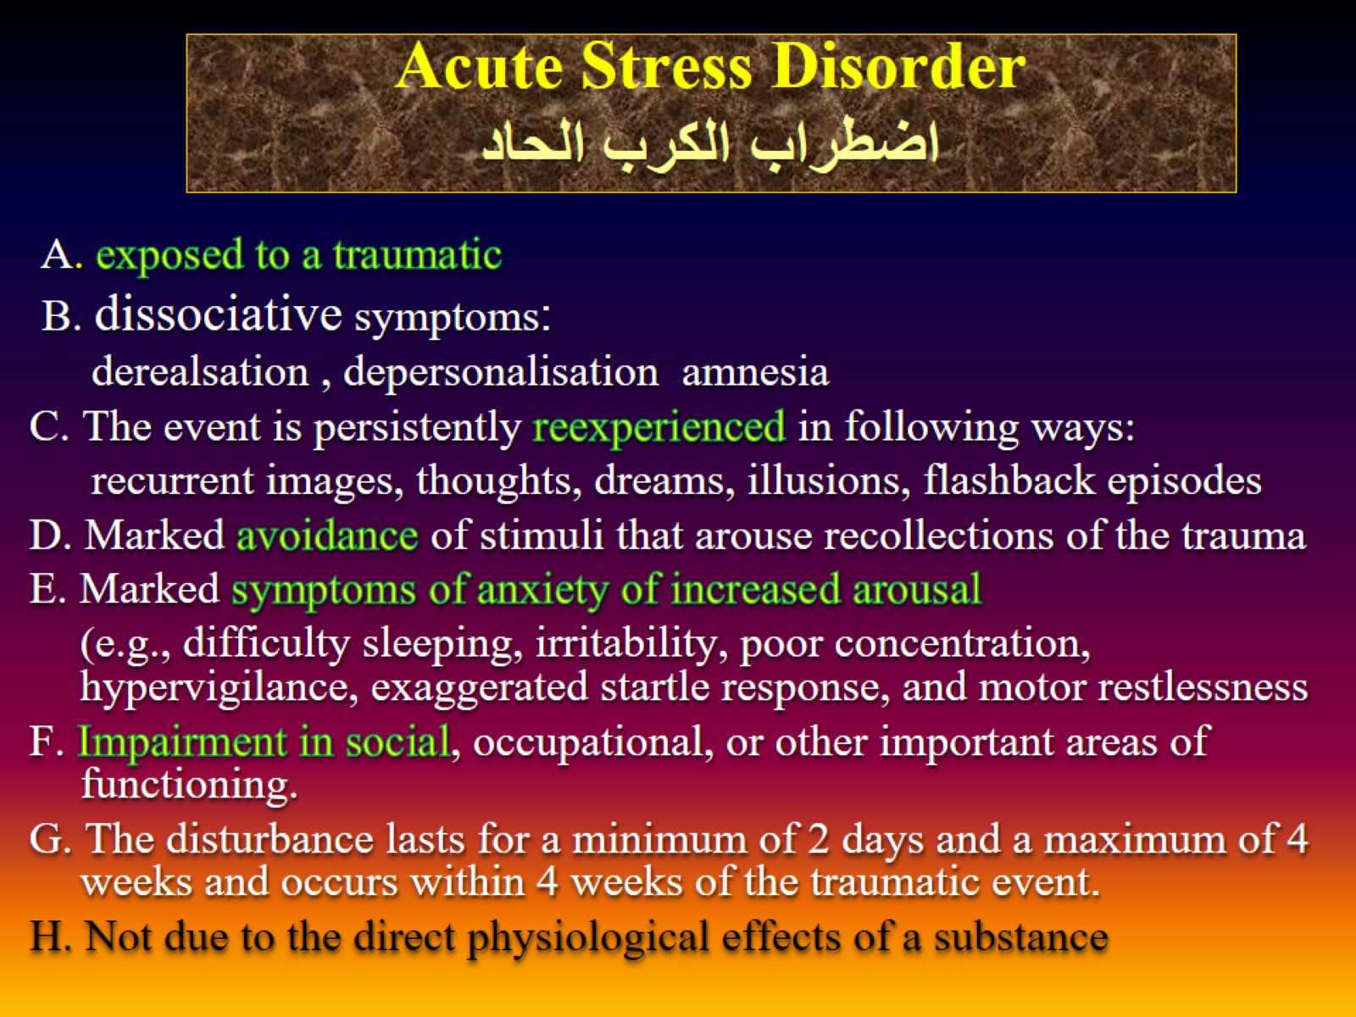
Acute Stress Disorder اضطراب الكرب الحاد

Slide 15
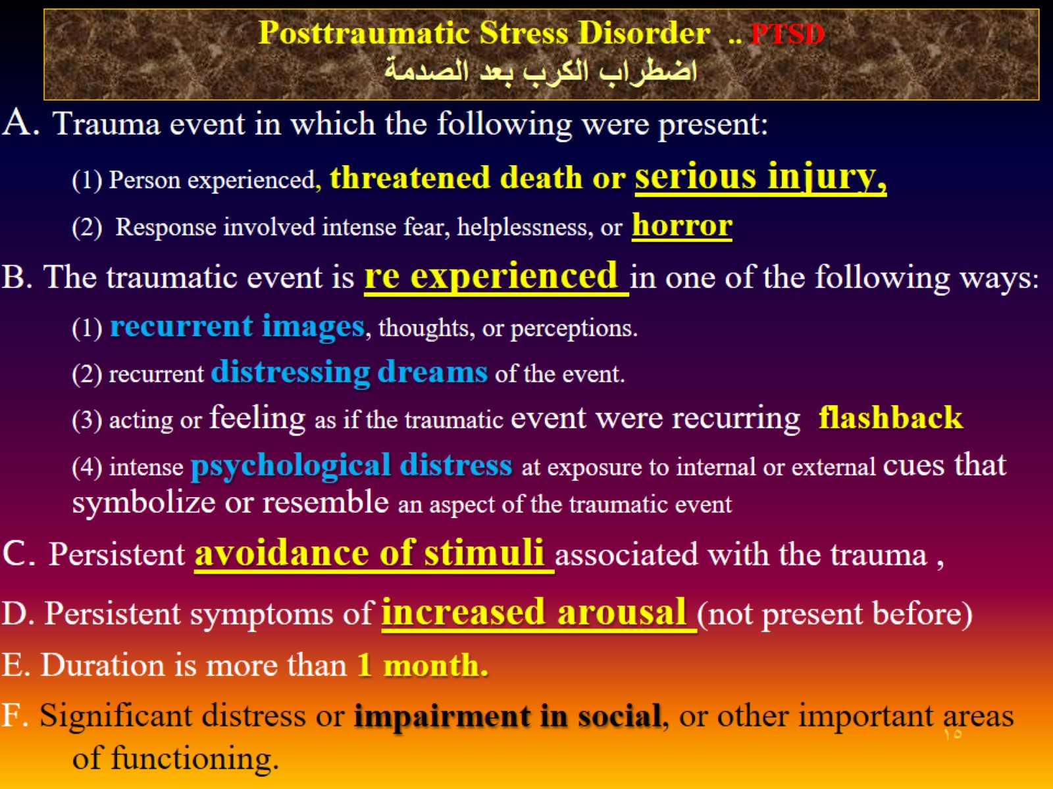
Posttraumatic Stress Disorder .. PTSD اضطراب الكرب بعد الصدمة

Slide 16
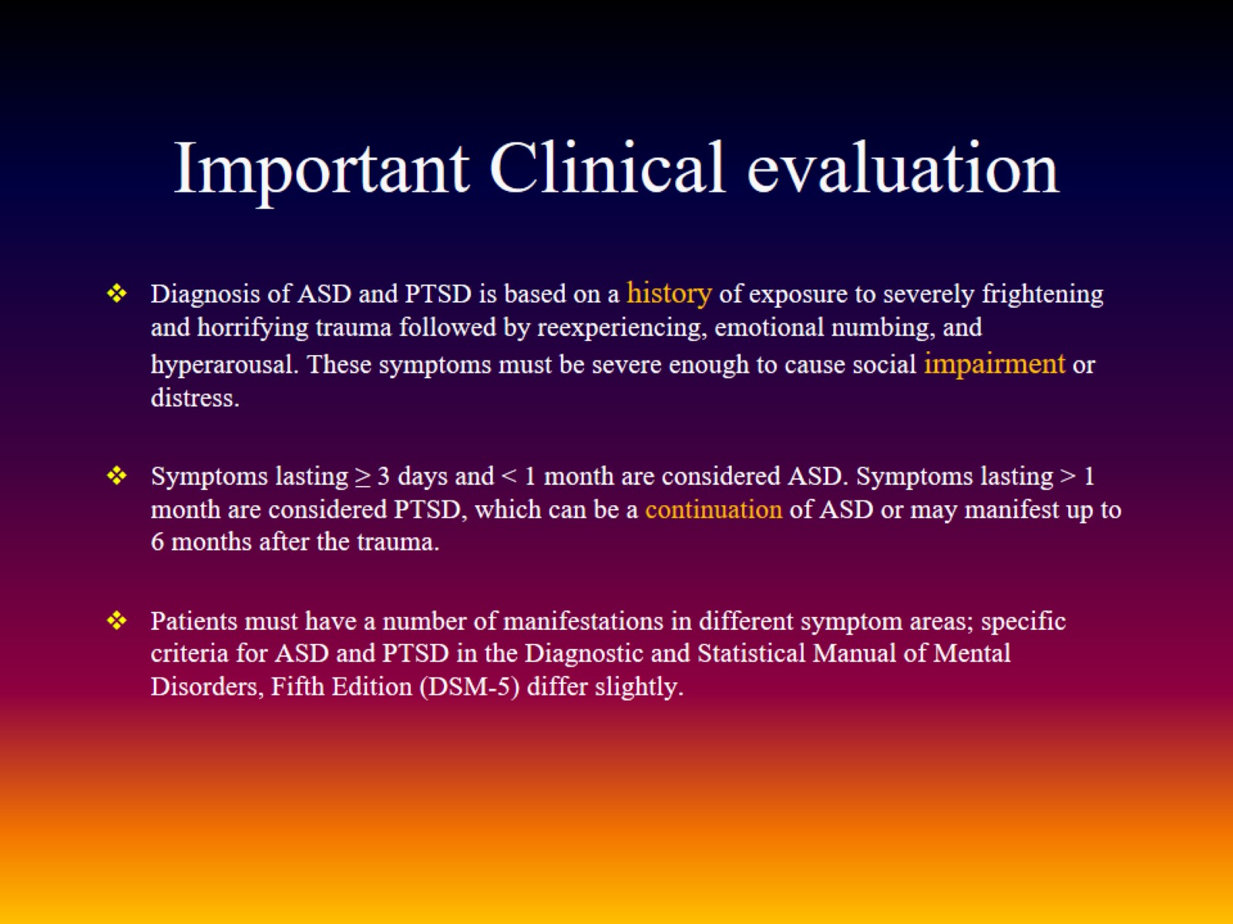
Important Clinical evaluation

Slide 17
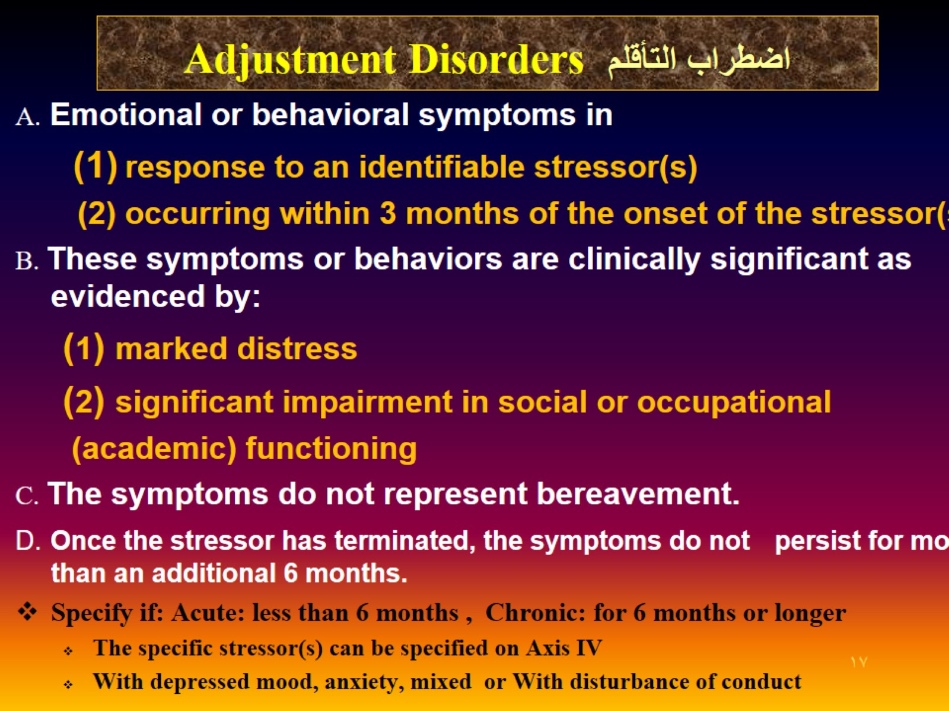
Adjustment Disorders اضطراب التأقلم

Slide 18
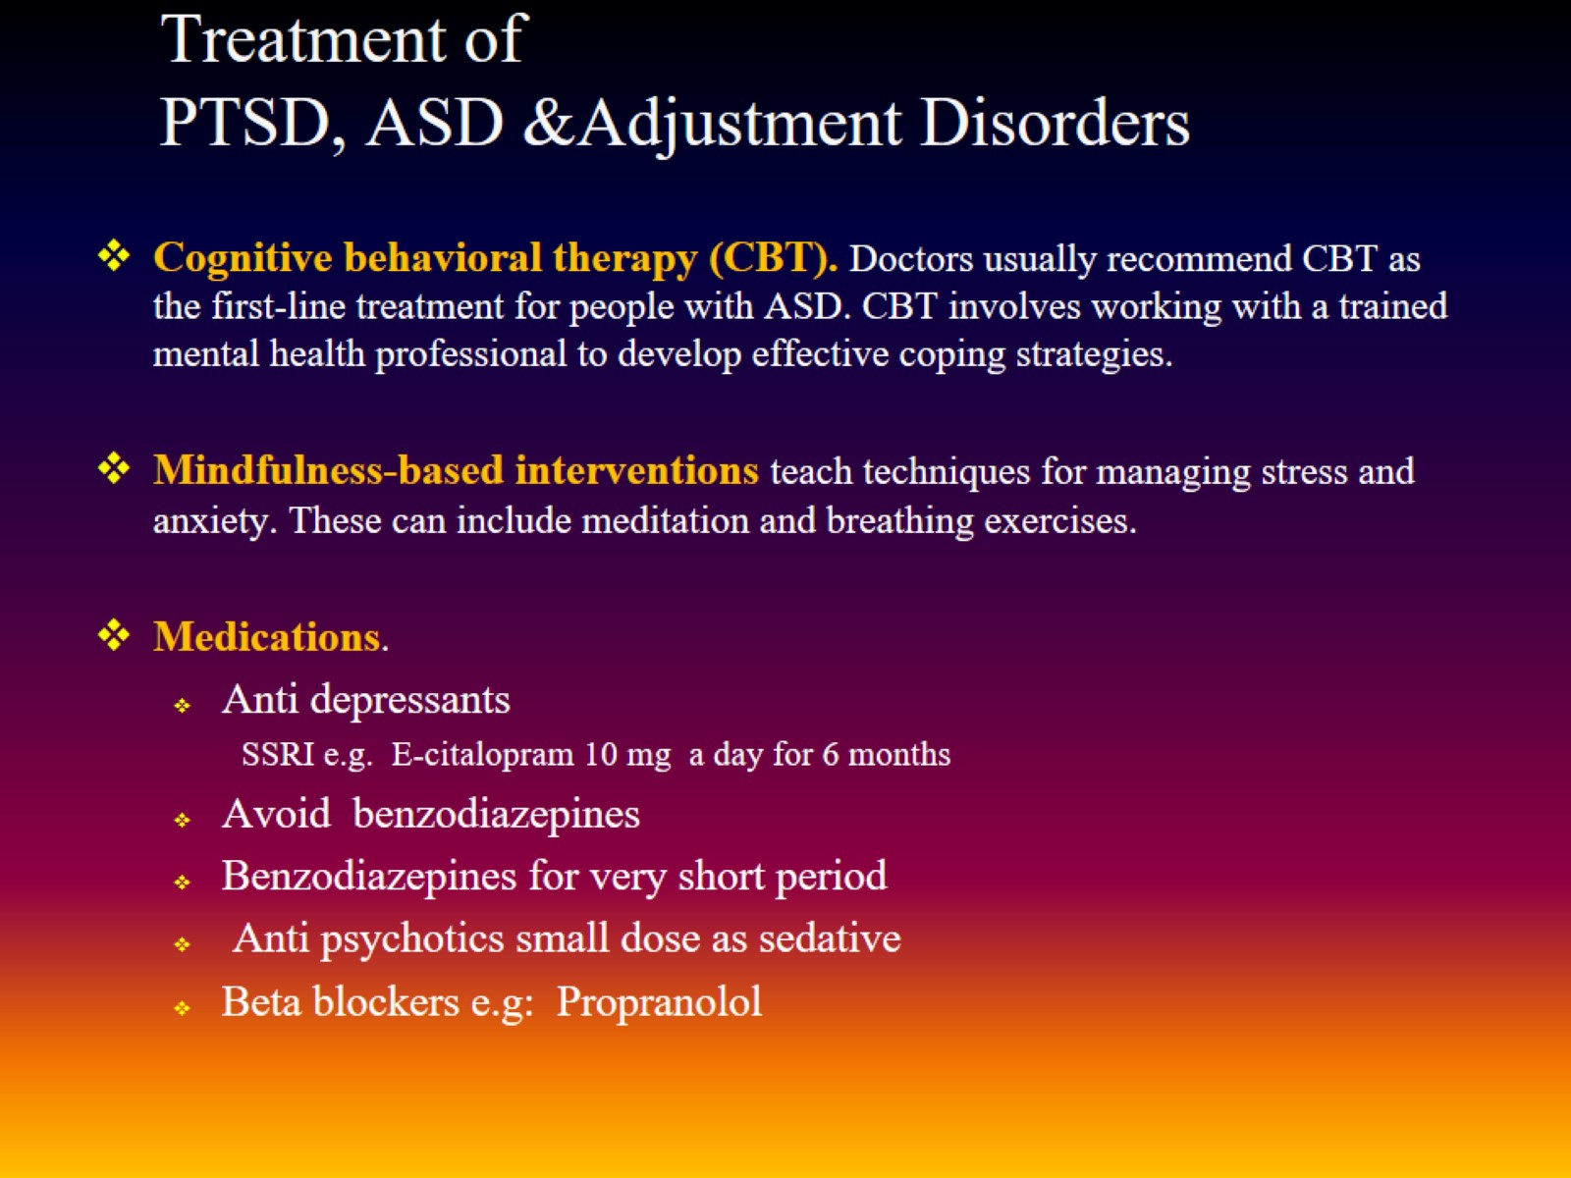
Treatment of PTSD, ASD &Adjustment Disorders

Slide 19
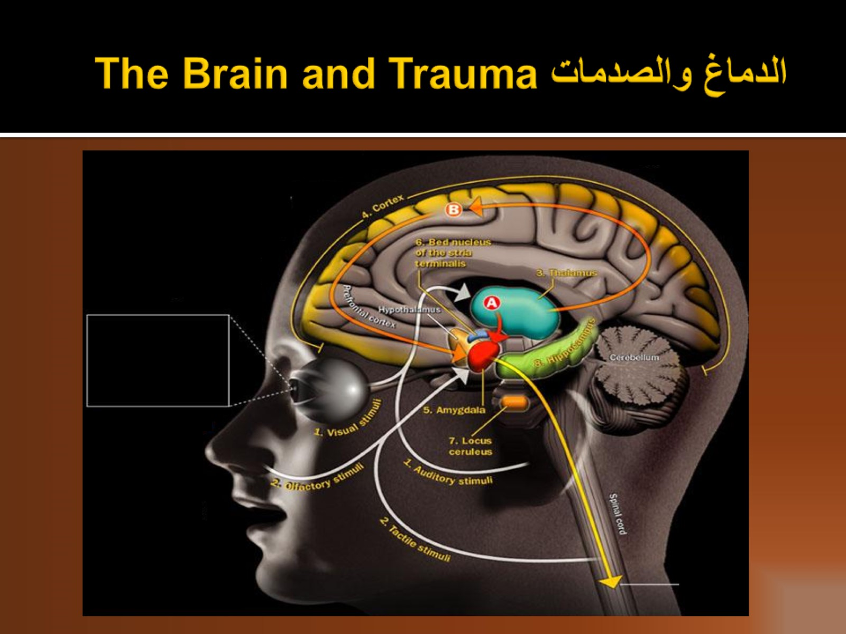
الدماغ والصدمات The Brain and Trauma

Slide 20
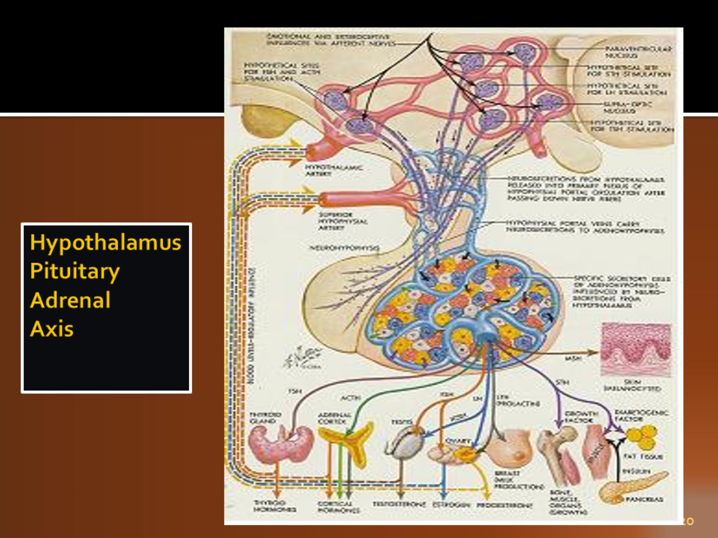
Hypothalamus Pituitary Adrenal Axis

Slide 21
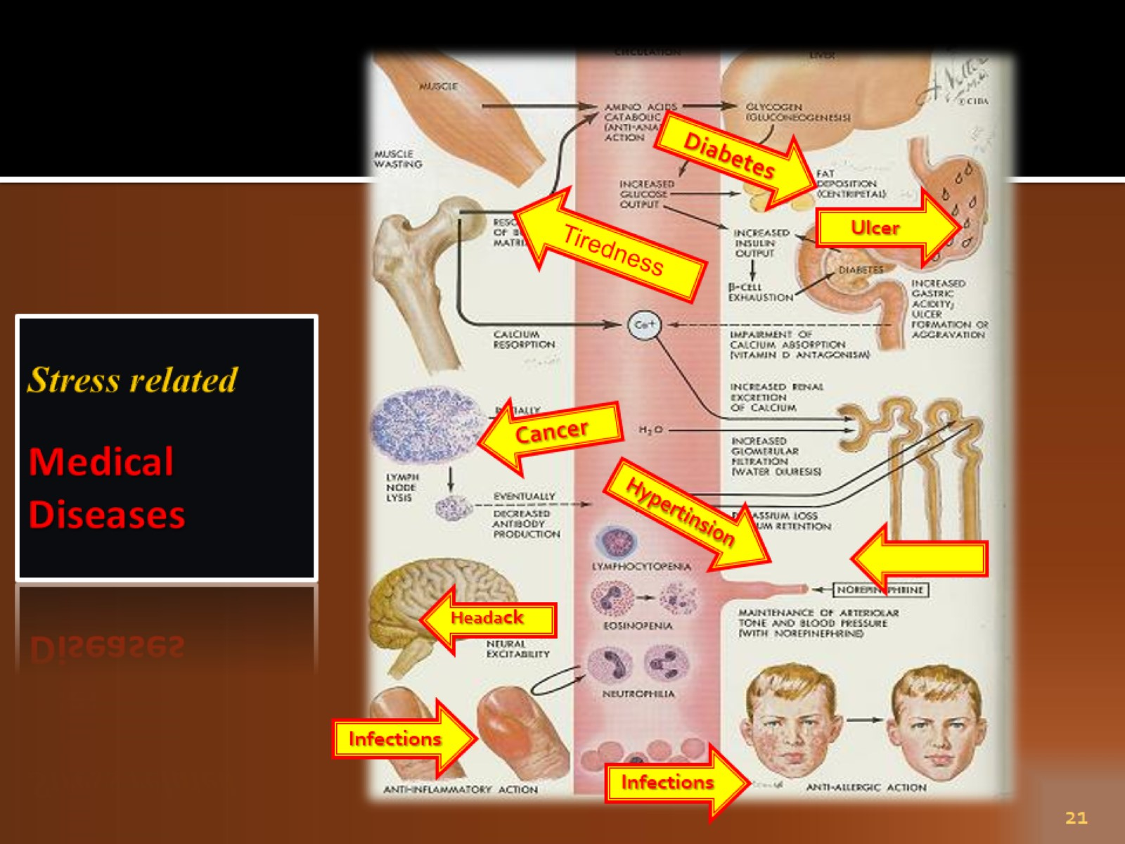
Stress related Medical Diseases

Slide 22
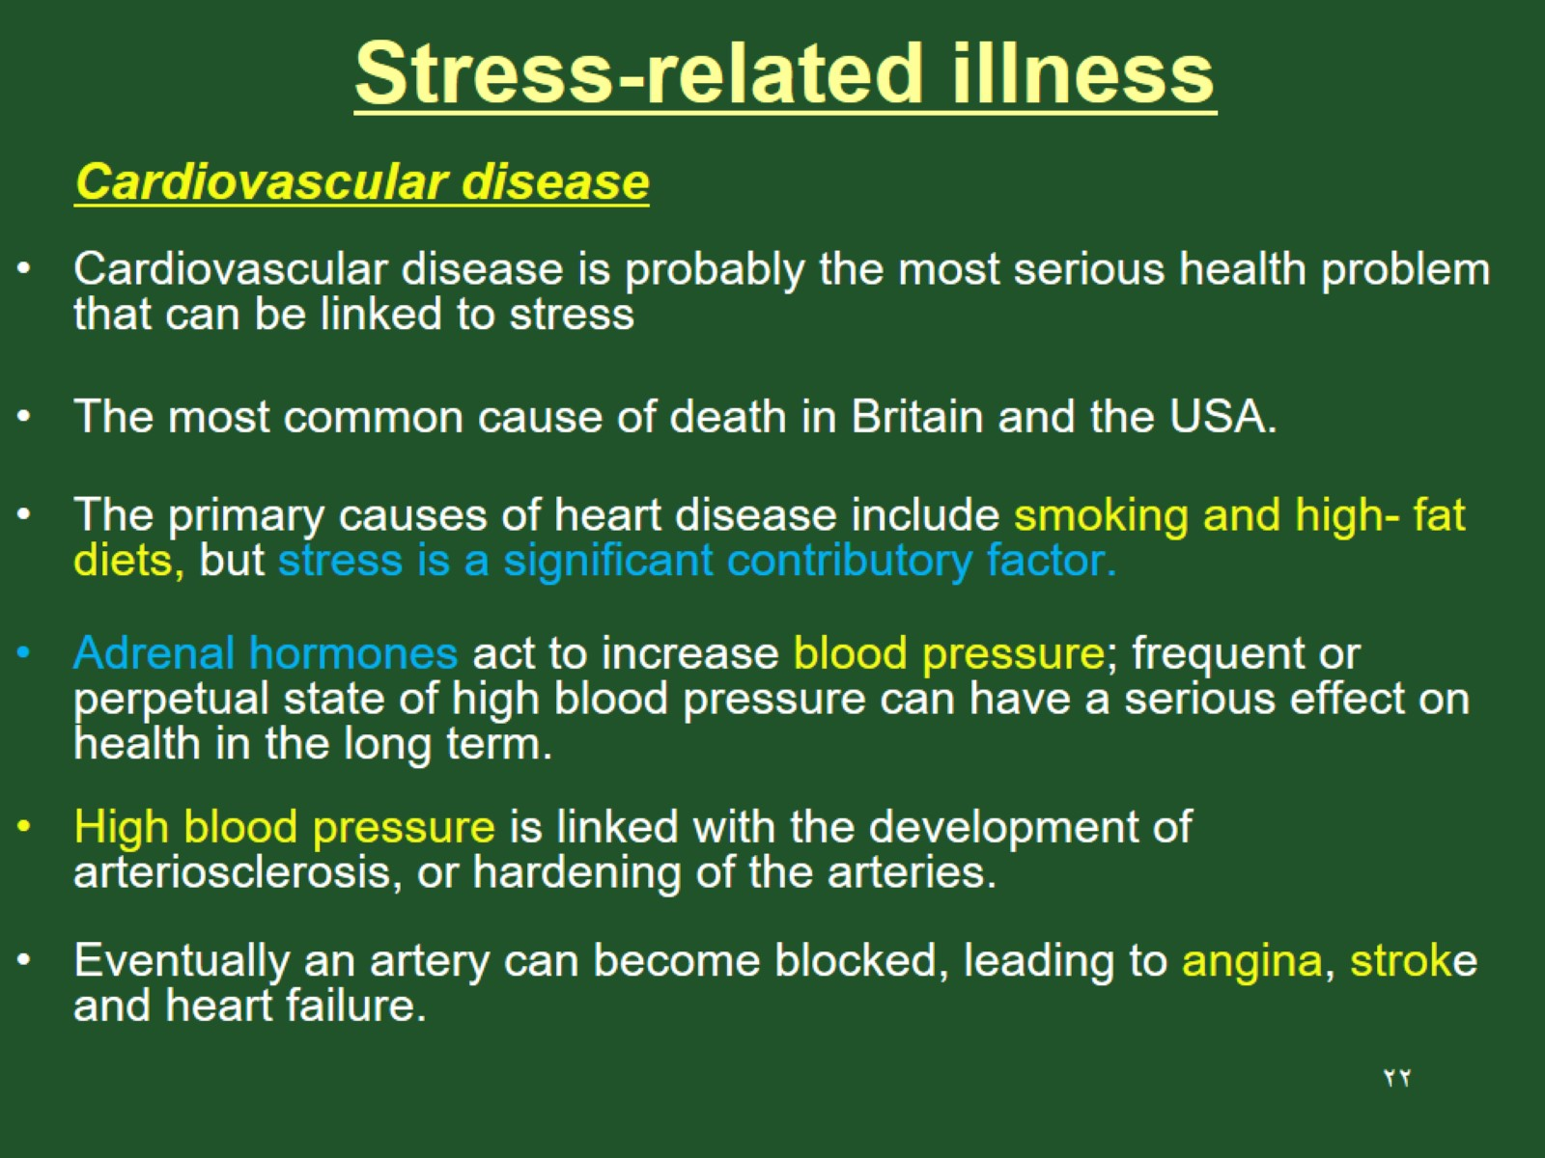
Stress-related illness

Slide 23
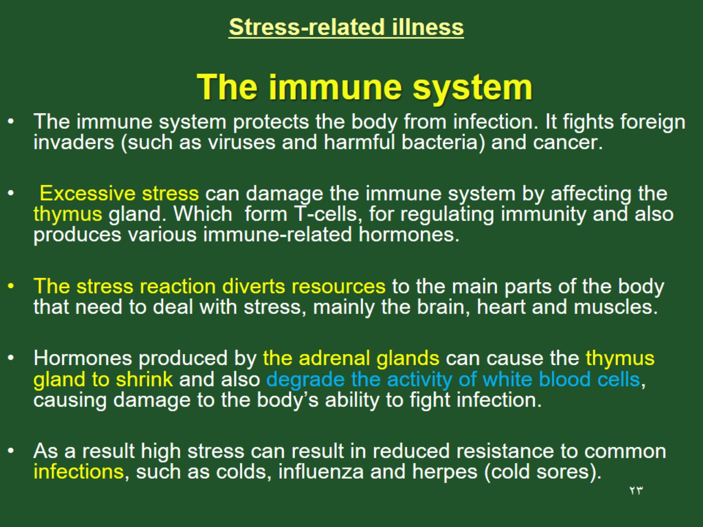
Stress-related illness

Slide 24
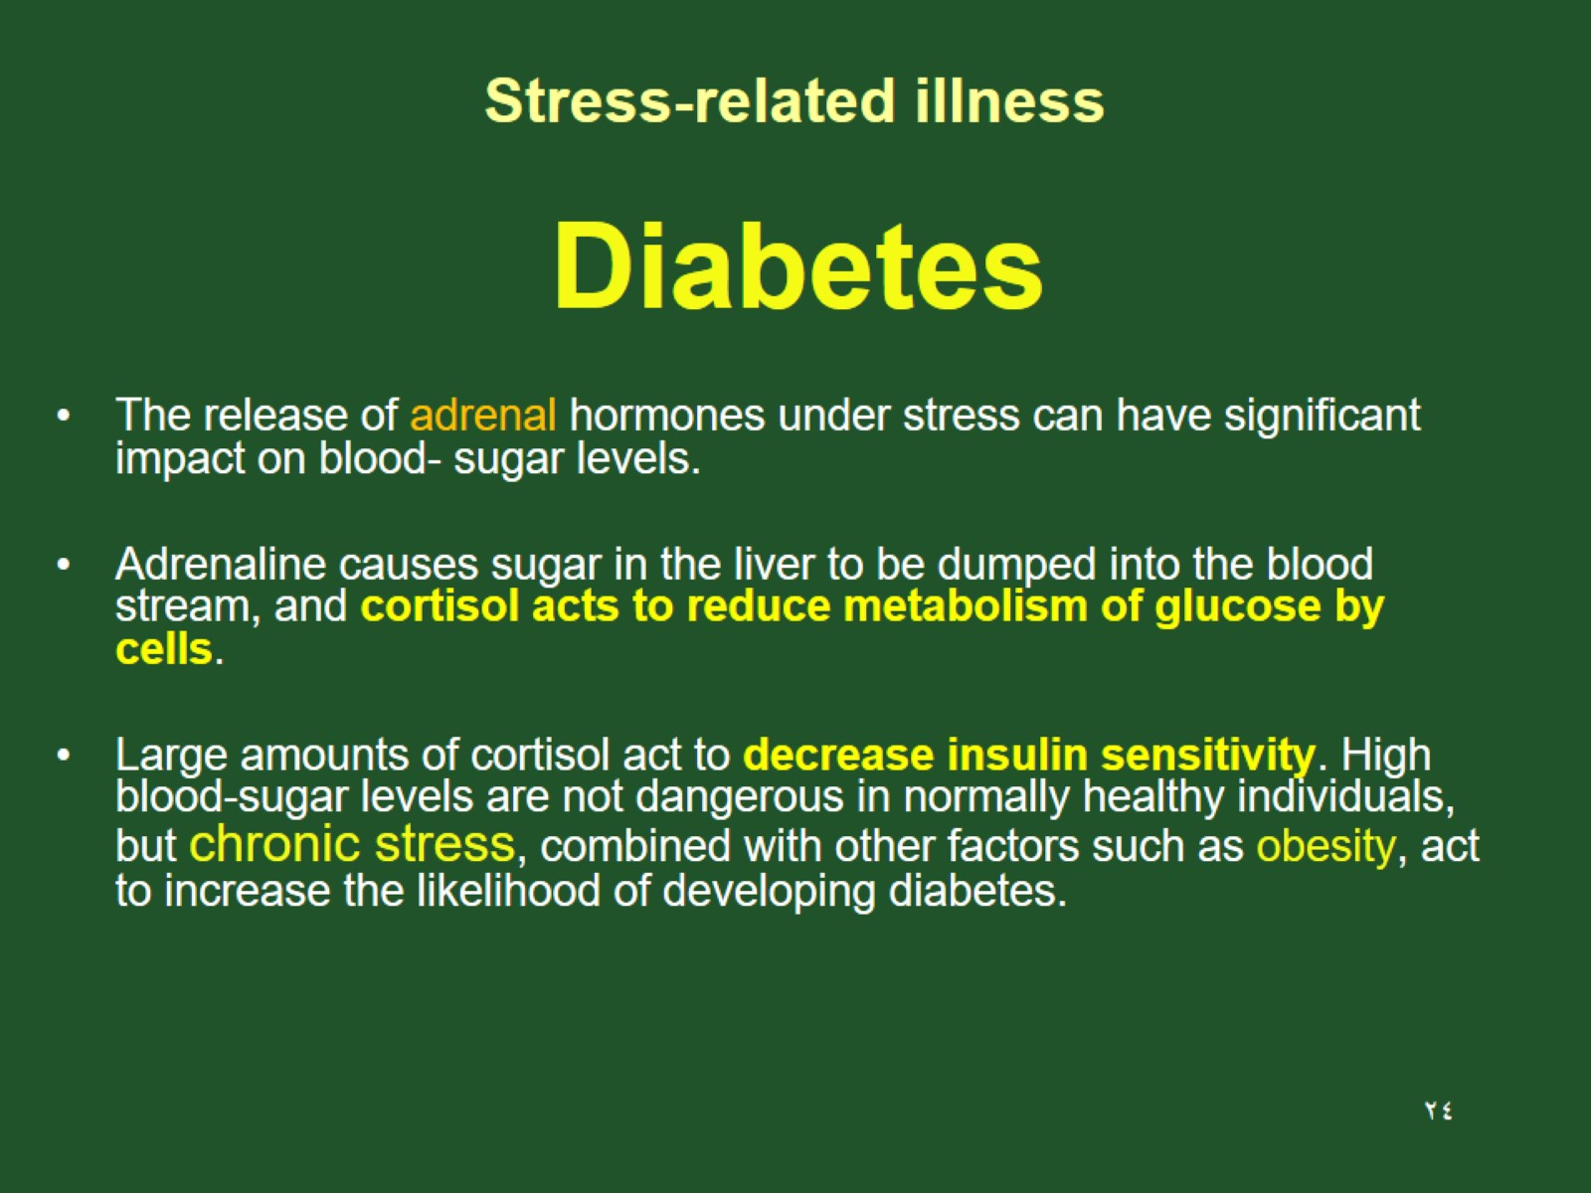
Stress-related illness

Slide 25
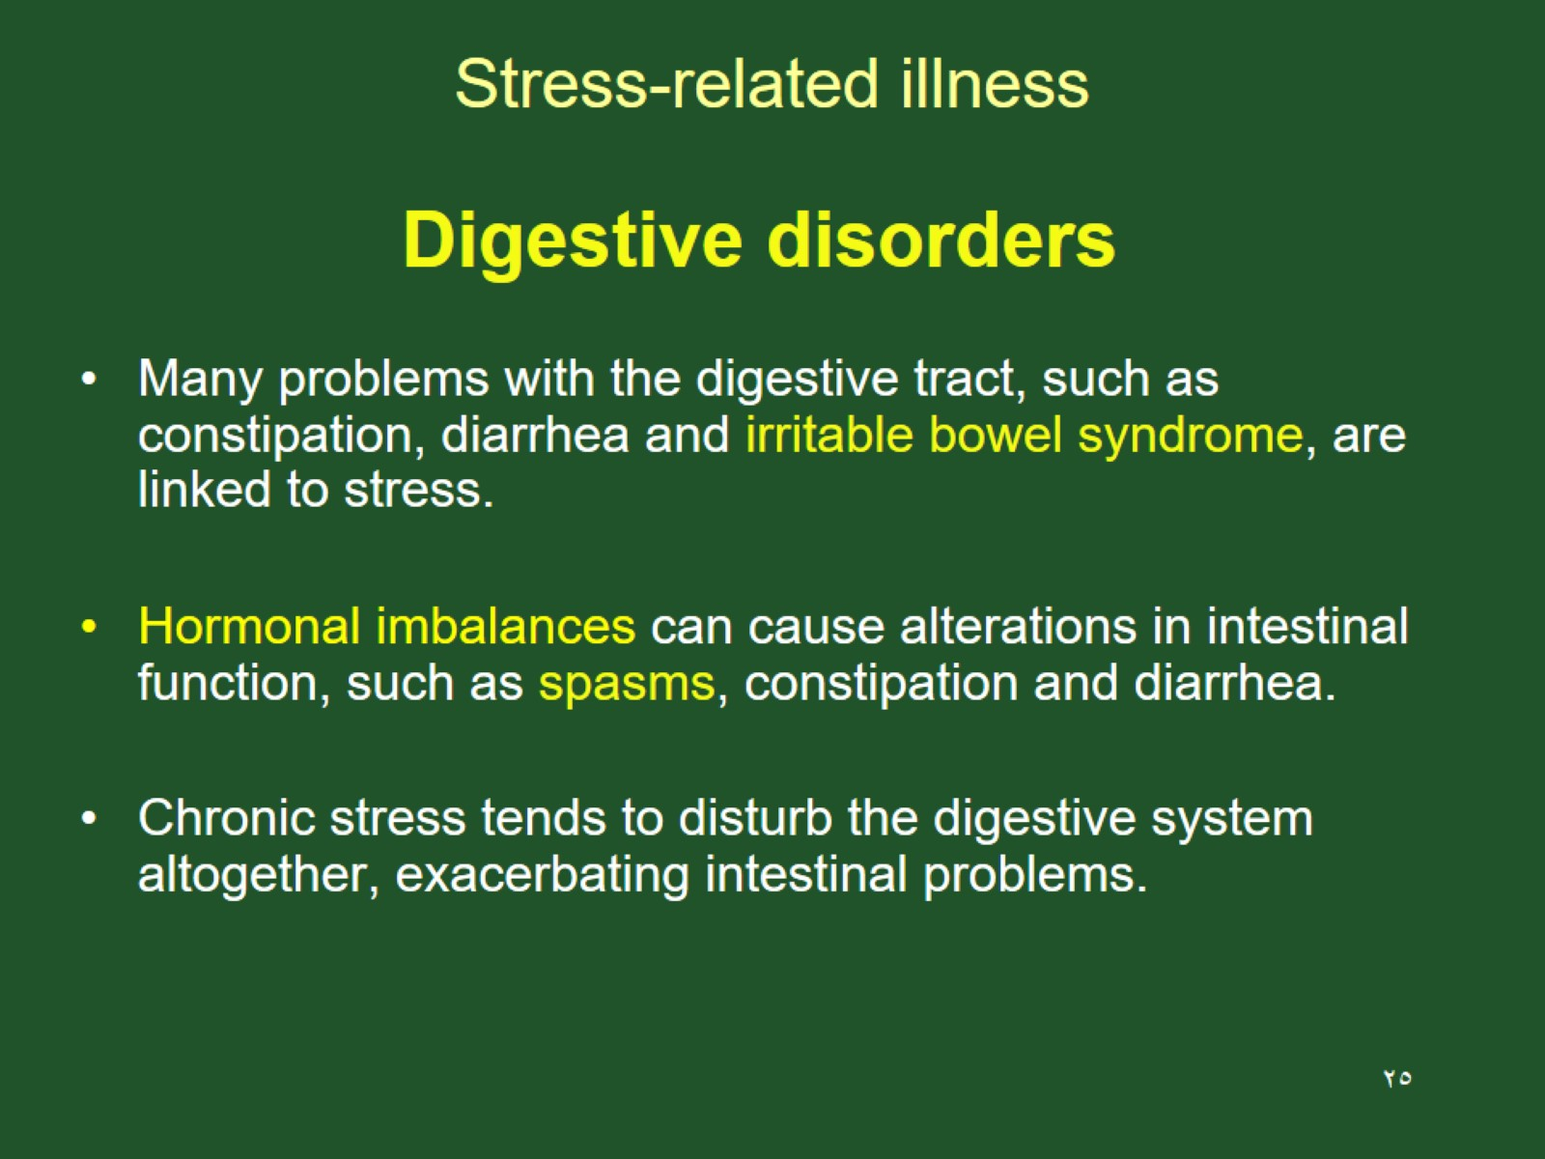
Stress-related illness

Slide 26
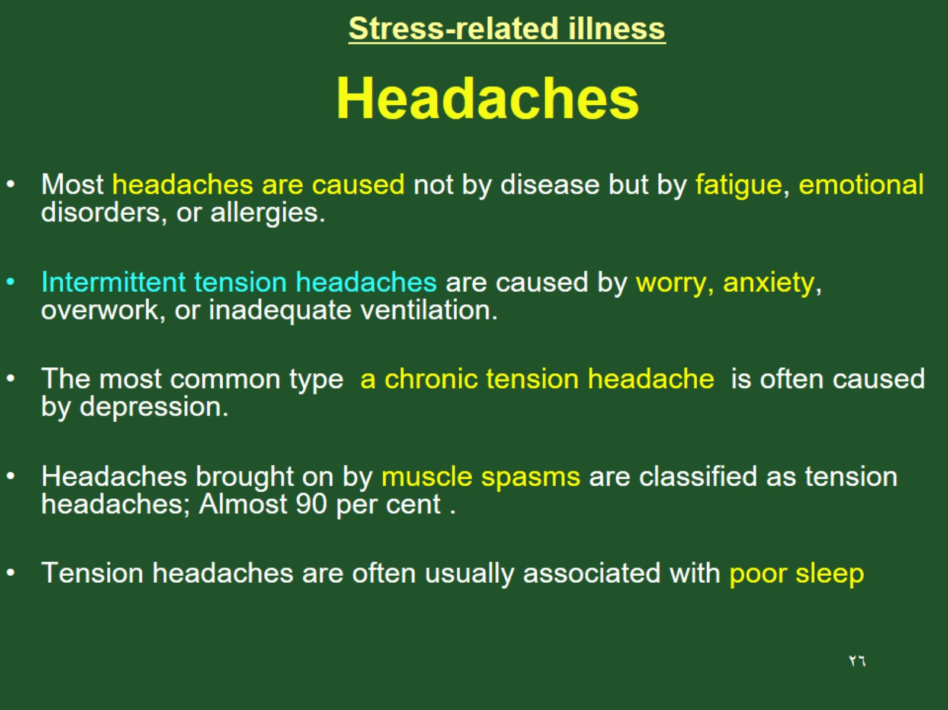
Stress-related illness

Slide 27
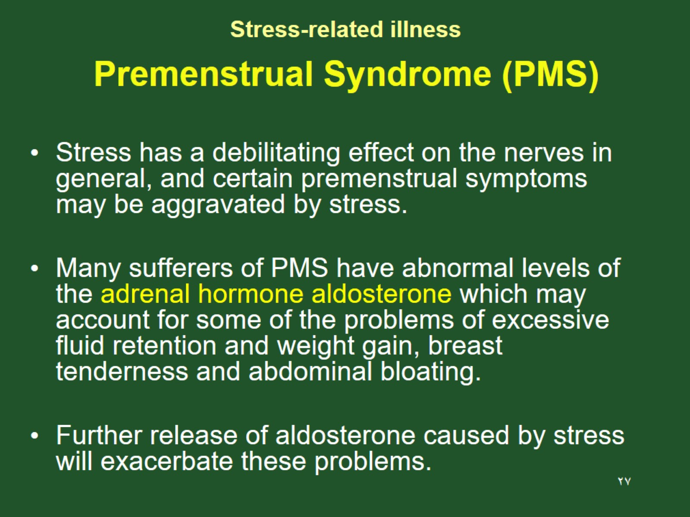
Stress-related illness

Slide 28
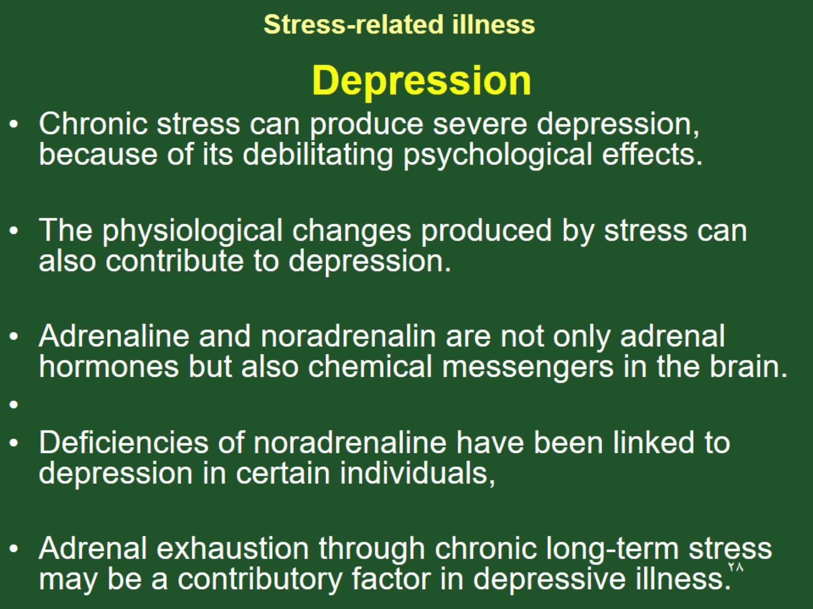
Stress-related illness

Slide 29
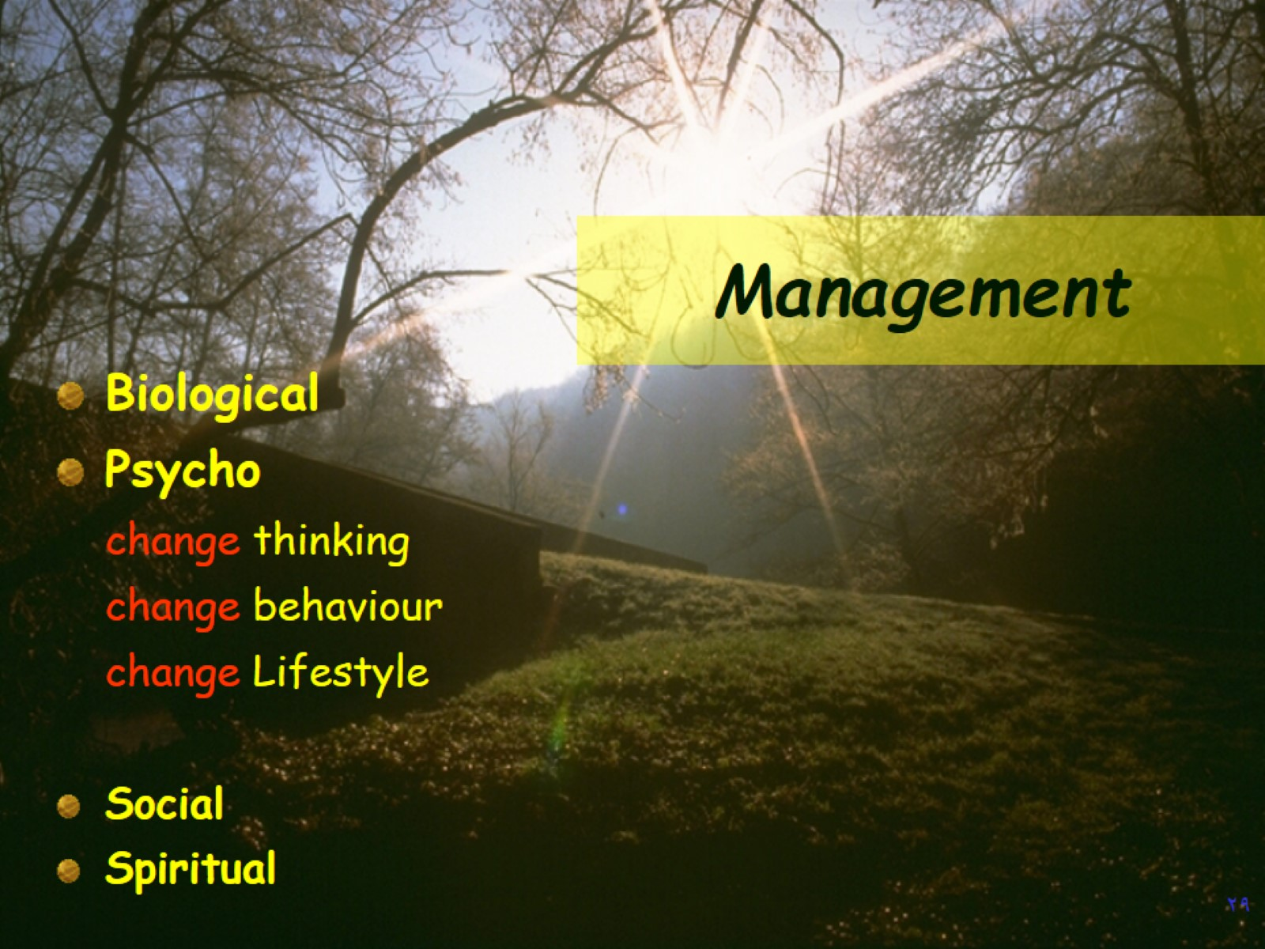
Management

Slide 30
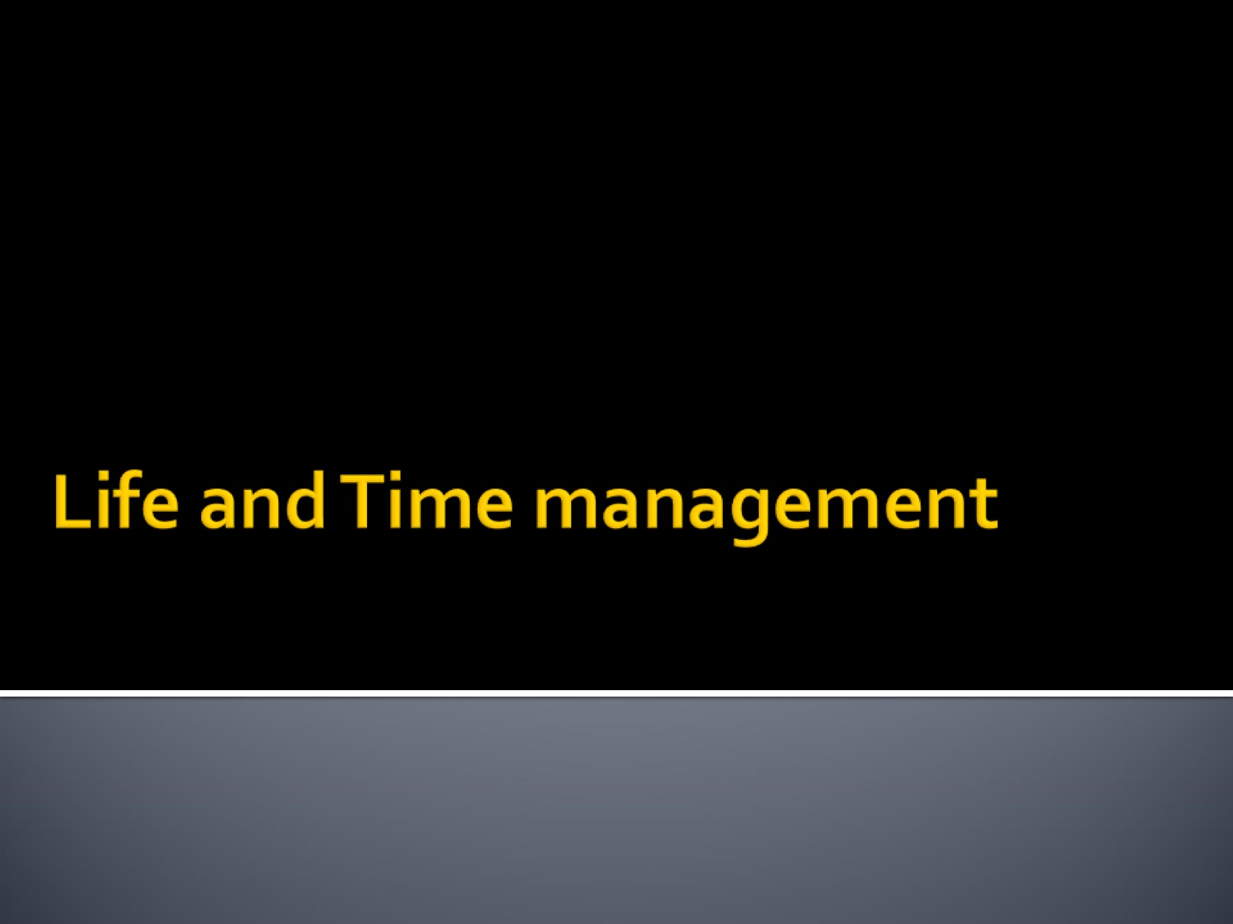
Life and Time management

Slide 31
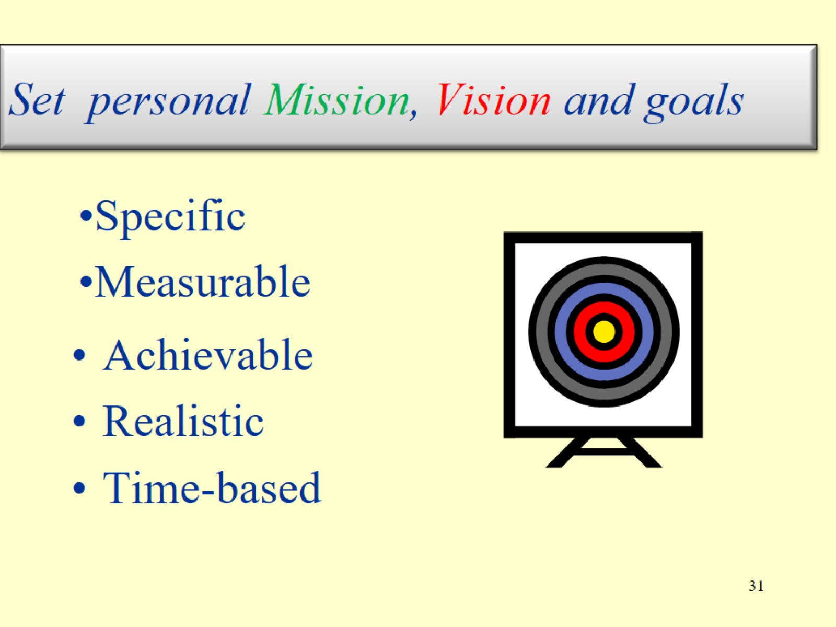
Set personal Mission, Vision and goals

Slide 32
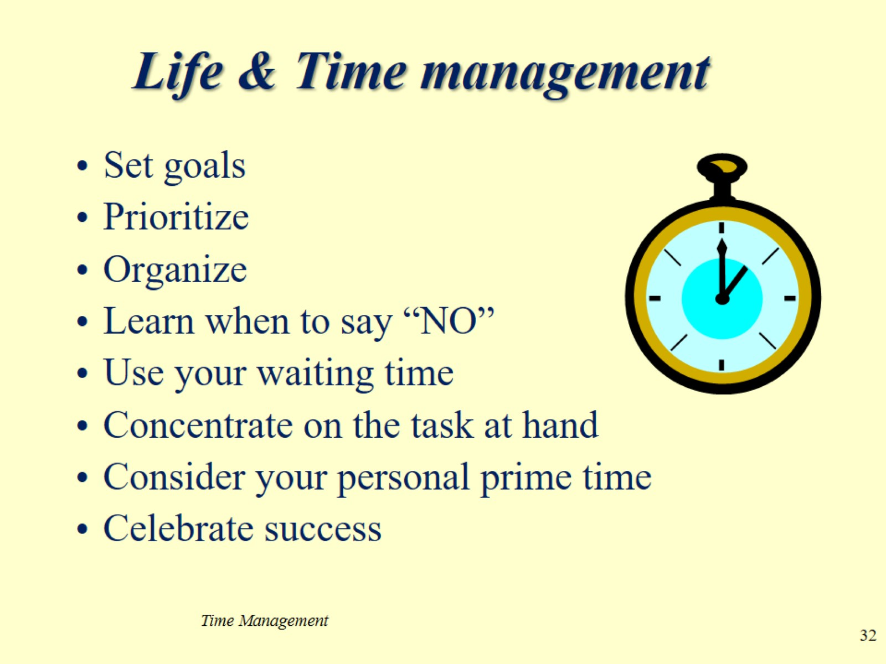
Life & Time management

Slide 33
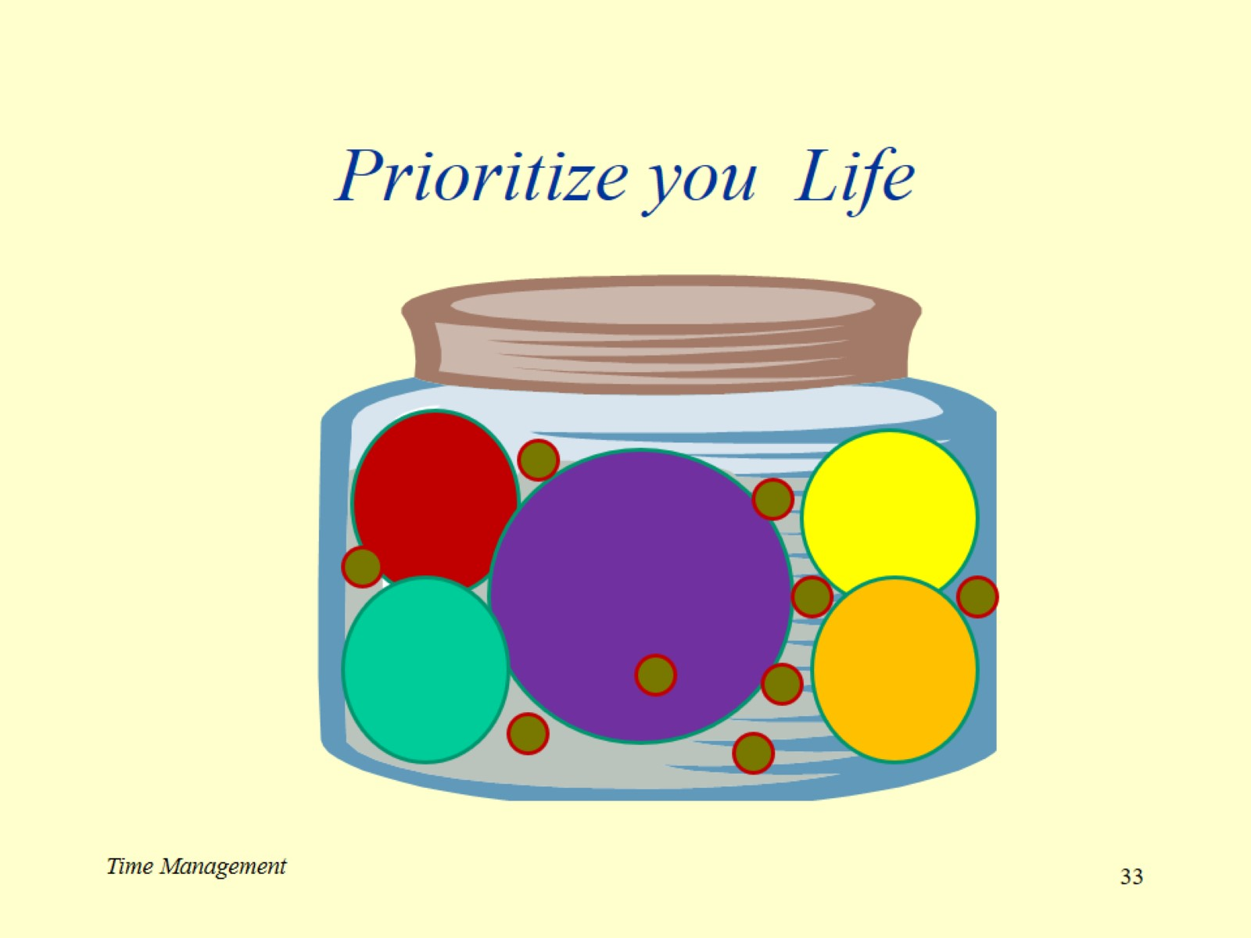
Prioritize you Life

Slide 34
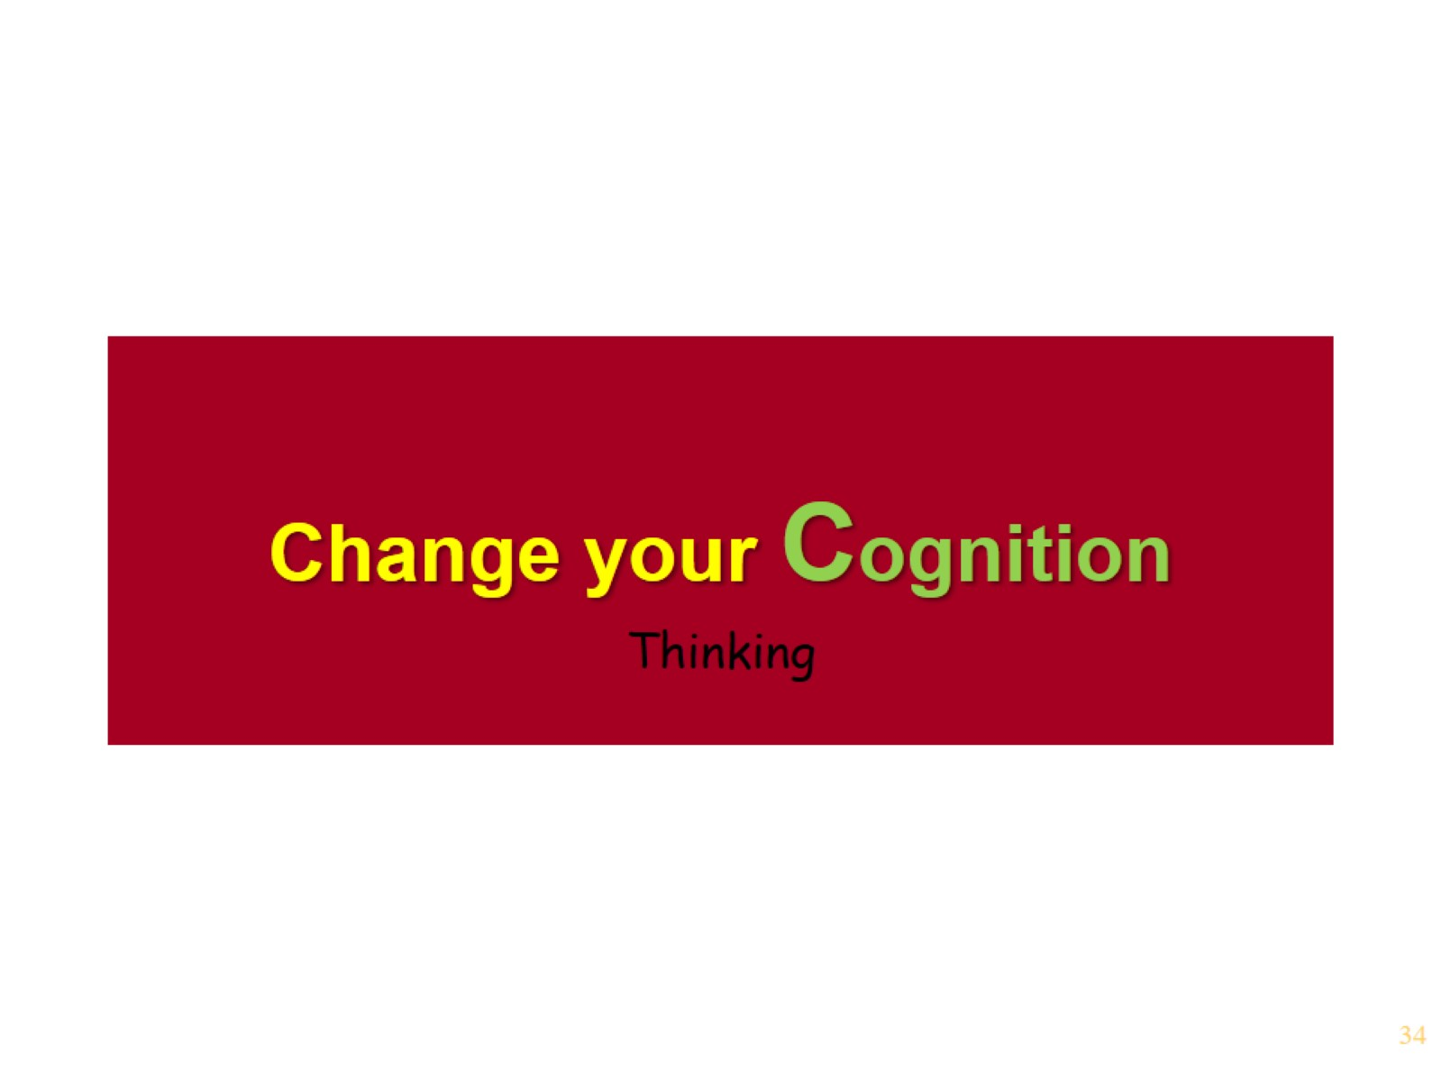
Change your Cognition

Slide 35
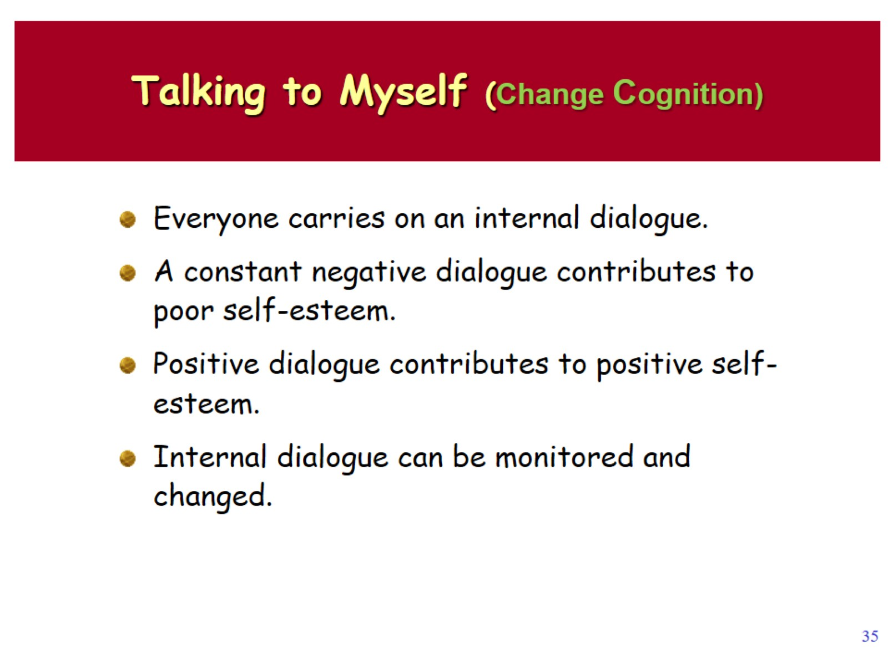
Talking to Myself (Change Cognition)

Slide 36
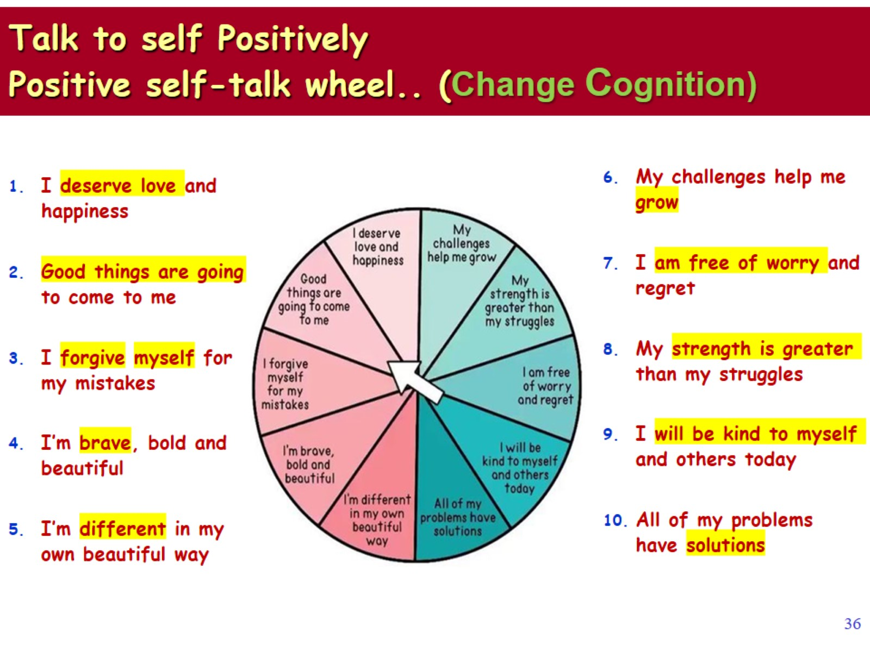
Talk to self Positively Positive self-talk wheel.. (Change Cognition)

Slide 37
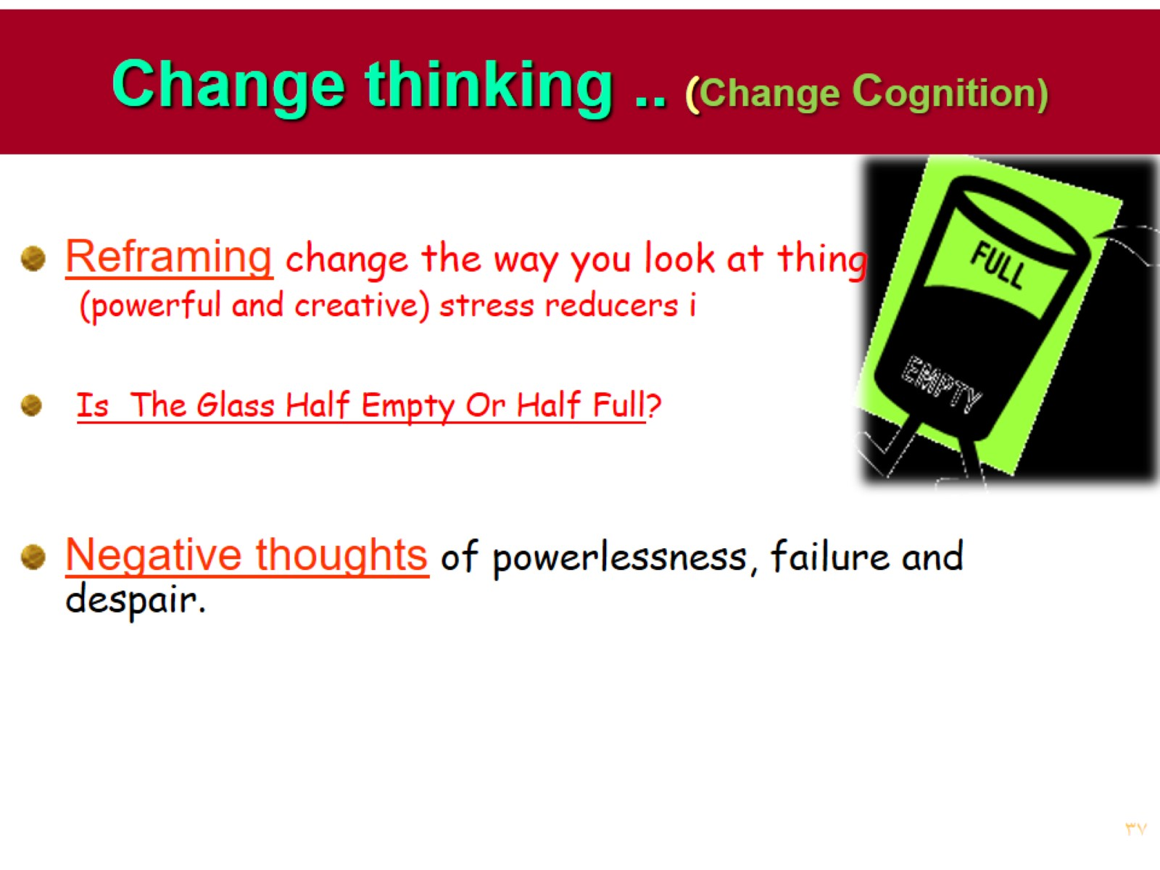
Change thinking .. (Change Cognition)

Slide 38
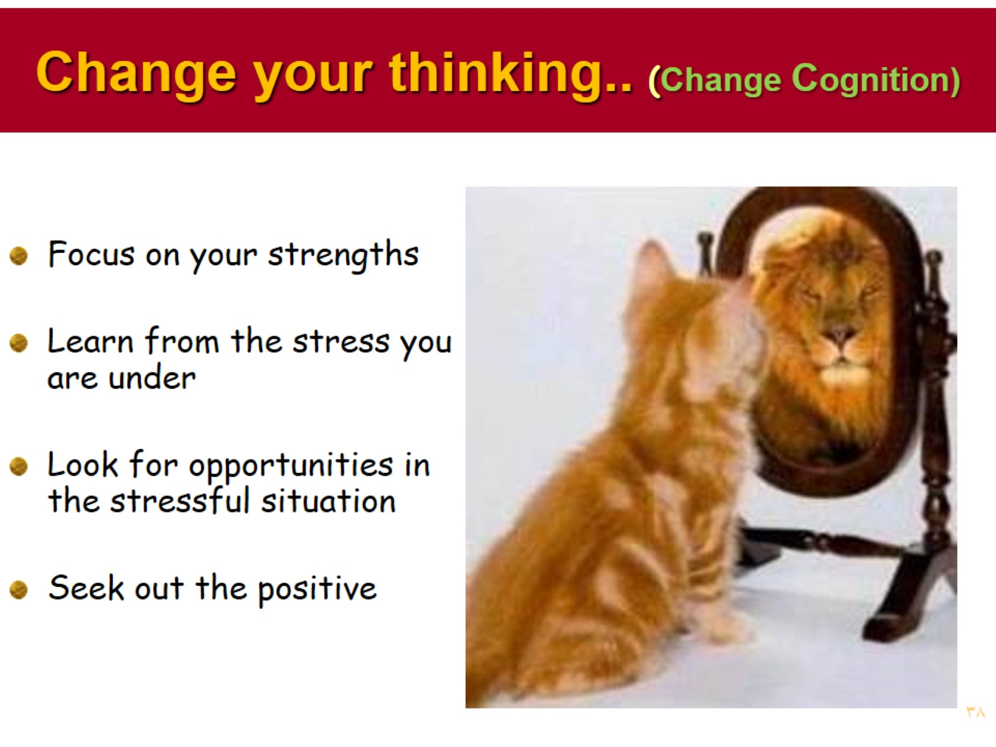
Change your thinking.. (Change Cognition)

Slide 39
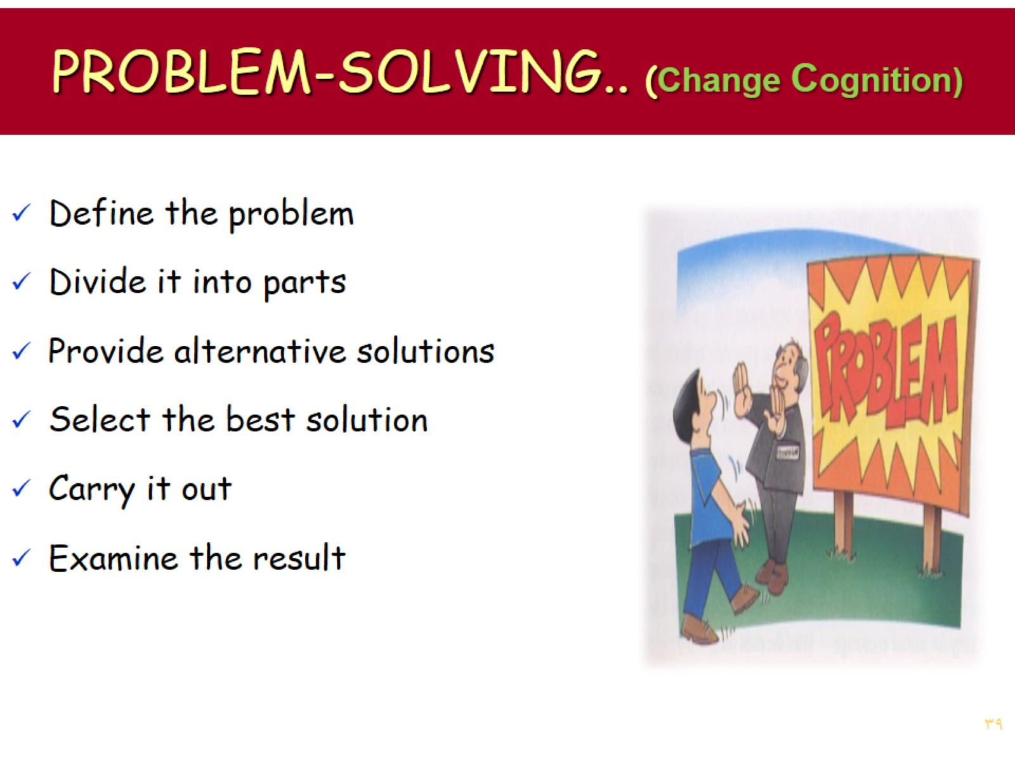
PROBLEM-SOLVING.. (Change Cognition)

Slide 40
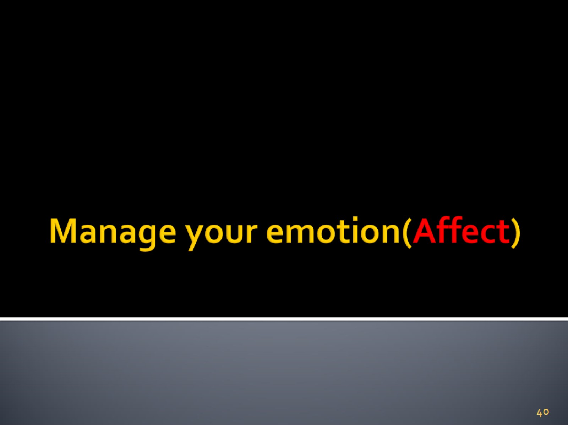
Manage your emotion(Affect)

Slide 41
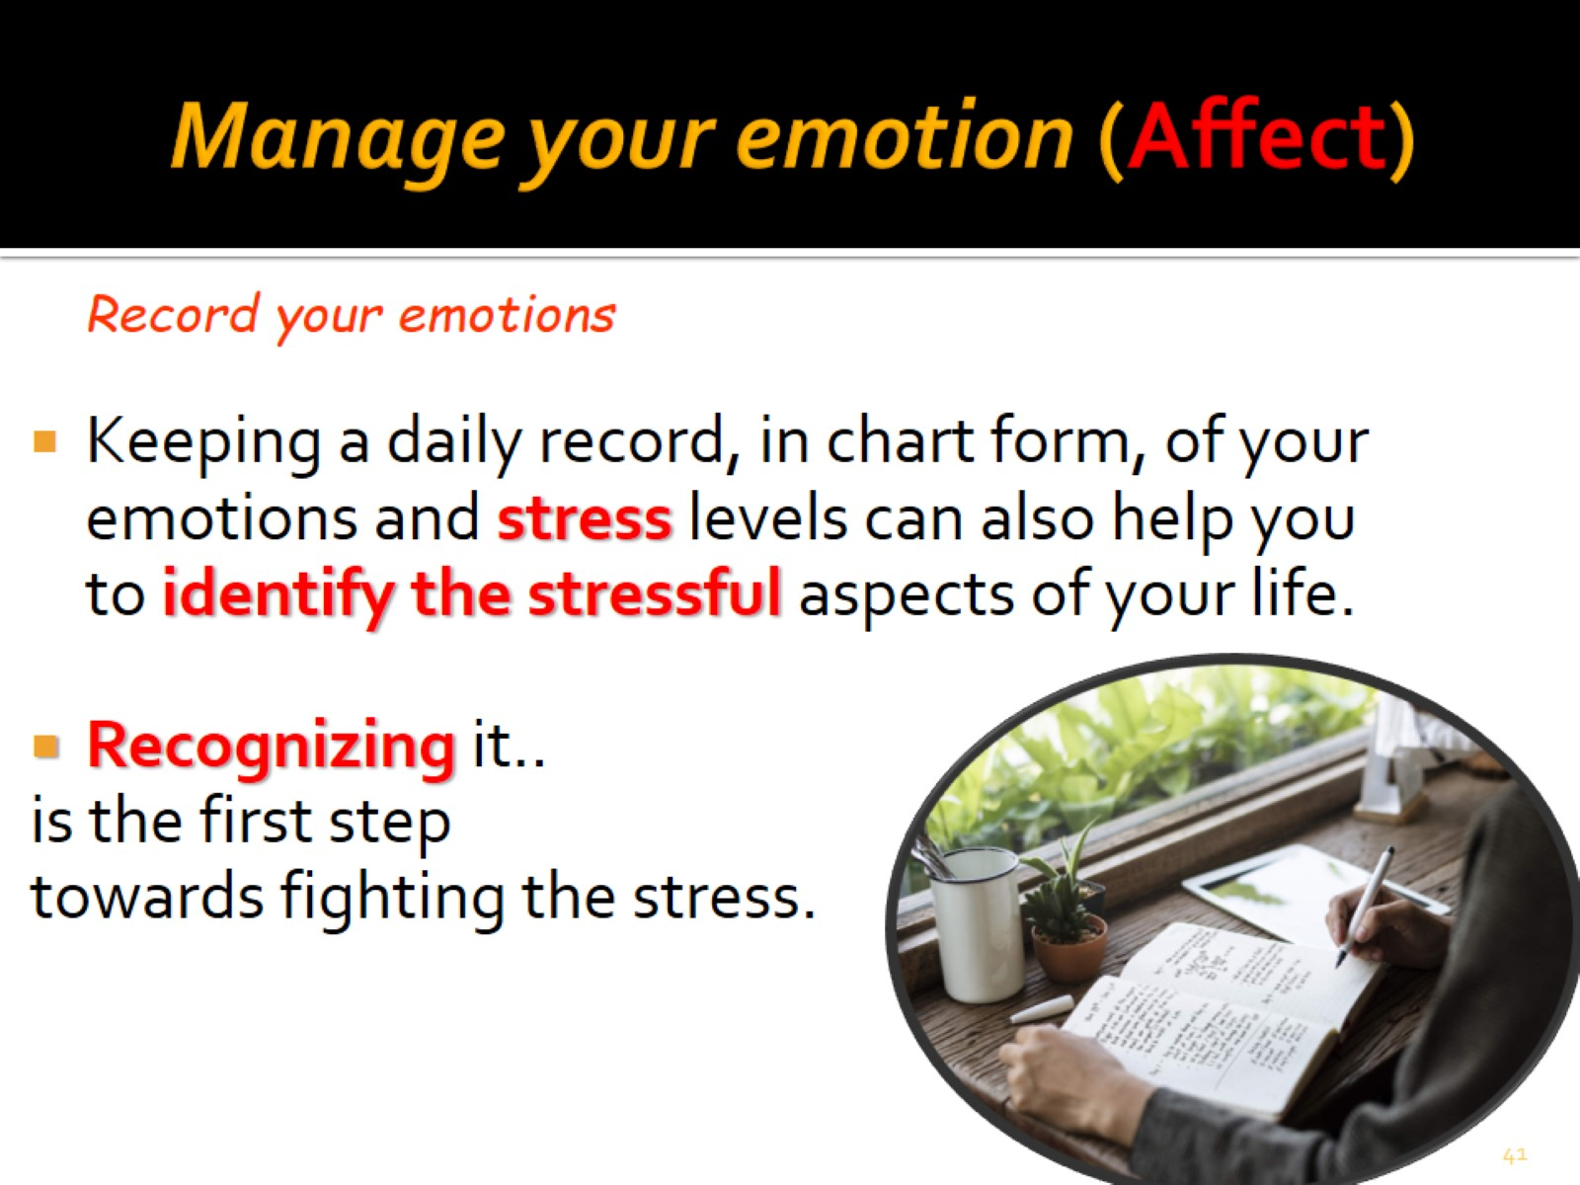
Manage your emotion (Affect)

Slide 42
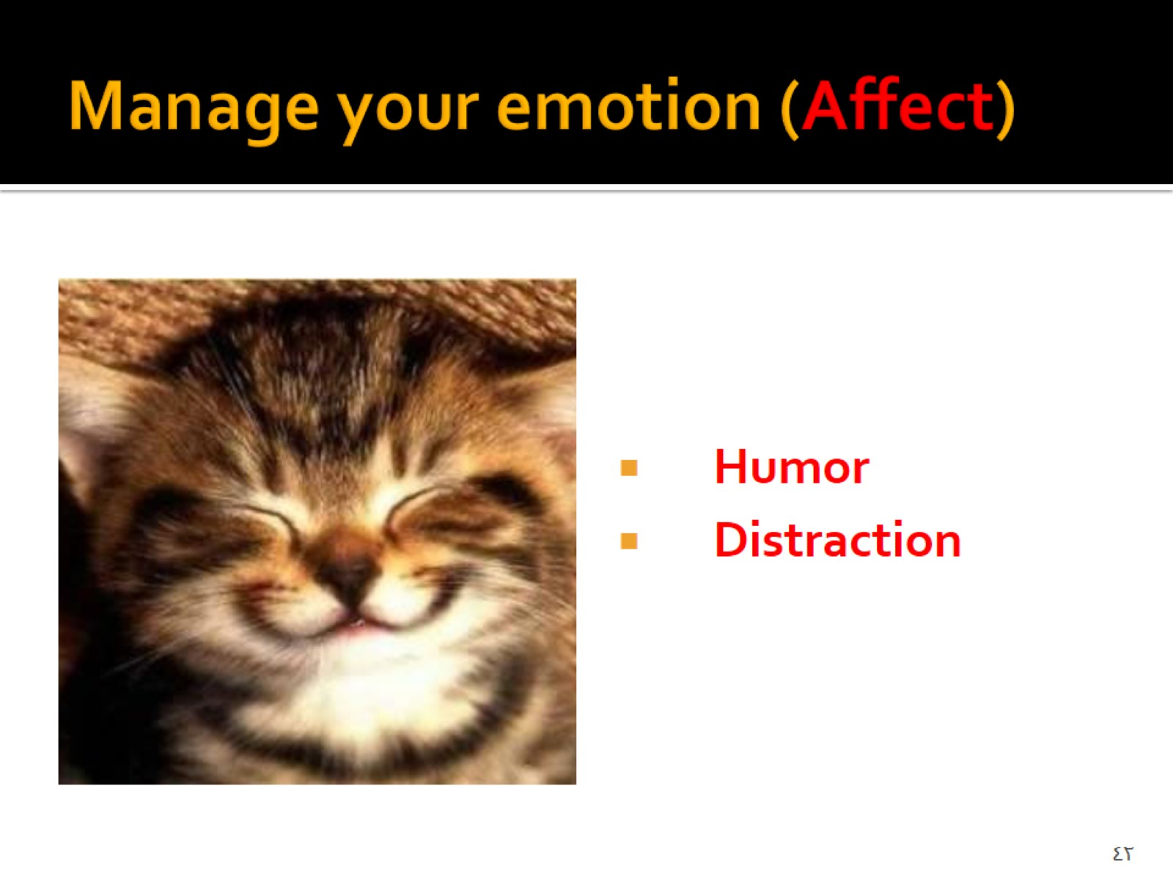
Manage your emotion (Affect)

Slide 43
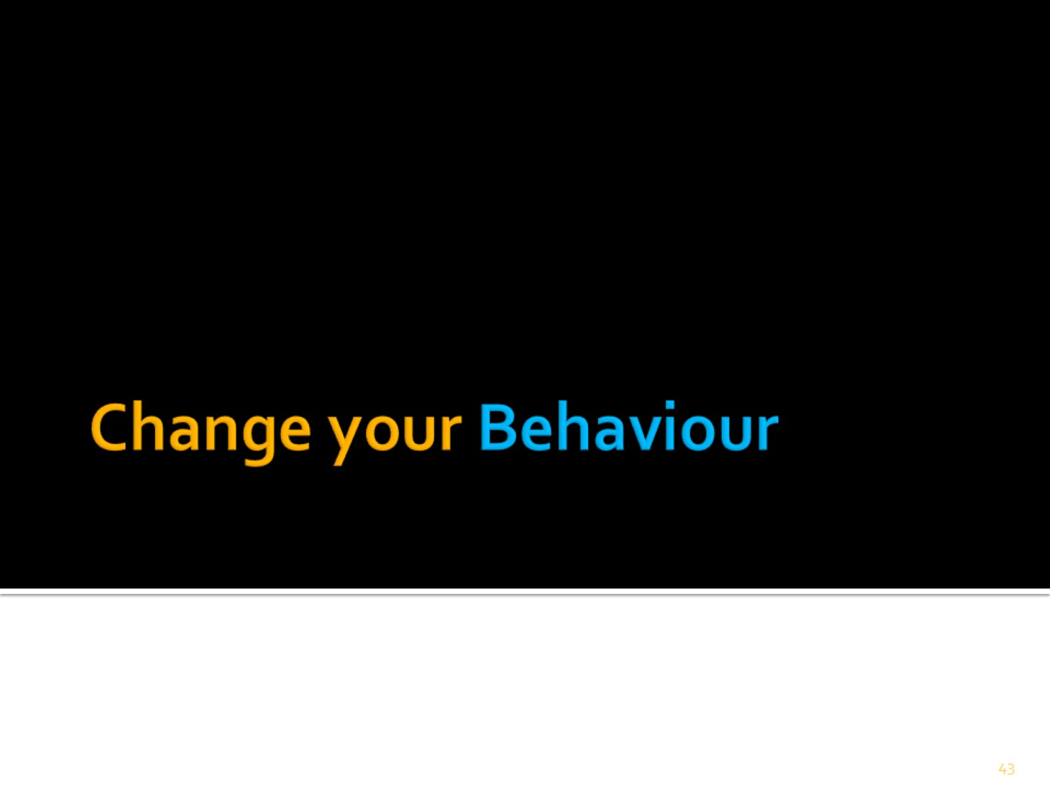
Change your Behaviour

Slide 44
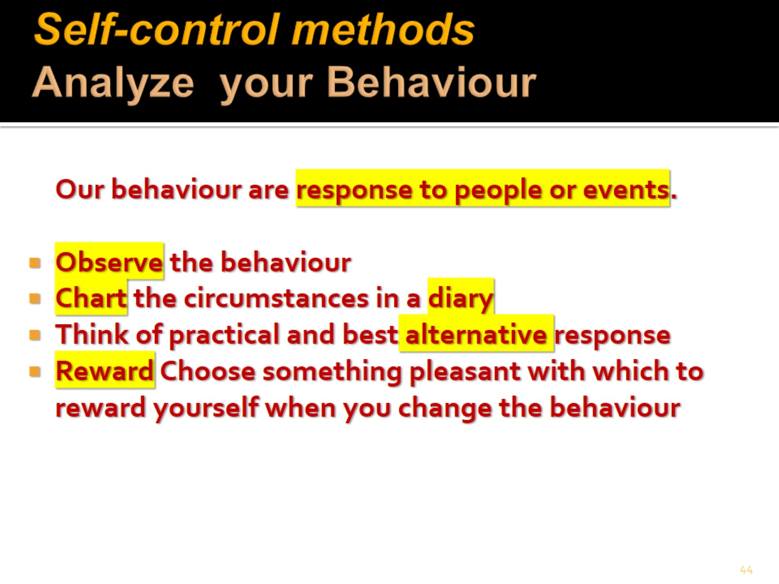
Self-control methods Analyze your Behaviour

Slide 45
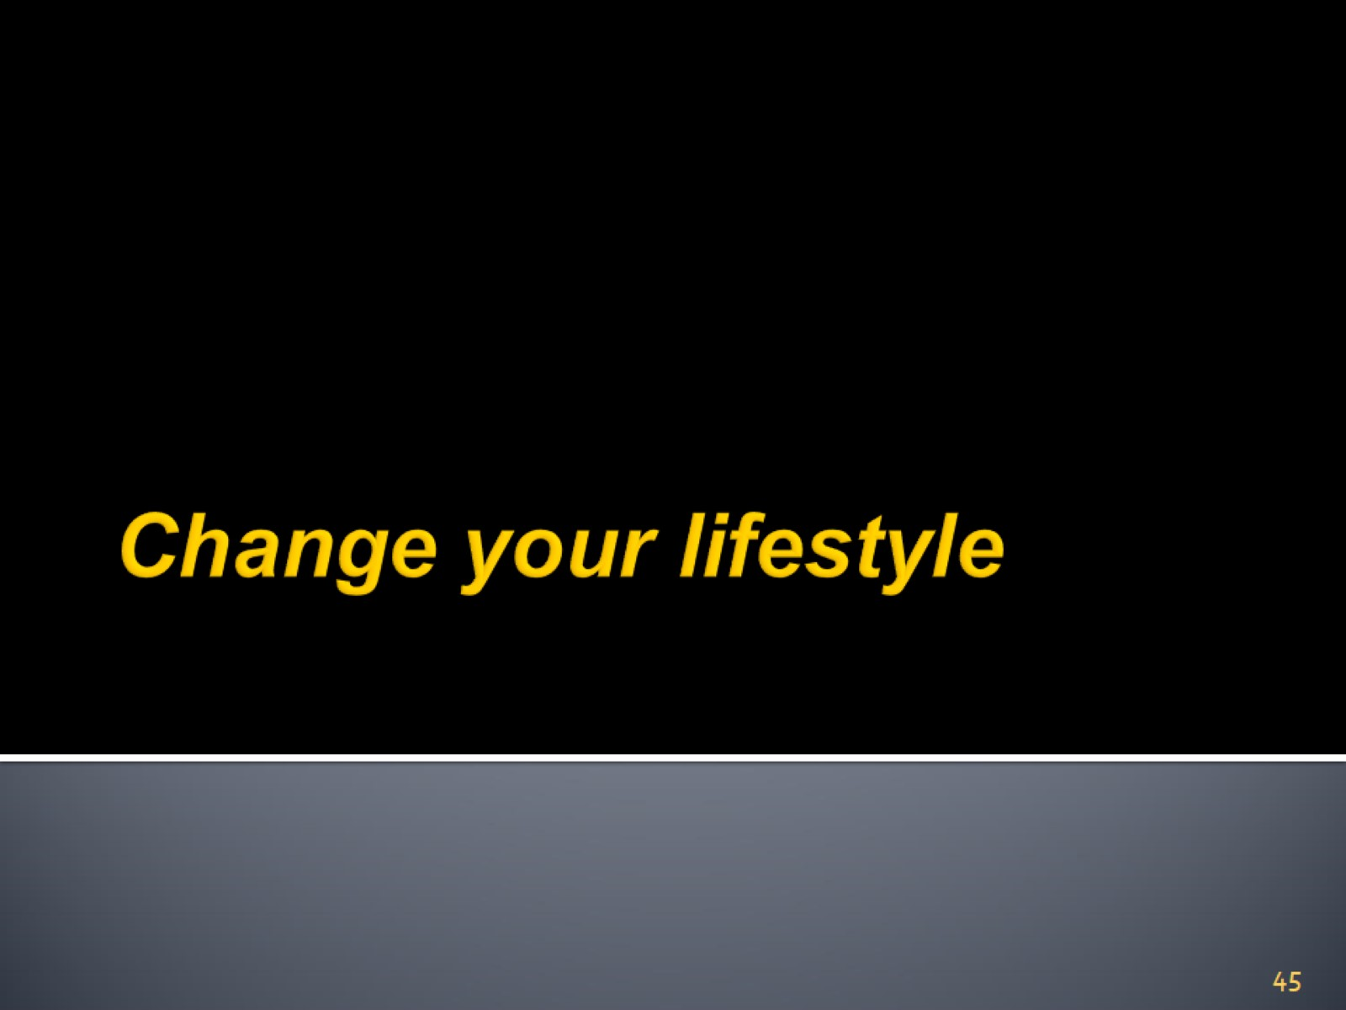
Change your lifestyle

Slide 46
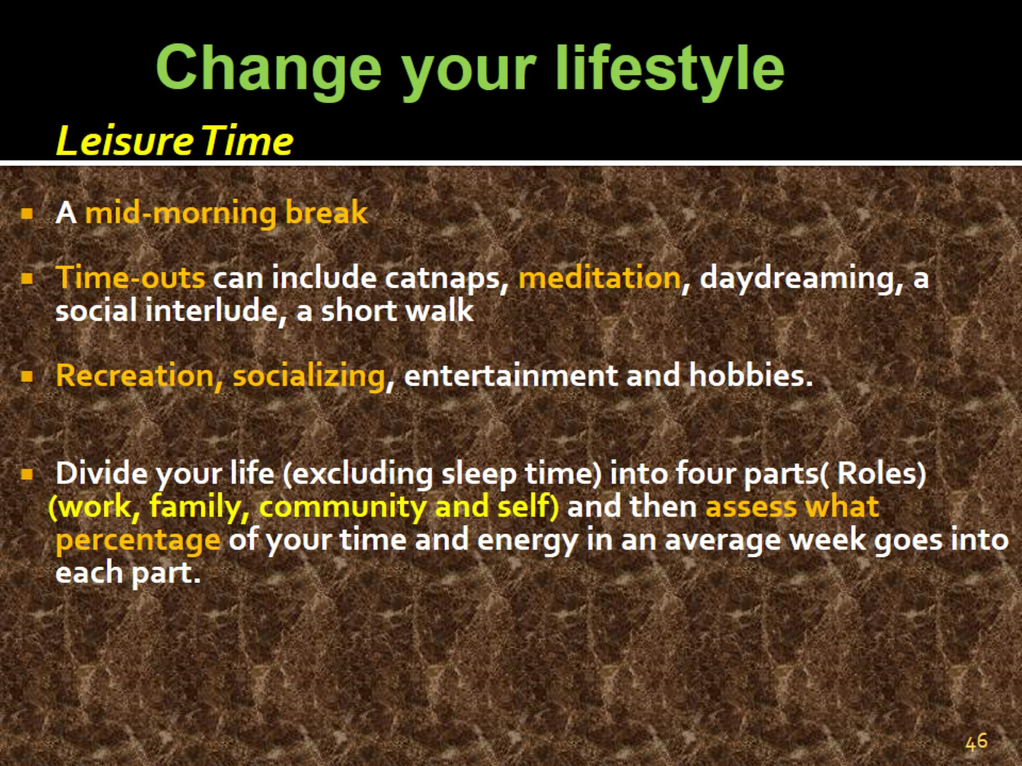

Slide 47
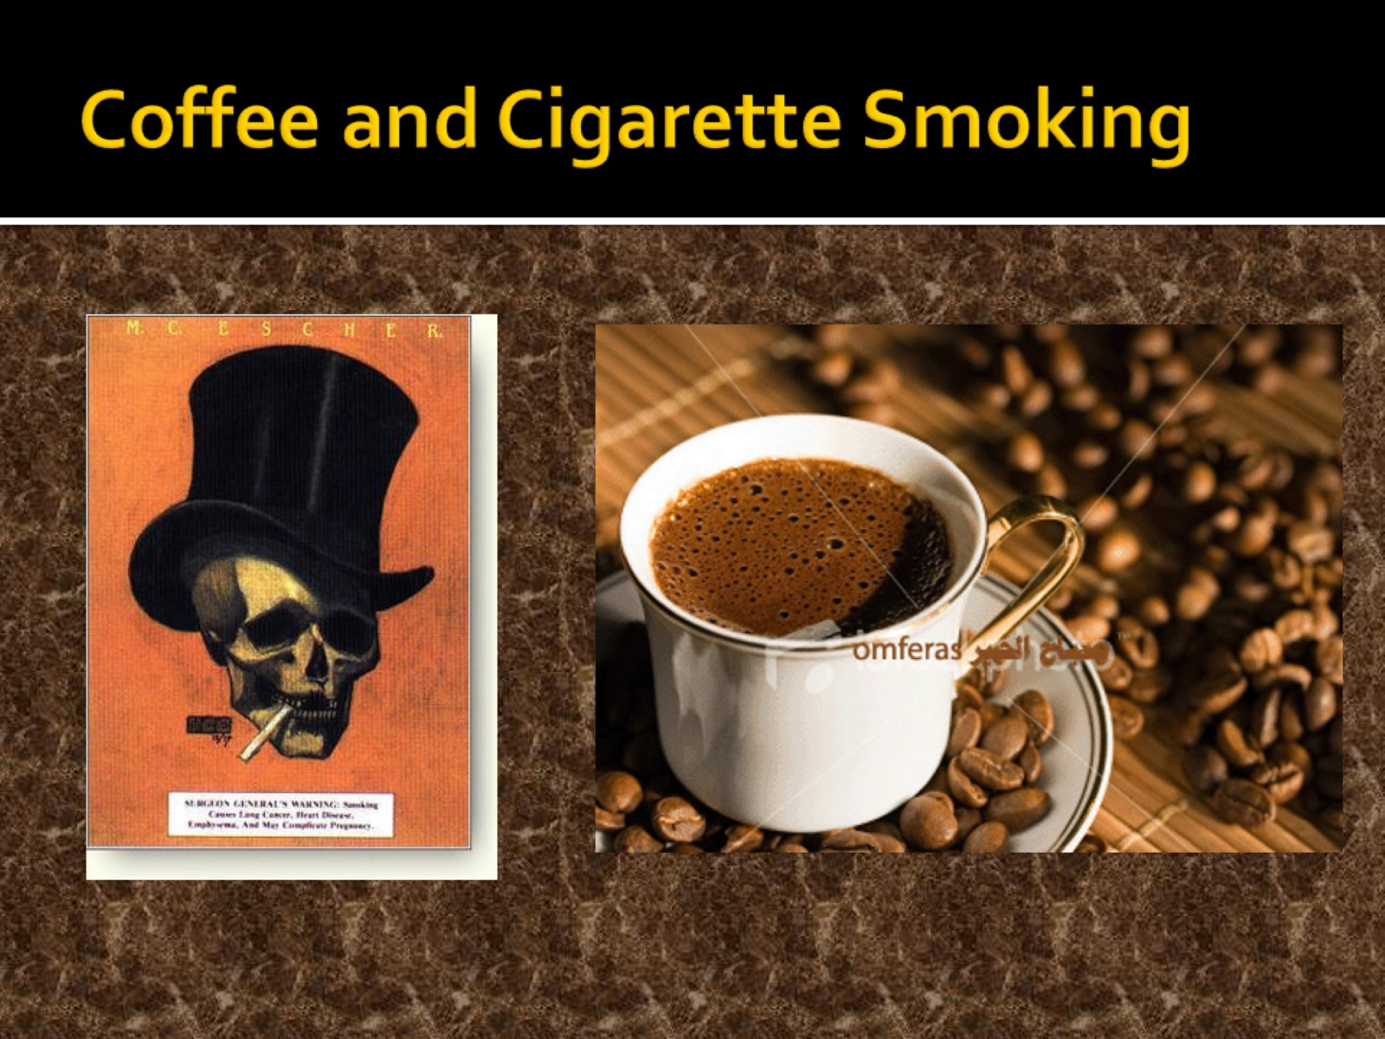
Coffee and Cigarette Smoking

Slide 48
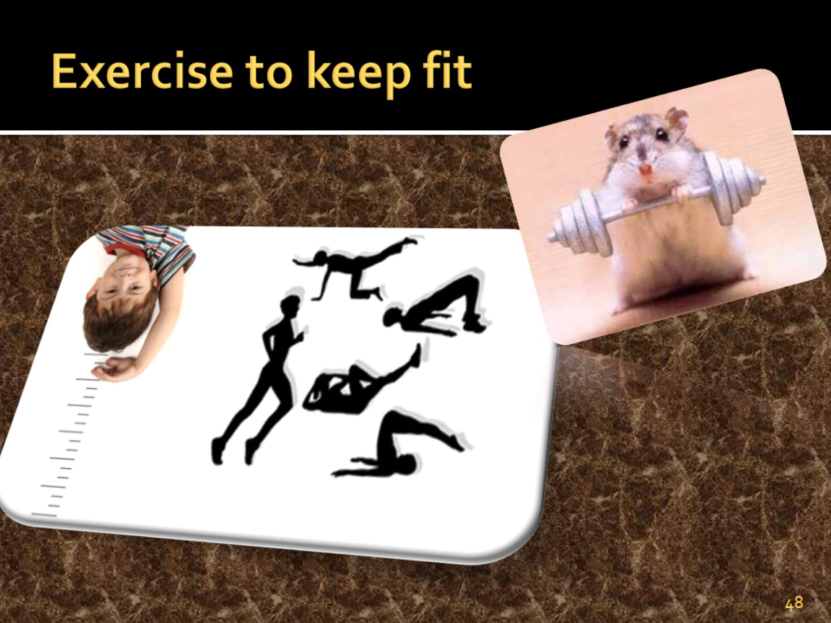
Exercise to keep fit

Slide 49
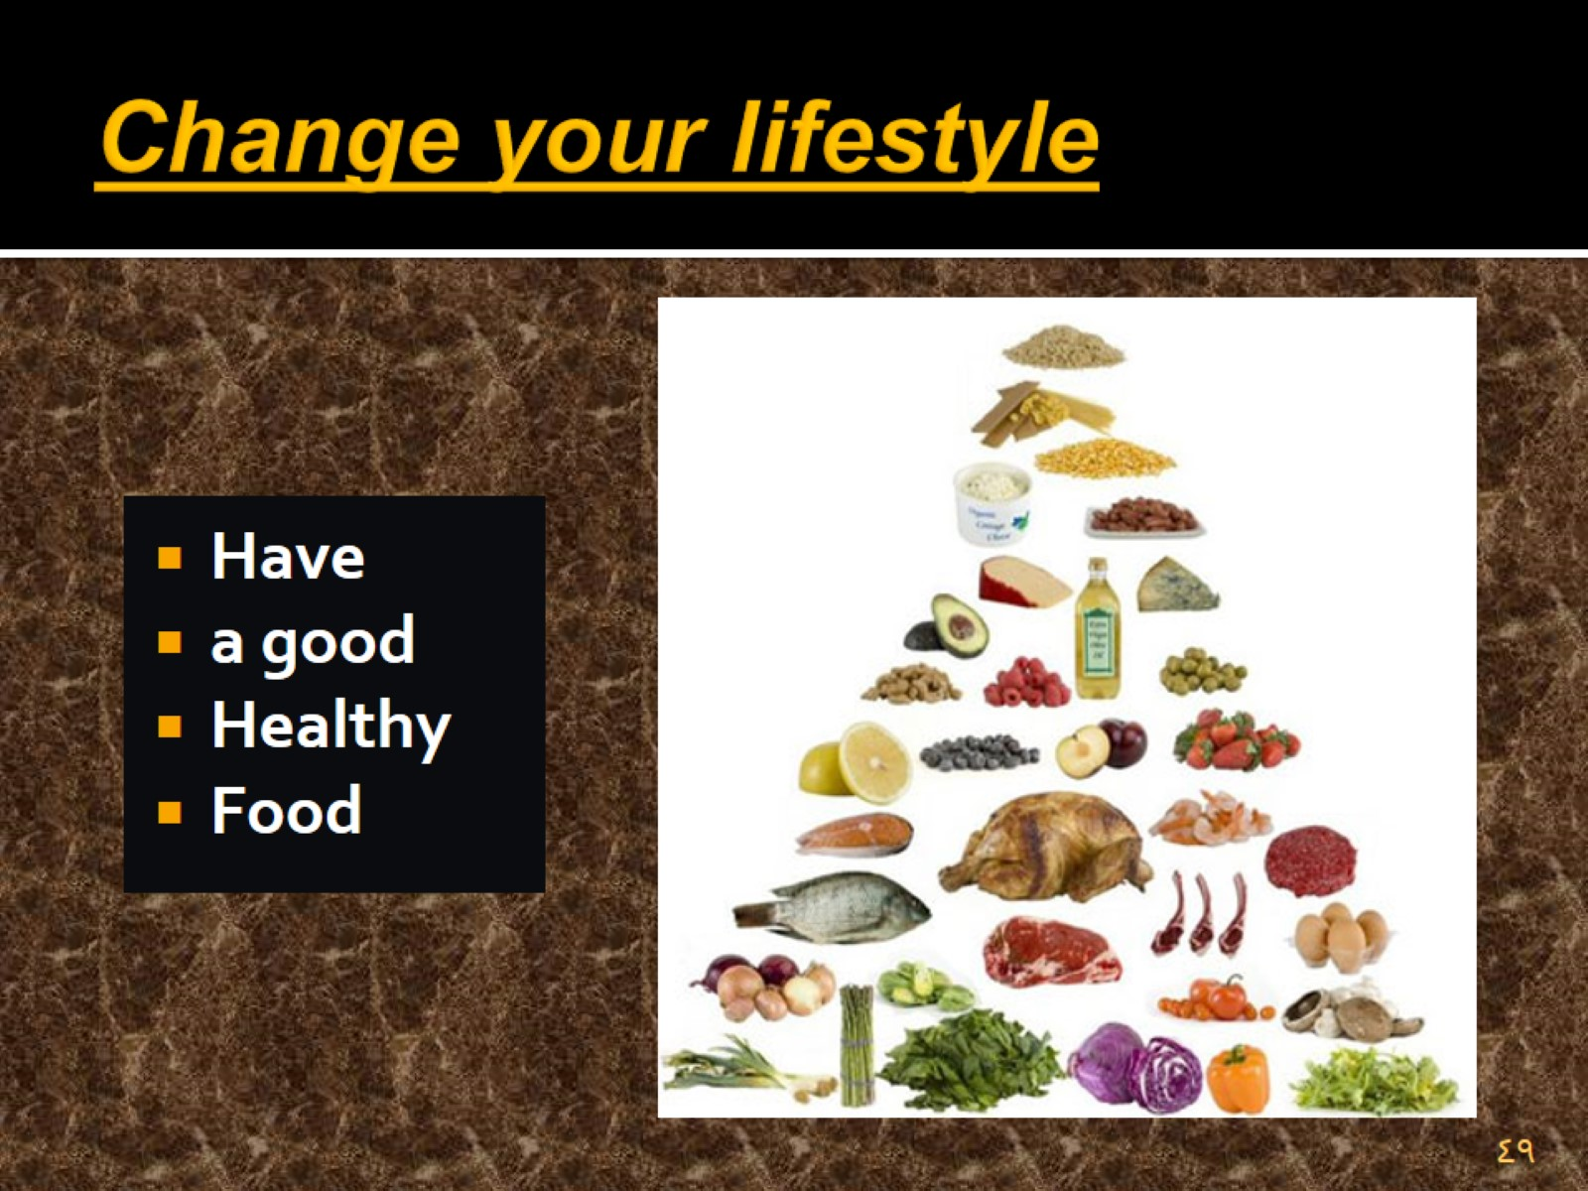
Change your lifestyle

Slide 50

Change your lifestyle

Slide 51
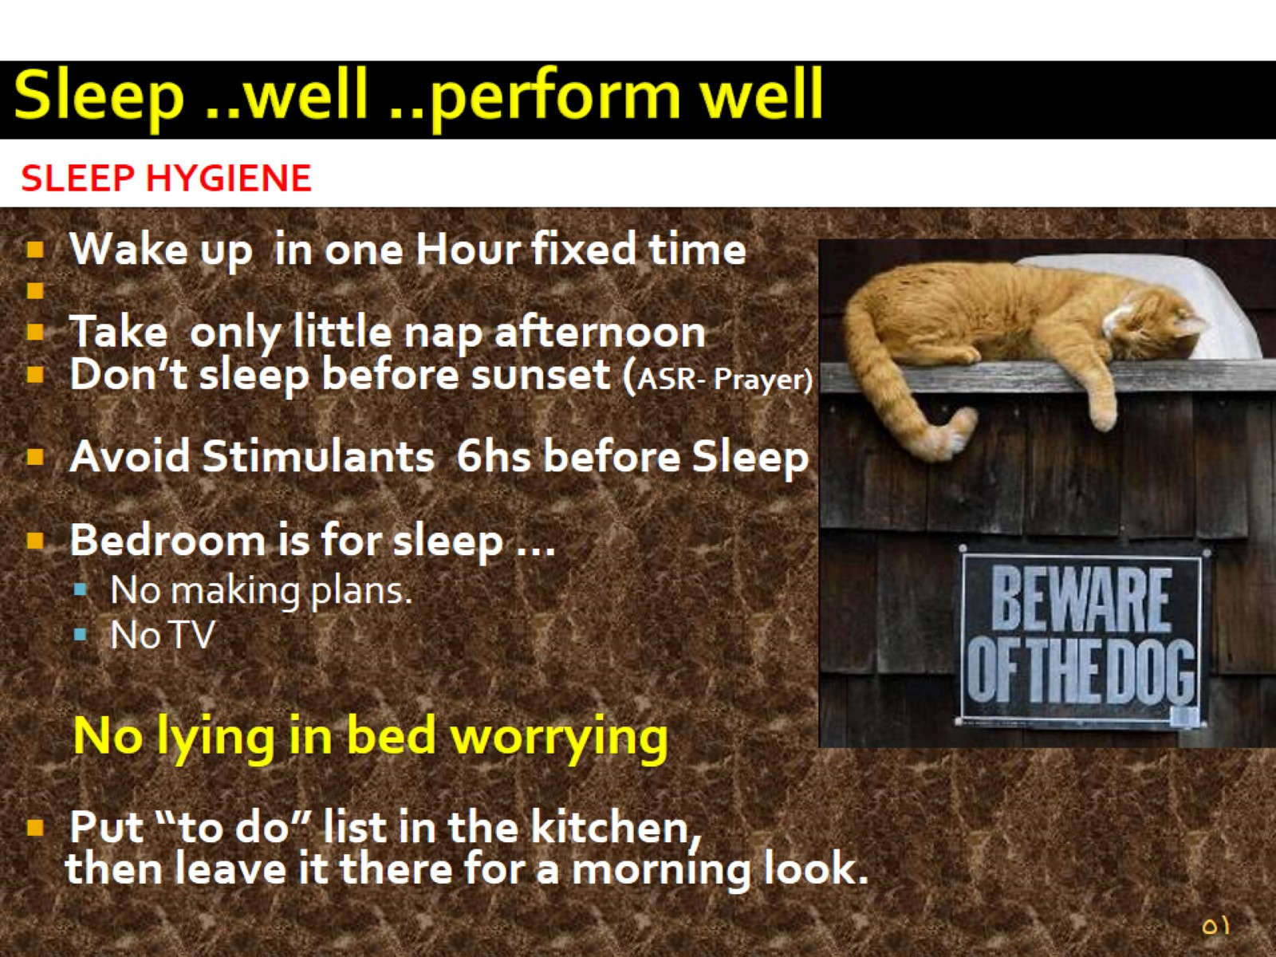
Sleep ..well ..perform well

Slide 52

Meditation & Mindfulness

Slide 53

RELAXATION

Slide 54

Social Management

Slide 55

SOCIAL APPROACHES

Slide 56

Protective factors / Resilience المرونة النفسية

Slide 57

Resilience

