Slide 1
ASPHYXIA
Medicolegal view

Slide 2
Definition of Asphyxia
Decrease or lack of Oxygen supply to the blood and tissues below the normal level, and Hypercapnea where there is an increase in carbon dioxide retention in the blood and tissues. Which affect tissue metabolism

Slide 3
Pathophysiology Classification of Asphyxia
1. Anoxic anoxia
2. Stagnant anoxia
3. Anemic anoxia
4. Histotoxic anoxia.

Slide 4
Anoxic anoxia
This results from either:
. Prevention of oxygen entering to lungs or
. Inability of lungs to oxygenate the blood.
It includes:
A. Due to lack of available oxygen in the air for inspiration ,e.g. at high altitude, staying near by fire
B. Due to inspiration of an inert gas like methane, sewer gas etc.
C. Due to interference with respiration by any mechanical obstruction in air passage, e.g. smothering, hanging
strangulation. choking etc.
D. Due to low oxygen content in anesthetic mixture of gases.
E. Due to interference with respiratory movements or function as seen in traumatic asphyxia, penetrating chest injury paralysis of respiratory muscles etc.
F. Due to congenital defect of heart or lung or blood vesseles.
Histotoxic Anoxia
In this condition, there is interference with tissue oxygenation.Here cells are not in a position to utilize the oxygen

Slide 5
Stagnant Anoxia
Stagnant Anoxia
This is a condition where there is slowing down of circulation with impaired oxygen delivery to tissues. This may be
seen in:
A. Congestive cardiac failure
B. Peripheral circulatory failure/shock
C. Acute corrosive/irritant poisoning
D. Heat stroke
Anemic Anoxia
It indicates reduced oxygen carrying capacity of blood. Here there is oxygenation of blood in the lungs but blood has reduced capacity to trnsfer the oxygen to tissues' It may be seen in:
A. Anemia
B. Carbon monoxide Poisoning
C. Hemorrhage
D. Formation of stable components of hemoglobin like sulphemoglobin, methemoglobin etc'

Slide 6
Causative Classification of Asphyxia
1. Mechanical asphyxia
2. Traumatic asphyxia
3. Environmental asphyxia
4. Toxic asphyxia
5. Pathological asphyxia

Slide 7
classical signs of asphyxia:
2) Congestion of organs
3) Petechial hemorrhages
4) Pulmonary edema
5) Fluidity of blood
6) Dilatation of right chamber of heart
1) Cyanosis

Slide 8
classical signs of asphyxia-cont.
Difficulty and/ or noisy breathing, which may ultimately lead to cessation.
Rapid pulse.
High blood pressure (hypertension)
Swollen veins on the head and neck.
Convulsions.
Paralysis.
Slowly losing consciousness.

Slide 9
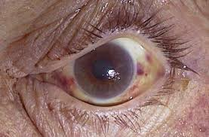
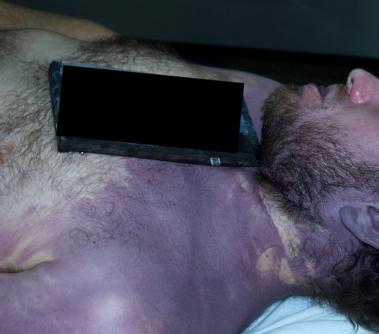
Cyanosis
Petechial Hemorrhages
Cyanosis is most commonly seen on the face, i.e. bluish discoloration of face due to reduced oxygenated hemoglobin.
Petechial hemorrhages are the pinpoint (1-2 mm) collections of blood in serosal and skin surfaces due to rupture of small venules under pressure.

Slide 10
Mechanical Asphyxia (Violent Asphyxia)
Hanging
Hanging is a form of violent death produced by suspending the body with a ligature round the neck, the constricting force being the weight of the body or a part of body weight.

Slide 11
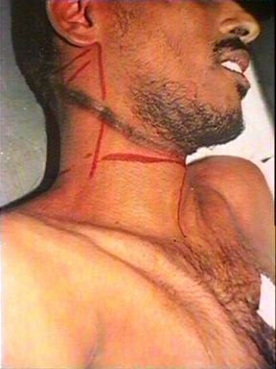
TYPES OF HANGING
I. On the basis of knot position
Typical Hanging: When the body is suspended by ligature with a point of suspension at center of occiput, i.e when the knot is at the nape of neck
Atypical hanging: In this type of hanging, the point of suspension is not at occiput i.e. the knot is not at nape of neck. Thus when knot in hanging is at other than nape of neck

Slide 12
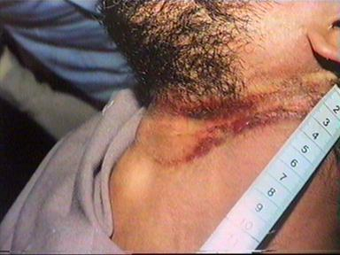
TYPES OF HANGING
II. On the basis of degree of suspension:
1. Complete
2.Partial
IV. In relation to death:
1. Antemortem 2. Postmortem
III. On the basis of manner of death: 1. Suicidal 2. Accidental 3. Homicidal 4. Judicial

Slide 13
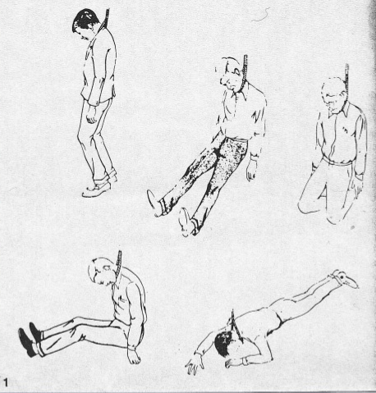

Slide 14
Mechanism of Hanging
. In hanging the constricting force may be-
1) Weight of entire body as in complete hanging or
2. Part of body weight as in partial hanging.
*A constriction pressure of 2 kg is sufficient to occlude jugular venous system causing cerebral venous congestion.
*A constricting pressure of 5 kg can compress the carotid arteries causing cessation of blood supply to brain.

Slide 15
Mechanism of Hanging cont.
*A constricting force of 15 kg can compress the trachea causing obstruction to respiration.
. A constricting force of 30 kg can obstruct the vertebral arteries.
. Thus it is not necessary that body should be suspended by ligature completely as in complete .hanging' Even though, body is touching the ground as in partial hanging, the person, may lead to death'

Slide 16
Cause of Death
1. IMMEDIATE CAUSES
1) Asphyxia: Obstruction of air way
2) Venous congestion: Obstruction of jugular venous
system.
3. Cerebral anemia: Compression of carotid arteries
causing cerebral ischemia.
4. Vagal Inhibition: Vagus nerve or carotid bodies when compressed may cause vagal inhibition with cessation of heart.
5. Combination of asphyxia and venous congestion'
6) Fracture dislocation of cervical vertebrae'

Slide 17
Cause of Death
B) DELAYED CAUSES
l) Aspiration pneumonia.
2) Infection and septicemia.
3) Pulmonary edema.
4) Hypoxic encephalopathy.
5) Laryngeal edema.
6) Abscess of brain/encephalitis'

Slide 18
Autopsy Findings
Clothes: Clothes may bear saliva stains.
External Examination:
A) Findings in neck
Ligature mark is most important finding in neck.
The Ligature used for hanging causes a mark over neck. It is a pressure abrasion caused by ligature.
The mark is in form of furrow or groove in the tissue and is pale in colour, which may turn yellowish brown to dark brown later on . The mark may be accompanied by reddish abraded
edges caused due to constriction. The mark is hard
and parchment like due to drying and desiccation of
abraded skin.
The ligature mark is usually situated above the thyroid cartilage and is running obliquely passing back-
ward and upwards on either side of the neck

Slide 19
Autopsy Findings cont.
lnternaI Examination
A) Neck
The tissues underneath the mark are dry white and glistening with occasional ecchymoses in the adjacent muscles.
Muscles of neck: may show confusion in some cases.
Carotid arteries: May be injured by the ligature
whereby there is slight bleeding into their walls at the level of the ligature.
Hyoid bone: Occasionally, hyoid bone may be fractured and is more common in individuals above 40
years of age.
Microscopic examination of thyroid gland and salivary gland shows focal interstitial hemorrhages
B) Brain: May be congested if there is compression of jugular venous system.
May be pale if there is compression of carotid and vertebral arteries.
C) Lungs: Lungs are congested and edematous with Tardieu spots over pleura
D) Abdominal viscera congested.

Slide 20
OTHER TYPES OF HANGING
JudiciaI Hanging is the way of legal execution of death
Lynching It is a homicidal hanging.
Autoerotic Hanging Also called as sexual asphyxia.

Slide 21
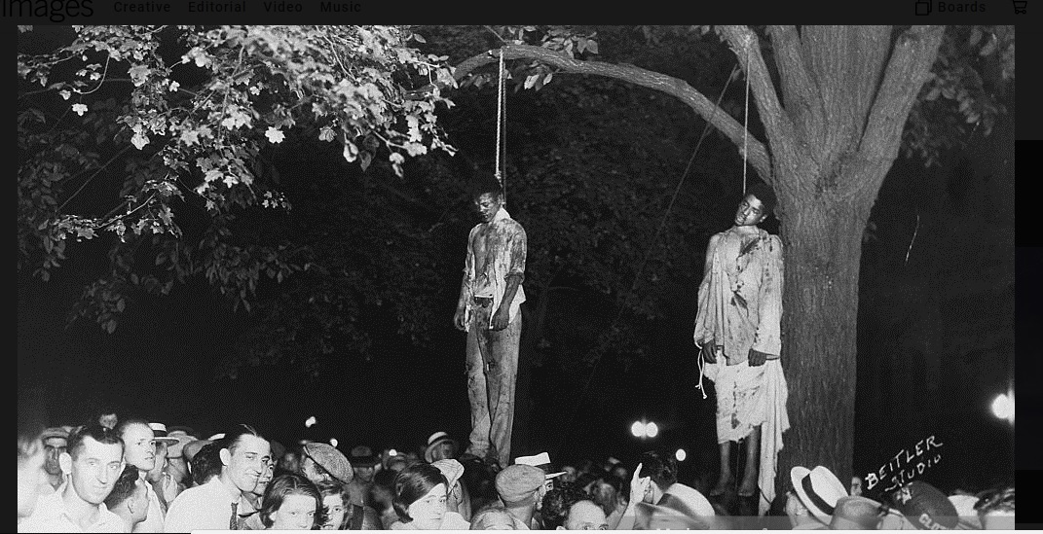
Lynching
Lynching is a form of homicidal hanging where an accused of murder or rape is hanged in a public square by a mob as a part of carrying out justice. The term “lynching” is derived from Charles Lynch (1736-96) who administered rough justice in Virginia. This was his system of punishment given to African-American (Negro) slaves for rape or murder who were being lynched by angry white mob

Slide 22
Strangulation
Definition: Strangulation is a form of violent asphyxial death caused by constricting the neck by means of ligature or by any other means without suspending the body.
In strangulation the constriction force is other than the weight of victim's body. There is application of external force such as compression of neck by rope, by
belt, by stick etc.

Slide 23
Strangulation deaths are classified on the basis of means used to constrict the neck and are of following types
1.Ligature strangulation
2. Manual strangulation or throttling
3. Mugging
4. Garroting
5. Palmar strangulation

Slide 24
Strangulation deaths are classified on the basis of means used to constrict the neck and are of following types
1.Ligature strangulation
2. Manual strangulation or throttling
3. Mugging
4. Garroting
5. Palmar strangulation

Slide 25
Depending on manner of death, strangulation is classified
Homicidal strangulation
Accidental strangulation

Slide 26
Cause of Death in strangulation
1. Asphyxia
2. Cerebral hypoxia
3. Cerebral congestion
4. Combined- asphyxia and venous congestion
5. Vagal inhibition
6. Fracture dislocation of cervical vertebrae
Ligature may be in form of rope, belt, wire, cable etc.

Slide 27
Autopsy Findings in strangulation
External Examination:
Findings in neck: The appearance of neck and findings
produced may vary according to the means used ; rope, wire, cable etc.
A) Ligature mark
-The ligature mark is usually well defined and grooved.
The mark is present over neck at any level but commonly it is placed at the level or below the thyroid cartilage.
The mark completely encircles the neck horizontally (transversely) and
may be prominent on front and at sides .
The mark may be multiple, if ligature is twisted many times round the neck.
- If knot is applied, there may be a wider area of
contusion at the site of the knot.
- The mark may be oblique as in hanging if the victim has been dragged by a cord after he has been strangled in a recumbent posture or if the victim
was sitting and the assailant applied ligature on
the neck while standing behind him, thus using the
force backward and upward.
.

Slide 28
Autopsy Findings in strangulation
EXTERNAL EXAMINATION cont.:
- Initially the base of mark is pale with reddish margin however, later on, it becomes dry dark, hard and parchment like.
If breadth of ligature is wide, the mark impression will be wider and superficial. If ligature used is narrow one for example metal wire, it may leave narrow but deeper impression on neck skin.
At times the mark is such deep that it appears that neck has been pierced by wire, so called cheese. cutter method or phenomenon.
The ligature mark of strangulation is not obliterated by putrefaction, but is preserved. Even though the mark gets obscured due to on going decomposition, subcutaneous hemorrhages in relation to mark may

Slide 29
Autopsy Findings in strangulation
INTERNAL FINDINGS IN NECK IN STRANGULATION
compressed.
The neck muscles may show hematoma or even lacerations
Subcapsular and interstitial hemorrhages may also be
noted in thyroid.
There may be extravasations or laceration of carotid sheath.
Fracture of hyoid bone and thyroid cartilage may be seen in some cases.
Other findings:
Lungs may be congested and edematous and may show fresh hemorrhages in parenchyma.
Pleura show petechial hemorrhages.
Abdominal viscera- congested.

Slide 30
Medicolegal Importance
Homicidal strangulation is more common than accidental strangulation.
Moreover, in forensic practice, it is said that strangulation is always homicidal unless proved otherwise.
Suicidal strangulation is a rare phenomenon
and occurs only if suicide employs special method and instrumentation.
2) Accidental strangulation may occur if some material like
scarf, machine belt etc. is suddenly wrapped around the neck and constricting the neck causing death .
The strangulation may be mistaken for hanging or vice
versa. It is important to distinguish between strangulation and hanging.

Slide 31
Throttling ( Manual Strangulation)
Definition : It is violent asphyxial death produced by compression of neck manually i.e by using human hands.
The neck is compressed by using hands' Either one hand or
both hands may be used to throttle a person.
AUTOPSY FINDINGS
In addition to signs of asphyxia, injuries may be seen in
neck. The injuries are in form of contusion and/or abrasion
and depend on:
1) The relative position of victim and the assailant.
2) The number of assailant.
3) The manner of grasping the neck , either with one hand
or both hands.
4) Degree of pressure exerted on the neck.

Slide 32
Throttling ( Manual Strangulation)
The following patterns of injuries are present:
I ) Cutaneous contusions
2) Cutaneous abrasions
3) Hemorrhages/contusions into the deep structure of the neck
4) Injury to hyoid bone and laryngeal complex.
Contusions over Neck
Contusions are produced as a result of grasping the neck
of victim by assailant's fingers.
Contusions produced by tips and pads of fingers are oval or round in shape.
If one hand is used, it may be possible to have one
prominent contusion on one side of neck (due to thumb)
and three to four contusions on the other side (due to fingers)
When both hands are used the thumb mark of one hand
and finger marks of other hand on either side of neck
may be found .

Slide 33
Throttling ( Manual Strangulation)
Abrasions on Neck:
Scratch abrasions may be present over neck and are caused by finger nails of either hands of assailant or that of victim in attempt to ward off the assailant.
Hemorrhages/ Contusions into the Deep Structure of the Neck
Injury to Hyoid Bone and Laryngeal Complex

Slide 34
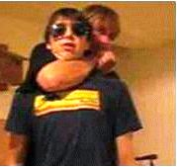
Garroting
Garroting is a type of strangulation.
The robbers used this method in lonely places to kill travelers and rob them.. There are various methods such as Indian method,
Spanish method etc.
In Indian method: Neck is grasped by a ligature thrown from behind and is quickly fastened or tightened by twisting it with lever or two sticks tied at the end of ligature
Asphyxiation of the unaware victim causes rapid loss of consciousness and death.
. Spanish method: In Spain it is method of judicial execution. Here, a twisting device known as Spanish windlass is used.
Mugging
Also known as arm lock . This is a type of strangulation. It is caused by holding
the neck of person in the bend of the elbow Here pressure is exerted over larynx or side of neck by the forearm and arm .

Slide 35
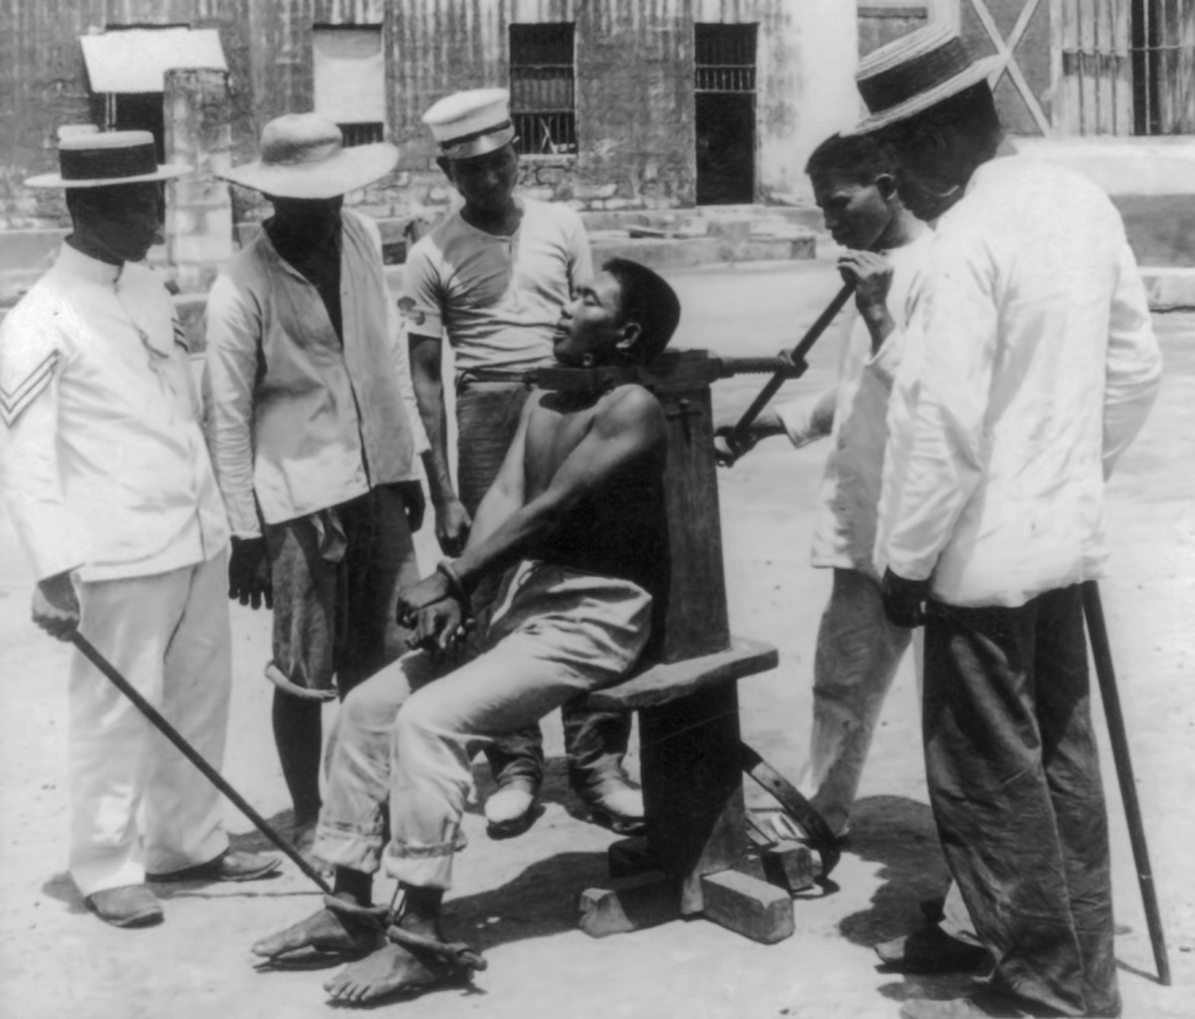

Slide 36
Suffocation
Definition:
Suffocation is a type of mechanical asphyxia
1. Either due to lack of oxygen in the environment or
2. By mechanical obstruction to the air passage by means
other than constriction of neck and drowning.
TYPES OF SUFFOCATION
1) Smothering
2) Choking
3) Gagging
4) Traumatic asphyxia
5) Burking
6) Overlying
7) Inhalation of irrespirable gases

Slide 37
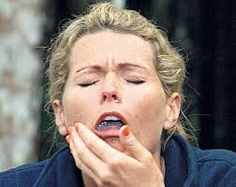
Gagging
Cloth or soft object in the mouth.
Person can breathe from nose, but if secretions accumulate in the nose and pharynx, asphyxia can happen
Manner:
  Accidental
  homicide

Slide 38
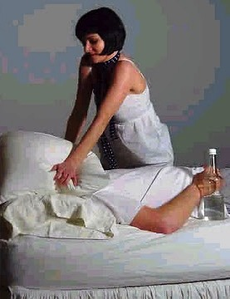
Smothering
Definition: It is form of asphyxia caused by mechanical occlusion of the external respiratory orifices i.e. the nose and mouth.
Death is caused by obstructing the air passage i.e. mouth and nostril by means of hand, cloth, pillow, towel etc.
Autopsy Findings
.There may be pale area around the mouth and nose (circumoral and circumnasal pallor) due to pressure of the object.

Slide 39
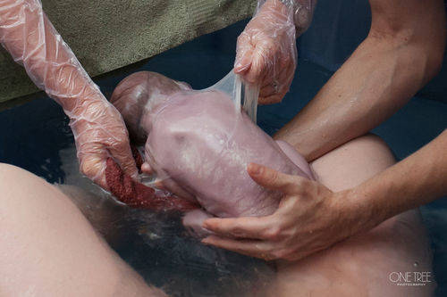
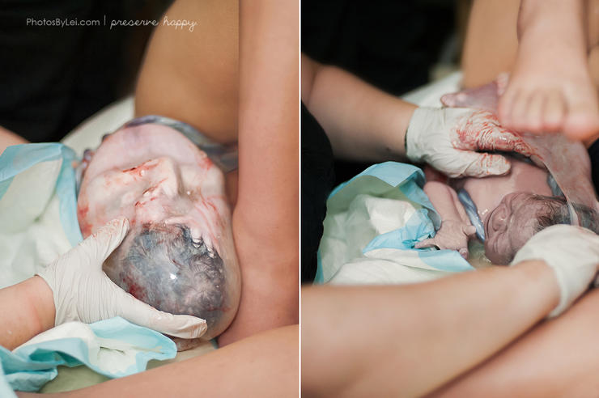
Medicolegal Importance
l) Homicidal smothering are common
2) Accidental smothering is rare
3) Sexually perverted person may cover the head with plastic bag during autoerotic activity and get suffocated.
4) A newborn baby may die due to suffocation if the baby is born with membrane (amniotic sac) covered with (cul-de-sac birth or caul birth).

Slide 40
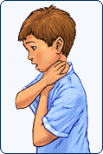
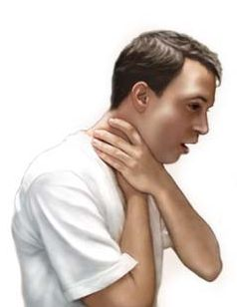
Choking:
This is due to blockage of the internal air passages, usually by foreign material e.g. inhaled vomit, blood, food particles - especially fruit seeds in children, the tongue in comatose patients etc
Postmortem findings:
Petechiae may be present if significant retching has occurred. There may be injuries to the buccal mucosa, related to resuscitation. The right ventricle of the heart is dilated and the lungs hyperinflated and possibly edematous

Slide 41
Traumatic asphyxia
It is the mechanical anoxic death due to mechanical pressure by a heavy object on the chest with or without abdominal compression leading to prevention of respiratory movements.
Postmortem findings:
Severe congestion and cyanosis above the level of compression frequently with a sharp line of demarcation.
prominent Petechial hemorrhages
There may be associated sternal, or spinal, fractures and interstitial emphysema.

Slide 42
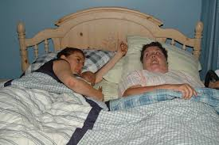
Overlying
.Overlying is also called as compression suffocation
. It results when mother or other person sharing a bed with infant. During sleep, the mother or person may compress the infant by overlying over it. Death occurs due to compression of chest and these deaths are accidental in nature.

Slide 43
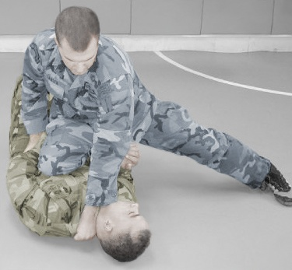
Burking
. Burking is a form of mechanical asphyxia where death
is caused by a combination of smothering and traumatic
asphyxia.
the victim is put to ground and Burke ( assailant) is to sit on chest and closes the mouth.

Slide 44
DROWNING
Introduction of drowning
Diatoms
Physiopathology
Autopsy finding
Investigation
Conclusion
References

Slide 45
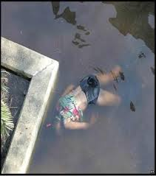
Introduction :
Drowning is a process resulting in primary respiratory impairment from submersion in a liquid medium.
Drowning almost always occurs as a result of an accident.

Slide 46
Introduction :
Drowning is a form of asphyxia due to aspiration of fluid into air passage, caused by submersion in fluid, complete submersion is not necessary , for submersion of the nose and mouth alone for sufficient period can caused death from drowning .
The diagnostic of drowning is the most difficult in forensic medicine .
The external examination ,autopsy finding and laboratory investigation in most of the cases not specific .

Slide 47
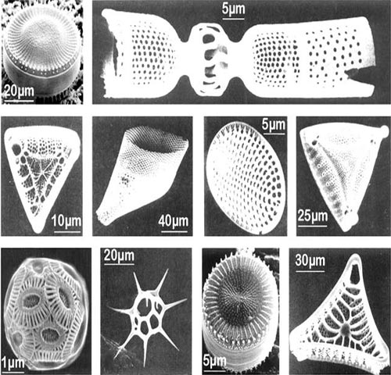
Diatoms:
Diatoms are unicellular microorganisms which are commonly found in almost all water bodies. Their silica wall plays important tool in forensic diatomology. Diatom test has been widely applied to detect post mortem or antemortem drowning and comparing the diatoms found in biological sample with those found in water sample confirms that death took place, probably in same water medium. However, in skeletonized stage or dismemberment of body parts at different location, diatom of specific kind helps to link the place of drowning.

Slide 48
Physiopathology :
Two phases:
1- Hold breath phase followed by involuntary inspiration and gasping the air will lead to loss of consciousness.
2- Death due to cerebral hypoxia lead to irreversible brain damage.

Slide 49
Physiopathology :
Fresh water is hypotonic and hyponatremic related to blood , after inhalation the movement from the alveoli into the blood ,sodium will move from blood alveoli ,the movement will cause haemodilution, hypervolemia, hyponatremia, hyperkalemia and hemolysis.
The sea water is hypertonic related to blood ,the water movement goes from blood into alveoli ,and the electrolytes (sodium, chloride, magnesium) goes from alveoli to the blood ,the consequences from sea water drowning is haemoconcentration and hypovolemia .

Slide 50
Physiopathology :
A vagal reflex maybe also induced by inhalation of water .
Stimulation of nerve ending at the skin , the mucosa of the ear drum ,the pharynx and larynx by cold water can lead to cardiac reflex arrest.
Small amount of cold water may induce vagal reflex and cardiac arrest.

Slide 51
Autopsy finding:
Lung weight are higher in drowning cases but shows a normal weight are possible in the drowning cases after cardiac arrest reflex or vaso vagal reflex.
Water inhalation lung maybe over inflated ,filing thoracic cavity ,generally water logged referred to as emphysema aquosum.
Large amount of froth present around nostrils, mouth, upper and lower airways in freshly drowned body.
The majority of the autopsy finding is related to asphyxia.

Slide 52
Autopsy finding:
Material may also enter the upper airways during the post-mortem immersion period and it is possible that small quantities may enter the oesophagus and stomach but it is unlikely that it will reach the alveoli to any significant extent if the post-mortem submersion is short.
The skin becomes wrinkled, pale and sodden like a “washer woman’s skin”.
Changes appear at the finger tips, palms,backs of the hands, and later, the soles. The next step is the detachment of the thick keratin of hands and feet which pull off in “glove and stoking fashion”. Nails and hair become loosened after a few days. Other signs of immersion are cutis anserine and post-mortem distribution of hypostasis. The presence of mud, silt or sand on the body was described but has no diagnostic value.

Slide 53
Investigations:
1-Histology:
The lung examinations can show over-distension of the alveoli.
Several staining techniques must be performed such as the staining for elastic fibers (orcein ) and reticulin fibers.
The examination of other organs (brain, heart, liver) shows none specific histological changes indicative of hypoxia such as acute congestion and swelling of the capillary endothelia.

Slide 54
Investigations:
2-Biological test:
The chemical changes in plasma after drowning were based on the fluid and electrolyte shifts after the penetration of either sea or fresh water in the alveoli and in the blood stream.
Measurement of the specific gravity of blood, of the concentration of sodium, chloride and potassium.

Slide 55
Investigations:
diatoms can be considered as particles present in the submersion water which are inhalated during drowning and once in the blood stream which reach the closed organs. Under strict extraction and identification conditions, these particles are good markers of drowning.

Slide 56
Conclusion:
The diagnostic of drowning may be achieved after having considered all the forensic investigations performed in those cases, i.e: external examination, autopsy findings, histological and toxicological analysis, blood strontium determination, biochemical analysis and diatom test. The diatom test was still considered controversial by the by the literature but we defined qualitative and quantitative criteria which could exclude false positive results. It is of particular interest in case of putrefied bodies where the other investigations have failed.

