Slide 1
DEATH
Medicolegal view

Slide 2
Objectives: cont. To know the following
Differentiate properly between the cause of death, the mode and manner of death
Describe different phases of death
Discuss the molecular life

Slide 3
Objectives: cont. To know the following
List the diagnostic criteria to diagnose somatic death and sure signs to avoid burial of comatose pt.
Discuss the accurate tests for diagnosis of
brainstem death and conditions of their application.
Discuss sudden death and causes.

Slide 4
Objectives: cont. To know the following
Realize the importance of the followings:
- Time of death
- Manner of death
- Difference between natural and unnatural death.

Slide 5
Diagnose of death
the cause of death,
the mode and
the manner of death

Slide 6
1. Cause of death
Any injury, disease or toxic substances that produces
of the body function that lead to death of an individual.
derangement

Slide 7
Mode of death : ( mechanism of death):
physiological derangement of the body function that precipitates death of an individual. . .
e.g .coma, hypotension etc.

Slide 8
Manner of death: how the death came out
Homicide
Suicide
Accident
Natural
Unclassified.

Slide 9
Phases of death
1. Somatic( clinical) death
Definition: irreversible loss of whole body function due to permanent cessation of vital functions ( respiration, circulation and CNS functions).
2. Molecular death
Death of the individual organs and tissue
Molecular life: is the period between somatic death and molecular death.

Slide 10
Brain death
Irreversible cessation of cortical brain function (activity), brain stem or whole brain.

Slide 11
Diagnosis of somatic or clinical death
1. Cessation of circulation
Cessation brain functions
2. Cessation of respiration

Slide 12
Diagnosis of death
The diagnosis of death was based on the
finding of any of death signs:
I. Irreversible loss of respiratory function
II. Irreversible loss of cardio-circulatory functions
III. Irreversible loss of brain functions
IV. Algor mortis (postmortem coldness)
V. Livor mortis (postmortem lividity )
VI. Rigor mortis (postmortem rigidity)
VII. Cadaveric spasm
VIII Loss of muscle contractions
IX. Putrefaction
Signs I and II correspond to the classical
respiratory and cardiocirculatory functions.
IV to IX are related to forensic circumstances

Slide 13
Complete Cessation of Circulatory Function
Magnus’s test.
Diaphanous test.
Finger nail test .
Heat test.
A flat E.C.G. for a continuous period of five minutes

Slide 14
Magnus’s test
Magnus's Test. This is one of the most reliable tests, and consists of tying a ligature tightly round the base of a finger, sufficient to cut off the venous channels without occluding the arteries. The finger remains white, if circulation has entirely ceased, otherwise the seat of the ligature is marked by a bloodless zone, and the portion beyond it becomes gradually blue and swollen.

Slide 15
Diaphanous test
Diaphanous Test. During life the webs of the fingers appear scarlet or very red and translucent, if the hand with the fingers abducted is held against a strong light. while they appear yellow and opaque after death.
The hand may, however, appear red in carbon monoxide poisoning, and yellow in anaemia or syncope.

Slide 16
Icard’s Fluorescein test
The hypodermic injection of a solution of fluorescin
does not produce any discoloration of the skin, if circulation has stopped ;
but it renders the neighbouring skin yellowish-green, if circulation is still going on. The substance may also be detected in the blood drawn by pricking the skin at some distance from the seat of injection.

Slide 17
Complete Cessation of Circulatory Function-cont.
Finger nail test
On the application and withdrawal of pressure to the finger nail
The application of heat
, e.g. a burning match or melted sealing-wax to the skin will not produce- a true blister with a red line of demarcation, If circulation has stopped
It opaque not assumes alternately a white and a pink color as in life.

Slide 18
Entire and permanent cessation of respiratory function
Mirror test
Feather test
Winslow’s glass water test.

Slide 19
The tests to determine the stoppage of respiration are
(a) The surface of a cold, bright looking-glass held in front of the open mouth and nostrils becomes dim, due to the condensation of warm moist air exhaled from the lungs, if respiration is still going on, but not otherwise. This test is useful in the cold weather.
(b) There will be no movement of a feather or cotton fibers held in front of the mouth and nostrils if respiration has stopped, but this is not a reliable

Slide 20
The tests to determine the stoppage of respiration cont.
(c) Winslow's Test. There will be no movement of an image formed by reflecting artificial or sun light on the surface of water or mercury contained in a saucer and placed on the chest or abdomen, if respiration has ceased.
Similarly, water will not be spilt from a vessel filled to the brim and placed on the chest or abdomen, if respiration has stopped

Slide 21
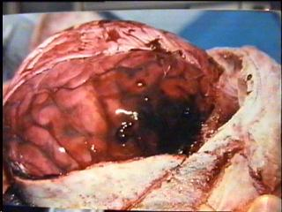
What is Brain Death?
Irreversible end of all brain functions, including the brain stem
NOT the same as:
Coma
Usually some evidence of interaction
with environment
Reflexes, painful stimuli
EEG
Persistent Vegetative State
Sustained autonomic function
Heart, lungs, sleeping and waking cycles

Slide 22
Brain –stem death:
The patient must be comatose state at least six hours.
All brain-stem reflexes must be absent.

Slide 23
PERSISTENT VEGETATIVE STATE
Definition : Patient with severe brain damage in whom coma has progressed to State of wakefulness without awareness.
Mechanism: Loss of the higher cerebral power but the brain stem functions as resp. circul . Are relatively intact.
Causes: massive cerebral infarction, head trauma, hypoxic encephalopathy and severe hypoglycemia.

Slide 24
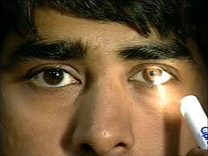
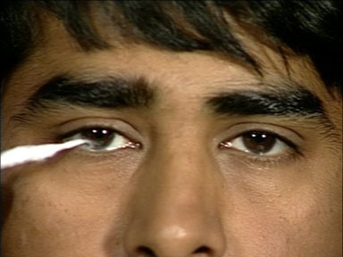
Examination of the eyes
pupils are fixed not respond to intense light.
pupils stop reacting to light
(Light reflex abolished
No corneal reflex
Corneal Changes;
Loss of Clear Glistening
Dry, Cloudy and opaque

Slide 25
Basic exam 5 Pharyngeal and tracheal reflexes
Both gag and cough reflexes are absent in patients with brain death
Gag reflex can be evaluated by stimulating the posterior pharynx with a tongue blade, but the results can be difficult to evaluate in orally intubated patients
Cough reflex can be tested by using ETT .

Slide 26
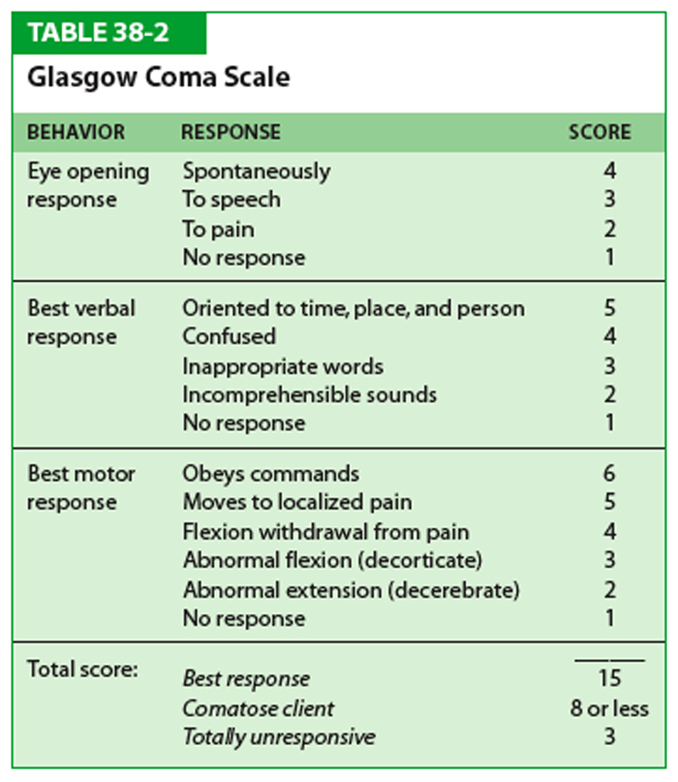

Slide 27
Diagnosis of brain death
Cases should be excluded before declaring brain death
o Patients under effects of drugs.
o Core temp. of the body shouldn’t be less than 36.5
o Shouldn’t be suffering from endocrine or metabolic disturbance

Slide 28
Confirmatory Tests
Electrical activity
Electroencephalography (EEG)
Cerebral blood flow = perfusion scan
Cerebral Angiography

Slide 29
Early signs of postmortem changes as: Supporting evidence of somatic (clinical death)
Severe hypothermia (31-32)
Hypostasis
Lab findings
Hyperkalemia ≥8 mmol/l
Severe acidosis ≤ 6.7

Slide 30
Early changes
Changes in the eye
Changes in the skin
Cooling of the body/Algor mortis
Post mortem lividity/Hypostasis
Rigor mortis/Cadaveric rigidity

Slide 31
Changes in the Skin
Loss of its translucency
Pale and Ashy white appearance
Loss of Elasticity
Wounds will not gape if it is inflicted after death
Wounds caused during life will retain their characteristic features.

Slide 32
Changes in the Skin cont.
paleness of the skin
conjuctivae and mucous membranes becomes pale due to fall of blood pressure and cessation of circulation of the blood
Skin of the face and the lips may remain red or blue in hypoxic/congestive deaths

Slide 33
Changes in the Muscles
Primary relaxation/ Flaccidity
Rigor mortis/Cadaveric rigidity
Secondary relaxation

Slide 34
Primary relaxation(flaccidity)
Starts immediately after death with generalized relaxation of muscle tone:
Drop of lower Jaw
Eye balls lose their tension
Pupils are dilated
Joints are flabby
Smooth relaxation- incontinence of Urine and Feces.

Slide 35
Early changes; primary flaccidity
primary flaccidity
complete loss of muscle tone.
loss of muscle tone in the sphincters .
(voiding of urine).
Regurgitation.
very common feature of terminal collapse.
common complication of resuscitation.

Slide 36
Early changes
primary flaccidity cont.
may retain reactivity
may respond to touch and other forms of stimulation hours after cardiac arrest
focal twitching decreases with time (discharges of dying motor neurons)

Slide 37
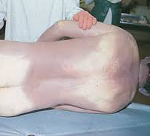
Postmortem Lividity; Livor mortis.
It means discolouration or staining of the skin and organs after death due to accumulation of fluid blood in the dependent parts of the body.
1- 3 hr. Starts
6-8 hr. Fixes.

Slide 38
Postmortem Lividity
start of Lividity.
Development of lividity.
Fixation of lividity
Site of distribution
Pattern
Extent
Difference between lividity and bruise.

Slide 39
Medico-Legal Importance
It is a reliable sign of death
It gives the information about the position of the body at the time of death
Time since death can be estimated
Colour suggest the cause of death
Distribution of lividity may give the information about the manner of death

Slide 40
Rigor Mortis/ Cadaveric rigidity :
This phenomenon comes immediately after the muscles have lost the power of contractility and is irreversible changes in the muscles of the body, both voluntary and involuntary.
Myofibrils
Myosin and Actin
Adenosine Triphosphate – A.T.P.?

Slide 41
Rigor Mortis/ Cadaveric rigidity :
Time of Onset :
…………..
Not related to nerves action
Develops in paralyzed limbs also
First appear in involuntary muscles
Last to be affected finger and toes muscles.

Slide 42
Duration :
Rigor Mortis/ Cadaveric rigidity :
Temperate climate – lasts for 2-3 days.
Tropical climate – 24 – 48 hours in winter
18 - 36 hours in summer
In general – 1-2 hours sets on
for , 12 hours develops
for - 12 hours maintains
and after 12 hours passes of

Slide 43
Rigor Mortis/ Cadaveric rigidity :
Circumstances modifying the
Onset and Duration of Rigor mortis.
Age-
Rigor Mortis is very rare in premature infants.
Rigor –mortis is slow in adolescent and healthy adults
Muscular condition and activity before death.
Onset is slow and duration is longer in muscular and healthy body at rest.

Slide 44
The effect of manner of death :
Rigor Mortis/ Cadaveric rigidity :
In wasting disease and great exhaustion- cholera, plague, typhoid, T.B. Cancer etc. the onset is early and disappears soon.
In diseases – Pneumonia, asphyxia and nervous conditions- onset is delayed .
In dry and cold air-onset slow and lost for long time.
Warm and moist air onset is rapid and duration short.

Slide 45
Conditions Simulating Rigor-Mortis
Heat Stiffening
Cold Stiffening
Cadaveric Spasm

Slide 46
Secondary Relaxation :
Muscles become soft and Flaccid
Do not respond to a mechanical and electrical stimulus.

Slide 47
Factors affecting the cooling curve:
Normal body temperature varies. Body cooling does not occur at a uniform rate Under average conditions, the body cools at the rate of about 1.5.0-2.5 degrees Fahrenheit per hour during the first few hours, then slower afterwards Skin cools more rapidly than the inside of the body .
We consider this equation of cooling
The fall in °C from 37°C =0.8 °C/hour

Slide 48
The rate of cooling is also dependent on following factors:
Age .
Condition of Body.
Manner of Death.
Atmosphere.

Slide 49
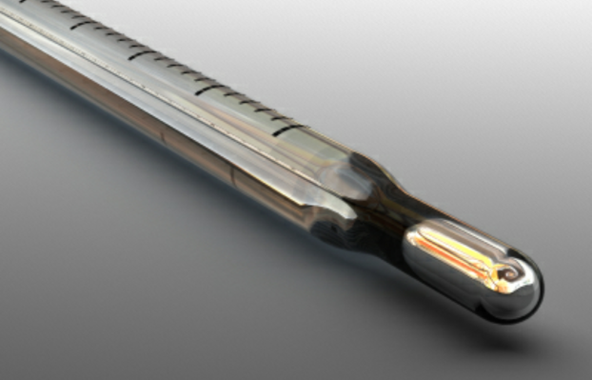
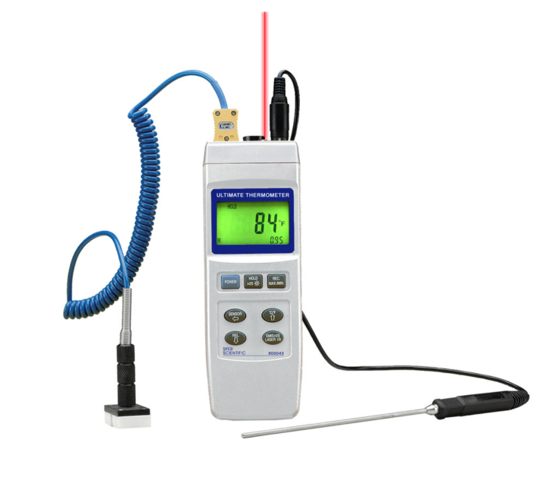
Methods of measuring body temperature:
Estimation of temperature by touching with the hand is a useful first maneuver when at the scene of a death.
The traditional method of taking the post-mortem temperature is by placing a mercury thermometer in the rectum.
More modern measuring devices include thermocouples, which register temperature accurately with minimum stabilization time

