Slide 1
Firearm Wounds
Medicolegal view
جامعة المعرفة
Notes:
.

Slide 2
Objectives: To know the following
definition and classification of wounds
the type of trauma and wounds of medico-legal importance
factors affecting the wound
estimate the date of wound occurrence
different types of wounds
complications of wounds

Slide 3
Firearm
“ An instrument or device with which it is possible
to propel a projectile by means of the expansive
force of the gases generated by the combustion
of an explosive substance “

Slide 4
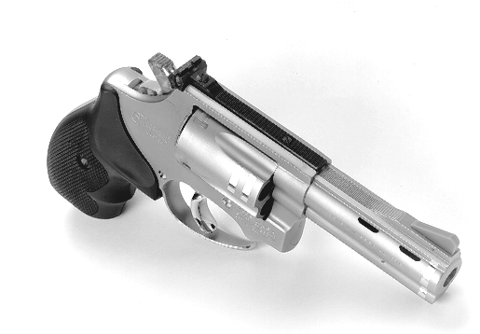
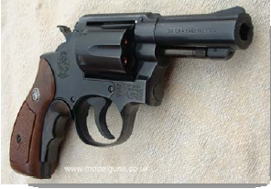
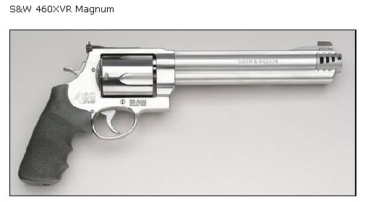
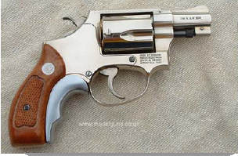
Revolver

Slide 5
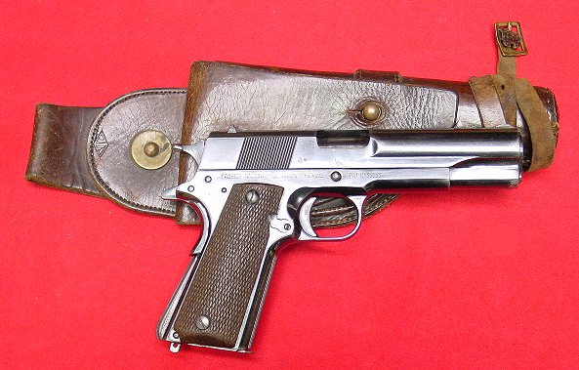
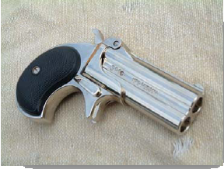
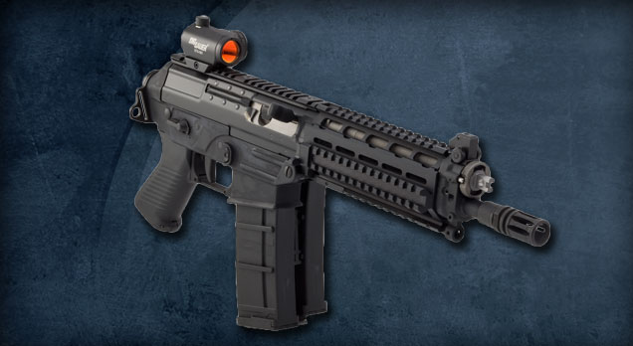
Pistol

Slide 6
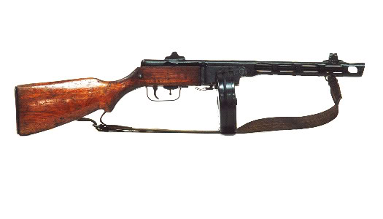
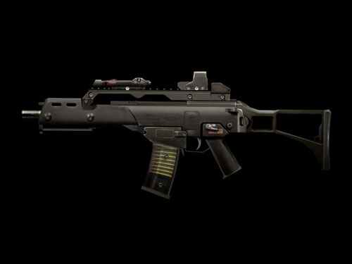
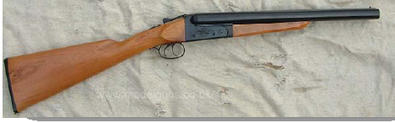
Rifle

Slide 7
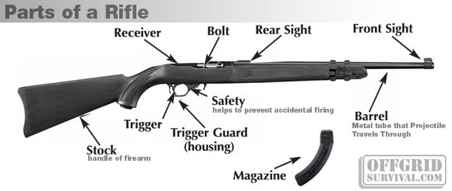
The component of firearm:

Slide 8
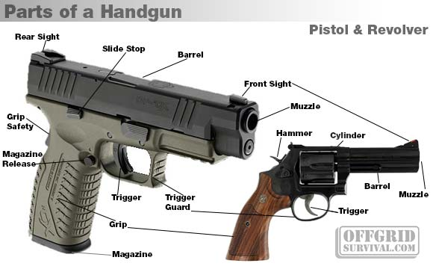

Slide 9
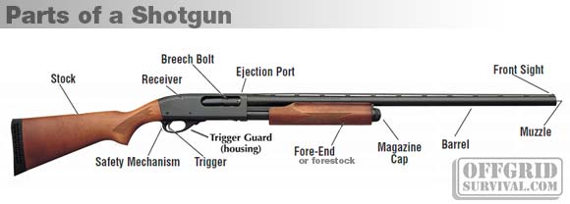

Slide 10
Ballistics
T
H
E
O
R
E
T
I
C
A
L
Interior ballistics
P
R
A
C
T
I
C
A
L
Wound ballistics
Exterior ballistics
Clear Concept

Slide 11
INTERIOR BALLISTICS
Knowledge of the forces responsible for propulsion of projectile within the bore of the barrel till the end of the projectile.

Slide 12
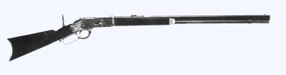
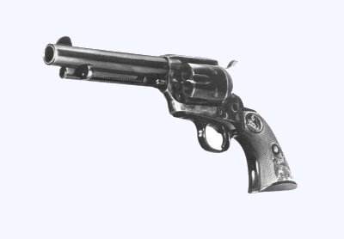
Firearm Design
Grip Action Barrel
Barrel
Grip or
But Stock
Action

Slide 13
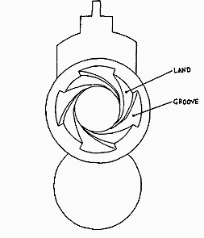
Classification of Firearms
Classified on the basis of barrel
Barrel
Steel tube for jetting of the projectile. Two ends --- Breach & Muzzle end
Bore
Internal diameter of the barrel. May be SMOOTH or RIFLED

Slide 14
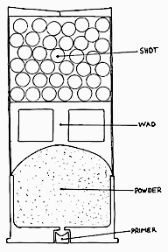
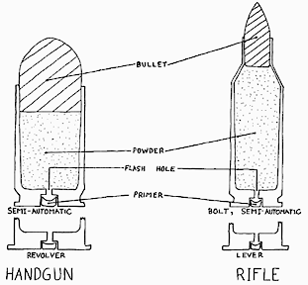
Ammunition Design Projectile consists of:-
Cartridge Case
Primer
Powder charge (Black or Smokeless)
Plastic Wad
Shot charge (Bullet or Lead shots)
C
A
R
T
R
I
D
G
E
B
U
L
L
E
T

Slide 15
CARTRIDGE CASE
Function: expands and seals chamber against rearward escape of gases.
Composition: usually brass (70% copper 30% zinc); also plastic and paper in shotgun shell tubes.
Shape: (a) straight ("always" pistol ammunition)
(b) bottleneck ("always" rifle ammunition)
(c) tapered ("obsolete").
Headstamp: manufacturers identification imprinted or embossed on cartridge case.

Slide 16

Primer
The major primer elements are Lead styphnate(Pb), Barium nitrate (Ba), or a Antimony sulphide(Sb). Usually, all three are present.
Less common elements include Aluminum (Al), Sulfur (S), Tin (Sn), Calcium (Ca), Potassium (K), Chlorine (Cl), or Silicon (Si).
Primer elements may be easier to detect in residues because they do not get as hot as the powder, and compounds (not just elements) may be detectable. (Tassa et al, 1982b)

Slide 17
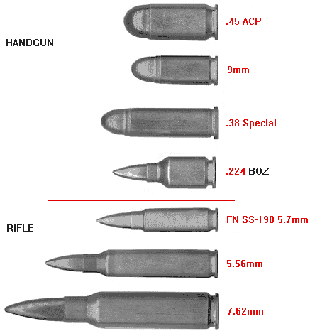
Various types of Ammunition

Slide 18
Chain of Events
Strike
Primer ignites
Powder charge burns
Temperature increases
Gases produce
Chamber pressure increases
Bullet/Shot charge moves
Exit of bullet
Chamber pressure zero
Gases produced: Carbon dioxide, Carbon monoxide
Nitrogen, Sulphurated hydrogen

Slide 19
Exterior Ballistics
“ Knowledge of forces acting on the shot while it
leaves the barrel till it reaches the target “
1- Velocity of bullet at the muzzle end for various firearms:-
i- Revolver:- 600 – 900ft/sec
ii- Pistol:- 1200 – 1440 ft/sec
iii- Rifle:- 2000 – 3500 ft/sec
2- Forces present in the medium
a- Air resistance
b- Gravity

Slide 20
Mechanism of Wound production
Laceration & Crushing
Shock waves
Cavitation

Slide 21
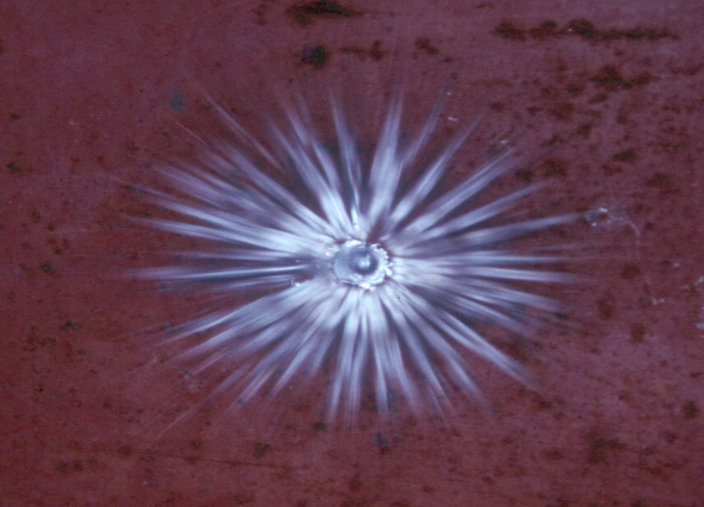
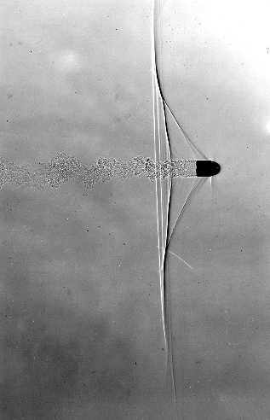
Laceration & Crushing …. produced by the direct effect of bullet
SHOCK WAVES

Slide 22
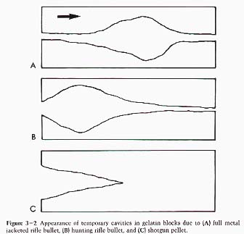
Types of cavitations
Temporary:
Permanent:
Cavitation …. created by the bullets travelling at speeds > 1000 ft/sec
Size & shape depends upon the capacity of the bullet to disperse energy in the surrounding tissues

Slide 23
M/L Importance of Wound Ballistics
1- Recognition of Entry & Exit wounds
2- Distance of Fire.
3- Direction of fire & Wound track.
4- Relative position of weapon/victim & angle of fire.
5- Cause of death.
6- Manner of death.
7- Identification of firearm.

Slide 24
Components of a Shot responsible for damage
1- Shot charge (bullet/pallet)
2- Flame & heat
3- Hot explosive gases
4- Smoke
5- Wad
6- Unburnt gun powder
7- Grease from the barrel

Slide 25
Firearm-wound complex has four parts:
An entry wound
A track with its direction
Place of resting of bullet or shot-charge.
Exit wound

Slide 26
ENTRY WOUND
SINGLE HOLE:
SIZE : depends upon skin elasticity, tail wag, explosive blast effect of gases so either proportionate to the diameter of the bullet, SMALLER or much larger having STELLATE SHAPE.
SHAPE: depending upon the angle of firearm with the target. Circular, Oval, Elliptical, An elongated furrow.
Inverted margins. May be everted.
Collar of abrasion: shape depends upon the angle of firearm with the target.

Slide 27
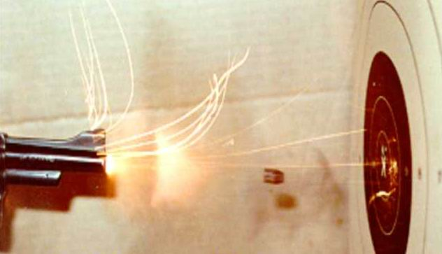
FLAME

Slide 28
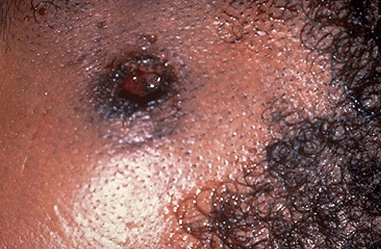
BURNING

Slide 29
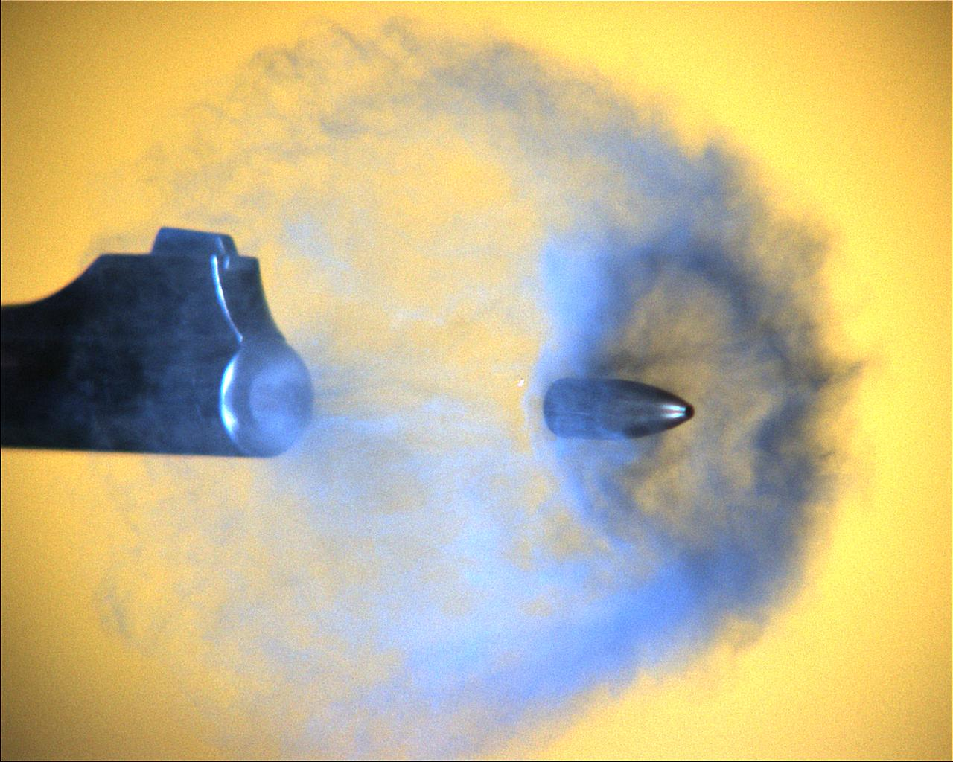
SMOKE

Slide 30
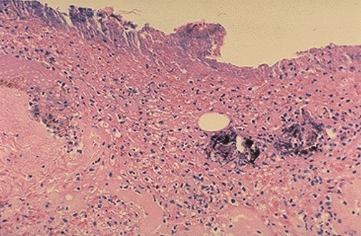
Carbon particles scattered on HISTOLOGICAL examination

Slide 31
Burning: Few inches in case of
revolver & one foot in case of a
Shotgun
Blackening: Absent after one yard

Slide 32
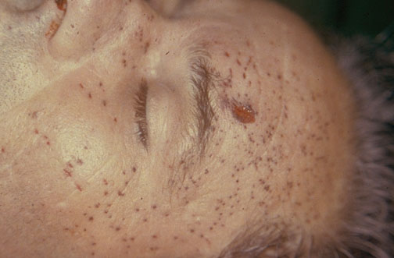
Tattooing (due to unburnt gunpowder particles)
Beyond 2 yards, tattooing is not present
by Naseeb R. Awan
“ They pierce under the superficial skin layers causing
punctate abrasions of smaller blood vessels under the
skin “

Slide 33
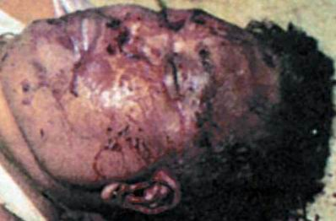
Un-burnt gunpowder particles pierce the skin while blood
stains are washable
Tattooing
Blood stains

Slide 34
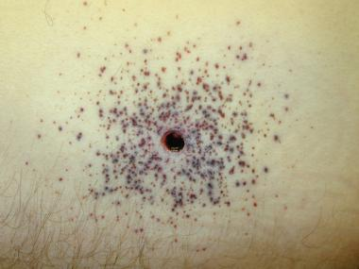

Slide 35
Skin changes
Bruising (at or around entry wound due to general tissue trauma) MUZZLE IMPRINT, Gases of the blast ballooning & bruising the skin/Vital reaction / Inflammatory reaction
Collar of Abrasion: Rub raw of the superficial skin layers while projectile enters the skin. More prominent in rifled firearms due to their rotational motion

Slide 36
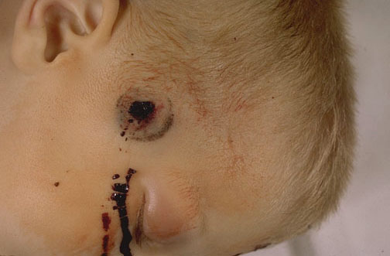
Collar Of Abrasion

Slide 37
Classification of Firearm Rifled Entry wound depending upon distance/range
Contact entry wound
Hard/Firm contact
Loose contact
Close range: Up to 2 yards
Distant range: Beyond 2 yards
Near distant: within six inches
Intermediate range:
1 – 2 yards

Slide 38
FEATURES OF ENTRY WOUND: DISTANT RANGE
Hole
Collar of Abrasion
No flame & gun powder effect.

Slide 39
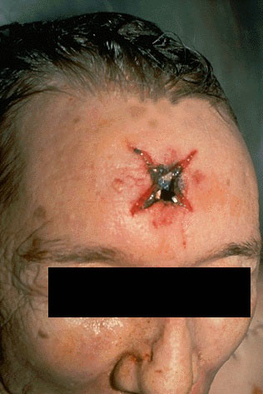
Contact Firearm Entry wound
Stellate Firearm wound
Muzzle of firearm pressed hard on some hard bony area as forehead / skull
Gases can’t enter skull & escape from sides causing lacerations in the scalp
Star shaped projections in scalp
Components of shot present inside skull in the track

Slide 40
Close Range Firearm Entry wound
Examination of clothes is important
Burning, blackening, tattooing present
Collar of abrasion present
Wad maybe present in the track in case of smooth bored firearm

Slide 41
Firearm Exit Wound
There may be no exit wound
May be multiple exit wounds of one entry wound due to Secondary missiles
May be large typical exit wound with everted margins
No close range characteristics
Shored exit wound: Collar of abrasion present

Slide 42
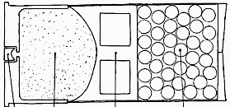
Shotgun Entry wound complex
Fanning
phenomenon

Slide 43
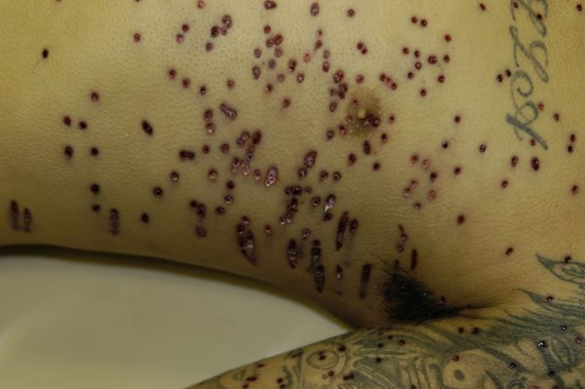

Slide 44
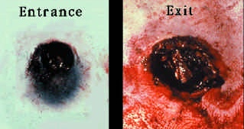
Loose contact shotgun wound and a larger, more ragged exit wound.

Slide 45
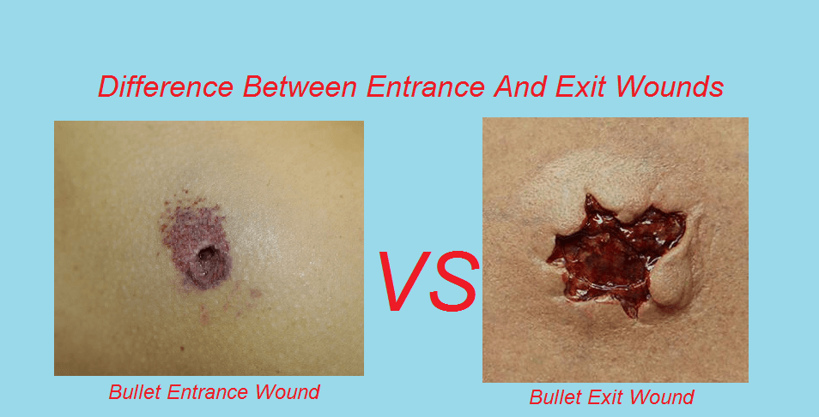

Slide 46
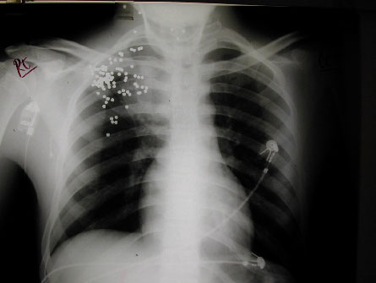
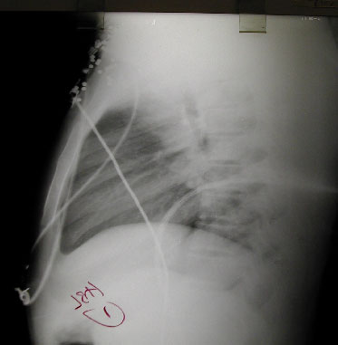
Shotgun pellets 1

Slide 47
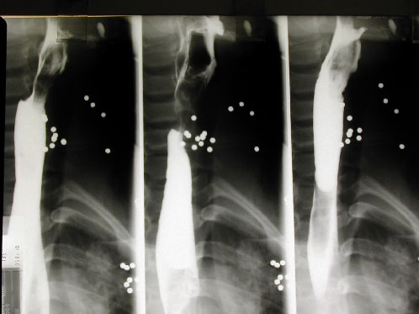
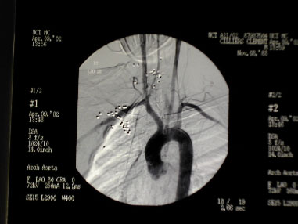
Shotgun pellets 2

Slide 48
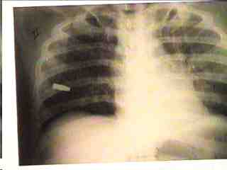
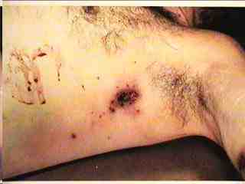
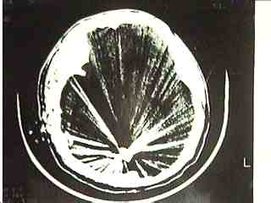
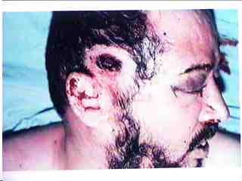

Slide 49
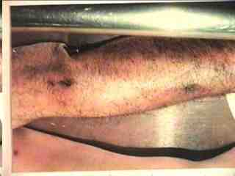
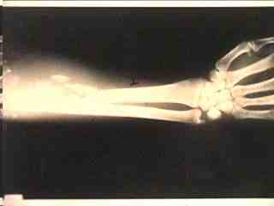

Slide 50
