Slide 1
INFANT DEATH
Medicolegal view
جامعة المعرفة

Slide 2
Definitions
1. Infanticide: It means unlawful destruction of a newly born child and is regarded as murder in law.
2. Feticide: It means killing of fetus prior to birth.

Slide 3
CAUSES
Either by:
1. Acts of commission or
2. Acts of omission
Acts of Commission
These are the willful acts done to cause the death of infant.
It includes:
Suffocation
Strangulation
Drowning
Head injury
Fracture-dislocation of cervical spine
Concealed puncture marks (pithing)
Poisoning.
Acts of Omission
Acts of omission refer to failure to take care of child or negligent towards the child during or after birth. It includes:
Failure to provide assistance during labor.
Failure to clear the air passage after birth.
Failure to cut and ligate the umbilical cord.
Failure to feed the child.
Failure to protect the child from heat or cold.

Slide 4
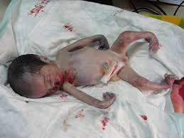
MEDICO LEGAL QUESTIONS
The following questions
are raised while doing autopsy in infant:
1. was the child stillborn or dead?
2. Was the child born alive (i.e. live born?)
3. If born alive, how long did the infant live the birth?
4. What was the cause of death?

Slide 5
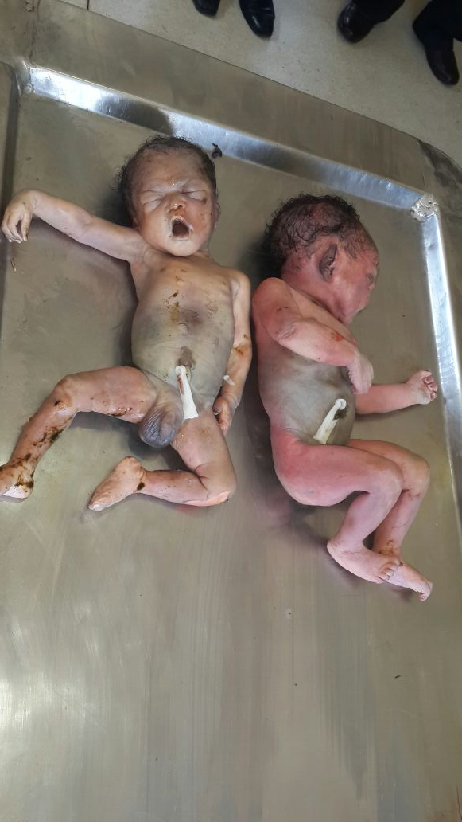
How do we examine a post mortem new born?

Slide 6
We should Examine the following:
Weight and measurement
External examination
Examination of head and neck
Vertebra and spinal cord
Mouth and pharynx
Thorax and abdomen
Abdominal organs
The skeleton
The placenta
Notes:
http://bmb.oxfordjournals.org/content/4/3/178.extract
http://www.ncbi.nlm.nih.gov/pmc/articles/PMC476937/?page=10

Slide 7
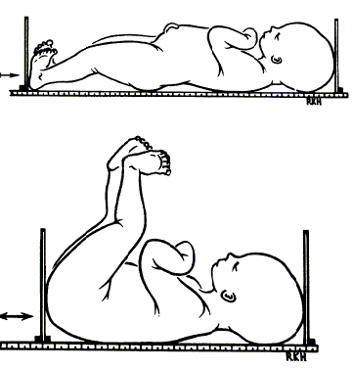
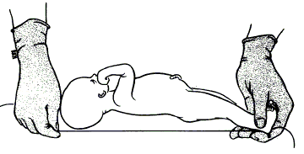
Weight and measurement
Size must be measured accurately and compared with known standers.
Length:
Crown-heel length by thread
A graduated board
Notes:
Why? Because the size of the body and its organs varies with the maturity of the infant.

Slide 8
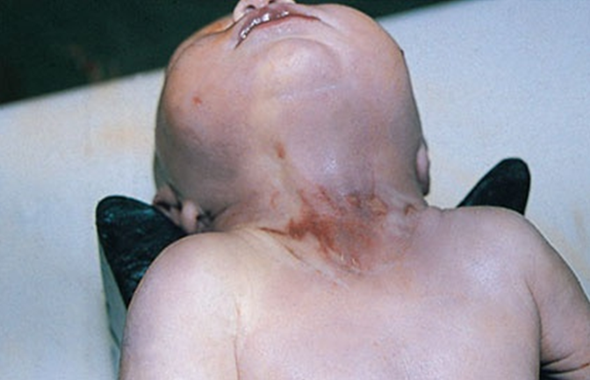
External examination
The external surface of the body is examined for evidence of maceration, cyanosis, petechial hemorrhages, injury and skin lesions and the orifices are examined for patency
Notes:
http://www.ncbi.nlm.nih.gov/pmc/articles/PMC476937/?page=10

Slide 9
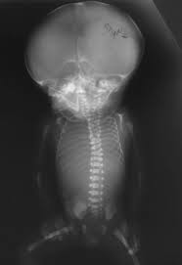
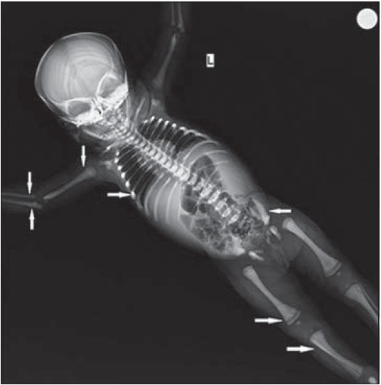
Examination of the skeleton
It’s better to have an X-ray photograph for each baby coming to necropsy.
Notes:
http://www.ncbi.nlm.nih.gov/pmc/articles/PMC476937/?page=10

Slide 10
Still-Born (Still Birth) Child
Definition: The child which has issued forth from the mother after the 28th week of pregnancy and did not AT anytime, after being completely expelled, breathes, or shows any other signs of life".
. Thus, a still-born child is alive in uterus up to the initiation of birth process and died during the process (i.e. delivery) but did not show any sign of life after being completely born

Slide 11
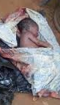
Dead-born Child (Dead Birth)
Definition: A dead-born child is one, which had died in uterus before the birth process begins and may show rigor mortis, maceration or mummification at birth.
Fetal death has been defined by World Health Organization
(WHO) as "death before complete expulsion or extraction from its mother of a product of conception, irrespective of the duration of pregnancy.

Slide 12
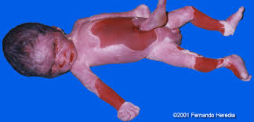
Maceration
Definition: It is a process of aseptic autolysis occurring in fetus that remains dead in the uterus surrounded by liquor amnii.
Maceration in fetus is sign of death.
. Mechanism: The cells of fetus break down after death and due to enzymatic action (autolysis) body becomes soft and flaccid.
Unlike putrefaction or decomposition, there is no bacterial action in maceration.
Duration required: If fetus remains in uterus after death, then the earliest sign of maceration is seen at about 6 to l2hours in form of areas of desquamation and appearance of brown-red discoloration of umbilical cord stumpa.

Slide 13
Maceration cont.
1. Features of Maceration
. The macerated fetus is soft and flabby and flattens when kept on table.
. Emits sweetish disagreeable smell
. The earliest sign of maceration is skin slippage (seen at 6-12 hours).
. Skin is sodden and shows red or purple coloration with large blebs (or blisters) containing serous or sero-sanguineous fluid. The epidermis is easily peeled off leaving moist, greasy areas underneath.

Slide 14
Maceration cont
1. Abdomen is distended.
Joints become abnormally mobile or flexible with
Bones get flexible and are easily detached from the soft parts.
. Skull bones show loss of alignment and they override over each other due to shrinkage of brain after death, known as Spalding sign. Brain becomes pulpy and grayish-red in color.
. Body cavities contain reddish serous fluid.
. Internal organs become soft and edematous
. Umbilical cord is red, smooth, softened and thickened.

Slide 15
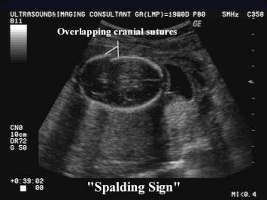
Maceration, ultrasound

Slide 16
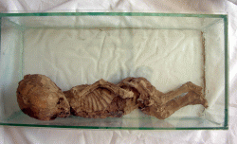
Mummification
. It is drying and shrinking of fetus occurring in uterus after death.
. It results when liquor amnii is scanty and no air enters the uterus.

Slide 17
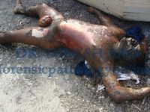
Putrefaction
If the membranes are ruptured early and air enters the uterus, then the dead fetus shows signs of putrefaction instead of
maceration.

Slide 18
Live-born Child (Live-birth)
A child showing a sign of life, even when only part of the child is out of mother, though the child has not breathed or completely born, is considered as live-born child.
. Causing death of such child is treated in the same manner as homicide.
Viability of Child
Viability means the ability of fetus to lead a separate existence after birth by virtue of certain degree of development.
A child is viable after 210 days or 7 months or 30 weeks
of intrauterine life.
Evidence of Live Birth (Signs of Live Birth)
Following are considered as signs of live birth.
1. Crying of baby
2. Movement of body or hand or foot
3. Muscle twitching or twitching of eyelid.
Following two conditions are considered:
l. Vagitus uterinus: Crying of a child even when it is in uterus
2. Vagitus vaginalis: Crying of a child even when it is in vagina
. Thus, it may possible that child may didn't show any sign when it comes out although cry of child is heard by people. So crying of child is not conclusive proof of live birth.

Slide 19
the external and internal autopsy findings in live birth
External changes
l. Changes in chest
2. Changes in skin
3. Changes in umbilicus
Internal changes
1. Changes in lung
2. Position of diaphragm
3. Changes in heart and circulation
4. Changes in gastrointestinal tract
5. Changes in middle ear
6. Changes in kidneys
7. Changes in blood

Slide 20
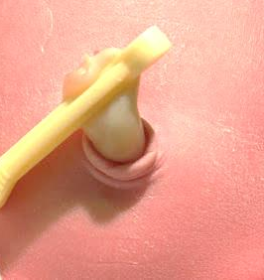
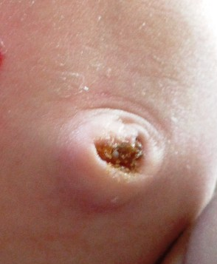
Changes in umbilicus and umbilical Cord

Slide 21
Gross and microscopic examination;
of the lungs
non-respired lungs appear
Respired lung
Volume
small, collapsed, lie in the back part of chest on side of vertebral column.
reddish-brown and hard in consistency like a liver, non crepitant.
uniform, hard and exude little froth-less fluid.
Sharp
alveolar lining epithelium is cuboidal to columnar with less vascularization.
filling the whole pleural cavities and medial margin overlaps the mediastinum and pericardium.
bright red or pinkish with mottled appearance, spongy, elastic and crepitant.
spongy and exude frothy blood.
rounded.
alveoli appear expanded with
flattening of epithelium and increased vascularization
Color
cut section
Margins
Microscopy

Slide 22
TESTS done on the lungs
non-respired lungs appear
Respired lung
Static test or Fodere's test
from 60 to 70 gm.
about1/35th of the weight of whole fetus.
940 to 950
lung pieces float
Pulmonary edema
Pneumonia
Atelectasis - non-expansion of lung
Obstruction by alveolar duct
weight of lungs (both)varies from 30 to 40 gm.
weight of both lungs is about1/70th of the weight of whole fetus.
1040 to 1050
lung pieces sink
Putrefaction - presence of gases of decomposition
Artificial respiration
Ploucquet's test
Specific gravity
Hydrostatic tests
Fallacies of hydrostatic test

Slide 23
Sudden Infant Death - SIDS
Sudden Infant Death Syndrome (crib death) - the sudden death of an infant, usually under 1 year of age, which remains unexplained after a complete postmortem investigation, including an autopsy, examination of the death scene and review of the case history
3,000 SIDS deaths per year in the U.S

Slide 24
SIDS - What It Is
Major cause of death in infants after 1st month of life
Sudden & silent in an apparently healthy infant
Unpredictable & unpreventable
Quick death with no signs of suffering - usually during sleep

Slide 25
SIDS - What It Is Not
Caused by vomiting or choking.
Caused by external suffocation or overlaying.
Contagious or Hereditary.
Child abuse.
Caused by lack of love.
Caused by immunizations.
Caused by allergy to cows milk.

Slide 26
Typical SIDS Infant Scenario
Almost always occurs during sleep or appearance of sleep
Usually healthy prior to death
May have had a cold or recent physical stress
May have been place down for nap, found not breathing or appearing dead
Parents not hearing signs of struggle

