Slide 1
Pregnancy
Medicolegal view
جامعة المعرفة

Slide 2
Definitions
1. Pregnancy is a physiological state in female where she conceives and carries developing product of conception in her (uterus) womb until birth of a child.

Slide 3
Medicolegal Importance-civil
Nullity of marriage (no valid marriage) : If a female is pregnant before marriage from another person and she concealed the
2. Divorce:
4. In alimonyالنفقة (support):
5. Inheritance of Property وراثة الممتلكات.
6. Blackmailing.
7. Defamationتشهير.
8. Compensation casesتعويض :
3. In case of breach (break) of promise of marriage.
9. Pregnancy may be taken as (defense) to avoid court.

Slide 4
Medicolegal Importance-crimimal
1. proof of sexual intercourse in rape cases.
2. cause for suicide in unmarried female.
3. Pregnancy may be motive of murder
4. Execution of death sentence
5. concealment of birth.

Slide 5
DIAGNOSIS OF PREGNANCY IN LIVING
Presumptive evidence of pregnancy.
Probable evidence of pregnancy.
Positive evidence of pregnancy.

Slide 6
DIAGNOSIS OF PREGNANCY IN LIVING Presumptive evidence of pregnancy
1. Secondary Amenorrhea
2. Breast Changes
The changes Revealed by pregnancy are:
Breast becomes full, tender and increases in size superficial veins become prominent.
8th week, hyperpigmentation of the areola and nipple occurs with appearance of Montgomery’s tubercles.
12th week, colostrum can be squeezed out of nipple and later milk can be extracted as pregnancy advances
However, these breast changes can also be seen in other conditions as;
Ovarian tumors secreting prolactin
Women taking contraceptive pills or tranquillizers.

Slide 7
DIAGNOSIS OF PREGNANCY IN LIVING Presumptive evidence of pregnancy
3. Changes in Vagina.
Jackquemir's sign (or Chadwick’s sign):
The normal pinkish mucosa of vagina changes to bluish by 4th week of pregnancy. The change in vaginal mucosa colour is due to venous congestion due to venous obstruction by pressure of gravid uterus. However, it can be observed in other conditions such as pelvic tumor (uterine fibroid).
Barne's sign: Flattening of anterior vaginal wall due to upward tilting of cervix
Osiander's sign: Palpable pulsation of the vaginal arteries felt through the lateral fornics at 8th week due to high arterial tension of pelvic arteries.
However, similar pulsation may be felt in acute pelvic inflammation.
- The secretion of mucous from vagina is increased.

Slide 8
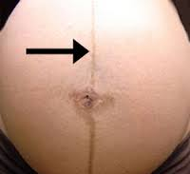
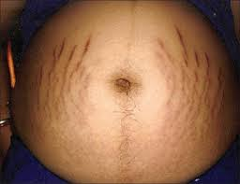
DIAGNOSIS OF PREGNANCY IN Presumptive evidence of pregnancy
Pigmentation of skin- Pigmentation may occur on forehead and cheeks in form of dark brown patches.
- A linear pigmentation known as linea nigra.
- The skin over abdomen shows depressed lines, pinkish or slightly bluish in appearance. These lines are called as striae gravidarum.
5. Morning sickness
- Morning sickness refers to nausea and at times followed by vomiting soon after waking.
6. Sympathetic disturbances
Increased salivation
Perverted appetite with desire for unusual food
Irritable temper
Easy fatigability
7. Frequency of micturition.
- In early and late trimester of pregnancy, due to pressure of enlarging gravid uterus over bladder, the bladder gets irritated and due to which female have
increase frequency of micturition.

Slide 9
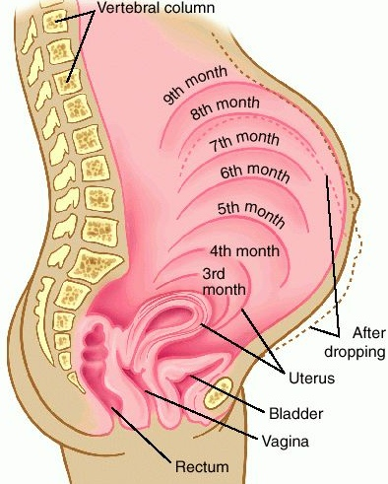
DIAGNOSIS OF PREGNANCY IN II. Probable Evidence of Pregnancy
1. Enlargement of abdomen
12th week, uterus can be palpated just above symphysis pubis.
l6th week it is half way between the symphysis and umbilicus .
20 weeks 2 fingers below the level of umbilicus
22 weeks At the level of umbilicus.
24 weeks 2 fingers Above the level of umbilicus
28 week the fundus raises one third of the way between umbilicus and xiphisternum .
32 week upper one third between umbilicus and xiphisternum.
38week the uterus reaches at the xiphisternum.

Slide 10
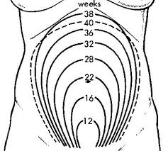
DIAGNOSIS OF PREGNANCY IN II. Probable Evidence of Pregnancy
Palmer’s sign- regular rhythmic contractions of uterus at 4th to 8th week.

Slide 11
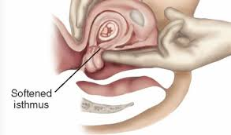
DIAGNOSIS OF PREGNANCY IN II. Probable Evidence of Pregnancy
2. Changes in cervix
Goodell's sign: The cervix normally is hard as tip of nose. However, due to pregnancy, it begins to soften from below upwards and is felt soft as lips. by 16th week
Mucous becomes thick and viscid plug blocks the cervical canal.
3. Hegar's sign
Lower segment of uterus becomes soft and is easily compressible. It becomes positive at 8 to 10 weeks.
4. Ballottement
A technique of palpating an organ or floating structure by bouncing it gently and feeling it rebound.
The test is positive by 16 to 20 weeks
Ballottement test can be negative if the amount of amniotic fluid is scanty

Slide 12
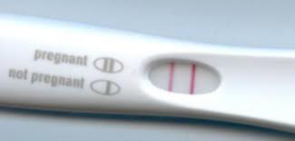
DIAGNOSIS OF PREGNANCY IN II. Probable Evidence of Pregnancy
5. The laboratory tests for pregnancy are classified as:
1. Bio-assay or biological tests
2. Immunoassay or immunological tests
3. ELISA test
4. Radio-immunoassay
Biological Tests
Not used now
Immunological Tests
Immunological tests are based on principle that antigen present in urine or serum (hCG) reacts with antibody.
Direct agglutination test
In this type of test, latex particles coated with anti-hCG monoclonal antibodies are mixed with urine. An agglutination reaction
develops indicating a positive result. It means female is pregnant.
Fallacies of Tests
Tests are based on Presence of hCG (as antigen). Could be positive in other conditions
1. Hydatidiform mole
2. Chorinoepithelioma

Slide 13
DIAGNOSIS OF PREGNANCY IN III Positive Evidence
1. Fetal parts and fetal movements the test can be done by palpation of fetal parts and movements by placing hands over abdomen. Fetal movements are appreciated by 16 to 20 weeks.
2. Fetal heart sounds ( soufflé ) is absolute sign of pregnancy and usually heard at about 18 to 20 week
3. X-ray examination
By X-ray, the diagnosis of pregnancy can be certain after 16th week. X-ray will reveal fetal skeleton in form of Circular shadow of skull outline.
4. Sonography
By this method, gestational sac (ring) is determined by 5th week and distinct echo’s of embryo within gestational sac by 8th week.

Slide 14
Diagnosis of Pregnancy in Dead
In addition to signs found in living persons, following are important signs of pregnancy found in dead female.
1. Presence of product of conception:
2.Presence of placenta
2. Changes in uterus
Uterus is enlarged, thickened and increase in size.
Marks of attachment of placenta
Microscopic examination of uterus reveals hypertrophy and hyperplasia of myometrium.
4. Changes in ovary
Corpus luteum is present and attains largest size at about 16th week of pregnancy. It secretes progesterone
5. Laboratory investigation
- hCG can be detected in blood/urine.

Slide 15
AVERAGE DURATION OF PREGNANCY
. The average duration of pregnancy
is 266 days (38 lunar weeks) from conception or
it is 280 days (40 lunar weeks, l0 lunar months or 9 calendar months and7 days) from the first day of the last menstrual period in woman with regular menstrual cycles. The former is called as ovulatory age or fertilization age and later is called as gestational age or menstrual age.
. The ovulatory or fertilization age is usually used by histologist or embryologist
. The gestational or menstrual age is used by Obstetricians and legal professionals.
Minimum Duration of Pregnancy
. The child born on or after 210 days or 7 months is considered as viable. However, cases have been reported where children born even less than 210 days have also
survived .

Slide 16
AVERAGE DURATION OF PREGNANCY
. Maximum Duration of Pregnancy
Cases have been reported where females have given birth even after 352 days from last day of menstruation .
. CALCULATION OF EXPECTED DATE OF DETIVERY
Expected date of delivery (EDD) is calculated by:
1. Nagele's rule - in this traditional method, EDD is calculated by adding 7 days to the first day of the last menstrual period (LMP) and count back three months (90 days). If a leap year intervenes, add 6 days instead of 7 days.
2. Sonography method - by measuring crown rump length, biparietal diameter etc.

Slide 17
CALCULATION OF DURATION OF PREGNANCY
. Following are the methods to estimate duration of pregnancy
1. Clinical method - here height of fundus is measured with reference to anatomical landmark and period of pregnancy is calculated for example if fundus is at umbilicus, then period of pregnancy is 24 weeks etc.
Pseudocyesis
. Synonyms: false or spurious pregnancy, phantom pregnancy, imaginary pregnancy. In this condition, the woman believes or imagines that she is pregnant. The fact is that, she is not pregnant.
. The woman has subjective symptoms of pregnancy in form of enlarged abdomen, breast changes with amenorrhea.
. The woman have imaginary thoughts that fetus is growing inside her womb.
. X-ray or sonography will resolve the issue.

