Slide 1
RAPE
Medicolegal view
جامعه المعرفة

Slide 2
Rape defined as unlawful sexual intercourse by a man with a woman:
Against her will :without her consent.
With her consent, when.
Her consent has been obtained by putting her or any other person in whom she is interested in fear of death or hurt.
With her consent, when the man knows that he is not her husband and that her consent is given because she believes that he herself to be lawfully married.
With her consent, when at time of giving such consent, by reason of unsoundness of mind or intoxication .

Slide 3
TYPES OF RAPE:
Statutory Rape: It is a forcible sexual intercourse by a man with a woman, who is less than 16 years of age.
Marital Rape. Also called as spousal rape. it is a forcible sexual intercourse by a man with his wife without her consent if the Wife is living separately from him under a decree of separation .
Custodial Rape (Custody Rape). It is done by persons taking advantage of their custodial positions and has forceful sexual intercourse with woman in their custody.
Gang Rape. Also called as group rape or pack rape. When rape is committed on a female by more than one person acting in furtherance of their common intention,
it is called as gang rape.
Date Rape. It is a forcible sexual intercourse by a boyfriend with girl friend when they are on date (for stay or vacation).In such cases, the girl may allege that her boyfriend had given her some intoxicant and proceed with the act
Stranger Rape: It is the rape committed by a male on a female who had no previous contact

Slide 4

Some mandatory points for examination:
examined within 24 hours after taking proper consent
Always examined in presence of female
Note the time of start and the time of end
Always state reasons for all conclusions
It is necessary to keep samples for examination of blood, stains, semen, swabs, sweat, hair, nails, DNA etc as required

Slide 5
MEDICAL EXAMINATION OF RAPE VICTIM
Doctors, examining a victim of rape are shouldered with dual responsibilities,
Firstly they have to treat the patient and provide support and
Secondly they have to examine the victim and collect material evidences to facilitate and aid the justice.
. A female nurse or attendant should be present while examining victim.
whenever female has to be examined it should be done by (or under supervision) of a lady doctor.

Slide 6
DUTIES OF REGISTERED MEDICAL PRACTITIONER TOWARDS STATE
Consent
Confidentiality
Maintenance Of Records
Collection And Preservation Of Samples
Notes:
6

Slide 7

STEPS IN SPECIFIC CASES:
IN RAPE CASE
Inform the police
After taking consent, medicolegal examination and treatment given
Samples for examination of blood, stains, semen, swabs, sweat, hair, nails etc preserved, sealed, labeled and sent to police under proper receipt
send report as early as possible
7
Notes:
7

Slide 8
THE MEDICAL EXAMINATION CONSISTS OF:
1. Recording history
2. Examination of clothes
3. Physical examination
4. Collection of material evidence.
CONSENT
Written informed consent of a victim is a must.
without consent doctor cannot proceed with medical examination.
A victim of and over 18 years of age can give consent.
If she is child under 18 years of age or of unsound mind, the consent of parent or guardian should be taken.

Slide 9
PREPARATION OF MEDICOLEGAL REPORT
Medicolegal report (MLR) prepared immediately after the examination of a medicolegal case is done
It is prepared in duplicate, preferably with a ball-point-pen, in a clear and legible handwriting
Cutting/ overwriting etc avoided as much as possible.
Abbreviations of any sort avoided.
9
Notes:
9

Slide 10
HISTORY :
VICTIM
CONDITION
ASSILANT

Slide 11
The history OF VICTIM
The history includes
Whether the victim had attended menarche?
If yes, whether she was menstruating at the time of alleged incident?
Her marital status and history.
Obstetric history, if relevant.
History of any venereal disease
The history OF CONDITION
History about the incident;
date ,the time,the location, ,
Nature of assault, whether penetration was;
vagina .
anal .
oral.

Slide 12
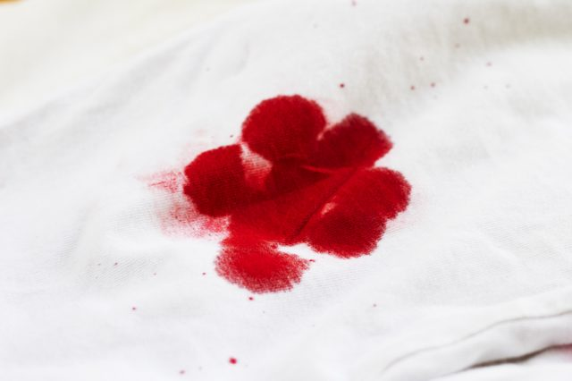
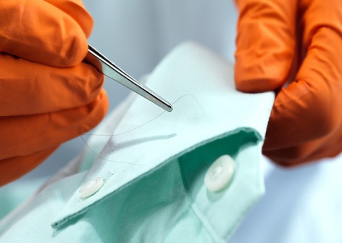
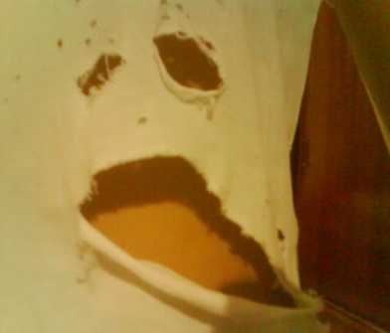
2. EXAMINATIONS OF CLOTHES:
should be examined for tears or presence of any foreign materials like hair, secretions or blood.

Slide 13
Physical examination:
1Request the victim to stand on a large clean, white sheet of paper and undress herself. The purpose is to collect any material evidence that falls on the paper.
General examination:
Local examination:
PUBIC HAIRS
THIGH
LABIA
HYMEN: It is said that tears of the hymen due to rupture with fingers are usually lateral, whilst rupture with the penis are usually posterior.
In children hymen may not be ruptured but becomes red and congested because hymen is deeply situated.
Hymen may not be ruptured if:
If penetration was not full
If victim happens to be female child as hymen is deeply situated
If hymen if tough, fleshy, elastic (false virgin) .
Defoliated female

Slide 15
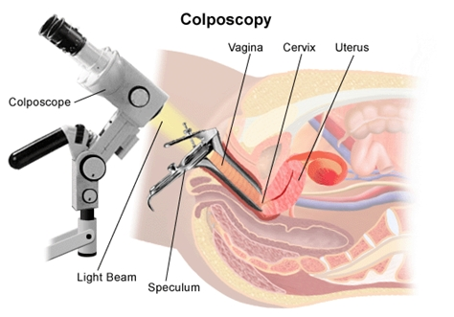
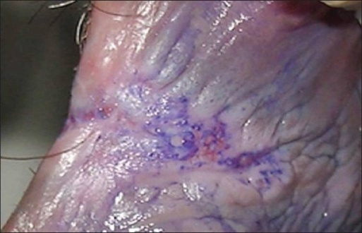
Physical examination:
1. Vagina -
Look for any vaginal bleeding
Look at vaginal mucosa for presence of any;
Injury,
foreign body.
Rugae of vaginal wall – distinct or not distinct.
Vaginal canal and fornix for collection of
any fluid/semen.
The examination should include deep vaginal examination, as occasionally, high vaginal tears occur, especially in violent assaults on children.
Colposcopy - provides magnification in a range of 5 to 30 times and greater illumination and thus help in detection of minor trauma. Many authorities recommend use of colposcopy examination in sexual assault
victims.
Toluidine blue - Toluidine blue stains nuclei and is used
on the posterior fourchette to identify lacerations of the
keratinized squamous epithelium that are not apparent
on gross visualization

Slide 16
Physical examination :
ANUS - look for any:
1.Discharge.
2.injury
3.Hemorrhage.
injury.

Slide 17
SAMPLES TO BE COLLECTED from VICTIM
l. Clothes .
2. Foreign evidentiary material - like hair, fiber, button etc.
3. Fingernail scrapings
4. Scrapings from suspected stain marks from body surface.
5. Scalp hairs - for comparison with scalp hairs found over body/clothes of alleged accused
6. Swab from teeth bite mark
7. Combing of pubic hairs
8. Hair clipping of victim.
9. Vaginal swab/smears, cervical smears.

Slide 18
Physical examination cont:
10. Washings of posterior fornix of vagina for:
Detection of spermatozoa.
Presence of mycobacterium smegmatis (smegma bacilli)
Presence of sexually transmitted disease
11. Blood for;
Serology
Pregnancy test
presence of drug/intoxicant
DNA profiling
For venereal disease.
12. Urine for
Pregnancy test
Detection of alcohol.
13. Condom if found at scene of crime - laboratory examination of condom may reveal presence of blood/vaginal epithelial cells on one side and semen on the other. Pubic hairs may also be present. DNA profiling of semen maybe of help.

Slide 19
Physical examination cont:
Spermatozoa - motile sperm found in endocervix up to seven days after intercourse.
Semen not likely to be found in the mouth after few hours.
Sperm not recovered if the assailant a zospermic or vasectomised.
Acid phosphatase found up to 12 hours after intercourse in 50% vaginal swabs. Also found after a vasectomy.
Anal intercourse - semen may be found up to 3 days later.

Slide 20
Summary of Sample to be taken
Clothing.
Sheet of paper.
Head hair (cut/combed).
Pubic hair (cut/combed).
Saliva.
Mouth swab.
Venous blood (EDTA/preserved).
Penile swab.
Anal swabs.
Vaginal swabs.
Fingernail scrapings.
Skin samples (UV light).

Slide 21
TREATMENT
Physical injuries
Psychic trauma.
Hepatitis B vaccine.
Chlamydia Prophylaxis Azithromycin 1g.
Prevent pregnancy:
Contraceptive pills
IUD.

Slide 22
Physical examination of accused:
The medical examination consists of:
l. Recording history
2. Examination of clothes
3. Physical examination
4. Collection of material evidence
CONSENT
CLOTHES
General Physical Examination
Systemic medical examination should be done.
Examination of the Penis
swelling,
tenderness and
injury especially to the rim of the glans and the frenulum.
Examine the shaft of penis for presence of vaginal epithelial cells and/or for presence of bloodstains. Glycogen rich vaginal epithelial cells may be detected from penis in sexual assault.
Potency.

Slide 23
Physical examination of accused:
The smegma :
is thick, cheesy whitish secretion with disagreeable odour comprising of desquamated epithelium and smegma bacilli (Mycobacterium smegmatis).
It takes about 24 hours to collect the smegma on corona glandis.
The smegma is wiped out during the act of sexual intercourse. Therefore presence of smegma indicates non-participation of a male in recent sexual intercourse act. However, caution should be exercised because the
smegma may be removed by a person during daily bathes a part of maintaining local hygiene.
Wipe the shaft of penis with moist filter paper and exposed to vapors of Lugol's iodine. Development of brown colour indicates presence of glycogen rich vaginal
epithelial cells. Similarly microscopic examination may also show vaginal epithelial cells .
:

Slide 24
complication OR DANGERS OF RAPE
1. Hemorrhage and shock due to injuries sustained to genitals or perineum
2. Death may occur due to:
Assault to obtain consent or put her in fear.
By suffocation - to prevent shouting
Strangulation - to hide the crime.
Suicide - due to depression or frustration of being raped
Intoxicants - overdose or adulteration.
3. Mental agony, which disrupts the victim’s physical, social, mental and sexual
life.
4. Rape trauma syndrome: The syndrome includes behavioral, somatic or
psychosocial reaction to the act of forceful sexual intercourse. It is regarded as posttraumatic stress disorder. The syndrome has been defined in two stages.

Slide 25
Complications OR DANGERS OF RAPE cont.
Immediate - the phase of disorganization characterized by feeling of guilt and humiliation.
Delayed - or phase of reorganization characterized by protracted response in form of recurrent and intrusive recollection of stressful event either in flashbacks or in dreams.
MEDICOLEGAL ASPECTS
1 Rape is a legal term and not medical diagnosis.
Whether the rape has taken place or not is a legal conclusion drawn by
judicial officer and not by medical doctor.
2. Mere penetration by penis up to vulva is sufficient to constitute the sexual
intercourse necessary to the offense of rape.

