Slide 1
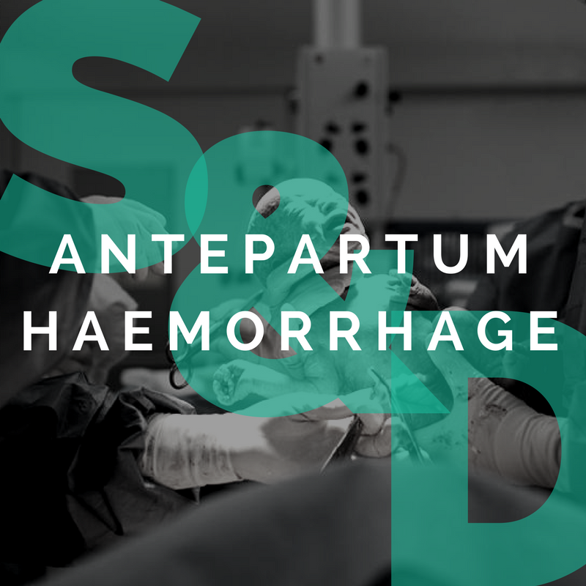
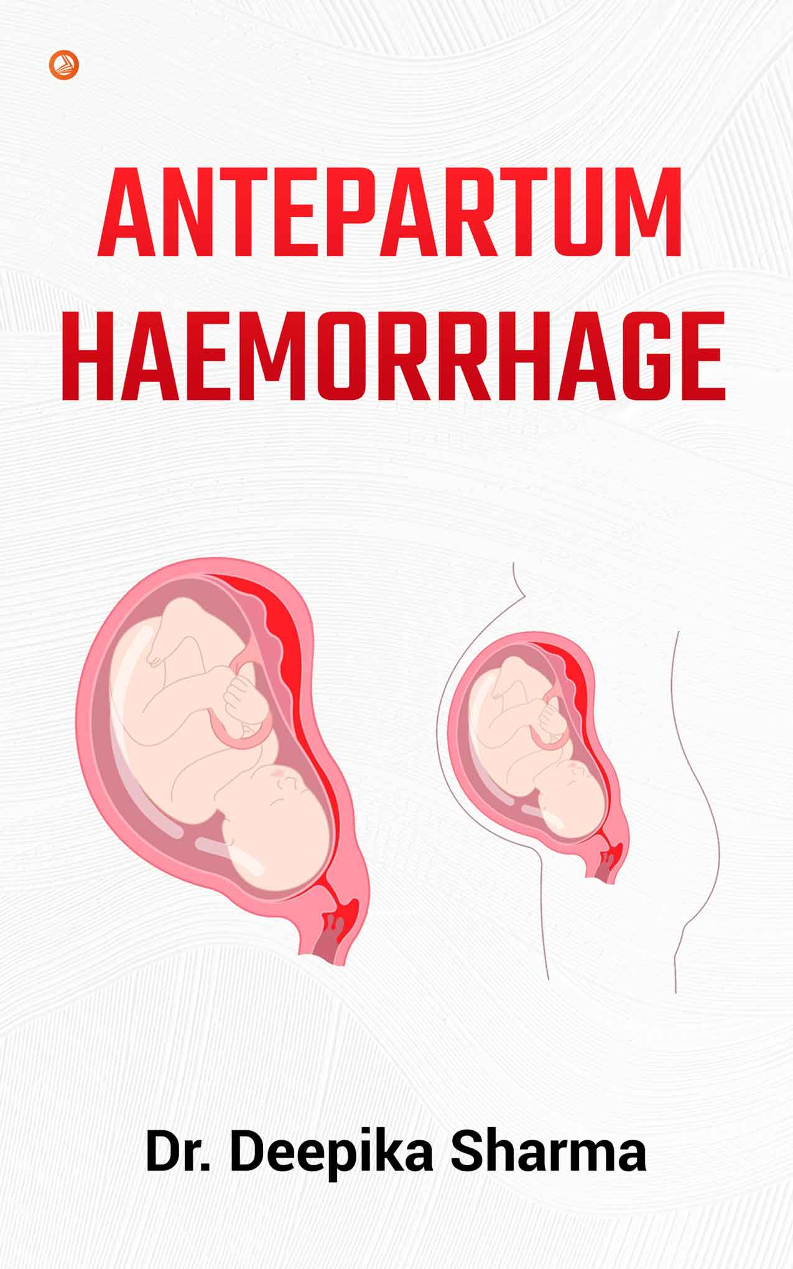
By dr.Mona Ahmed
Almareefa University
Assistant professor
SMSB

Slide 2
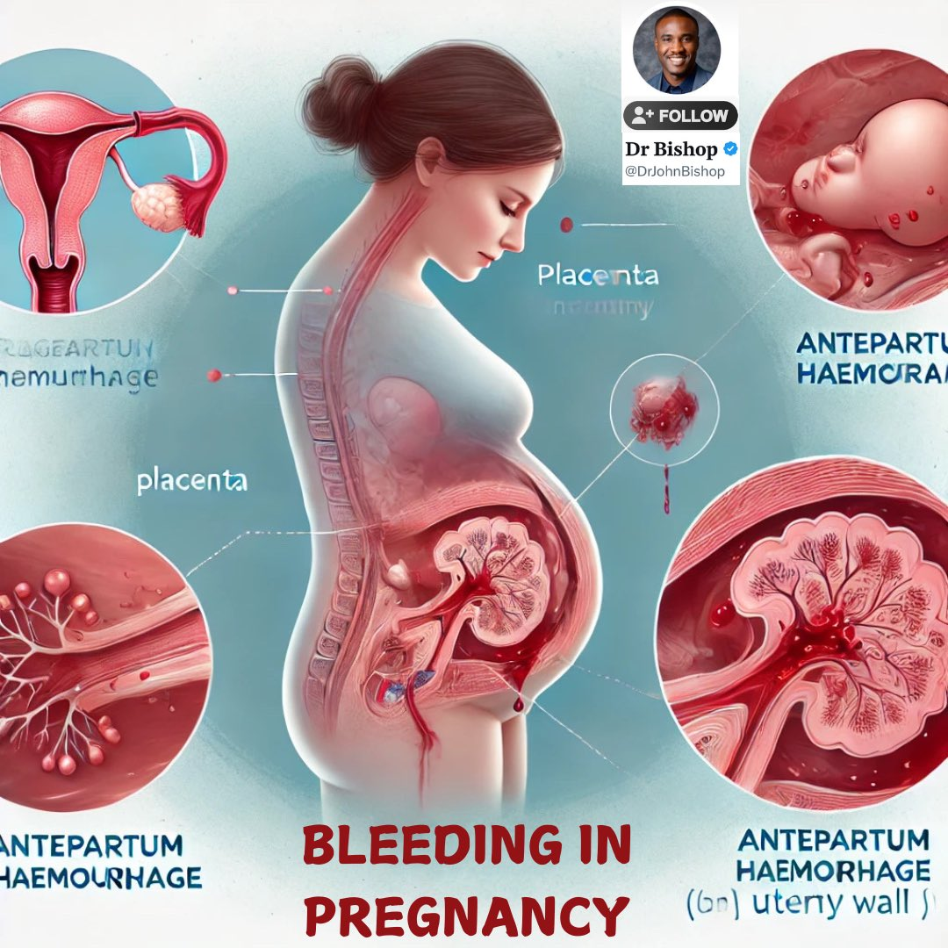

Slide 3
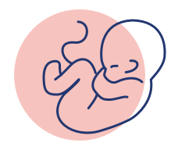
Learning objectives:
At the end of this lecture, the students will be able to:
1. Define antepartum hemorrhage.
Identify the risk factors for placenta previa, abruptio
placenta and placenta accreta.
3. Describe the clinical features and diagnostic criteria for
placenta previa, placental abruption and placenta previa accreta.
4. Distinguish between placenta previa. abruptio placenta and other possible causes.
Describe the appropriate management plan
based on the cause.

Slide 4
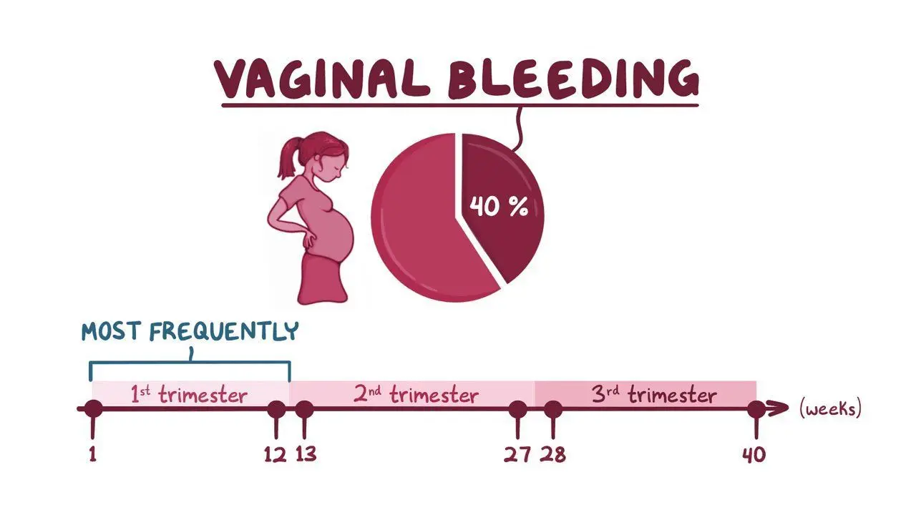

Slide 5
APH
Definition :
This is defined as vaginal bleeding after 20 weeks’ gestation.
Incidence:
It complicates 2–5% of pregnancies.

Slide 6
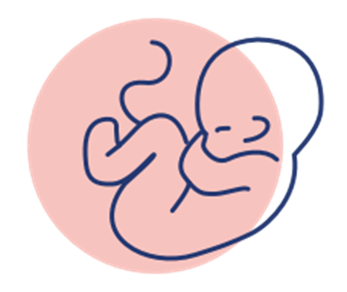
Causes
The causes can be classified into:
placental
fetal
maternal

Slide 7
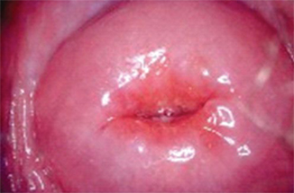
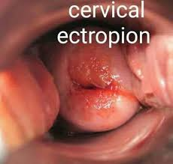

Placental causes:
placental abruptio.
placenta previa.
Fetal cause:
vasa previa.
Maternal causes:
vaginal trauma.
cervical ectropion.
cervical carcinoma.
vaginal infection.
cervicitis.

Slide 8
Placental causes are the most worrying.
the key questions are:
whether the bleeding is placental or not ?
and is compromising the mother and/or fetus?
Or whether it has a less significant cause?

Slide 9
History
Triggering factors (e.g. truma).
Associated with pain or contractions?
Timing & amount of bleeding
Fresh or old associated with mucus?
site of placenta on anomaly scan
Is the baby moving?
Last cervical smear (date/normal abnormal)?

Slide 10

Examination
Signs of shock (pulse , blood pressure, pallor).
Abdominal examination:
*fundal level.
*Is the uterus soft or tender and firm?
Fetal heart auscultation/CTG.
Speculum vaginal examination
.pv: should be avoided if pp suspected.

Slide 11


Investigations
full blood count.
clotting factors.
Keilhauer test
cross-match(save 6 units of blood).
Urea & electrolytes.
Ultrasound
(fetal size, presentation.
amniotic fluid, placental position
and morphology).

Slide 12


Initial management
Depend on
Cause
maternal & fetal conditions
GA
degree of bleeding
Two large bore cannulae (14-16).
Resuscitation.
Liaison with hematologist
prepare 4-6 unites of blood

Slide 13

Acute management checklist
ABC
Hemodynamic monitoring: continuous ECG, pulse oximetry ,Oxygenation: e.g., supplemental O2
Immediate hemodynamic support: including emergency blood transfusion for Hemorrhagic shock
Focused gynecologic history :and pelvic examination
Laboratory studies: CBC, coagulation studies, type and screen
Fetal heart rate tracing
Transvaginal ultrasound: to confirm placental location
Rh(D)-negative mothers: Kleihauer-Betke test,
anti-D immunoglobulin
Urgent OB/GYN consult to determine further
management

Slide 14
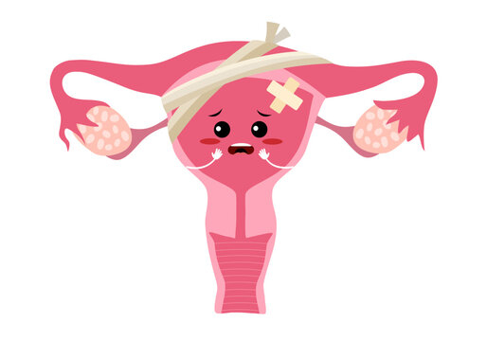

Complications of APH
Hypovolemic shock.
Preterm labour.
DIC.
PPH.
Emergency C-section.
Hysterectomy.
Complications of blood transfusion.
Fetal death.

Slide 15
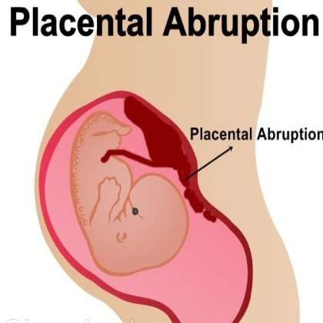


Slide 16
Placental abruption
Definition:
Placental abruption is the premature separation of the placenta from the uterine wall.
The bleeding is maternal and/or fetal and abruption is acutely dangerous for both the mother and fetus.
Prevention
avoidance of precipitating factors such as :
control of blood pressure
Avoidance of cocaine and smoking.

Slide 17
Risk factors:
Hypertension (most common cause)
Preeclampsia/eclampsia
Smoking. Alcohol and cocaine use
Abdominal) trauma: e.g., car accidents, falls).
multiple pregnancy.
Increase parity.
ECV.
Sudden decrease in intrauterine pressure ; decompression of an overdistended uterus (e.g., ruptured membranes in polyhydramnios)
Previous abruption, chorioamnionitis, short umbilical cord
Idiopathic.

Slide 18
Clinical presentation
vaginal bleeding.
abdominal pain.
Shock.(Hypotension – tachycardia).
Absence or reduced fetal movements.
Tense abdomen.
CTG( fetal distress).
P.V: os may be closed or opened

Slide 19
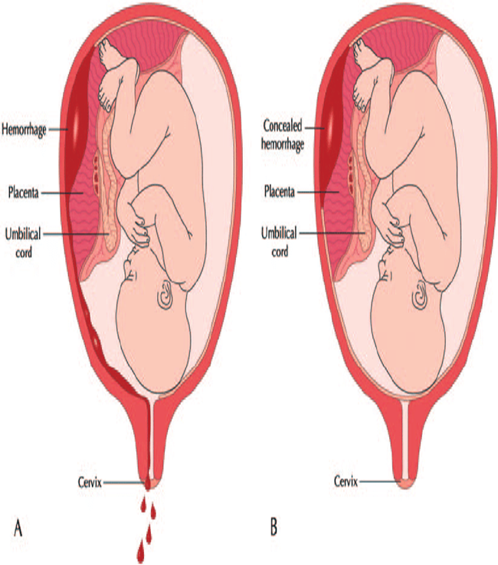
Types of placental abruption:
Revealed
Blood tracks from site of placental
Separation between decidua &chorion
To the cervix causing vaginal bleeding.
concealed
Blood form retroplacental clot between
placenta and uterus with no vaginal
bleeding.

Slide 20
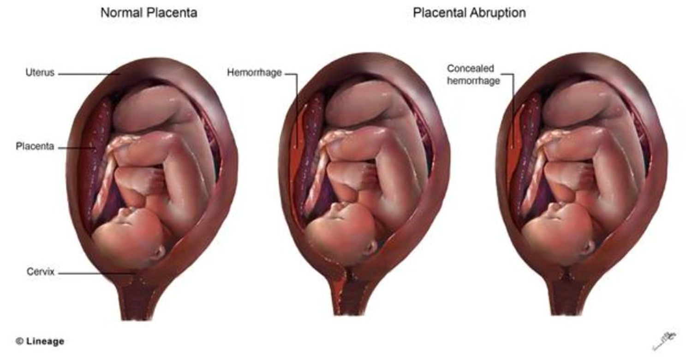

Slide 21
Management
If maternal & fetal collapse:
Resuscitation
Delivery (if baby alive .most expedient rout
Fully dilated cervix: instrumental delivery
If not fully dilated C/S ..if baby is died vaginal delivery ).
if DIC resuscitation.
Hysterectomy
Strict fluids.

Slide 22
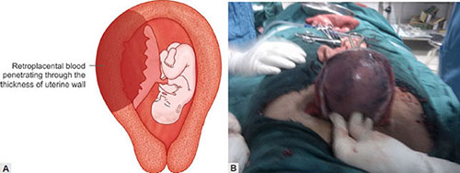
Complications
DIC
Couvelaire uterus.
Acute renal failure.
PPH.
Fetomaternal haemorrhage.
Fetal risks:
Prematurity.
Hypoxia & ARDS.
Death.

Slide 23
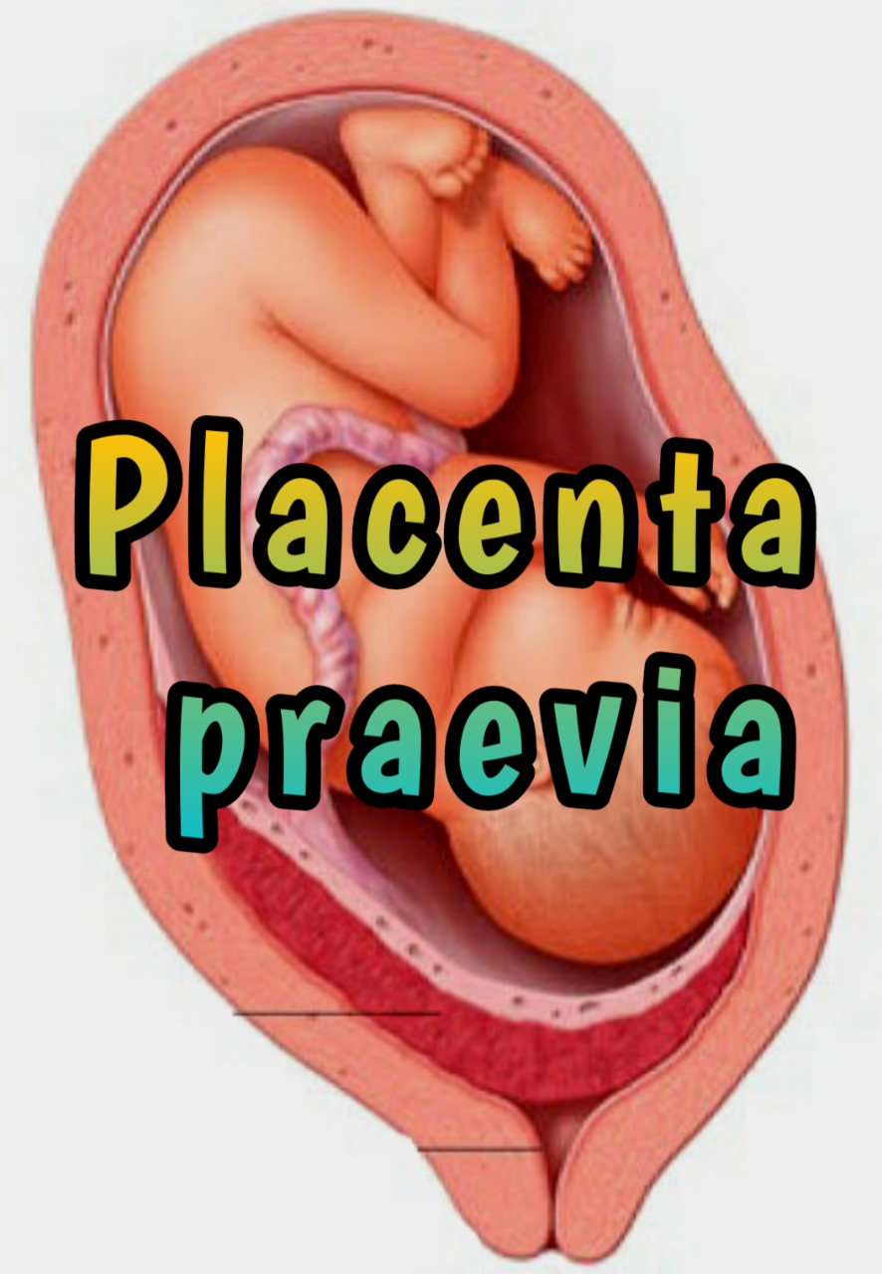


Slide 24
Placenta previa
A Presence of the placenta in the lower uterine segment, which can lead to partial or full obstruction of the internal os.
The bleeding is from the maternal not fetal circulation and is more likely to compromise the mother than the fetus.

Slide 25
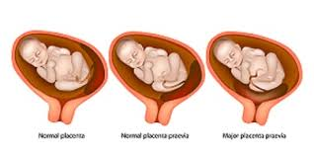
Placenta previa
Types:
Minor placenta previa:
placenta sited in the lower segment
but does not cover the cervical os
Major placenta previa:
placenta cover the cervical os.

Slide 26
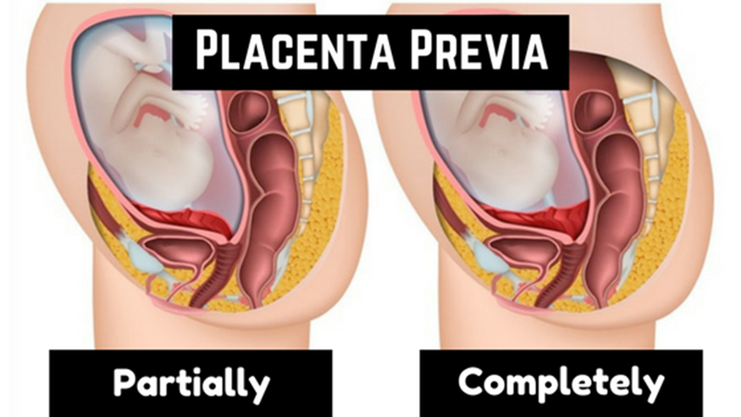

Slide 27
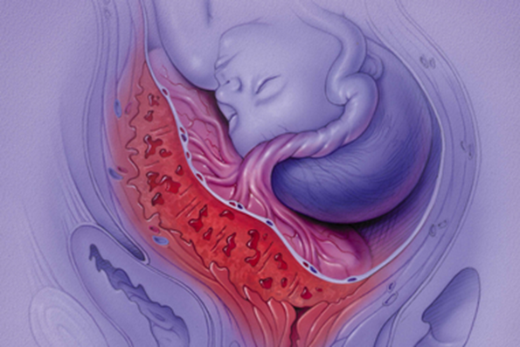
Prevention:
avoidance of non-clinically indicated caesarean section.
Risk factors:
multiple gestation.
previous caesarean section.
uterine structural anomaly.
assisted conception.
Increase parity
Previous placenta previa.
Previous dilatation & curettage.
Maternal age > 35 years, multiparity, short intervals between pregnancies
History of uterine surgery, e.g., myomectomy.

Slide 28
Warning signs:
low-lying placenta at 20 week anomaly scan.
maternal collapse.(Shock signs)
painless vaginal bleeding

Slide 29
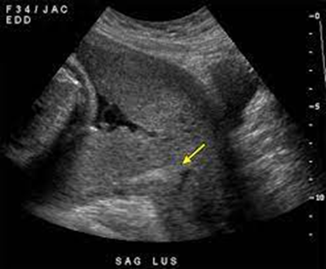
Clinical presentation and diagnosis
presenting complaint:
painless vaginal bleeding.
But may have irregular abdominal pain (associated with uterine contractions).
Diagnosis:
Ultrasound(preferably transvaginal).
patients will have been highlighted
as having a low-lying placenta
at their anomaly scan .

Slide 30
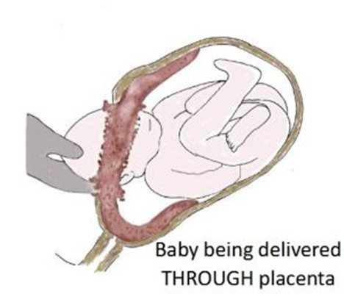
Management
Minor: reach term then vaginal delivery.
Major:
if no bleeding :
Admission at 34 weeks or send to home?.
If there is bleeding:
Should be admitted to hospital(length of stay depend on GA amount of bleeding).
If sever bleeding resuscitation +immediate delivery.
Delivery (between 37-38) by C/S.
Prepare blood
Give corticosteroid.
Give anti D(if needed)

Slide 31
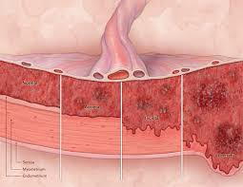
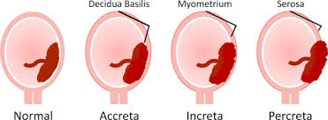
Complications:
Placenta accreta.
Antepartum hemorrhage.
postpartum hemorrhage.
Fetal distress.
Preterm labor and delivery
Amniotic fluid embolism

Slide 32
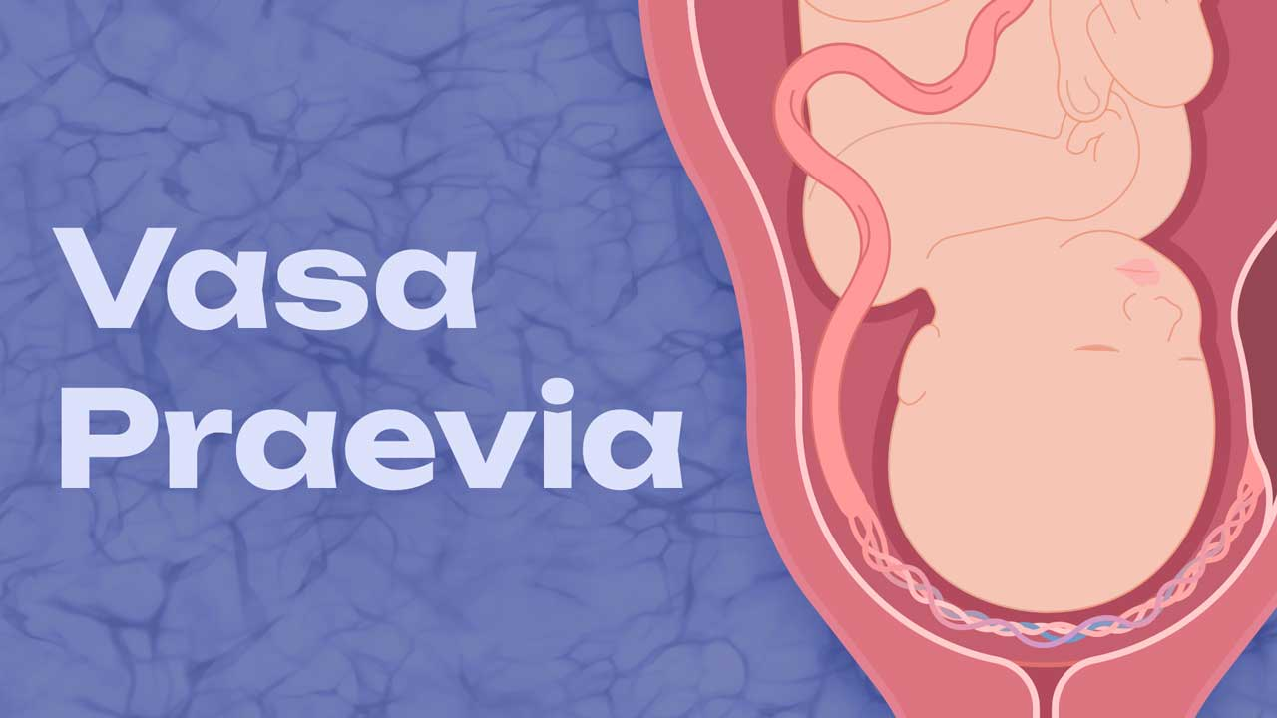

Slide 33
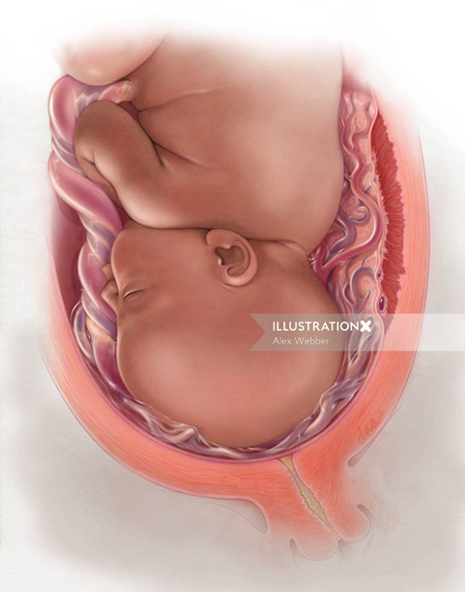
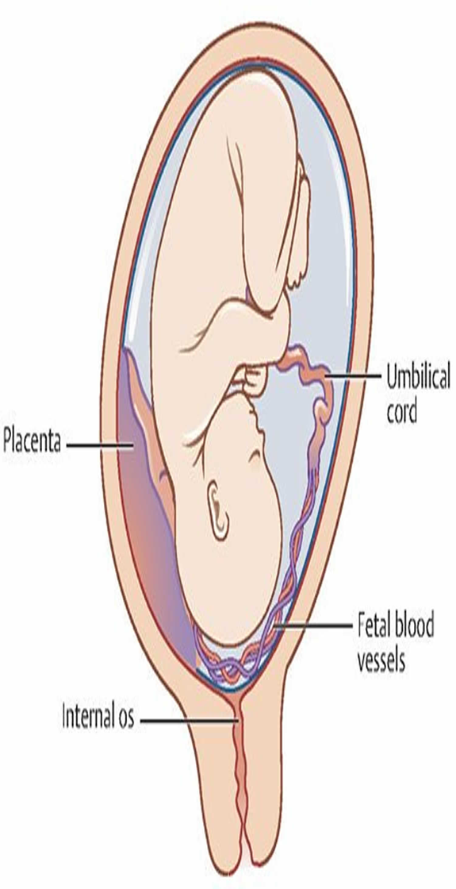
Vasa praevia
occurs when fetal vessels traverse the fetal membranes over the internal cervical os.
Causes:
Velamentous insertion of the umbilical
cord.
Or joining an accessory (succenturiate)
placental lobe to the main disc
of the placenta.

Slide 34
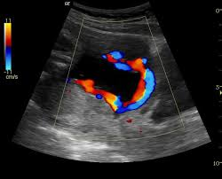
Vasa praevia diagnosis
usually suspected when either spontaneous or artificial rupture of the membranes is accompanied by:
painless fresh vaginal bleeding .
During pregnancy by doppler US.
This condition is associated with a very
high perinatal mortality .
So immediate action is delivery by
Emergency caesarean section.

Slide 35

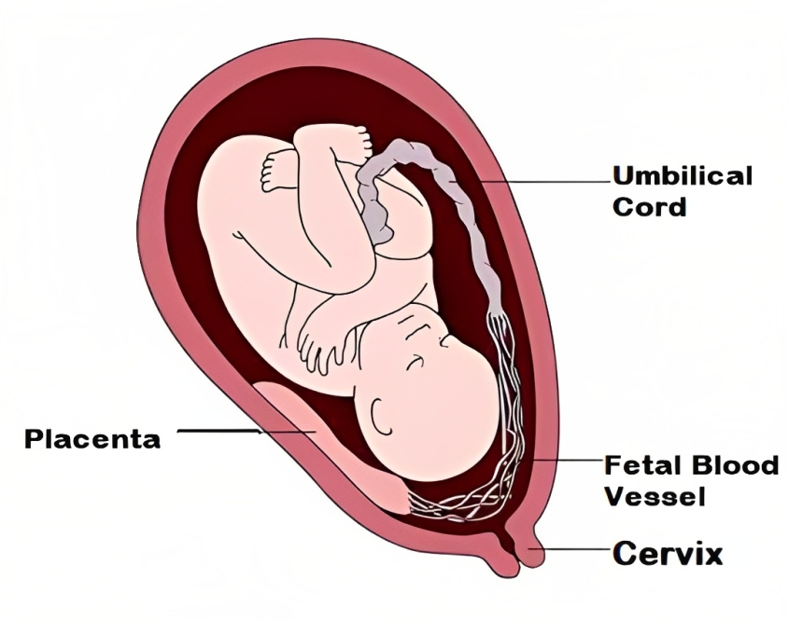

Slide 36
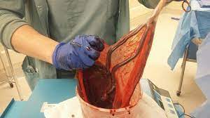
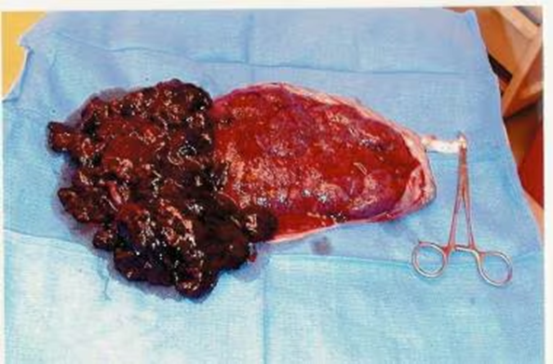

Slide 37
KEY LEARNING POINTS
Placenta praevia is most dangerous for the mother.
Placental abruption is more dangerous for the fetus than the mother.
Vasa praevia is not dangerous for the mother but is nearly always fatal for the baby.
Management involves resuscitation and stabilization of mother and senior input regarding timing of delivery

Slide 38



