Slide 1
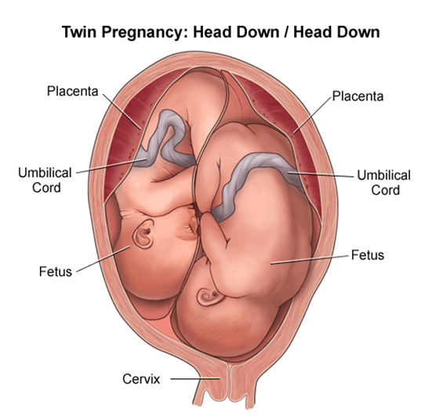
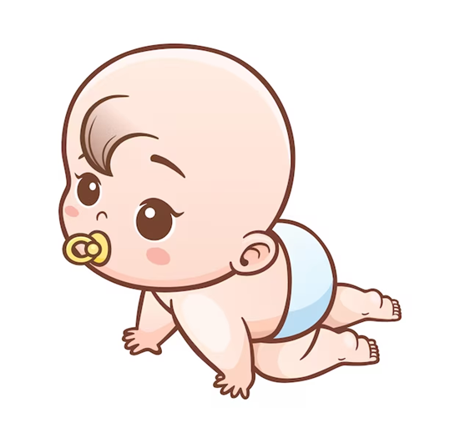
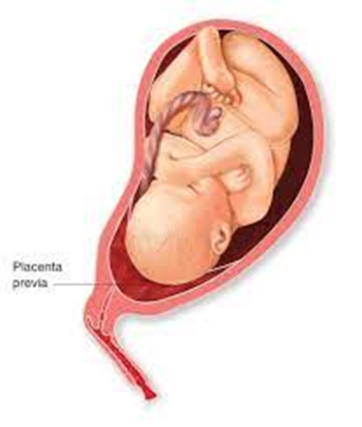


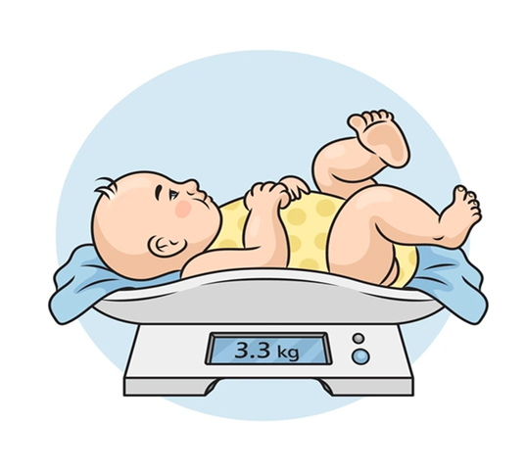
Abnormal labour
Dr .Mona Ahmed
Dr.Mona Ahmed SMSB Assisted professor Almareefa university

Slide 2


Abnormal labour
What is abnormal labour

Slide 3
Aetiologies
Power Poor uterine contraction.
Poor maternal effort.
Passenger Large baby.
Malpresentation.
Passage Contracted pelvis.
Soft tissue abnormalities(myoma, cervical ca ..)

Slide 4
Abnormal Labor Indicators
Indication | Nullipara | Multipara
Prolonged latent phase | >20 h | >14 h
Average second stage | 50 min | 20 min
Prolonged second stage without (with) epidural | >2 h (>3 h) | >1 h (>2 h)
Protracted dilation | < 1.2 cm/h | < 1.5 cm/h
Protracted descent | < 1 cm/h | < 2 cm/h
Arrest of dilation* | >2 h | >2 h
Arrest of descent* | >2 h | >1 h
Prolonged third stage | >30 min | >30 min

Slide 5
When we consider Labour as abnormal ?
1.Poor progress (as evidenced by a delay in cervical dilatation or descent of the presenting part)
2. The fetus shows signs of compromise.
3. There is a fetal malpresentation
4. A multiple gestation
5. A uterine scar
6. Labour has been induced.

Slide 6
Complications
Maternal infection
Fetal compromise.
Hyperstimulation of the uterus.
fetal compromise.
cord compression.
Uteroplacental insufficiency.
Uterine rupture.
Postpartum hemorrhage

Slide 7
Power (Uterine contraction)
Types of abnormal uterine contraction
1.hypotonic uterine dysfunction
2.hypertonic/uncoordinated uterine dysfunction

Slide 8
Poor progress 1.(power)
First stage of labour :
defined as cervical dilatation of less than 2 cm in 4 hours.
usually associated with failure of descent and rotation of the fetal head
Divided into:
Primary and secondary arrest
Poor progress in the second stage of labour
• Diagnosed if delivery is not imminent after 2 hours in a nulliparous & 1 hour in a parous woman.
With epidural use …..3 hours in nulliparous
…..and 2 hours in parous women

Slide 9
Causes of poor progress in labour
A. Dysfunctional uterine activity
B. Abnormal fetal size, presentation and position .
C. Abnormalities of the birth canal (the ‘passages’)

Slide 10
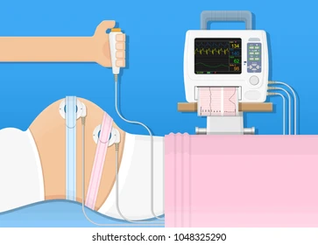

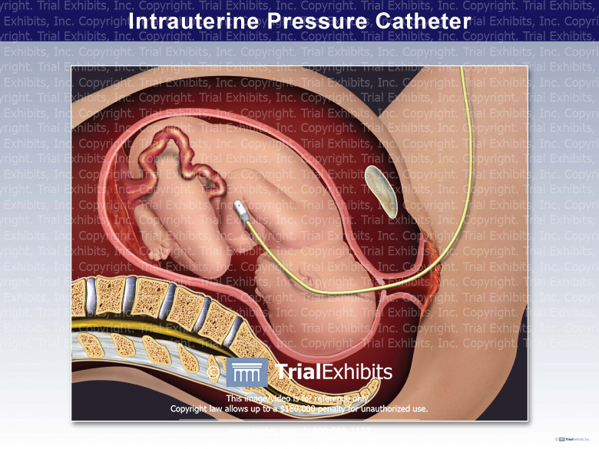
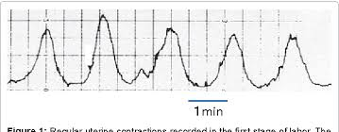
How would you assess uterine activity?
1. By clinical examination
2. By using external uterine topography
3. Intrauterine pressure catheters
Efficient uterine contractions:
3-4cont. 10 min.
Each lasting 45-60 sec.

Slide 11

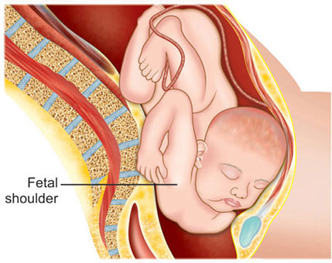
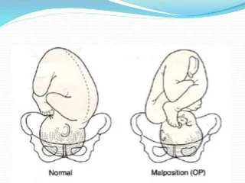
2.Passenger(fetal causes)
Abnormal fetal size……..fetal macrosomia:
Abnormal fetal presentation
Abnormal Fetal position

Slide 12
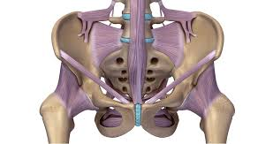
3.Passage(birth canal)
Abnormalities of the birth canal.
• The bony pelvis may cause delay in the progress of labour (android pelvis).
• Abnormalities of the uterus and cervix can also delay labour
fibroid in the lower uterine segment.
cervical dystocia (noncompliant cervix)
…..usually as a result of cone biopsy.

Slide 13
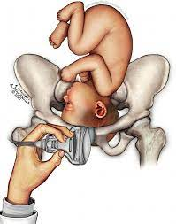

Cephalopelvic disproportion:
Anatomical disproportion between the fetal head and maternal pelvis
Causes of CPD:
Large head .B
Small pelvis .P
Combination of the two. B&P
Previous fracture. P
Metabolic bone disease. P
Fetal anomaly ( hydrocephaly). B
Malposition like OP. B

Slide 14
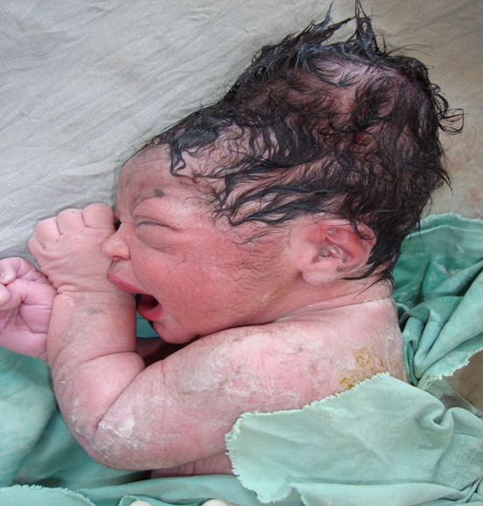
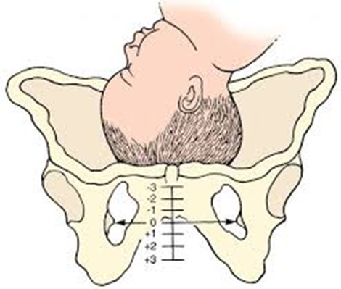
Diagnosis of Cephalopelvic disproportion
1 progress is slow or actually arrests despite efficient uterine contractions
2 the fetal head is not engaged
3 vaginal examination shows severe moulding and caput formation
4 the head is poorly applied to the cervix
5 haematuria

Slide 15
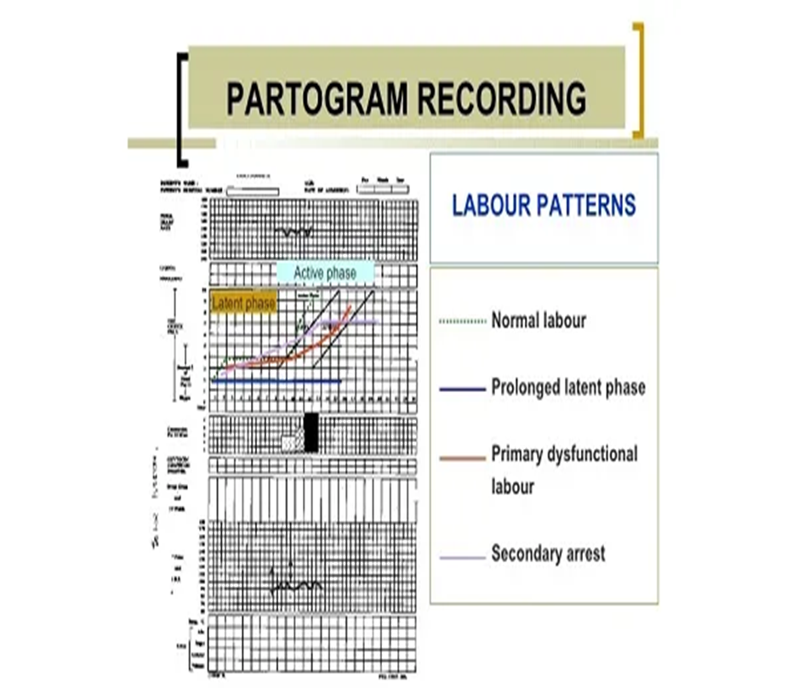
Management of prolonged labour:
A. Diagnosis:
History should include:
Age.
parity .
Duration of labour.
Partograph abnormality.
Duration of ROM(amount & colour of liquor).
Antenatal records and complications
Previous prolonged labour:* fetal death,
*instrumental delivery. * caesarean sections.

Slide 16
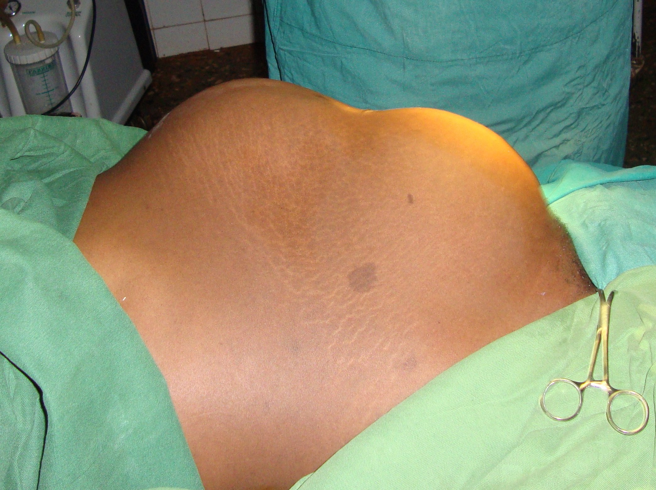

Examination
General exam.
Features of maternal distress.
Abdominal exam (Revise):
Frequency and intensity of uterine contractions.
Presentation.
Engagement.
Estimated fetal weight
Retraction ring (bandl's ring) is seen and felt
between upper & lower segment (site of uterine rupture).

Slide 17
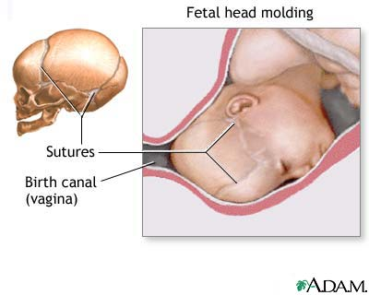
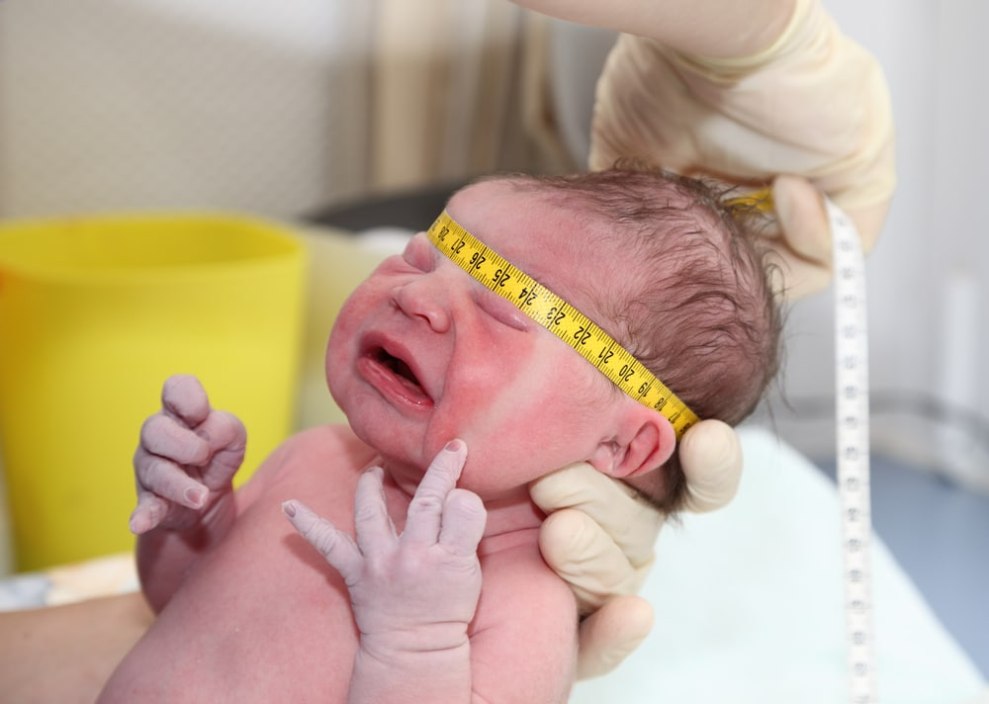
Examination con.
Vaginal exam:
Dry hot vagina.
Cervical dilatation.
Fetal presentation and position, station.
Excessive caput and moulding.

Slide 18
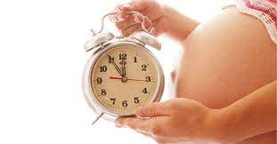
Treatment of poor progress
Treatment of poor progress in the 1st stage of labour :
Good hydration.
Pain relief.
Empty bladder.
Cross match blood.
Emotional support.
When poor progress in labour is suspected :
Repeat vaginal examination every 2(rather than 4 hours ) & plot on partograph

Slide 19
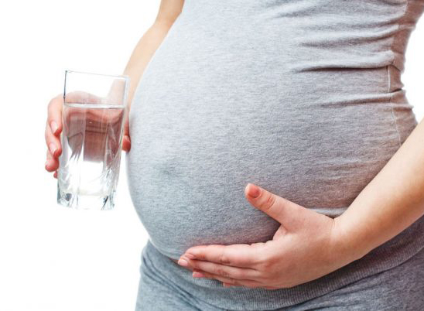
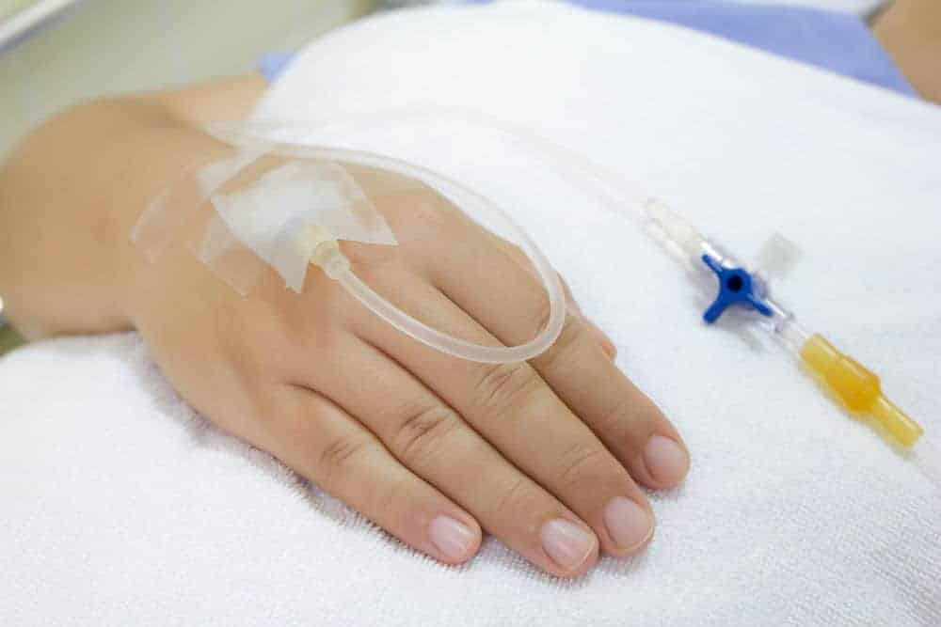
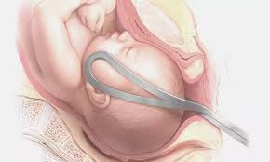
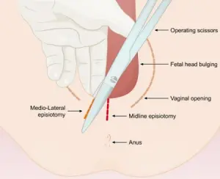
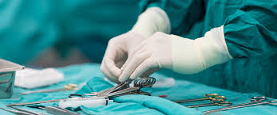
In the 2nd stage of labour
Rehydration.
Intravenous oxytocin for inefficient uterine cont.
Instrumental birth can be considered .
Caesarean delivery if :
*Instrumental birth attempt is unsuccessful.
*or if obstructed labour present .
Episiotomy for a resistant perinium.

Slide 20

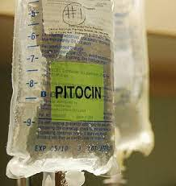
Treatment of CPD
Oxytocin must never be used in a multiparous woman where CPD is suspected.
A Caesarean section is indicated in cases of CPD with elements of obstructed labour

Slide 21
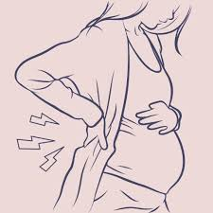
Complications of prolonged labour
Maternal :
maternal exhaustion and dehydration.
rupture of uterus.
increased operative intervention.
maternal injury.
Shock.
postpartum haemorrhage.
puerperal sepsis
Maternal death
Late maternal complications:
Fistula.
Infertility.

Slide 22
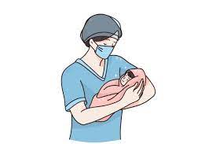
Complications of prolonged labour con.
Fetal complications:
birth asphyxia.
Acidosis.
intracranial haemorrhage.
meconium aspiration.
fetal trauma.
Death.
Neonatal infection.
Late fetal complications:
cerebral palsy.
Mental retardation.

Slide 23
Fetal compromise in labour
Presentation
Fetal compromise (hypoxia)may present as:
Fresh meconium
staining to the amniotic fluid a (dark green , containing mucus, bile and epithelial cells)
Or
Abnormal CTG.
What are causes of physiological meconium (old meconium)?
Fetal maturity(post date).
Breech presentation.

Slide 24

Indications for continuous EFM
Significant meconium staining of the amniotic fluid.
Abnormal FHR detected by intermittent auscultation.
Maternal pyrexia (temperature ≥38.0°C).
Fresh vaginal bleeding.
Augmentation of contractions with an oxytocin.
Maternal request.

Slide 25
Risk factors for Fetal compromise in labour
Placental insufficiency – *FGR and *pre-eclampsia.
Prematurity.
Post maturity.
Multiple pregnancy.
Prolonged labour.
Augmentation with oxytocin/hyperstimulation.
Precipitate labour.
Intrapartum abruption.
Cord prolapse.
Uterine rupture/dehiscence.
Maternal diabetes.
Cholestasis of pregnancy.
Maternal pyrexia/chorioamnionitis.
Oligohydramnios.

Slide 26
Management of possible Fetal compromise
Suspicious CTG:
Repositioning of the mother.
Intravenous fluids.
Stopping the oxytocin infusion.
If a CTG becomes ‘pathological:
Vaginal examination to exclude :
Malpresentation
Cord prolapse
To assess the progress of the labour.
If the cervix is fully dilated…instrumental delivery.
if the cervix is not fully dilated.... a Fetal blood sampling with abnormal result…immediate C/S.

Slide 27
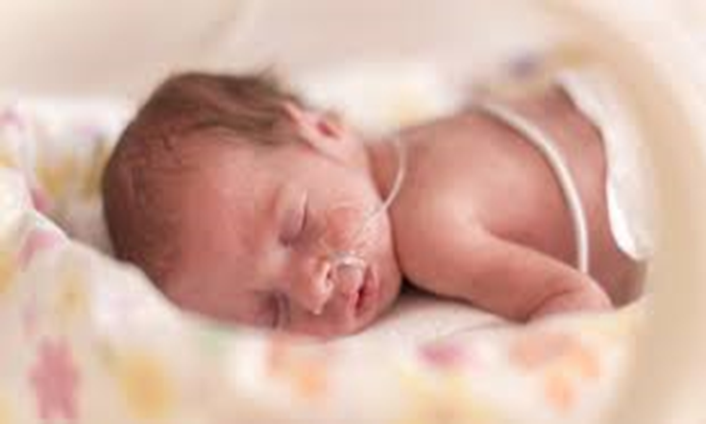
Resuscitating in labour:
Maternal dehydration ….. intravenous fluids.
Maternal hypotension ….. fluid bolus……drugs rarely needed.
Uterine hyperstimulation …..stope oxytocin & tocolytic drugs.
Venocaval compression
…..turning the woman into a left lateral position.

Slide 28


Slide 29
Occipitoposterior
Options of delivery
C-section
Vaginal delivery (direct OP or rotate into OA)
Forceps delivery

Slide 30

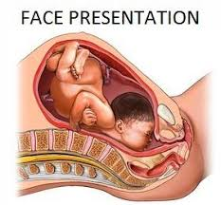
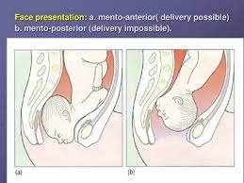
Face presentation
Face presentation is due to complete extension of the fetal head.
Rarely, extension may be due to a Fetal anomaly such as a thyroid tumour.
The presenting diameter is the submento-bregmatic( measures 9.5 cm )
Engagement of the Fetal head is late and progress in labour is slow.

Slide 31
Diagnosed in labour by
palpating the nose, mouth and eyes on vaginal examination .
If progress in labour is good and the chin remains mento-anterior…
vaginal delivery .
If the chin is posterior (mento-posterior position)….delivery caesarean section.
Forceps delivery is acceptable for low mento-anterior face presentations but ventouse is contraindicated.

Slide 32
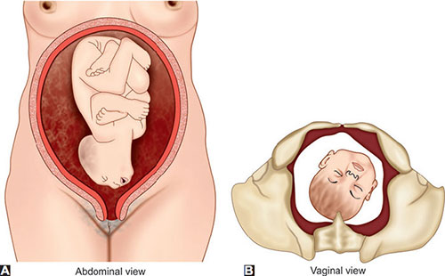
Brow presentation
Brow presentation arises when there is
less extreme extension of the Fetal neck than
that with a face presentation.
It can be considered a midway position
between vertex and face.
It is the least common malpresentation.
The causes are similar to those of face presentation.
The presenting diameter is the mento-vertical (measuring 13.5 cm) .
This is incompatible with a vaginal delivery.
It is diagnosed in labour by palpating the anterior fontanelle, supraorbital ridges and nose on vaginal examination . If this presentation persists, delivery by caesarean section

Slide 33
Breech
The incidence of breech presentation is 4% of all deliveries.
Before 28 weeks, approximately 25% of fetuses are breech presentation .
By 34 weeks’ gestation, most fetuses have assumed the vertex presentation position.

Slide 34
Classification
Types of breech presentation:
Frank
Complete.
Incomplete or footling.
At term
65% of breech fetuses are frank.
25%are complete.
10% are incomplete.

Slide 35
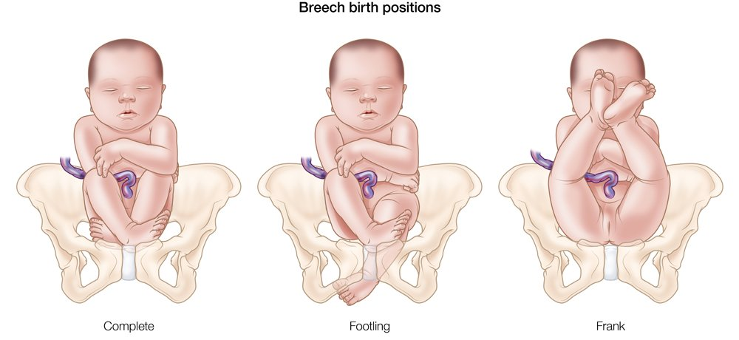

Slide 36
Etiology
The major factor is prematurity. Approximately 20-30% of all singleton breeches are of low birth weight (<2500 g).
Fetal structural anomalies (e.g., hydrocephalus). In breech presentations, the incidence of structural anomalies is greater than 6%, or two to three times that of a vertex.
Other etiologic factors include uterine
anomalies (e.g., bicornuate uterus).
multiple gestation.
placenta previa.
Poly hydramnios,
contracted maternal pelvis,
and pelvic tumors that obstruct the birth canal

Slide 37
VAGINAL DELIVERY
Until the publication of randomized
trials demonstrating that vaginal breech delivery
was associated with increased perinatal mortality compared with planned cesarean, vaginal breech deliveries
were performed in selected centres in patients who met strict criteria(next slide)
The standard of care now in most practices is to deliver all breeches by cesarean to avoid the potential morbidities of umbilical cord prolapse, head entrapment, birth asphyxia, and birth trauma.

Slide 38
CRITERIA FOR VAGINAL DELIVERY OF A BREECH PRESENTATION
Fetus must be in a frank or complete breech
presentation.
Gestational age should be at least 36 weeks.
Estimated fetal weight should be between 2500 and 3800 g.
Fetal head must be flexed.
Maternal pelvis must be adequately large, as assessed by
x-ray pelvimetry* or tested by prior delivery of a reasonably
large baby.
There must be no other maternal or fetal indication for
cesarean delivery.
Anesthesiologist must be in attendance.

Slide 39
Factors Favouring Cesarean Delivery of the Breech Fetus
Lack of operator experience
Patient request for cesarean delivery
Large fetus: > 3800 to 4000 g
Preterm fetus either with active labor or with indicated delivery
Severe fetal-growth restriction
Fetal anomaly incompatible with vaginal delivery
Prior perinatal death or neonatal birth trauma
Incomplete or footling breech presentation
Hyperextended head
Pelvic contraction or unfavourable pelvic.
Prior cesarean delivery

Slide 40
Complications of a breech
Increased risk of cord prolapse: particularly with footling breech.
Increased risk of CTG abnormalities as cord compression is common.
Mechanical difficulties with the delivery of the shoulders and/or after-coming head, leading to damage of the visceral organs or the brachial plexus.
Delay in the delivery of the head lead to hypoxia.
Uncontrolled rapid delivery of the head may occur with a smaller fetus and predisposes to tentorial tears and intracranial bleeding.
A small or preterm fetus may deliver through an incompletely dilated cervix, resulting in head entrapment.

Slide 41
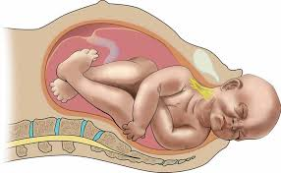
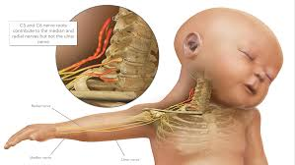
Shoulder dystocia
definition:
vaginal cephalic delivery
that requires additional obstetric manoeuvres
to deliver the fetus after the head has delivered
and gentle traction has been unsuccessful in
delivering the shoulders.
*Associated with significant morbidity both for the mother and fetus.
Maternal complications include:
increased perineal trauma (third- and fourth degree tear).
postpartum haemorrhage ,
psychological trauma.
Fetal complications include:
brachial plexus injury .
fractured clavicle or humerus .
hypoxic brain injury.

Slide 42
Prevention:
Diagnosis.
optimal control of gestational and insulin-dependent diabetics
reduction of maternal obesity.
Careful plan for mode of delivery in women with previous shoulder dystocia delivery.
Risk factors:
macrosomia.
poorly controlled gestational and insulin-dependent diabetes.
maternal obesity.
previous shoulder dystocia.
instrumental.
Warning signs:
failure of restitution of head following delivery of the head.
retraction of the fetal head against the perineum ( turtle sign).

Slide 43
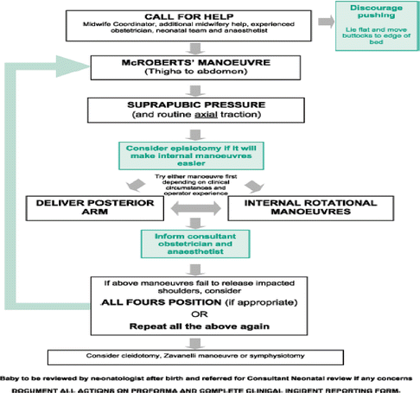
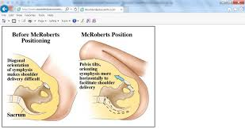
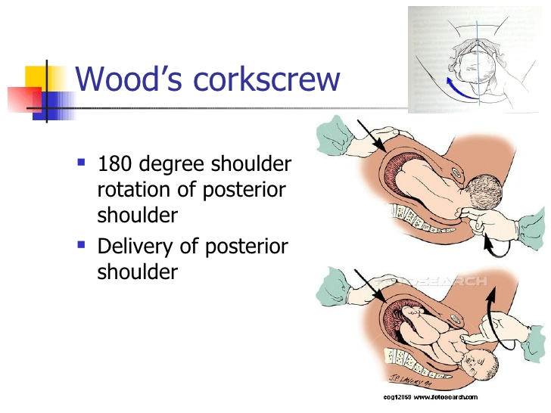
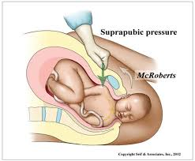
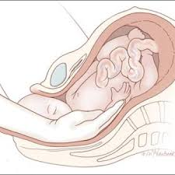
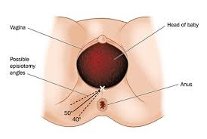
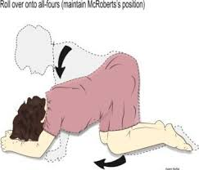
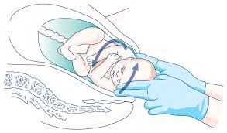
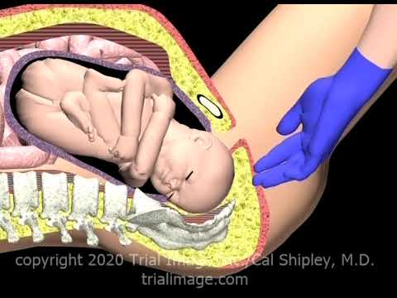

Slide 44
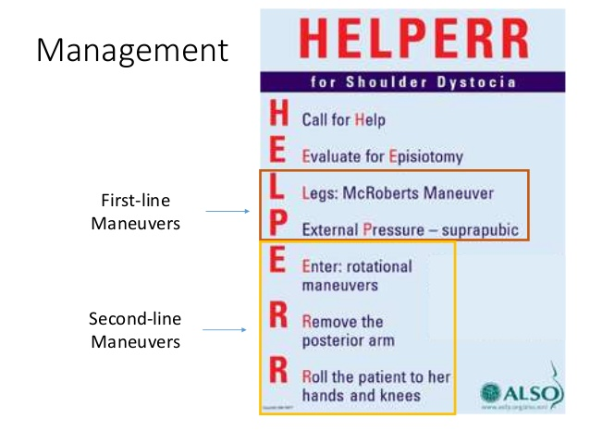
Procedures used in the management of shoulder dystocia
McRoberts maneuver
thighs are abducted
and flexed onto her abdomen.
(suprapubic pressure)
Rubin II maneuver (posterior
pressure on anterior shoulder)
Wood’s corkscrew maneuver
posterior shoulder is rotated to anterior
position.
Delivery of the posterior shoulder first
All fours position with the back arched.
This widens the pelivic outlet
Zavanelli’s maneuver
Cleidotomy –
Maternal symphysiotomy

Slide 45

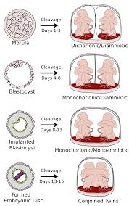
Multiple pregnancy
About 1 in 80 pregnancies at term
incidence is rising with increasing maternal age
and assisted conception.
The second twin is at greater risk of intrapartum compromise .
Vaginal birth is usually safely achievable where the presenting twin is in a cephalic vertex presentation.
Caesarean section performed If the first twin presents by the breech or transverse.
Associated with :
abnormal fetal growth
malpresentation
CTG abnormalities
cord prolapse
need for emergency caesarean section in labour
PPH .

Slide 46
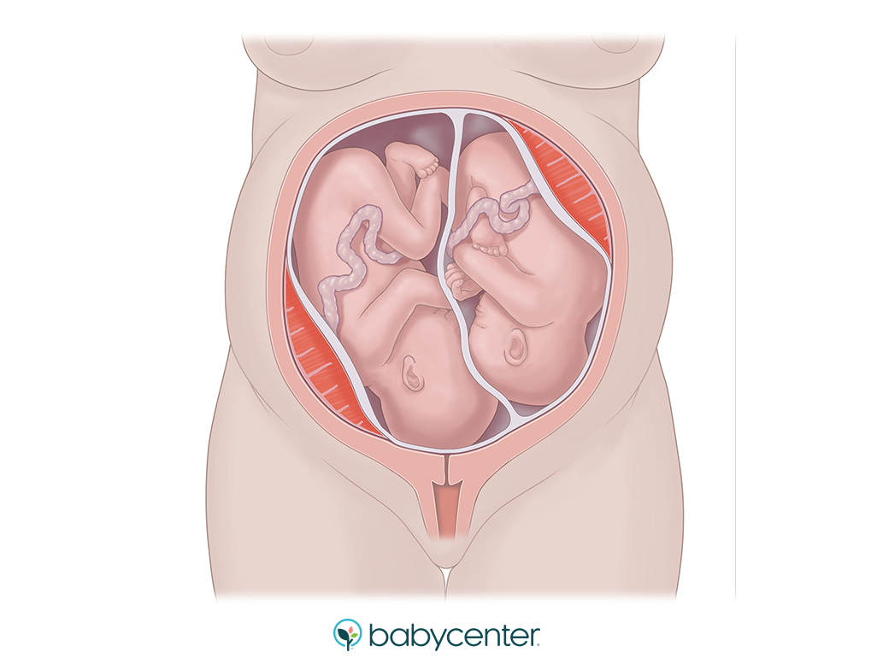
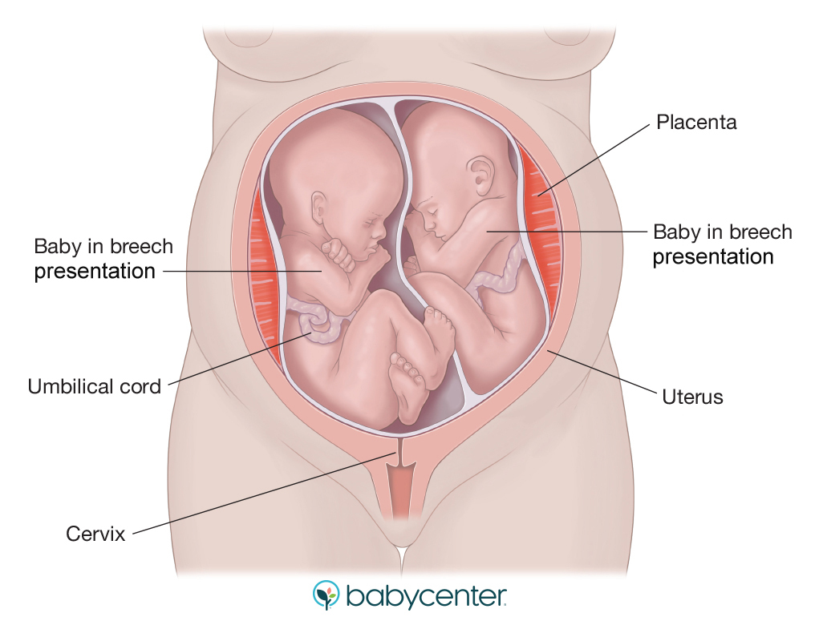
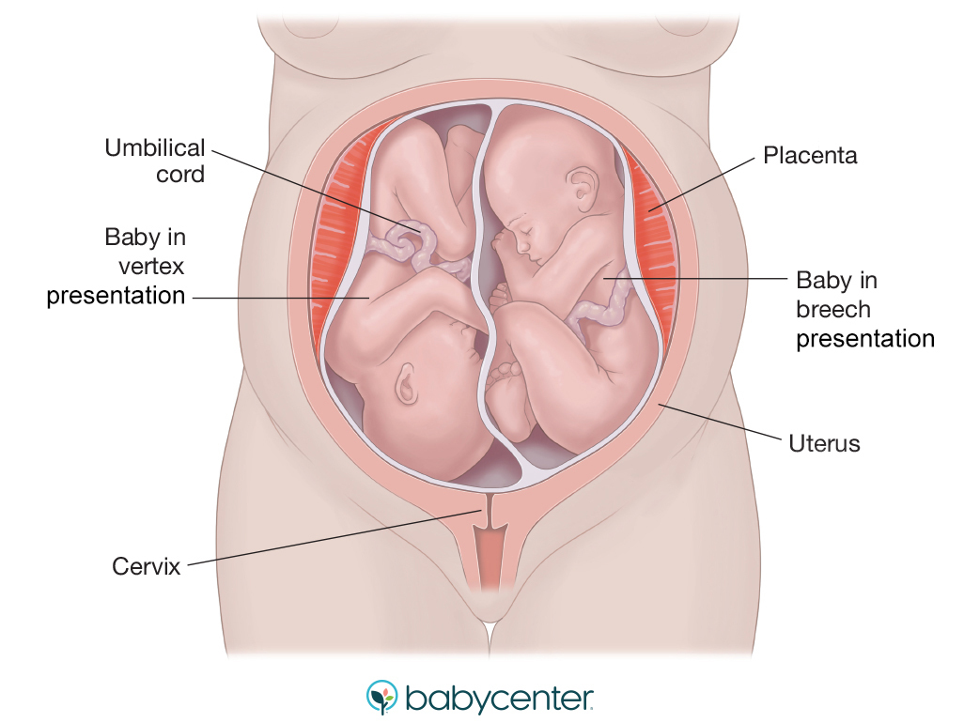
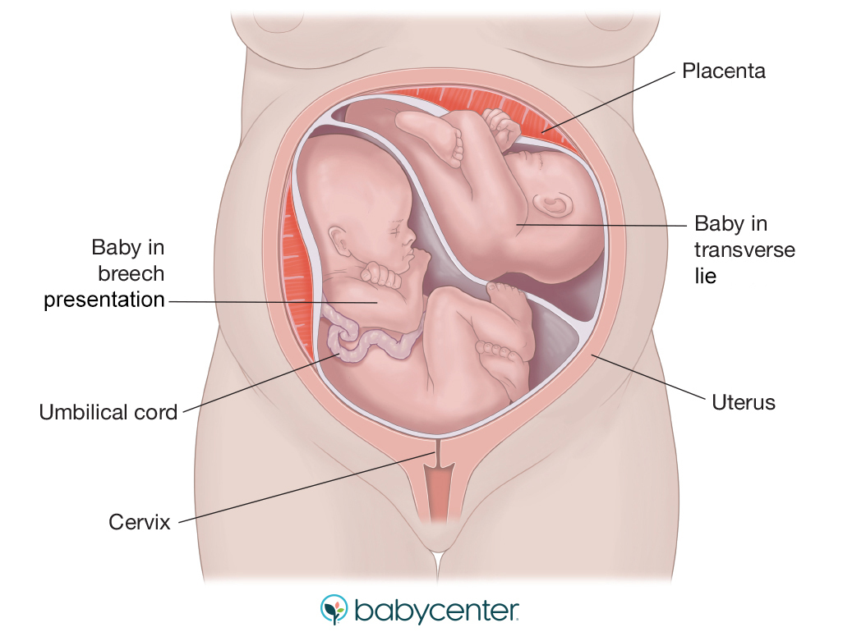

Slide 47
The second twin is at greater risk of intrapartum compromise
Vaginal birth if the first twin is in a cephalic (vertex) presentation.
Caesarean section performed If the first twin presents by the breech or transverse.(not cephalic)
Delivery of the 2nd twin:
After the delivery of the 1st twin:
clamp the cord.
Determine the position of the 2nd twin.
Bring the nearest pole (breech or cephalic).
Do ARM & give oxytocin iv.

Slide 48
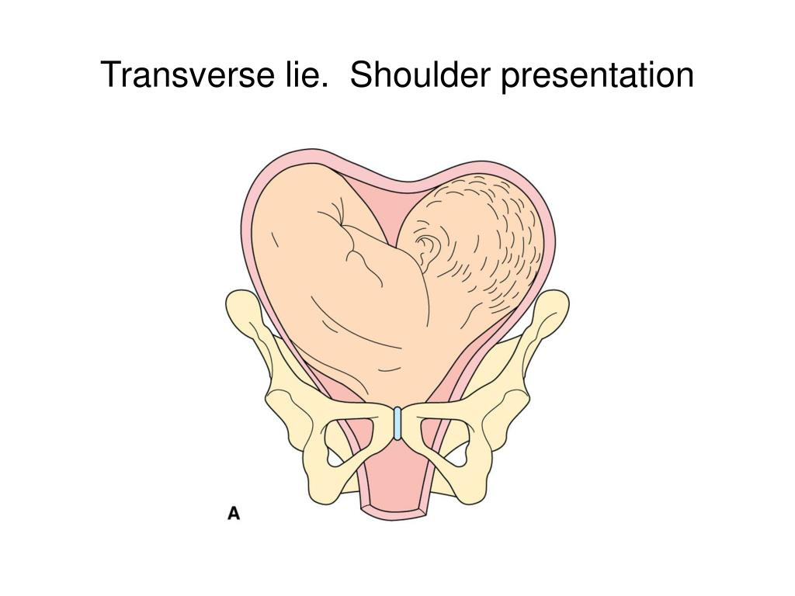
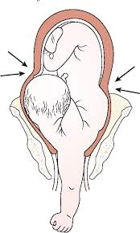
Shoulder presentation
Shoulder presentation occurs as the result of
a transverse or oblique lie of the fetus.
causes include:
placenta praevia.
high parity.
pelvic tumour .
uterine anomaly.
Delivery should be by caesarean section.
Delay:
cord prolapse .
uterine rupture.

Slide 49

Induction of labour

Slide 50
IOL is the planned initiation of labour prior to its spontaneous onset.
performed when the risks to the fetus and/or the mother of the pregnancy continuing outweigh those of its end.
chance of success (determine by parity & favourable cervix).
How to assess the cervical favourability?
By Bishop score .
if the risks of the process to the mother and/or fetus are acceptable.

Slide 51
Indications for induction of labour :
Prolonged pregnancy (usually offered after 41 completed weeks).
PROM.
Pre-eclampsia and other maternal hypertensive disorders.
FGR.
Diabetes mellitus.
Fetal macrosomia.
Deteriorating maternal illness.
Unexplained antepartum haemorrhage.
Twin pregnancy continuing beyond 38 weeks.
Intrahepatic cholestasis of pregnancy.
Maternal isoimmunization against red cell antigens.
‘Social’ reasons.

Slide 52


Slide 53



Methods of induction
Mechanical :
Membrane sweep (offer weekly from 40 weeks).
Ballooning.
Surgical :
ARM (cervix must be favourable).

Slide 54


Slide 55

Medical:
Prostaglandin gel, tablet to ripen .
cervix & initiate contractions.
Oxytocin infusion(membranes ruptured first,
spontaneous or artificial).
Mifepristone and misoprostol.
Mifepristone (antiprogesterone).
Misoprostol (prostaglandin) .
used only to induce labour following intrauterine Fetal
death(IUFD).

Slide 56
Complications of induction of labour
Increase need for epidural analgesia (pain).
Increase rates of instrumental delivery .
PPH secondary to uterine atony(long labour).
Uterine hyperstimulation.( treated by stopping the oxytocin and if necessary administration of a tocolytic drug) .
Uterine rupture.
Fetal compromise may( uterine hyperstimulation(brady cardia).
Cord prolapse(high head).
No evidence of a higher rate of caesarean section

Slide 57



