Slide 1
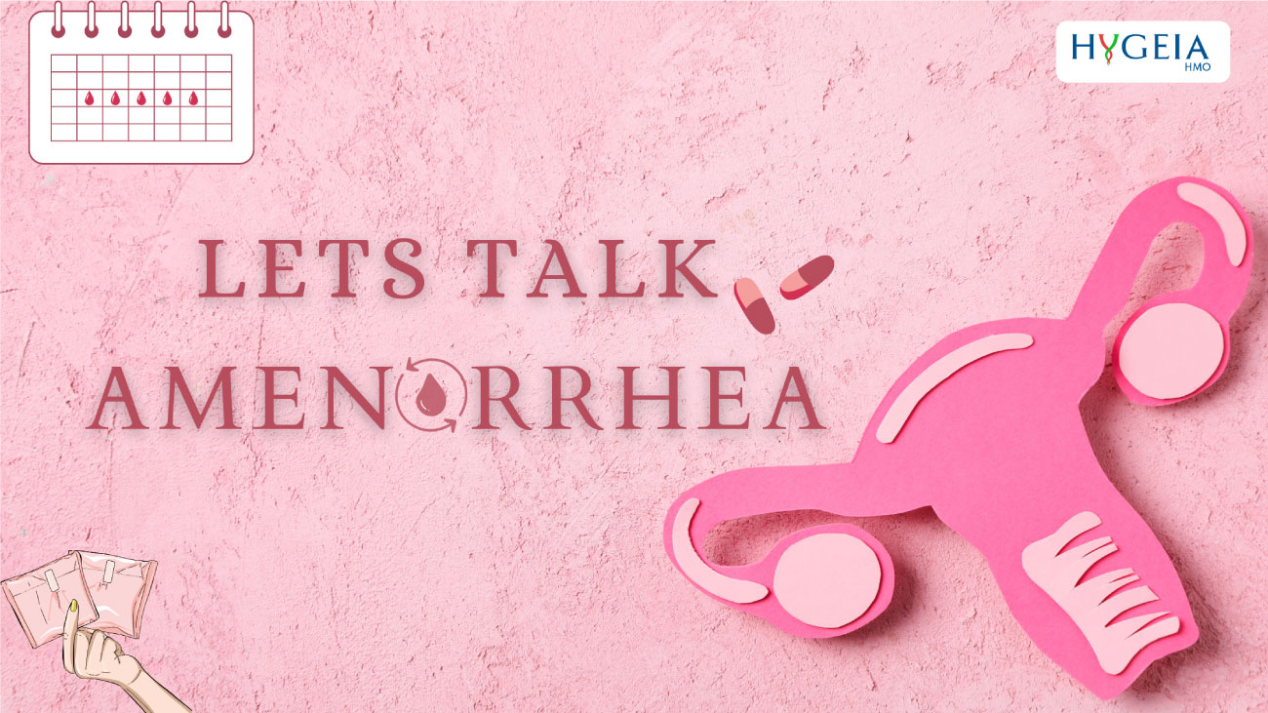

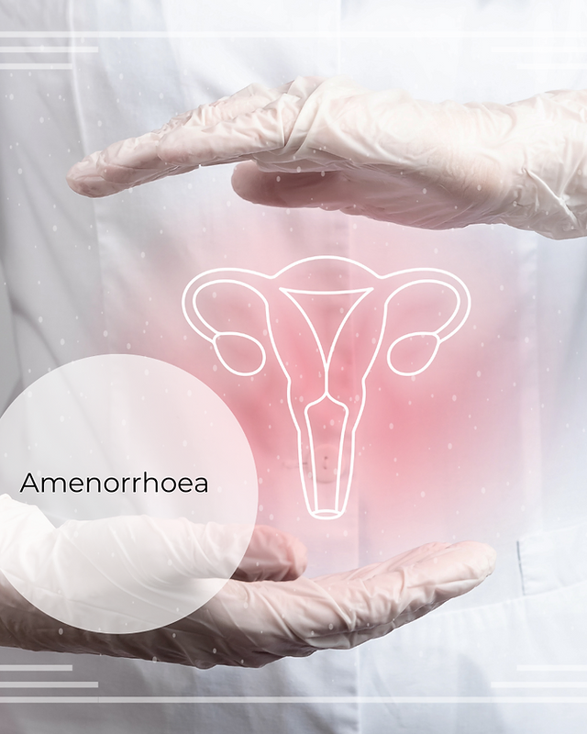
Amenorrhea
Mona Ahmed
Assistant professor
SMSB

Slide 2

Definitions
Amenorrhea is the absence of menses, could be:
Physiologic during pregnancy, lactation and menopause.
Pathologic :the lack of menses for any other reason after the expected age of menarche .
a.Primary amenorrhea:
No menses by age 14 years in the absence of secondary sexual development
or
No menstruation by age 16 years with the presence of secondary sexual characteristics.
b. Secondary amenorrhea:
The absence of menses in a previously menstruating woman.
It is also defined as the lack of menses for 6 months or for three menstrual cycles in women that have experienced menarche.

Slide 3


World Health Organization (WHO) amenorrhea groups
WHO group I (hypogonadotropic hypoestrogenic) has no endogenous estrogen production, normal or low follicle-stimulating hormone (FSH) levels, normal prolactin (PRL) levels, and no lesion in the hypothalamus or pituitary.
WHO group II (normogonadotropic normoestrogenic) has endogenous estrogen production and normal levels of FSH and PRL.
WHO group III (hypergonadotropic hypoestrogenic) has elevated FSH levels and low to absent estrogen, indicative of premature ovarian failure (POF).

Slide 4
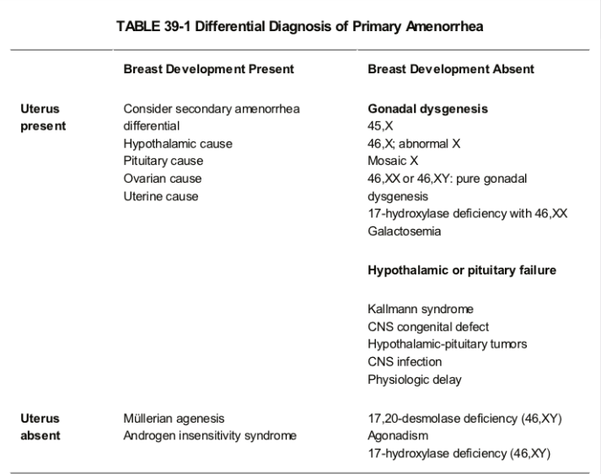

Slide 5
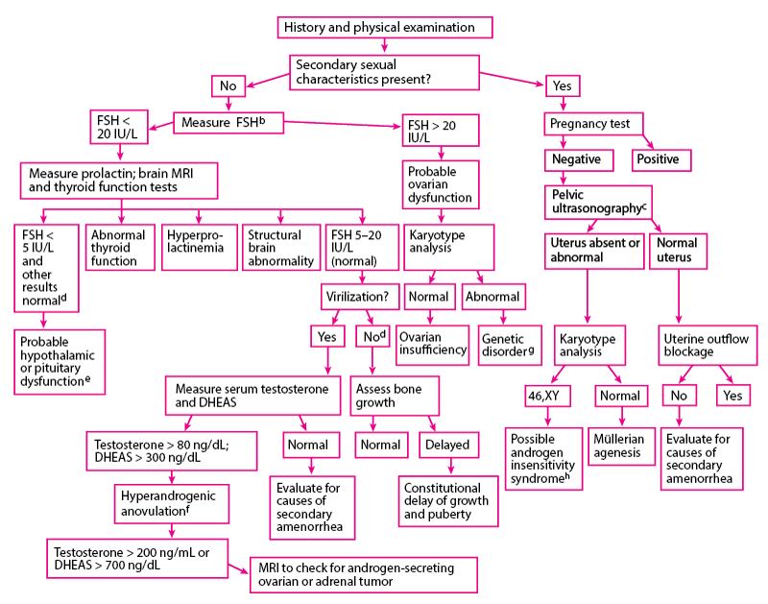

Slide 6
Androgen insensitivity (testicular feminization) Brest present , uterus absent
Etiology : absence of androgen receptors or lack of responsiveness to
androgen stimulus.
Genetic :X- linked, recessive disorder
karyotype 46 XY
Gonads: normally functioning Intra-abdominal testes .
Hormones :normal male levels of testosterone and dihydrotestosterone.
The müllerian ducts regress due to the presence of antimüllerian hormone.
Internal organs :no male or female internal genitalia
The wolffian ducts do not develop because they are not stimulated by testosterone.
External genitalia : have normal female ,short or absent vagina.
2ry Sexual characteristic: normal breasts tanner stage IV and scant or absent axillary and pubic hair.
Risk :Intra-abdominal testes or those in the inguinal canal have an ↑ risk of developing a malignancy (gonadoblastoma or dysgerminoma), usually after age 20.
Management :The gonads should be removed after puberty to allow for breast development and adequate bone growth. Estrogen is then given. These patients are raised as females.

Slide 7
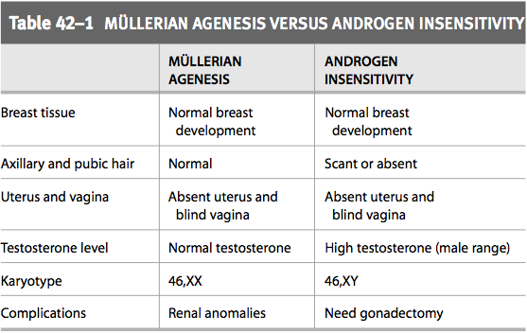
Brest present , Uterus absent

Slide 8
Causes of Secondary Amenorrhea
Physiological : pregnancy , post OCP amenorrhea and lactational amenorrhea
Outflow tract : (normogonadotropic ,normogonadism):
Cervical stenosis :due to Surgical procedure (i.e., LEEP)
Asherman syndrome :(intrauterine synechiae) :
Causes:
1-Aggressive postpartum curettage or abortion.
2-uterine or cervical surgeries, such as cesarean section, septoplasty and myomectomy.
3- Infectious causes include :endometritis , tuberculosis, schistosomiasis.
Diagnosis can be confirmed with HSG, Sonohysterogram, or hysteroscopy.
Treatment requires hysteroscopic lysis of intrauterine adhesions and placement of intrauterine stent or hormonal IUCD .

Slide 9
Ovarian cause :
1-Premature ovarian failure :
Idiopathic.
Chromosomal abnormality.
Autoimmune disease.
Infection.
Iatrogenic.
2-Polycystic ovary syndrome .

Slide 10
Pituitary causes (hypo/hypo):
a.Hyperprolactinemia :
Etiology : pituitary adenoma ,drugs (e.g) Antipsychotics, metoclopramide, PPI), hypothyroidism
-cause negative feedback on hypothalamic GnRH secretion thereby lowering gonadotropin release .
-May associated galactorrhea
Dx: serum prolactin level, TFT , MRI of brain if PRL>1000.
Rx : dopamine agonist therapy (bromocriptine or cabergoline
Sheehan syndrome :
pituitary necrosis and hypopituitarism following postpartum hemorrhage and hypotension.
Dx :.
-Hormone profiles including cortisol, plasma ACTH, thyroid hormones, TSH, FSH, LH and prolactin were all low as a result of panhypopituitarism
- pituitary and cerebral MRI which showed an empty sella turcica
Rx :replacement of pituitary hormones (thyroxin , hydrocortisone ,HRT )

Slide 11
CNS CAUSES :
Hypothalamic Dysfunction:
Stress.
Eating disorders ( e,g anorexia nervosa).
Weight loss , athletes
Brain injury
Inflammatory or infiltrative process

Slide 12
Other endocrinopathies
-Hypothyroidism :
Thyrotropin-releasing hormone (TRH) stimulates the release of TSH and PRL from the anterior pituitary
- late-onset adrenal hyperplasia

Slide 13
EVALUATION OF AMENORRHEA
Rule out pregnancy, as both primary and secondary amenorrhea require an immediate evaluation for pregnancy.
Use a systematic approach:
Evaluating each critical component of menstruation: hypothalamus.
Pituitary.
Ovaries.
Uterus.
and genital outflow tract.

Slide 14
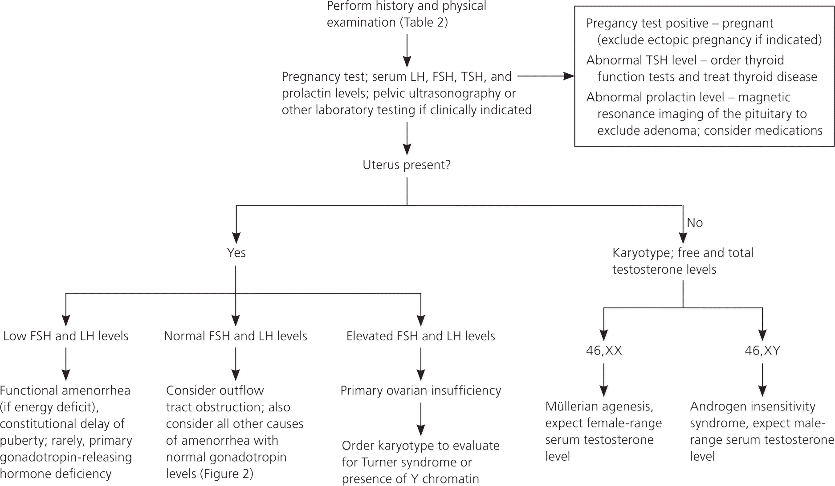
1ry amenorrhea

Slide 15
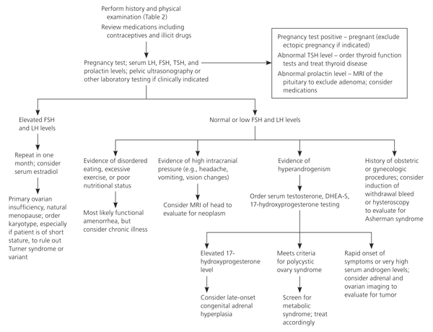
2ry amenorrhea

Slide 16
Case scenario
A 30-year-old G2P2002, with last menstrual period (LMP) 8 weeks ago complains of no menses for the past 2 months. She usually has menses regularly every 28 days, lasting for 5 days. She denies any medical or surgical history. She has had two term spontaneous vaginal deliveries. She uses combination oral contraceptive pills (OCPs) regularly, and has not missed any pills recently.
What is the next step in management of this patient?

Slide 17
Case scenario
A 35-year-old G2P2002 with LMP one year ago presents with hot flashes and vaginal dryness. Her serum FSH is very high and in the menopausal range. What is the most likely diagnosis?

Slide 18
Case scenario
A 35-year-old G3P3003 complains of absence of menses for 8 months. She reports menarche at age 12 with menses every 40–50 days until recently. She complains of an ↑ of 20 lb in her weight over the last year. She denies any family history or use of medications or drugs. She used clomiphene to become pregnant with her last two pregnancies. Her weight 106 kg, BP 120/80. She has hair on her upper lip and chin. She has acne and oily skin on her face.
What is the most likely diagnosis? If left untreated, what is this patient at ↑ risk for?

Slide 19
Case scenario
A 40 year old patient, G3P3, with no significant medical or surgical history, was admitted to the intensive care unit with hemorrhagic shock due to postpartum hemorrhage following a normal delivery at home. The clinical examination on arrival confirmed the state of shock: an undetectable blood pressure, a tachycardia of 120 beats/min, cold peripheries, pale conjunctivae
Immediate care involved vascular expansion with colloids via a central venous catheter, followed by a transfusion of 5 units of cross matched packed red cells since the haemoglobin level was 5g/dl. The short-term evolution was marked by lactational failure ,The medium-term evolution was marked by prolonged amenorrhea, fatigue and apathy.
What is your diagnosis , workup and management ?

Slide 20
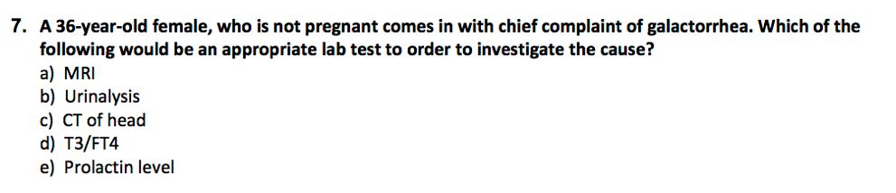
Question

Slide 21


Slide 22
A 17-Year-old female, no menstruation, high testosterone, Normal breast development, coarse pubic hair?
A. Mayer Rokitansky Kuster Hauser syndrome (or Mullerian agenesis)
B. Complete androgen insensitivity
C. Congenital hypothyroidism
D. Turner syndrome

Slide 23
A 17-Year-old female, no menstruation, high testosterone, Normal breast development, coarse pubic hair?
A. Mayer Rokitansky Kuster Hauser syndrome (or Mullerian agenesis)
B. Complete androgen insensitivity T
C. Congenital hypothyroidism
D. Turner syndrome

Slide 24
A 17-Year-old female, no menstruation, normal testosterone, Normal breast development, normal pubic hair?
A. Mayer Rokitansky Kuster Hauser syndrome (or Mullerian agenesis)
B. Complete androgen insensitivity
C. Congenital hypothyroidism
D. Kalman's syndrome

Slide 25
A 17-Year-old female, no menstruation, normal testosterone, Normal breast development,
normal pubic hair?
A. Mayer Rokitansky Kuster Hauser syndrome (or Mullerian agenesis) T
B. Complete androgen insensitivity
C. Congenital hypothyroidism
D. Kalman's syndrome

Slide 26
A 17-year-old female, medically free, (athlete) gymnast in her class, breasts later and never
menstruated, on developed examination she is tanner stage 5, but no menstruation, diagnosis?
A. Hypothalamic hypogonadism
B. Transverse vaginal septum
C. Gonadal agenesis
D. Testicular feminization

Slide 27
A 17-year-old female, medically free, (athlete) gymnast in her class, breasts later and never
menstruated, on developed examination she is tanner stage 5, but no menstruation, diagnosis?
A. Hypothalamic hypogonadism T
B. Transverse vaginal septum
C. Gonadal agenesis
D. Testicular feminization

Slide 28
A 35-Year-old female complaining of secondary amenorrhea for 8 months, what to do next?
A. Pregnancy test
B. US
C. Full history taking
D. Physical exam

Slide 29
A 35-Year-old female complaining of secondary amenorrhea for 8 months, what to do next?
A. Pregnancy test
B. US
C. Full history taking T
D. Physical exam

Slide 30
A 36-year-old lady with secondary amenorrhea (elevated FSH & LH) which of risk or complication she might probably develop in the future?
A. Risk of endometrial cancer
B. Risk of ovarian cancer
C. Risk of osteoporosis
D. Risk of DM

Slide 31
A 36-year-old lady with secondary amenorrhea (elevated FSH & LH) which of risk or complication she might probably develop in the future?
A. Risk of endometrial cancer
B. Risk of ovarian cancer
C. Risk of osteoporosis T
D. Risk of DM

Slide 32



