Slide 1
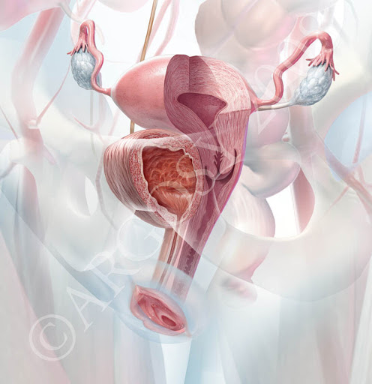
Femal genital tract & pelvic floor By dr. Mona Ahmed Assisted professor Elmareefa university Sudanese medical specialization board

Slide 2
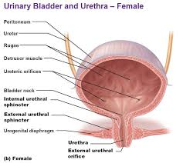
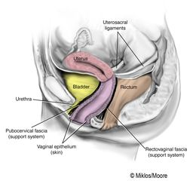
The bladder
The bladder wall is made of involuntary muscle .
It is lined with transitional epithelium
Has an average capacity of 400 ml.
The ureters open into the base of the bladder .
The urethra leaves the bladder below
the ureteric orifices.
The base of the bladder is adjacent to the cervix
& separated from the anterior vaginal wall
by the pubocervical fascia .

Slide 3
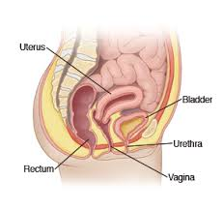
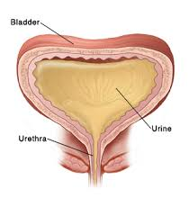
The urethra
The female urethra is 3.5 cm long.
and lined with transitional epithelium.
The lower part occasionally become infected.
The upper part of the urethra is mobile
but the lower part is fixed.

Slide 4
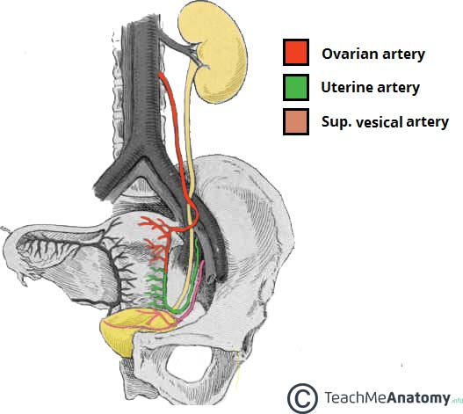
The ureter
As the ureter crosses the pelvic brim
it lies in front of the bifurcation of
the common iliac artery.
The ureter runs close to the lateral
vaginal fornix to enter the bladder.
Blood supply from the ovarian artery.
Due to its close relationship to the cervix
the vagina and the uterine artery
the ureter may be damaged during
hysterectomy (cut or tied).
ureter

Slide 5
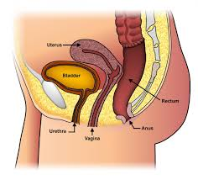
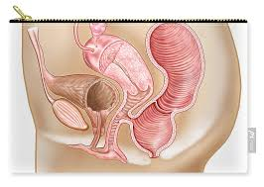
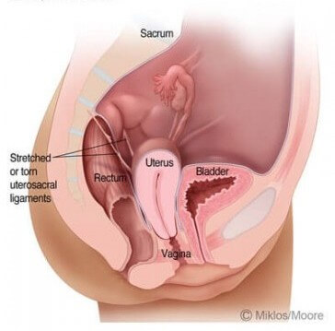
The rectum
The rectum extends from the
level of the third sacral vertebra to the anal canal.
The front and sides are covered by
the peritoneum of the rectovaginal pouch.
the middle third only the front is covered
by peritoneum.
rectum is separated from the posterior
wall of the vagina by the rectovaginal fascial .
Lateral to the rectum, the uterosacral ligaments.

Slide 6
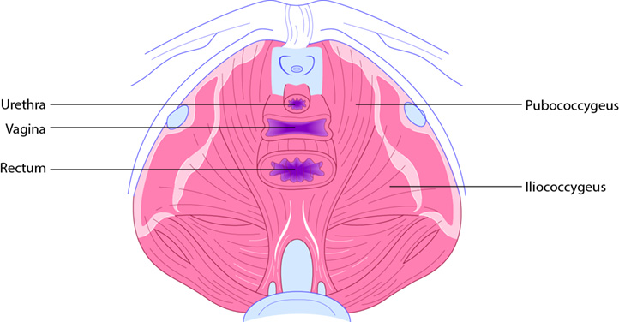
The pelvic muscles, ligaments and fascia The pelvic diaphragm
The pelvic diaphragm is formed by the levator ani muscles, which are broad, flat muscles the fibres .
The two muscles, one on either side, constitute the pelvic diaphragm.
The muscles arise from :
The body of the pubis.
The pelvic fascia.
The ischial spine.
The levator ani muscle inserted into :
The preanal raphe .
The anal canal.
The anococcygeal raphe.
The coccyx.

Slide 7
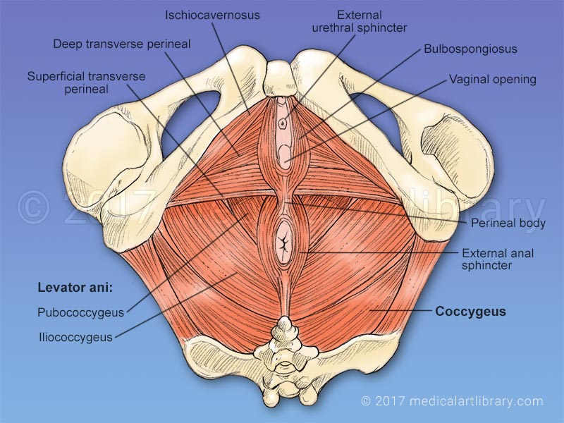
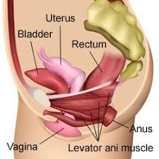
The muscle is described in two parts:
The pubococcygeus.
The iliococcygeus.
They have some sphincteric action.
The nerve supply is from the third and
fourth sacral nerves.
The pubococcygeus muscles support:
the pelvic
abdominal viscera(including the bladder).
Together with the fibres from the opposite muscle
they form a loop that maintains the angle between
the posterior aspect of the urethra and
the bladder base.
During micturition, this loop relaxes
to allow the bladder neck and upper urethra to
open and descend.

Slide 8
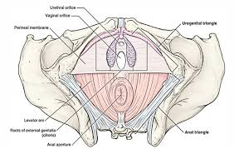
Urogenital diaphragm
Is made up of two layers of pelvic fascia .
deep transverse perineal muscles
(compressor urethrae) lie between the
two layers and the diaphragm
is pierced by the urethra and vagina.
The perineal body This is
( a mass of muscular tissue) that
lies between the anal canal and the
lower third of the vagina.
Its apex is where the rectum and posterior vaginal walls come into contact.

Slide 9
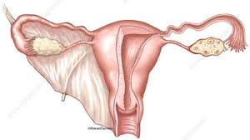
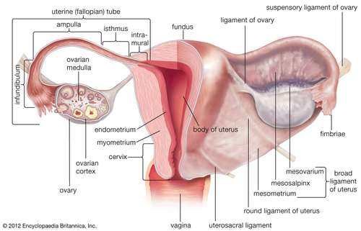
The pelvic peritoneum
the broad ligament :
peritoneum double reflection from
the lateral borders of the uterus . on either sides.
Its not a ligament but a peritoneal fold
and it does not support the uterus.
The Fallopian tube runs in the upper
free edge of the broad ligament .
The lateral portion is called the
‘infundibulopelvic fold ”suspensory”
where ovarian vessels and lymphatics.

Slide 10
The mesosalpinx
the portion of the broad ligament that
lies above the ovary.
the mesovarium
is a short mesentery that attached the ovary
to the posterior layer of the broad ligament
through which the ovarian vessels lies.
The ovarian ligament
passes from the medial portion
of the ovary to the uterus .
The round ligament continuation
enter the inguinal canal, to end in the the labium major.

Slide 11
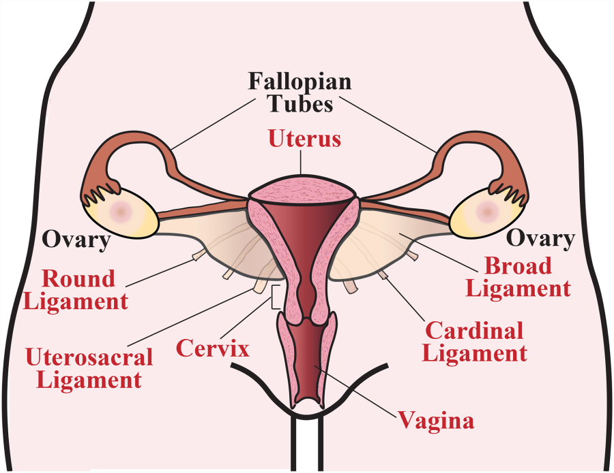
Uterine support:
The cardinal ligaments
(transverse cervical ligaments)
The uterosacral ligaments
run from the cervix and vagina
to the sacrum.
Round ligament
• The bladder is supported by
pelvic fascia.
pubocervical fascia.

Slide 12
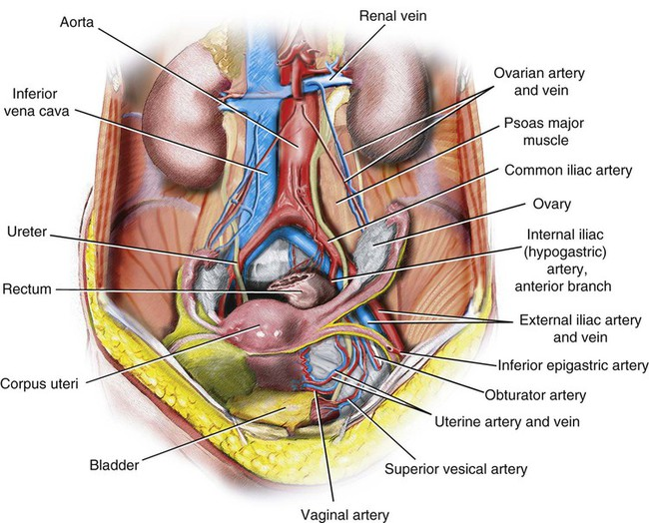
The blood supply
The ovarian arteries :
supply the ovary and tube
they anastomose with the terminal
branches of the uterine artery.
The internal iliac (hypogastric)artery
supply ….the pelvic organs by the following
branches
The uterine artery ………supply to the uterus.
• The vaginal …..supply the vagina.
• The vesical arteries …. supply the bladder and terminal ureter.
• The pudendal artery…. supplying the vestibular bulbs and clitoris.
The superior rectal artery …..supply the rectum
Notes:
The uterine artery provides the main blood supply to the uterus.

Slide 13
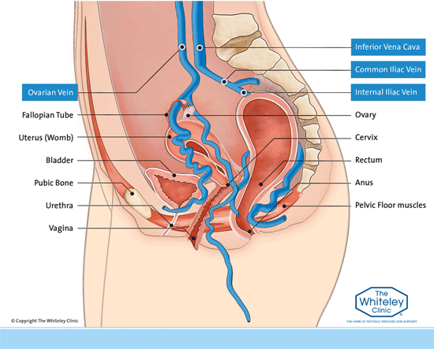
The pelvic veins
Around the bladder
Uterus
vagina
rectum form……. plexuses
that drain into the internal iliac veins.
The ovarian veins on each side begin
in the pampiniform plexus in the broad
ligament ending in the inferior vena cava.

Slide 14
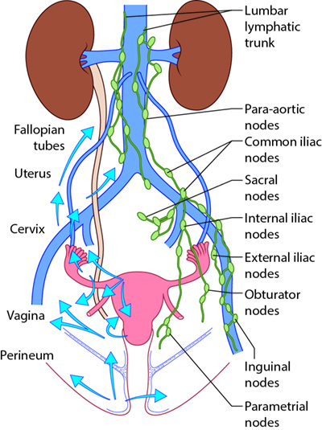
Lymphatics
The pelvic lymphatics draining :
inguinal nods.
superficial femoral nodes.
Pelvic nods.
para aortic nods.

Slide 15
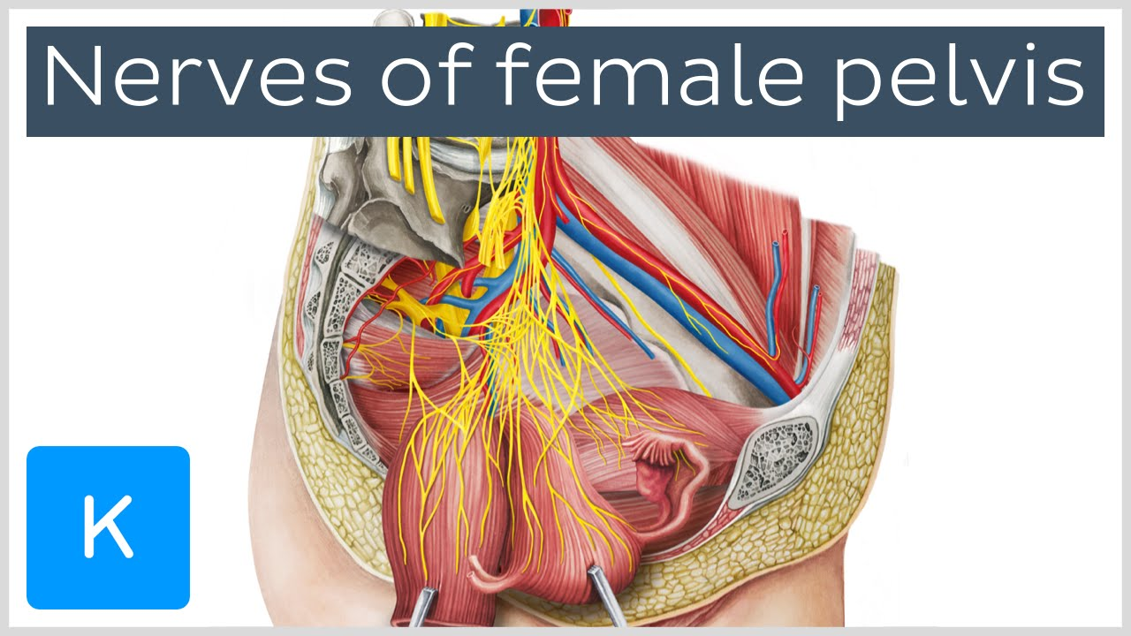
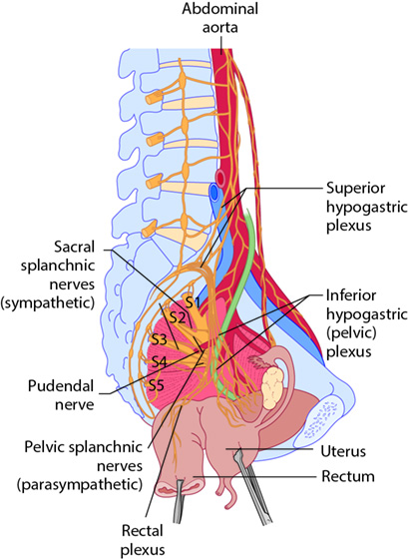
The nerves
Nerve supply
The pudendal nerve .
The perineal nerve .
sacral nerves.
Autonomic nerve supply
of the pelvic viscera
the preaortic plexus
superior hypogastric plexus

Slide 16




