Slide 1
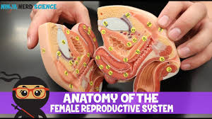

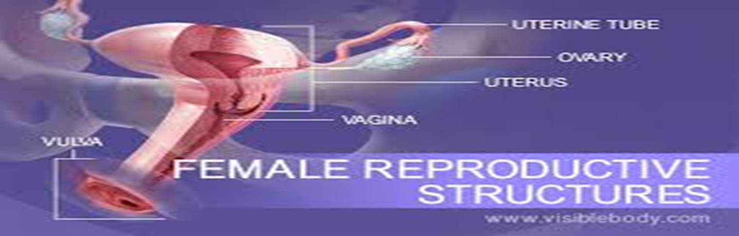
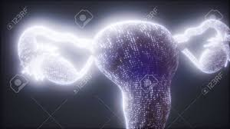
Anatomy of reproductive organs of female
By dr Mona Ahmed assisted professor Elmareefa university
SMSB

Slide 2
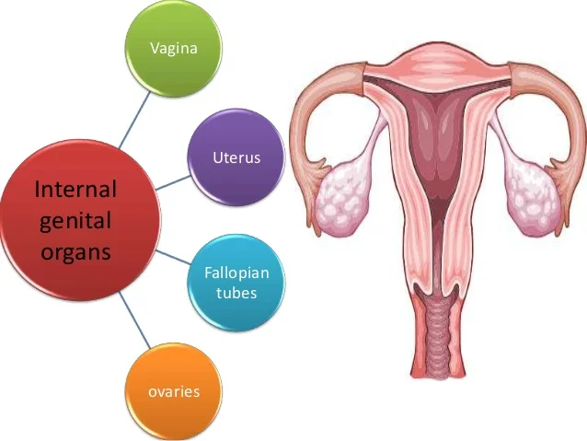
The female genital tract
The female genital tract is divided into:
The external genitalia.
The internal genitalia.
The internal genital tract, including
( the female reproductive system), consists of:
The vagina.
The uterus.
The two fallopian tubes.
The ovaries.

Slide 3
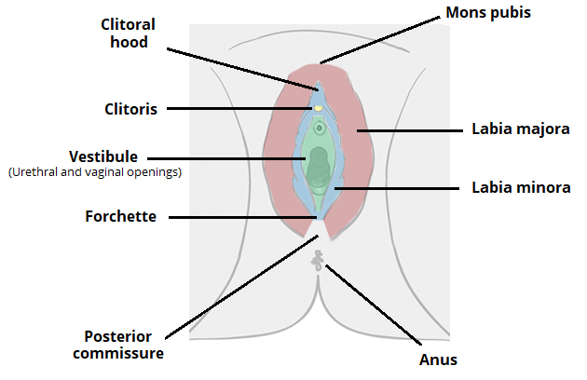
External genitalia
The external genitalia are
vulva include :
1. Mons pubis.
2. Labia majora.
3.Minora.
4.Vaginal vestibule,
5. Clitoris
6. Greater vestibular glands.
7.Hymen
8.Vaginal opening
.

Slide 4
The mons pubis
is a fibro-fatty pad.
covered by hair-bearing skin.
& it covers the bony pubic ramus.

Slide 5
The labia majora
Are two folds of skin with underlying adipose
tissue lying either side of the vaginal opening.
They contain:
sebaceous and sweat glands
and specialized apocrine glands.
In the deepest part of each labium is
a core of fatty tissue continuous with that
of the inguinal canal & the round ligament
which terminate here

Slide 6
The labia minora :
are two thin folds of skin
that lie between the labia majora.
Anteriorly, they divide in two to
form the prepuce and frenulum of
the clitoris (clitoral hood).
Posteriorly, they divide to form
the fourchette at the back of the vagina
introitus.
They contain sebaceous glands
but have no adipose tissue.
They are not well developed before puberty
and atrophied after menopause

Slide 7
The clitoris.:
The body of the clitoris is the main part
of the visible clitoris.
And is made up of paired columns of
erectile tissue and
vascular tissue called the ‘corpora cavernosa’.
These become the crura at the bottom
of the clitoris and run deeper and laterally.
The vestibule:
is the cleft between the labia minora.
It contains openings of the urethra
the Bartholin’s glands and the vagina.

Slide 8
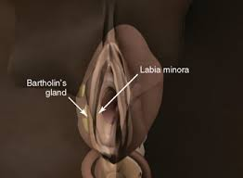
The vagina
Is surrounded by two bulbs
that are completely cover the distal vaginal wall.
The Bartholin’s glands
Are bilateral and about the size of a pea.
They open via a 2 cm duct into the
vestibule below the hymen
The hymen
is a thin covering of mucous membrane
across the entrance to the vagina.
It is usually perforated, which allows menstruation.

Slide 9
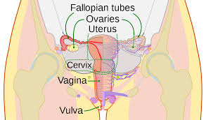
Internal reproductive organs

Slide 10
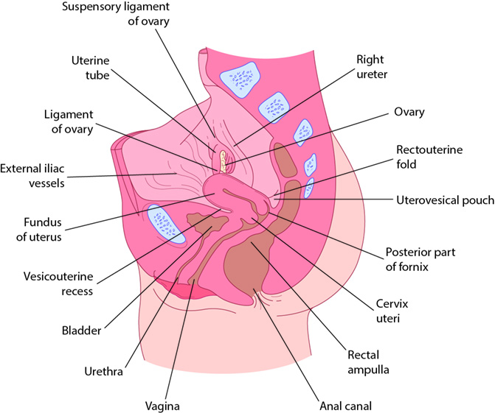
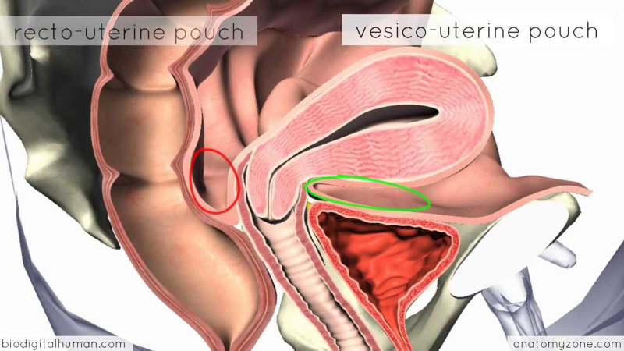
Internal reproductive organs
The vagina
fibromuscular canal lined with stratified
squamous epithelium that leads from
the uterus to the vulva.
longer in the posterior wall (9 cm)
than in the anterior wall (7 cm).
The vaginal walls are normally
in apposition.
except at the vault
where they are separated by the cervix.

Slide 11
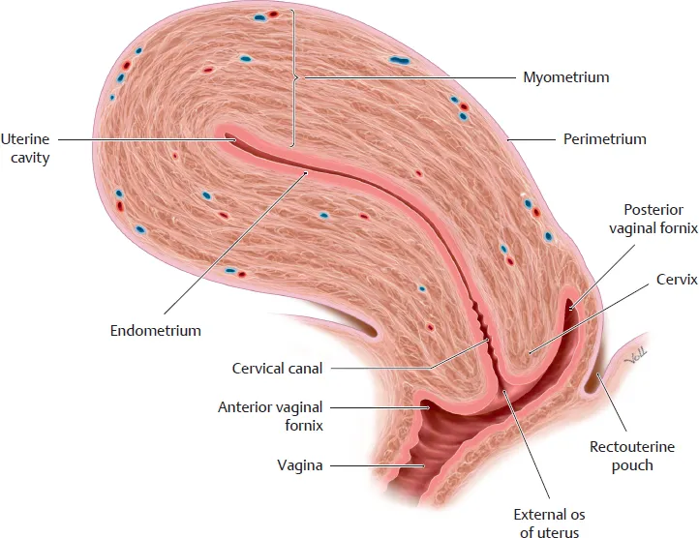
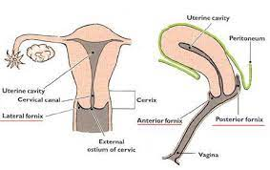
The vault of the vagina is divided into four fornices:
- posterior
-anterior
and two lateral
The vagina has no gland.
kept moist by secretions from
the uterine secretions.
cervical glands secretions.
transudation from its epithelial lining.

Slide 12
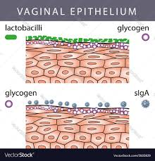
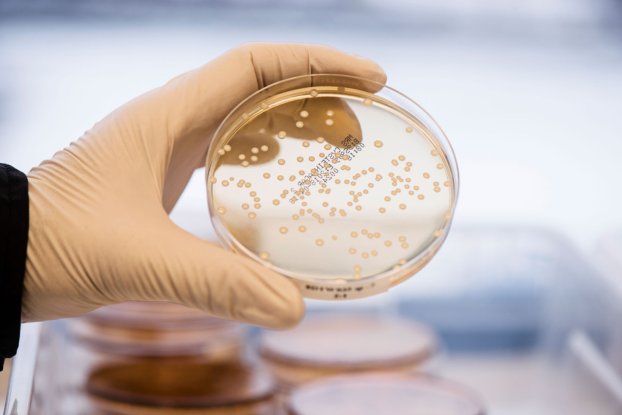
The epithelium is thick and rich in glycogen.
which increases in the postovulatory phase of the cycle.
Before puberty and after the menopause,
the vagina is devoid of glycogen due to
the lack of oestrogen.
Doderlein’s bacillus is a normal vaginal flora
and breaks down glycogen to form lactic acid
producing a pH of around 4.5.
This has a protective role for the vagina in
decreasing the growth of pathogenic bacteria.

Slide 13
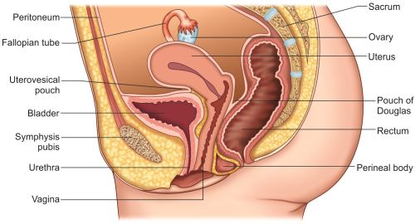
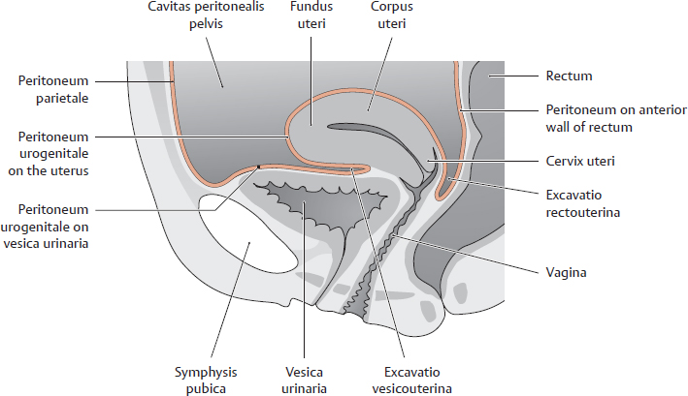
Relations :
posteriorly:
The upper….reflection of the pouch of Douglas.
The middle…. separated from the rectum
by pelvic fascia .
The lower ….third from the perineal body.
Anteriorly:
Upper……Base of the bladder.
Middle & lower …..urethra.

Slide 14
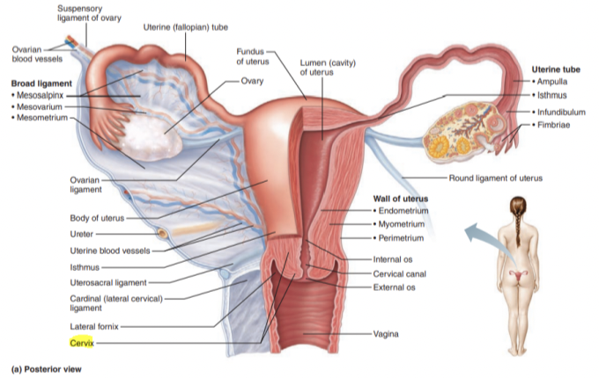
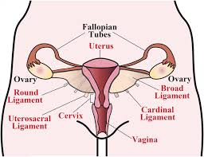
Laterally
cardinal ligaments.
levator ani muscles.
ischiorectal fossae.
Supports of the vagina:
The cardinal ligaments.
the uterosacral ligaments.

Slide 15
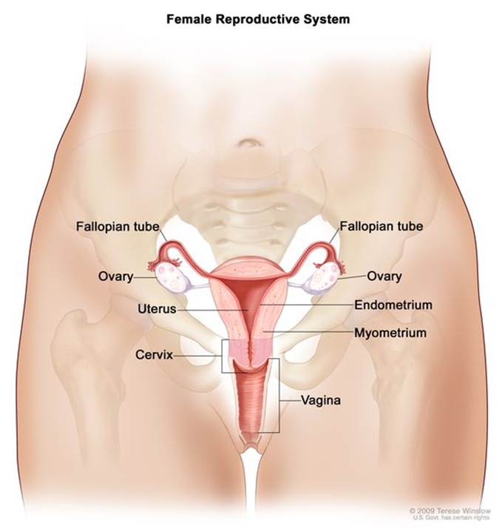
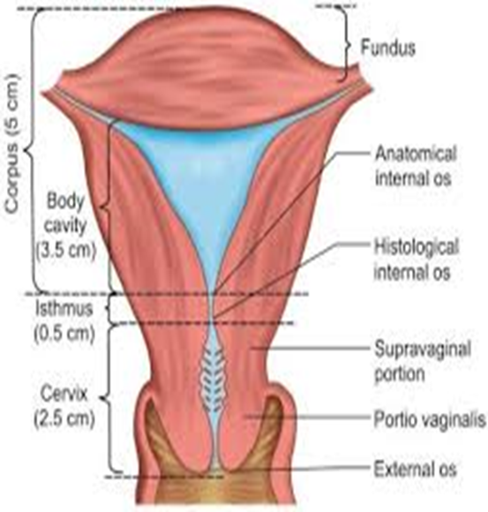
The uterus
The uterus in non-pregnant state is situated
entirely within the pelvis.
It has muscular walls.
Its dimensions are
7.5 cm long.
5 cm wide.
3 cm thick.
An adult uterus weighs approximately 70 g.

Slide 16
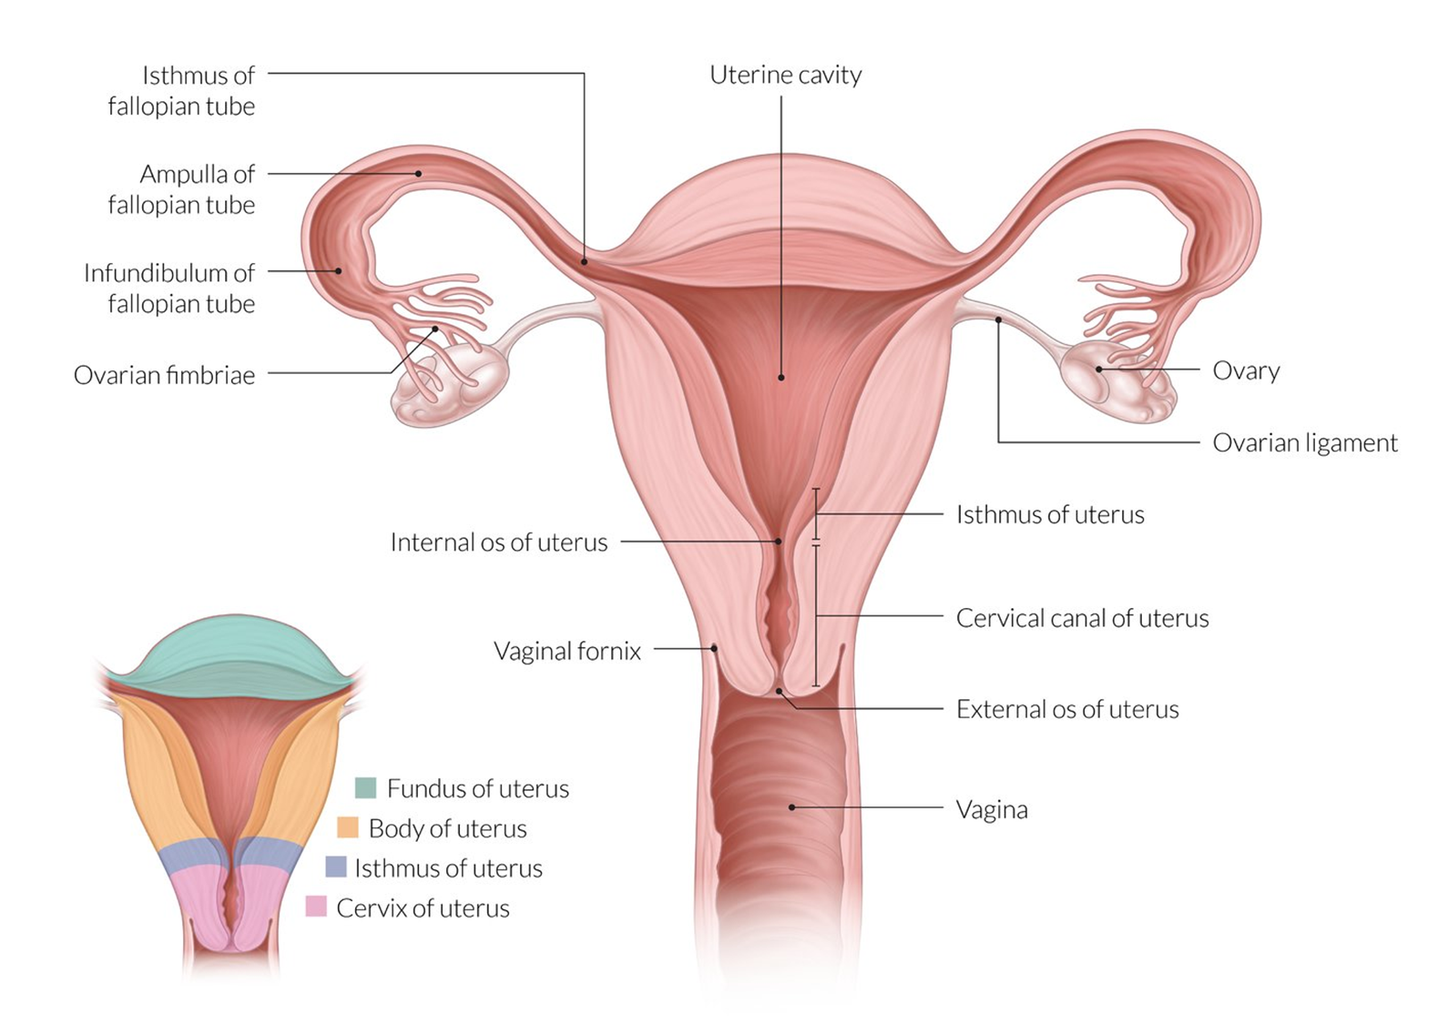
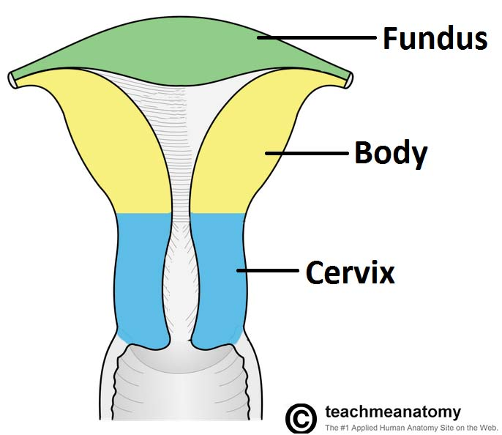
In the upper part:
of the uterus is termed the body or ‘corpus’.
The area of insertion of each Fallopian
tube is termed the ‘cornu’
the body above the cornu is called the ‘fundus’.
The uterus tapers to a small constricted area,
the isthmus
and below this is the cervix (the lower part),
which projects obliquely into the vagina.

Slide 17
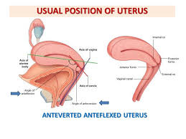
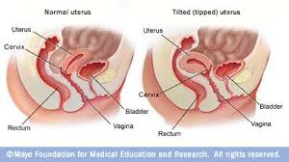

The longitudinal axis of the uterus is approximately
at right angles to the vagina and normally tilts forward.
This is called ‘anteversion’.
The uterus is also usually flexed
forward on itself at the isthmus – anteflexion.
In around 20% of women,
the uterus is tilted backwards
retroversion and retroflexion.
This has no pathological significance in most women
Although retroversion that is fixed and
immobile may be associated with endometriosis.

Slide 18
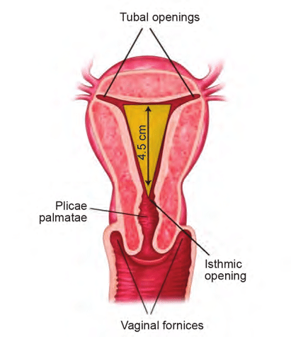
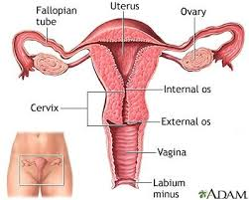
The cavity of the uterus is the shape of an inverted
Triangle.
The Fallopian tubes open at lateral angles
The constriction at the isthmus where the corpus
joins the cervix is the anatomical os:
Seen microscopically.
histological internal os is where the mucous
membrane of the isthmus becomes that of the cervix.

Slide 19
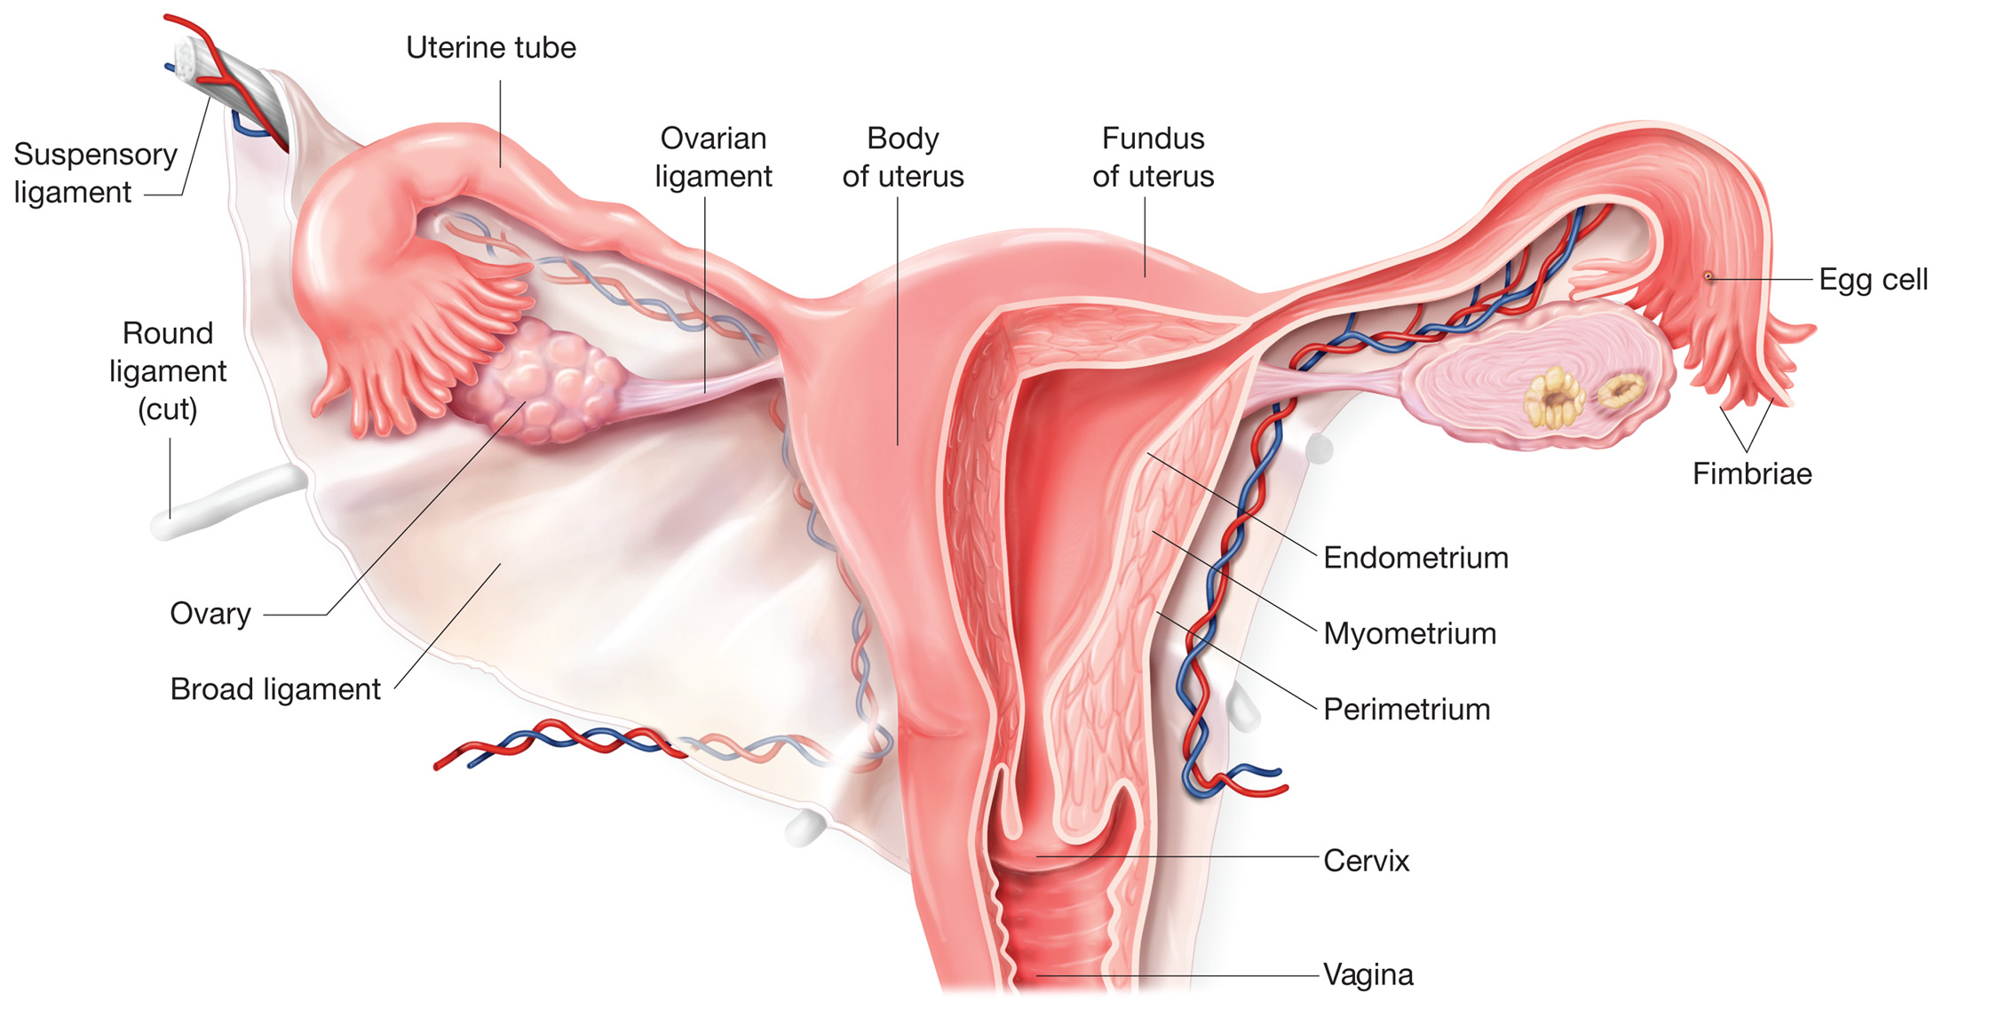
The uterus consists of three layers:
Outer serous layer (peritoneum).
Middle muscular layer (myometrium).
Inner mucous layer (endometrium).

Slide 20
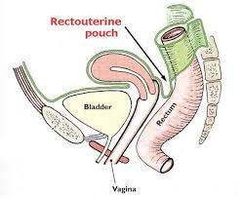
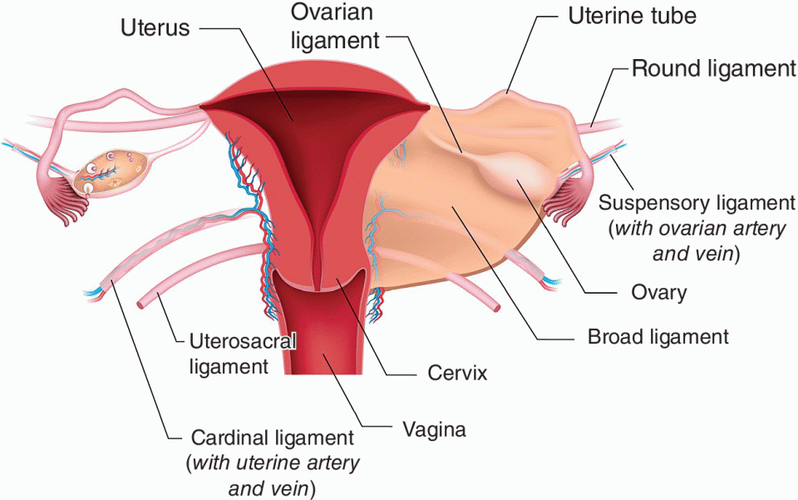
The peritoneum covers the body
of the uterus and posteriorly it covers
the supravaginal part of the cervix.
The peritoneum laterally spreads
out to form the leaves of the broad ligament.
The muscular myometrium forms the main
bulk of the uterus.

Slide 21
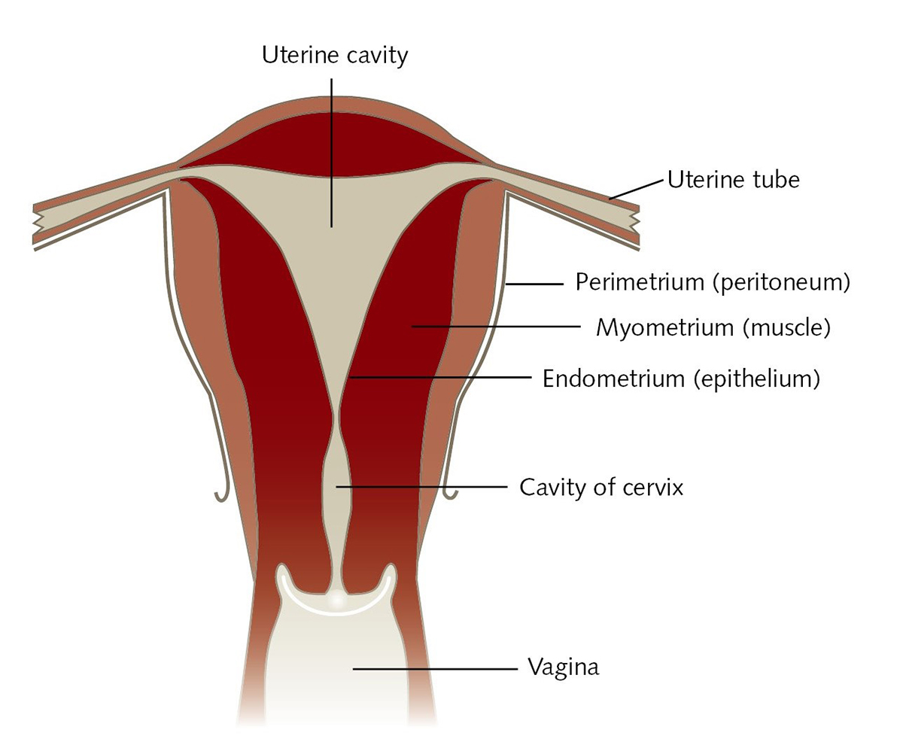
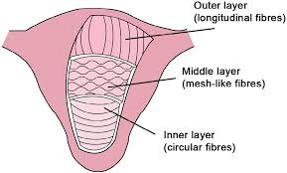
Externally, the muscle fibres are longitudinal.
intermediate interlacing longitudinal, oblique and transverse fibres.
Internally, they are longitudinal and circular.
The inner endometrial layer has glands that dip into the myometrium.
The endometrial layer is covered by a single layer of epithelium.
The endometrium undergoes cyclical changes during menstruation.

Slide 22
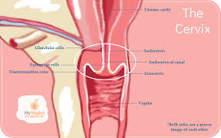

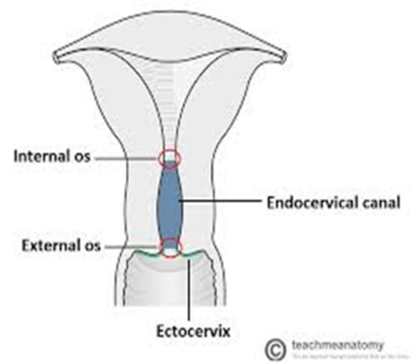
The cervix
The cervix is 2.5 cm in length.
Lateral to the cervix:
lies the ureter within the parametrium.
Posteriorly:
the cervix is covered by the peritoneum
of the pouch of Douglas.
It has glands that secrete clear alkaline mucus
( physiological vaginal discharge).
The epithelium of the endocervix is columnar
changes to squamous epithelium in the external os
And the junction between them is
the ‘squamocolumnar junctions

Slide 23
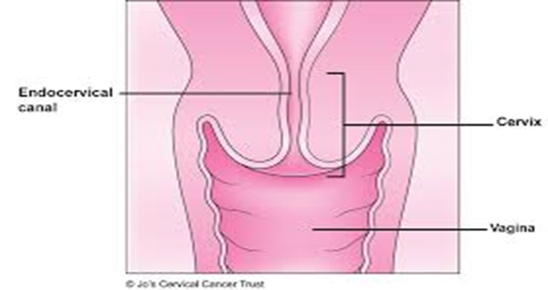
Age changes
Disappearance of maternal oestrogens after birth
causes the uterus to decrease in length.
During childhood, the uterus grows slowly in length,
in parallel with height and age.
After the onset of puberty, the diameters of the
uterus start to increase & reaches its adult size by
the late teenage years.
After the menopause, the uterus atrophies.

Slide 24
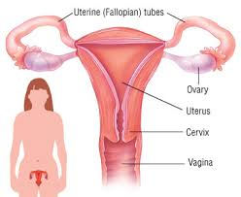
The Fallopian tubes
The Fallopian tube extends outwards
From the uterine cornu
To end near the ovary.
At the abdominal ostium, the tube opens into the
peritoneal cavity, this is essential (Why?)
to allow the sperm and egg to meet.
The Fallopian tubes transfer the ovum from the ovary to
the uterus and promote oxygenation and nutrition for
sperm, ovum & then for zygot.
The Fallopian tube runs in the upper margin of the broad
ligament, known as the mesosalpinx so peritoneum encloses
the tube completely , except for a narrow strip along this inferior aspect.

Slide 25
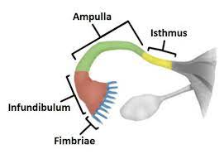
The Fallopian tubes
Each tube is about 10 cm long
described in four parts:
The interstitial portion(lies within the wall of the uterus)
The isthmus( a narrow portion adjoining the uterus)
The ampulla. (the widest and longest portion)
The infundibulum or fimbrial portion
(where ampulla terminates).

Slide 26
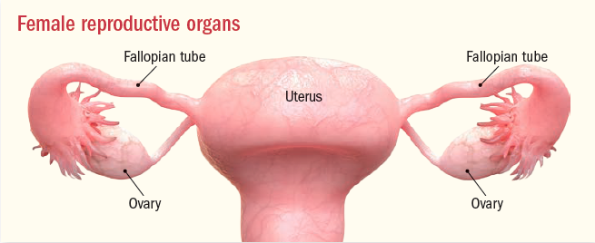
The opening of the tube into the peritoneal cavity
is surrounded by finger-like processes, known as fimbria.
Its inner surface is covered by ciliated epithelium .
The muscle fibber arranged in :
inner…… circular outer….. longitudinal layer.
There are Changes under the influence of the menstrual
cycle but….
there is no cell shedding during menstruation.

Slide 27
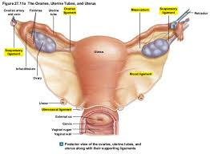
The ovaries
The size and appearance depends on:
age.
and stage of the menstrual cycle.
In a child, the ovaries are small structures.
In the young adult:
they are almond-shaped.
measure approximately 3 cm long.
1.5 cm wide and 1 cm thick.
After the menopause, no active follicles and the ovary becomes smaller .

Slide 28
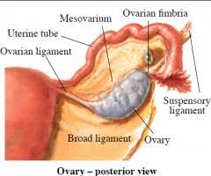
The ovary is the only intra-abdominal
structure not to be covered by peritoneum.
Ligaments of the ovary
1.ovarian ligament between the ovary &
the cornu of the uterus by the.
2.Mesovarium of the broad ligament :
Suspend the ovaries (but not cover them)
Contains nerves & blood vessels.
3.suspensory ligament:
Which attach each ovary to the pelvic side wall.

Slide 29
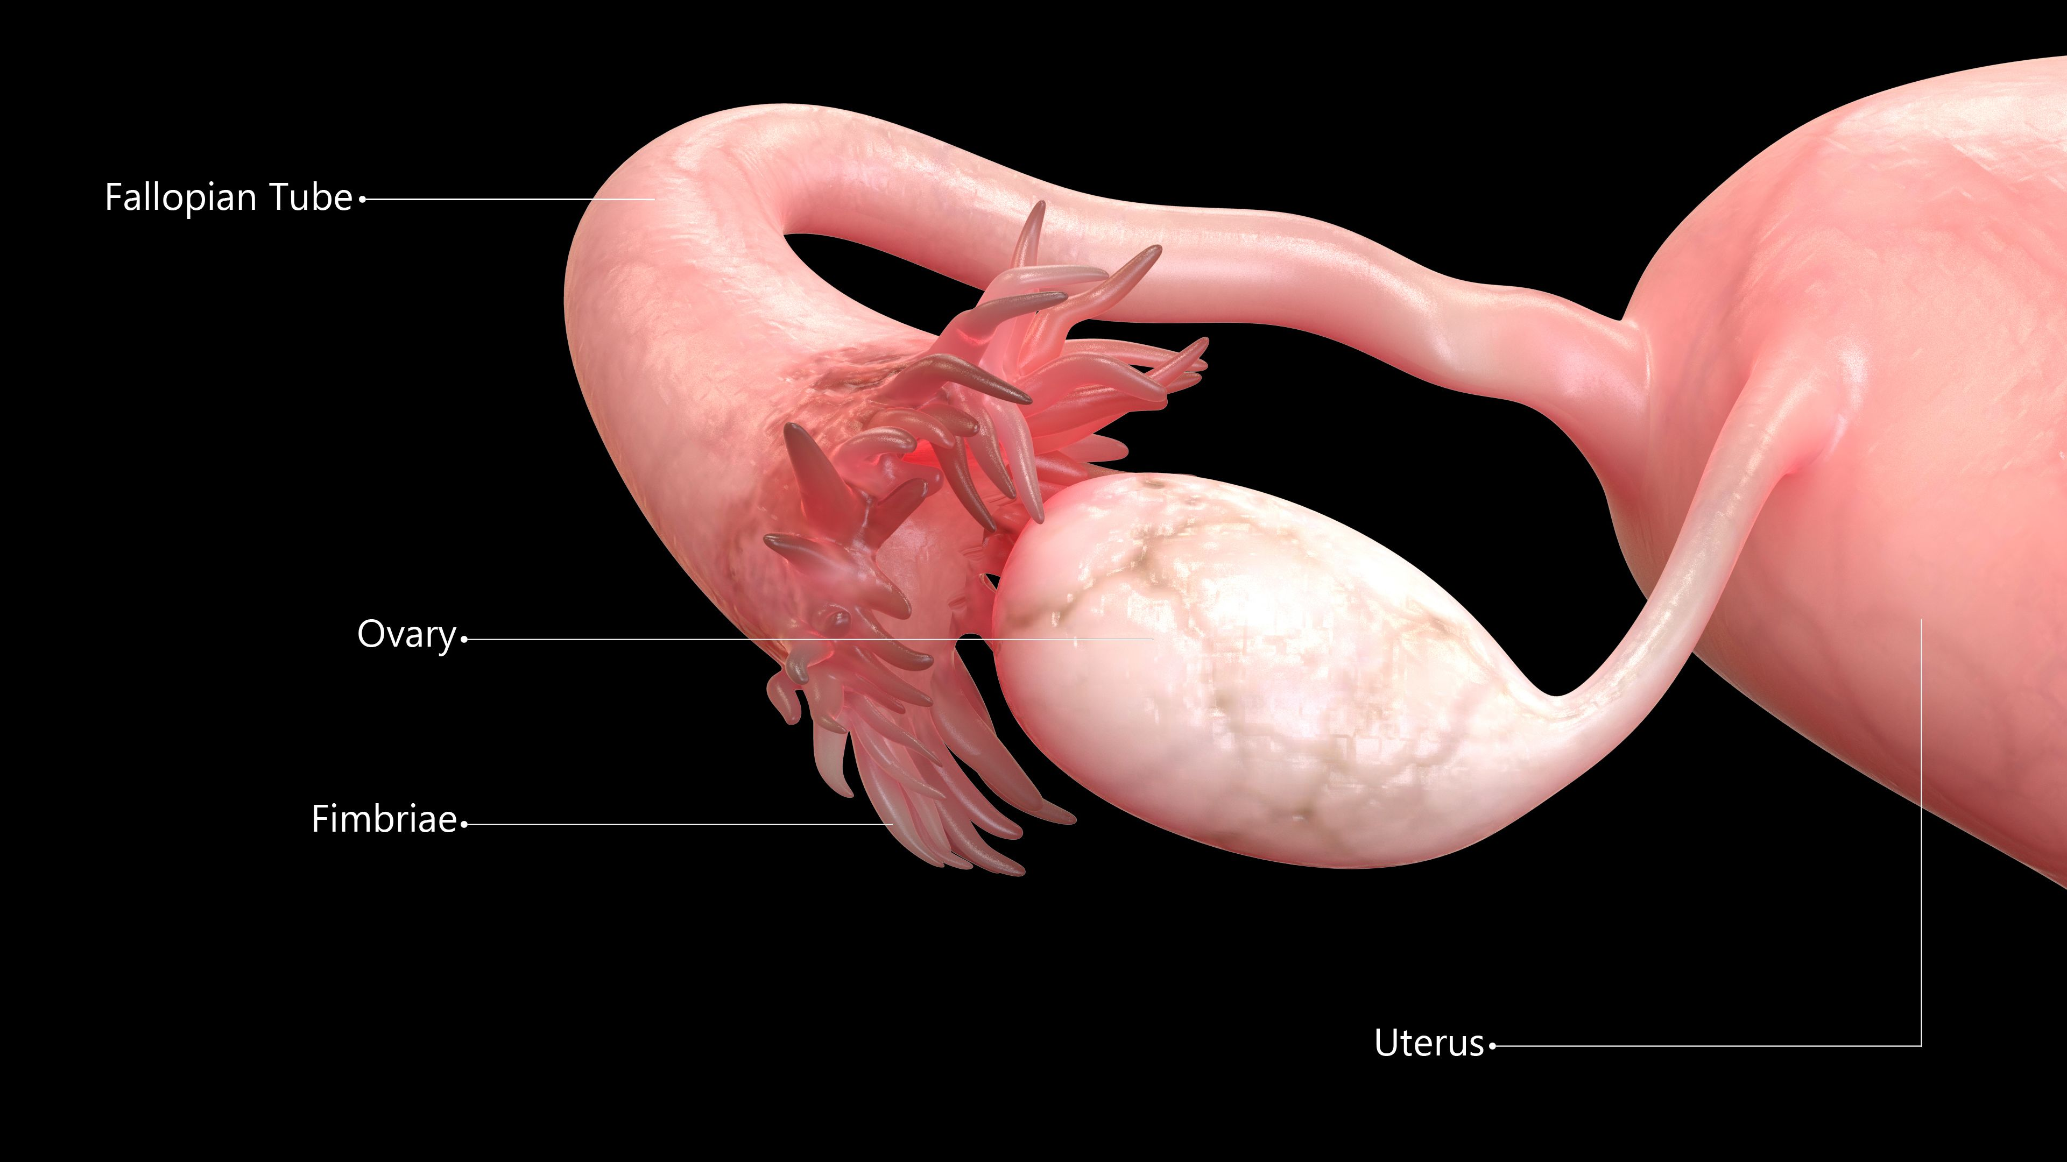

Slide 30
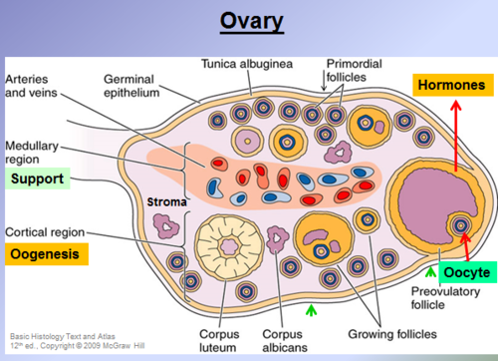
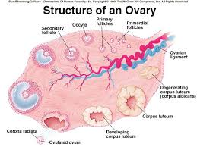
Structure of the ovary
The ovary has a central vascular medulla .
It has an outer thicker cortex.
The surface of the ovaries is covered by
cuboidal cells, (the germinal epithelium).
Beneath this is ‘tunica albuginea’, which increases
in density with age.
At birth, numerous primordial follicles are found .
With puberty, some form each month into
the graafian follicles under gonadotrophic control
to ovulate then form corpus lutea
or corpus albicans.

Slide 31



Slide 32



