Slide 1


Gynaecology terminology
By dr Mona Ahmed
Assisted professor of obs & gynae
SMSB

Slide 2


Menstruation
Amenorrhea:
Absence or cessation of menstruation.
Oligomenorrhea:
Infrequent menstrual periods(>35 days).
Polymenorrhea:
Menstrual cycle that is shorter than 21 days.
Menorrhagia:
Excessive bleeding during the menstrual cycle.
Scanty menorrhea(hypomenorrhoea):
extremely light menstrual blood flow

Slide 3
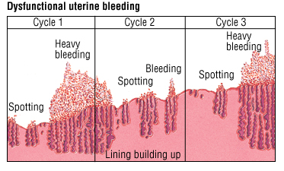
Menstruation
Metrorrhagia:
Irregularly frequent periods.
Dysfunctional uterine bleeding (DUB):
Irregular uterine bleeding that occurs in absence of pathology or medical illness.
Intermenstrual bleeding (IMB):
Vaginal bleeding between menstrual cycles.
post coital bleeding:
Vaginal bleeding after sexual intercourse

Slide 4
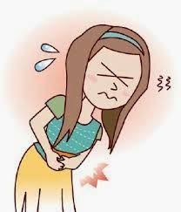
pain
Dysmenorrhea:
Pain associated with menstruation.
Dyspareunia:
Pain during intercourse.

Slide 5
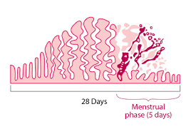
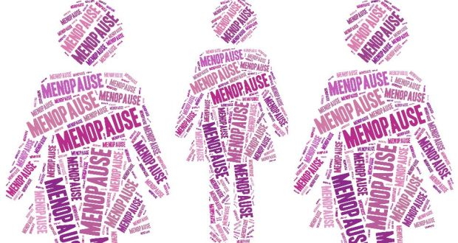
Cycle
Menarche :
First menstrual cycle.
Katamina(Kata) :
Duration of bleeding/time between cycle & cycle(eg 5/28).
Menopause:
permanent cessation of menstruation.
Perimenopause:
phase prior to the onset of menopause.

Slide 6
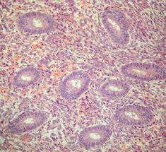
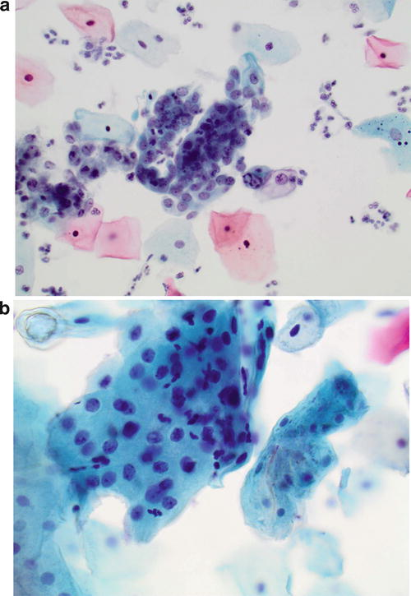
Tumors
Dysplasia:
The growth of abnormal cells
Precancerous condition:
May or may not develop into cancer

Slide 7
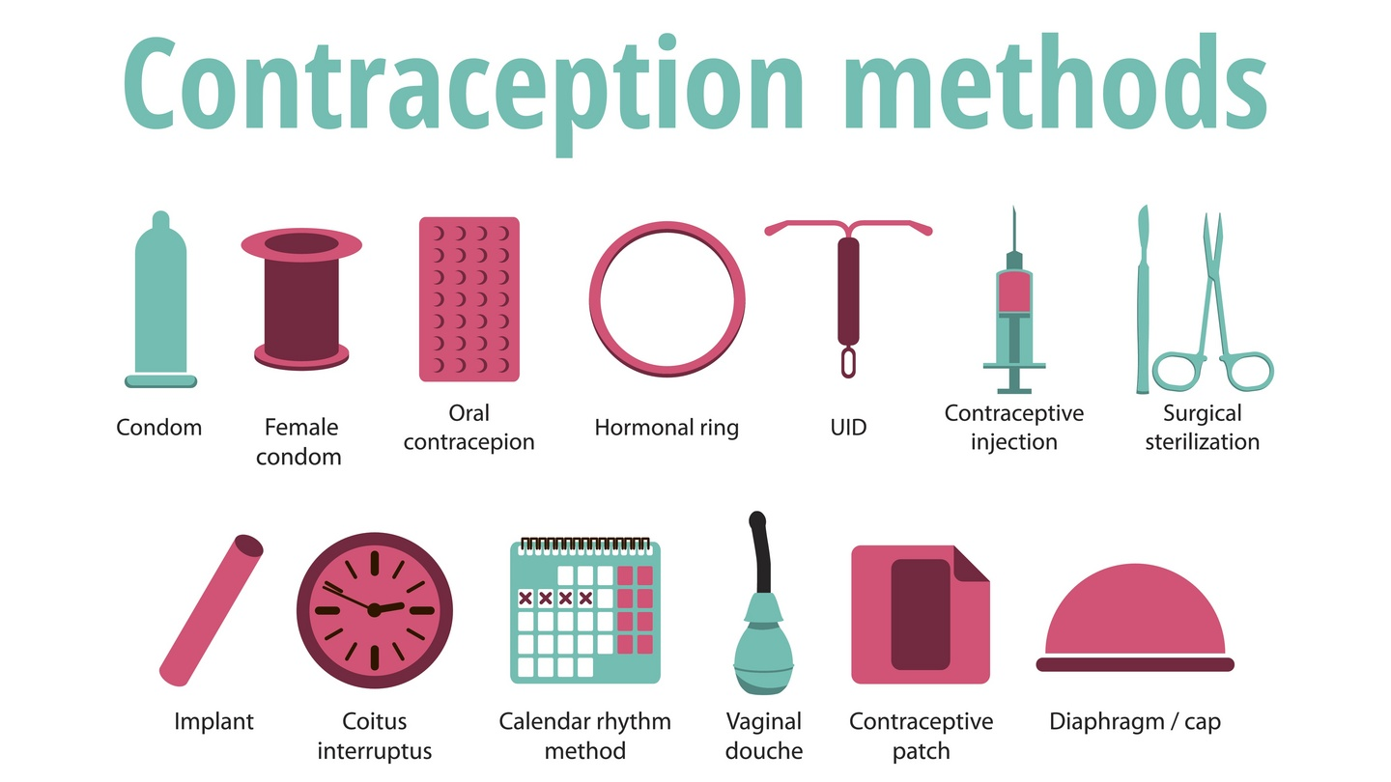
Contraception
Birth control methods.

Slide 8
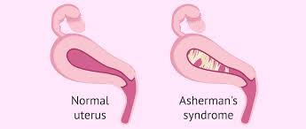
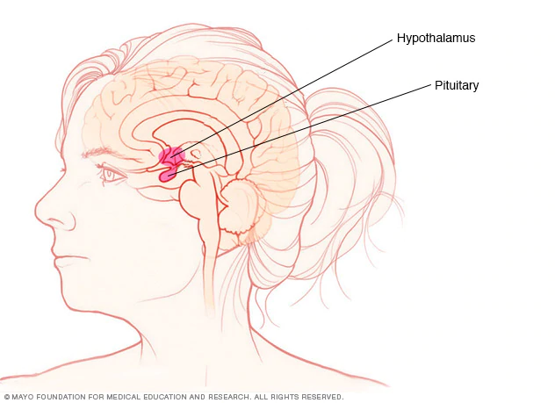
Syndromes
Asherman's syndrome:
scar tissue or adhesions form in the uterus
Sheehan syndrome:
Pituitary infarction due to massive obstetrical haemorrhage.

Slide 9
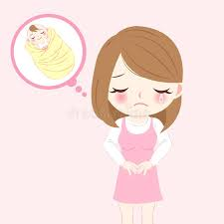
Fertility
Infertility:
Infertility is inability to conceive naturally after one year of trying.
Subfertility :
is delay in conceiving.

Slide 10
Genital tract
Cervicitis :
Inflammation of the cervix.
Endometritis:
Inflammation of the endometrium.
Salpingitis:
Inflammation of fallopian tube.
Oophoritis:
Inflammation of the ovary.

Slide 11



