Slide 1
IUGR & IUFD

Slide 2

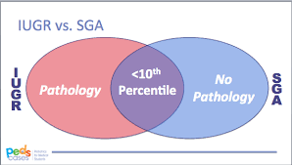

Definitions
Intrauterine growth restriction (IUGR)
When the estimated fetal weight falls below the 10th percentile for gestational age. “always pathological”
Small for gestational age (SGA)
newborns who are smaller in size than normal for the gestational age or ( weight below 2 SD below the mean). “Pathological or non-pathological”

Slide 3
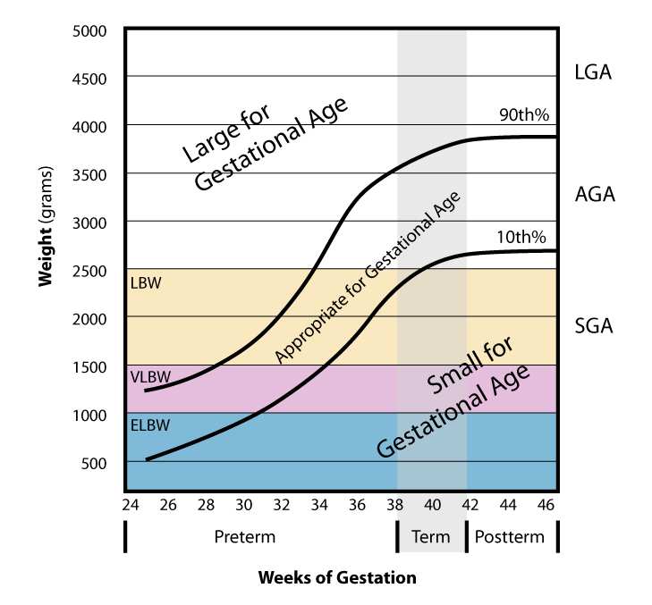


Slide 4
Symmetrical vs. asymmetrical IUGR
Symmetrical | Asymmetrical
20-30% of IUGR The fetus is proportionally small Thought to result from an intrinsic (i.e. genetic) or first-trimester *early* insult (e.g. infection) that interferes with early fetal cellular hyperplasia, producing uniformly reduced growth | 70-80% of IUGR Abdominal growth lags behind head circumference. Late pregnancy insult Thought to result from adaptation to a hostile environment by redistributing blood flow in favour of vital organs (e.g. brain, heart) at the expense of nonvital fetal organs (e.g. liver, kidneys)
Causes :chemical exposure, infection, or chromosomal disorders , congential malformation | Placental insufficiency (Main pathology)
Head circumference, length, weight and abdomen circumference are decreased proportionally | Head circumference is spared relative to decreased weight, length, and/or abdominal circumference

Slide 5
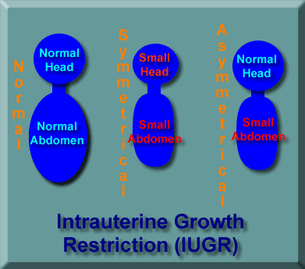
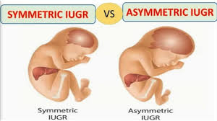

Slide 6
Etiologies

Slide 7
*TORCH: Toxoplasmosis, Other (syphilis), Rubella, Cytomegalovirus, Herpes simplex virus **While diabetes with vascular involvment can cause restricted fetal growth, WHILE DM without vascular involvement it typically causes excessive growth resulting in a fetus who is large for gestation age (LGA).
Maternal factors | Placental factors | Fetal factors
Chronic illness (e.g. diabetes with vascular involvment**, hypertension, renal disease, anemia, pulmonary disease) Pre-eclampsia Early or advanced age Malnutrition Uterine malformations Substance abuse (e.g. cigarettes, alcohol, narcotics, cocaine) Medications (e.g. warfarin, anticonvulsants) | Uteroplacental insufficiency Abnormal implantation Vascular anomalies Placental abruption Infarction Tumour Villous placentitis (bacterial, viral, parasitic) | Chromosomal disorders Congenital anomalies Multiple gestation Infection (e.g. TORCH*, malaria, varicella) Metabolic disorders

Slide 8
Complications
Increase perinatal mortality .
Cerebral palsy .
Stillborn infants (IUFD).
Delay milestones.
Short stature.
Intrapartum fetal distress and asphyxia.
Meconium aspiration.
Emergency CS.
Necrotizing enterocolitis.
Hypoglycaemia and hypocalcaemia.
Later on life more borne to CVD & diabetes .

Slide 9
Diagnosis
History :
Identifiying mother at high risk
Gestational age must be established with certainty, preferably in the first trimester, to assess fetal growth accurately.
Clinically : A lag in fundal height of more than 4 cm from gestational age after 20 weeks should prompt sonographic evaluation.
Sonographic assessment:
Most useful tool for diagnosis of IUGR.
To differentiate between symmetrical and a symmetrical IUGR .
To monitor fetal condition .

Slide 10

Sonographic component Used to Assess Fetal Growth
1-Fetal biometry :
Estimed fetal weight
Abdominal circumference(AC) : AC and weight are most accurate US parameters for diagnosis IUGR
BPD (Biparital diameter): to determine GA and type of IUGR
Head circumference (HC) : better than BPD in predicting IUGR
HC:AC ratio (head circumference/abdominal circumference)
normally decreases linearly from 16 to 20 weeks of gestiona
-HC/AC increase > 2 SD above mean is predictive of IUGR ( a symmetrical )
FL/AC ratio ( Femur length /abdominal circumference) : normal ranges 22 % , ratio above 23 % consider abnormal

Slide 11
Sonographic component Used to Assess Fetal Growth
2- placenta morphology
Advanced placental grade.
3- Amniotic fluid index
Presence of Oligohydramnios without ruptured membranes.
2-Umbilical artery Dopplers

Slide 12
Role of Dopplers in diagnosis IUGR.
Can help distinguish between constitutionally small vs. IUGR
Useful for evaluating pregnancies at risk for adverse events

Slide 13
Doppler features:
Umbilical artery doppler assessment (most important )
Increased S/D ratio(s) , absent end diastolic flow and finally reversed end diastolic flow.
Perinatal mortality rate increases significantly in fetuses with absent end diastolic flow (9-41%) and reversed end diastolic flow (33-73%) in umblical artery.
Increased resistive index (RI)
Middle cerebral a. (MCA) : ↓ resistance and ↑Peak systolic velocity (blood redistribution, brain sparing)
Abnormal ductus venosus flows associated with fetal acidaemia and the highest perinatal mortality compared to those where flow abnormalities are confined to the umbilical or middle cerebral artery
Umbilical venous doppler assessment
Presence of pulsatility
Uterine arterial doppler assessment
Increased S/D ratio(s)

Slide 15
Management
Since IUGR fetus is at increased risk of intrauterine hypoxia and intrauterine demise, the decision needs to delicately balance the risk to the fetus in utero with continuation of pregnancy and that of prematurity if delivered before term
Identify cause : Growth restriction less than the third percentile diagnosed before 32 weeks prompts offering amniocentesis or fetal blood sampling for karyotype and viral studies.

Slide 16
Management
Delivery vs conservative management : Depend on gestational age
Preterm IUGR :
Conservative management : if less than 37 weeks of gestaion
Treat/modify underlying cause .
Restrict physical activity, left lateral position , steroid , low dose aspirin, Maternal oxygen therapy
Adequate nutrition ,
Initiate fetal surveillance.(Includes daily kick counts, serial fetal growth ultrasounds every 3 to 4 weeks, and nonstress testing and biophysical profile twice per week , weekly or twice weekly Doppler .
Continue expectant management and deliver if fetal lung maturation has been achieved at 37 weeks .
Deliver earlier if no fetal growth has been documented ( 2 weeks interval) , oligohydrominous absent or reversed end diastolic , poor BPP, un-assure nonstress test
Term IUGR
Delivery : if IUGR ≥37 weeks

Slide 17
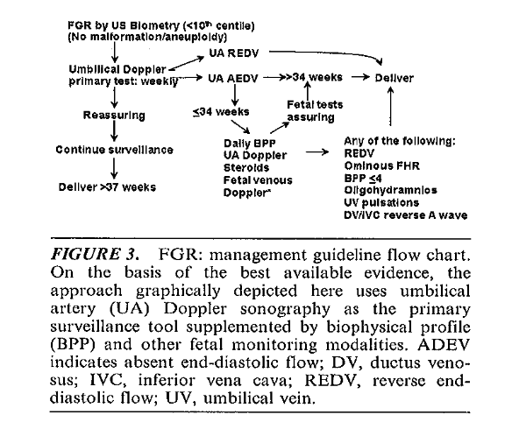

Slide 18
Mode of delivery :
Vaginal delivery is not contraindicated, can be allowed as long as there is no obstetric indication for caesarian section and fetal heart rate is normal , but there is an increased risk of fetal intolerance of labor.
Fetuses with major anomaly incompatible with life should also be delivered vaginally.
Caesarian section: is indicated In all cases of IUGR with features of acidosis , these include:
Abnormal CTG ,poor BPP , reversed of end diastolic flow in UA
, acidic fatal PH .

Slide 19
Outcomes
Symmetric vs. Asymmetric IUGR
symmetric has poorer outcome compared to asymmetric
Preterm IUGR has high incidence of abnormalities
IUGR with chromosomal disease has 100% incidence of handicap
Congenital infection has poor outcome - handicap rate > 50%
IUGR has higher rate of learning disability.

Slide 20
IUFD

Slide 21
IUFD
Def. : Antenatal diagnosis of a stillborn infant after 20 weeks’ gestation or before the onset of labor
IUFD is suspected with any maternal report of more than a few hours of absent fetal movement.
Definitive diagnosis is by absent fetal cardiac activity on ultrasonography.
Fetal deaths can be categorized by occurrence during the antepartum period or during labor (intrapartum stillbirth).

Slide 22
Causes
The etiology of antepartum fetal death can be divided into broad categories:
Idiopathic/unexplained (most common).
Maternal conditions: e.g advanced age ,post-term , Trauma , sepsis, diabetes & preeclampsia, thrombophilia , Antiphospholipid syndrome.
Fetal conditions: e.g malformations, chromosomal and genetic disorders, infections, growth restriction, TTS
Fetomaternal conditions: fetomaternal hemorrhage (rh alloimmunization)
Placenta and cord complications: e.g Placental insufficiency ,abruption, infarction, tight knot in the cord ,cord prolapse .

Slide 23
Diagnosis
History :Absence of fetal movements for a few hours
Ultrasonography ( accurate 100% )
-Spalding sign (irregular overlapping of skull bones after 7days)
-Robert’s sign (gas shadows in the chambers of the heart & great vessels after 12h)

Slide 24
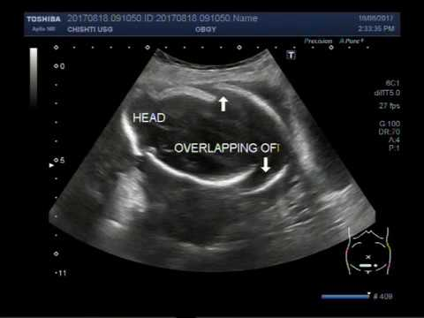
Spalding sign

Slide 25
Robert’s sign

Slide 26
Management
Expectant management: wait for Spontaneous labor , occurs within 2 to 3 weeks in 80% of cases.
Active management: In cases of prolonged demise of failure of expectant , induction of labor should be offered due to emotional burden and the risk of chorioamnionitis and DIC with prolonged demise.
Testing to determine the cause of the loss is usually negative but can include parent and fetal karyotyping , infection evaluation (TORCH), maternal thyroid screening and HbA1c, antibody screen , Throbophilia screening , and fetal autopsy , Umbilical Cord /placenta spcimen.
Dopamine agonists to suppress lactation (cabergoline is superior to bromocriptine) ,should not be given to women with hypertension or pre-eclampsia.

Slide 27
Prevention in next pregnancy
Preconception counseling before next pregnancy .
Manage next pregnancies as high-risk
Women with a previous unexplained IUFD should be recommended to have obstetric antenatal care
And screening for gestational diabetes.
Antepartum fetal assessment for next pregnancy may not prevent but can significantly reduce the frequency of antenatal fetal deaths.
Maternal request for scheduled birth should take into account the gestational age of the previous IUFD, previous intrapartum history and the safety of induction of labour.

Slide 28

Thank you

