Slide 1

Multiple pregnancy

Slide 2
DIZYGOTIC TWINS
• Most common represents 2/3 of cases.
• Fertilization of more than one egg by more than one sperm.
• Non identical may be of different sex.
• Two chorion and two amnion.
• Placenta may be separate or fused.

Slide 3
Factors affecting it's incidence
• Induction of ovulation, 10% with clomide and 30% with gonadotrophins.
• Increase maternal age? Due to increase gonadotrophins production.
• Increases with parity.
• Heredity usually on maternal side.
• Race; Nigeria 1:22 North America 1:90.

Slide 4
MONOZYGOTIC TWINS
• Constant incidence of 1:250 births.
• Not affected by heredity.
• Not related to induction of ovulation.
• Constitutes 1/3 of twins.

Slide 5
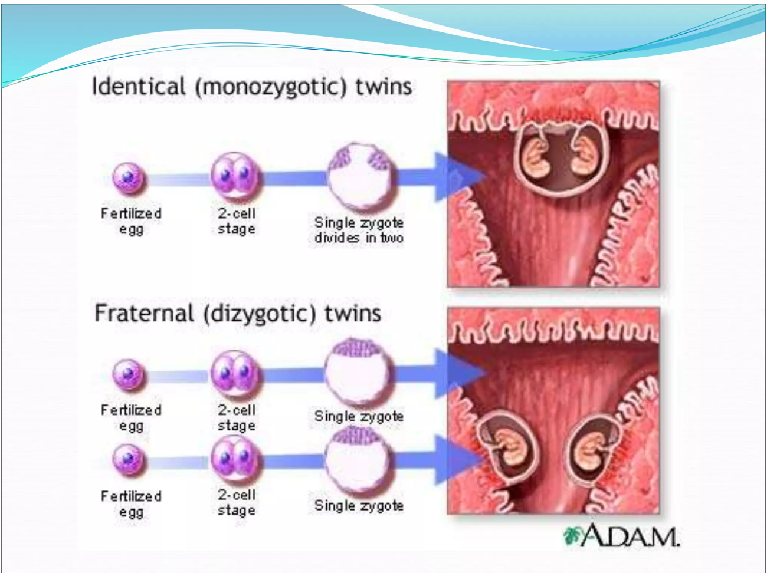

Slide 6
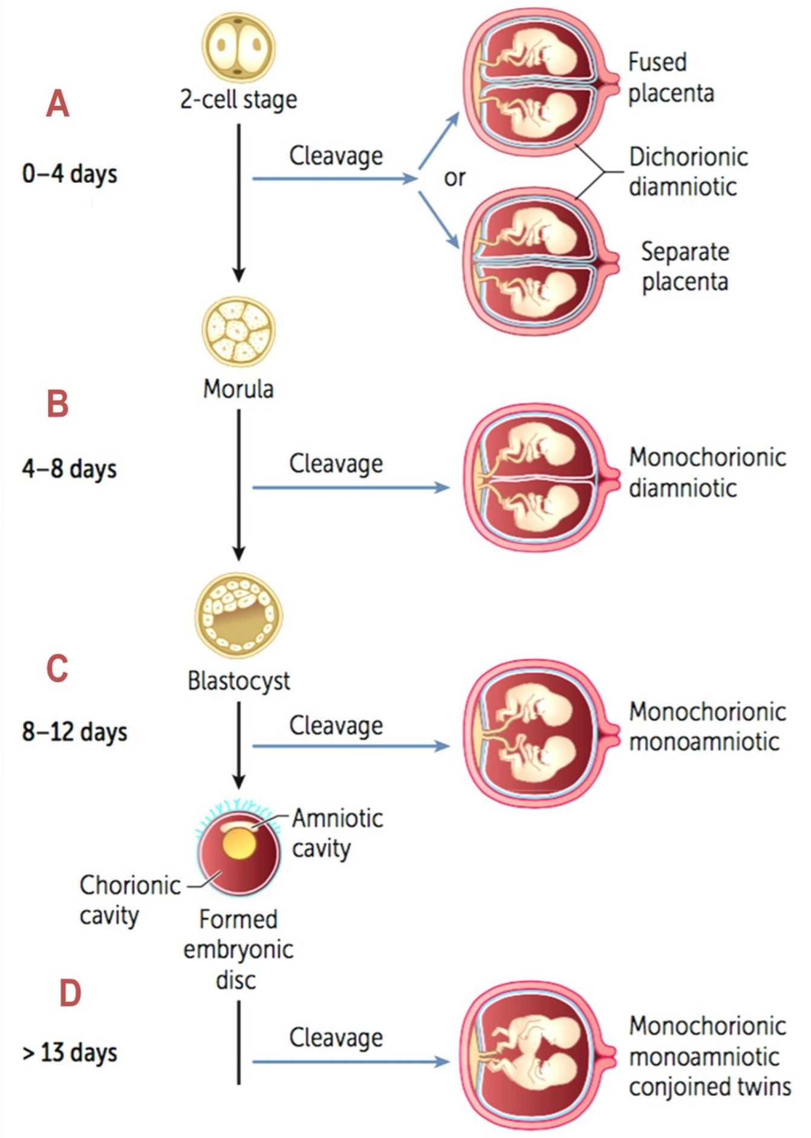

Slide 7
MONOZYGOTIC TWINS
•70%are diamniotic monochorionic.
•30% are diamniotic dichorionic

Slide 8
Diagnosis of zygotic
During pregnancy by USS
• Very accurate in the first trimester, two sacs, presence of thick chorion between amniotic membrane. T sign” is 2 amniotic sacs &1 placenta (monochorionic).
• Less accurate in the second trimester the chorion become thin and fuse with the amniotic membrane.
“lambda” or “twin peak” sign,(dichorionic).(10-14 weeks)

Slide 9
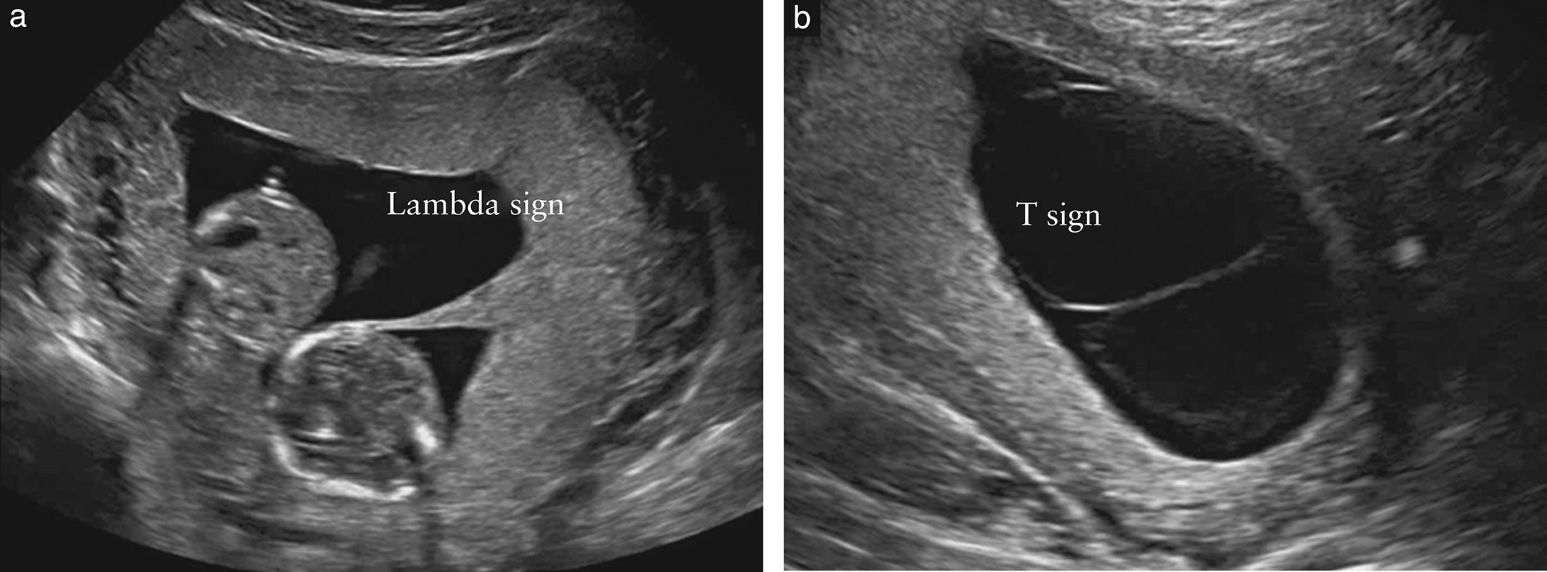

Slide 10
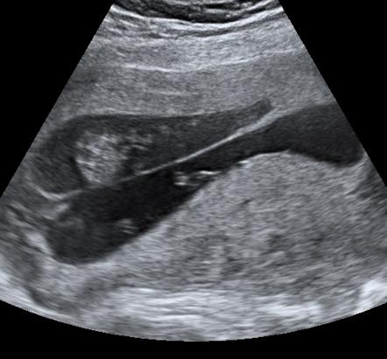

Slide 11
Different sex indicates dizygotic twins.
Separate placenta indicate dizygotic twins .

Slide 12
Determination of zygozity After Birth
• By examination of the MEMBRANE, PLACENTA,SEX, BLOOD group.
• Examination of the newborn DNA and HLA may be needed in few cases.

Slide 13
Complications of multiple pregnancy
Maternal :
• Anemia
• Hydramnios
• Preeclampsia
• Preterm labour
• Postpartum hemorrhage
• Cesarean delivery
Fetal:
• Malpresentation
• Placenta previa
• Abruptio placenta
• Premature rupture of the membranes
• 'Prematurity
• Umbilical cord prolapse
• Intrauterine growth restriction
• Congenital anomalies

Slide 14
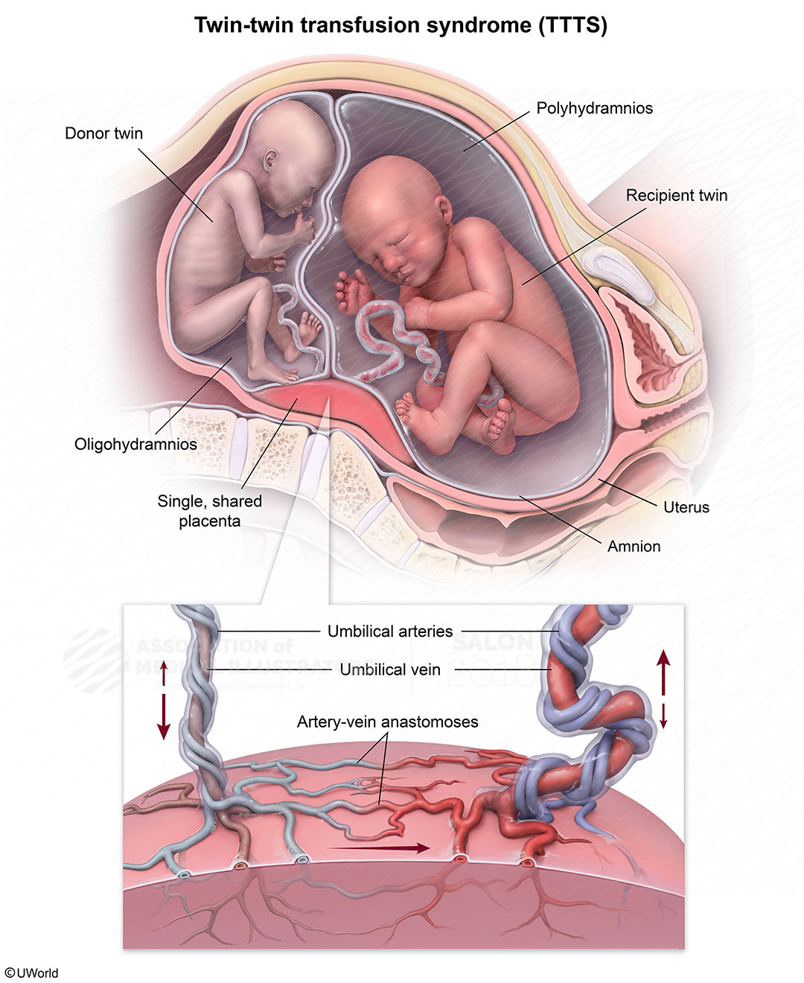
Monochorionic complications
TWIN-TWIN transfusion.
• Results from vascular anastomoses between twins vessels at the placenta.
• Usually arterial (donor) venous (recipient).
• Occurs in 10% of monochorionic twins.
• Chronic shunt occurs, the donor bleeds into the recipient so one is pale with oligohydramnios while the other is polycythemia with hydramnios.
• If not treated death occurs in 80-100% of cases.

Slide 15

Possible methods of treatment
• Repeated amniocentesis from recipient.
• Indomethacin.
• Fetoscopy and laser ablation of communicating vessels.

Slide 16
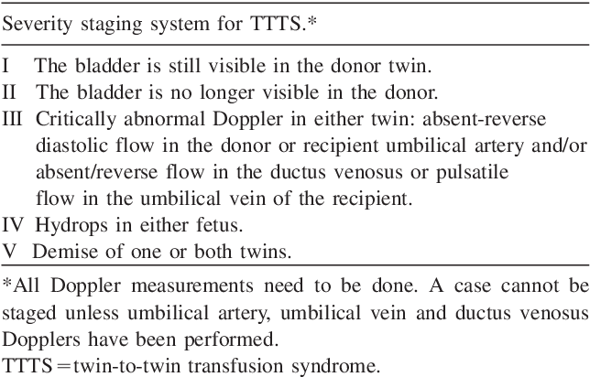

Slide 17
Other Complications in Monochorionic Twins:
• Congenital malformation. Twice that of singleton.
• Umbilical cord anomalies. In 3 - 4 %.
• Umbilical cord anomalies. In 3 - 4 %.
• Conjoined twins. Rare 1:70000 deli varies. The majority are thoracopagus.
• PNMR of monochorionic is 5 times that of dichorionic twins(120 VS 247 1000 births)

Slide 18
diagnosis
Hx
Examination
Us

Slide 19
Antenatal care
Fetal surveillance
• Monthly USS from 24 weeks to assess fetal growth and weight.
• A discordinate weight difference of >25% is abnormal
(IUGR).
• Weekly CTG from 36 weeks.

Slide 20
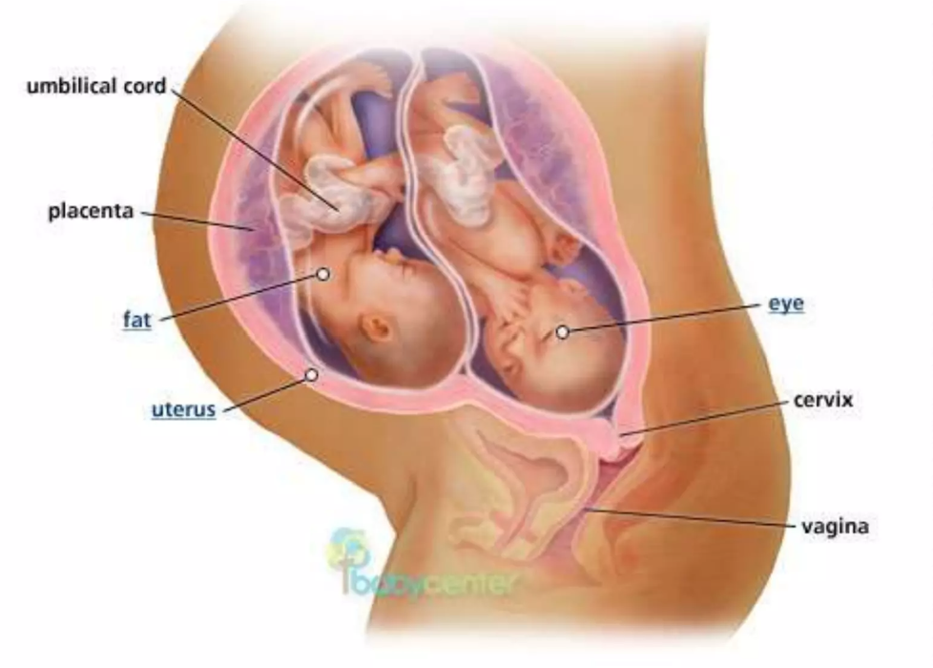
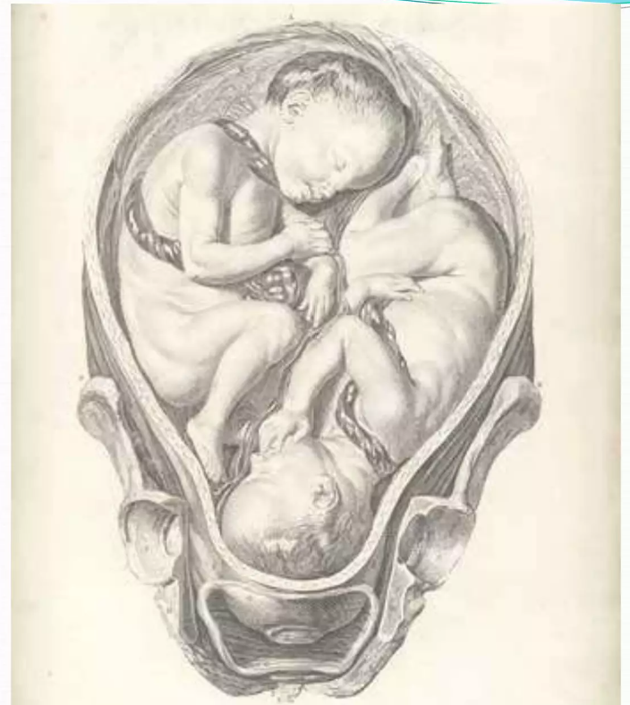
Methods of delivery
Vertex-vertex (50)%
Vaginal delivery
Vertex-breech(20%)
Vaginal delivery by senior

Slide 21
Breech-vertex(20%)
Cs is safer to avoid interlocking twins .
Breech-breech(10%)
Usually cs
For Monochorionic twins
CS

Slide 22
Perinatal outcome complication
Perinatal mortality is 5 times more than singleton.
RDS 50% more
Incidence of still birth istwice than singleton
Anamoly
Cerebral haemorrhage and asphyxia
Cerepral palsy 4 times than the singleton .

Slide 23

Others
Triplets
Quadruplets

Slide 24




