Slide 1
placenta

Slide 2
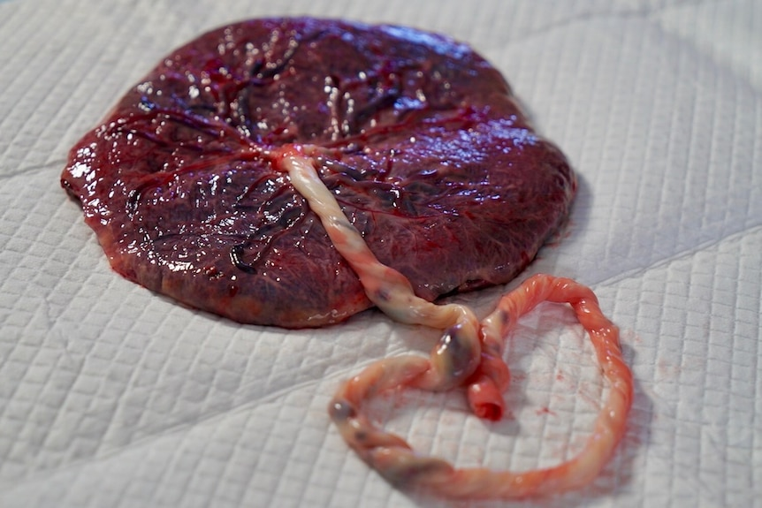
Placenta

Slide 3
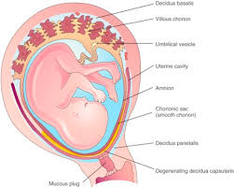
The human placenta is discoid. because of its shape; hemochorial, because of direct contact of the chorion with the maternal blood and deciduate, because some maternal tissue is shed at parturition.
The placenta attached to the uterine wall and establish connection between the mother and the fetus through the umblical cord.

Slide 4
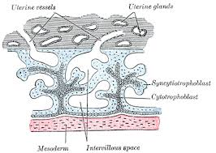
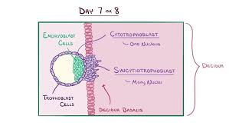
Development of placenta
The placenta is developed from two sources:
    fetal which develops from the Trophoblast.
    Maternal component consists of decidua basalis.
    As fertilisation of the ovum occurs and a zygote is formed
    ﻿﻿This cleavage continues till it is 16 cell staged and is called as Morula.
    The cells of the outer layer give rise to a structure called as the trophoblast. The trophoblast differentiates 7-9 days after fertilisation into cytotrophoblast and synctiotrophoblast. The trophoblast gives rise to the Amnion, Chorion and the fetal side of the placenta.
    The syncytiotrophoblast grows into the endometrium (Decidua). The maternal blood vessels are opened up and blood from them fills the lacunar space.
    So, lacunae have maternal blood.
    Each trabeculas is, initially made up entirely of syncytiotrophoblast.
    Later cells of cytotrophoblast begin to multiply and grow into each
    trabeculas. T

Slide 5
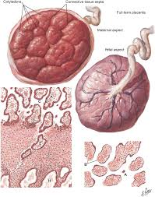
The Placenta at Term
The placenta, at term, is almost a circular disk with
a diameter of 15–20 cm and thickness of 3 cms at its center.
It weighs 500 gm
It have two services :
    Maternal surface:is rough and spongy.
    Fetal surface:is covered by the smooth and glistening amnion with the umbilical cord attached at or near its center. At term, about four-fifths of the placenta is of fetal origin.
A cotyledon or lobule is the functional unit of placenta.
Only the decidua basalis and the blood in the intervillous space are of maternal origin.

Slide 6
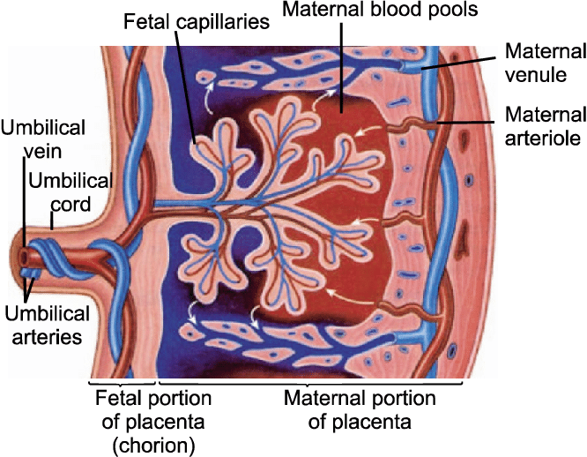
Placental Circulation
Uteroplacental circulation:
    It is concerned with the circulation of the maternal
    blood through the intervillous space.
Fetoplacental circulation:
    The two umbilical arteries carry the blood from
    the fetus to the placenta.
    fetal blood around 400ml per min

Slide 7
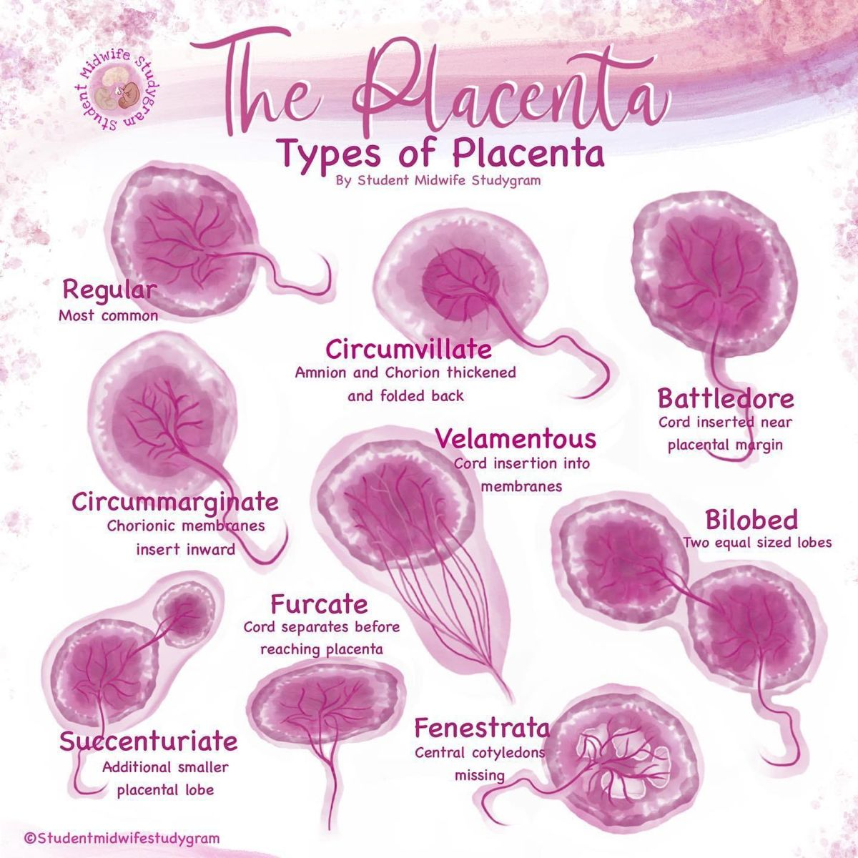

Slide 8
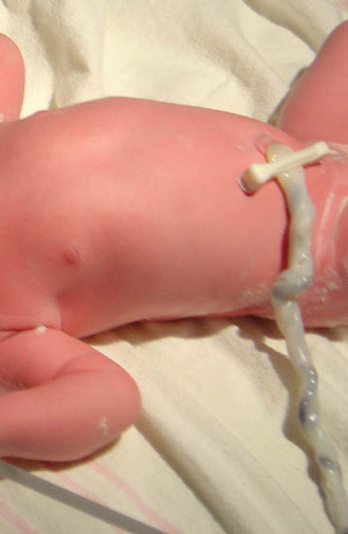
UMBILICAL CORD
Range is between 30-100 cm.
It has 2 arteries and one vein.The two arteries are smaller in diameter than the veins.
The extracellular matrix, which is specialized connective tissue consists of Wharton’s Jelly.

Slide 9
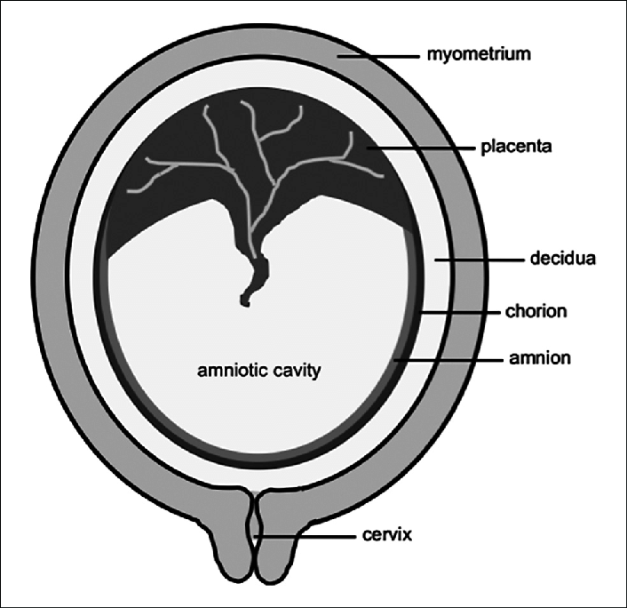
Fetal membrane
Chorion (outer layer)
Amnion( inner layer)

Slide 10
Function of placenta
Transfer of nutrient and waste products.
Enzymatic function.
Barrier function.
Immunological function.
Storage.
Endocrine function

Slide 11
AMNIOTIC FLUID
Rate of amniotic fluid turn over is 500 cc/hr.
Volume of Amniotic fluid maximum is between 36-38 weeks (1l) and then decreases such that at term it is roughly 800-900 ml
Amniotic fluid originates both from maternal and fetal sources:
    In early pregnancy – As an ultrafiltrate of maternal plasma. y By beginning of the second trimester – It consists of extracellular fluid which diffuses through the fetal skin.
    After 20 weeks – Cornification of skin prevents this diffusion and amniotic fluid is composed of fetal urine

Slide 12
Function of amniotic fluid
During pregnancy:
    (1) It acts as a shock absorber, protecting the fetus from possible extraneous injury
    (2) Maintains an even temperature
    (3) The fluid distends the amniotic sac and thereby allows for growth and free movement of the fetus and prevents adhesion between the fetal parts and amniotic sac
    (4) It has some nutritive value.
During labor:
    (1) The amnion and chorion are combined to form a hydrostatic wedge which helps in dilatation of the cervix

Slide 13
Abnormality of amniotic fluid
Oligohydramnios is a condition where liquor amnii is deficient (< 200 ml at term).
  Sonographically it is defined as:
    Absence of amniotic fluid pocket.
    Maximum vertical diameter of amniotic fluid pocket less than 2 cm.
    Amniotic fluid index less than 5 cm

Slide 14
Causes of oligo hydramnious
Drug ( Prostaglandin Synthetase inhibitors and ACE inhibitors).
IUGR Leaking of fluid following amniocentesis or chorionic villus sampling.
Maternal conditions like hypertension and preeclampsia.
Post-term pregnancy
Premature rupture of membrane
Abruptiochronic .
chromosomal anomaly like triploidy .
Renal anomalies of fetus .

Slide 15
Comlications of oligo..
Complications Fetal:
    Abortion
    Deformity due to intra-amniotic adhesions or due to compression.
    Fetal pulmonary hypoplasia (may be the cause or effect)
    Cord compression
    Fetal growth restriction.
Maternal:
    Prolonged labor
    Increased operative interference due to malpresentation.
    The sum effect may lead to increased maternal morbidity.

Slide 16
POLYHYDRAMNIOS
Defined when amniotic fluid index (AFI) is > 25 cmQ or finding of a pocket of fluid measuring 8 cm.
Grades of Polyhydramnios
  Mild defined as pockets measuring 8-11 cm in vertical dimension.
  Moderate defined as pocket measuring 12-15 cm in vertical dimension.
  Severe defined as free floating fetus found in pockets of fluid of 16 cm or more .

Slide 17
Causes of poly…
Fetus produces more urine for e.g.:
    a. multifetal pregnancy (number of fetus is more: more of urine)
    b. Maternal hyperglycemia/diabetes Maternal hyperglycemia → Fetalhyperglycemia → Fetal polyuria → increased amniotic fluid.
    c. Twin to Twin transfusion syndrome
The amount of amniotic fluid will increase if; fetal swallowing is impaired as in case of:
    a. Cleft lip and cleft palate
    b. Esophageal atresia or stenosis
    c. Duodenal atresia or stenosis
    d. Bowel obstructione.
    e. Anencephaly
Other
    1. Placental Causes a. Chorangioma of placenta and circumvallate placenta.
    2. Fetal Causes a. Hydropsfetalis b. Rubella, syphilis, Toxoplasma infection of fetus. c. Trisomy (note – Triploidy leads to oligohydraminos) d. Sacrococcygealteratoma e. Thallasemia of fetus.

Slide 18



