Slide 1

By dr Mona ElAjami ….Assisted professor of obs & gynae… Elmareefa university…SMSB

Slide 2

Gravidity
Gravida:
Total number of confirmed pregnancies regardless of the outcome . (times of pregnancy)
a current pregnancy is included in this count.
Multiple pregnancy is counted as one

Slide 3
Gravidity Types
Nulligravida
Primigravida
Multigravida

Slide 4

Gravidity Types
Nulligravida:
A woman who has never
been pregnant.

Slide 5

Gravidity Types
Primigravida :
A ‘’Primigravida’’ is a woman
who is pregnant for the first time .
PG

Slide 6
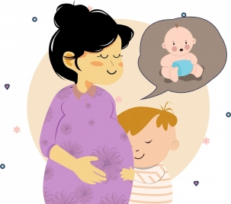
Gravidity Types
Multigravida:
A ‘’Multigravida’’ is a woman
who has been pregnant more
than one time

Slide 7
Parity
Para:
Number of times that she has given
birth to a fetus with a gestational age
of 24 weeks or more(times of deliveries)

Slide 8

Parity
Total number of pregnancies
that delivered after 24 weeks
(including stillbirths).

Slide 9
Parity types
Nulliparous
Primipara
Multipara
grand multipara

Slide 10

Parity
Nulliparous :
a woman who has not given
birth previously.

Slide 11

Parity
Primipara:
Is a woman who has been given
birth once.

Slide 12

Parity
Multipara :
Is a woman who has been given
birth more than once.

Slide 13

Parity
Grand multipara:
A woman who has delivered
five or more infants (24 weeks or more).

Slide 14

Example
G 5 P 4
Means She is pregnant for 5 times : one is current pregnancy so she delivered 4 times .
G 5 P3 + 1
Means she is pregnant for 5 times :
One is current pregnancy & she delivered 3 times & has one loss.
losses means: miscarriages , ectopic pregnancy
& molar pregnancy (mention them in
details).

Slide 15
Questions
19. A 34 years old lady came pregnant in her 10th weeks. her past obstetrical history is as follow: she delivered vaginally a male 9 YS a/w.
Then male of 7 ys a/w
Then miscarriage at 8 weeks.
Then twins vaginal delivery, two females 4 ys a/w
Then miscarriage at 9 weeks.
Then preterm baby at 32 weeks was still birth
Then current pregnancy. She is:
A. G 8 P 5 +2
B. G 7 P4+ 2
C. G 7 P 5+2
D. G 8 P4+3

Slide 16

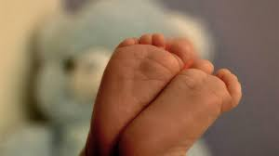
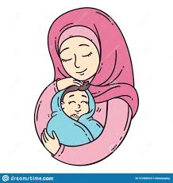
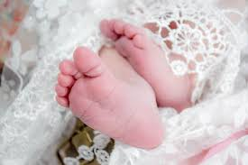


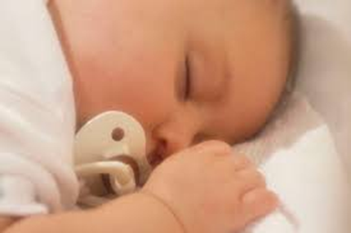



Slide 17

Baby’s loss
Abortion:
Termination of a pregnancy before viability.
Miscarriage:
Spontaneous expulsion of a human fetus before 24weeks of gestation. (without any medical intervention).
Induced Abortion:
An abortion that is the result of any procedure done by a licensed physician.
Criminal abortion Any abortion that is the result of any
procedure done by unlicensed physician.

Slide 18
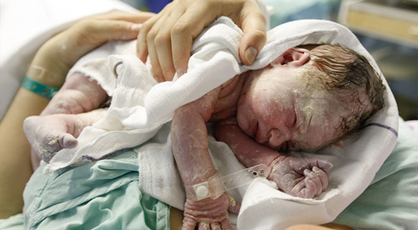
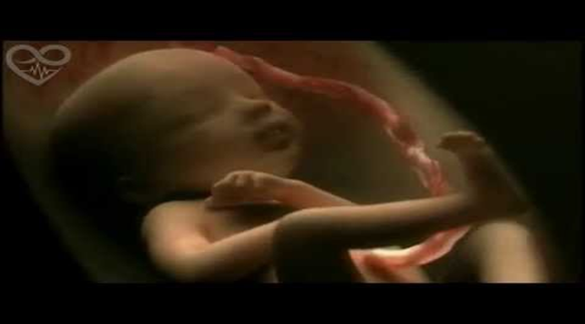
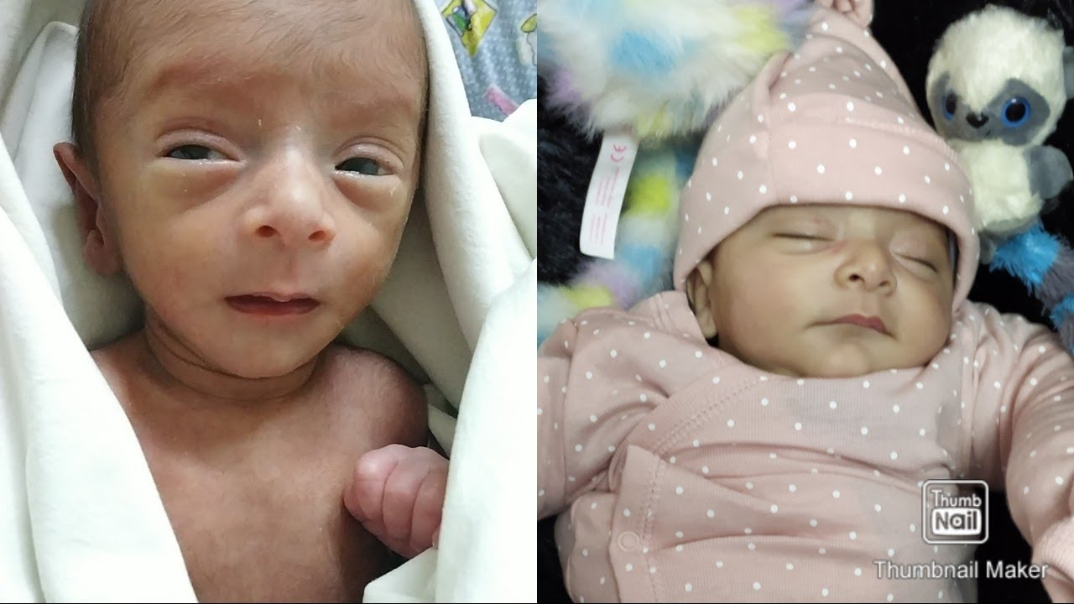
Baby’s loss
Stillbirth:
Stillbirth as ‘a baby delivered
with no signs of life after
24 weeks of pregnancy’.
Intrauterine Fetal Death (IUFD):
Babies with no signs of life in utero.
INTRAUTERINE GROWTH RETARDED
(IUGR):
Baby with lower weight than gestational age.

Slide 19
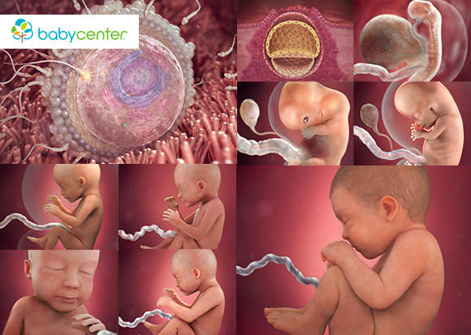
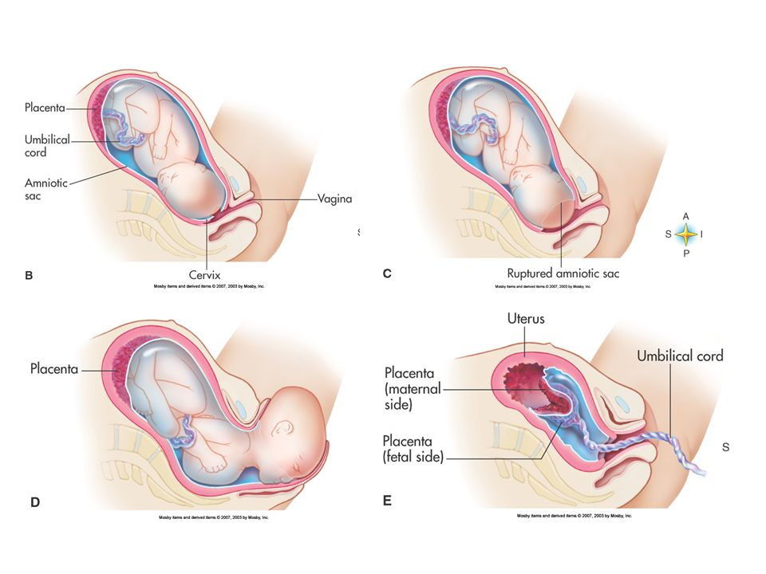
Gestation:
Period of development
of the baby from
fertilization to birth.
Parturition(labour):
the birth process.

Slide 20
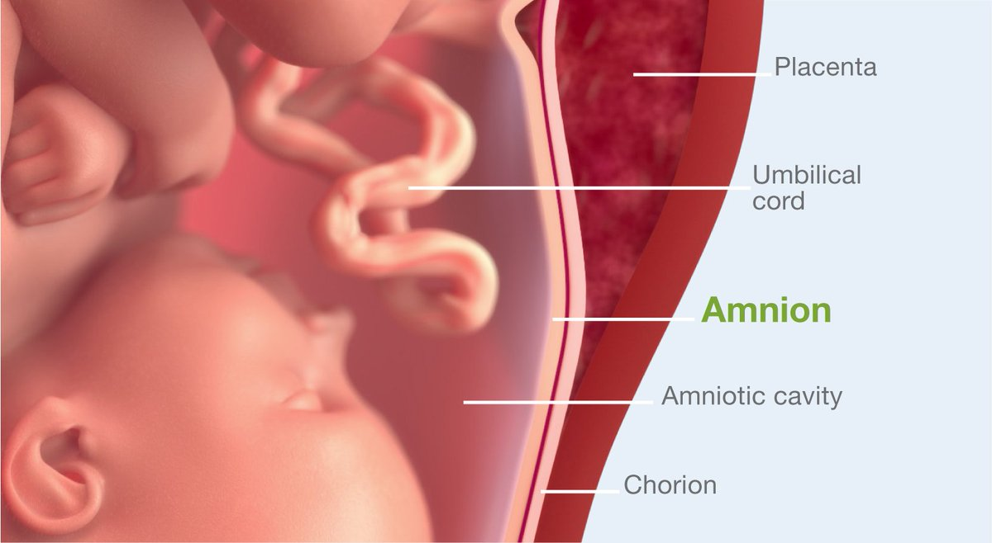
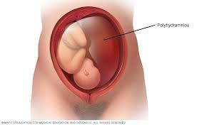
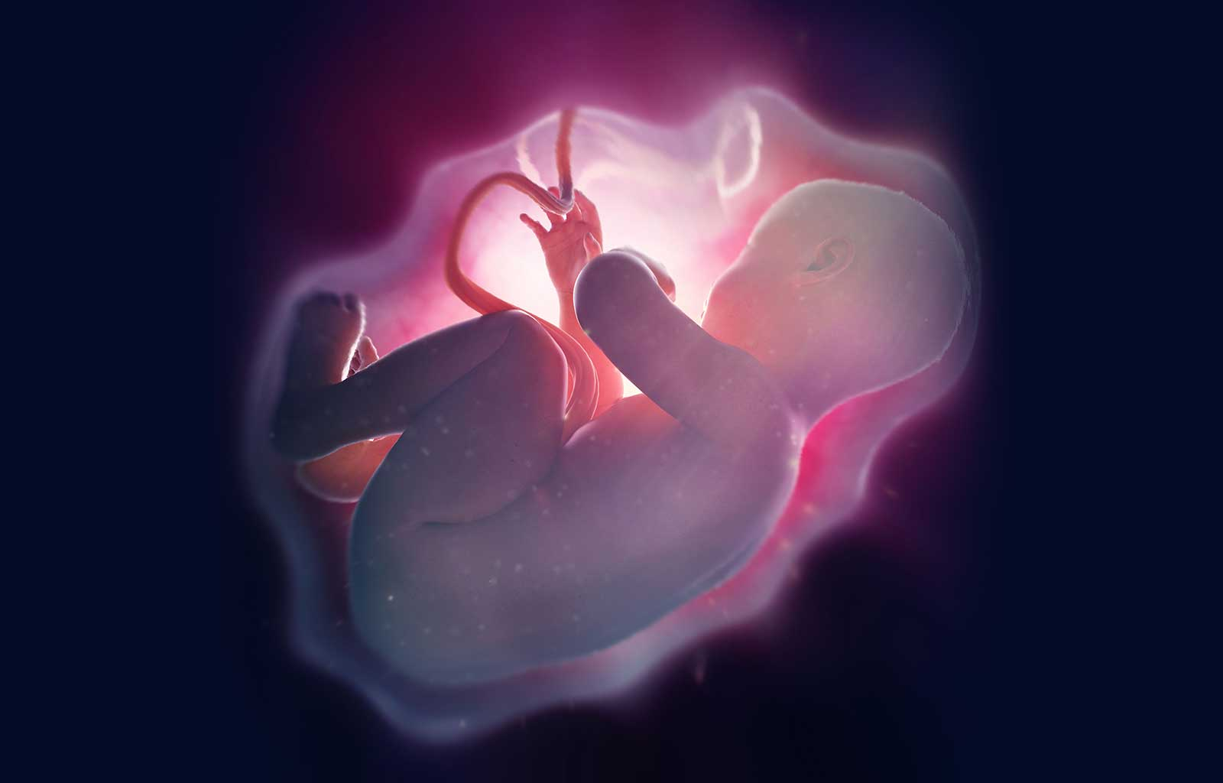
Amnion:-
Inner membrane &
fluid surrounding the fetus.
Chorion:
the outer most foetal
membrane
Polyhydramnios:
Excessive amniotic fluid.
Oligohydramnios:
Reduce amniotic fluid.

Slide 21
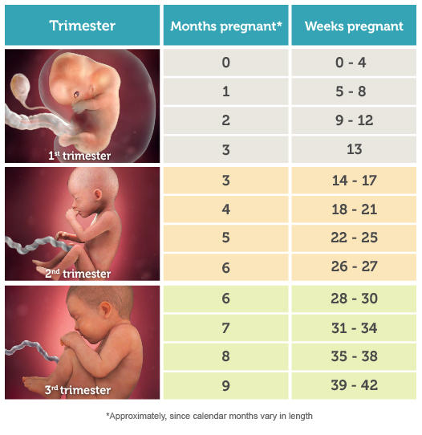
Trimester:
Means ‘’3 months’’.
A normal pregnancy
lasts about 9 months
and has 3 trimesters
1st 0-13 weeks
2nd 14-26 weeks.
3rd 27-40 weeks

Slide 22
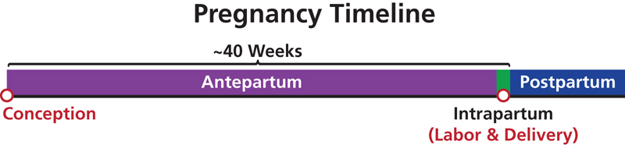
Ante-partum:
Before birth.
Intrapartum:
During labor.
Postpartum:
After birth.

Slide 23
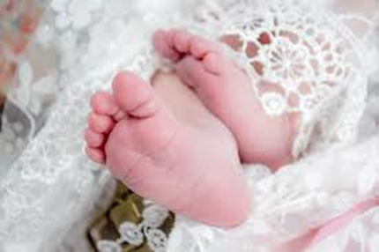
Antenatal (prenatal):
During pregnancy
postnatal care:
After pregnancy (refers to baby)
Puerperium:
the period immediately after delivery
continuing up to 6weeks.

Slide 24


Hyperemesis Gravidarum
Excessive nausea & vomiting of pregnancy.
Associated with:
Dehydration
Electrolytes imbalance
Ketonuria.
Other name Nausea & vomiting of
pregnancy (NVP).

Slide 25
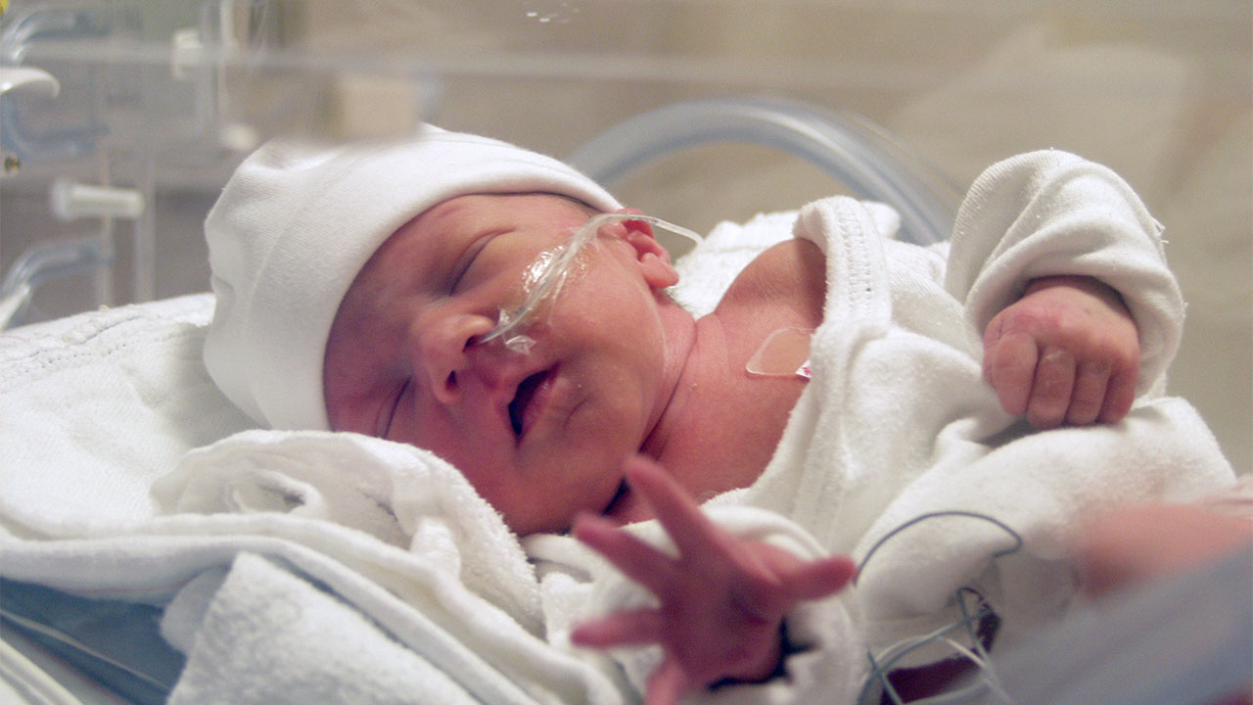

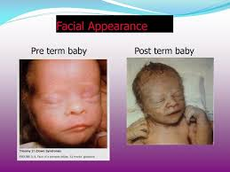
Birth
Preterm/Premature birth:
Birth of a baby at before 37 weeks
of gestational age.
Term Birth:
Birth of baby between 37 weeks
& 42weeks .
Full Term Birth:
A baby born at 40 weeks.
Post Term:
Birth of a baby after 42 weeks .

Slide 26
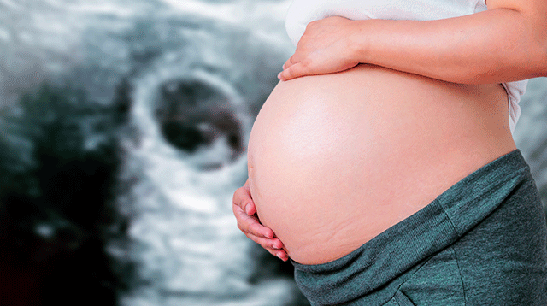
Quickening
first movement of the foetus felt by the mother in pregnancy

Slide 27



