Slide 1
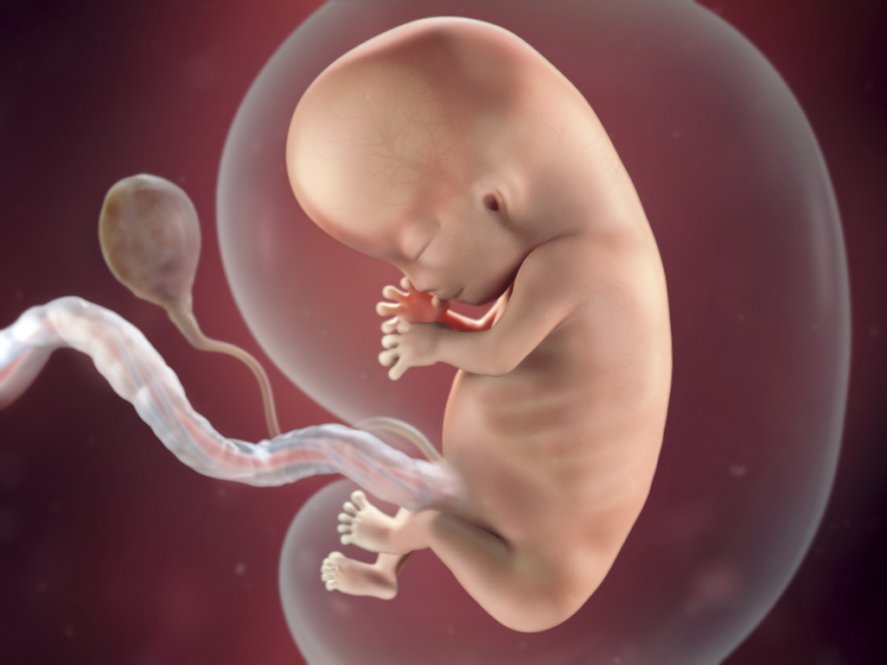
Embryology

Slide 2
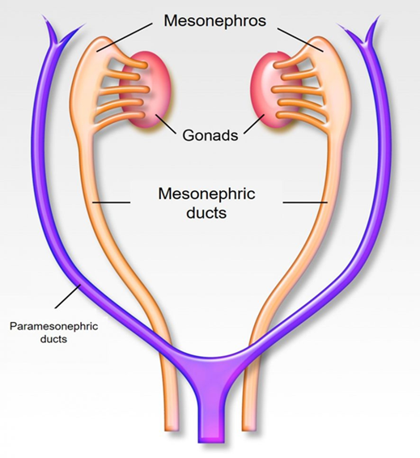
Development of the reproductive system
Development of the reproductive system begins with :
Formation of undifferentiated gonads .
and mesonephric and paramesonephric ducts.
Further differentiation of the gonads:
In male
SRY gene on the Y chromosome testes.
differentiation of the
Testosterone (by Leydig cells) differentiation of
the mesonephric ducts into male internal sex organs
Dihydrotestosterone differentiation of male external genitalia.
MIF (by Sertoli cells), suppresses paramesonephric differentiation

Slide 3
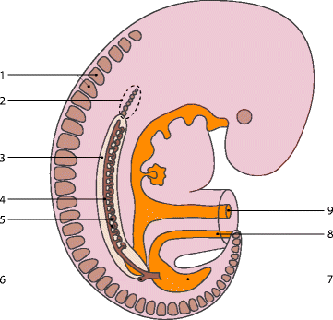
The male and female reproductive tracts
are derived from the :
same embryonic/fetal issue.
• The gonads develop from
three sources
Mesothelium (coelomic
epithelium) lining the posterior abdominal wall.
Mesenchyme (intermediate mesoderm)
Primordial germ cells

Slide 4
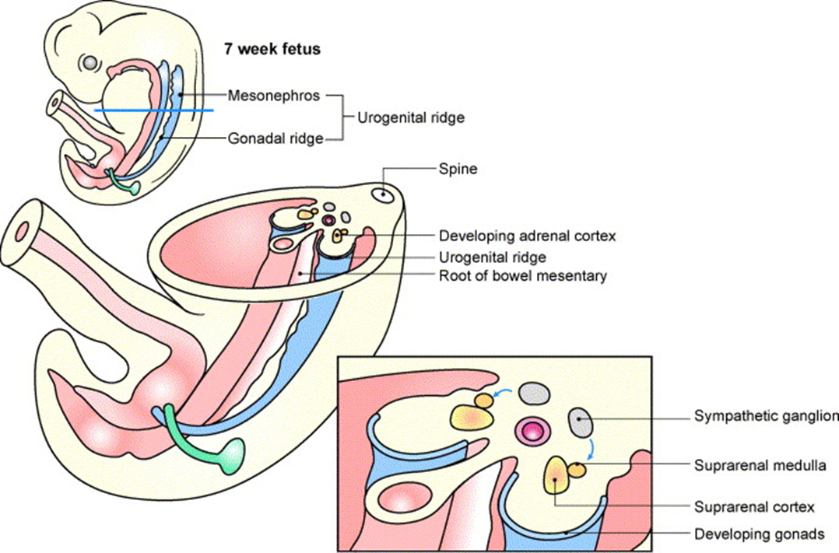
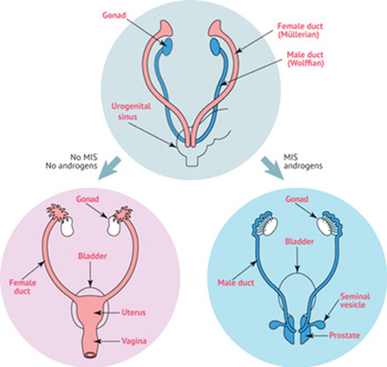
Up to the 7th week the
Internal genital organs in
both sexes on both sides
consist of two canal
systems
The indifferent gonads consist of
medulla and cortex
In XX: Ovary will originate from
the cortex, and medulla will
regress.
• In XY: Testes will develop from
medulla and the cortex regress
Cortex is the outermost
Medulla is the innermost

Slide 5
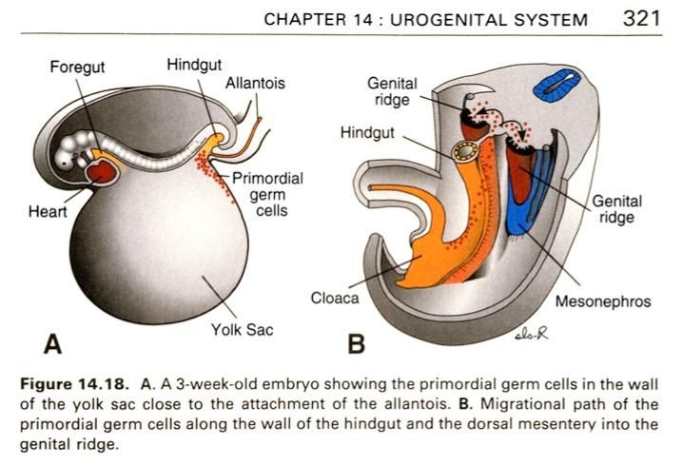
Primordial Germ Cells (PGC)
• Migrate from
the allantois
to the endoderm
of the yolk sac.
• Then reach the genital
ridge where they settle
and lose their
mobility.

Slide 6
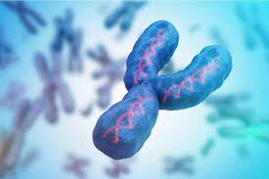
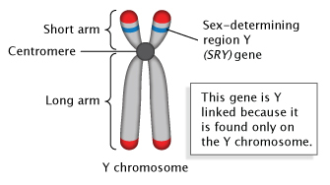
Male Gonads
Regulated by SRY
A gene on the Y chromosome that
initiates the cascade resulting in
male sexual differentiation
By 7th week
Primary sex cords enter the medulla and
differentiate into
the seminiferous cords.
• These are the precursors to the
seminiferous tubules where sperm
will be produced.

Slide 7
Female Gonads
• By 12th week
• The ovary develops more slowly than the testes
•The somatic cell will develop into follicle
cells in the absence of
SRY gene As there are no Sertoli cell There
is no AMH
• Stromal cells will surround the PGS.
• The germ cells go on to differentiate into oogonia,
proliferate, and enter the first meiotic division to form primary
oocytes

Slide 8
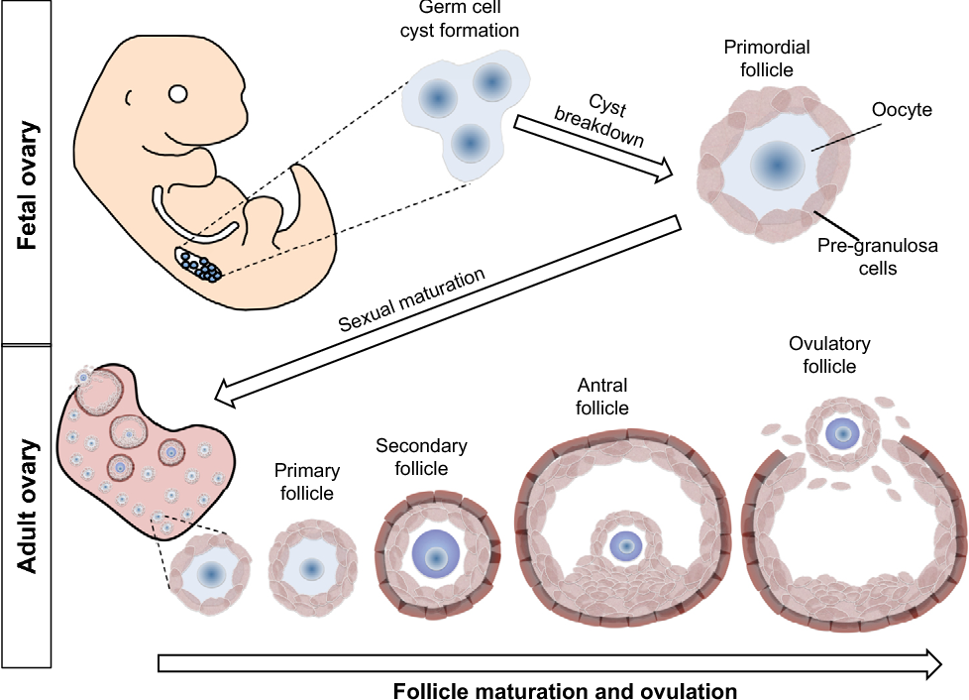
The maximum number of
primordial follicles is reached at
20 weeks’ gestation when there
are six to seven million
primordial follicles present.
• The numbers of these reduce by
atresia they are 1-2 million at
birth and 400,000 at puberty

Slide 9
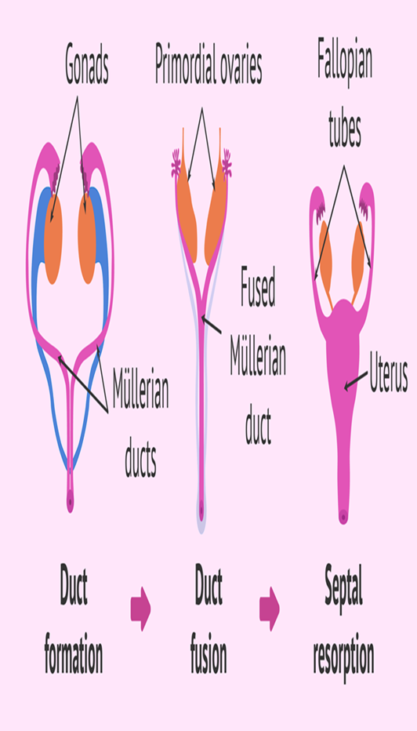
The fusion of the Mullerian ducts forms:
the uterovaginal
canal that gives rise to the
Uterus
Cervix.
upper two thirds of the vagina.
The lower third of the vagina
urogenital sinus.
The embryological origin of the hymen is controversial.
The unfused, cranial portions of the
paramesonephric ducts become the
Fallopian tubes
Many anomalies related to development of the uterus and vagina are attributable to abnormal fusion or regression of the caudal portion of the paramesonephric duct

Slide 10
overview of sexual differentiation
Weeks 1–6: No sexual differentiation is apparent (no phenotypical differences).
Week 6–7: Differentiation of the mesonephric and paramesonephric ducts begins.
Week 12: Development of the external genitalia is complete.
Week 20: Phenotypic differentiation is complete.
Week 33: Descent of the gonads is complete.

Slide 11
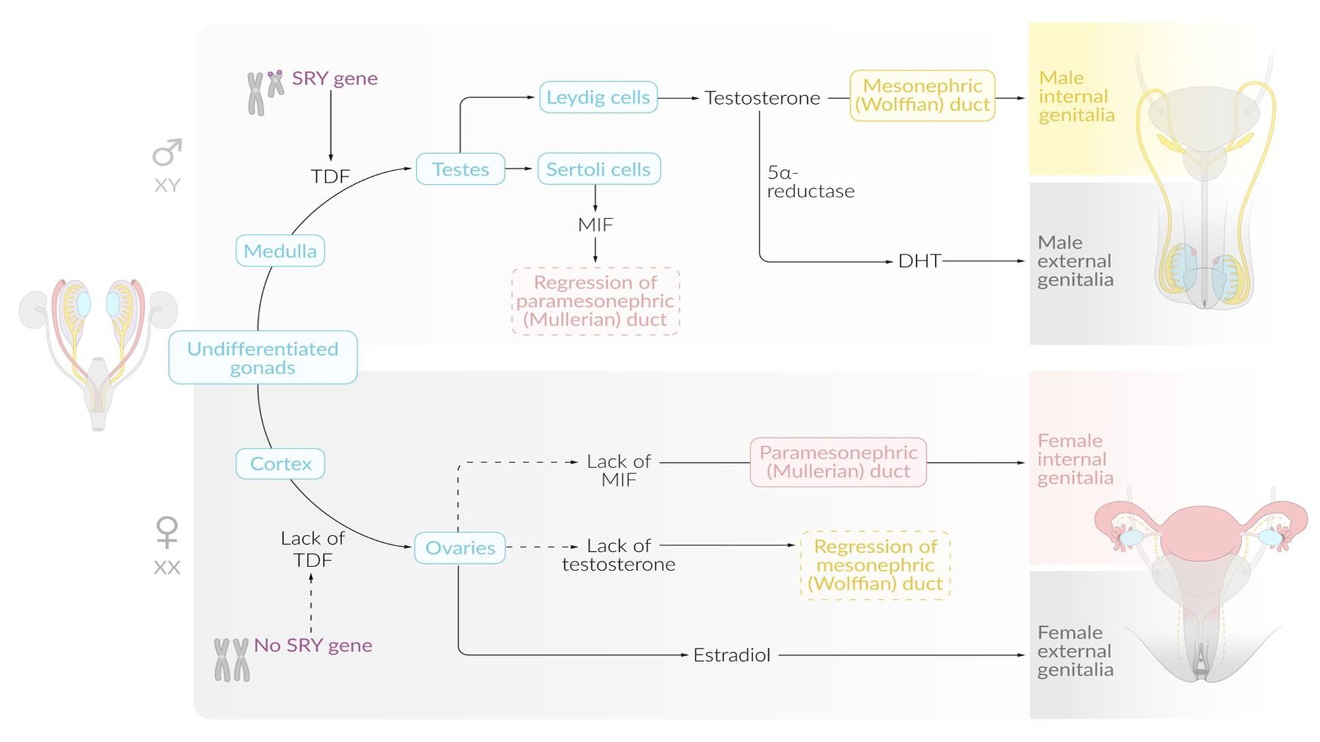

Slide 12
External genitalia and urogenital differentiation
Male:
testosterone → dihydrotestosterone (via 5α-reductase) → differentiation of embryonic structures into male external genitalia.
Female:
estradiol and absence of DHT → differentiation of embryonic structures into female external genitalia

Slide 13
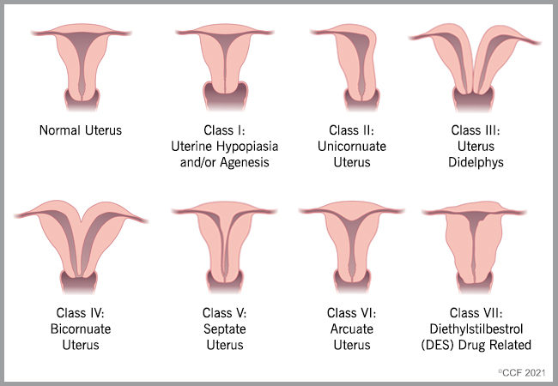

Slide 14



