Slide 1
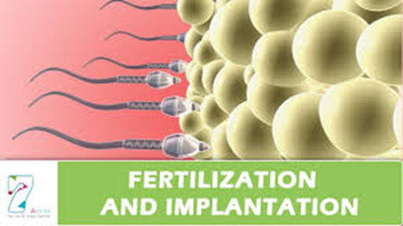
By dr. Mona Ahmed assisted professor of obs & gynae
SMSB

Slide 2
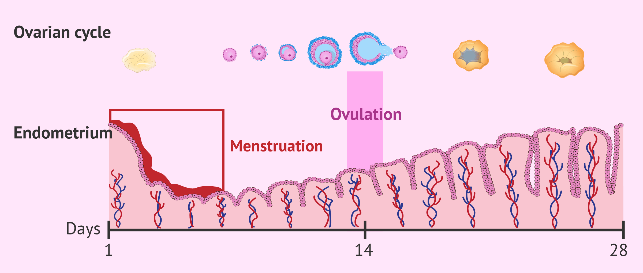
After ovulation
the cells of the dominant follicle & CL produces large amounts of progesterone which prepares the endometrium to support a pregnancy.

Slide 3
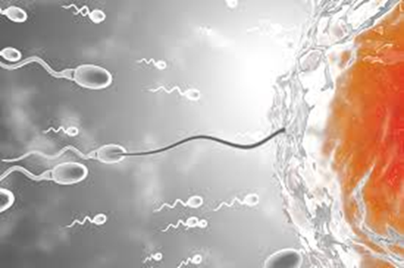
Fertilization
Involves the fusion of two haploid gametes with 23 chromosomes each to produce a zygote that contains 46 chromosomes
• fertilization generally occurs in the fallopian tube and generally within one day of ovulation.
Both sperm and egg can show their vitality only to a limited period.
Sperm is alive for 48-72 hours in a female reproductive system
whereas the egg can be fertilized for 24 hours.

Slide 4
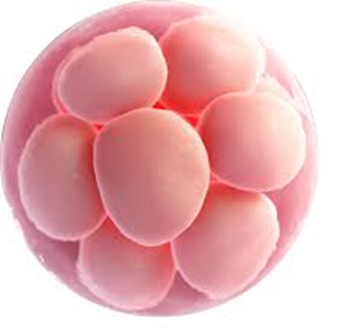
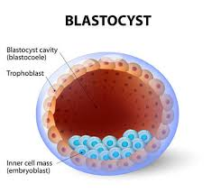
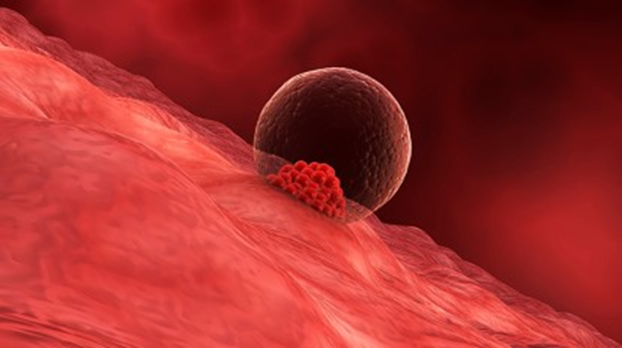
Implantation
After fertilization the zygote travels down the fallopian tube
where it becomes a morula.
Once it reaches the uterus, the morula becomes a blastocyst.
The blastocyst then burrows into the uterine lining
a process called implantation.

Slide 5
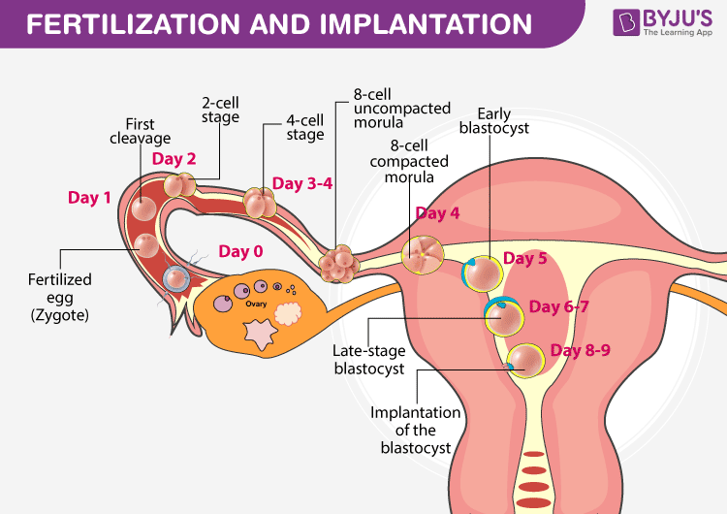

Slide 6
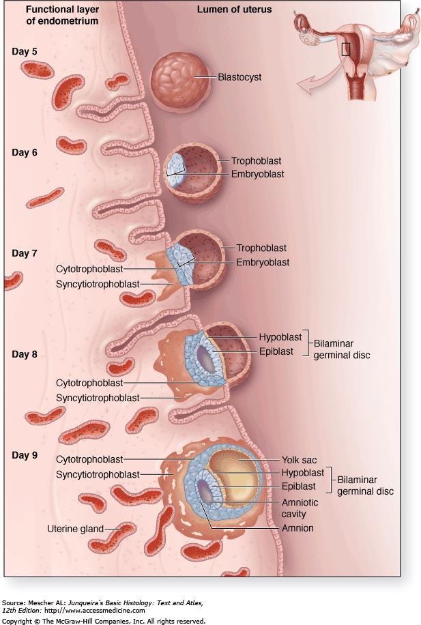
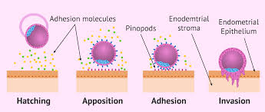

Slide 7
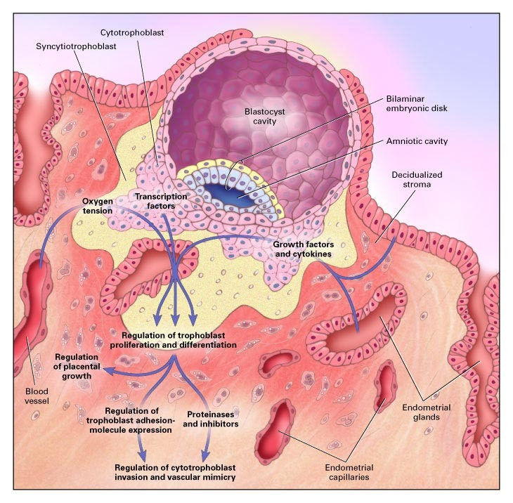
The implanted blastocyst secretes human chorionic gonadotrophin (hCG) w:
‘rescue CL from luteolysis to maintain progesterone secretion.
prevent menstruation.
and support the early conceptus ( for approximately 8 weeks).
after which the early placental tissue becomes the main source of progesterone support.

Slide 8
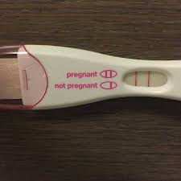
hCG can be detected in the urine in sensitive pregnancy tests 1 or 2 days before the expected date of menstruation.
Most women delay taking a pregnancy test until after a missed period.

Slide 9
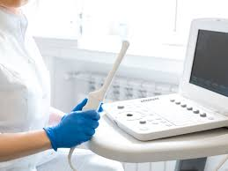
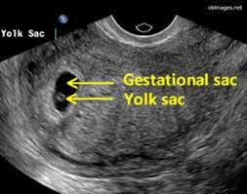
A transvaginal ultrasound scan (TVUSS) can detect an early intrauterine gestational sac, the first sign of a normal pregnancy, at around 5 weeks’ gestation.
A few days later a circular yolk sac can be seen within the gestational sac, and the embryonic fetus can usually be identified after 5.5 weeks’ gestation.
The fetal heartbeat may be visible as early as 6 weeks’ gestation.

Slide 10
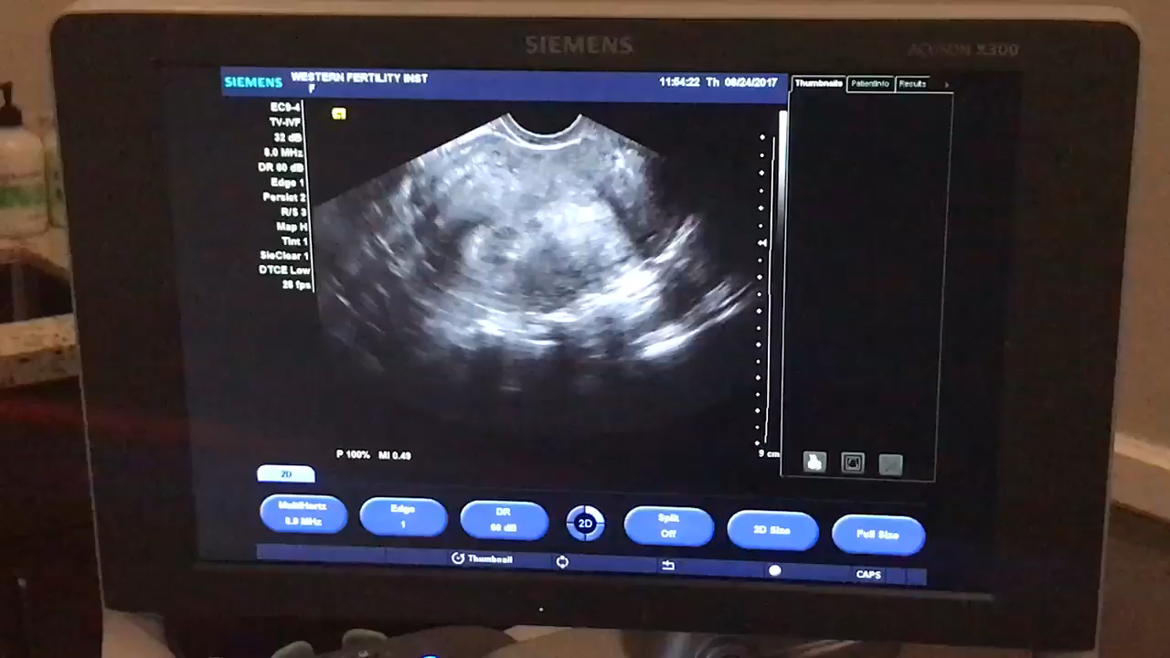

Slide 11
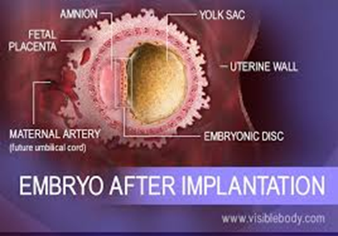

Slide 12
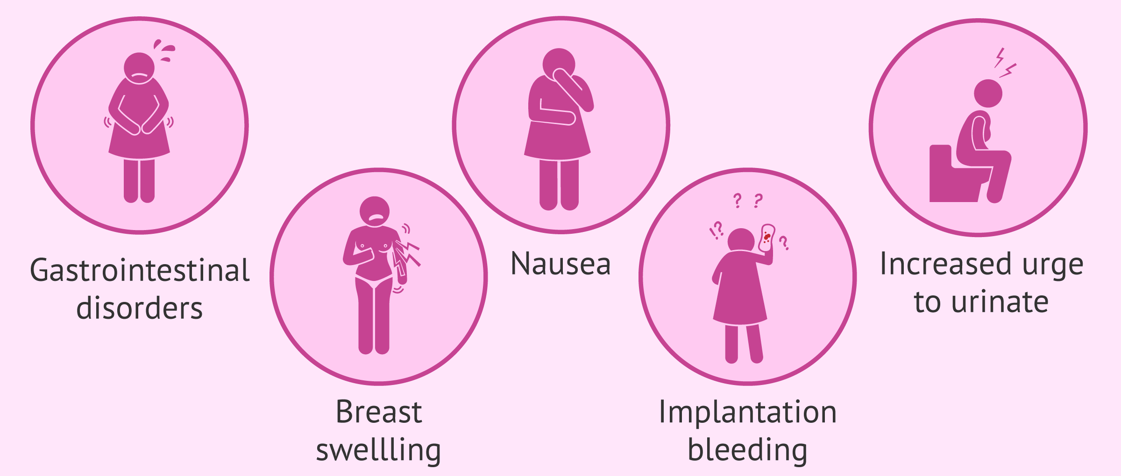
Symptoms & sings of implantation

Slide 13
hCG (human chorionic gonadotropin)
Primarily produced by syncytiotrophoblasts.
Detected from 6 days after fertilization; forms basis of modern
pregnancy testing.
Concentrations reach a peak at 10–12wks gestation, then plateau for
remainder of the pregnancy.
Effect
continuation of pregnancy
Maintenance of the corpus luteum graviditatis
Stimulation of progesterone and estrogen synthesis of the corpus luteum graviditatis

Slide 14
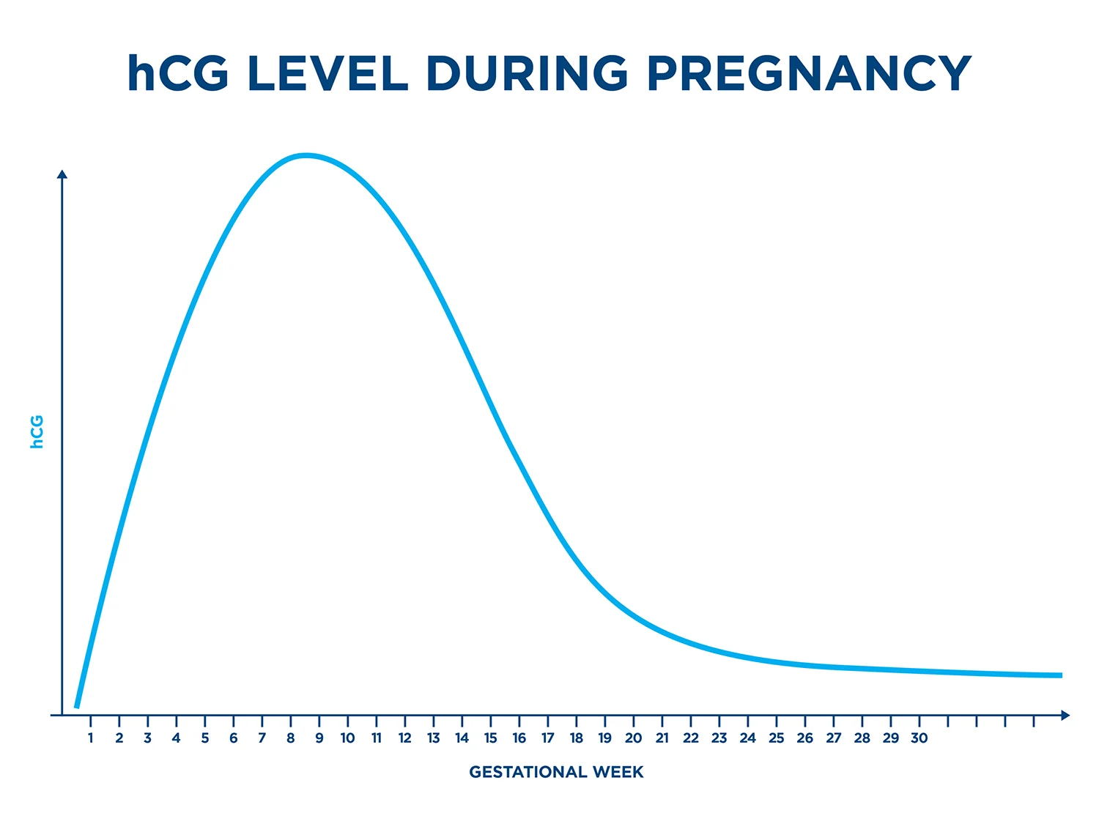
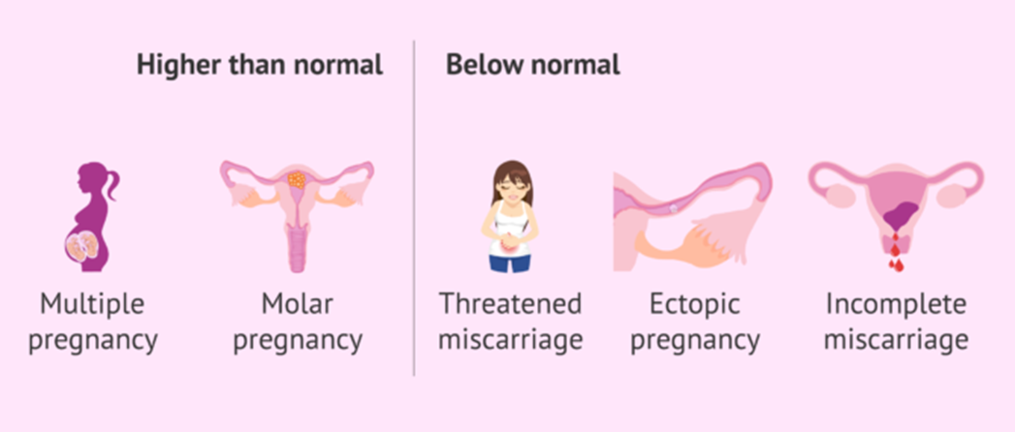

Slide 17




