Slide 1

By Dr. Mona Ahmed
Associated Professor
Elmareefa University
SMSB

Slide 2
Learning out comes
Systemic supervision (examination & advice)of a women during pregnancy is called ANC(prenatal care).
Started with begging of pregnancy & end by delivery
Aiming to
Screen high risk pregnancy
Treat complications detected by early examination
To educate mother by demonstrating labour
To ensure continuous medical surveillance and prophylaxis

Slide 3

Mrs Hanaa Ahmed is 38 years old G v P ii + ii came to antenatal clinic
To follow her pregnancy .
LMP 16/8/2023.
What are the questions you will focus in history?

Slide 4
How to take history?
Steps
Identification.
Past Medical History.
Family History.
Drug History.
Social History.
Obstetrical History.(current & previous).
Gynaecological History.
Complain of & History of presenting illness.
Summary.

Slide 5

Obstetrical History
(if obstetrical case in details ).
& Gynae History will be in brief
In gynae hx vis versa
Gynae hx will be in details
and obstetrical hx will be in brief

Slide 6
Identification
Name(at least three names) .
Age .
Occupation .
Blood grouping.
Husband name -age -BG -occupation consanguinity.
Address.
Date of marriage.
Date of first examination.

Slide 7

Women has her first pregnancy at age of 35 or more is called elderly primigravida.
Extremes of age (teenagers & elderly)
are obstetric risk factors

Slide 8
Past Medical History.
*DM *HTN
*ASTHMA *RENAL DISEASES
*HEART DISEASES *(OTHERS)
Family History.
*DM *HTN
*ASTHMA *RENAL DISEASES
*HEART DISEASES *CONGENITAL ANOMALIES.
Drug History.
*Chronic medications * Allergy
Social History

Slide 9
Obstetric history
Gravidity.
Parity.
LMP.
EDD.
History of current pregnancy:
1st trimester.
2nd trimester .
3rd trimester.
History of previous pregnancies.

Slide 10

Risks associated with grand multiparity:
Anaemia.
Increase risk of miscarriage.
Abnormal Fetal presentation.
preterm delivery.
Uterine atony.
Placenta praevia.
Uterine rupture.
Amniotic fluid embolism.
Postpartum haemorrhage.
Stress incontinence and urinary urgency symptoms.

Slide 11
Ex: A woman who has had six miscarriages with only one live baby born at 32 weeks and is pregnant again will be:
gravida 8, para 1. (para 1+6.)(G viii P i+ iv)
OR to say ‘Mrs Wafaa is in her eighth pregnancy. She has had six miscarriages at gestations of 8–12 weeks and one spontaneous delivery of a live baby boy at 32 weeks. Baby Ahmed is now 2 years old and healthy.

Slide 12
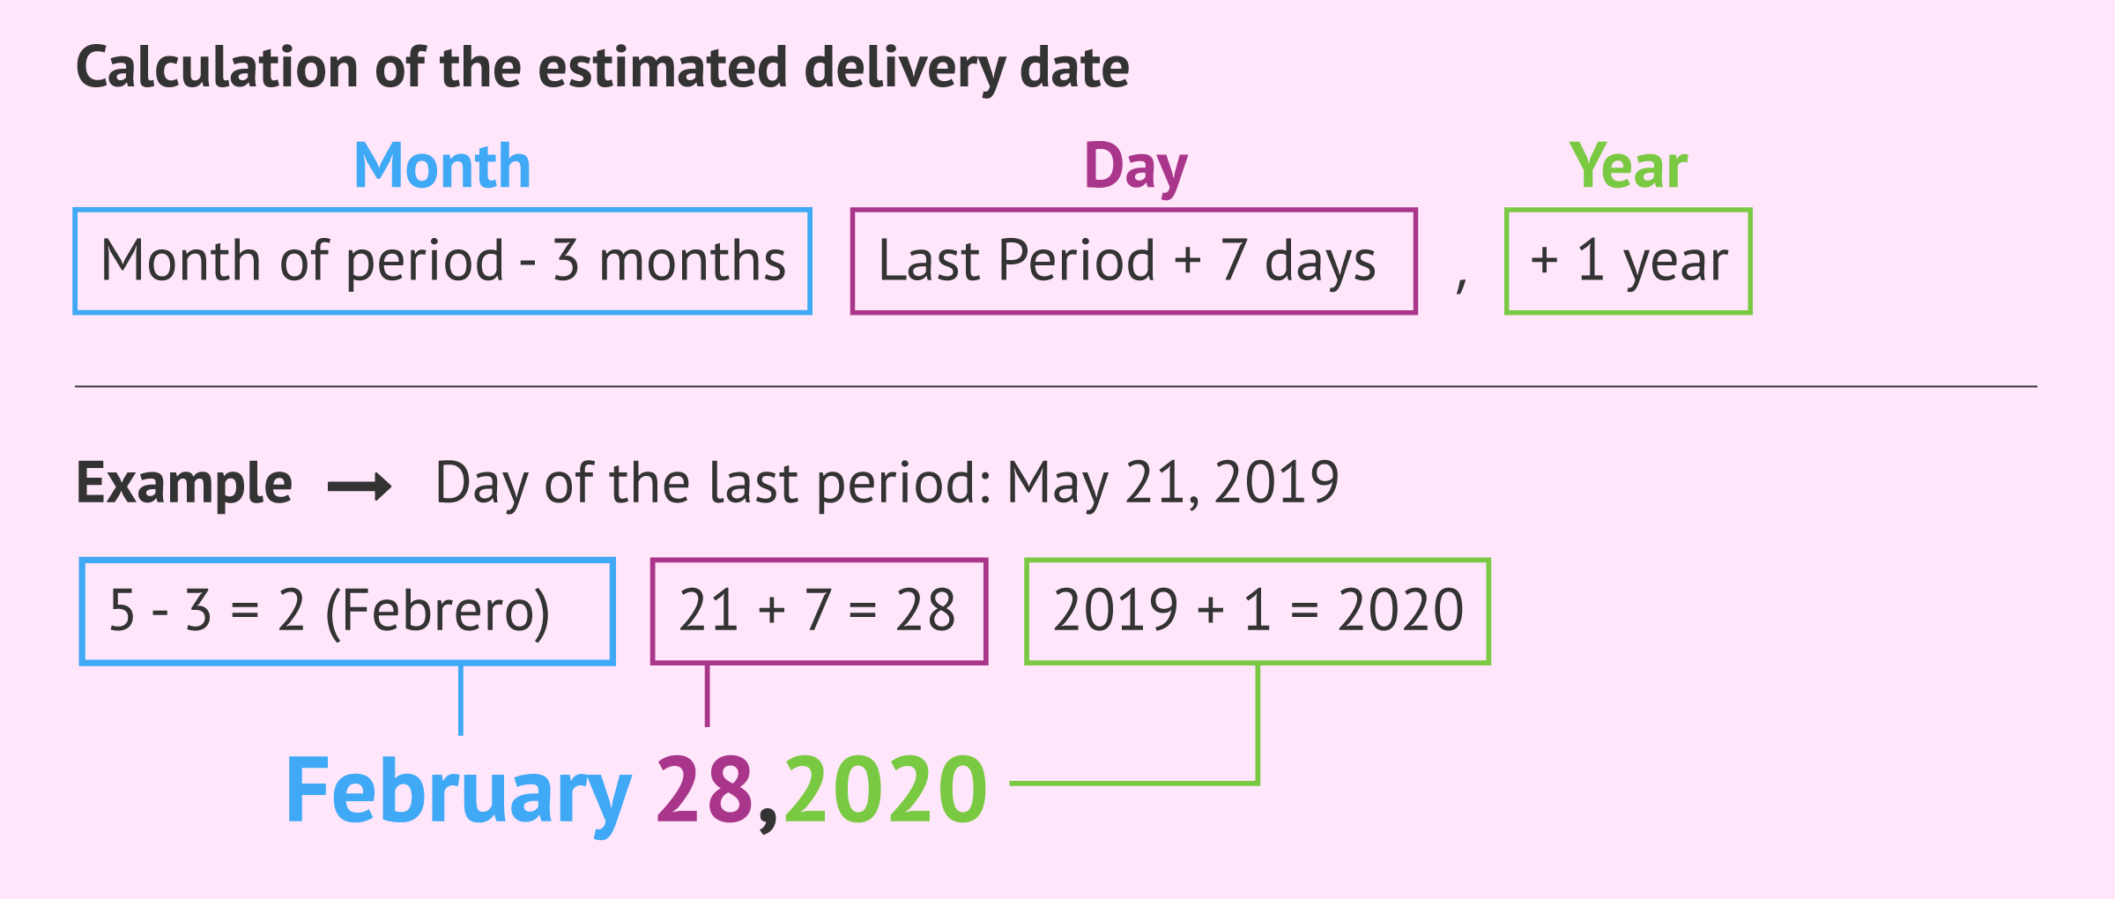
LMP
Use to date pregnancy.
If the cycle was a normal cycle
The EDD is calculated by taking the date of the LMP, counting forward by 9 months and adding 7 days.

Slide 13

EDD(by Naegele’s Role):
the expected date of pregnancy
The median duration of pregnancy is 280 days (40 weeks) and this gives the estimated date of delivery (EDD).
How to calculate?
Add 7 to days.
Subtract 3(or add 9)to months .
Add 1 to year if(month is bigger than 3rd month).
EX:
LMP 7/7/2021AD
EDD 14/4/202AD
GA(gestational age) calculate the pregnancy age today
In previous ex GA 34 weeks.

Slide 14


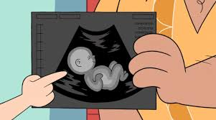

history of current pregnancy
1st trimester(0-13weeks)
Folic acid(drug history- teratogens).
NVP.
Dating scan.
Downs syndrome screening.

Slide 15

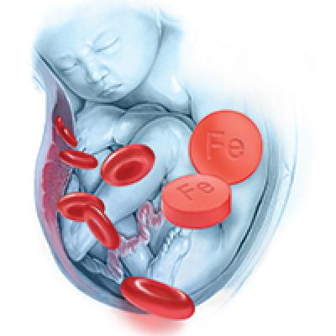
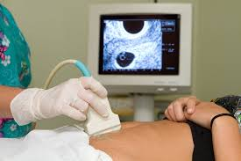
2nd trimester(14-26 weeks)
Quickening.
Vaccination.
Anomaly scan.
Iron supplementation.

Slide 16
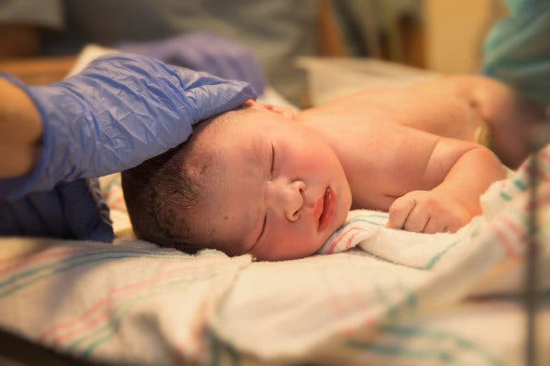
3rd trimester(27-40weeks)
Baby's movement.
Assessment scan.
Mode of delivery.
Puerperium & breast feeding

Slide 17

In all trimesters :
Bleeding .
UTI.
Signs of anaemia.

Slide 18
Previous obstetric history
It is helpful to list the pregnancies in date order and to discover what the outcome was in each pregnancy.
For each pregnancy note :
Antenatal complications.
Duration of pregnancy.
Labour duration method complications.
Hx of PPH.
Birth weight and sex of infant its age now
is he/she alive and well?
Complications of puerperium.

Slide 19
Possible complications of puerperium
PPH.
Urinary tract infections.
DVT.
Perineal wound.
Psychological complications(e.g postpartum depression).

Slide 20
Gynaecological history in current pregnancy
Ask about cycle regularity.
Vaginal discharge.(colour, Oder, itching).
Cervical smear.
Contraceptives(prior to conception).
Gynaecological operations.
assisted conception.

Slide 21
Complain of :
If no complain ask her about:
sleep appetite
bowel habit urination
History of presenting illness

Slide 22
If you are taking gynaecological history in gynae case:
The same steps
Identification.
Past Medical History.
Family History.
Drug History.
Social History.
Obstetrical History.(in brief).
Gynaecological History.
Complain of & History of presenting illness.
Summary.

Slide 23
Gynaecological history
Cycle.
Menarche.
Kata.
Regularity.
Amount .
Dysmenorrhoea
bleeding PCB IMB.

Slide 24
Vaginal discharge.(amount, colour, Oder, itching, time)
Dyspareunia.
Cervical smear.
Contraceptives.
Gynaecological operations
assisted conception

Slide 25
summary
Summarise your history

Slide 26


summary

Slide 27
Before examination
Explained to the pt need nature & purpose of examination.
Obtain verbal consent.
Examiner should be accompanied by other female.
Respect her privacy and examine in a privet room.
Expose only relevant part of examination.
Ensure pt. is comfortable & worm
Ask pt. to empty bladder.

Slide 28
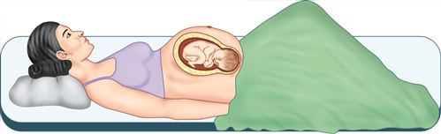
Before examination
Pt should lie in dorsal position.
Stand right to her.
Rolled her slightly to left(to decrease vena
cava compression).
Ask about any tender area before palpation.

Slide 29
General examination
Vital signs.
weight.
Hight.
Face.
Skin.
Eyes.
Neck.
Breast.
Hands.
Legs.

Slide 30

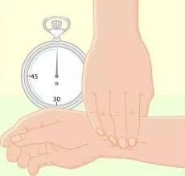
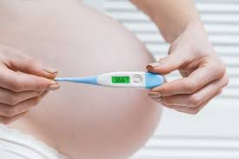
summary
Vital signs :
1.Blood pressure.
Chronic hypertension. Gestational hypertension.
2.Pulse rate.
3.Heart rate(increased).
Increased
Haemic murmur.
4.Respiratory rate:
Usually un affected ..slight increase (diaphragm raise).
5.Temprature (increase due to increase MR)

Slide 31
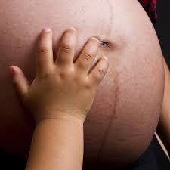
summary
Weight:
Abnormal
* obesity * overweight.
* underweight * emaciation.
Check it every visit.
Weight gain (11-16kgs).
Hight :
Short stature (small pelvis).
Skin:
Pallor
Hyperpigmentation.

Slide 32
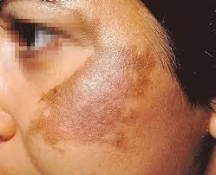
summary
Face:
Appearance
Psychological status
Diseases (thyrotoxicosis).
Hyperpigmentation (chloasma).
Eyes
Pallor
jaundice cyanosis.
Tongue
Pallor
dehydration
stomatitis
jaundice

Slide 33
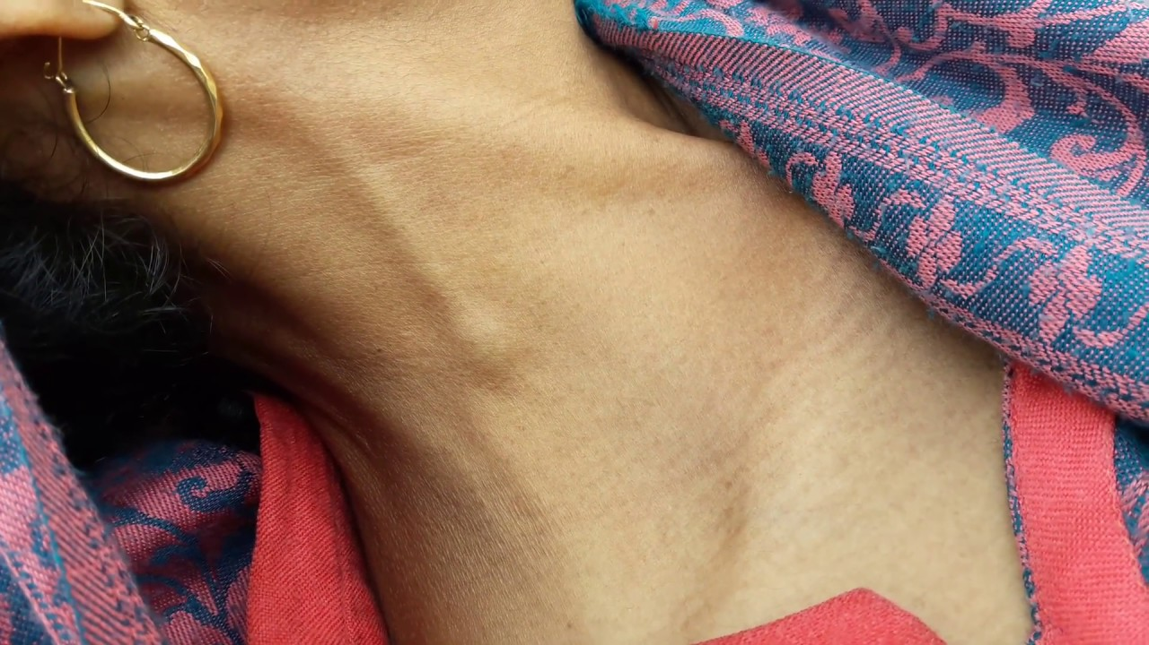
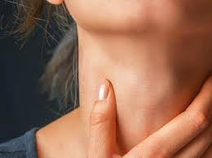
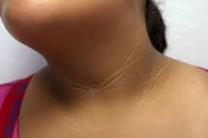
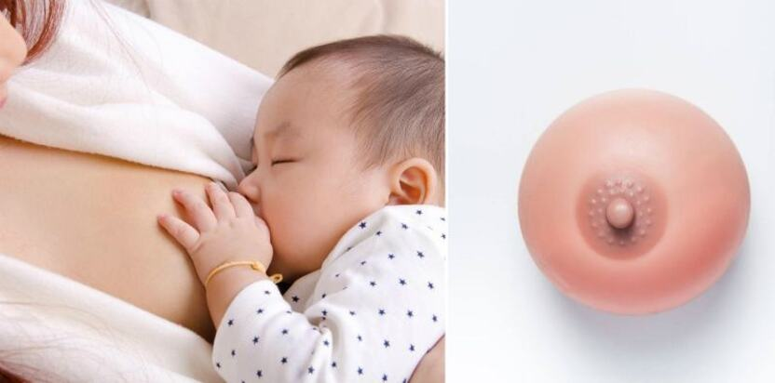
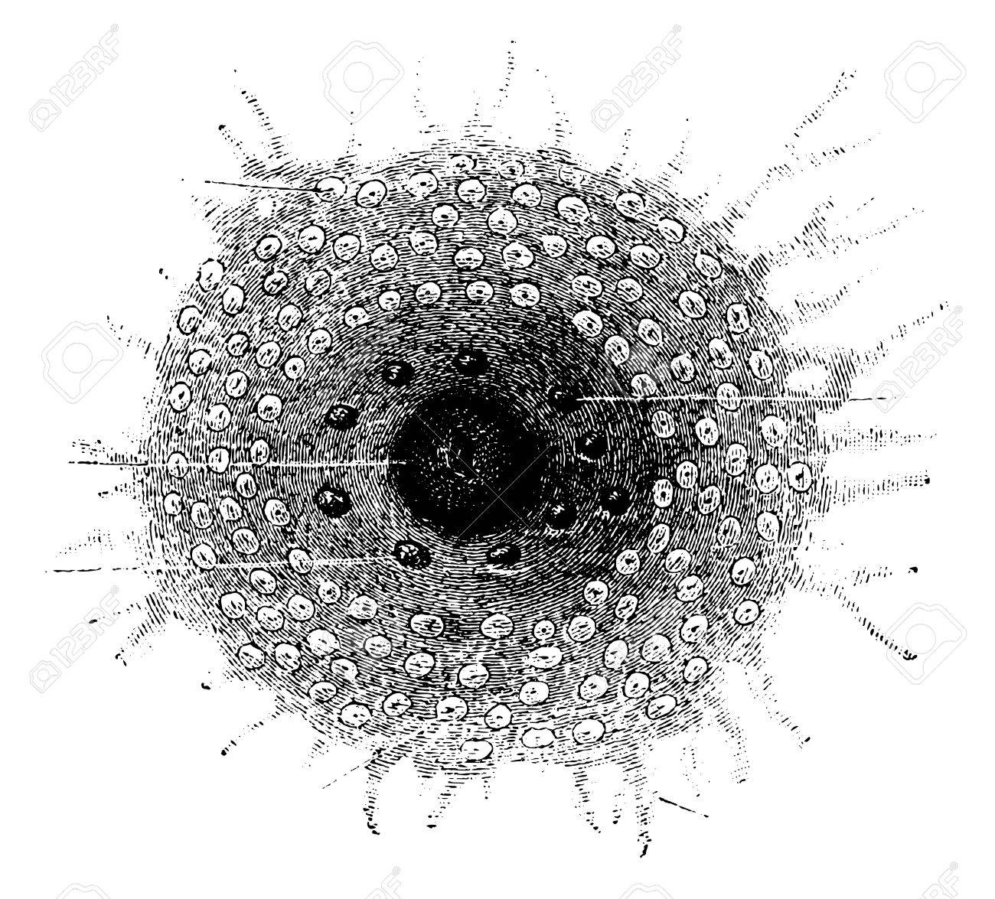
summary
Neck:
JVP.
Thyroid.
Hyperpigmentation
(acanthosis nigricans).
Dilated veins.
Lymph nodes.
Breast:
Enlarged in size.
2ry areola.
Montgomery’s gland •
redness .
vascular engorgement.
Colostrum.
Cracked or fissure nipple.

Slide 34

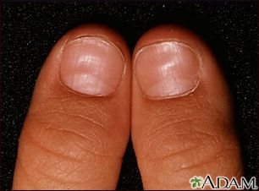
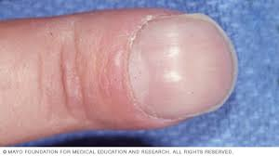

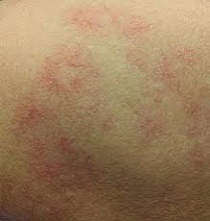
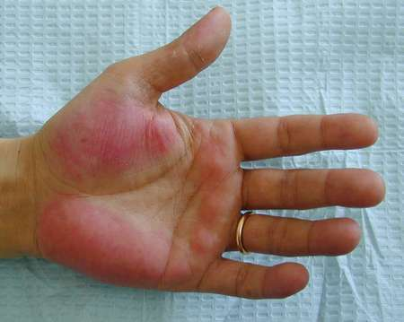
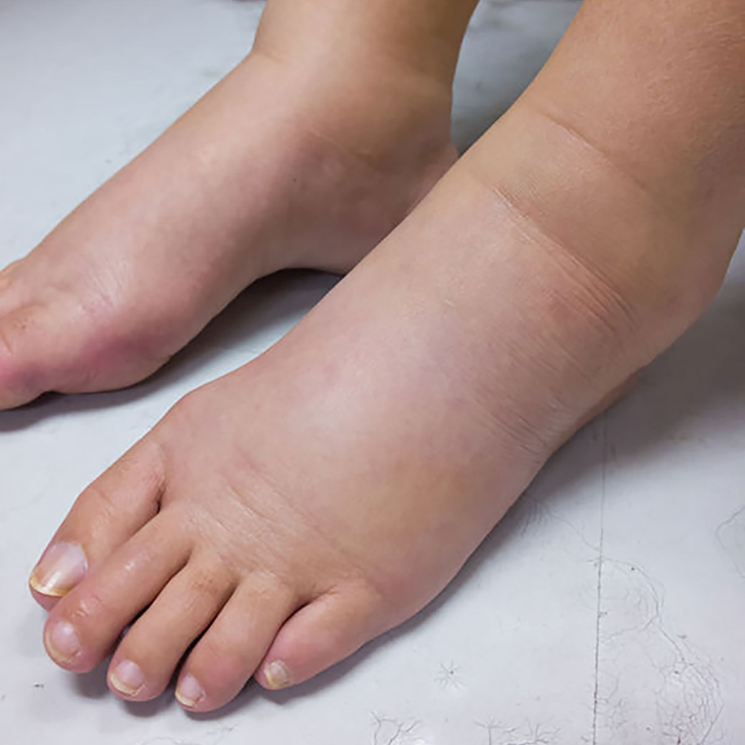
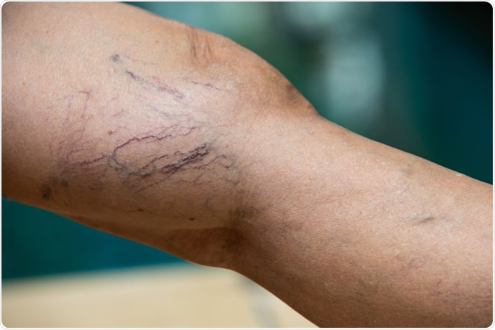
Hands:
Nails:
clubbing
spooning (koilonychia)
cyanosis.
palms
Pallor.
Palmer erythema.
spider navi
legs:
Varicose vein .
Oedema
Causes :
Physiological
Preeclampsia
Anaemia
Heart failure.
Nephrotic syndrome.

Slide 35
summary
General systemic review
CNS
GIT
Urinary system
Locomotor system.

Slide 36
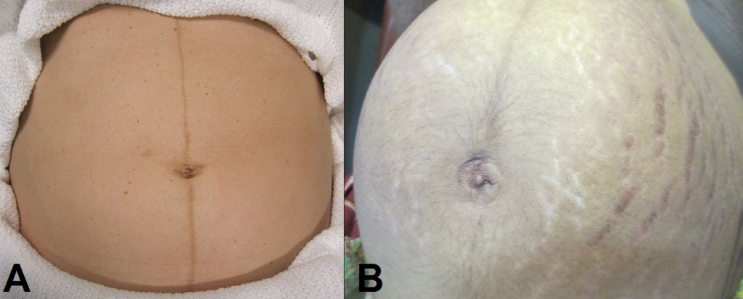
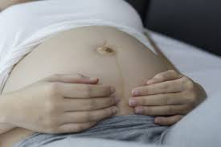
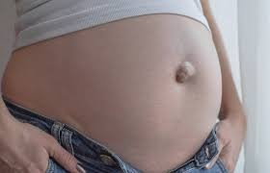
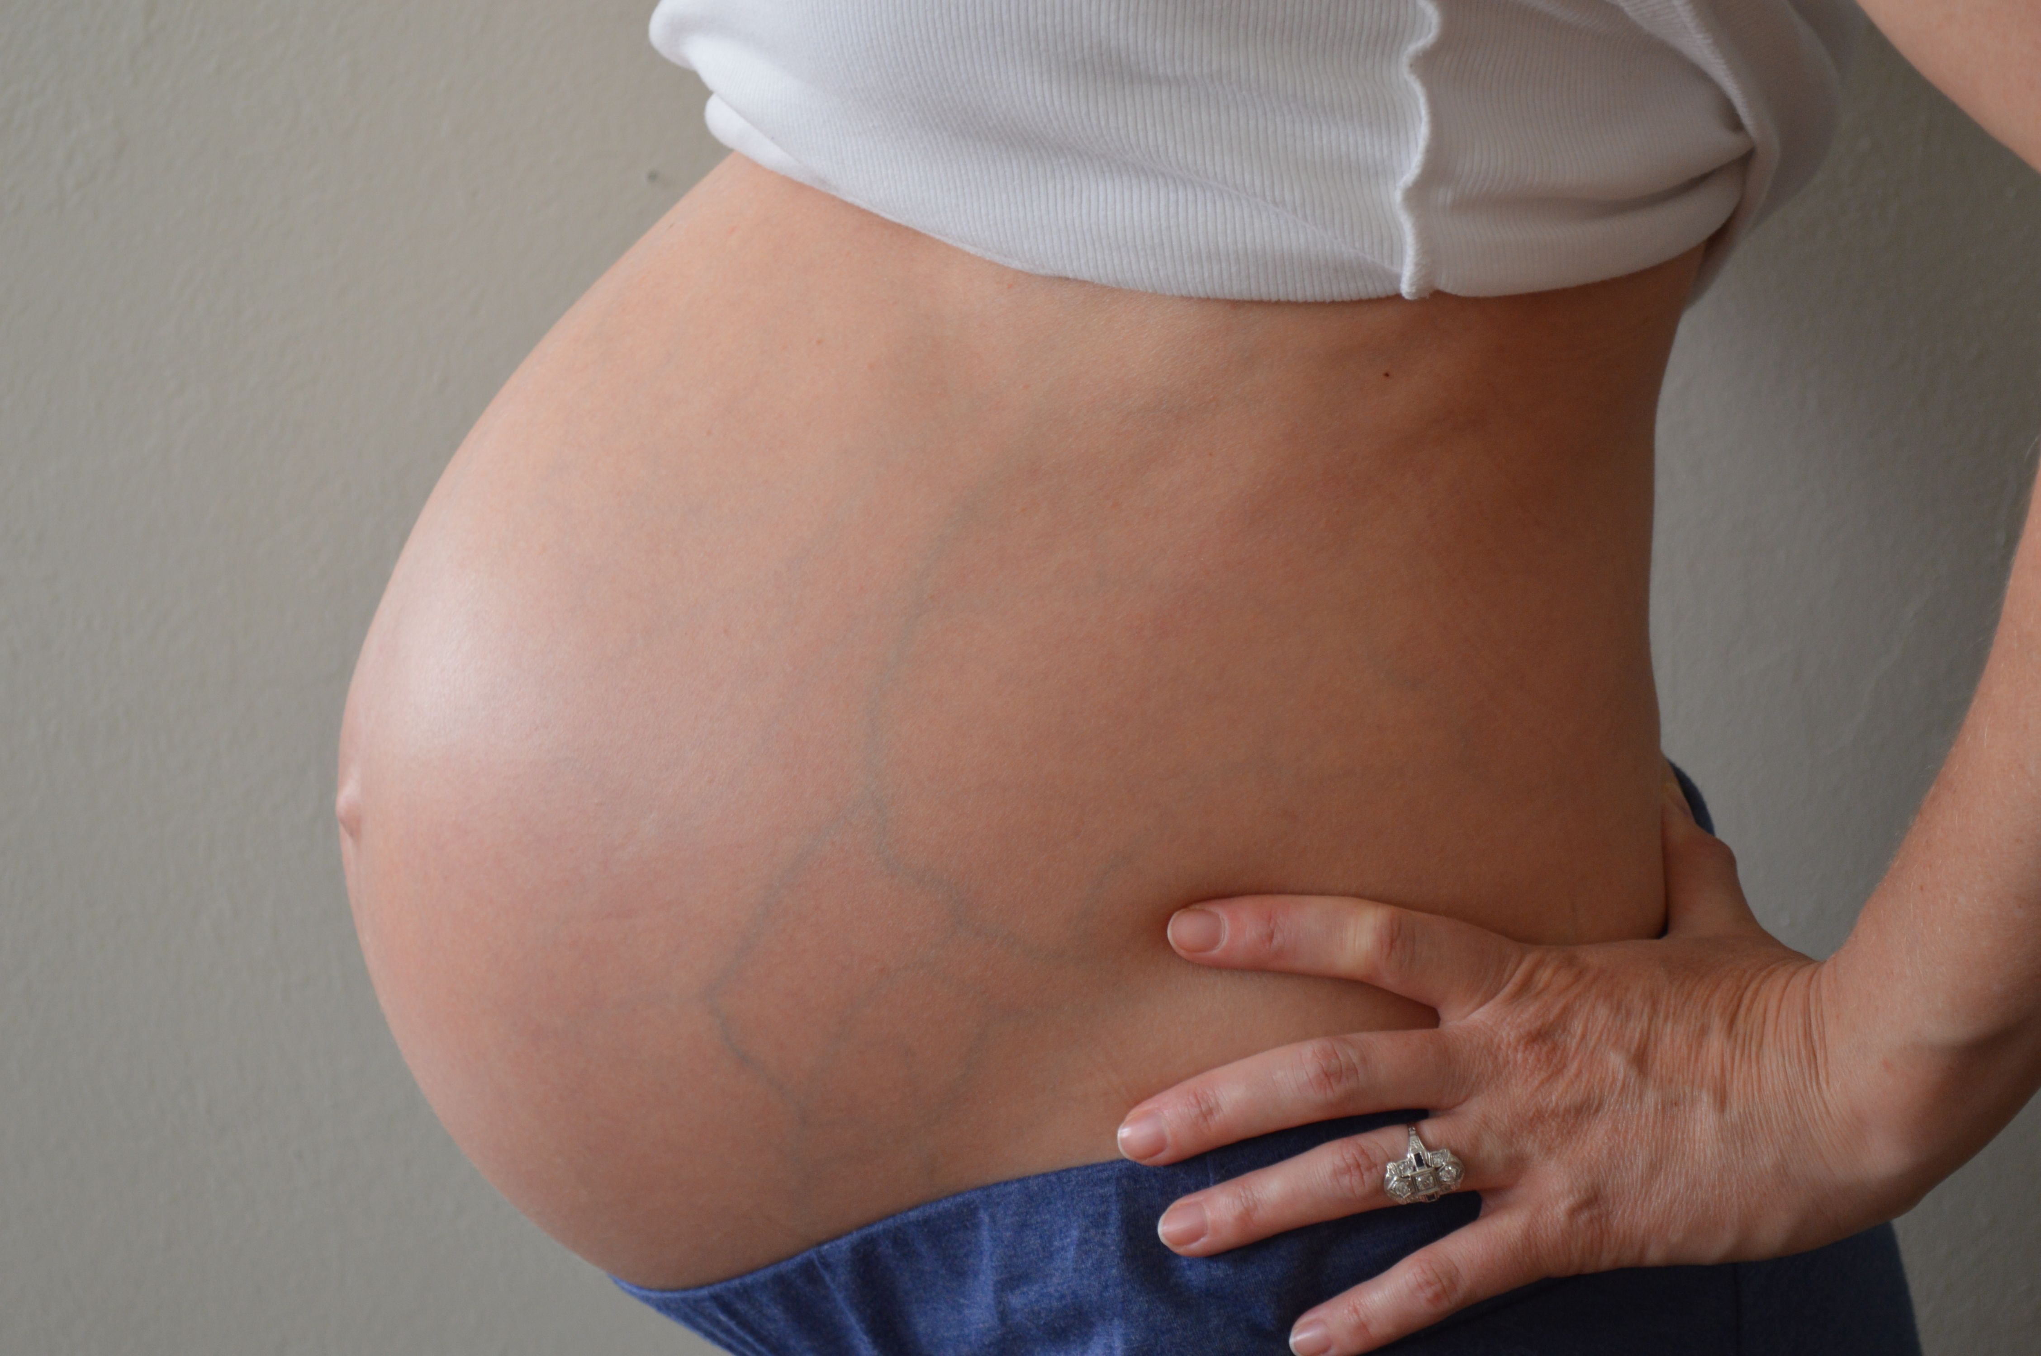
summary
Abdominal examination
Can be examined in three parts
Inspection
Palpation.
Auscultation.
inspection:
Skin of the abdomen
Linea nigra
striae gravidarum
dilated veins
umbilicus flat inverted everted.
Fetal parts .
Skin conditions

Slide 37
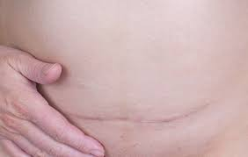
summary
inspection of
Size of uterus.
Shape of uterus .
Fetal movement.
Scars.
Herniation.

Slide 38
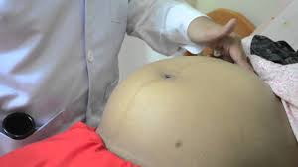
summary
palpation
1.Superficial palpation
AF
Organomegaly.
Uterine contractions.
2.Deep palpation.
What The Examiner Should Identify?
1.First fundal grip.
2. second fundal grip .
3. lateral grip.
4. Fetal heart auscultation .
5.First pelvic grip.
6.Second pelvic grip.
7.Vaginal examination(if indicated).

Slide 39
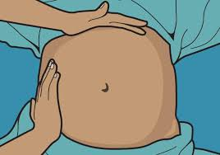
fundal height(1st fundal grip):
Keep the ulnar border of curved left hand on woman’s abdomen parallel to symphysis pubis
Start from xiphisternum and gradually proceed towards symphysis pubis lifting the hand
between each step till a bulge /resistance
of uterine fundus is felt
Mark the level of fundus

Slide 40
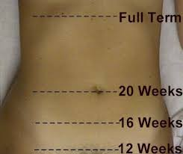
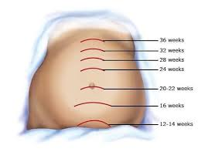
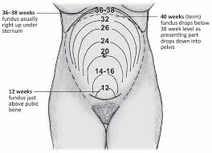
Examination
How will you estimate gestational age from fundal height?
Measurement of fundal height
Divide the abdomen by an imaginary
lines passing through umbilicus .
Divide the lower abdomen in 3 parts
with 2 equidistant lines between
the pubic symphysis and the
umbilicus
Divide the upper abdomen into
3 parts again with 2 imaginary
equidistant lines between the
umbilicus and xiphisternum

Slide 41
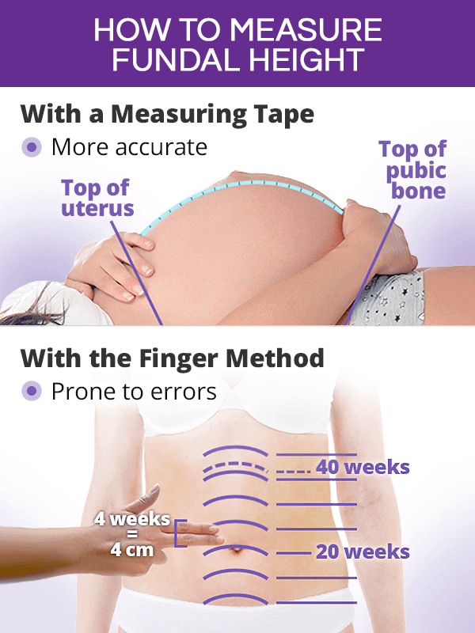

Slide 42
Significance of fundal height
Indicates:
Duration of pregnancy
Fetal growth
Any abnormality in the pregnancy

Slide 43
What are the reasons of fundal height less than date
Wrong date.
Intrauterine growth restriction (IUGR)
Missed abortion.
Intrauterine death ( IUD).
Transverse lie.
Deep engagement.
Oligohydramnios.

Slide 44
What are the reasons of fundal height more than date
Wrong date.
Poly hydramnios.
Macrosomia.
Multiple pregnancy.
Placenta previa.
tumours.
.hydrocephalus.
Molar pregnancy.

Slide 45
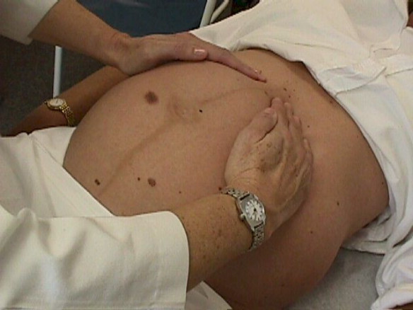
2.2nd fundal grip (leopold I):
Using two hands and compressing the maternal abdomen till a sense of Fetal part is reached.
This to determine which part of the baby occupying the fundus.
How to identify head?
Hard smooth , rounded .
How to identify breech?
Soft irregular broad.

Slide 46
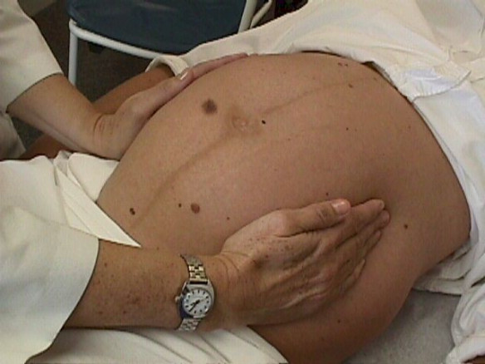
3.lateral grip(leopold II):
To detect the lie
To detect Fetal back
why?
To determine the scapula to
know where to put the sonic aid
(hearing Fetal heart sound).
How ?
The sides of the uterus are palpated to determine the
position of the Fetal back.(hard regular)

Slide 47
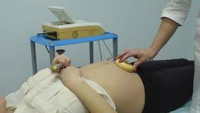
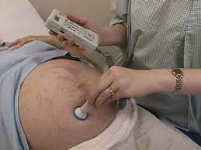
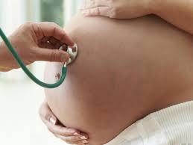


4. Detect Fetal heart
Below umbilicus if cephalic presentation.
Above umbilicus if breech presentation.
How to measure?
Pinnards stethoscope.
Regular sthesoscope.
Ultrasound.
Doppler machine.
CTG machine.

Slide 48
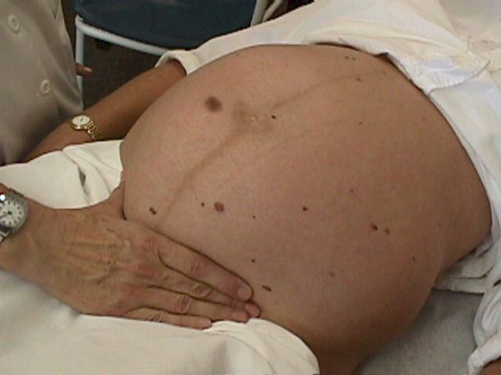
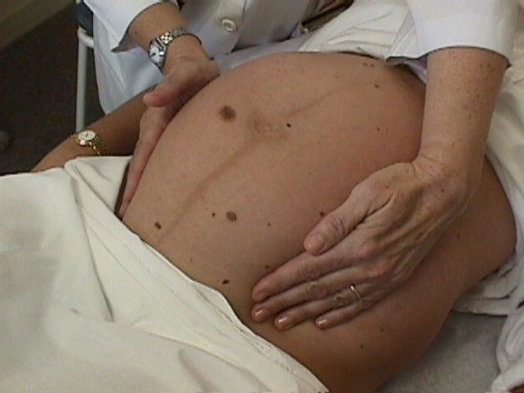
5.First pelvic grip:
To determine which part of
fetus occupying the pelvis.
6.Second pelvic grip :
To determine engagement.

Slide 49
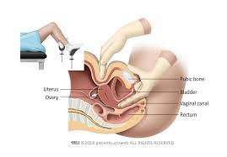
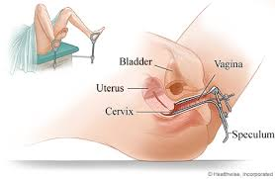
Vaginal examination(PV):
Pt should be in lithotomy position
How to perform?
Bimanual.
speculum .

Slide 50
Vaginal Examination In Pregnancy
Bimanual examination is no longer a routine part of antenatal examination but still sometimes required:
To assess maturity in early pregnancy
2. To exclude suspected abnormalities such as incarcerated retroversion of the uterus or ovarian tumor.
3. To identify a presenting part this cannot be confidently identified abdominally.
4. To exclude or confirm gross degrees of contraction (in very small patients).
5. To assess the ripeness of the cervix near term.
6. To assess pelvic cavity.

Slide 51
Suspicion of multiple pregnancy on abdominal examination
An unexpectedly large uterus for the estimated gestational age
Multiple Fetal parts felt on abdominal palpation
FHS is heard at more than one place.
Poly hydramnios.

Slide 52
To summarize
Abdominal examination is done for :
Fundal height
Fetal lie and presentation
Fetal movement
Fetal heart sounds
Any other abdominal finding

Slide 53



