Slide 1

Puerperium
Dr. Rayan Albarakati
MBBS,SB-OB
Almaarefa University

Slide 2
Introduction
Definition : The puerperium consists of the period following delivery of the baby and placenta to about 6 weeks postpartum.
In this period the reproductive organs and maternal physiology return toward the pre-pregnancy state, and colostrum is replaced by mature milk.

Slide 3
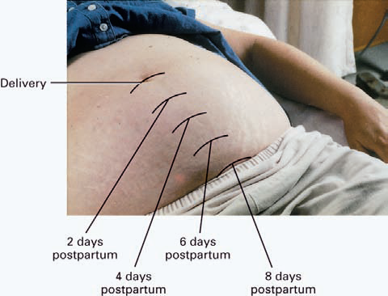
Anatomic and physiologic changes
Uterus:
Involution through tissue catabolism, the uterus rapidly decreases in weight from about 1000 g at delivery to 100 to 200 g at about 3 weeks postpartum, and at a rate of 1cm/day.

Slide 4
Anatomic and physiologic changes
Cervix : similarly loses its elasticity and regains its pre-pregnancy firmness.
Vagina : Although the vagina may never return to its pre-pregnancy state, the supportive tissues of the pelvic floor gradually regain their former tone & strength this cane be encouraged by doing Kegel exercises*
* (intermittent tightening of the perineal muscles) to maintain & improve the supportive tissues of the pelvic floor

Slide 5
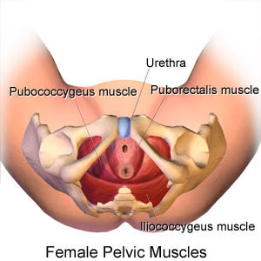
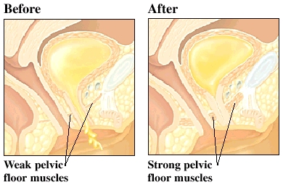
Pelvic floor muscles

Slide 6
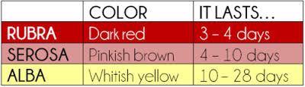
Lochia (the uterine discharge)
Post partum uterine discharge (lochia) appears red (­lochia rubra), After 3 to 4 days, the lochia becomes paler (­lochia serosa) ,by the 10th day, it assumes a white or yellow-white color (­lochia alba).
Note : Foul-smelling lochia suggests endometritis

Slide 7
Cardiovascular System
Immediately after delivery, there is a marked increase in peripheral vascular resistance due to the removal of the low-pressure uteroplacental circulatory shunt.
The cardiac output and plasma volume gradually return to normal during the first 2 weeks of the puerperium.
As a result of the loss of plasma volume and the diuresis of extracellular fluid, a marked weight loss occurs in the first week.

Slide 8
Psychosocial Changes
It is fairly common for women to exhibit a mild degree of depression a few days after delivery.
The “postpartum blues” are probably due to both emotional and hormonal factors.
With understanding and , this usually resolves without consequence.
Any prolonged episodes of depression should receive urgent attention.

Slide 9
Return of Menstruation & Ovulation
In women who do not nurse, menstrual flow usually returns by 6 to 8 weeks.
contraceptive counseling and use should be emphasized during the puerperium to avoid an undesired pregnancy.

Slide 10
Follow up for episiotomy or c/s wound
Episiotomy: it is sutured with absorbable material for stitching and it gets absorbed or just fall off with time, how ever you have to ensure before discharge that there is no gapping of wound and educate about the signs of infection
C/S scar: sutured and care for with water proof dressing then it expose to air after 48 hours or in some cases of high risk for infection negative pressure dressings can be used instead and kept for longer periods
it could be sutured by stiches or clips
A. Stitching: either subcutaneous (no visible stiches ) or interrupted ( falls within 3 Wks.)
B. Clips: either non absorbable → removed on day 5 to 7 OR absorbable ,placed in subcuticular layer and dissolves by its own-(INSORB)
Others: Glue (Dermabond), non invasive skin closure zipper( Zipline medical)

Slide 11
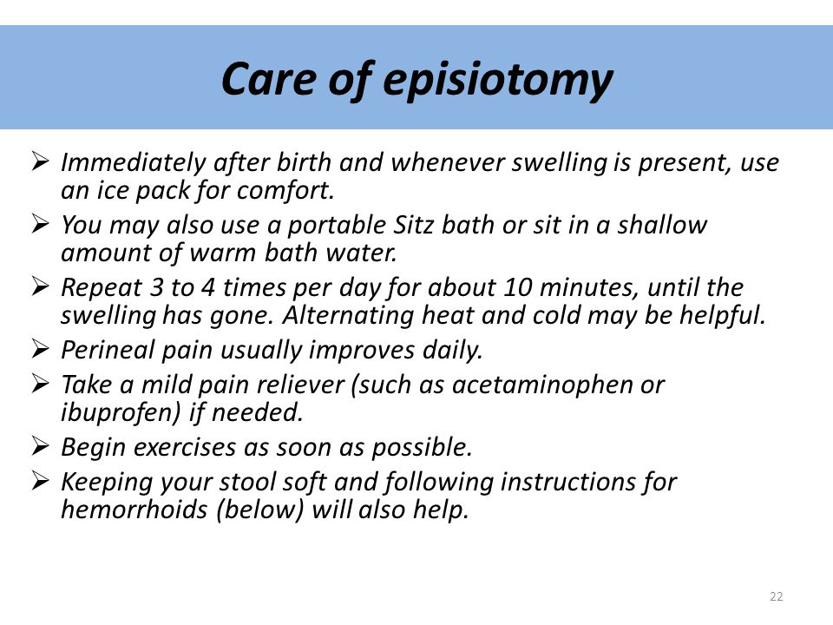
Episiotomy care

Slide 12
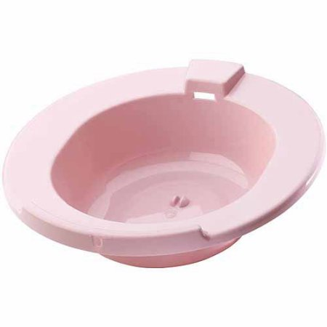
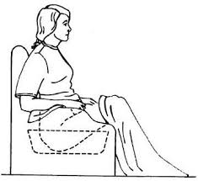
Sitz Bath

Slide 13
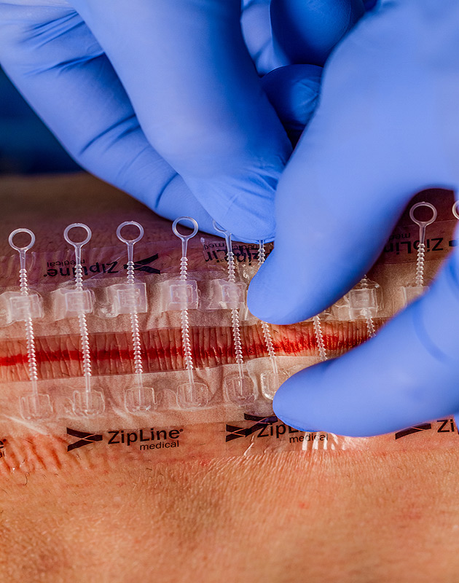
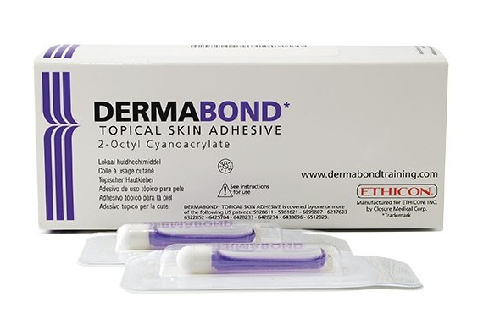

Slide 14
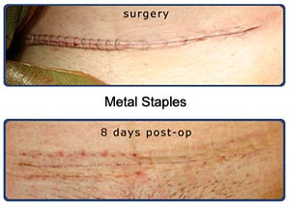
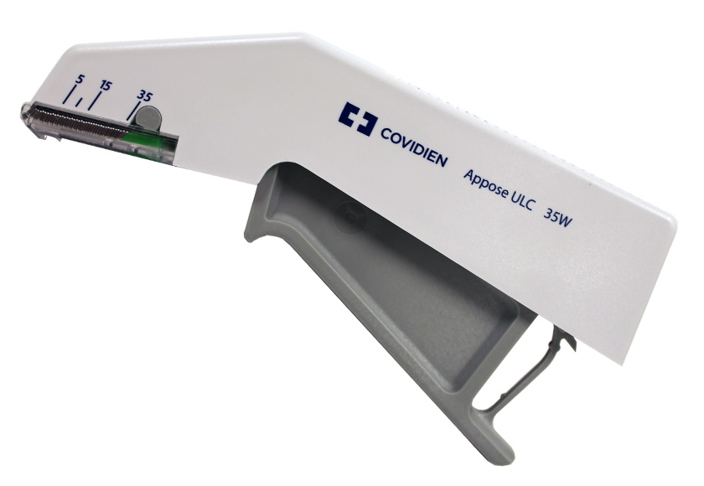

Slide 15
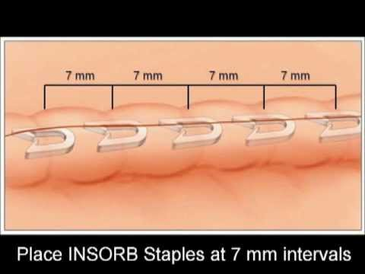
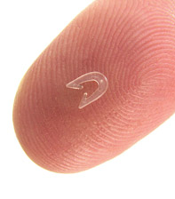
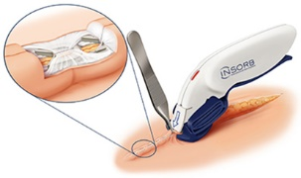

Slide 16
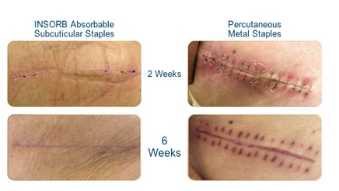

Slide 17
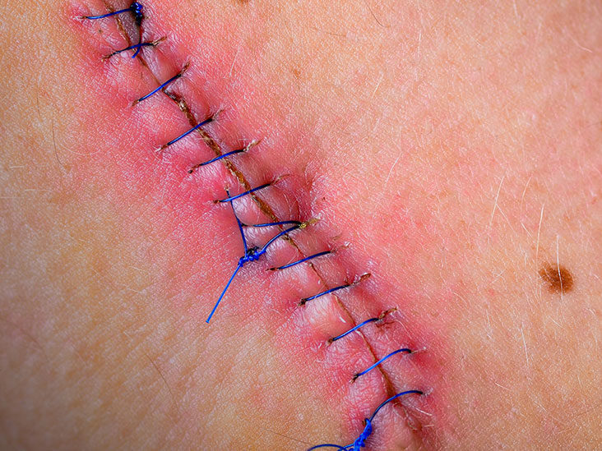
Infected stiches

Slide 18
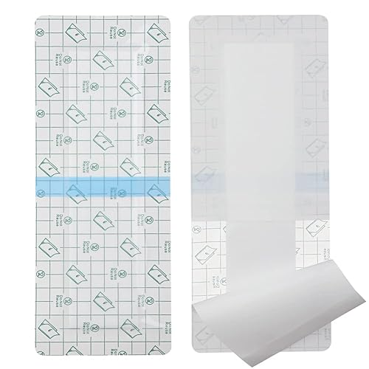
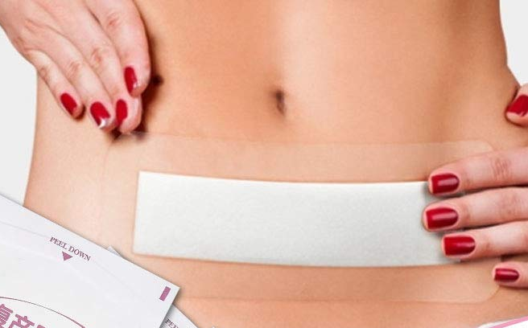

Slide 19
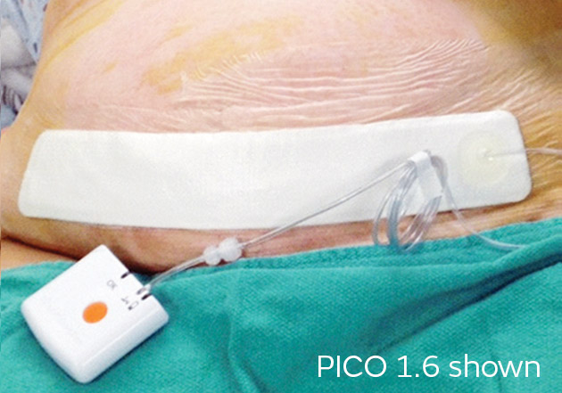
Cesarean section wound infection prevention

Slide 20
Common post partum complications and management:
Breast: Breast engorgement – cracked nipples – mastitis – breast abscess
Episiotomy site: pain – infection
Emotional disturbance: feeling overwhelmed – concerned about her physique
Abdominal pain: uterine involution- endometritis - surgical site infection
UTI
Fever or Post partum pyrexia … what's the difference ?
Vaginal infection vaginitis fungal/bacterial
Constipation
Hemorrhoids

Slide 21
Post partum Pyrexia
Definition?
Incidence?
Risk factors?
Causes ?

Slide 22
Conducting a post partum round
  History: review history, delivery notes and documents including labs , baby out come and any previous orders or recommendations
  Documentation : Title ( post partum round, physician note) , day of post partum with pt. parity, mode of delivery and any major medical or surgical history , use the SOAP approach
  Physical examination: V/S - general - fundal height& Abdominal distention - lochia - episiotomy site or c/s wound – Lower Limbs.
  Labs: CBC, blood group, rubella screen, U.A, blood sugar
  Instructions: for breast feeding – episiotomy site/ cesarean section wound- life routines
  Contraception & medications: counsel the pt. & review her medications
  Discharge: anytime between 12 hours to 5 days depending on multiple factors
  Follow up: routinely 6 weeks -- what about other special conditions ?
  Referrals ?

Slide 23
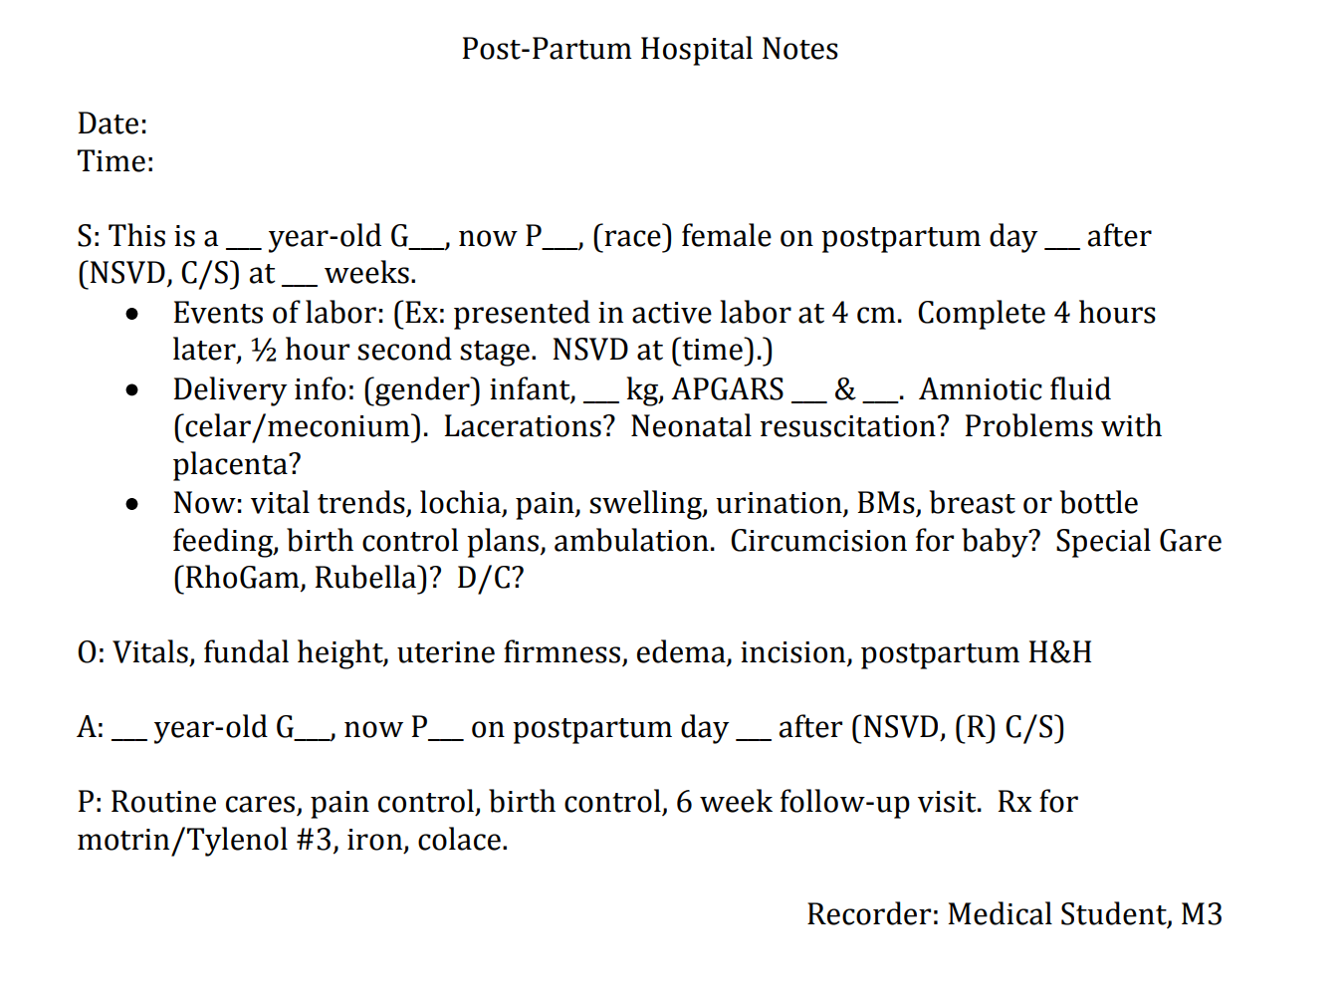
Postpartum Round documentation sample

Slide 24
THANK YOU

