Slide 1

History & Clinical Examination in Orthopedics
Prof. Mamoun Kremli
Dr. Tarif Al-Akhras

Slide 2

History Taking in Orthopedics

Slide 3
History taking
Patient's story
Doctor/student reconstructs the history
  Open ended questions
    How do you feel now
  Leading questions
    What increases the pain?
    Can you open a door key?
    Can you comb your hair?

Slide 4
Orthopedics History
History Structure:
  Patient Demographic
  Chief Complaint
  History of Presenting Complaint
  Past medical/surgical history
  Medication history
  Family history
  Personal history and background
  Diet
  Activity
  Systemic review

Slide 5
Orthopedics History
Patient Demographic
  Name
  Age
  Occupation
  Hand Dominant

Slide 6
Orthopedics History
Chief Complaint:
  Site
  Onset
  Progression
  Management

Slide 7
Orthopedics History
History of Presenting Complaint
  Pain
  Swelling
  Deformity
  Limping
  Stiffness
    Usually related to function
  Loss (altered) function
    Caused by: stiffness / pain / deformity / instability / weakness
  Altered sensation

Slide 8
Orthopedics History
Pain
  Site
  Onset
  Character
  Radiation
  Associations
  Time course
  Exacerbating/relieving factors
  Severity
SOCRATES

Slide 9
Orthopedics History
Pain
  Site:
    Referred Pain perceived at a location other than the site of the painful stimulus.
    this pain referred along the tissues developed from the same sclerotome -somite.
        e.g. Discogenic pain with no thecal or root compression radiated from L-S spine to groin, gluteal region, but not down to the knee.
        Hip: to the medial aspect of the thigh and knee
    Radiating pain: pain begins in one place and travels to another location along the path of a nerve.
    e.g. Sciatica :root pain radiated to lower limb below the knee
SOCRATES

Slide 10
Orthopedics History
Pain
  Onset:
    When did it start?
    Was it
      Gradual or sudden? (acute – related to incident/action)
      Constant or intermittent?
SOCRATES

Slide 11
Orthopedics History
Pain
  Character:
    What is the pain like e.g.
      Sharp,
      Burning
      Tight?
  Radiation:
    Pain perceived at the site of stimulus and radiate to another site
    Does it radiate/move anywhere?
SOCRATES

Slide 12
Orthopedics History
Pain
  Associations:
    Is there anything else associated with the pain e.g.
      Swelling
      Sweating
      Fever
      Vomiting
  Time course:
    Does it follow any time pattern, how long did it last?
SOCRATES

Slide 13
Orthopedics History
Pain
  Exacerbating/relieving factors:
    Does anything make it better or worse?
  Severity:
    How severe is the pain
    Consider using the 1-10 scale
SOCRATES

Slide 14
Orthopedics History
Stiffness
  Patients complain of loss of/altered function, not stiffness
    Can not comb hair, can not bend forward, can not sit cross-legged, can not sit in prayer, …
  Joint involved
  Cause:
    Real stiffness of joint / mechanical block
    Protective mechanism:
      Muscle spasm to avoid pain on movement of joint
  Generalized: systemic disease
    e.g. Rheumatoid Arthritis, Ankylosing spondylitis
  Localized
    To a particular joint

Slide 15
Orthopedics History
Swelling
  Soft tissue, joint, bone
  After trauma:
    Injury or reactive
  Rapid or Slow developing
    Rapid: bleeding / Slow: effusion
  Painful vs. Painless
  Constant vs. comes and goes
  Size:
    Same, increasing, decreasing

Slide 16
Orthopedics History
Deformity
  Progressive, or improving?
  Impairing function?
  Associated with
    Pain
    Stiffness
    Other metabolic diseases

Slide 17
Orthopedics History
Functional affection:
  Relate to normal function of part
    Walking
    Bending, Praying
    Going to toilet
    Sitting cross-legged
    Eating
    Reaching,
    Holding,
    Opening,
    etc…

Slide 18
Orthopedics History
Instability
  Joint “gives way” or “jumps out of place”
Weakness
  Generalized: part of a systemic disease
  Localized: Patients usually describe it as:
    The limb is “dead” / “heavy”

Slide 19
Orthopedics History
Associated conditions / other diseases
Careful about history of mild trauma
  History of mild trauma , especially in children, can be a normal daily occurrence

Slide 20
Orthopedics History
Past medical/surgical history
Medication & Allergy history
Family history
  Genetic – e.g. RA, CDH
  Communicable – e.g. TB
Personal history and background
  Occupation
  Travel
  Recreation
  Home condition
  Drug or Alcohol abuse

Slide 21
Orthopedics History
Diet
  Food / drinks (good and bad!)
  Sun exposure
Activity
Systemic review
  Respiratory – e.g. TB
  UTI – source of infection
  GIT – deficiency
  Renal – disease

Slide 22
Trauma History
Details discussed in:
  “PRINCIPLES OF FRACTURES”
Either Low or High energy trauma

Slide 23
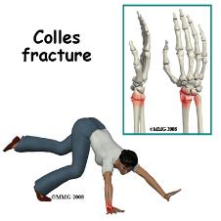
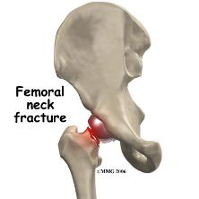
Trauma History
Low Energy:
  When, How & Where ?
  AMPLE History:
    Allergy,
    Medication,
    Past Medical & Surgical History,
    Last Meal,
    Event
  Weight bearing status

Slide 24
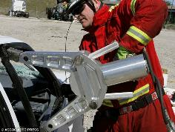
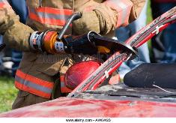
Trauma History
High Energy:
  Road Traffic Accident (RTA)
    Low energy Qs, and:
    Driver / Passenger / Pedestrian
    Seat belted / non-belted
    Speed and location of impact
    Position of the patient and the limb at impact
    Severity of crash

Slide 25
Trauma History
High Energy:
  Fall from Height
    Low injury Qs
    How many levels
    Position of the patient and the limb at impact
    Missed injuries – combination injuries

Slide 26
Trauma History
Details of injury
  Mechanism, force, bleeding, consciousness, …
Details of facture
  Deformity, pain, loss of function, ..
Other medical problems
Anti-tetanus status if open injuries
Careful:
  Fractures are not always at the site of impact
  Some fractures do not need severe force

Slide 27
Summary – History-taking
Chief complaint
  Onset, Progression, Management
    Pain
    Swelling
    Deformity
    Limping
    Stiffness
    Loss (altered) function
    Altered sensation
  Detailed mechanism of injury in trauma
    High velocity Vs. Low velocity
    Open Vs. Closed
Relate to function

Slide 28
Examples
Chronic knee pain
Chronic back pain
Acute knee pain after football injury
Chronic shoulder pain, recently increased
Child with fever and inability to walk

Slide 29
Clinical Examination in Orthopedics

Slide 30
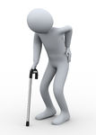
Clinical examination
The examination begins from the moment we set eyes on the patient. Observe:
  General appearance
  Posture
  Gait:
    limping, in pain, using stick, …
  Deformities:
    Knock-knees? Spinal curvature? short limb? paralyzed arm?
  Pain?
  …….The clues are endless

Slide 31
Principles of Assessment
Proper interaction with patient
Normal side first
Compare to other side/joint
Do not cause pain
  Watch facial expressions
Extra careful with children
  Proceed slowly, do no attack!
  Play with child!

Slide 32
Orthopedic Examination
Which system to use?
  Look
  Feel
  Move
  Special tests

Slide 33
LOOK
What do we look at ?
What do we look for ?

Slide 34
Look
General ➔ on patient.
General ➔ local (shoulder, back, hip, thigh, …):
  Position
  Major deformity, swelling
  Extra: cast, splint, traction, dressing …
Anatomic local:
  Skin: swelling, scars, color, hair, dryness …
  Subcut.: LN, veins, nerves, tendons …
  Muscles: bulk, wasting, twitches …
  Bones: landmarks, swelling, angulation, deformity.
  Joints: position, swelling, redness…

Slide 35
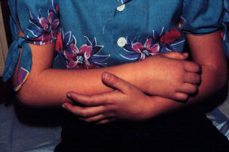
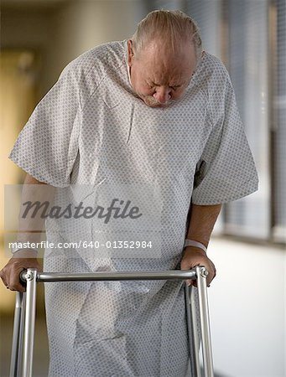
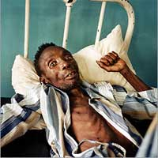
Look
General ➔ on patient
  Patient in pain, sitting on a chair holding the right wrist and hand
  Lying comfortably in bed not in pain.
  Lying supine, in pain, holding R thigh in flexion.
  Patients is restless in bed
www.bethanynaz.org/

Slide 36
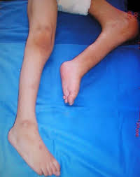
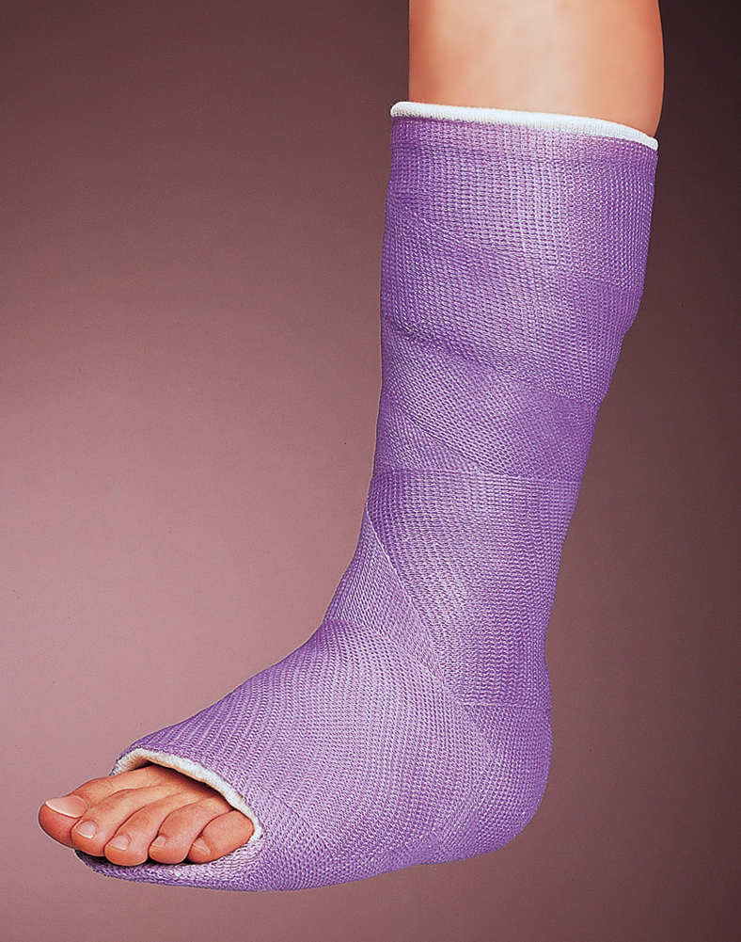
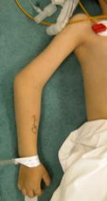
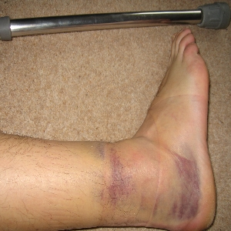
Look
General ➔ on patient.
General ➔ local (shoulder, back, hip, thigh,. ):
  Position of joint
  Major deformity, swelling
  Extra: cast, splint, traction, dressing …etc.
http://openi.nlm.nih.gov/
www.findherbalremedy.com/

Slide 37
Look
Important Considerations:
  Amount of exposure
  Duration of exposure
  Persons present during exposure
  Place of exposure
  Attitude and behavior during exposure

Slide 38
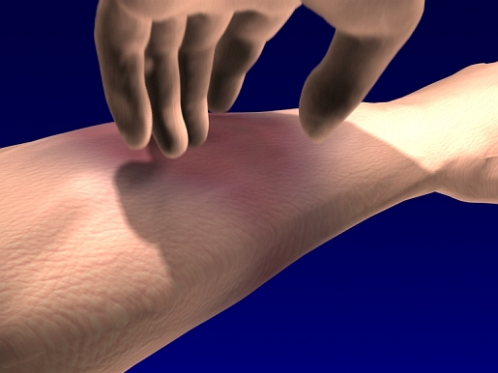
Feel
Ask for pain or tenderness before you put your hands on the patient!
Inform patient (take permission) you are going to touch him/her and ask to inform you if it hurts

Slide 39
Feel
What do we feel for ?
  Tenderness
  Temperature
  Anatomical

Slide 40
Feel
Tenderness:
  Generalized - Specific
Temperature:
  Compare distal / proximal, R / L
Anatomic:
  Skin: dryness, hyper/hyposthesia, scars
  Subcut.: LN, nerves, vessels, tendons, nodules
  Muscle: tone, bulk, twitches, gaps, tenderness
  Bone: landmarks, tenderness, mass, crepitus
  Joint: swelling, effusion, crepitation, synovial thickening, joint line tenderness (if joint accessible)

Slide 41
Move
Active Vs. Passive
Active
  Always to start with / not to cause pain
  More used in upper limb
  A must for assessment of muscle power
Passive
  If need to see difference from active
    In muscle weakness /neurological problems
  More used in lower limbs

Slide 42
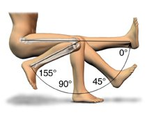
Range of Movement
Recorded in degrees!
Range of motion:
  Starting from resting xx degrees to
  xx degrees where motion stops
Zero is the neutral or anatomical position of the joint
Do NOT use the words:
  ‘full’, ‘good’, ‘limited’, ‘poor’

Slide 43
Range of Movement
Recorded in degrees
Examples:
e.g, ‘knee flexion 0–140º means
  range of flexion from zero (the knee absolutely straight) through an arc of 140º
e.g, ‘knee flexion 20–90º means
  flexion begins at 20º (i.e. the joint cannot extend fully) and continues only to 90º

Slide 44
Range of Movement
Assess painful arc, if present
  e.g. Shoulder painful abduction
    At initial abduction
    In mid-abduction
    At extreme of abduction
Painful range of motion
  e.g. Knee flexion from zero to 90º, with pain from 90º to 110º then could not flex more because of pain

Slide 45
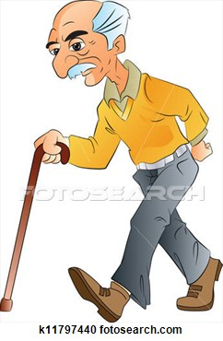
Special Tests
Different for different joints
  e.g. Anterior Drawer Test for ACL tear in Knee
  e.g. Patellar Tap for knee effusion
  e.g. Thomas Test for fixed flexion deformity of Hip
Weight-bearing / gait
  Examination of all weight-bearing joints is not complete until weight-bearing is assessed!

Slide 46
Bony Lumps
Size
Site
Margin
Consistency
Tenderness
Multiplicity

Slide 47
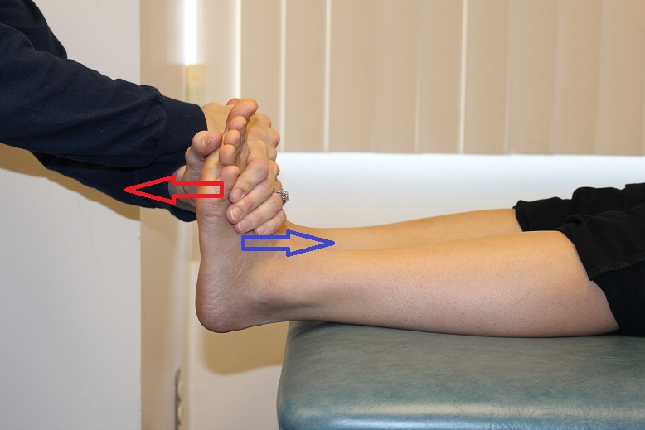
Motor Power Grading
0 = No power
I = fasciculation of muscle fibers – no movement
II = move with gravity eliminated
III = move against gravity
IV = less than full power
V = full power - normal
www.orthopaedicsone.com/

Slide 48
Nerve Roots LL
Hip
  Flexion: L1,2,3
  Extension: L5, S1
Knee
  Extension: L3,4
  Flexion: L5, S1
Ankle
  Dorsiflexion: L4,5
  Plantarflexion: S1,2
  Inversion: L4,5
  Eversion: L5,S1
Toe
  Extension: L5
  Flexion: S1
  Abduction: S1,2

Slide 49
Nerve Roots UL
Deltoid: C5,6
Supra/Infraspinatus: C5,6
Serratus anterior: C5,6,7
Elbow
  Flexion: C5,6
  Extension: C7
Supination: C5,6
Pronation: C6
Wrist
  Extension:C6
  Flexion: C7
Finger
  Extension: C7
  Flexion: C7,8, T1
  Abd/Adduction: C8, T1

Slide 50
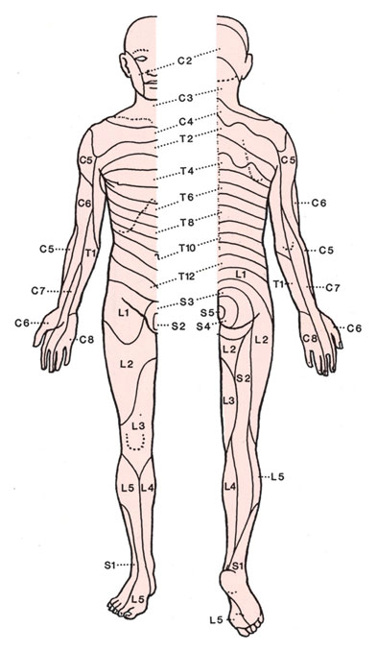
Sensation
Dermatomes:

Slide 51
Sensation
Dermatomes:

Slide 52
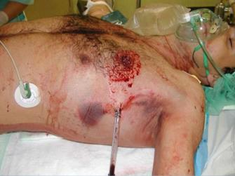
Trauma – Clinical Exam
General medical condition
  Should be evaluated to exclude
    Shock
    Brain injury
    Other problems
Vital signs
  Should be observed and followed up
  Head/neck, Chest

Slide 53
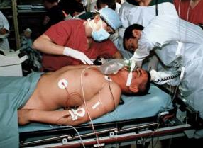
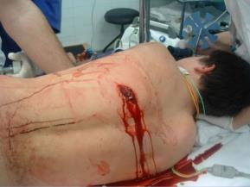
Trauma – Clinical Exam
Look:
  Adequate exposure
  General on patient
  Local:
    Swelling, deformity, bruises, color, …
    Special attention is to be paid to wounds
  Do not forget the back!
http://kids.britannica.com/
www.slideshare.net

Slide 54
Trauma – Clinical Exam
Feel:
  Tenderness, temperature and crepitus on movement
  Sensory and motor deficits
  Pulse distal to injury
  Compartment syndrome
Move:
  With care
    Make sure not to cause more pain or injury
  Crepitus & abnormal movement indicates a fracture
  Joints distal to the affected area

Slide 55
Trauma – Clinical Exam
Examination of the viscera
  Liver and spleen in rib fractures
  Urinary bladder and urethra in pelvic fractures
  Neurological examination in head and spinal injury

Slide 56
Summary
Examination:
  Look
    General on patient, general local, anatomical
  Feel
    Tenderness, temperature, anatomical
  Move
    Passive, active – differs from joint to another
  Special tests
    Differ from joint to another

