Slide 1

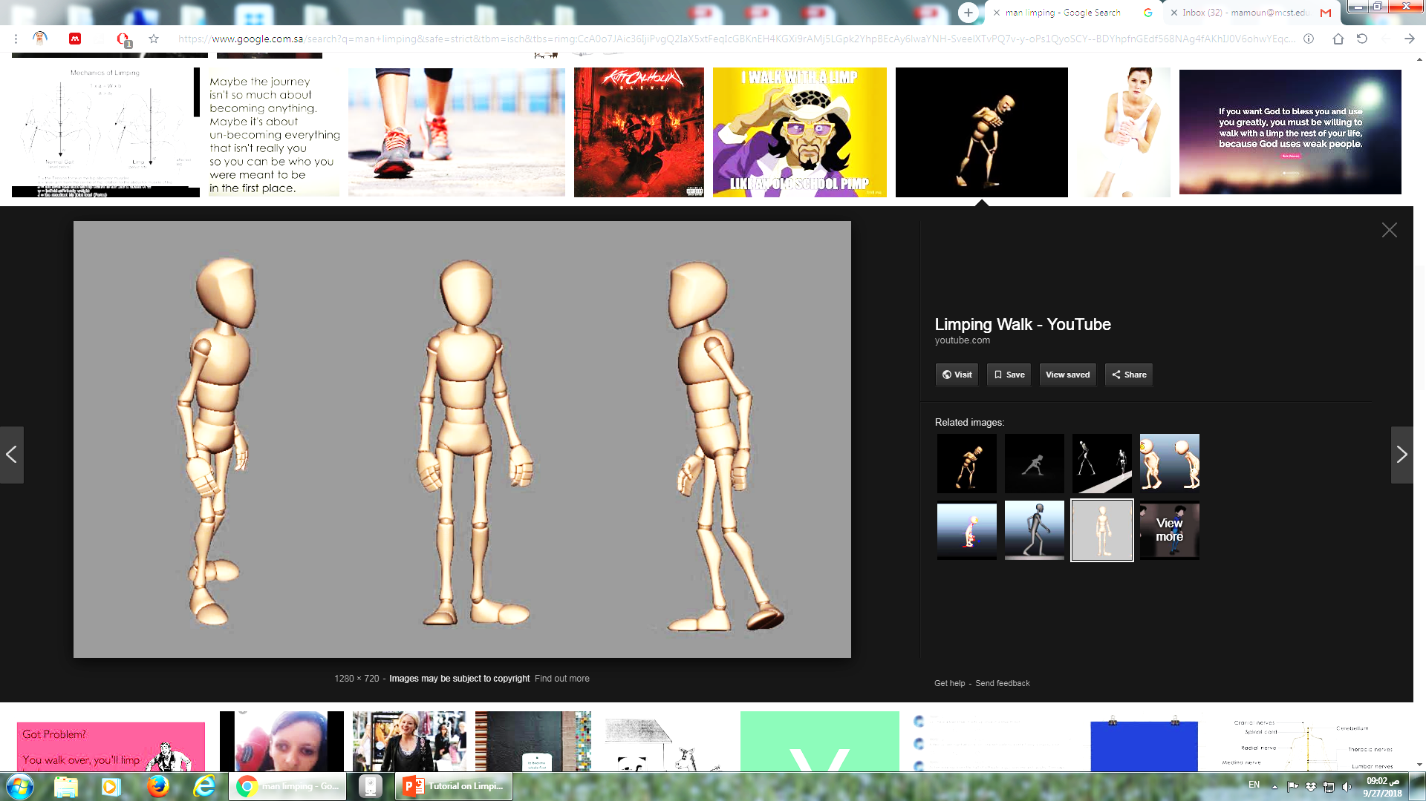
Limping
Dr Sultan Almisfer
Pediatric Orthopedic Consultant

Slide 2
Introduction
Limping is a common presentation in children and adults
Can be caused by many diseases
Need to take a proper
History
Physical examination
Investigations
Some diseases related to specific age groups

Slide 3
What is limping?
A form of walking that favors the use of one leg over another
An asymmetric abnormality of the gait

Slide 4
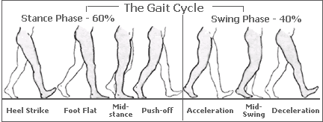
The Normal Gait Cycle
Stance phase (60%)
Swing phase (40%)
Heel strike
Foot flat - mid-stance
Push off
Acceleration
Mid-swing
Deceleration
http://www.root2being.com/foot-function.html

Slide 5
Causes of limping
Pain
Deformity
Weakness
Imbalance
Other diseases

Slide 6
Causes of limping
Pain
Trauma
Bone, ligament, muscle
Pricks, wounds
Inflammation
Degenerative arthritis
Achilles tendinitis
Plantar fasciitis
Inflamed bunion
Infection
Joints, bones, toe nails
Tumors
Benign osteoid Osteoma
Malignant

Slide 7
Causes of limping
Pain
Deformity
Congenital
DDH, Club foot
Congenital shortening
Acquired
Mal-union
Developmental
Metabolic

Slide 8
Causes of limping
Pain
Deformity
Weakness
Nerve injuries/diseases
Muscle weakness
Secondary to disuse
Secondary to nerve injury
Dystrophy

Slide 9
Causes of limping
Pain
Deformity
Weakness
Imbalance
Inner ear infections
Cerebellar ataxia
Neurological
Stroke, Cerebral palsy
Parkinson's Disease
Multiple sclerosis
Peripheral nerve disorders

Slide 10
Causes of limping
Pain
Deformity
Weakness
Imbalance
Other diseases
SCFE
Perthe's disease
Sickle cell disease
Osteochondritis
Hemophilia
Leukemia
Appendicitis / Psoas abscess
Conversion disorders

Slide 11
History
Onset
Acute / Gradual
Duration
Associated with
Pain
Deformity
Swelling
Other symptoms
Fever, night sweating, anorexia, weight loss

Slide 12
Limping
Painful
Antalgic gait – short stance phase of gait cycle
Painless
Normal or prolonged stance phase

Slide 13
Causes of painful limping
Trauma
Major musculoskeletal
Splinter into foot, prick, wound
Infection
Acute OM, Septic arthritis
Inflammatory joint diseases
Rheumatic
Degenerative
Acute slipped capital femoral epiphysis (SCFE)
Perthe's disease (Avascular necrosis)
Bone tumor

Slide 14
Causes of painless limping
Deformity
Developmental / Post injury/ Congenital
Leg length discrepancy
Post injury / Congenital
Congenital
DDH, club foot, congenitally short femur, short tibia
Benign bone tumors
AVN – Perthe’s disease
Slipped capital femoral epiphysis (chronic) (SCFE)

Slide 15
Types of gait
High steppage:
Foot drop – neurologic disease
Trendelenburgh:
DDH, weak hip abductors, could not abduct
Circumduction:
Stiff hip, neurologic disease
Tip-toe
Tight Achilles tendon, CTEV, Cerebral Palsy, habitual, compensating length discrepancy
Lurching:
Short limb

Slide 16
Types of gait
Wide-base:
To gain balance – neurologic disease
Scissoring
Tight hip adductors – Cerebral Palsy
Hemiplegic gait
Cerebral palsy - neurologic
Ataxic
Neurologic disease
Foot inversion / eversion
Foot deformity / avoiding pain

Slide 17
Types of gait
Stiff-knee
Knee disease / arthrogryposis
Hand-knee
Weak quadriceps femoris muscle

Slide 18
History
Sudden onset:
Trauma
Gradual onset:
Disease

Slide 19
Walking With Crutches
Prof. Mamoun Kremli

Slide 20
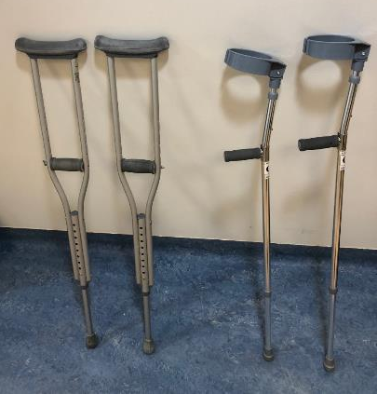
Crutches
Indications:
Transfers weight from the legs to the upper body in people who cannot use the legs to support their weight
Post surgery or casting of the lower limbs
Types:
Axillary crutches
Elbow crutches
Axillary crutches
Elbow crutches

Slide 21
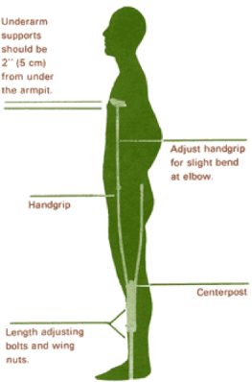
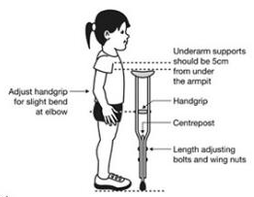
Axillary Crutches
Adjust total height
Axillary part should not press on axilla (5 cm away)
Adjust hand piece level
Hand piece at level of wrist
Elbow slightly flexed during weight transfer

Slide 22
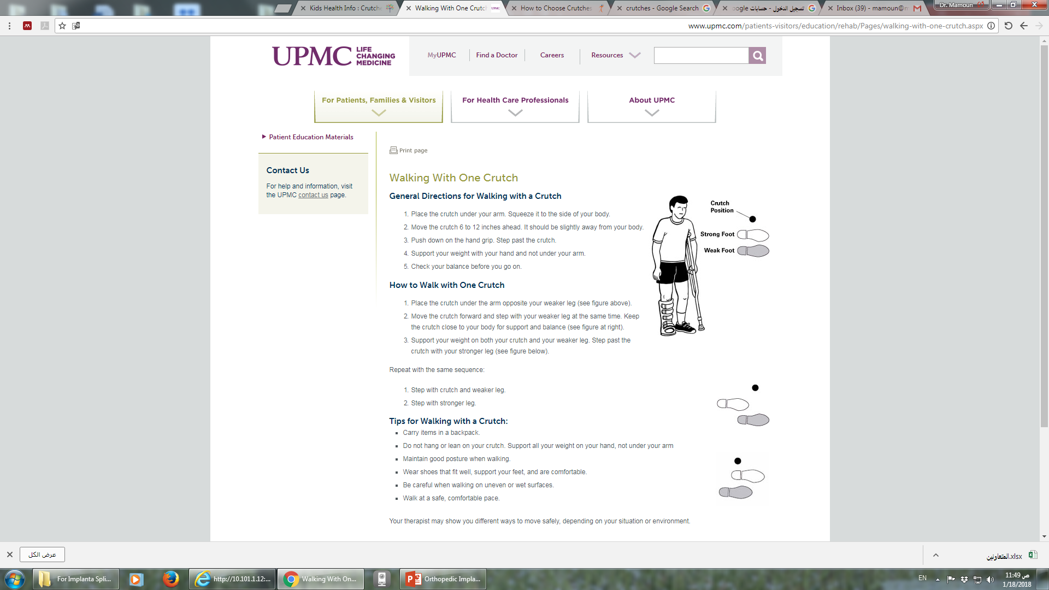
Walking with Crutches

Slide 23
General directions for walking with crutches
Place the crutches under your arms. Squeeze them to the sides of your body.
Move the crutches 6 to 12 inches ahead. They should be slightly away from your body.
Push down on the hand grips. Step past the crutches.
Support your weight with your hands and not under your arms.
Check your balance before you go on.

Slide 24

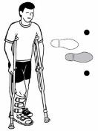
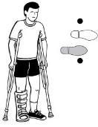
Walking with two crutches
Stand in the middle of your crutches
Place crutches in front of you and step with your weaker leg at the same time (crutches & weak leg together)
Push down on the hand grips. With your stronger leg, step up past the crutches with your normal foot
http://www.upmc.com

Slide 25
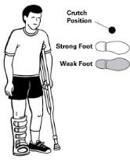


How to Walk with One Crutch
Place the crutch under the arm opposite your weaker leg
Move the crutch forward and step with your weaker leg at the same time. Keep the crutch close to your body for support and balance
Support your weight on both your crutch and your weaker leg. Step past the crutch with your stronger leg
http://www.upmc.com

Slide 26
Walking With Crutches
Non weight bearing
Affected LL off the ground all the time
Start by standing with all weight on the normal side
Transfer both crutches forwards
Small step - not too much forwards
Put all weight on both crutches through hand pieces
Transfer normal foot forwards to the line between both crutches
Do not go beyond the line between both crutches
Transfer body forwards to level of crutches

Slide 27
Walking With Crutches
Partial weight bearing
Affected leg partially takes weight along with crutches
Start standing with most weight on normal side, with affected side touching the floor
Transfer both crutches forwards along with the affected leg
Small step - not too much forwards
Put partial weight on crutches through hand pieces and partial weight on affected leg together
Transfer normal foot forwards to level of crutches

Slide 28
Walking With Crutches
Partial weight bearing – More on affected leg
Affected leg takes more weight along with one crutch only
One crutch held on normal side
Start standing with most weight on normal side, and affected side touching the floor
Transfer crutch forwards along with the affected leg together
Small step - not too much forwards
Put partial weight on crutch through hand piece and partial weight on affected leg together
Transfer normal foot forwards to level of crutch

