Slide 1

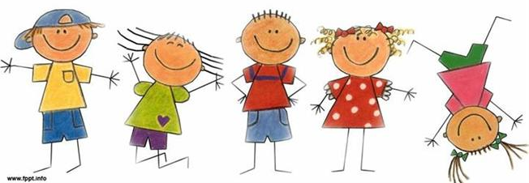
The Limping Child
Dr. Sultan Almisfer
Pediatric Orthopedic Consultant

Slide 2
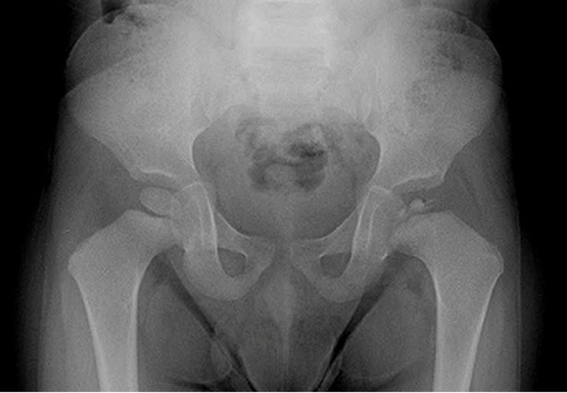
6-year-old, limping on L
http://www.choa.org/Childrens-Hospital-Services

Slide 3
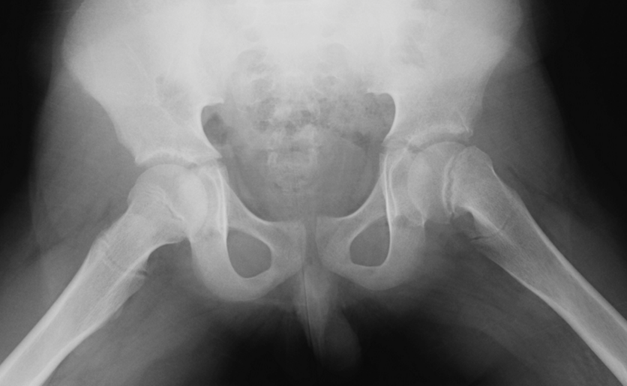
14-year-old boy, limping on L
http://www.choa.org/Childrens-Hospital-Services

Slide 4
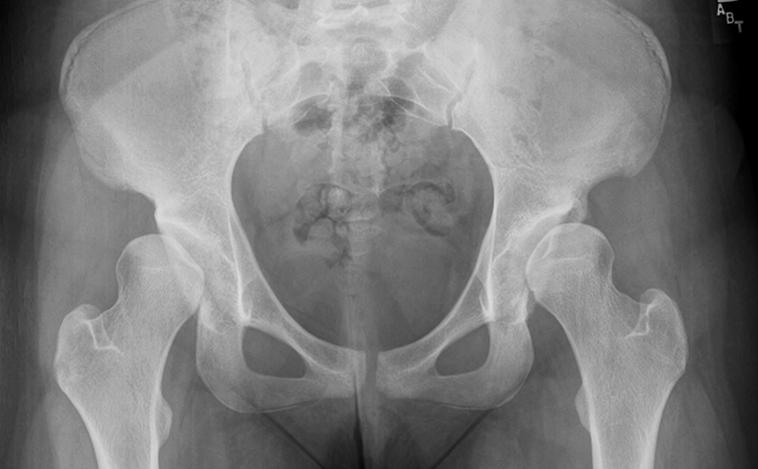
16-year-old, bilateral limping
http://www.choa.org/Childrens-Hospital-Services

Slide 5
Introduction
Limping is a common presentation in children
  Seen by orthopedic surgeons, pediatricians, primary care physicians
Need to take a proper
  History
  Physical examination
  Investigations
Some diseases related to specific age groups

Slide 6
History
Duration, when first noticed
Pain
History of trauma
Associated systemic symptoms
  Fever, night sweating, anorexia, weight loss

Slide 7
Pitfalls
Misled by parents’ history
  History of trauma
  Noticing leg length inequality
Misled by patients’ complaint
  Hip problems may present with knee pain
  Children below 5 years may not complain of pain!

Slide 8
Many causes
Different diseases occur more commonly at specific age groups

Slide 9
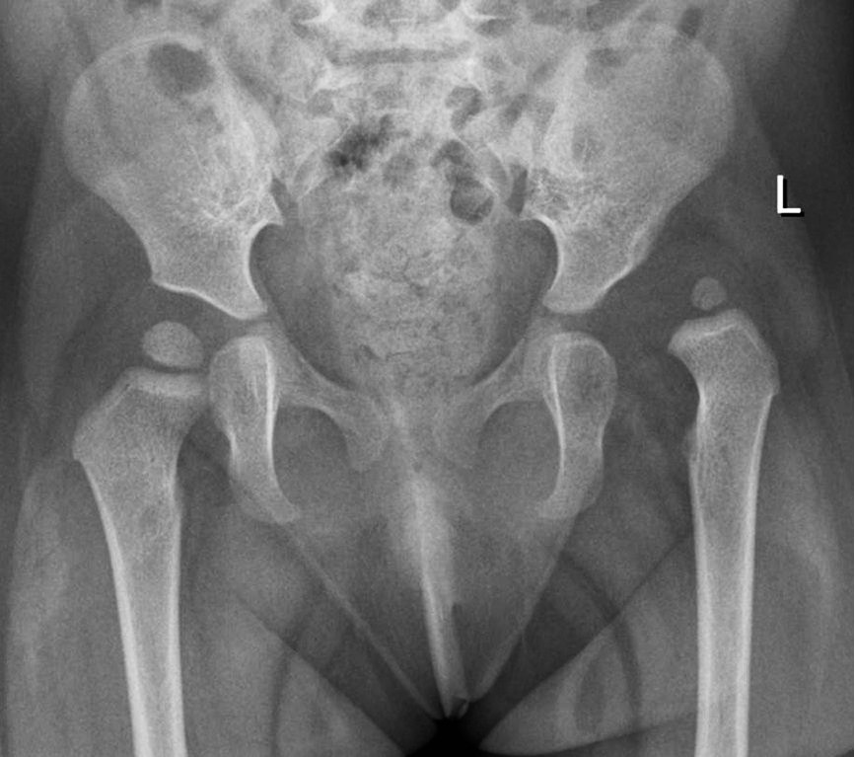
Age 1-4 years
CDH – DDH
History: at risk groups
  e.g. F, breach, F.H, mihad (swaddle)
  Torticollis, MT adductus, calc. valgus
Physical findings:
  Asymmetrical folds
  Limited abduction
  Shortening
  Positive Trendelenburgh sign

Slide 10
Age 3–6 years
Transient synovitis
  Limping, painful to move, ?WBC, ? Fever, ? ESR
  Resolves in days
  Disappears without treatment
Septic arthritis
  Limping-refuses to walk
  Fever >38.5ºC
  WBC >12,000
  ESR >40 mm/h
If in doubt: Aspiration

Slide 11
Legg-Calve-Perthe's
Idiopathic avascular necrosis of femoral head
Age usually: 4-8 years, Boys: 4X girls
  Female worst natural history

Slide 12
Legg-Calve-Perthe's
Idiopathic avascular necrosis of femoral head
Age usually: 4-8 years, Boys: 4X girls
Blood supply of femoral head:
  Neonates: metaphyseal, lateral epiphyseal, and scanty ligamentum teres vessels
  4 years: no epiphyseal vessels
  7 years: ligamentum teres vessels developed well
  4–7 years: dependent on lateral epiphyseal vessels
    If trauma or synovitis, pressure occludes blood supply

Slide 13
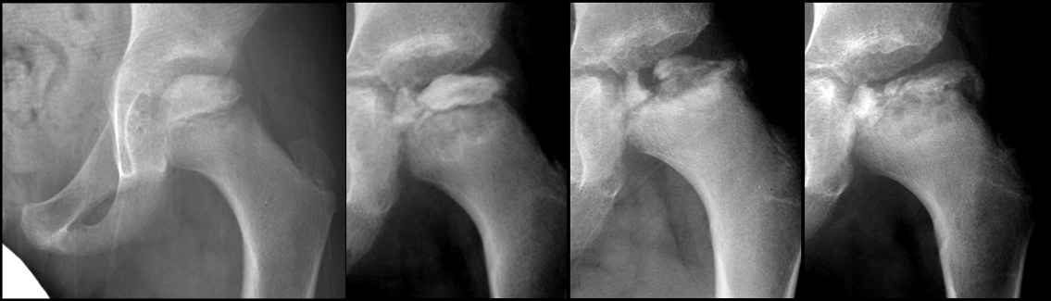
Legg-Calve-Perthe's
Stages:
  Bone death: (Sclerosis)
    May initially look normal on x-ray
    Increased density, then collapse
  Revascularization and Repair:
    Reduced density and fragmentation on x-ray
  Distortion and Remodeling
    Distortion, flattening (coxa plana), and enlargement (coxa magna), with partial uncoverage

Slide 14
Legg-Calve-Perthe's
Clinical picture:
  Boys X4 girls
  Limping (painful / painless)
  May present with knee/thigh pain
  Early: limitation of all movements
    Pain and muscle spasm with passive motion
  Later: limitation of abduction and internal rotation
  Positive Trendelenburgh

Slide 15
Legg-Calve-Perthe's
Different stages of Perthe's in a patient
Sclerosis Collapse Fragmentation Remodeling
http://community.tsrhc.org/Perthes-disease-about-perthes-disease

Slide 16
Legg-Calve-Perthe's
Apley’s System of Orthopedics and Fractures

Slide 17
Legg-Calve-Perthe's
Apley’s System of Orthopedics and Fractures

Slide 18
Legg-Calve-Perthe's
Treatment:
  Rest
  Physiotherapy: abduction / rotation
  Containment by abduction splint
  Surgery:
    Containment: to improve cover
      Acetabuloplasty / femoral varus osteotomy
    Later: for residual deformity/problem

Slide 19
Legg-Calve-Perthe's
Prognosis:
  Depends on
    Age at onset: the earlier, the better
    Extent of head involvement
      all head involved: worse prognosis
  Complication
    Stiffness, related to deformed head
    Secondary OA

Slide 20
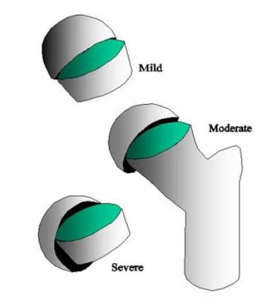
Age 10–15 years
Slipped Capital Femoral Epiphysis (SCFE)
  Acute Vs. chronic
  Boys, overweight, ?hypogonadism
  Signs:
    Limited internal rotation
    Hip externally rotates when flexed
  X-ray: AP and Frog lateral
  Really is an antero-superior slippage of the metaphysis
www2.massgeneral.org/ortho/SCFE.htm

Slide 21
SCFE
Around puberty
? Hormonal imbalance between gonadal and growth hormones
Tall, or obese, gonads underdevelopment
Presents with limping
May present with thigh/knee pain
Acute slip vs. chronic slip
Apley’s System of Orthopedics and Fractures

Slide 22
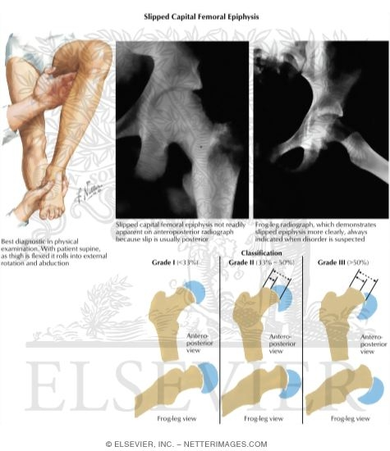
SCFE
Externally rotated hip
Loss of internal rotation
Obligatory external rotation on flexion
Slippage of other hip
  In 1/3 of patients
Apley’s System of Orthopedics and Fractures
www.aafp.org/afp/2017/0615/p779.html

Slide 23
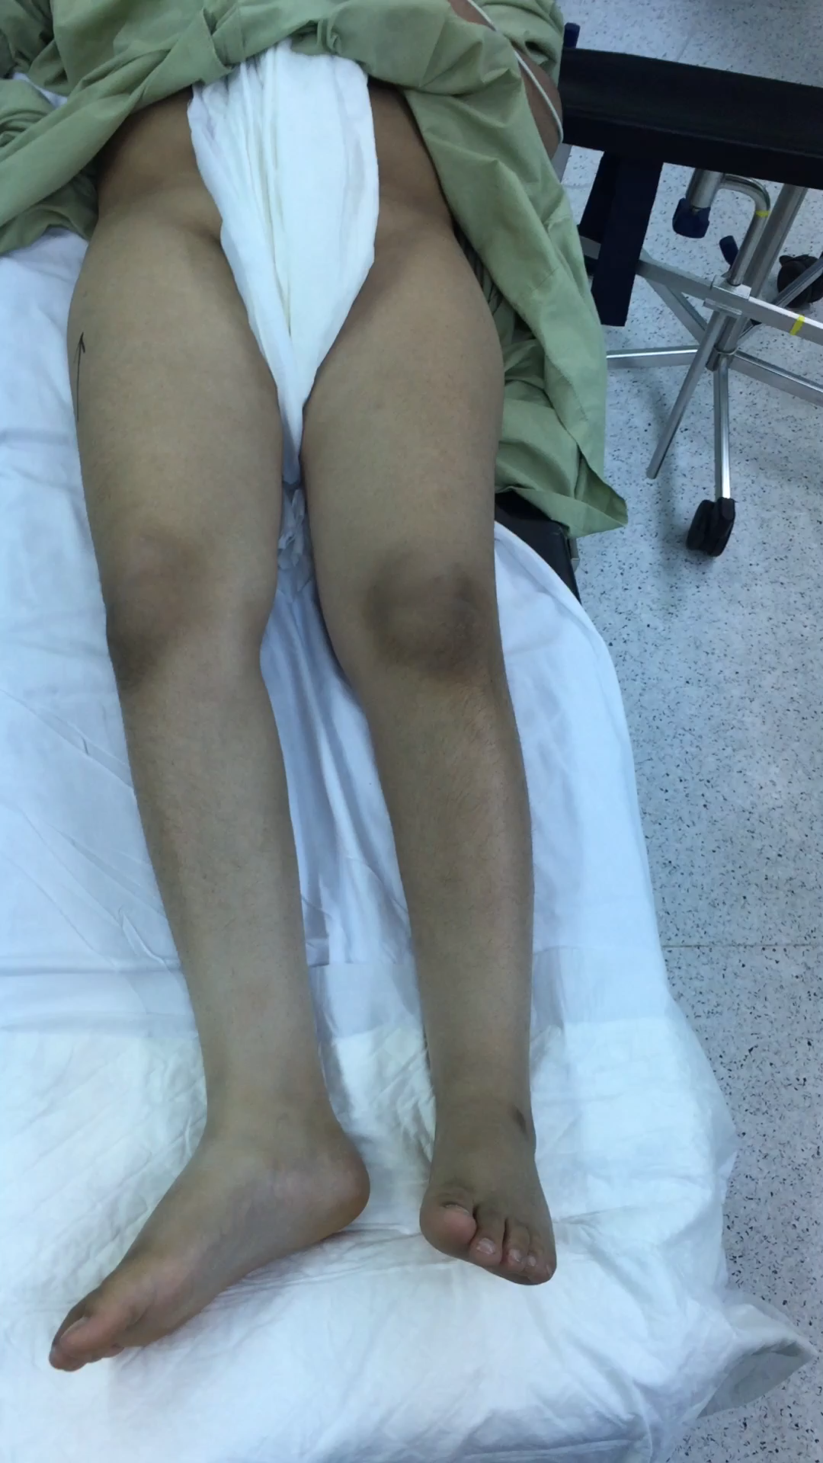
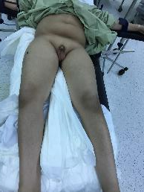
SCFE - Signs
Overweight
Hypogonadism
Externally rotated hip
Loss of internal rotation
External rotation on flexion

Slide 24
SCFE - Xray
Slipped Normal
AP
Frog lat
Apley’s System of Orthopedics and Fractures

Slide 25
SCFE – X-ray
Recent slip
Chronic slip
Hump
http://dontforgetthebubbles.com/

Slide 26
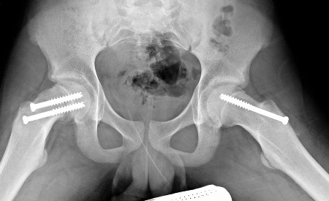
SCFE
Treatment
  Manipulation to try to reduce the slip may cause AVN
  Fixation in situ
    ? Fix the other hip
      1/3rd affects other side
Complications:
  Avascular Necrosis
  Coxa Vara
  Slippage of opposite hip
  Secondary osteoarthritis
http://bestpractice.bmj.com/

Slide 27
3–12 years
Acute osteomyelitis:
  Constitutional symptoms
  WBC, CRP, ESR
  X-ray may initially be normal
  MRI

Slide 28
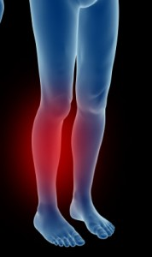
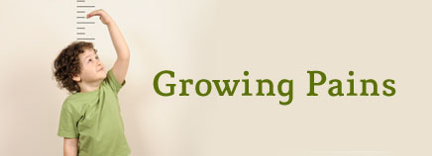
Growing pain
Diagnosis by exclusion of all other diseases
Pain in legs, not at joints
Age: (3-5 yrs.) – (8-12 yrs.)
  No S&S except localized pain
http://kidshealth.org/
www.footphysics.co.uk

Slide 29
Growing pains
Diagnosis by exclusion of all other diseases
Pain in legs, not at joints
Age: (3-5 yrs.) – (8-12 yrs.)
Growing Pains” MUST Meet 3 Criteria
  Leg pain is bilateral
  Pain occurs only at night
  No limping nor pain symptoms during the day
  Relived mildly with palpation

Slide 30
Growing pains
Inaccurately diagnosing a limping child with “growing pains” risks missing significant disease

Slide 31
6-year-old, limping on L
http://www.choa.org/Childrens-Hospital-Services

Slide 32
14-year-old boy, limping on L
http://www.choa.org/Childrens-Hospital-Services

Slide 33
Time algorithm
Trauma
Infection
Growing pain
Growing pain
SCFE
Perthe's
DDH
1
2
3
4
5
6
7
8
9
10
11
12
13
14
15
years

Slide 34
Time algorithm
Trauma
Septic arthritis
Osteomyelitis
Growing pain
Growing pain
SCFE
Perthe's
DDH
1
2
3
4
5
6
7
8
9
10
11
12
13
14
15
years

