Slide 1

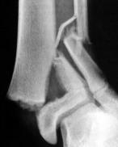
Pediatric Neuromuscular Disorders
Dr. Sultan Almisfer
Pediatric Orthopedic Consultant

Slide 2
Cerebral Palsy

Slide 3
Definition
Non-progressive injury to developing brain
Leads to motor control and tone abnormalities
Static brain injury, dynamic musculoskeletal manifestations

Slide 4
Epidemiology & Etiology
Incidence: 2–3 per 1000 live births
Causes: prematurity, hypoxic-ischemic injury, malformations, infections

Slide 5
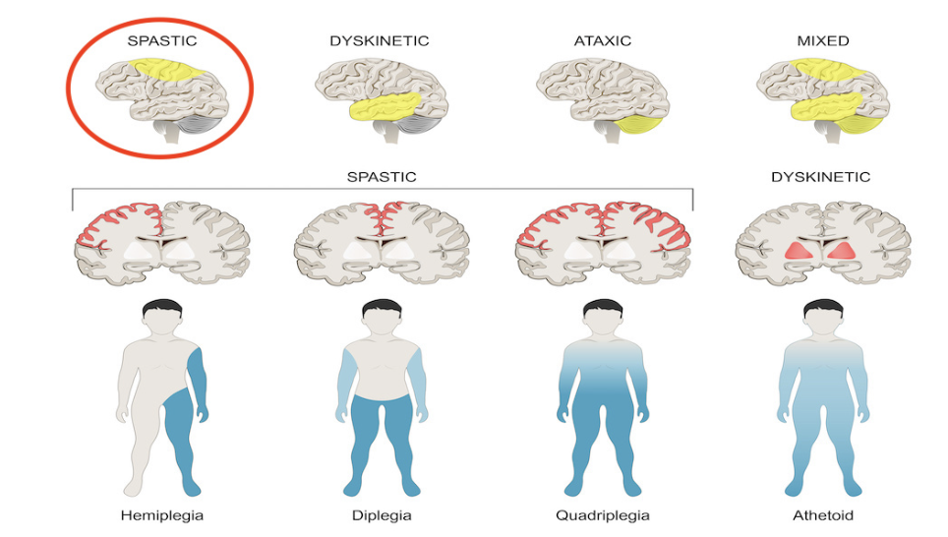
Classification
By tone: Spastic (most common), athetoid, ataxic, mixed
By distribution: hemiplegia, diplegia, quadriplegia
GMFCS I–V (functional classification)

Slide 6
Clinical Features
Spasticity, contractures, abnormal gait
Hip subluxation/dislocation, scoliosis, foot deformities
Associated problems: seizures, vision/hearing, cognition, swallowing issues.

Slide 7
Management
Multidisciplinary: PT, OT, orthotics, spasticity control
Spasticity control: botulinum toxin, baclofen (oral/intrathecal)
Surgical: soft tissue releases, tendon transfers, osteotomies, SEMLS
Selective dorsal rhizotomy (specialized cases)

Slide 8
Duchenne Muscular Dystrophy

Slide 9
Definition & Genetics
X-linked recessive; absence of dystrophin protein
Onset: 2–6 years;

Slide 10
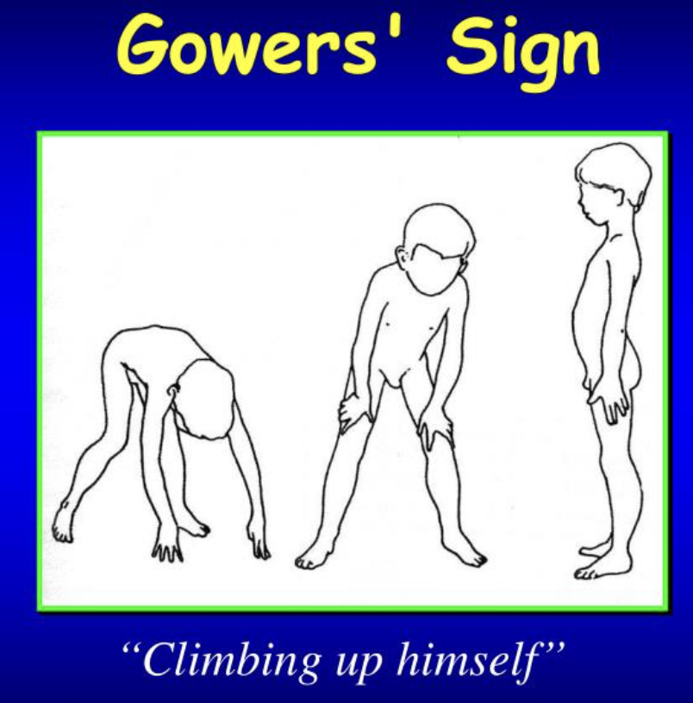
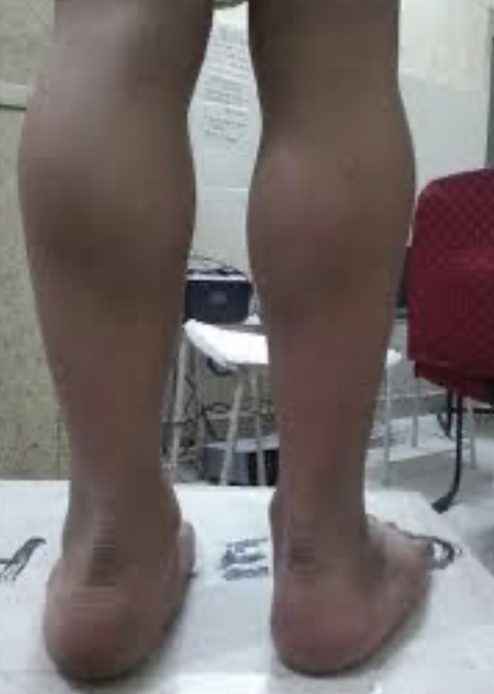
Clinical Features
Proximal muscle weakness, waddling gait
Gower’s sign
Calf pseudohypertrophy
Contractures, scoliosis, cardiomyopathy, respiratory decline

Slide 11
Investigations
CPK ↑ (10–200x normal)
Genetic testing for dystrophin mutation
Muscle biopsy if needed
Echo & pulmonary function tests

Slide 12
Management
Corticosteroids prolong ambulation
Exon skipping therapies (eteplirsen)
Cardiac meds, respiratory support, PT
Orthopaedic surgery: soft tissue releases, scoliosis fusion

Slide 13
Prognosis
Without treatment: wheelchair by 12, death ~20 years
With therapy: survival into 30s, prolonged ambulation

Slide 14
Myelodysplasia (Spina Bifida)

Slide 15
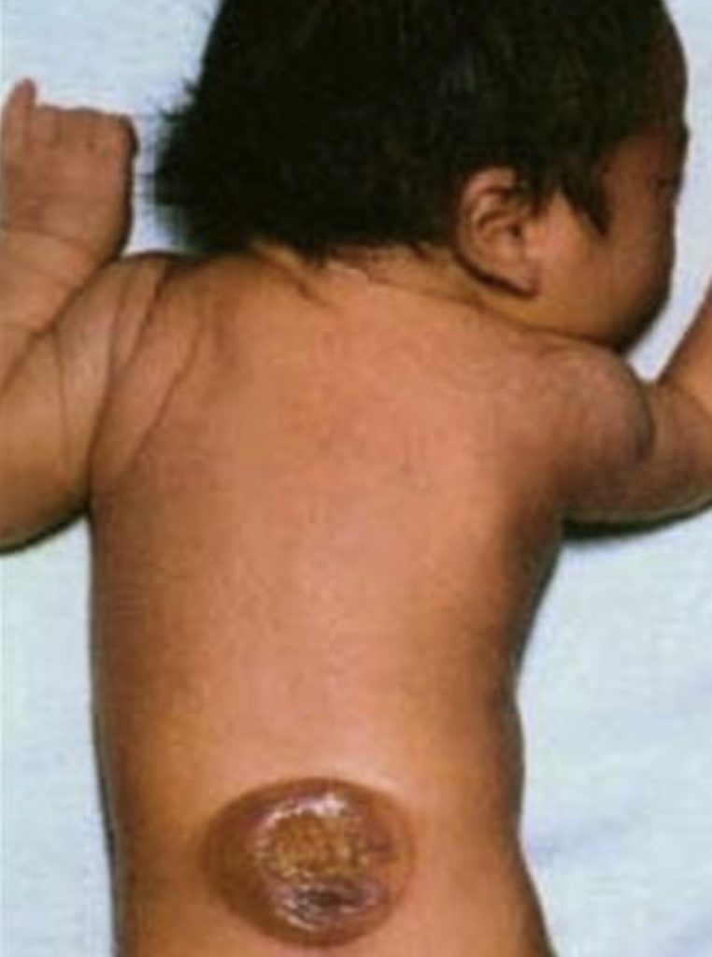
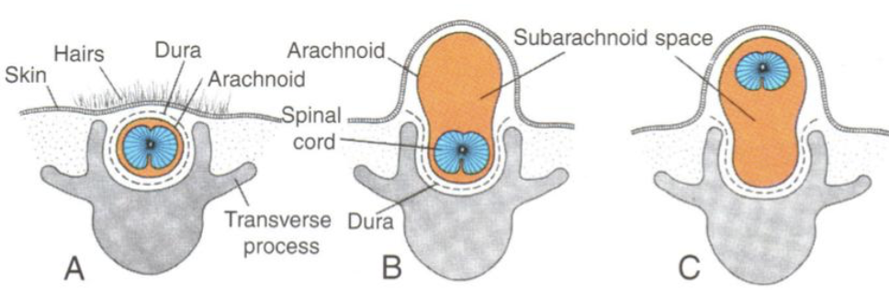
Definition & Etiology
Failure of neural tube closure
Types: spina bifida occulta, meningocele, myelomeningocele
Risk factors: folate deficiency, maternal diabetes, valproic acid

Slide 16
Clinical Features
Orthopaedic: hip dislocation, foot deformities, scoliosis/kyphosis
Neurologic: hydrocephalus, Chiari II, tethered cord
Urologic: neurogenic bladder

Slide 17
Diagnosis
Prenatal: ↑ AFP, ultrasound
Postnatal: MRI spine, radiographs for deformities

Slide 18
Management
Multidisciplinary: neurosurgery, orthopaedics, urology, rehab
Spine fusion for scoliosis/kyphosis
Hip and foot surgery as needed
Fracture care with caution (osteopenia, insensate limb)

Slide 19
Take-Home Messages
Cerebral Palsy: static brain injury, spasticity, contractures
Duchenne: progressive, steroids/gene therapy, scoliosis fusion
Myelodysplasia: congenital defect, multisystem involvement
Team care is essential: ortho, neuro, rehab, urology, cardiology

