Slide 1

Sport Injuries of the Knee
Prof. Mamoun Kremli
Dr. Tarif Al -Akhras

Slide 2
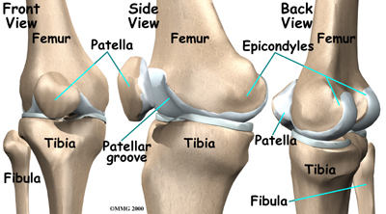
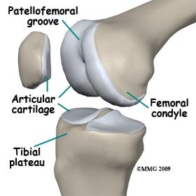
Objectives
Revise anatomy
Common injuries:
Ligaments:
Cruciate ligaments:
(ACL, PCL)
Collateral ligaments:
(MCL, LCL)
Menisci:
(medial. lateral)
Basic management

Slide 3
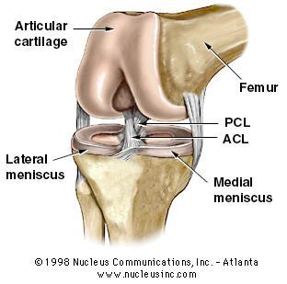
Anatomy
Compound joint
Femoral condyles and Tibial articular surfaces
Pattello-femoral joint
Menisci:
Medial / Lateral
Ligaments:
Cruciate: ACL, PCL
Collateral: MCL, LCL

Slide 4
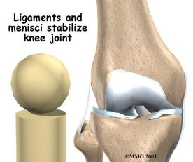
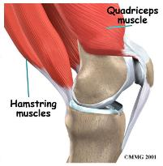
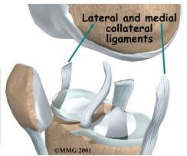
Knee stability
Bony structure of the knee is unstable
Knee stabilization depends on:
Strong capsule
Intra-articular ligaments
Extra-articular ligaments
Muscles around the knee
Menisci add to stability

Slide 5
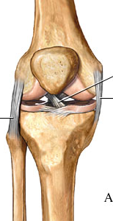
Knee stability
Valgus stresses are resisted by:
Pes ansernius
Medial collateral ligament
Origin:
Insertion:
Varus stresses are resisted by:
Iliotibial tract
Lateral collateral ligament
Origin:
Insertion:
ACL
MCL
LCL
http://www.ethoshealth.com.au

Slide 6
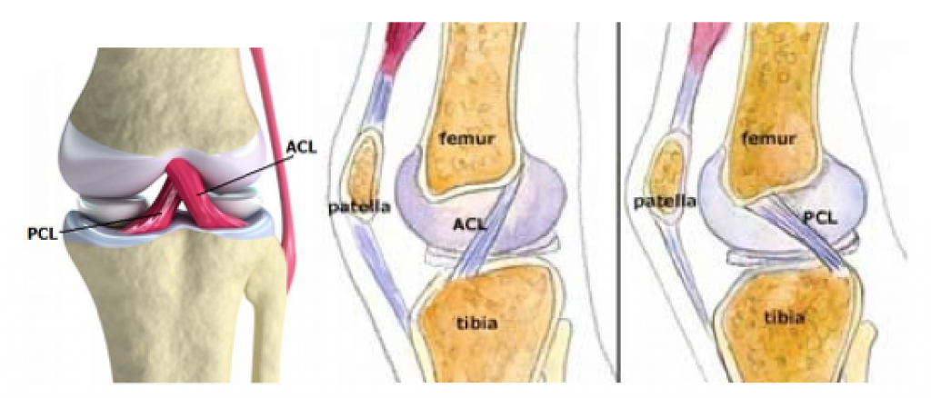
Knee stability
Anteroposterior & rotatory stabilizers
Anterior cruciate ligament (ACL)
Posterior cruciate ligament (PCL)
Both also resist excessive valgus/varus angulation
www.strengthpowerspeed.com

Slide 7
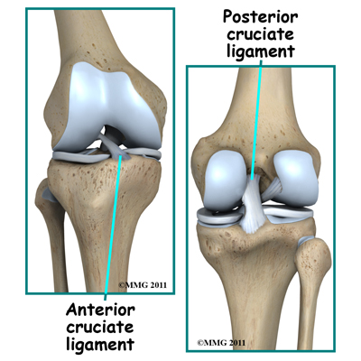
Anterior Cruciate Ligament
Tibial attachment:
Between intercondylar eminence
Femoral attachment:
Posteromedial aspect of lateral femoral condyle

Slide 8
Posterior Cruciate Ligament
Tibial attachment:
Tibial sulcus below articular surface
Femoral attachment:
Anterolaterally on medial femoral condyle

Slide 9
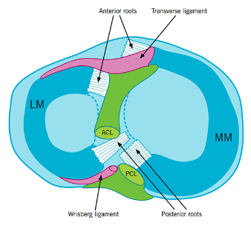
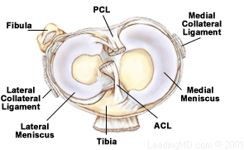
Anatomy (Menisci)
Medial Meniscus
C- shaped
Peripheral 20-30% is vascular
Lateral Menciscus
Round shaped
Peripheral 10-25% vascular
www.aspetar.com

Slide 10
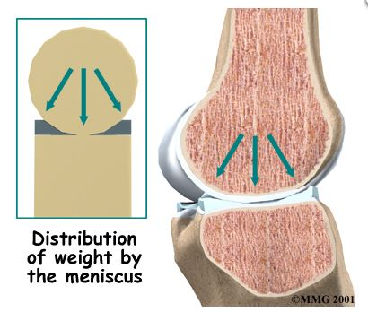

Function of Menisci
Deepen the articular surfaces of tibial plateau
Have role in:
Controlling rolling & gliding actions
Load distribution
Without menisci, load
on articular cartilage
increases five folds
Stability (wedge effect)
/www.partdeal.com

Slide 11
Knee injuries - statistics
Most commonly injured
ACL
MCL

Slide 12
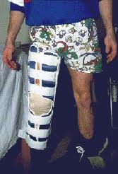
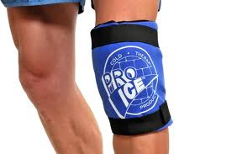
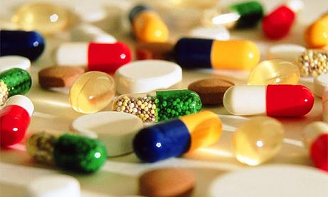
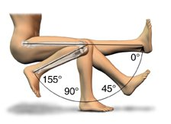
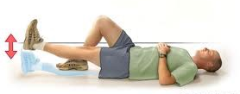
Management of Acute Injury
Rest
Splint
Ice Packs
Analgesia
Exercises:
Quadriceps
Rom

Slide 13
Investigations
X-rays
AP, Lateral

Slide 14
Investigations
X-rays
AP, Lateral
AP standing

Slide 15
Investigations
X-rays
AP, Lateral
AP standing
Skyline

Slide 16
Investigations
X-rays
AP, Lateral
AP standing
Skyline
Stress films

Slide 17
Investigations
MRI: The best to show
Ligament injuries / sprains
Meniscal injuries

Slide 18
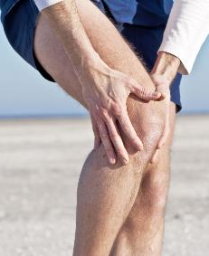
Specific Injuries
Cruciate ligaments:
Anterior Cruciate Ligament (ACL)
Posterior Cruciate Ligament (PCL)
Collateral Ligaments:
Medial Collateral Ligament (MCL)
Lateral Collateral Ligament (LCL)
Menisci:
Medial meniscus
Lateral meniscus
www.verywell.com

Slide 19
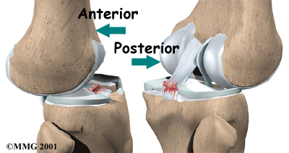
Cruciate ligament tears
Need a strong force to cause a tear
ACL much more common

Slide 20
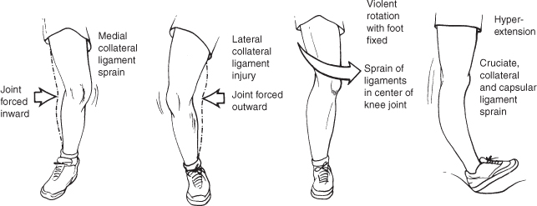
ACL Tears
History of acute injury(sport):
Acute pain
Mechanism of injury:
Violent rotation with flexion
Non-contact pivoting injury
Hearing a “pop”
Swelling – almost immediate (why?)
haemarthrosis
Later-on:
History of giving way (sudden instability of knee)
Repeated attacks of swelling and pain

Slide 21
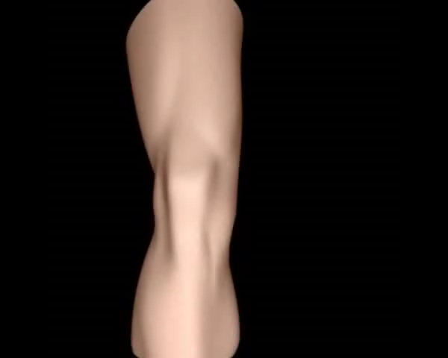
Mechanism of Injury

Slide 22
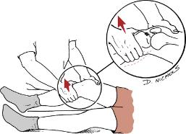
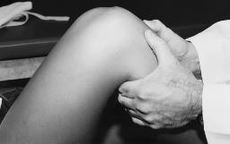
ACL Tears
Signs:
Swelling:
(initially haemarthrosis, later effusion)
Wasting of quadriceps muscle
Special tests:
Anterior drawer
Lachemann's
Pivot shift
https://clinicalgate.com

Slide 23
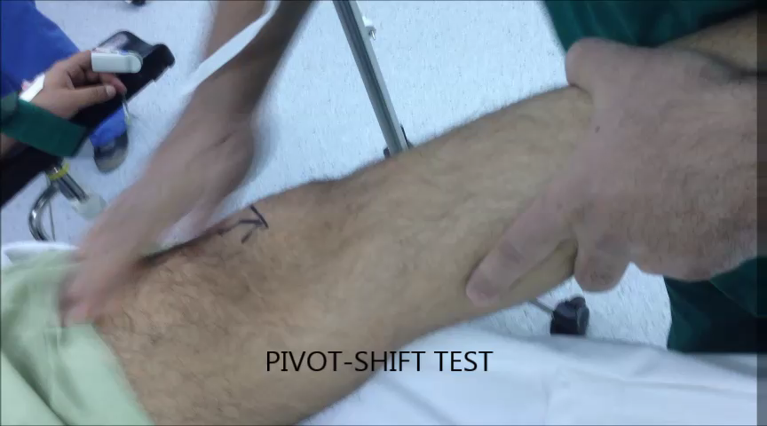
ACL Tears
Clinical Signs

Slide 24
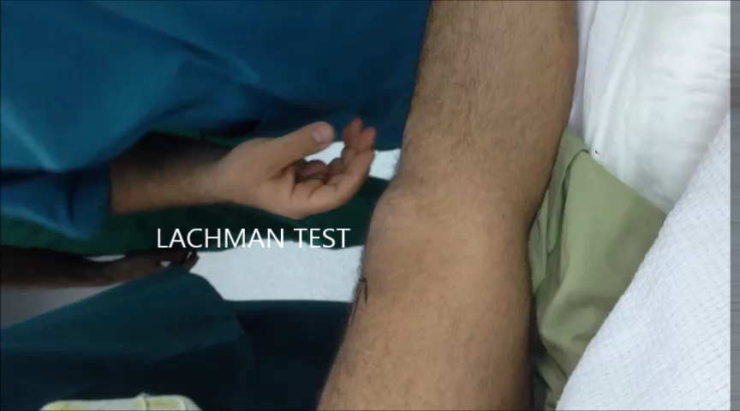
ACL Tears
Clinical Signs

Slide 25
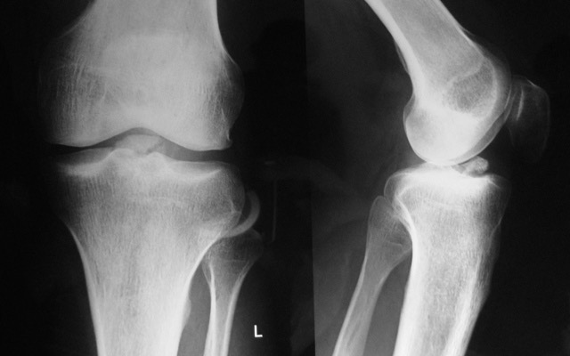
ACL tears - Investigation
Plain X-ray:
Excludes other bony injuries
If there is tibial eminence fracture
Signifyis ACL bony avulsion

Slide 26
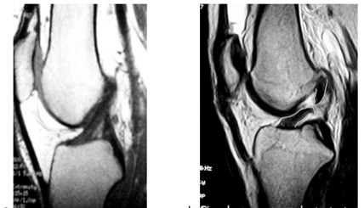
ACL tears - Investigation
MRI (the best to show ACL injuries)

Slide 27
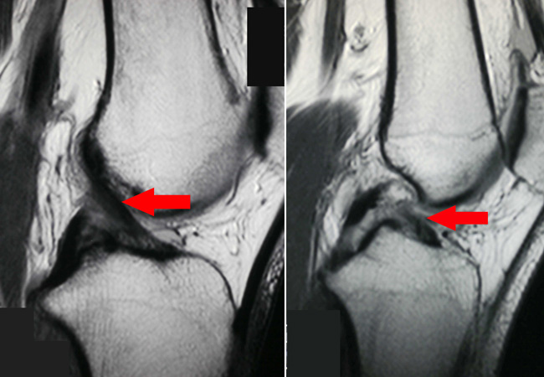
ACL tears - Investigation
MRI (the best to show ACL injuries)
Normal ACL Torn ACL
http://orthoinfo.aaos.org

Slide 28
ACL Tears - Treatment
Treatment is individualized depending on
Age
Level of activity
Instability
Associated injuries
Associated injuries:
Meniscal tears are more common than Lateral Meniscal tears

Slide 29
ACL Tears - Treatment
Conservative
Indications:
Isolated tears with no instability
Partial tears
Less active patient:
Light sport only
Sedentary
Quadriceps and Hamstring strengthening exercises
Reconstruction
Indications:
Associated injuries
Full thickness tears with instability
Patient active in competitive sports
Surgical reconstruction with
Bone-Patella tendon
Hamstring Tendon

Slide 30
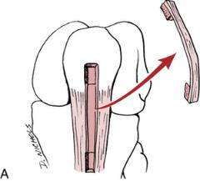


ACL Tears - Treatment
Surgical reconstruction
https://clinicalgate.com
https://youtu.be/Xsq0sQp6DwU

Slide 31
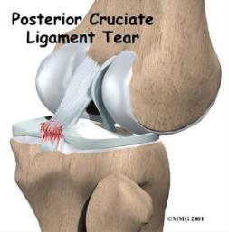
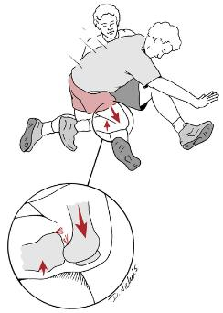
PCL Tears
Less common
Mechanism of injury:
Direct blow to anterior tibia with knee flexed
Dashboard injury
Hyperextension or Hyperflexion
https://clinicalgate.com

Slide 32
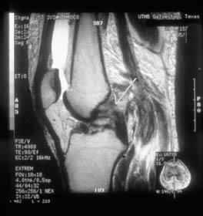
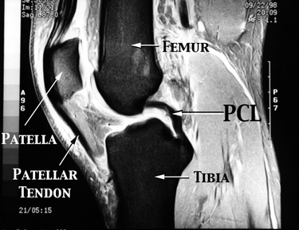
PCL Tear
MRI

Slide 33
Collateral Ligament Injuries
History of acute injury:
Acute pain
Swelling
Mechanism of injury:
Sudden side-way force
MCL>>LCL (why?)

Slide 34
Collateral Ligament Injuries
Signs:
Swelling
Tenderness
(in collaterals / origin / insertion)
Stressing ligament is painful
(in complete tears, stressing ligament may produce abnormal movement with little pain)

Slide 35
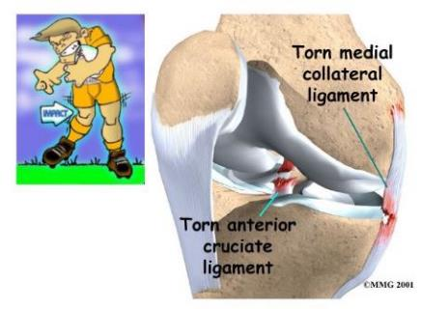
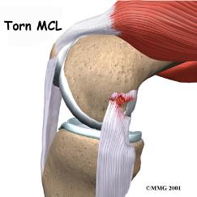
MCL Injury
Valgus stress to the knee
https://m.blog.naver.com

Slide 36
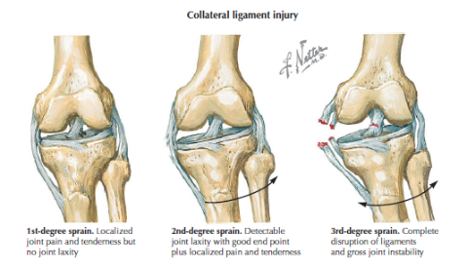
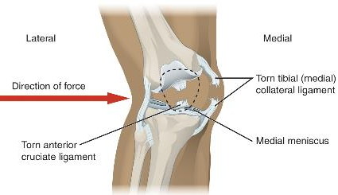
MCL Injury
Valgus stress to the knee
Most commonly occurs at medial femoral attachment
https://en.wikipedia.org/wiki/Knee

Slide 37
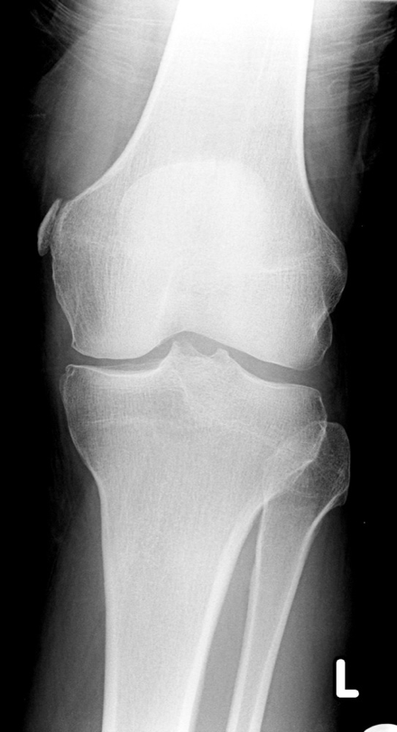
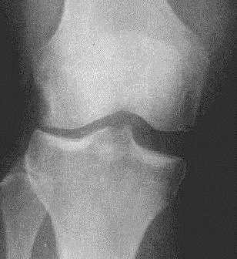
MCL Injury
X-ray
Avulsion Stress Film

Slide 38
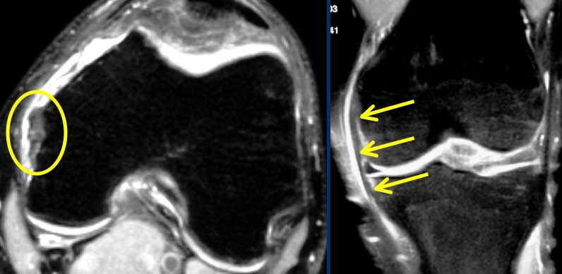
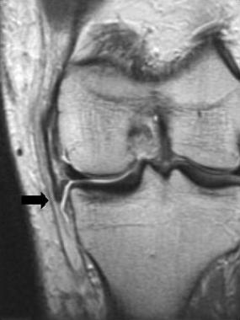
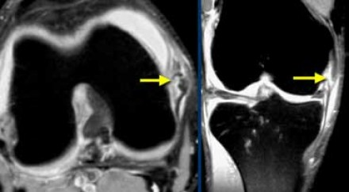
MCL Injury
MRI
http://emedicine.medscape.com

Slide 39
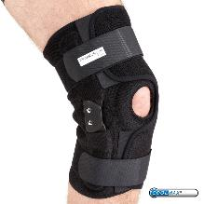
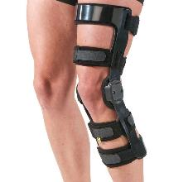
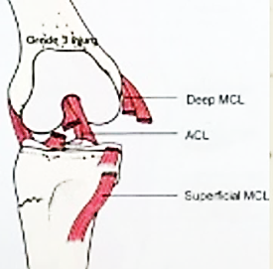
MCL Injury
Treatment:
Hinged Knee Brace for isolated injuries
Combined injuries:
Require reconstruction of the respective ligaments (ACL, PCL, posteromedial corner)
www.hipandkneeadvice.com

Slide 40
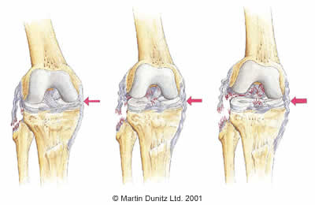
LCL Injury
Isolated LCL injuries
Uncommon
treated conservatively with brace if grade II
Complete tears with associated ACL/PCL requires reconstruction

Slide 41
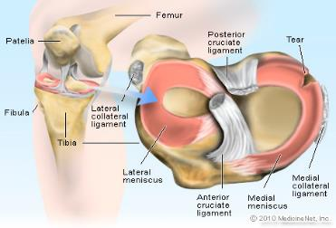
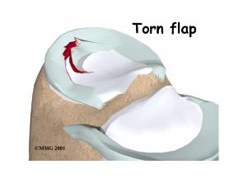
Meniscal tears
Common in young adults – sport injuries
Mechanism of injury:
Weight bearing on flexed knee with twisting
Medial meniscus >> lateral meniscus
? Because it is less mobile / more attached to capsule

Slide 42
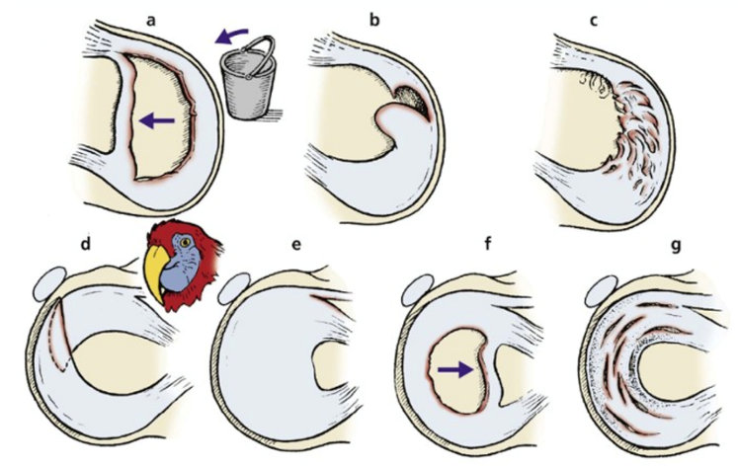

Meniscal tears
Types of tear:
Bucket handle
Flap tear
Oblique “Parrot-beak”
Healing power:
Most is avascular
Therefore: no healing
C
Essential Orthopaedics and Trauma, Davis Dandy
Fifth edition, 2009, Churchill Livingstone, Elsevier

Slide 43
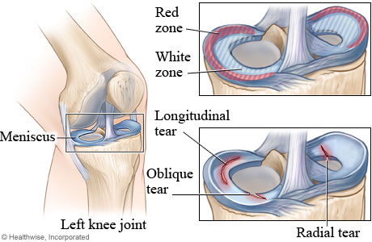

Meniscal Tears
Red zones: have a blood supply (can heal)
Dr. Nabil Ebraheim

Slide 44
Meniscal Tears
Presentation:
Young adults / sport injury
Injury history is not as dramatic as cruciate injuries
Swelling after several hours/next day (why?)
History of locking and/or giving way
Signs:
Wasting of quadriceps muscle
Swelling (effusion)
McMurray test positive

Slide 45


Meniscal Tears
MRI

Slide 46


Meniscal Tears
Treatment is surgical:
Arthroscopy
Peripheral tears:
Operative repair possible (why?)
Other tears: Partial meniscectomy
Remove the displaced portion
Normal meniscus
Torn meniscus
After shaving
http://www.orthopaedie-fachaerzte.de
http://321gomd.com/meniscus-tears

Slide 47
Meniscal Tears
Partial Menisectomy
Tears in white zone
Radial tears
Longitudinal tears
Bucket handle tears
Meniscal Repair
Peripheral, longitudinal tears in red zone ?

Slide 48
Summary
Acute Injuries: splint, ice packs, NSAID & Physiotherapy
Specific Management:
ACL: depends upon the age and activity level
PCL: according to grades
MCL and LCL: depends upon isolated injuries or in combination
Menisci: repair v/s meniscectomy

