Slide 1


Slide 2


Slide 3
LEUKEMIAS
BY
DR WAQAR ALI
ASST. PROFESSOR

Slide 4
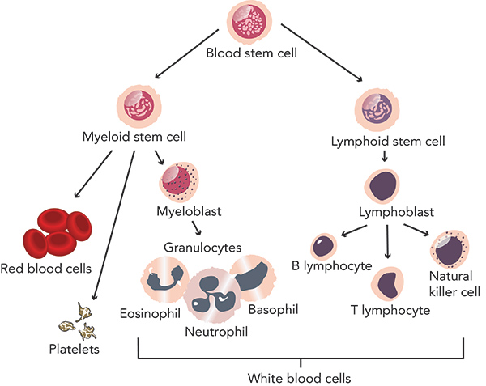
NORMAL HEMATOPOEISIS IN BONE MARROW

Slide 5
DEFINITION
Leukemia is a malignant neoplasm ( cancer) of the of WBCs ( or their precursors) in the bone marrow.
There is an overproduction of these cells and they are “functionally abnormal”

Slide 6
NORMAL HEMATOPOEISIS IN BONE MARROW

Slide 7
CLASSIFICATION OF LEUKEMIAS
LYMPHOID MYELOID
( arising from lymphoid ( arising from
cells) myeloid cells)
Acute Chronic Acute Chronic
A.L.L. C.L.L. A.M.L. C.M.L.

Slide 8
COMPARISON OF ACUTE & CHRONIC
Acute leukemias:
Arise from precursors of WBCs
Symptoms develop quickly & progression is rapid
Leukemic cells are immature looking blast cells
Chr. Leukemias:
Arise from mature WBCS

Slide 9
b. Disease progresses slowly, so symptoms occur after a long time
c. Leukemic cells are mature looking. They are not called blast cells

Slide 10
A.L.L. : Acute lymphoblastic leukemia
C.L.L. : Chronic lymphocytic leukemia
A.M.L. : Acute myeloblastic/myeloid leukemia
C.M.L. : Chronic myeloid leukemia

Slide 11
Acute leukemias are rapidly growing, so if not treated early, they can cause death within a few weeks or months.
Chronic leukemias are slow growing and don’t cause death quickly.

Slide 12
ACUTE LYMPHOBLASTIC LEUKEMIA

Slide 13
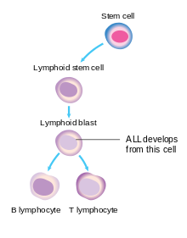
DEFINITION OF A.L.L.
It is a malignancy of lymphoblasts ( a precursor of lymphocytes).
There is overproduction of immature &abnormal lymphoblasts which do not mature into B & T lymphocytes

Slide 14
PATHOGENESIS
Due to genetic damage in the lymphoblast, there is uncontrolled production of these cells.
Excess lymphoblasts which are produced, are the leukemic cells( cancer cells). They don’t mature into normal lymphocytes.
These leukemic cells infiltrate the marrow & replace the normal RBC, WBC & platelets.
They come into the blood & spread to other organs also.

Slide 15
GENERAL POINTS
1) Age group:
* Mostly seen in children ( peak is b/w 2-5 yrs)
* Second peak occurs in old age ( above 50)
2) Increased risk in Down’s syndrome patients
3) In children, the response to treatment is very
good (90% cure rate)

Slide 16
S/S
General weakness, fatigue (due to anemia)
Recurrent infections ( due to low numbers of normal WBCs). Fever is the most common presentation.
Bleeding, easy bruising (due to thrombocytopenia)
CNS involvement ( headache, cranial nerve palsies etc.)
Enlarged nodes,hepatomegaly,splenomegaly

Slide 17
DIAGNOSIS
CBC Peripheral Bone marrow Flow
Smear biopsy cytometry
CBC: * Anemia * Low platelets
* Very high WBC count ( very high
lymphoblasts)

Slide 18
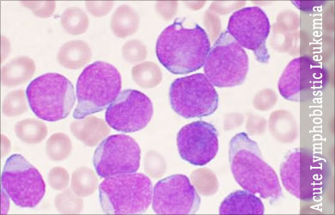
Contd.
2) Peripheral Smear: excess lymphoblasts
which are large abnormal cells with large nucleus & very little cytoplasm

Slide 19
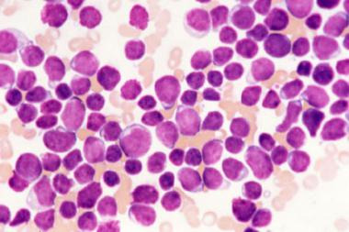
3) Bone marrow biopsy shows excess lymphoblasts ( more than 30% of marrow cells are abnormal lymphoblasts)

Slide 20
4) Flow cytometry: Cancer cells have certain abnormal antigens on their surfaces which we can detect in the lab. by flow cytometry.
In ALL, TdT antigen is positive on the cell surface

Slide 21
After diagnosis, CT scan is done to find any metastases in other body organs

Slide 22
TREATMENT
MAINLY CHEMOTHERAPY
Drugs Used: Vincristine, Dexamethasone, Asparaginase, Daunorubicin, Cytarabine etc.
Very Dark And Dirty Clothes (VDADC)
HOW CHEMO IS GIVEN
Induction Consolidation Maintenance
phase phase phase

Slide 23
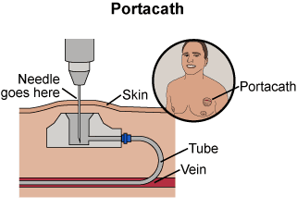
Chemo in cancers is given through a port-a-cath

Slide 24
Treatment ( contd)
Induction phase:
This is the first phase of treatment
Aim is to kill most cancer cells quickly to achieve remission.
2) Consolidation phase:
This is the second phase of treatment
Chemotherapy is given to further reduce the tumor cells

Slide 25
Treatment contd.
3) Maintenance phase:
This is the last phase
Aim is to kill any remaining cancer cells, to prevent relapse
Given for 2 to 3 yrs with a combination of drugs (oral MTX, Mercaptopurine, Vincristine & prednisone)
A.L.L. frequently involves the CNS, so prophylactic chemotherapy (Cytarabine + Methotrexate) is given intrathecally, sometimes combined with radiotherapy.

Slide 26
OTHER TREATMENTS
* Stem cell transplant ( if it recurs after
chemo)
* Gene therapy
For bone pain due to mets, local
radiotherapy is given

Slide 27
PROGNOSIS
Prognosis is very good in children
* Cure rate is almost 90% in children
* Survival rate in adults is not so good ( 30%)
2) With new treatments, cure is possible in
some adults also.

Slide 28
SUMMARY POINTS
Mostly seen in children ( ATFALL)
Arises from lymphoblasts
Main treatment is chemo, with maintenance chemo for 2 yrs.
Very good response in children
“May” be cured in some adults also
Treatment : Very Dark And Dirty Clothes

Slide 29


