Slide 1
LEUKEMIAS
BY
DR WAQAR ALI
ASST. PROFESSOR

Slide 2
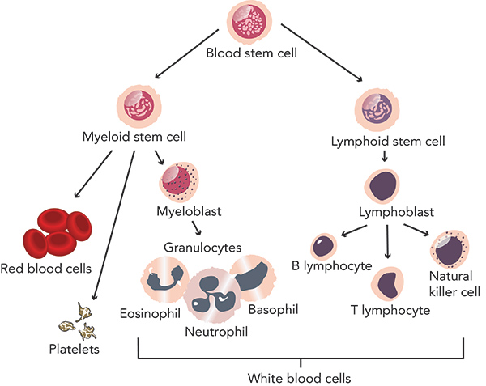
NORMAL HEMATOPOEISIS IN THE BONE MARROW

Slide 3
DEFINITION
Leukemia is a malignant neoplasm ( cancer) of the WBC or their precursors in the bone marrow.
There is excess formation of these cells and they are functionally abnormal
If it develops from the myeloid stem cells, it is called Myeloid leukemia, and if it develops from lymphoid stem cells, it is called Lymphoid leukemia.

Slide 4
CLASSIFICATION OF LEUKEMIAS
LYMPHOID MYELOID
( arising from lymphoid ( arising from
cells) myeloid cells)
Acute Chronic Acute Chronic
A.L.L. C.L.L. A.M.L. C.M.L.

Slide 6
ACUTE MYELOBLASTIC LEUKEMIA
Pathogenesis: Genetic damage in the myeloblast causes excess proliferation
too many abnormal myeloblasts are produced which don’t function normally.
These leukemic cells accumulate in the marrow and also enter the blood & other organs

Slide 7
Age Group: Mostly seen in old people (middle to old age).
Classification of AML:
* W.H.O. classification
* F.A.B. classification(French-American-British)
Classification is based on the appearance of cells, immuno-phenotyping and genetic abnormality in the cells

Slide 8
RISK FACTORS
Myelodysplastic Syndrome (MDS): A patient with MDS has increased risk of getting AML
Chemotherapy for other cancers can also increase the risk of AML
Radiation exposure : eg cancer radiotherapy
( radiologists don’t have a high risk due to
modern day safety practices in X-Ray rooms)

Slide 9
Risks ( contd)
4) More chance in genetic diseases like Down’s
syndrome ( 10-18 times more) .
( Down’s syndrome more chances of ALL and AML)

Slide 10
S/S
S/S occur mainly due to replacement of normal cells of the marrow by the leukemic cells. So,
Low RBCs: Features of anemia ( fatigue etc)
Low WBC : Infections
Low platelets: Bruising/ bleeding
Also, leukemic cells can infiltrate other organs &
cause hepatomegaly, splenomegaly , lymph node enlargement, gum hypertrophy ,CNS involvement

Slide 11
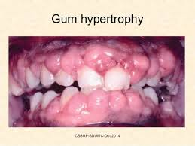

Slide 12
Sometimes, patients are asymptomatic & discovered only on routine blood tests.

Slide 13
DIAGNOSTIC TESTS
CBC
* Very high WBC count ( rarely norm. or low)
( the high WBCs are mostly myeloblasts)
* Anemia * Low platelets
2) Peripheral Smear:
* Shows characteristic myeloblasts with Auer rods ( intracellular needle shaped body)

Slide 14
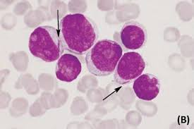
Blats cell w/ Auer rods

Slide 15
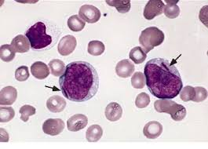
Blast cell w/ Auer rods

Slide 16

HOW TO REMEMBER?
Professor AMaL beats with RODS

Slide 17
Tests ( contd)
3) Bone Marrow: Shows excess immature myeloblasts ( more than 20% cells in the marrow)
Other cell lines are decreased ( RBC, mature WBC, platelets) because the leukemic cells have replaced them.
4) Flow cytometry: Detects certain abnormal antigens on the surface of the cancer cells

Slide 18
TREATMENT
In many cases, AML is curable but the chance of cure depends on many factors specially chromosomal pattern in the cancer cells.
Treatments used are:
Chemotherapy : Cytarabine, Daunorubicin
Stem cell transplant ( if chemo. fails or there is relapse of the cancer)
Treatment of Anemia & thrombocytopenia
Treatment of infections

Slide 19
CAUTION !
In any leukemia, before starting chemo., first always treat the anemia, thrombocytopenia & any infections

Slide 20
PATTERN OF CHEMO
Treatment is given in 2 phases:
INDUCTION PHASE:
* The start of chemo. This kills most cancer cells & they become undetectable. This is called “remission” of the cancer.
Drugs used: Cytarabine plus Daunorubicin
Pattern: 7 + 3 pattern ( 7 days of iv Cyta plus first 3 days iv Dauno also)

Slide 21
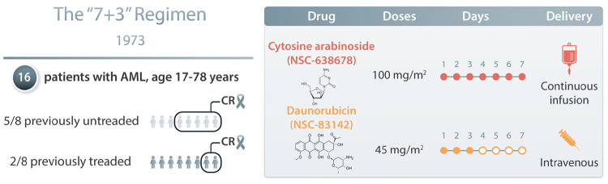
7 + 3 pattern

Slide 22
Contd.
2) CONSOLIDATION PHASE:
* Even after induction chemo., some cancer cells are left behind.
* So, chemo. is given for a few more cycles to completely destroy the hidden cells.
Which drug? : High dose Cytarabine

Slide 23
PROGNOSIS
Overall prognosis is good and it is a curable cancer in many cases
Prognosis is poor if:
* if it is secondary to MDS or radiation
exposure or secondary to chemotherapy for
another cancer.
* if the leukemic cells have certain
chromosomal abnormalities
* Old age, more than 60 years

Slide 24
PROGRESSION
As an acute leukemia, it progresses rapidly and is fatal within a few months if left untreated

Slide 25


