Slide 1
CHRONIC LYMPHOCYTIC LEUKEMIA ( CLL)

Slide 2
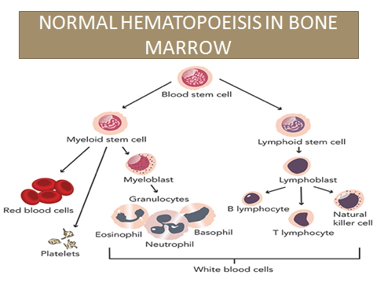
NORMAL HEMATOPOEISIS

Slide 3
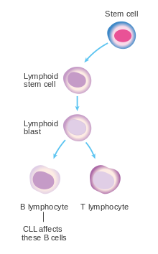
CLL is a malignancy of B
lymphocytes.

Slide 4
DEFINITION
It is a malignancy of the B lymphocytes. There is excess production of B lymphocytes which are normal looking but not functioning normally (can’t produce antibodies).
* It is a disease of old age(usually above 50)

Slide 5
NATURAL COURSE
It is a slow growing cancer and patients may be asymptomatic for many years.
The leukemic cells infiltrate the marrow and replace the RBC, platelets & other WBCs.
The cells then come in the blood and spread to other organs (mets)

Slide 6
S/S
1) Asymptomatic. Incidental finding of high
WBC count.
2) Lymph node enlargement
3) Hepatomegaly, splenomegaly
4) Fatigue, weakness (due to anemia)
5) Infections ( due to non-functional B lymphos)
6) Bleeding ( due to low platelets)

Slide 7
DIAGNOSIS
CBC
* Very high WBC count ( lymphocytes).
( a very high lymphocytosis in an old patient
be alert !)
* Low RBCs & Platelets
2) Peripheral blood smear:
* Excess lymphocytes
* Smudge cells in the blood: B lymphocytes in the blood which get damaged during slide preparing

Slide 8
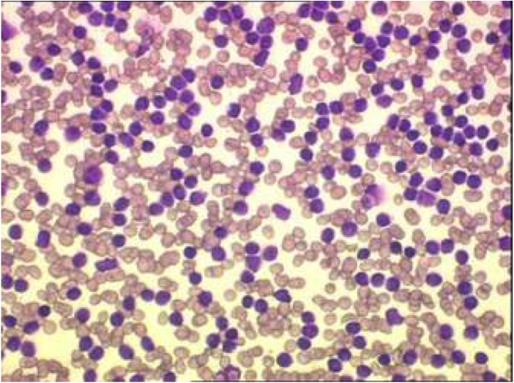
PERIPHERAL SMEAR IN CLL
EXCESS OF “B” LYMPHOCYTES( purple color)

Slide 9
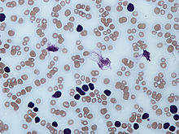
Smudge cells ( broken B lymphocytes)

Slide 10
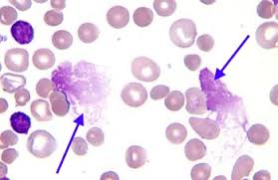
SMUDGE CELLS

Slide 11
3) Bone Marrow : Excess B lymphocytes
4) Flow cytometry: Abnormal B lymphocytes in the blood can be identified by this method.

Slide 12
STAGES
RAI Staging system ( 5 stages)
Stage 0 : Only lymphocytosis
Stage 1: Lympho. + lymph node enlargement
Stage 2: Lympho. + hepatosplenomegaly, +/- above
Stage 3: Lympho. + anemia, +/- above
Stage4 : Lympho.+ thrombocytopenia, +/- above

Slide 13
Cause of anemia & low platelets in CLL:
Infiltration of the bone marrow
Autoimmune hemolytic anemia ( antibodies are produced which destroy the RBC & platelets)

Slide 14
TREATMENT
SOME GENERAL POINTS
No treatment is given in early stages ( stage 0 & 1) because it does not improve survival
CLL progresses very slowly and some patients
with stage 0 and 1 lead normal & active lives
without treatment

Slide 15
Treatments for CLL
Mainly chemotherapy
Monoclonal antibodies used if poor
Stem cell transplant response to
chemo.

Slide 16
DRUGS USED
1) CHLORAMBUCIL
2) CYCLOPHOSPHAMIDE
3) FLUDARABINE
4) RITUXIMAB ( a monoclonal antibody)
For CLL treatment = Chocolate Cake From Riyadh

Slide 17
Some new drugs
Tyrosine kinase inhibitors
Monoclonal antibodies ( like rituximab)

Slide 18


