Slide 1
CHRONIC MYELOID LEUKEMIA (CML)
By:
Dr Waqar
Asst. Professor
Maarefa University

Slide 2
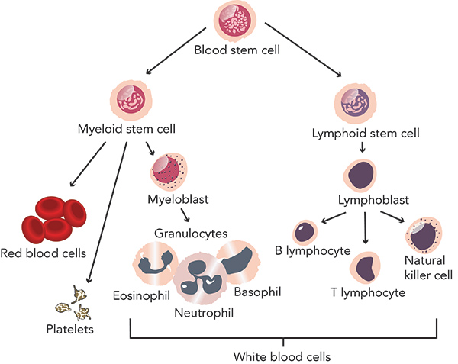
NORMAL WBC FORMATION

Slide 3
CML DEFINITION
It is a malignancy of WBCs in which there is excess production of myeloid cells (neutros.,basophils & eosinophils). The cells are mature looking but functionally abnormal.

Slide 4
REMEMBER !
AML is also a malignancy of myeloid cells but:
It runs an acute course ( rapid)
The leukemic cells are immature looking “blasts”( myeloblasts) & the cell of origin is an earlier precursor of WBCs
( remember, blast cell is always an immature cell & seen in acute leukemias)

Slide 5
SOME GENERAL POINTS
It has an insidious and gradual onset.
Occurs in middle to old age (around 55)
The cancer cells contain an abnormal chromosome called “Philadelphia chromosome” having the bcr/abl gene
In most cases, it is curable
The drug IMATINIB has revolutionized the treatment & prognosis

Slide 6


Ph chromosomes with bcr/abl gene

Slide 7
EPIDEMIOLOGY
Age group : Middle to old age. Rare in children
Gender: Slightly more in males
Accounts for 8% of all leukemias in U.K.

Slide 8
PHASES OF CML
CML is classified into 3 phases , based on clinical features and lab findings:
Chronic Accelarated Blast
phase phase crisis

Slide 9
CHRONIC PHASE
* This is the initial phase & lasts for 3-4 yrs, if no
treatment is given
* Tumour grows slowly & gradually
* Patients often asymptomatic initially & discovered on routine CBC ( v. high WBC)
* Later, maybe fatigue, wt. loss, night sweats, huge
spleen causing abdominal heaviness.
* Fever, night sweats, recurrent infections
* If treatment is not given, this progresses into the
next phase.

Slide 10
ACCELERATED PHASE
* The cancer grows faster during this phase &
WBC count rises fast
* There are specific W.H.O. criteria for diagnosis
of accelerated phase ( increased no. of
basophils & blast cells, spleen size etc)

Slide 11
BLAST CRISIS
* Final phase in the course of CML (if no treatment was given)
* Cancer progresses very rapidly and quick
death occurs (behaves like acute leukemia)
* Excess “blast” cells can now be seen in the
bone marrow & blood
* Patients present with fever, anemia, bleeding,
& infections (more severe now.)

Slide 12
If treatment is given during the chronic phase, it may stop the tumor progression into the next phases

Slide 13
S/S
Depend on the phase of the disease at the time of diagnosis :
Asymptomatic
Fatigue, weakness, wt. loss, fever, night sweats
Splenomegaly ( often massive)
Hepatomegaly, lymph node enlargement
Features of anemia, bleeding & infections

Slide 14
DIAGNOSIS
1) Blood:
* Very high WBC count usually 150,000)
* High neutros., basophils & eosinophils
( myeloid cells)
* Low Hb., low platelets
2) Bone Marrow :
* Hypercellular, with very high number of
myeloid cells

Slide 15
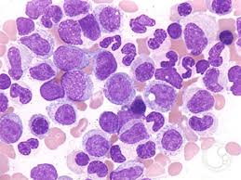
BLOOD FILM

Slide 16
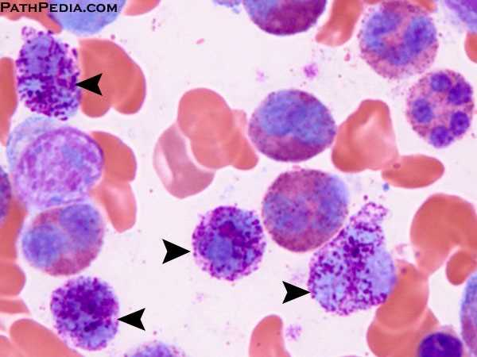
BLOOD FILM

Slide 17

BONE MARROW
Note the excess myeloid series cells

Slide 18
Diagnosis (contd)
3) Cytogenetics ( gene analysis of the cells)
* Leukemic cells have the Philadelphia
chromosome (Ph chromosome) / bcr-abl gene

Slide 19
TREATMENT
1) Chronic phase :
* Imatinib ( tyrosine kinase inhibitor)
* Introduced in 1999/2000. Very good survival
rates with this drug (response in more than
95% cases).
* Given for 2 years , can be repeated for a relapse
2) Accelerated & blast phase:
* These phases treated like acute leukemia( more aggressive treatment with other chemo drugs, plus imatinib)

Slide 20
PROGNOSIS
*Greatly improved after “tyrosine kinase
inhibitors”
3) Bone marrow transplant/ Stem cell transplant

Slide 21


