Slide 1
PARASITIC INFECTIONS
DR FAROOQ
FRCP
ASSOCIATE PROFESSOR

Slide 2
MALARIA
GIARDIA
ENTAMEBA
LEISHMANIA
WORMS (ASCARIS, TAP WORM)
ECCHINOCOCCUS

Slide 3
AMOEBIASIS
Infection by the parasite Entamoeba is called
amoebiasis. There are 2 main species:
Entamoeba Dispar:
* Most common entamoeba
* Always asymptomatic * No treatment given
2) E. Histolytica:
* Can be symptomatic or asympt
* Treatment is given in all cases

Slide 4
MODE OF SPREAD
It is by fecal contamination of food & water. So, very common in areas of poor sanitation & unhygienic conditions
Spread by flies or the use of human feces as fertiliser for plants

Slide 5
PATHOGENESIS
Amebic cysts in the food enter the GI tract
In the colon, cysts change to trophozoites, which cause diarrhea

Slide 6
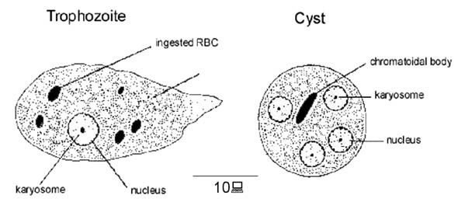
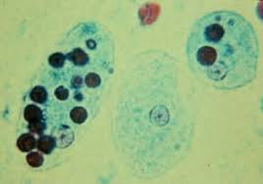
Stool sample

Slide 7
What can E. Histo. produce?
Asymp. Infec. Diarrheal disease Liver abscess
Many people may have E. histo. cysts in their stool but no symptoms (asymptomatic). They also need treatment (as said, E. Histolytica always needs treatment)

Slide 8
Asymptomatic Infection
These patients have cysts only, no trophozoites.
Treat with one of the following:
1) Di-loxa-nide furoate 7
2) Iodo-quinol to
3) Paromomycin 10
days
(DIP)

Slide 9
Diarrheal Disease
Usually, it causes mild to moderate disease
Diarrhea, but no gross blood
Gas, abdominal pain
No fever
Increased bowel sounds
In case of severe diarrhea(dysentery) or colitis :
10- 20 stools /day
Blood in stools
Fever, weakness, vomiting
Abdominal pain & tenderness

Slide 10
COMPLICATIONS
Severe dysentery may cause intestinal perforation with high mortality rates
Mild/moderate infection, if not treated, may cause chronic diarrhea with weight loss

Slide 11
INVESTIGATIONS
Stool analysis shows:
* Cysts & trophozoites of Entamoeba
* Blood & WBCs
3) Stool antigen test: E. Histo. antigens positive
4) Serology(to detect antibodies) is available but not recommended
5) In case of asypmtomatic infec., only cysts are seen in the stool

Slide 12
TREATMENT OF DIARRHEAL ILLNESS
Metronidazole (flagyl) 500 mg TID (10days)
+
2) Diloxanide furoate (kills the cysts)
3) Increased fluids

Slide 13
Liver abscess by E. Histo.
Usually occurs without prior diarrheal illness
Some patients may have diarrheal illness followed by liver abscess.
Pain in RHC
Fever +/- chills & sweating
Hepatomegaly +/-
Tender liver (if palpable)

Slide 14
Investigation
Ultrasound shows abscess (but it can be any abscess)
2) Serology for anti amoeba antibodies is a very good test
3) Sometimes, aspiration of the abscess is done.
It shows brownish yellow pus (ANCHOVY SAUCE) check for E. histo. antigens

Slide 15
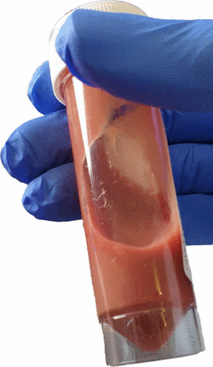

ANCHOVY SAUCE

Slide 16
TREATMENT OF ABSCESS
Drain the abscess if it is very large or patient is very sick.
Otherwise
2) Metronidazole (flagyl) + Diloxanide furoate
( same doses as in diarrhea)

Slide 17
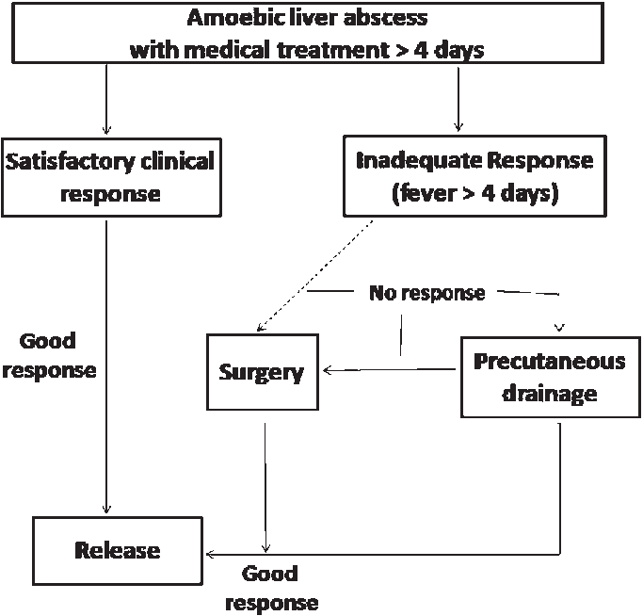

Slide 18
Recape
So:
* Asymptomatic infection DIP
* Acute diarrhea M+D
* Abscess M+D and/or drainage
D: diloxanide I: iodoquinol P: paromomycin
M: metronidazole

Slide 19
ECHINO COCCOSIS
It is a parasitic infection caused by the tapeworm Echinococcus. It produces cysts in liver, lung, brain etc.
Also called hydatid disease
It is a zoonosis (?)

Slide 20
2 types of Echinococcus tapeworms can cause disease in humans:
E. Granulosus E. multi-locularis
Causes cystic echi causes alveolar nococcosis echinococcosis

Slide 21
Transmission to humans
Primary host: usually dogs & sheep
Humans can get infection by fecal oral route ( infected animal’s feces contains the eggs contaminates food /water ingestion by humans infection)
In human GIT, eggs hatch into larva penetrate the intestinal wall reach different organs and there, form a cyst (hydatid cyst)

Slide 22
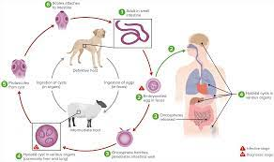
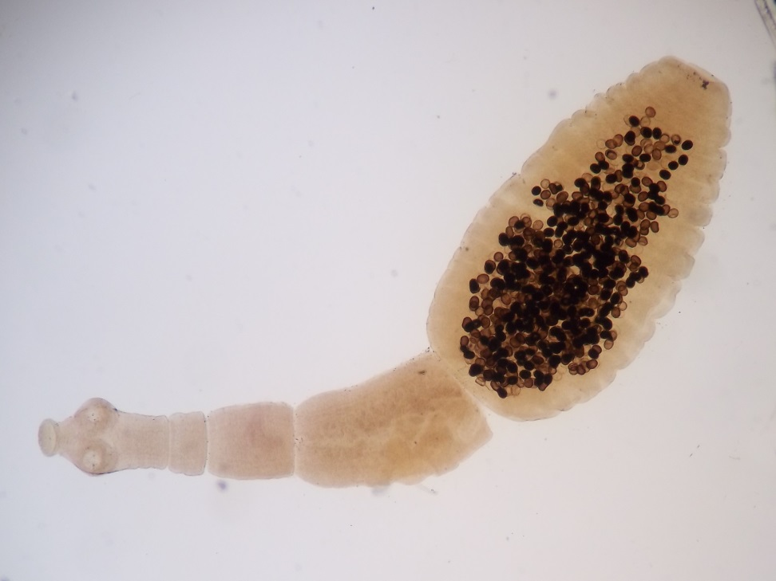
LIFE CYCLE
PARASITE

Slide 23
INCUBATION PERIOD: Many years ( 5 to 10 yrs)
S/S
Cystic echinococcosis:
* Caused by E. granulosus
* Usually a single hepatic cyst (hydatid cyst)
* May be asymptomatic or cause hepatomegaly, nausea, malaise, RUQ pain
* Cyst in the lungs may cause cough, chest pain, dyspnea, hemoptysis

Slide 24
B) Alveolar echino.
* Caused by E. multilocularis
* Much more aggressive than cystic type

Slide 25
INVESTIGATIONS
CBC: May show eosinophilia
Anti echinococcus antibodies in the blood
Ultrasound of the liver:
* Shows smooth walled cyst in the liver, with
eggshell calcification & daughter cysts
& septa
4) CT scan:
* Gives more details
* Best test for evaluating extra hepatic cysts
( brain, lungs)

Slide 26
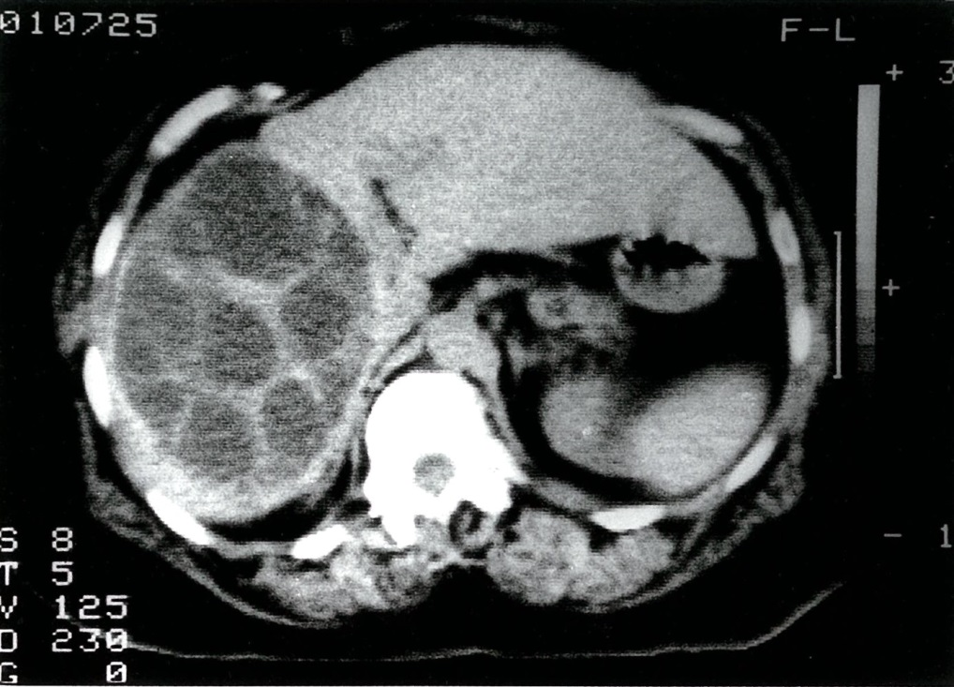
CT ABDOMEN

Slide 27
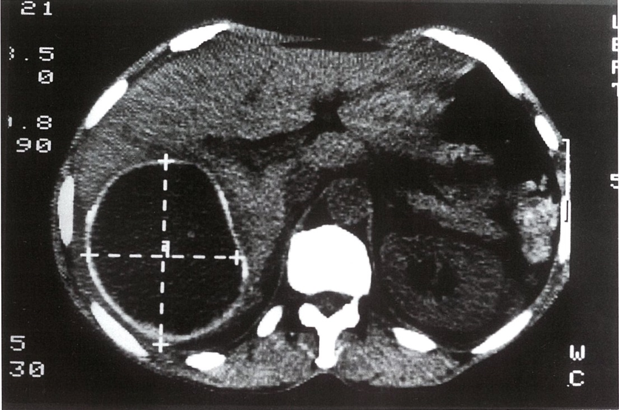
CT ABDOMEN

Slide 28
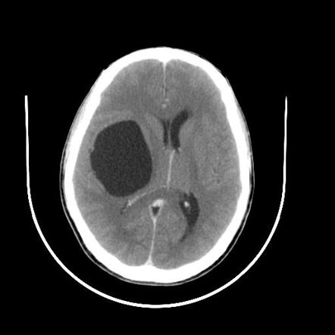
CT BRAIN

Slide 29
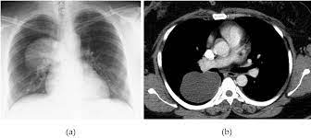
Pulmonary hydatid Cyst

Slide 30
TREATMENT
Small cyst:
* Medical therapy only (Albendazole)
* Alternative drugs: Mebendazole,
Praziquental

Slide 31
TREATMENT (contd)
C) Large or complicated cysts( eg hemorrhage, infection):
* Surgical resection of the whole cyst

Slide 32
IMPORTANT !
Any invasive procedure of the cysts, like aspiration or surgery, should be done with extreme care, avoiding any spilling of cyst contents into the peritoneal cavity. Spillage can lead to fatal anaphylaxis and shock & also spread of the daughter cysts

Slide 33
References
www.cdc.gov/parasites/echinococcosis
www.who.int/mediacentre/factsheets

