Slide 1
Sarcoidosis
DR FAROOQ SATTAR DHEDHI

Slide 2
Introduction
Sarcoidosis is a multisystem granulomatous disorder of unknown cause.
Characterised by non-caseating granulomas in affected organs.
Most commonly affects lungs, lymph nodes, skin, and eyes.
Can present acutely or chronically.

Slide 3
Epidemiology
Worldwide distribution, more common in northern Europe and African Americans.
Peak incidence: young adults (20–40 years).
Slight female predominance.
Genetic and environmental factors.

Slide 4
Pathophysiology
Granulomatous inflammation with non-caseating granulomas.
Exaggerated immune response to unknown antigen.
CD4+ T cells and macrophages play key role.
Leads to organ damage and fibrosis in chronic cases.

Slide 5
Clinical Manifestations
Pulmonary (>90%)
Cutaneous (25-35%)
Ocular (10-25%)
Dyspnea, dry cough, chest pain
Erythema nodosum
Anterior uveitis
Hilar lymphadenopathy
Lupus pernio
Conjunctival granulomas
May progress to pulmonary fibrosis
Maculopapular lesions
Lacrimal gland enlargement
Cardiac (5-10%)
Neurological (5-10%)
Metabolic (10-15%)
Conduction defects
Cranial nerve palsies
Hypercalcemia
Cardiomyopathy
Peripheral neuropathy
Hypercalciuria
Sudden cardiac death
Seizures, encephalopathy
Kidney stones, nephropathy

Slide 6
Clinical Features – General
Can be asymptomatic (incidental finding on chest X-ray).
Constitutional symptoms: fever, fatigue, weight loss, night sweats.
Organ-specific manifestations depend on site of involvement.

Slide 7
Clinical Features – Pulmonary
Most common site of involvement (~90%).
Dry cough, dyspnoea, chest pain.
Bilateral hilar lymphadenopathy on chest X-ray.
Pulmonary fibrosis in chronic disease.

Slide 8
Clinical Features – Skin & Eyes
Skin: Erythema nodosum, lupus pernio, maculopapular rash.
Eyes: Uveitis, conjunctivitis, lacrimal gland enlargement.
Risk of visual impairment if untreated.

Slide 9
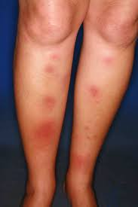

Slide 10
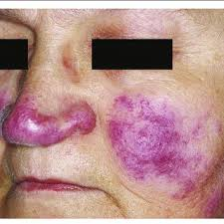
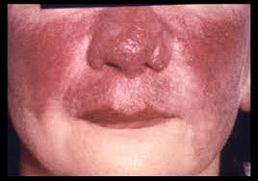

Slide 11
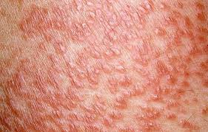

Slide 12
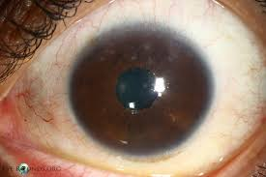
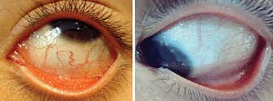
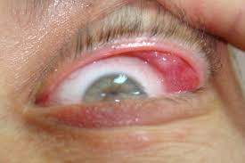

Slide 13
Clinical Features – Other Organs
Liver and spleen: hepatosplenomegaly.
Heart: arrhythmias, cardiomyopathy.
Kidneys: hypercalcemia, nephrocalcinosis.
Nervous system: cranial nerve palsies (esp. facial nerve).

Slide 14
Investigations
Chest X-ray: bilateral hilar lymphadenopathy, interstitial changes.

Slide 15
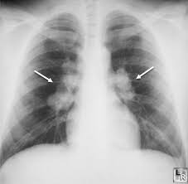

Slide 16
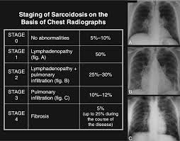

Slide 17
HRCT: pulmonary infiltrates, fibrosis.

Slide 18
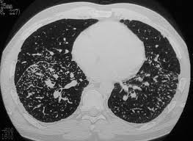
Sarcoidosis – Clinical Images
Insert clinical images here:
• Bilateral hilar lymphadenopathy (X-ray)
• Erythema nodosum
• Lupus pernio
• Non-caseating granuloma histology

Slide 19
Blood:
↑ serum ACE, ↑ calcium, ↑ ESR.
Biopsy:
non-caseating granulomas (diagnostic).
Exclude TB and fungal infections.

Slide 20
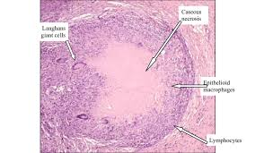
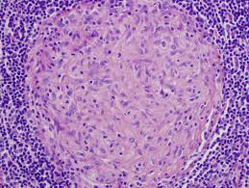

Slide 21



Diagnostic Criteria: Confirming Sarcoidosis
Exclusion of Other Granulomatous Diseases
Histopathological Confirmation
Clinical and Radiological Suspicion
Non-caseating epithelioid granulomas in one or more organs
Rule out infections, malignancy, and other granulomatous disorders
Compatible symptoms and imaging findings (often incidental)
Differential Diagnosis
Infections
Malignancies
Autoimmune
Tuberculosis, fungal infections, non-tuberculous mycobacteria
Granulomatosis with polyangiitis, eosinophilic granulomatosis
Lymphoma, lung cancer, metastatic disease

Slide 22
Differential Diagnosis
Tuberculosis.
Lymphoma.
Fungal infections (e.g., histoplasmosis).
Hypersensitivity pneumonitis.
vasculitis

Slide 23
Löfgren syndrome,
characterized by acute onset of erythema nodosum, bilateral hilar lymphadenopathy, fever, and arthritis.

Slide 24
Heerfordt syndrome (uveoparotid fever
involves uveitis, parotid gland swelling, fever, and facial nerve palsy

Slide 25
Management
Asymptomatic/mild cases may resolve spontaneously.
Corticosteroids: mainstay of treatment.
Immunosuppressants: methotrexate, azathioprine in resistant cases.
Symptomatic treatment for organ involvement.
Regular monitoring for complications.

Slide 26
Prognosis
Many cases resolve spontaneously within 2–5 years.
Chronic progressive disease in ~20%.
Poor prognosis with cardiac, neurological, or fibrotic lung involvement.

Slide 27
Summary
Sarcoidosis is a multisystem granulomatous disease of unknown cause.
Non-caseating granulomas in affected organs.
Common sites: lungs, lymph nodes, skin, eyes.
Diagnosis: biopsy + exclusion of infections.
Treatment: corticosteroids, immunosuppressants if needed.
Prognosis usually good, but variable.

