Slide 1
CNS CLINICAL EXAMINATION
DR. M. SOFI MD; FRCP (LONDON); FRCPEdin; FRCSEdin

Slide 2
Steps in the neurologic examination
In examining a patient, abnormalities of function lead to localization and, eventually, to the pathophysiology.
These steps include the following:
  General Appearance, including posture, motor activity, vital signs and perhaps meningeal signs if indicated.
  Mini Mental Status Exam, including speech observation.
  Cranial Nerves, I through XII.
  Motor System, including muscle atrophy, tone and power.
  Sensory System, including vibration, position, pin prick, temperature, light touch and higher sensory functions.
  Reflexes, including deep tendon reflexes, clonus, Hoffman's response and plantar reflex.
  Coordination, gait and Romberg's Test
  Examining the comatose patient

Slide 3
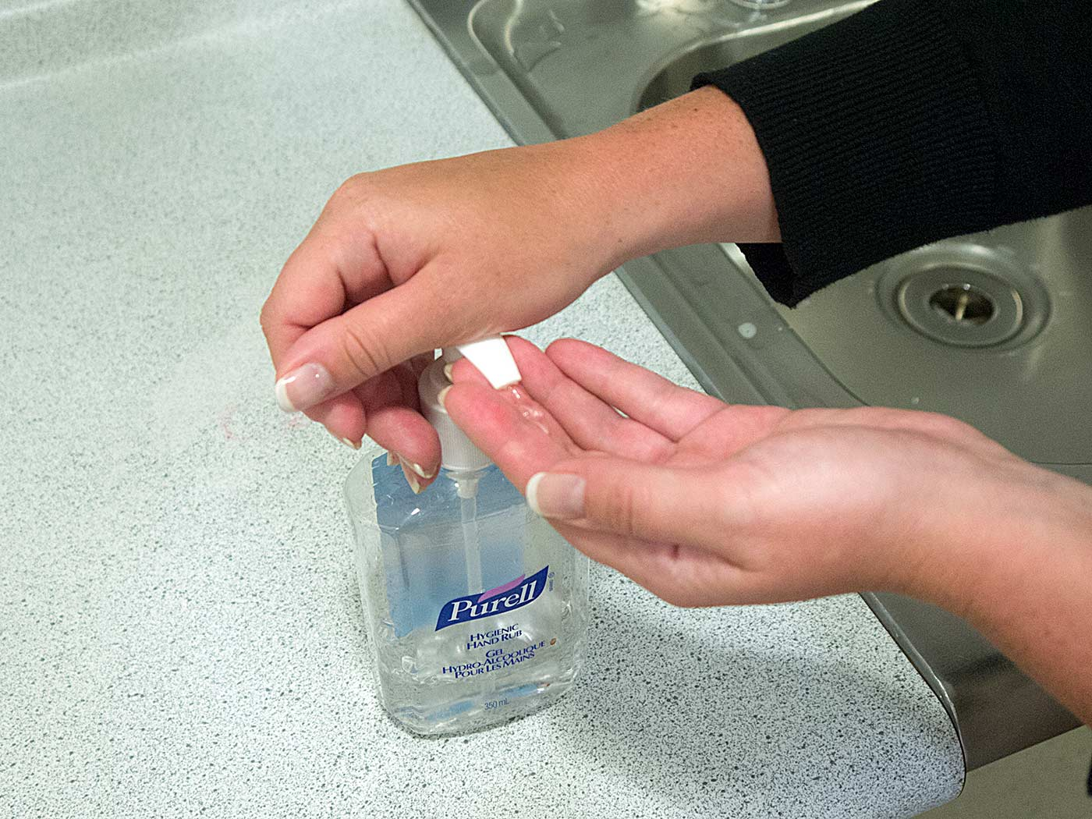
Wash your hands, introduce yourself to the patient and clarify their identity. Explain the procedure and obtain consent.

Slide 4
Mini–mental state examination
Category | Maximum score | Patient Score | Questions
Orientation to time | 5 |  | “What is the year? Season? Date? Day? Month?”
Orientation to place | 5 |  | “Where are we now? State? County? Town/city? Hospital? Floor?”
Registration | 3 |  | The examiner names three unrelated objects clearly and slowly, then the instructor asks the patient to name all three of them.
Attention & calculation | 5 |  | “I would like you to count backward from 100 by sevens.” (93, 86, 79, 72, 65, …) Or: “Spell WORLD backwards.” (D-L-R-O-W)
Recall | 3 |  | “Earlier I told you the names of three things. Can you tell me what those were?”
Naming | 2 |  | Show the patient two simple objects, such as a wristwatch and a pencil, and ask the patient to name them.
Repetition | 1 |  | “Repeat the phrase: ‘No ifs, ands, or buts.’”
Language | 3 |  | “Take the paper in your right hand, fold it in half, and put it on the floor.” (The examiner gives the patient a piece of blank paper.)
Complex commands | 6 |  | Varies. Can involve drawing figure
Total score | 30

Slide 5
Examination of the Higher Functions
Speech Speech is communication between individuals | Dysphonia or aphonia Dysphonia is the impairment or inability to phonate. | Dysarthria or anarthria Dysarthria is the inability to articulate spoken words. | Dysphasia or aphasia: In dysphasia, the ability to process language is impaired
Essential Features of Common Dysphasias
Type of Dysphasia | Fluency | Comprehension | Naming | Localization
Broca | Non-fluent | Intact | Impaired | Broca area
Wernicke | Fluent | Impaired | Impaired | Wernicke area
Conduction | Fluent | Intact | Impaired | Arcuate fasciculus
Global | Nonfluent | Impaired | Impaired | Broca and Wernicke areas

Slide 6
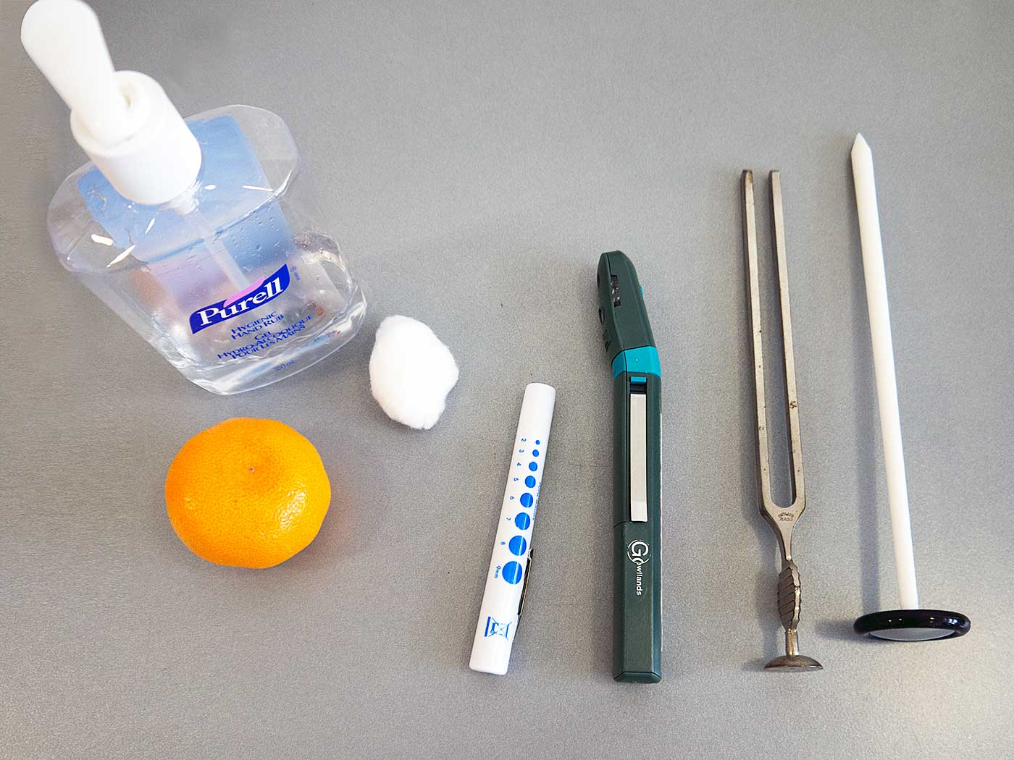
CLINICAL EXAMINATION OF THE CNS: EQUIPMENT NEEDED
Tools needed for cranial nerve examination
The following equipment is required for a cranial nerve examination:
Hand wash.
Item with distinct odour (e.g. orange/lemon peel, coffee, vinegar, etc).
Cotton ball.
Pen torch.
Fundoscope.
Tuning fork.
Neurological reflex hammer.
Snellen charts.
Ishihara plates.
Cranial nerve examination equipment

Slide 7
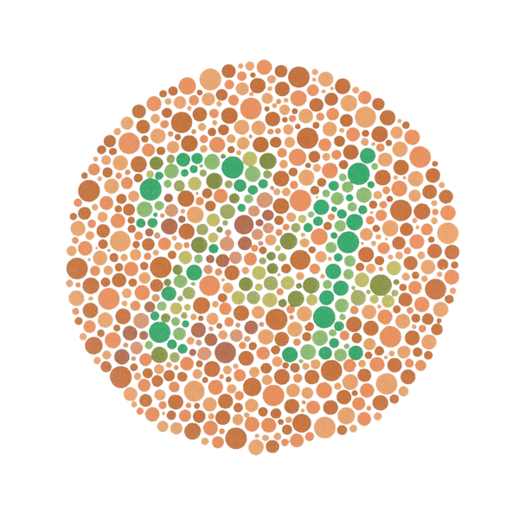
CLINICAL EXAMINATION OF THE CNS
Example of an Ishihara color test plate.

Slide 8
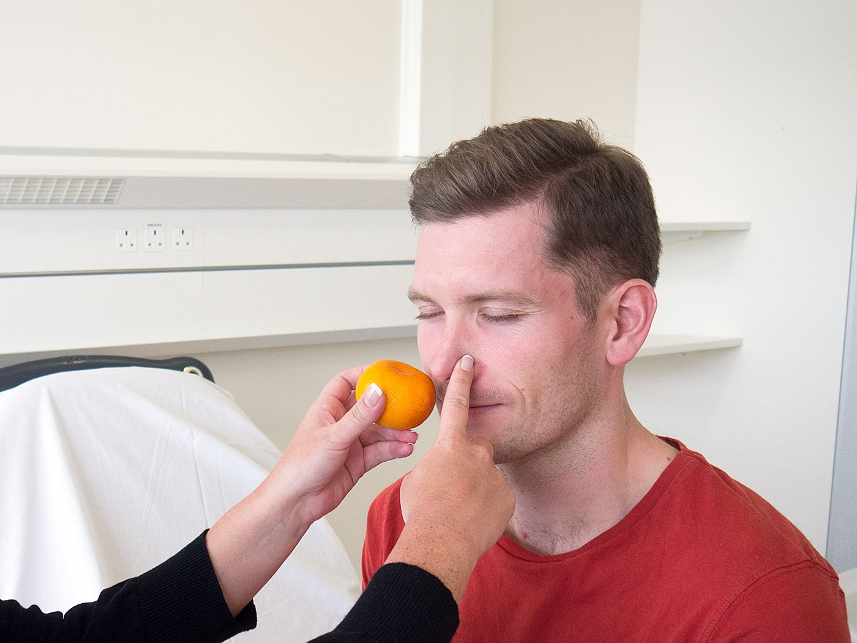
The Olfactory Nerve
The Olfactory nerve (CN I) is simply tested by offering patient familiar smell and asking patient to identify, for example orange/lemon peel, coffee, or vinegar.
Test the olfactory nerve

Slide 9
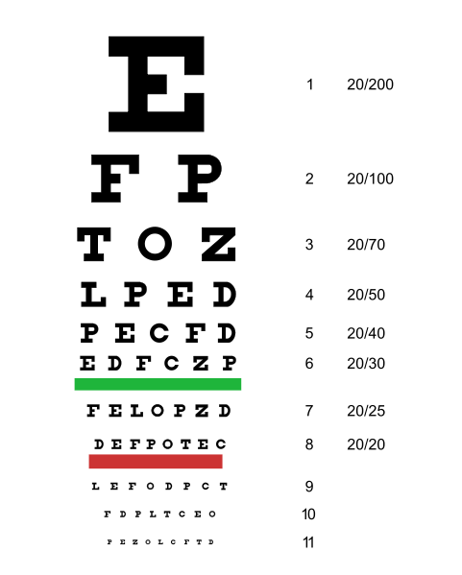
  Acuity
  Colour
  Fields
  Reflexes
  Fundoscopy
Visual Acuity
Visual acuity is tested using Snellen charts. If the patient normally wears glasses or contact lenses, then this test should be assessed both with and without their vision aids.
The Optic Nerve
The Optic nerve is tested in five ways:
Snellen chart to estimate visual acuity

Slide 10
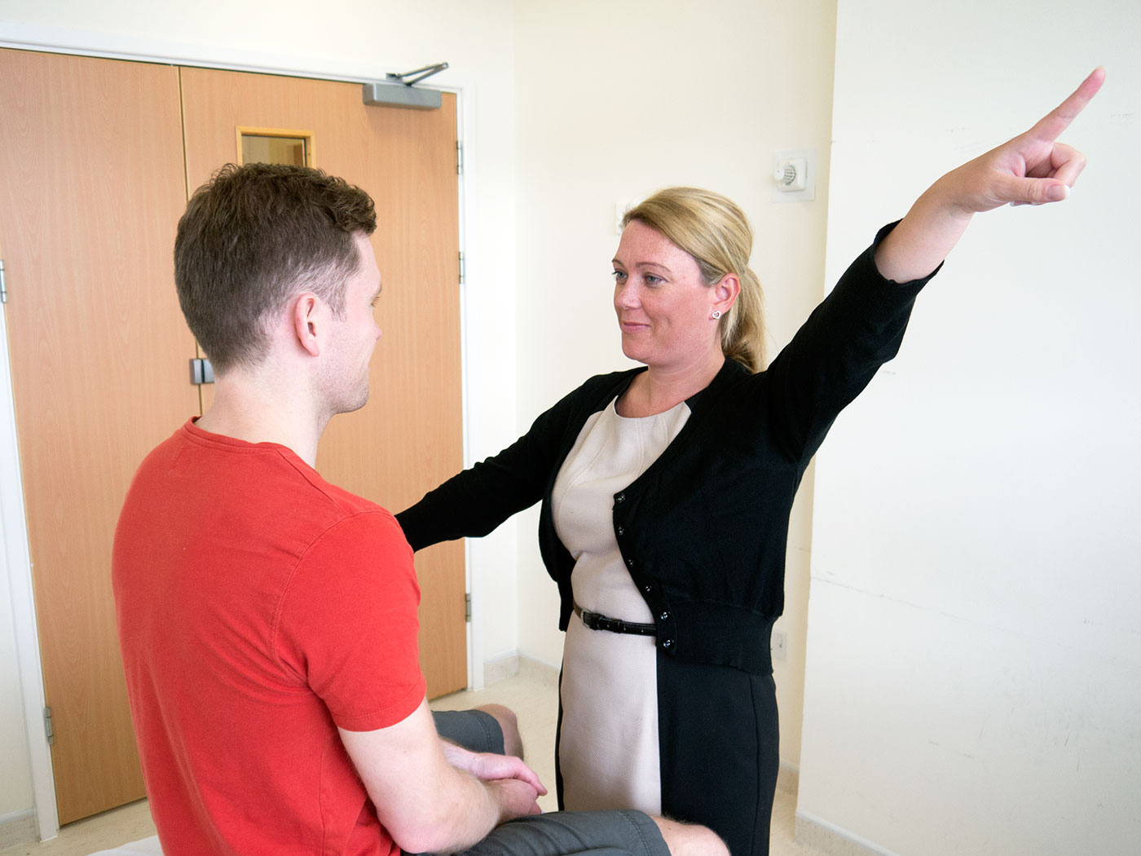
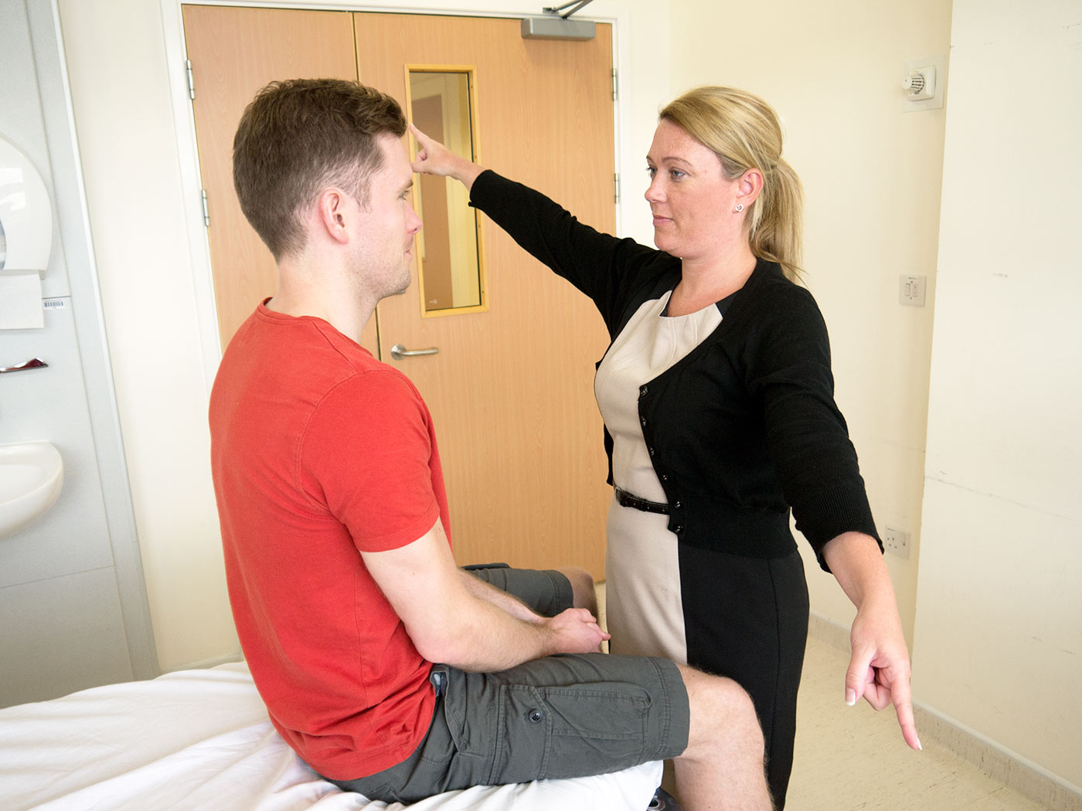
Visual field :Is tested by asking the patient to look directly at you whilst you wiggle one of your fingers in each of the four quadrants. Ask the patient to identify which finger is moving.
Visual Inattention: Visual inattention can be tested by moving both fingers at the same time and checking the patient identifies this.
Visual fields test in the alternative pair of quadrants

Slide 11
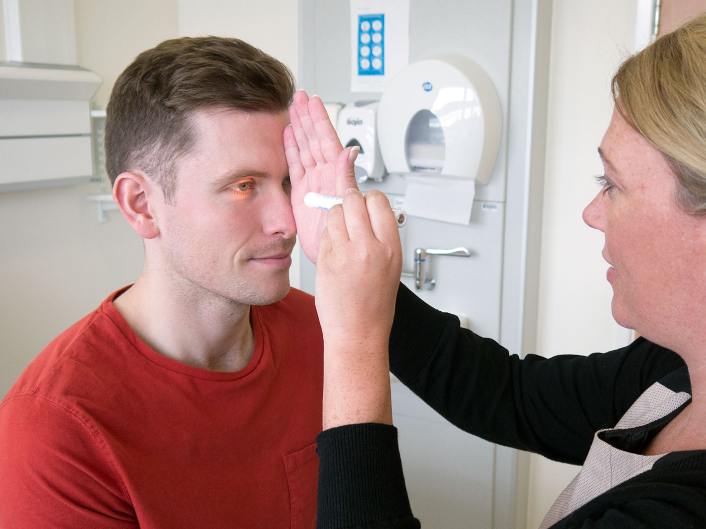
CLINICAL EXAMINATION OF THE CNS: VISUSL REFEXES
Visual Reflexes (DPR)
Visual reflexes comprise direct and concentric reflexes.
Place one hand vertically along the patients nose to block any light from entering the eye which is not being tested. Shine a pen torch into one eye and check that the pupils on both sides constrict. This should be tested on both sides.

Slide 12
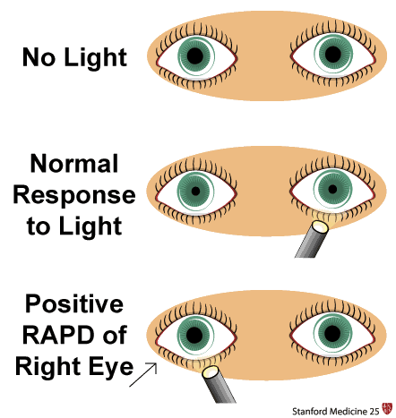
CLINICAL EXAMINATION OF THE CNS: RAPD (REFLEX)
Relative Afferent Pupillary Defect (RAPD) is a condition in which pupils respond differently to light stimuli shone in one eye at a time due to unilateral or asymmetrical disease of the retina or optic nerve (only optic nerve disease occurs in front of the lateral geniculate body).

Slide 13
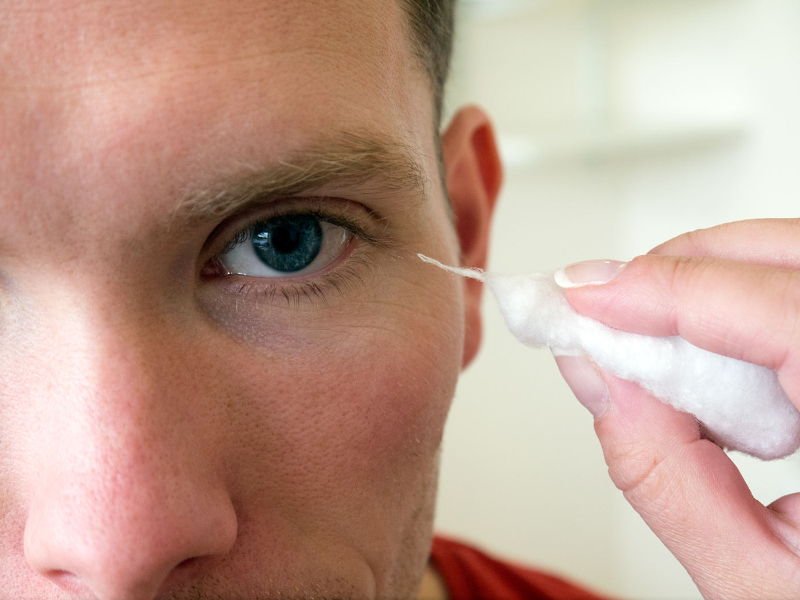
CLINICAL EXAMINATION OF THE CNS: (CORNEAL REFLEX)
Corneal reflex:
should also be examined as the sensory supply to the cornea is from V nerve. Do this by lightly touching the cornea with the cotton wool. This should cause the patient to shut their eyelid.
The corneal blink reflex is caused by a loop between the trigeminal sensory nerves and the facial motor (VII) nerve innervation of the orbicularis oculi muscles.
Corneal reflex test

Slide 14
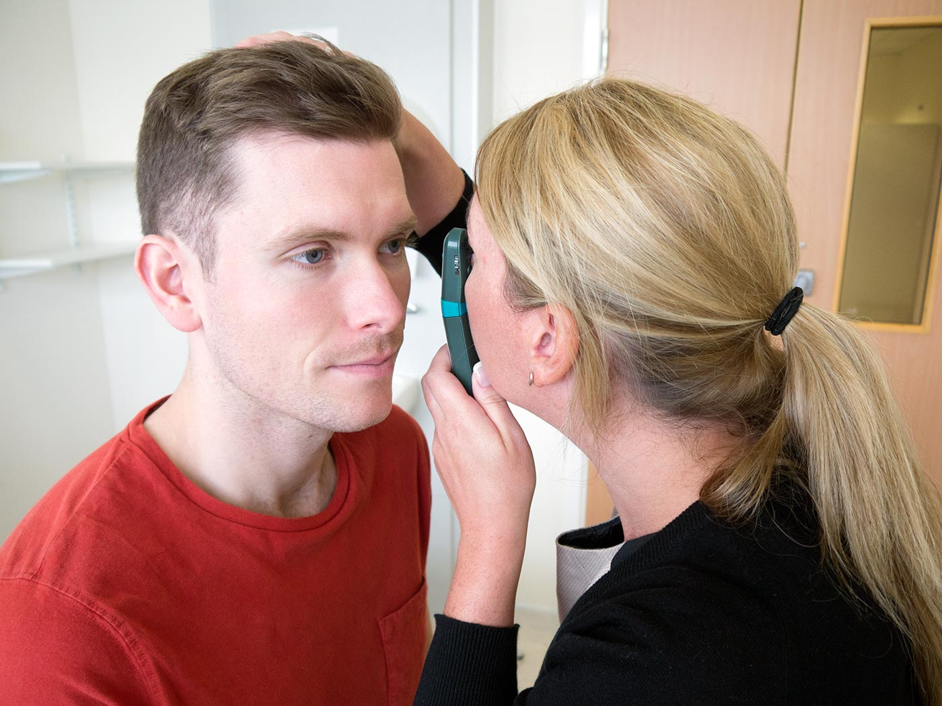
CLINICAL EXAMINATION OF THE CNS: FUNDOSCOPY

Slide 15
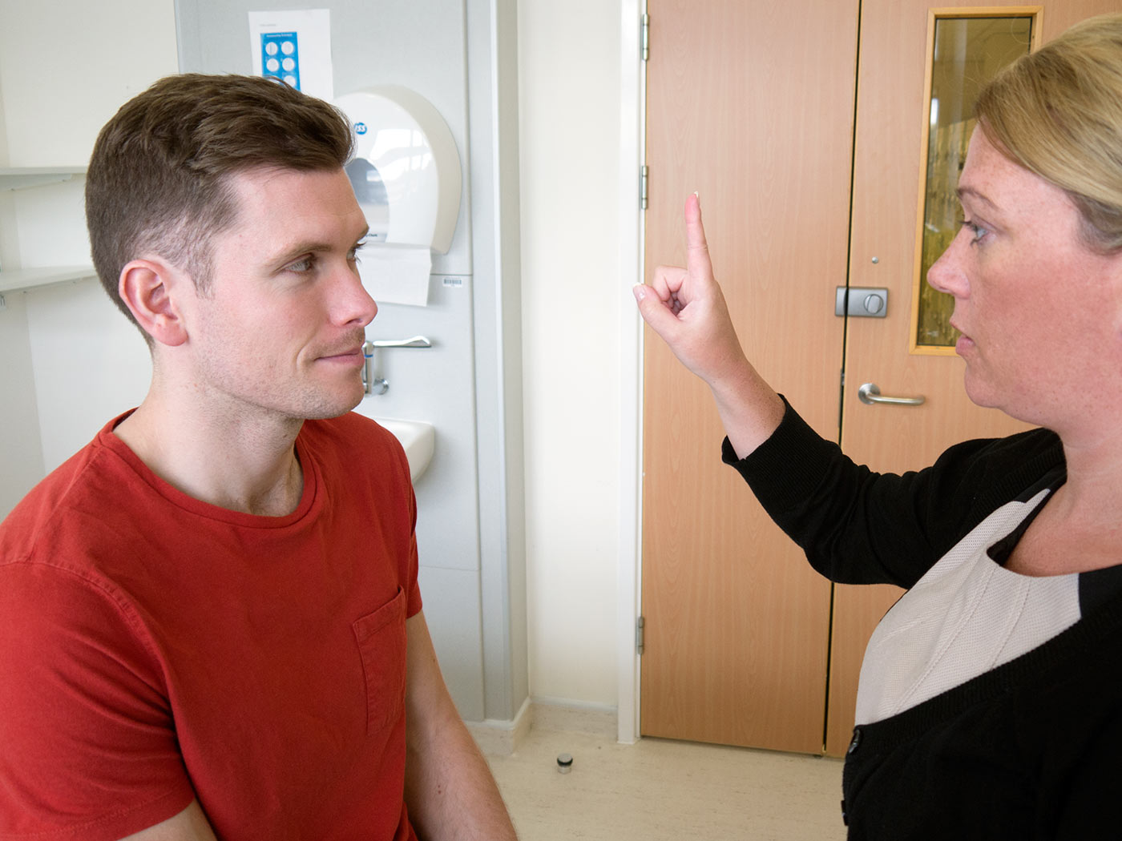
CLINICAL EXAMINATION OF THE CNS: III, IV, VI CRANIAL NERVES
Oculomotor Nerve (CN III), Trochlear Nerve (CN IV), Abducens Nerve (CN VI)
The Oculomotor nerve (CN III), Trochlear nerve and Abducens Nerve (CN VI) are involved in movements of the eye.
Asking the patient to keep their head perfectly still directly in front of you, you should draw two large joining H’s in front of them using your finger and ask them to follow your finger with their eyes. It is important the patient does not move their head.
Always ask if the patient experiences any double vision, and if so, when is it worse?
Get the patient to follow your finger

Slide 16
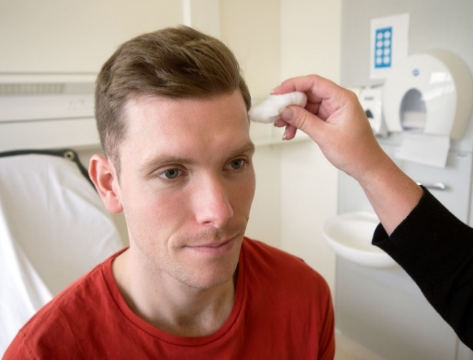
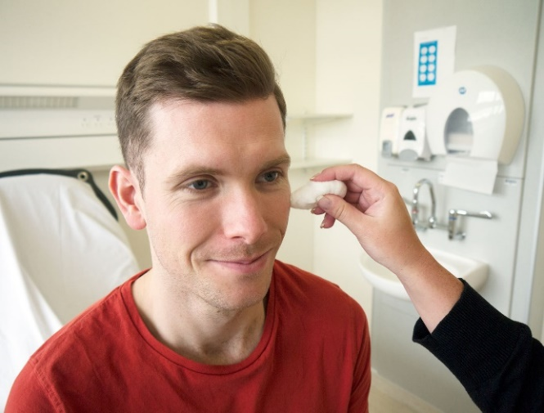
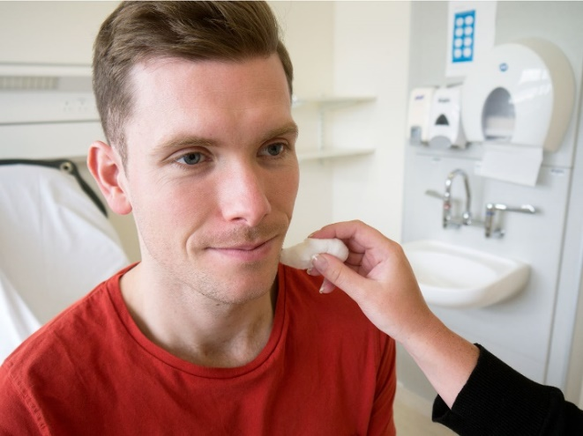
Trigeminal Nerve (CN-V light touch sensation)
The Trigeminal nerve (CN V) is involved in sensory supply to the face and motor supply to the muscles of mastication. There are 3 sensory branches of the trigeminalnerve: ophthalmic, maxillary and mandibular
Initially test the sensory branches by lightly touching the face with a piece of cotton wool followed by a blunt pin in three places on each side of the face:
Ophthalmic
Maxillary
Mandibular

Slide 17
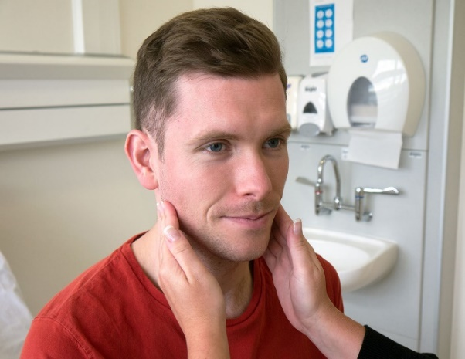
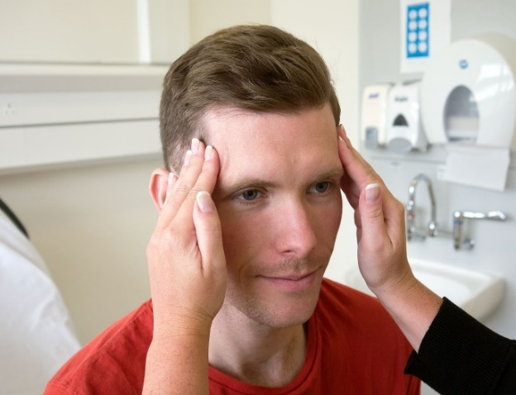
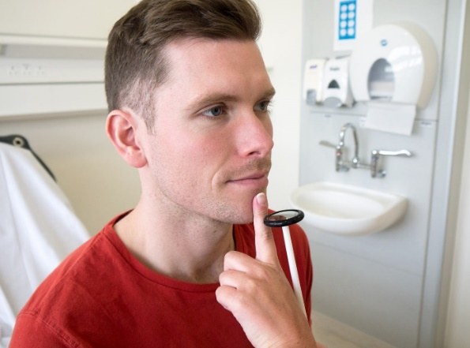
CLINICAL EXAMINATION OF THE CNS:
V NERVE MUSCLES OF MASTICATION
Masseter
Motor Supply
To test the motor supply, ask the patient to clench their teeth together, observing and feeling the bulk of the masseter and temporalis muscles
Ask the patient to then open their mouth against resistance.
Finally perform the jaw jerk on the patient by placing your left index finger on their chin and striking it with a tendon hammer. This should cause slight protrusion of the jaw.
Temporalis
Jaw jerk

Slide 18
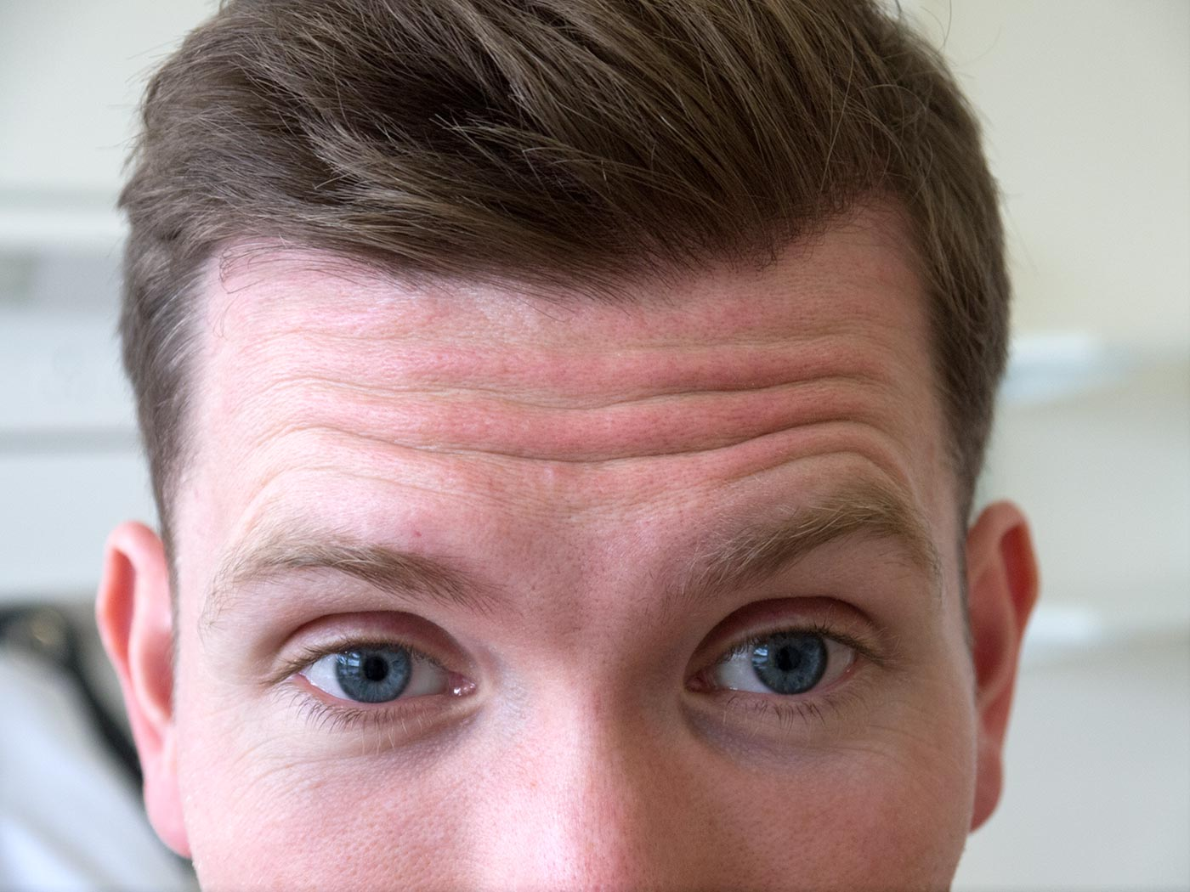
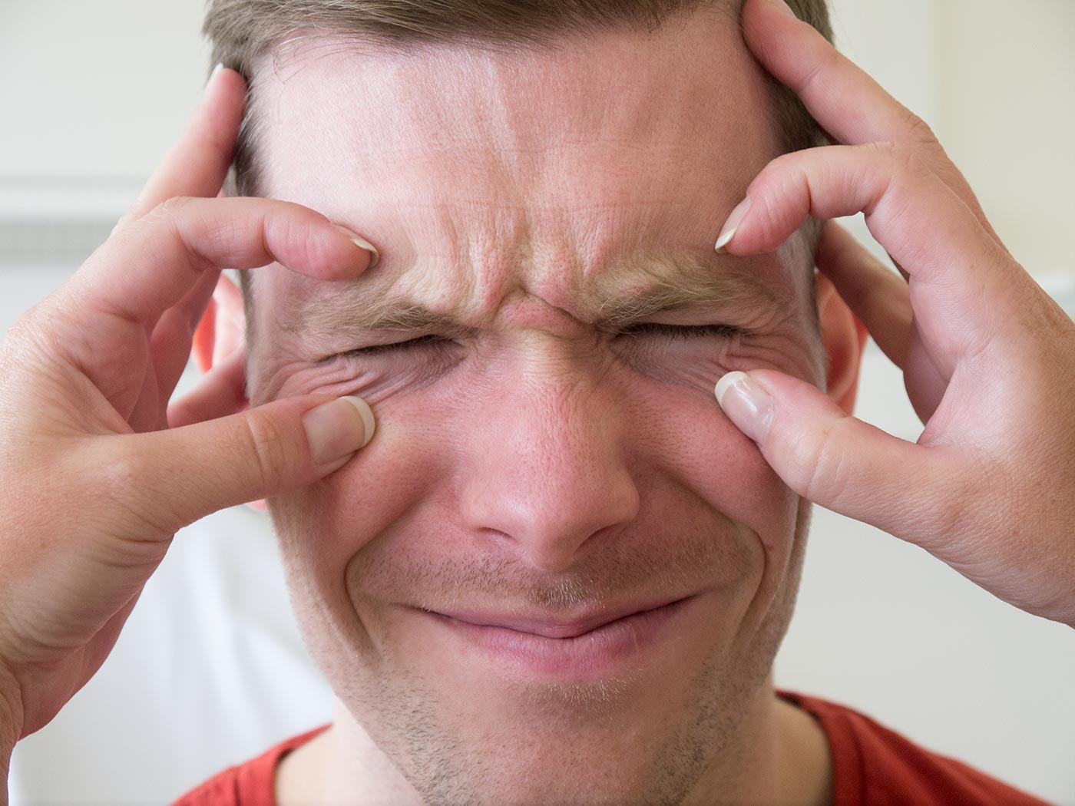
Abducens Nerve: (VI CR motor examination)
As previously mentioned, the abducens nerve is tested in the same manner as the oculomotor and trochlear nerves, again in eye movements.
The Facial Nerve: (VII CR motor examination)
The facial nerve supplies motor branches to the muscles of facial expression.
This nerve is therefore tested by asking the patient to crease up their forehead (raise their eyebrows), close their eyes and keep them closed against resistance, puff out their cheeks and reveal their teeth.
Frown up the forehead
Keep eyes closed against resistance

Slide 19
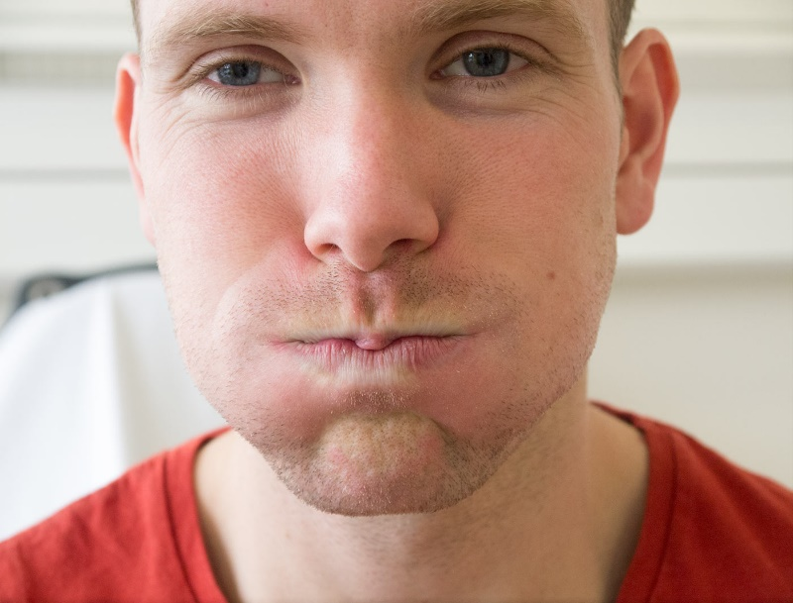
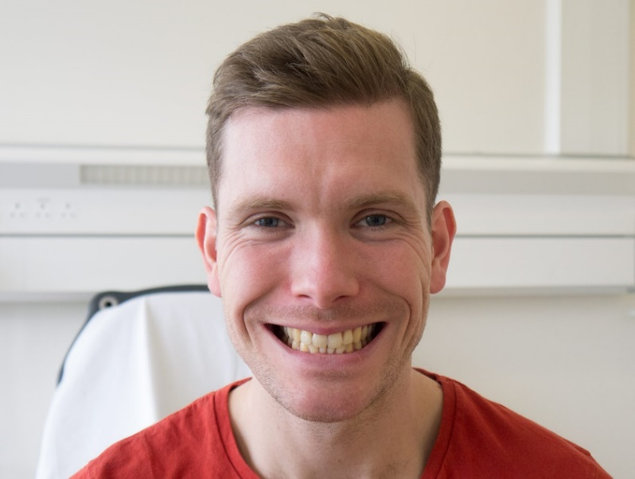
CLINICAL EXAMINATION OF THE CNS: VII CRANIAL NERVE
The Facial Nerve
Ask the patient to puff out his/her cheeks against resistance.
This nerve is tested by asking to show his/her teeth.
Blow your cheeks
Show your the teeth

Slide 20
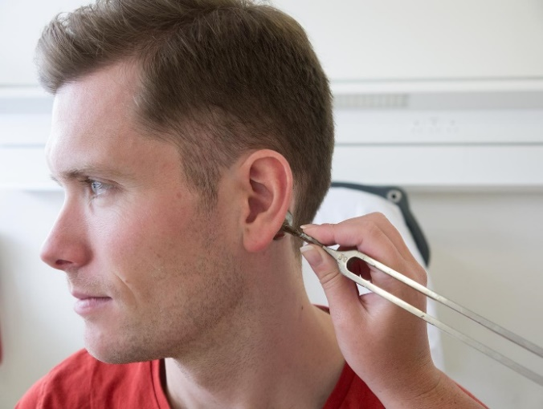
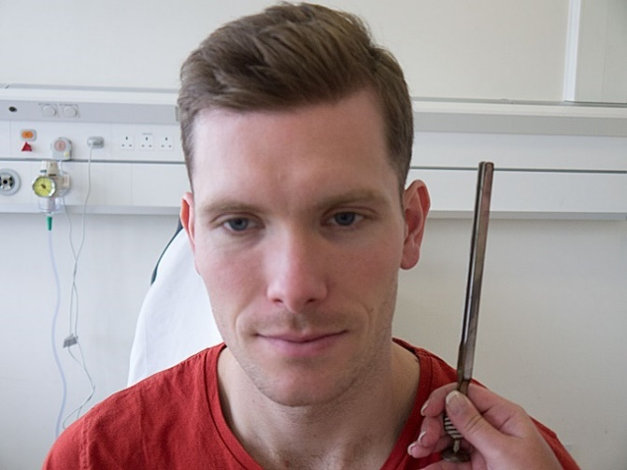
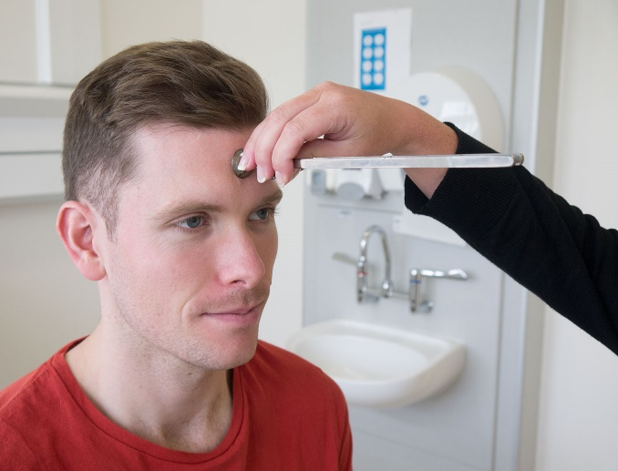
The Vestibulocochlear Nerve (CR VIII)
The vestibulocochlear nerve provides innervation to the hearing apparatus of the ear and can be used to differentiate conductive and sensori-neural hearing loss using the Rinne and Weber tests.
To carry out the Rinne test, place a sounding tuning fork on the patient’s mastoid process and then next to their ear and ask which is louder. A normal patient will find the second position louder.
To carry out the Weber’s test, place the tuning fork base down in the centre of the patient’s forehead and ask if it is louder in either ear. Normally it should be heard equally in both ears.
Rinne test - place tuning fork on the mastoid process
Rinne test - place tuning fork beside the ear
Webers test - place the tuning fork base down in the centre of the forehead

Slide 21
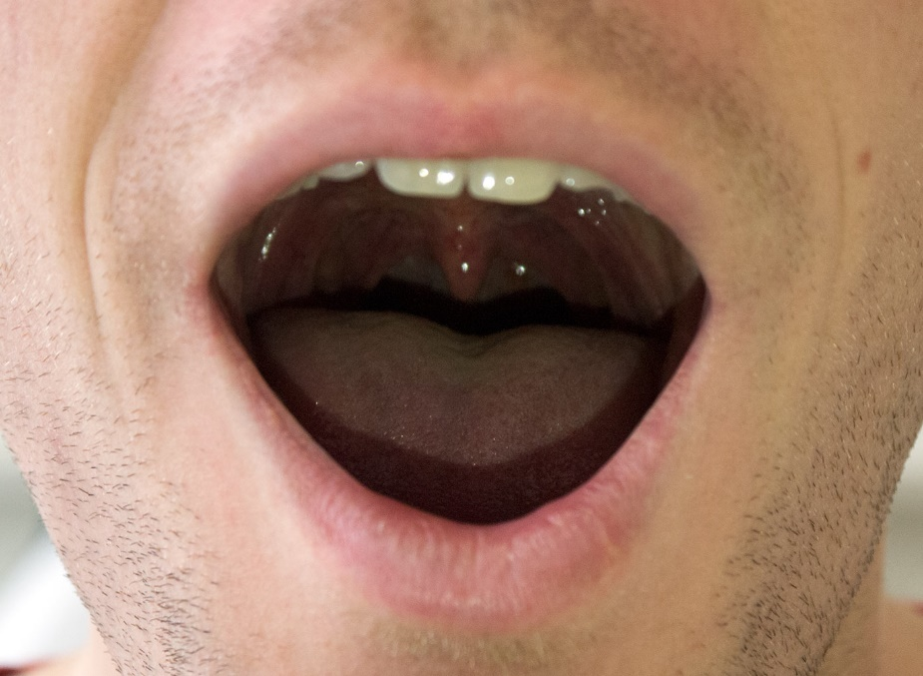
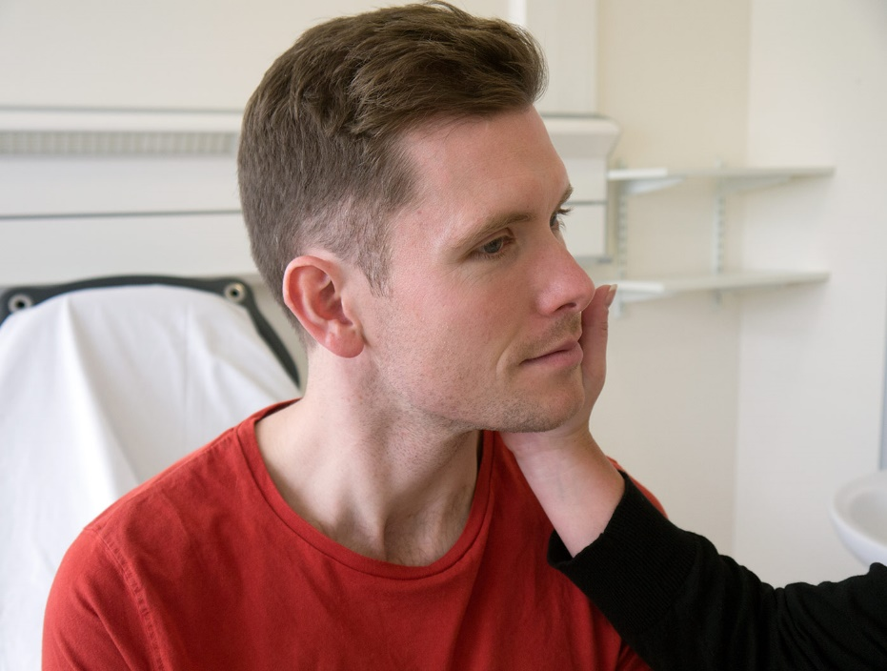
The Glossopharyngeal Nerve(CR IX)
The glossopharyngeal nerve provides sensory supply to the palate. It can be tested with the gag reflex or by touching the arches of the pharynx
The Vagus Nerve (CR X)
The vagus nerve provides motor supply to the pharynx
Asking the patient to speak gives a good indication to the efficacy of the muscles. The uvula should be observed before and during the patient saying “aah”. Check that it lies centrally and does not deviate on movement.
The Accessory Nerve (CR XI)
The accessory nerve gives motor supply to the sternocleidomastoid and trapezius muscles. To test it, ask the patient to shrug their shoulders and turn their head against resistance.
Glossopharyngeal nerve examination
Sternocleidomastoid muscle test against resistance

Slide 22
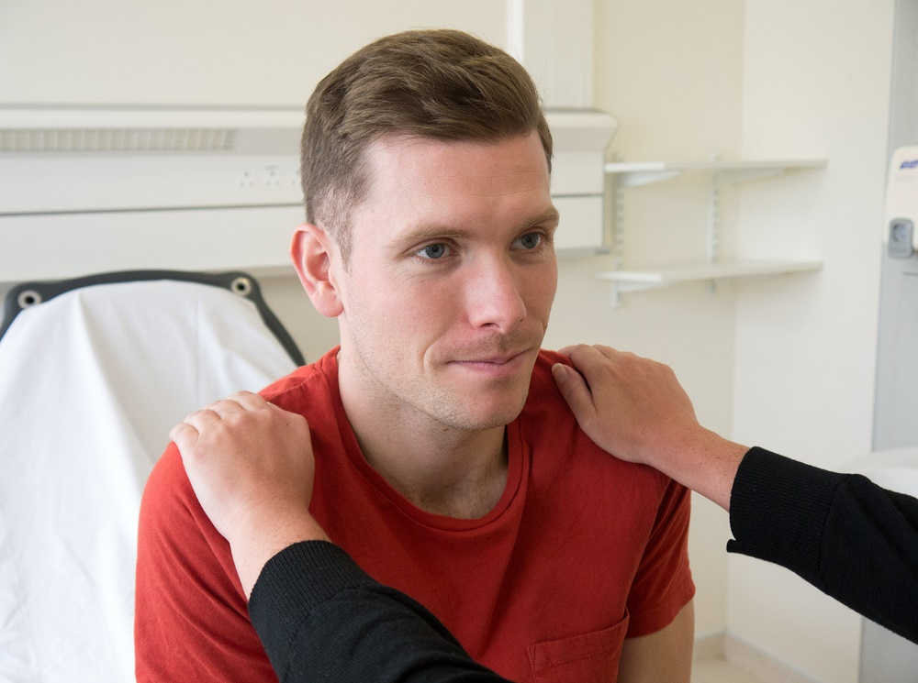
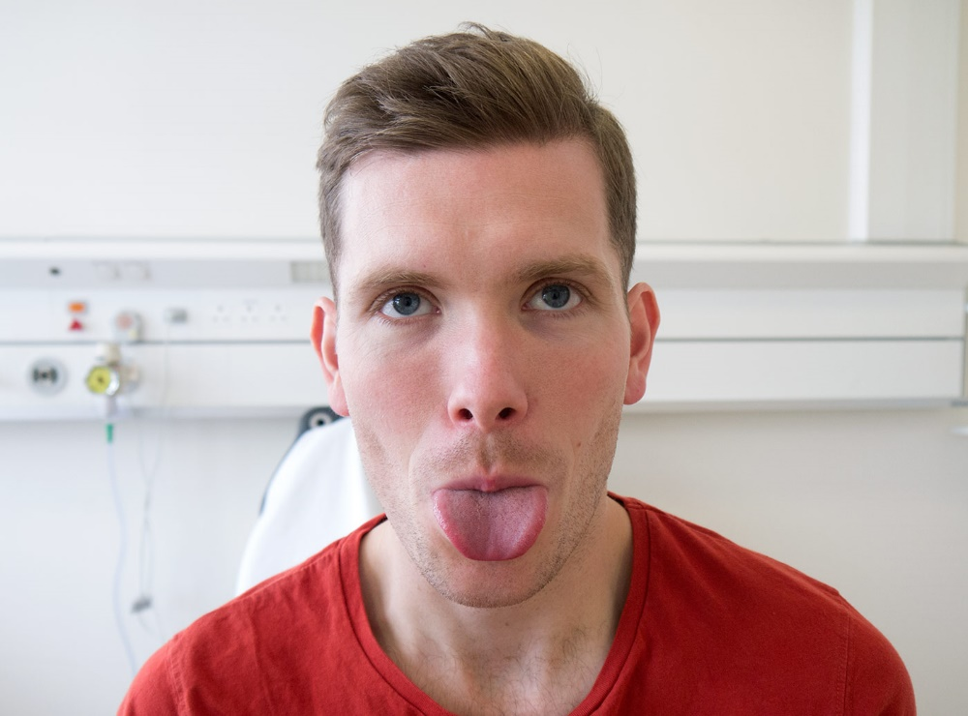
The Accessory Nerve (CR XI)
The accessory nerve gives motor supply to the sternocleidomastoid and trapezius muscles. To test it, ask the patient to shrug their shoulders and turn their head against resistance.
The Hypoglossal Nerve (CR XII)
The hypoglossal nerve provides motor supply to the muscles of the tongue.
Observe the tongue for any signs of wasting or fasciculations. Ask the patient to stick their tongue out. If the tongue deviates to either side, it suggests a weakening of the muscles on that side.
Trapezius muscle test against resistance
Hypoglossal nerve examination

Slide 23
CLINICAL EXAMINATION THE CNS: MOTOR SYSTEM EXAMINATION
The motor system examination allows to quantify the degree of motor function impairment and often to differentiate between central and peripheral lesions. The motor examination involves examining the following and comparing both sides to note abnormalities:
Bulk and nutrition of muscles.
Tone of muscles.
Power of muscles.
Reflexes.
Coordination of movements.
Involuntary movements.
Gait.
Wash your hands
Introduce yourself to the patient and clarify their identity.
Explain the procedure you about to perform and obtain consent.
The upper body should be exposed for this examination.
Initially, observe the patient’s arms, look for any muscle wasting, fasciculations or asymmetry.

Slide 24
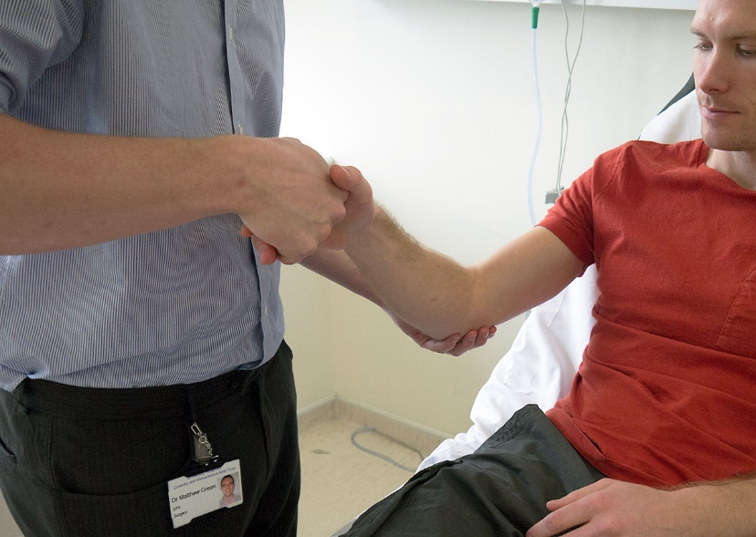
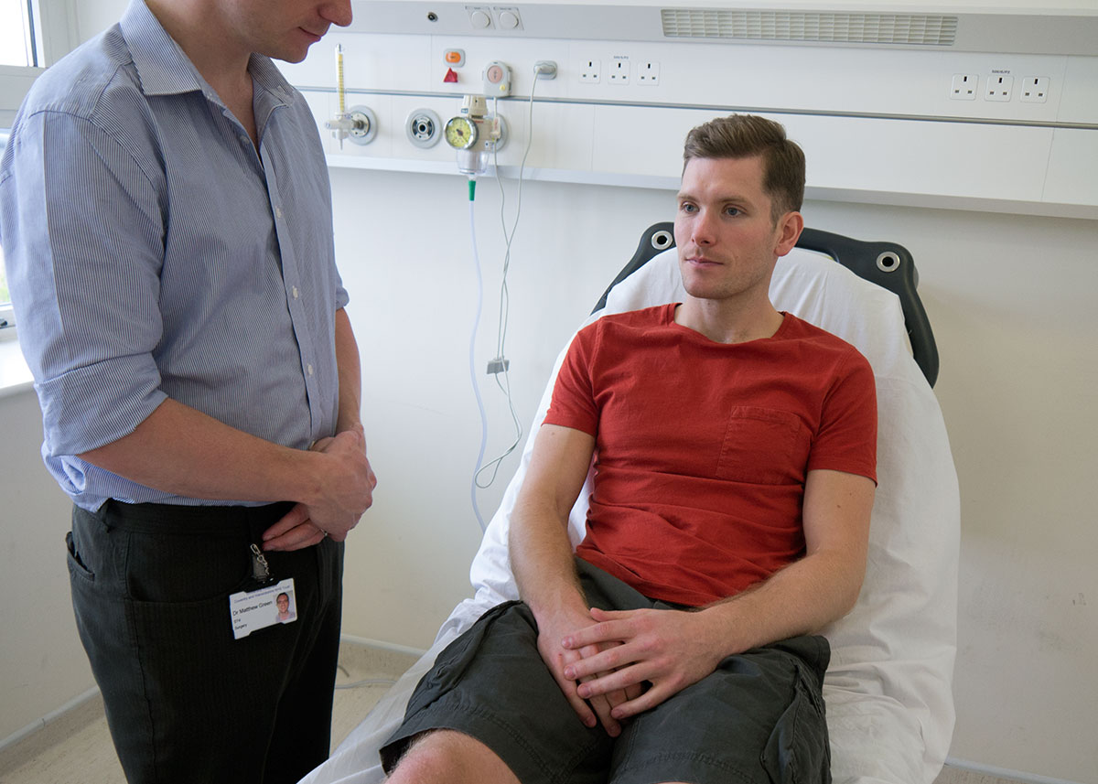
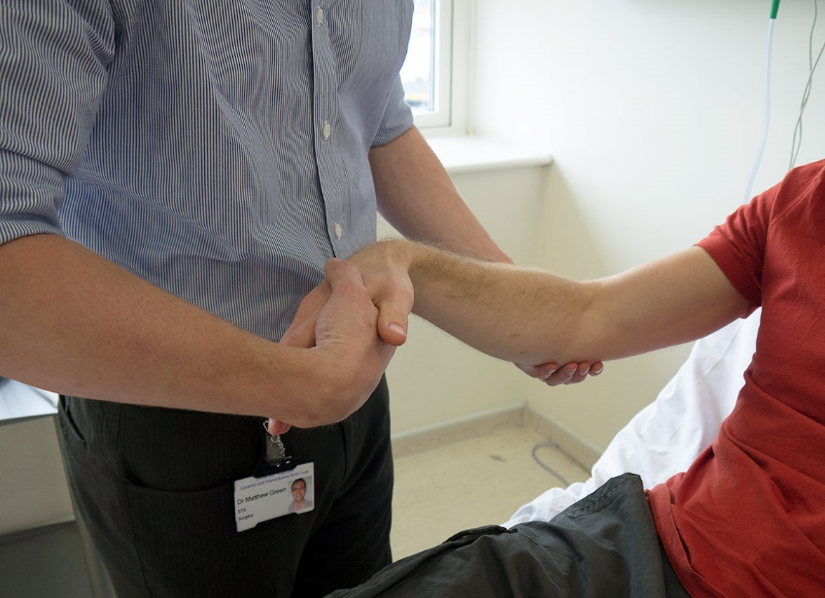
CNS UL MOTOR SYSTEM EXAMINATION: TONE OF MUSCLES
Start proximally at the shoulder, feeling how easy the joint is to move passively. Then move down to the elbow, wrist and hand joints, again assessing each one’s tone in turn.
Observe the patients arms, look for any muscle wasting, fasciculations or asymmetry
Assess elbow, wrist and hand joints

Slide 25
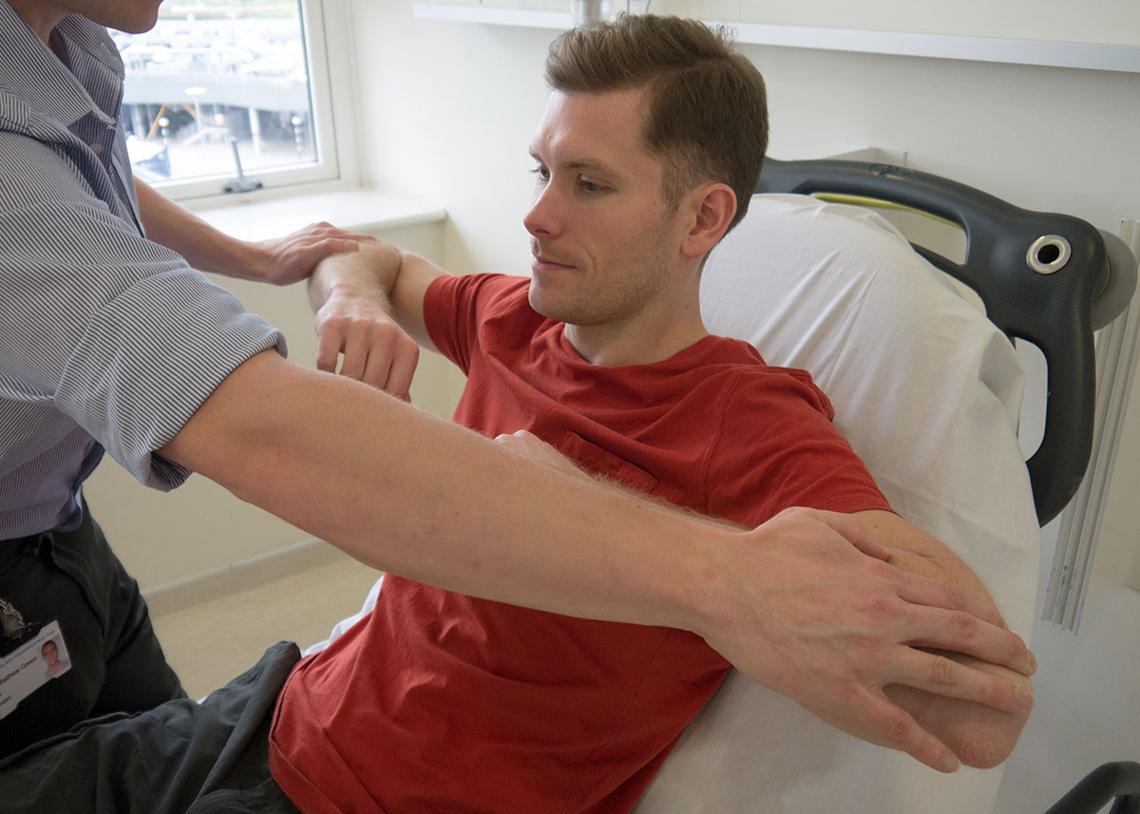
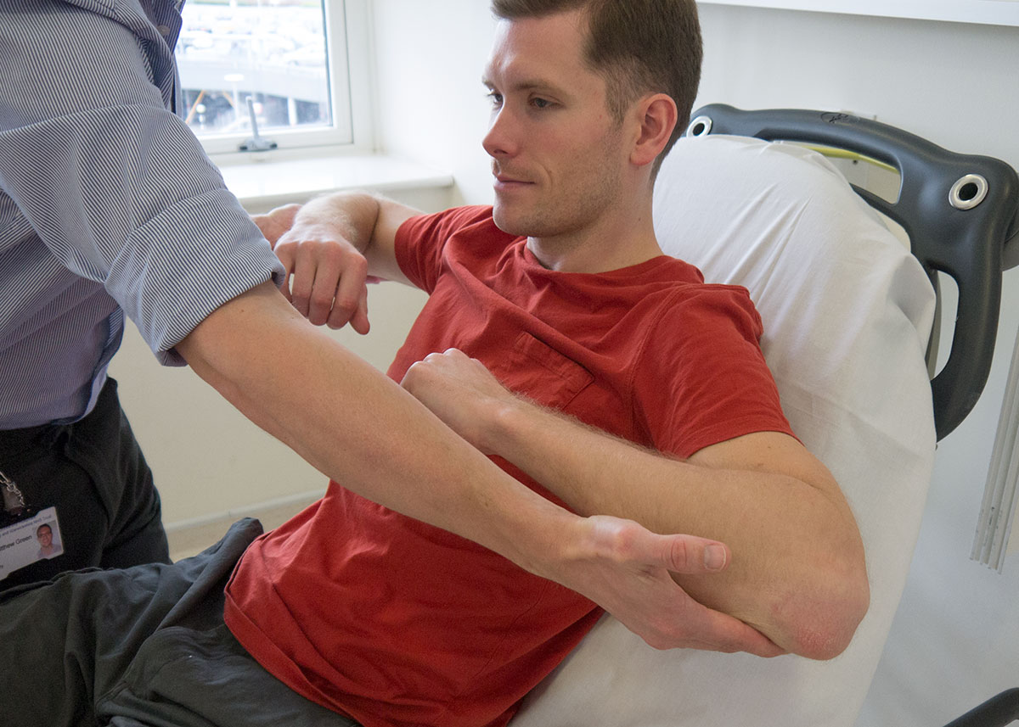
CNS UL MOTOR SYSTEM EXAMINATION
(UL MOTOR EXMINATION)
Start at the shoulder asking the patient to abduct and adduct against your hand so you can assess how much force they can overcome. Do the same for flexion and extension at the elbow and wrist, as well as the fingers; also checking abduction and adduction of the thumb.
Assess power of the shoulders 1
Assess power of the shoulders 2

Slide 26
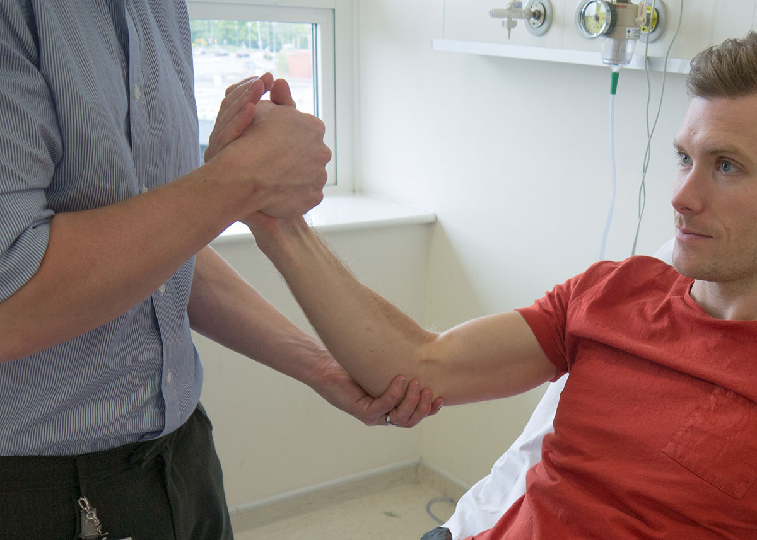
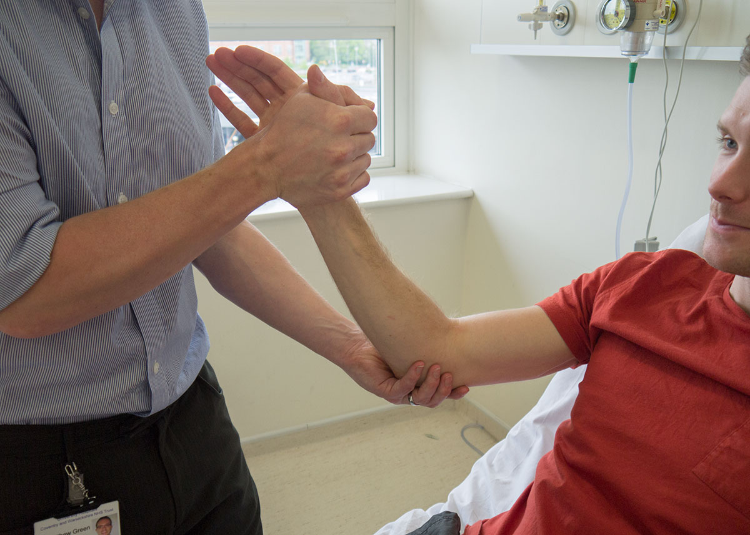
CLINICAL EXAMINATION T CNS: UL POWER BICEPS)
Elbow flexion
Elbow extension

Slide 27
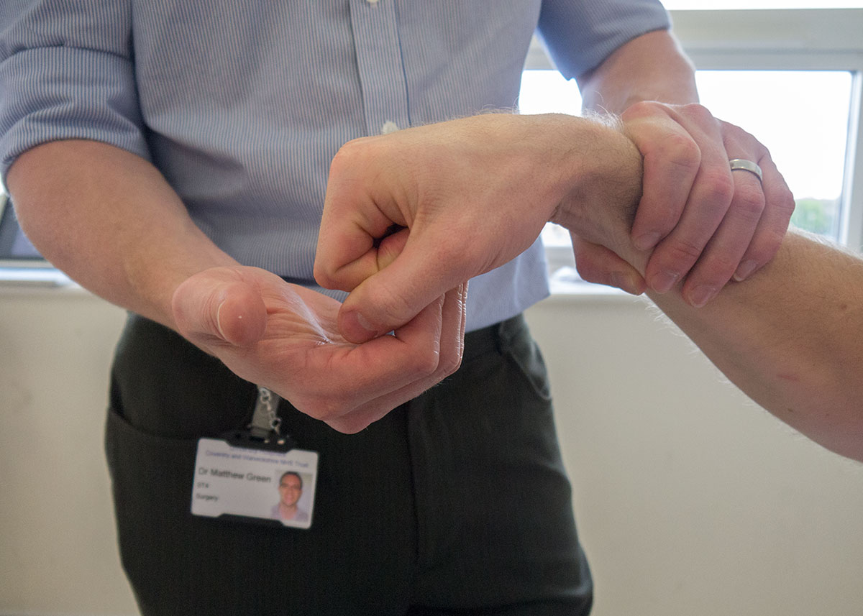
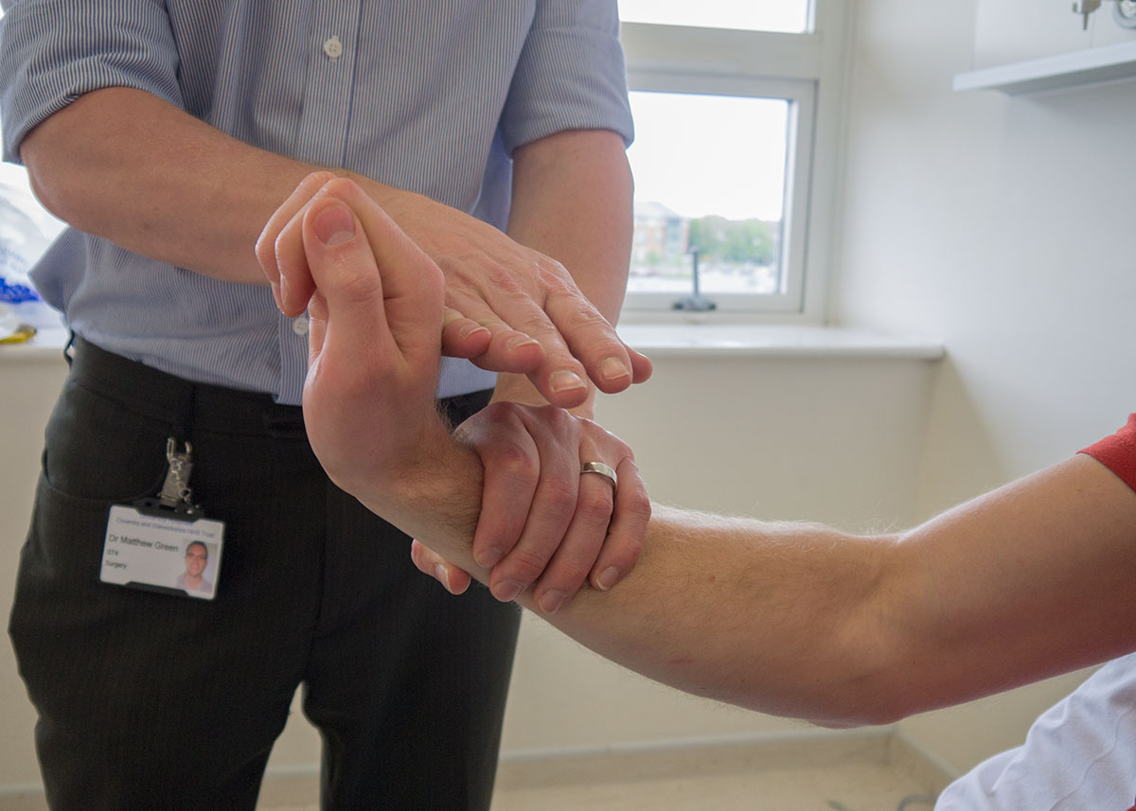
CLINICAL EXAMINATION CNS: UL (Power wrist flexion and extension)
Wrist flexion
Wrist extension

Slide 28
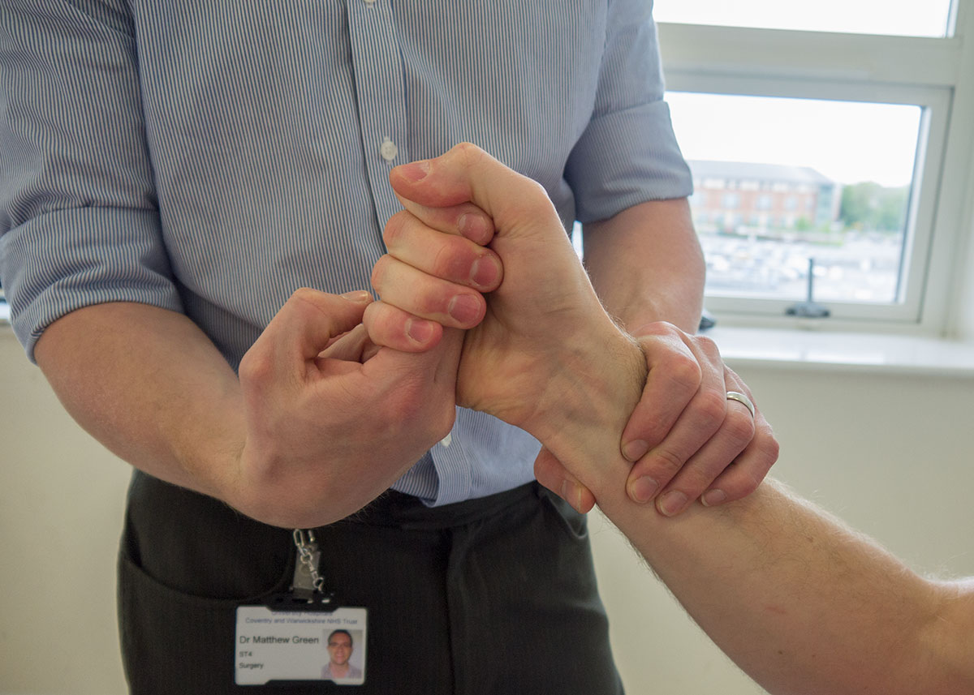
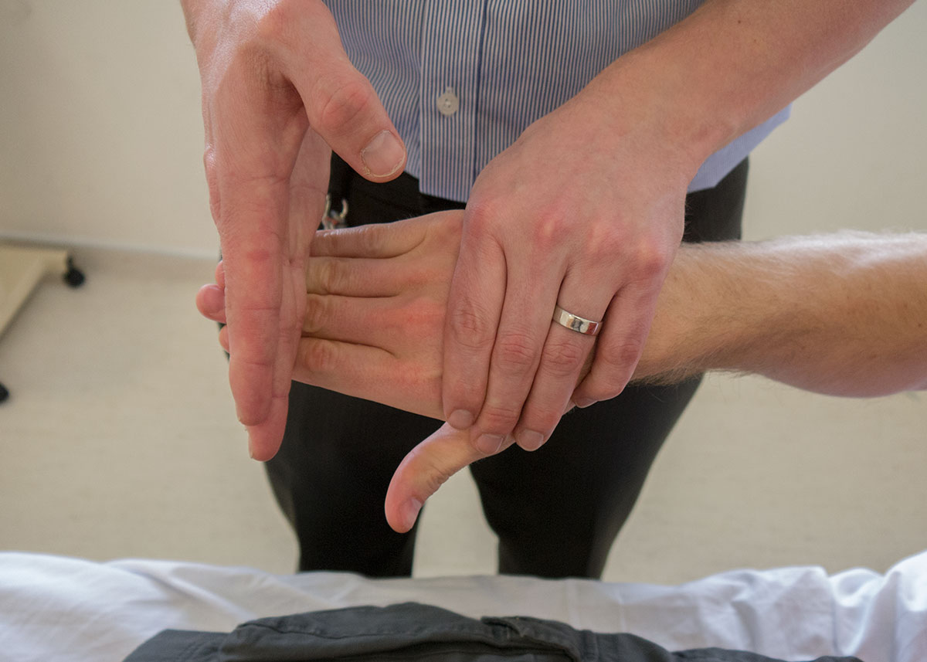
CLINICAL EXAMINATION CNS: UL ( finger flexion )
Finger flexion
Finger extension

Slide 29
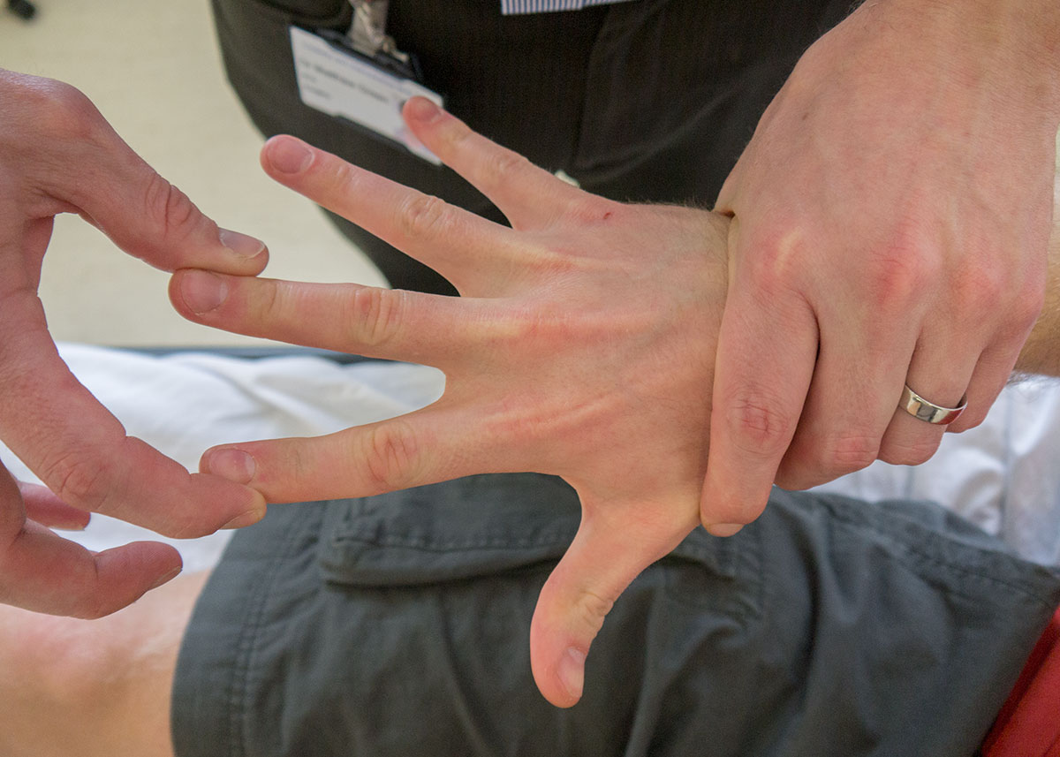
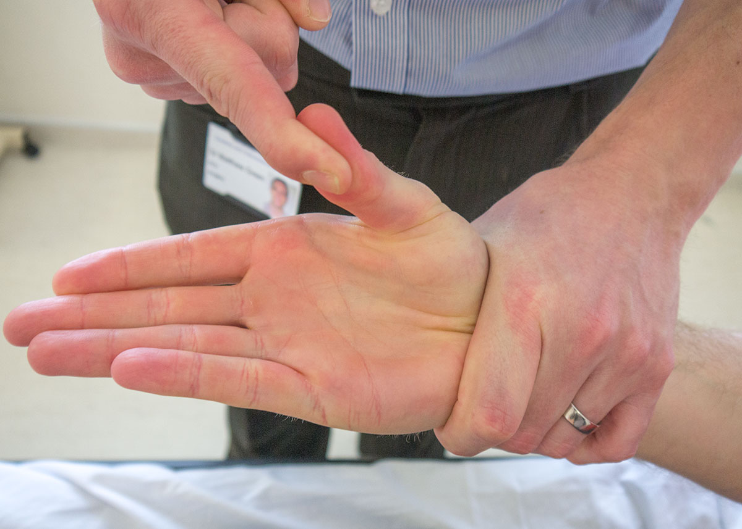
CNS CLINICAL EXAMINATION:UL (finger extension and thumb adduction)
Finger abduction
Abduction of the thumb

Slide 30
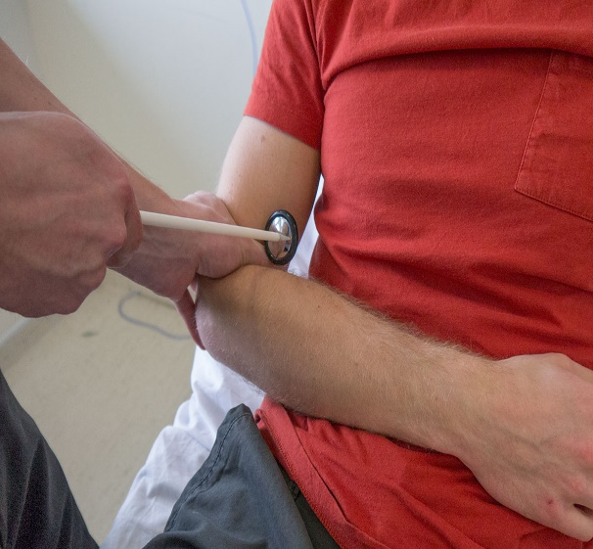
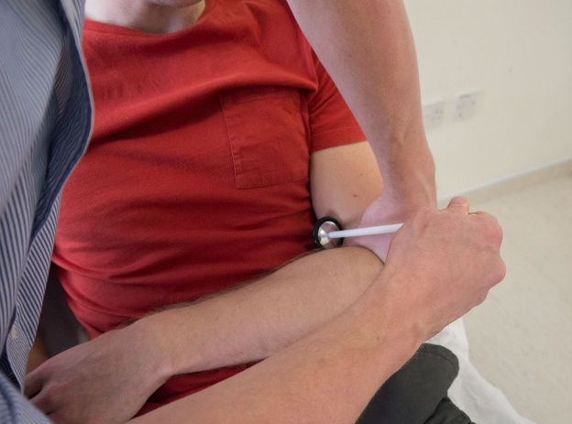
CNS CLINICAL EXAMINATION OF THE: UL (BICEPS REFLEXES)
Reflexes
There are three reflexes in the upper limb:
The biceps reflex
The triceps reflex
The supinator reflexes
Biceps Reflex
The biceps reflex is tested by supporting the patient’s arm, with it flexed at roughly 60 degrees, placing your thumb over the biceps tendon and hitting your thumb with the tendon hammer. It is vital to get your patient to relax as much as possible and for you to take the entire weight of their arm. Root value C5-C6
R
L

Slide 31
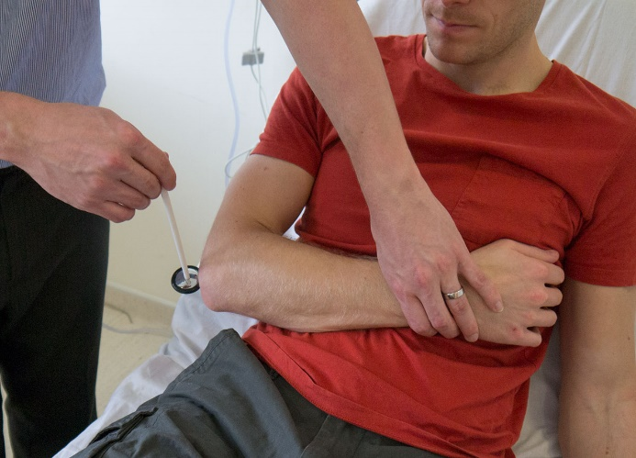
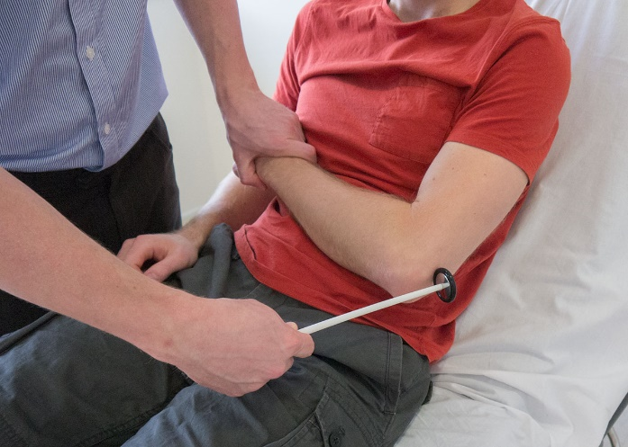
CLINICAL CNS: UL (TRICEPS REFLEXES)
Triceps reflex:
The triceps reflex, a deep tendon reflex. It is a reflex that elicits involuntary contraction of the triceps brachi muscle. It is initiated by the cervical (of the neck region) spinal nerve 7 nerve root.
The triceps reflex is mediated by the C6 and C7 nerve roots, predominantly by C7.
R
L

Slide 32
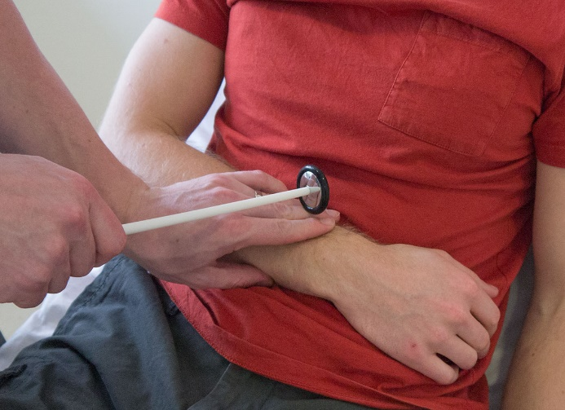
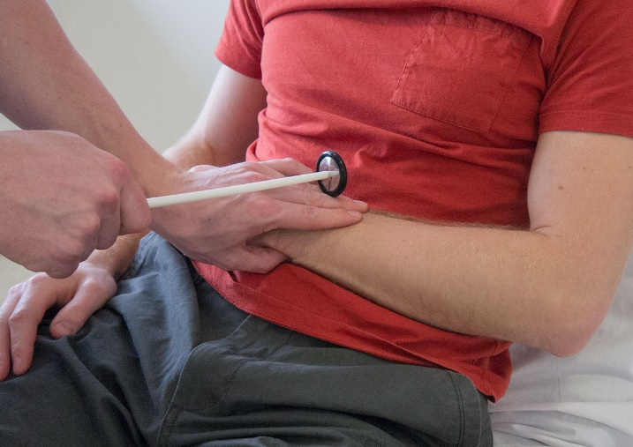
CNS CLINICAL EXAMINATION: UL (SUPINATOR REFLEXES)
Supinator reflex
The supinator reflex is testing the reflex motor arc associated with the brachioradialis muscle.
The supinator reflex is tested by striking the lower end of the radius just above the wrist with a tendon hammer. This normally causes contraction of the brachioradialis and hence flexion of the elbow.
Root value C5 – C6

Slide 33
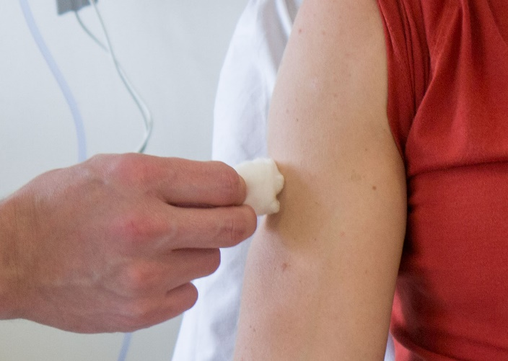
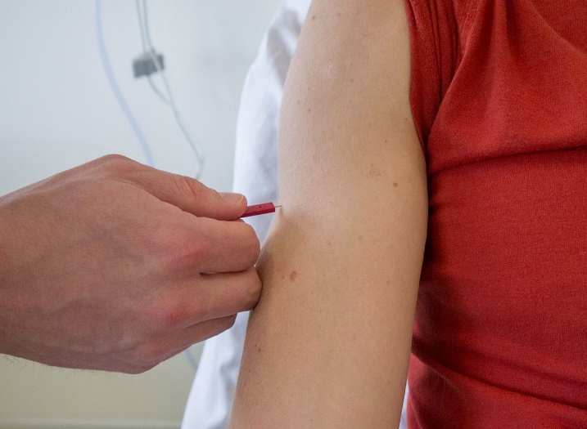
CNS CLINICAL EXAMINATION: UL (Touch & pain test)
Sensation
Testing light touch, pin prick, vibration, and joint position sense, or proprioception.
Light Touch
Ask the patient to place their arms by their sides with their palms facing forwards. Lightly touch the patient’s sternum with a piece of cotton wool so that they know how it feels.
Then, with the patient’s eyes shut, lightly touch their arm with the cotton wool. The places to touch them should test each of the dermatomes – make sure you know these! Tell the patient to say “yes” every time they feel the cotton wool as it
Touch sensation cotton wool
Pin prick sensation

Slide 34

CNS CLINICAL EXAMINATION: UL Proprioception/tuning fork test)
Vibration
To assess vibration you should use a sounding tuning fork. Place the fork on the patient’s sternum to show them how it should feel.
Now place it on the bony prominence at the base of their thumb and ask them if it feels the same. If it does, there is no need to check any higher. If it feels different you should move to the radial stylus and then to the olecranon until it feels
Testing vibration

Slide 35


CNS CLINICAL EXAMINATION:UL Proprioception joint position0
Proprioception
Assess proprioception Hold the distal phalanx of the thumb on either side so that you can flex the interphalangeal joint.
Show the patient that when you hold the joint extended, that represents Up whereas when you hold it flexed that represents Down. Ask the patient to close their eyes and, having moved the joint a few times hold it in one position – up or down. Ask the patient which position the joint is in.
Thumb position up
Thumb position down

Slide 36


CNS CLINICAL EXAMINATION: LL TONE ASSESSMENT
Lower limbs
As with all examinations, the best method is your own – one with which you are comfortable and familiar. The one explained here takes the following format:
Tone.
Power.
Reflexes.
Function.
Sensation.
Assess leg tone
Assess knee tone

Slide 37


CNS CLINICAL EXAMINATIOS: LL POWER ASSESSMENT (THIGHS)
Power. A full motor system examination includes assessment of the legs and the following format:
Tone.
Power.
Reflexes.
Function.
Sensation.
Start at the hip asking the patient to abduct, adduct, flex and extend against your hand so you can assess how much force they can overcome.
Do the same for flexion and extension at the knee and ankle as well as the toes.

Slide 38




CNS CLINICAL EXAMINATION: KNEE FLEXORS/ AND XTENSORS
Assess knee flexion& Extension
Ankle dorsiflexion & Planter flexsion

Slide 39


CNS CLINICAL EXAMINATION:Toe extention and flexion power assessment)
Toe extension involves extending the toes away the sole of the foot. The muscle of the toe extension is extensor digitorum longus, and the intrinsic foot muscles.
Toe flexion involves bending the toes towards the sole of the foot. The muscle and tendon involved in toe flexion is flexor digitorum longus and intrinsic foot muscles.
Toe extension
Toe Planter flexion

Slide 40


CNS CLINICAL EXAMINATION: KNEE AND ANKLE REFLEXES
Patellar reflex is tested by placing the patient’s leg flexed at roughly 60 degrees, taking the entire weight of their leg with your arm, and hitting the patellar tendon with the tendon hammer. Root value (L3/L4)
Ankle Jerk
The ankle jerk is elicited by resting the patient’s leg on the bed with their hip laterally rotated. Pull the foot into dorsiflexion and hit the calcaneal tendon. Root value S1

Slide 41


CNS CLINICAL EXAMINATION: PLANTER REFLEXES
Babinski reflex occurs after the sole of the foot has been firmly stroked. The big toe then moves upward or toward the top surface of the foot. The other toes fan out. Babinski reflex is one of the normal reflexes in infants and in children up to 2 years old.
Normal planter response in an adult
Positive Babinski in an adult

Slide 42

CNS CLINICAL EXAMINATION: Hoffman’s sign
Hoffman's sign is an involuntary flexion movement of the thumb and or index finger when the examiner flicks the fingernail of the middle finger down. This has sensitivity of 59% and a specificity of 49% to screen for upper motor neuron lesion (UMN lesions).

Slide 43


CNS CLINICAL EXAMINATION: ANKLE AND PATELLAR CLONUS
Clonus: is an abnormal reflex response that involves involuntary and rhythmic muscle contractions. Like other signs of upper motor neuron syndrome clonus indicates some insult to the central rather than peripheral nervous system, so part of its utility as a clinical examination skill is in differentiating the two.
Ankle clonus
Patellar clonus

Slide 44


CNS CLINICAL EXAMINATION: CEREBELLAR SIGNS
Tandem gait: The examiner asks the patient to walk in a straight line with the heel of the leading foot touching the toes of the lagging foot as if walking on a tightrope. Romberg’s test. Ask the patient to stand with their feet apart and then close their eyes. Any swaying may be suggestive of a posterior column pathology.
Tandem Gait
Romberg test

Slide 45

CNS CLINICAL EXAMINATION: (Cerebellar walking & tandem gait)
The cerebellar examination is performed in patients with neurological signs or symptoms of cerebellar pathology, for example: dizziness, loss of balance, or poor co-ordination. There are many causes of cerebellar dysfunction and include vascular, for example: stroke, space-occupying lesions, multiple sclerosis, and genetic conditions such as Friedreich’s Ataxia.
The cerebellar examination needs to reflect these symptoms and as such involves examining the gait, balance and co-ordination.
Gait Observe the patient walking
Walk heel-to-toe to assess balance

Slide 46


CNS CLINICAL EXAMINATION: (Lower limb touch and pain assessment)
Sensation
Sensations to be tested include light touch, pin prick, vibration, and joint position sense, or proprioception.
Light Touch
Ask the patient to place their legs out straight on the bed. Lightly touch the patient’s sternum with a piece of cotton wool so that they know how it feels.
With the patient’s eyes shut, lightly touch their leg with the cotton wool. The places to touch the patient should test each of the dermatomes
Sensation test with cotton wool
Sensation test with pin prick

Slide 47


CNS CLINICAL EXAMINATION OF THE: Lower limb proprioception JPS
Proprioception
Hold the distal phalanx of the great toe on either side so that you can flex the interphalangeal joint.
Show the patient that when you hold the joint extended, that represents Up whereas when you hold it flexed that represents Down. Ask the patient to close their eyes and, having moved the joint a few times hold it in one position – up or down. Ask the patient which position the joint is in.
Flex the interphalangeal joint down
Flex the interphalangeal joint up

Slide 48

CS CLINICAL EXAMINATION OF THE: Lower limb proprioception (vibration)
Vibration
To assess vibration, use a sounding tuning fork. Place the fork on the patient’s sternum to show them how it should feel.
Now place the tuning fork on their great toe and ask them if it feels the same. If it does, there is no need to check any higher. If it feels different you should move to the tibial epicondyle and then to the greater trochanter until it feels normal.

Slide 49


CNS CLINICAL EXAMINATION: Cerebellar function (tremor & tone assessment)
Check for a resting tremor in the hands by placing a piece of paper on the patient’s outstretched hands.
Test tone in the arms (shoulder, elbow, wrist).
Check for a resting tremor
Test tone in the shoulder

Slide 50


CNS CLINICAL EXAMINATION : erebellar function (dysdiadochokinesis)
Co-ordination: Test for dysdiadochokinesis by showing the patient how to clap by alternating the palmar and dorsal surfaces of the hand. Ask them to do this as fast as possible and repeat the test with the other hand.
Test for dysdiadochokinesis 1
Test for dysdiadochokinesis 2

Slide 51


CNS CLINICAL EXAMINATION: FINGER NOSE TEST
Perform the finger-to-nose test by placing your index finger about two feet from the patients face. Ask them to touch the tip of their nose with their index finger then the tip of your finger. Ask them to do this as fast as possible while you slowly move your finger. Repeat the test with the other hand.
Finger-to-nose test 1
Finger-to-nose test 2

Slide 52


CNS CLINICAL EXAMINATION: HEEL SHIN TEST
Perform the heel-to-shin test. Have the patient lying down for this and get them to run the heel of one foot down the shin of the other leg, and then to bring the heel back up to the knee and start again. Repeat the test with the other leg.
Heel-to-shin test 1
Heel-to-shin test 2

Slide 53
THANKYOU FOR YOUR ATTENTION

