Slide 1
Neurological History Taking and Physical Examination
Dr. M. A. Sofi MD; FRCP (London); FRCPEdin; FRCSEdin

Slide 2
Neurological History & Physical Examination
Patient's history is the first step in virtually every clinical encounter.
The history of the presenting illness should include:
Symptom onset (acute, subacute, chronic, insidious)
Duration
Course of the condition (eg, static, progressive, or relapsing and remitting)
Associated symptoms, such as pain, headache, nausea, vomiting, vertigo, numbness, weakness, and seizures
Aspect | Pain should be defined
Site | Where is the pain? Or the maximal site of the pain
Onset | When did the pain start, and was it sudden or gradual? Include also whether it is progressive or regressive.
Character | What is the pain like? An ache Stabbing
Radiation | Does the pain radiate anywhere?
Associations | Any other signs or symptoms associated with the pain
Time course | Does the pain follow any pattern?
Exacerbating relieving factors | Does anything change the pain?
Severity | How bad is the pain?

Slide 3
Neurological History : Definition of Terms
Cataplexy Cataplexy is characterized by transient episodes of voluntary muscle weakness precipitated by intense emotion.
Cerebritis Inflammation of the cerebral hemispheres
Encephalitis Inflammation of the brain and brainstem
Encephalopathy Dysfunction of the brain
Epilepsy Sudden, uncontrolled burst of electrical activity in the brain
Mononeuropathy Dysfunction of individual nerves
Mononeuritis multiplex Dysfunction of multiple single nerves
Myelitis Inflammation of the spinal cord
Myopathy Myopathies are a group of disorders that are characterized by a primary structural or functional impairment of the skeletal muscle.
Myelopathy Dysfunction of the spinal cord
Myositis Inflammation of the muscles
Narcolepsy Sudden attacks manifesting as an uncontrollable urge to sleep
Neuronopathy Dysfunction of the cortical cranial, or spinal neurons
Polyneuropathy Bilateral symmetric ascending (stocking and glove) or descending dysfunction of the peripheral nerves
Radiculopathy Dysfunction of the nerve roots

Slide 4
Neurological History : Presenting Complaints?
Neurological presenting complaints include:
Headache.
Seizures.
Presyncope or syncope.
Muscular symptoms - weakness, tremor, spasm.
Peripheral sensory symptoms - numbness, paraesthesia.
Visual changes - blurring, diplopia.
Pain. One of the most common symptoms of neurological diseases.
Difficulties with Memory
Sleep Issues
Partial or Complete Loss of Vision
Ataxia
Dizziness
Vertigo
Stroke

Slide 5
Fainting/Syncope
Syncope is a temporary loss of consciousness usually related to insufficient blood flow to the brain. It's also called fainting or "passing out.”
There are 3 major criteria for the definition of syncope:
There must be a LOC. An initial loss of postural tone (going floppy)
The loss of consciousness must be transient. Self limiting
It is caused by global cerebral hypoperfusion, which almost always means a reduction in systemic blood pressure.
Fainting may be triggered by:
  Fear/emotional trauma.
  Severe pain.
  A sudden drop in BP.
  Low BS due to diabetes or from going too long without eating.
  Hyperventilation.
  Dehydration.
  Standing in one position for too long.

Slide 6
Syncope versus seizure
Many patients experiencing syncope are wrongly diagnosed with epilepsy and vice versa, with long term consequences. It is very important to distinguish these two classically similar events. It is helpful to know what before, during and after the event.
Before
Was there a trigger?
Was there a prodrome?
Did the patient change color?
After
How long did it take for full recovery?
During
How long did the unconsciousness last?
Was there a convulsion?
Was there tongue biting?
Was there urinary incontinence?

Slide 7
Syncope versus seizure
Alarming symptoms
Sudden without preceding symptoms
H/O heart disease
H/O sudden death in family
Syncope with chest pain
Seizure disorder
Syncope with weakness and or speech problems
No alarming symptoms
Young age
Feeling dizzy warm or nauseated
Syncope with urination or defecation
Syncope with pain or sight of blood
No history of heart disease
History, physical exam, ECG, basic lab tests
Suspected cardiac cause
No
Suspected neurologic cause
No
Light headedness on standing
No
Reflex mediated
No
Unexplained recurrent syncope
Yes
Yes
Yes
Yes
Yes
Echocardiogram
Stress test
Holter monitoring
Electrophysiology
Drugs
Electroencephalogram (EEG)
Brain imaging (CT, MRI/MRA)
Vital signs
BP in sitting & standing position
Tilt table test
Carotid massage
Implantable loop monitor
Endocrine study
Electrophysiology
study

Slide 8
Dizziness
Dizziness is a term used to describe a range of sensations, such as feeling faint, woozy, weak or wobbly.
Dizziness can be classified into four main types: vertigo, disequilibrium, presyncope, or lightheadedness. Although appropriate history and physical examination usually leads to a diagnosis, the final cause of dizziness is not identified in up to one in five patients
CATEGORY | DESCRIPTION | PERCENTAGE OF PATIENTS WITH DIZZINESS
Vertigo | False sense of motion, possibly spinning sensation | 45 to 54
Disequilibrium | Off-balance or wobbly | Up to 16
Presyncope | Feeling of losing consciousness or blacking out | Up to 14
Lightheadedness | Vague symptoms, possibly feeling disconnected with the environment | Approximately 10

Slide 9
Vertigo
Peripheral
Attacks : sudden , severe, usually seconds or minutes
Nystagmus: horizontorotatory, worsened by head position
No neurologic findings
Central
Attacks: gradual, mild usually continuous for weeks and months but can be sudden, severe and seconds or minutes with vascular causes
Nystagmus: usually vertical and downbeat
Little change with head position
Neurologic findings usually present
Cerebellar hemorrhage
BVP
Short livid, positional caused by stray otoconial particles
Positive Hallpike test
Meniere’s disease
Tennitus
Hearing loss
Attacks in clusters
Long symptom free intervals
Vestibular neuronitis
Severe vertigo for days
Mild persistent positional vertigo
No auditory symptoms
Head thrust test +
Acoustic neuroma
Peripheral cause that can become central vertigo hearing loss Tennitus
Hypoglycemia
Head trauma
Labyrinthitis
Multiple sclerosis
Vertebrobasilar migraine
Acute suppurative
Toxic patient
Severe vertigo
Serous: Inflammatory response to nearby infections
Toxic
Hearing loss
Tennitus
Chronic
Symptoms secondary to fistula
Vertebrobasilar insufficiency
Associated with neurological abnormalities

Slide 10
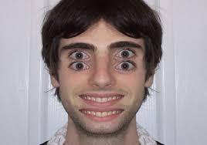
Diplopia: Clinical assessment
Diplopia is the simultaneous perception of two images of a single object that may be displaced horizontally or vertically in relation to each other.
Diplopia
Monocular
Binocular
Refractory process
Corneal abnor
Cataract
Cortical process
Cerebral polyopia
Psychologic
Orbital disease
Thyroid myopathy
Cavernous sinus dis
Orbital myositis
Tolosa Hunt
Pain prominent
PCOM/SAH
VA dissection
GCA
Cavernous sinus dis
Cranial nerve Mononeuropathy
Elderly/DM/HTN
Microvascular ischemia
Cranial nerve Polyneuropathy
Elderly/DM/HTN
Microvascular ischemia
Other neurological deficits
Brain stem stroke
Multiple sclerosis
Basilar meningitis
Other neurological deficits
Botulism
Wernicke encephalopathy
Miller Fischer syndrome
Myasthenia gravis

Slide 11
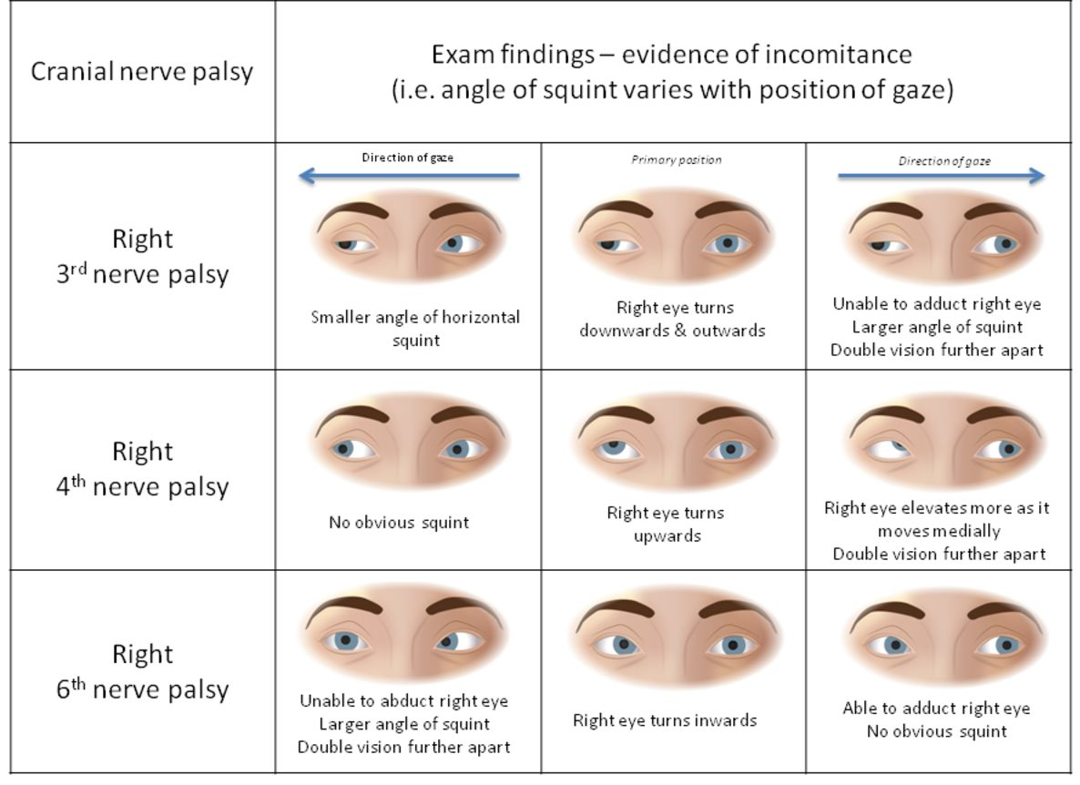

Slide 12
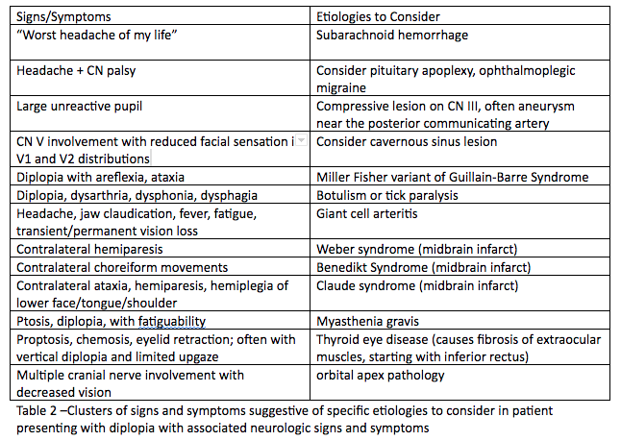

Slide 13
SEIZURE CLASSIFICATION
Loss of consciousness
Yes
No
Generalized seizure
Partial seizure
Tonic/Clonic
Alteration of consciousness
Myoclonic
No
Yes
Absence
Simple partial
Complex partial
Atonic

Slide 14
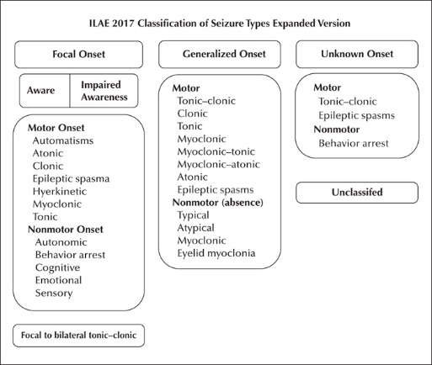
INTERNATIOL LEAGUE AGAINST EPILEPSY

Slide 15
FOCAL NON-MOTOR SEIZURES
Seizure Types | Meaning
1. Focal Non-motor Autonomic Seizures | These are seizures affecting autonomic nervous system presenting with symptoms like rising sensation in the stomach, hot and cold feelings, a strange taste or smell, etc
2. Focal Non-motor Behavior Arrest Seizures | These are seizures presenting with the cessation of all activities and unresponsiveness for the entire duration of the seizure event.
3. Focal Non-motor Cognitive Seizures | When there are hallucinations, illusions, Déjà rêvé, or impaired speech during the seizure event, the patient is said to have had cognitive seizures.
4. Focal Non-motor Emotional Seizures | These seizures refer to non-motor seizures that begin with panic, anxiety, fear, joy, crying, depression, or any other emotion.
5. Focal Non-motor Sensory Seizures | These seizures present with abnormal sensations such as visual, olfactory, auditory, gustatory, somatic hallucination, or vertigo?

Slide 16
GENERALIZED ONSET NON-MOTOR SEIZURES
Seizure Types | Meaning
1. Typical Absence Seizures | These seizures are characterized by interruption of activities that occur suddenly with a blank stare and occasionally associated with deviation of the eyes that lasts for a few seconds to half a minute with subsequent rapid recovery. May be associated with flicking of eyelids.
2. Atypical Absence Seizures | It has a slow onset with significant changes in muscle tone that is more pronounced than in typical absence. It has a slow spike-waves at EEG, usually less than three per second.
3. Myoclonic-absence seizure | This seizure starts with few rhythmical jerks, which is then followed by a staring spell.
4. Eyelid myoclonia | In this seizure, there is sudden forceful upward jerking of eyelids, which may be associated with the staring spell (absence seizure). It usually stimulated by the closure of the eyes.

Slide 17
GENERALIZED ONET SEIZURES
Generalized absence seizure:
Manifest by a sudden onset, interruption of ongoing activities, a blank stare.
They generally occur in young children through adolescence.
GTC seizures
There is a sudden sharp tonic contraction of muscles followed by a period of rigidity and clonic movements.
During the seizure, the patient may cry or moan, lose sphincter control, bite the tongue, or develop cyanosis.
After the seizure, the patient may have altered consciousness, drowsiness, or confusion for a variable period of time (postictal period) and frequently goes into a deep sleep.
Tonic and clonic seizures can also occur separately
Myoclonic seizures
Manifests brief shock-like muscular contractions of the face, trunk, and extremities
Atonic seizures: A sudden loss of muscle tone, which may present as a head drop, the dropping of a limb, or a slumping to the ground.
Epilepsy Syndromes include many different seizure types e.g.
The syndromic approach includes seizure type(s) and possible etiologic classifications (e.g., idiopathic, symptomatic, or unknown)
Infantile Spasms (West Syndrome | Doose Syndrome | Benign Rolandic Epilepsy (BRE)
Rasmussen Syndrome | Lennox-Gastaut Syndrome | Electrical Status Epilepticus of Sleep (ESES)

Slide 18
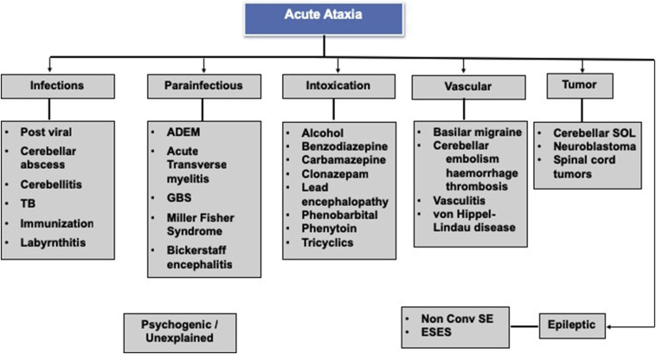
ATAXIA
Ataxia is lack of voluntary coordination of muscle movements & can include gait abnormality, speech changes, and eye movement
Types: Cerebellar/Sensory/Vestibular

Slide 19
Sensory Examination
Pattern of involvement
Symmetrical distal neuropathy
Symmetrical proximal neuropathy
Asymmetrical proximal neuropathy
Motor
Sensorimotor
Sensory
Possible neurological screening and consultation for possible underlying cause
Look for sensations |  |  |  |  | Look for reflexes
Touch | Pain | Temperature | Vibration | JPS | Biceps | Triceps | Supinator | Knee | Ankle
Diminished/ Absent Sensations
Diminished/Absent reflexes
Nerve conduction EMG testing

Slide 20
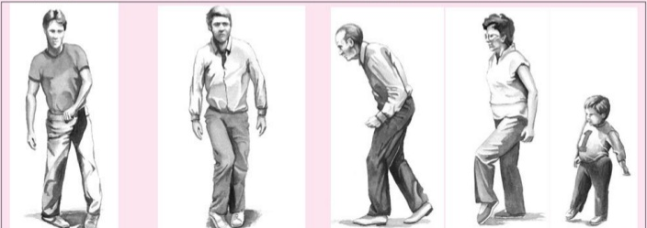
Types of gait
Human gait is defined as bipedal, biphasic forward propulsion of center of gravity of the human body, in which there are alternate sinuous movements of different segments of the body with least expenditure of energy
Gait | Gait is an attitude of a person in upright position | Gait WNL
Hemiplegic
Scissoring
Shuffling
High steppage
Waddling

Slide 21
Mini–mental state examination
Category | Maximum score | Patient Score | Questions
Orientation to time | 5 |  | “What is the year? Season? Date? Day? Month?”
Orientation to place | 5 |  | “Where are we now? State? County? Town/city? Hospital? Floor?”
Registration | 3 |  | The examiner names three unrelated objects clearly and slowly, then the instructor asks the patient to name all three of them.
Attention & calculation | 5 |  | “I would like you to count backward from 100 by sevens.” (93, 86, 79, 72, 65, …) Or: “Spell WORLD backwards.” (D-L-R-O-W)
Recall | 3 |  | “Earlier I told you the names of three things. Can you tell me what those were?”
Naming | 2 |  | Show the patient two simple objects, such as a wristwatch and a pencil, and ask the patient to name them.
Repetition | 1 |  | “Repeat the phrase: ‘No ifs, ands, or buts.’”
Language | 3 |  | “Take the paper in your right hand, fold it in half, and put it on the floor.” (The examiner gives the patient a piece of blank paper.)
Complex commands | 6 |  | Varies. Can involve drawing figure
Total score | 30

Slide 22
Examination of the Higher Functions
Speech Speech is communication between individuals | Dysphonia or aphonia Dysphonia is the impairment or inability to phonate. | Dysarthria or anarthria Dysarthria is the inability to articulate spoken words. | Dysphasia or aphasia: In dysphasia, the ability to process language is impaired
Essential Features of Common Dysphasias
Type of Dysphasia | Fluency | Comprehension | Naming | Localization
Broca | Non-fluent | Intact | Impaired | Broca area
Wernicke | Fluent | Impaired | Impaired | Wernicke area
Conduction | Fluent | Intact | Impaired | Arcuate fasciculus
Global | Nonfluent | Impaired | Impaired | Broca and Wernicke areas

Slide 23
Steps in the neurologic examination
In examining a patient, abnormalities of function lead to localization and, eventually, to the pathophysiology.
These steps include the following:
  General Appearance, including posture, motor activity, vital signs and perhaps meningeal signs if indicated.
  Mini Mental Status Exam, including speech observation.
  Cranial Nerves, I through XII.
  Motor System, including muscle atrophy, tone and power.
  Sensory System, including vibration, position, pin prick, temperature, light touch and higher sensory functions.
  Reflexes, including deep tendon reflexes, clonus, Hoffman's response and plantar reflex.
  Coordination, gait and Romberg's Test
  Examining the comatose patient

Slide 24
 | Grady Coma Scale | Respond to:
Grade | State of awareness | Calling name | Light pain | Deep pain
I | Confused, drowsy, lethargic, indifferent and/or uncooperative; does not lapse into sleep when left undisturbed | Yes | Yes | Yes
II | Stupor; may be disoriented to time, place, and person; will lapse into sleep when not disturbed; or belligerent and uncooperative | No | Yes | Yes
III | Deep stupor; requires strong pain to evoke movement | No | No | Yes
IV | Exhibits decorticate or decerbrate posturing to a deep pain stimulus | No | No | No
V | Does not respond to any stimuli; flaccid | No | No | No

Slide 25
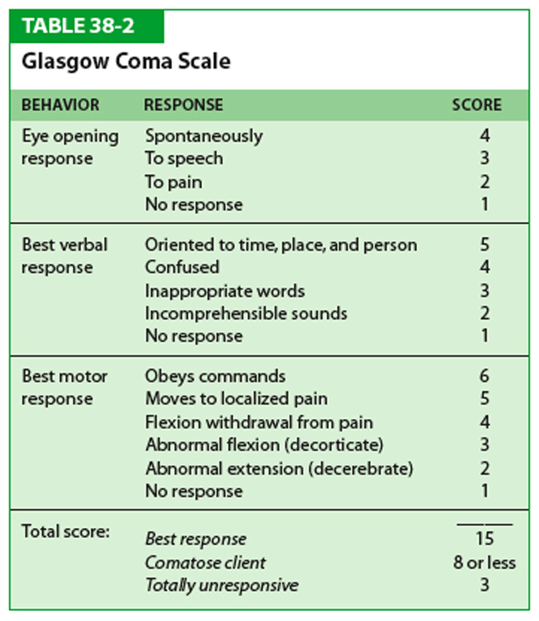
Assesses patient’s neurological condition
Value range 3 -15
3 totally
comatose
patient
9-12 Moderate
altered
level of
conscious
15 fully alert
patient

Slide 26
THANK
YOU

