Slide 1

History taking & clinical examination
Cardiorespiratory System
Dr. Nada Abdelrahman
Associate Professor of internal medicine
This Photo by Unknown Author is licensed under CC BY

Slide 2
Learning outcomes
By the end of this lecture, the students will be to
Take a history from a patient with a cardiac problem
List a differential diagnosis for the most common causes of chest pain based on history
Perform appropriate clinical cardiovascular examination

Slide 3

Cardiovascular History taking

Slide 4

History Chest Pain
Before starting
Introduce yourself to the patient.
Confirm his name and date of birth.
Explain that you are going to ask him some questions to uncover the nature of his chest pain and obtain his consent.
Ensure that he is comfortable

Slide 5

















Frame
Presenting complaint (PC)
History of presenting complaint (HPC)
Past medical history (PMH)
Family history
Drug history
Social history

Slide 6
Presenting Complaint
(PC)
Chest pain
Breathlessness (dyspnoea)
Palpitation
Dizziness
Blackouts (syncope)
Lower limb swelling
Intermittent claudication

Slide 7
History of presenting complaint (HPC)
As with any pain history, the mnemonic SOCRATES can help develop your differential diagnosis:
Site: where exactly is the pain?
Onset and progression: when did the pain start and how has it changed or evolved?
Character: what type of pain is it (dull, sharp, or crushing)?
Radiation: does the pain move anywhere (into the jaw, arm, or back)?
Associated S&S: ask about sweating, N and V, SOB, cough, haemoptysis, dizziness, & palpitations
Timing and duration: does the pain occur at particular times of the day? How long does each episode last?
Exacerbating and alleviating factors: what make the pain better or worse (exercise, movement, deep breathing, coughing, cold air, large or spicy meals, alcohol, rest, GTN, sitting up in bed)?
Severity: “How would you rate the pain on a scale of 1 to 10, & effect on everyday life.
Ask about any previous episodes of chest pain.

Slide 8
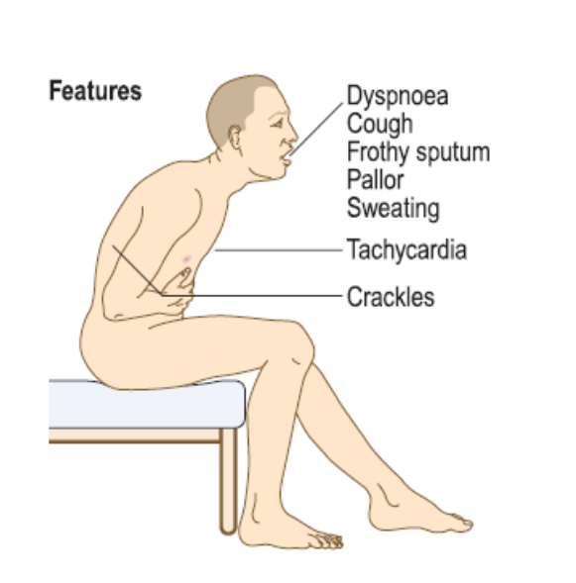
Other symptoms of CVS
Breathlessness: orthopnoea, paroxysmal nocturnal dyspnoea, ankle swelling, cough, wheeze, haemoptysis?
Palpitation: sudden onset and offset, ‘thumps’ or ‘pauses’, presyncope or syncope?, Fatigue
Dizziness/syncope: provoking factors, warning, duration, recovery?
Notes:
Infective endocarditis, : non-specific symptoms, including weight loss, tiredness, fever and night sweats.
Embolisation of intracardiac thrombus, tumour (such as atrial myxoma) or infective ‘vegetations’ symptoms of stroke , acute limb ischaemia or acute mesenteric ischaemia.
Advanced heart failure: abdominal distension due to ascites, or weight loss and muscle wasting (‘cardiac cachexia’) due to a prolonged catabolic state.

Slide 9
Risk factors of cardiovascular disease
Coronary heart disease ( myocardial infarction)
Stroke
Pneumonia
Pulmonary embolism
Deep vein thrombosis
Hypertension
Hyperlipidaemia
Diabetes
Smoking, alcohol use, and recent long-haul travel.

Slide 10
Past medical history (PMH)
Current, past, and childhood illnesses.
Stroke or transient ischaemic attack (TIA),
Renal impairment,
rheumatic fever, heart murmur
Peripheral vascular disease
Operations, hospital clinic attendances
Systemic disorders (pericarditis and Raynaud’s
Marfan’s syndrome (aortic dissection)
myotonic dystrophy (atrioventricular block).
Notes:
• potential causes of bacteraemia in patients with suspected infective endocarditis, such as skin infection, recent dental work, intravenous drug use or penetrating trauma
• systemic disorders with cardiovascular manifestations such as connective tissue diseases (pericarditis and Raynaud’s phenomenon), Marfan’s syndrome (aortic dissection) and myotonic dystrophy (atrioventricular block).

Slide 11
Drug history
Current, compliance with treatment
Prescribed medication, including the oral contraceptive pill if female.
Over-the-counter medication.
Recreational drugs.
Allergies.

Slide 12
Family history
Parents, siblings, and children.
Ask specifically
Heart disease
Hypertension,
other heritable cardiovascular risk factors
Sudden death

Slide 13
Social history
Effect of the chest pain on the patient’s life:
Employment.
Housing.
Hobbies.
Smoking
Alcohol
Recreational drugs such as cocaine and amphetamines
Notes:
Smoking is the strongest risk factor for coronary and peripheral arterial disease. Take a detailed smoking history (p. 14). Alcohol can induce atrial fibrillation and, in excess, is associated with obesity, hypertension and dilated cardiomyopathy. Recreational drugs such as cocaine and amphetamines can cause arrhythmias,

Slide 14
After taking the history
Ask the patient if there is anything else that he might add that you have forgotten to ask.
Summarize your findings and offer a differential diagnosis.
Thank the patient
State that you would like to examine the patient and order some investigations,
for example, ECG and chest X-ray, to confirm your diagnosis
Notes:
This is an excellent question to ask in clinical practice, and an even better one to ask in exams.
.

Slide 15
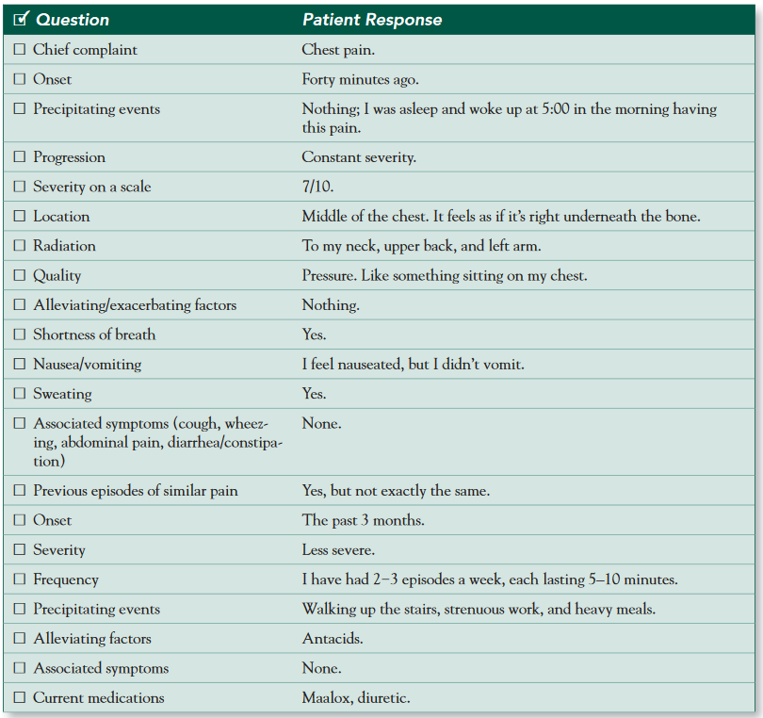
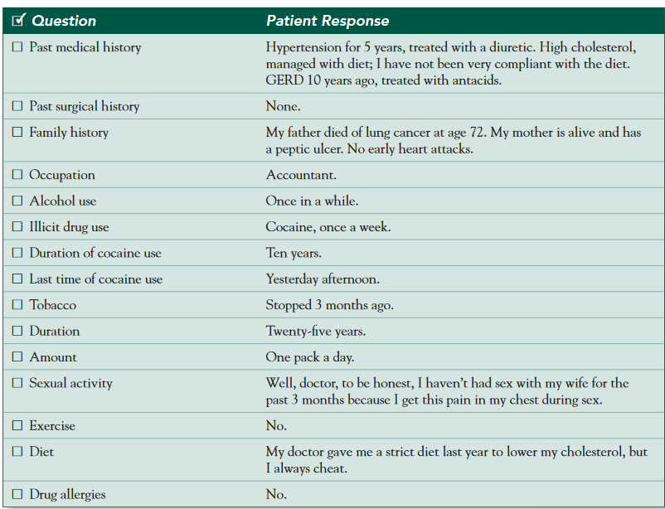
What is your diagnosis?
Notes:
Mr. Short, the source of your pain can be a cardiac problem such as a heart attack or angina, or it may be due to acid reflux, lung problems, or disorders related to the large blood vessels in your chest. It is crucial that we perform some tests to identify the source of your problem. We will start with an ECG and some blood work, but more complex tests may be needed as well. Do you have any questions for me?

Slide 16
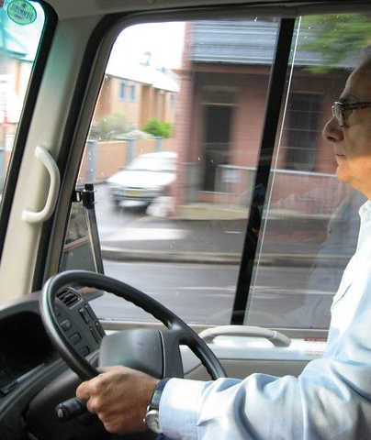
CASE 1
A 48-year-old bus driver presents with ‘pressure’ over his chest when walking long distances, worsening over the last few months. He also notes that chest pain occurs when he is angry or when out in the cold.
The pain is relieved on rest and when taking his GTN spray.
He is obese, smokes 20 cigarettes a day, drinks 30 units of alcohol a week and suffers from hypercholesterolaemia.
He has a family history of diabetes, and his mother has hypertension.
This Photo by Unknown Author is licensed under CC BY-NC

Slide 17

CASE 2
A 59-year-old builder with a history of sudden onset retrosternal chest pain radiating to his jaw and his left arm at rest. The pain is not relieved by GTN spray and lasts for 20 minutes.
He is also complaining of feeling nauseous, cold and breaking into a sweat. He is known to suffer from diabetes, hypertension and hypercholesterolaemia.
He is currently taking aspirin, bisoprolol, nicorandil, ramipril, ISMN, simvastatin and metformin. His brother died aged 49 from a heart attack.

Slide 18

Case 3
A 39-year-old gentleman who suffers from Marfan syndrome presents with sudden onset of severe tearing central chest pain which radiates to the back and is persistent in nature.
His past medical history includes hypertension.
He is a known smoker but has been teetotal for his whole life.
This Photo by Unknown Author is licensed under CC BY-NC-ND

Slide 19

CASE 4
A 25-year-old pregnant lady recently returned from a long flight from Thailand complaining of right calf pain and swelling.
She has recently developed sharp onset chest pain, worse on deep inspiration and associated with slight haemoptysis and shortness of breath.
She does not complain of any pain on movement or mention any recent falls or trauma

Slide 20

CASE 5
A 28 year old lady complaining of acute onset of retrosternal chest pain that radiates to her left
shoulder. She has recently suffered with a viral infection.
The pain is made worse on deep inspiration and lying down, whilst it is relieved on sitting forward and taking ibuprofen.
She is not taking the pill. There is no relevant family history.
This Photo by Unknown Author is licensed under CC BY

Slide 21
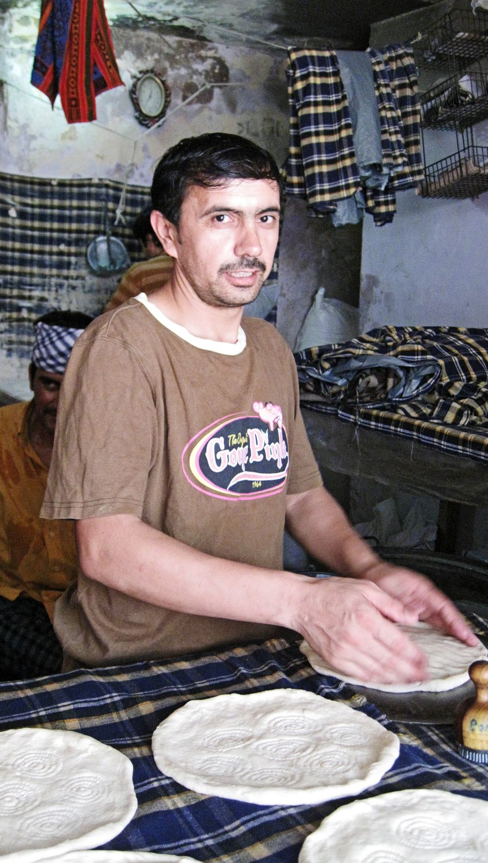
CASE 6
A 34-year-old gentleman who works in an Indian restaurant. He complains of a burning sensation in the lower chest that radiates to his throat. The pain is worse on lying down and after meals but improves on leaning forward. He also notes a bitter taste in his mouth with extra salivation in the mornings.
He drinks 6 cups of coffee every day and is a heavy drinker.
He smokes 2 packs of cigarettes a day. He also states that he has been taking ibuprofen for a recent cold.
This Photo by Unknown Author is licensed under CC BY

Slide 22

CASE 7
A 32-year-old delivery man complaining of an acute onset of aching pain localized on the right chest wall. It is made worse on inspiration, movement and lifting, and is tender to touch.
There is no radiation nor any associated symptoms such as shortness of breath, palpitations or haemoptysis.
There is no relevant past medical, family or drug history. He is a social drinker.

Slide 23


Nicholas J Talley: clinical examination. A systematic guide to physical diagnosis 8th edition: 57- 108
HUTCHISON’S CLINICAL METHODS . Page 189-194
References
Macleod’s Clinical Examination : 15 edition Page 43-50
This Photo by Unknown Author is licensed under CC BY-NC
This Photo by Unknown Author is licensed under CC BY-NC

