Slide 1


History Taking & Physical Examination

Slide 2

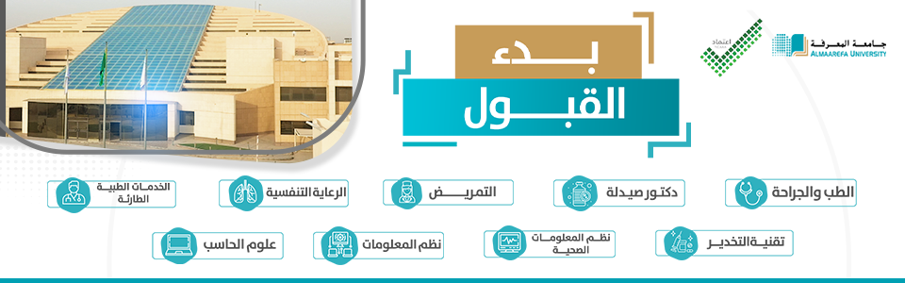
Dr. Nada Abdelrahman
Associate professor of Medicine and consultant of internal medicine
Almaareffa University

Slide 3
Learning Outcomes
04
Recognize abnormal Signs relevant to GIT examination
03
Conduct appropriate systematic abdominal examination
02
Take a focus GIT history in a chronological order, and appropriate sequences in GIT framework.
Illicit and give a rational differential diagnosis of GIT symptoms
01

Slide 4
Important Learning outcomes
Specific learing outcomes: By the end of this lectures, the students are expected to
Describe a clear GIT framework, pinpointing important historical relevant data.
construct a differential diagnosis for the common Git symptoms.
List detail differential diagnosis and work up of a patient with abdominal pain
Perform a systematic abdominal examination
Recognize relevant signs related to abdominal examination.

Slide 5




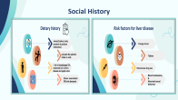



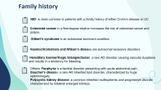


GIT Framework
01
03
02
01
04
Demographic Profile
Past medical history
X name, age, sex, nationalaty, occupation, date of admission
Presenting illness
02
05
Drug History
Presenting complaint(s)
History of Present Illness
Current medications, illegal, over-the-counter, herbal
03
Systemic Review
06
Family history
06
Social history
06
Notes:
Age: Certain conditions are more likely to occur in certain age groups, e.g. mesenteric adenitis in children, diverticular disease in the elderly.

Slide 6
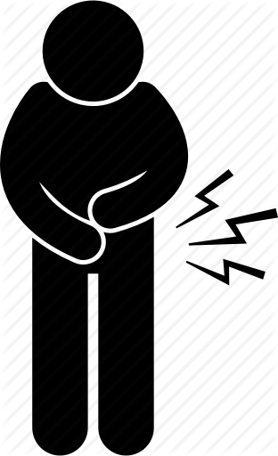
History of Present Illness
A comprehensive and chronological account of the presenting chief complaint
Symptom characterization:
O ="' Onset (When, what the patient was doing at 1he time) and duration
P ="' Palliating and Provoking factors
Q="' Quality of pain (e.g. sharp, dull, throbbing)
R ="' does the pain Radiate?
S="' Severity of pain on a scale from 1 to 10, with 1 being the least and 10 being the most severe")
T = Timing and progression ("is the pain constant or intermittent? worse in the
morning or at night-time?")
U= "how does it affect 'U' In your daily life?" - consider Impact on self, work, family, friends, others
V = Deja Vu ("Has this happened before?")
W ='What do you think it is?" "What are you most worried about?"

Slide 7

Past medical history
History of a similar problem .
Pancreatitis, bleeding peptic ulcer or inflammatory bowel disease.
Coexisting peripheral vascular disease, hypertension, heart failure or atrial fibrillation may suggest aortic aneurysm or mesenteric ischaemia.
Primary biliary cirrhosis and autoimmune hepatitis are associated with thyroid disease,
Non-alcoholic fatty liver disease (NAFLD) is associated with diabetes and obesity.
Ask about previous abdominal surgery.

Slide 8
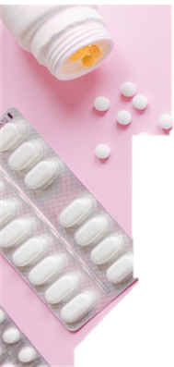
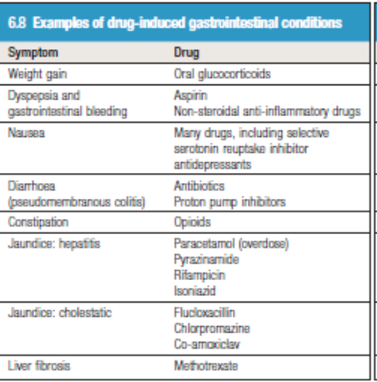
Many drugs affect the gastrointestinal tract and are hepatotoxic.
Notes:
Which drug can cause weight gain
Glucocoertoids
What drugs cause diarrhoea
Antibotics
What drugs causes Jaundice#
Rifampicin, Paracetamol
Which drug cause cholestatic Jaundice
Coamoxiclav, Flucloxaclin

Slide 9
Family history
IBD is more common in patients with a family history of either Crohn’s disease or UC
Colorectal cancer in a first-degree relative increases the risk of colorectal cancer and polyps.
Gilbert’s syndrome is an autosomal dominant condition
Haemochromatosis and Wilson’s disease are autosomal recessive disorders
Hereditary haemorrhagic telangiectasias a rare AD disorder causing vascular dysplasia and results in a tendency for bleeding.
Others: Porphyria is a familial disorder presenting with acute abdominal pain,
Gaucher’s disease: a rare AR inherited lipid disorder, characterized by huge splenomegaly
Polycystic kidney disease: a common inherited multisystemic and progressive disorder characterized by bilateral enlarged kidneys.
Notes:
Family history is important in GIT disorder, outline some examples
IBD, Colorectal cancer, Gilbert, Wilson, Haemochromatosis.

Slide 10
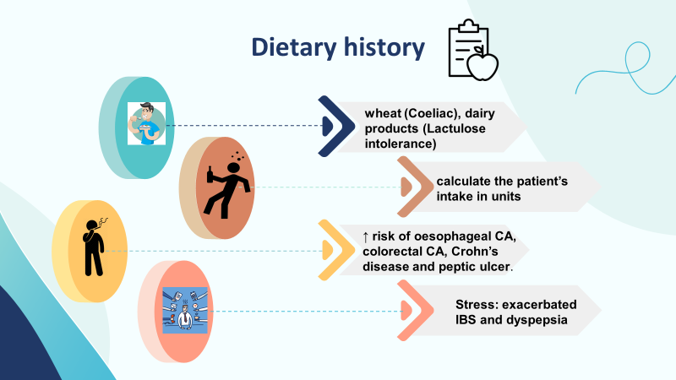
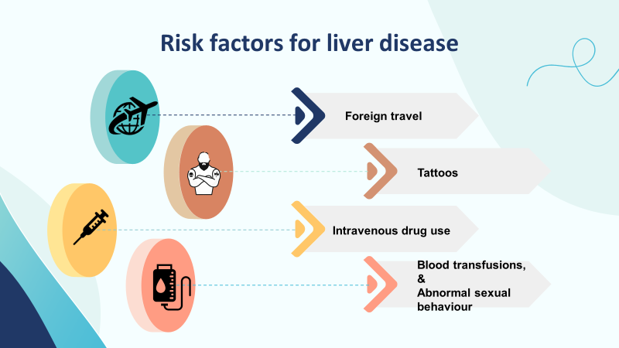
Social History
Notes:
Dietary history : assess the intake of calories and sources of essential nutrients. For guidance, there are 9 kcal per g of fat and 4 kcal per g of carbohydrates and protein.
Food intolerances: patients with irritable bowel syndrome often report specific food intolerances, including wheat, dairy products and others.
Painless diarrhoea may indicate high alcohol intake, lactose intolerance or coeliac disease.

Slide 11
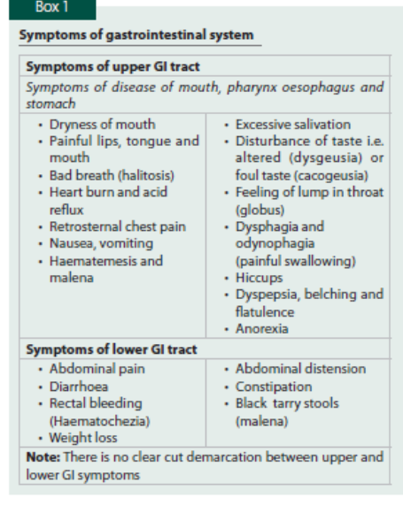
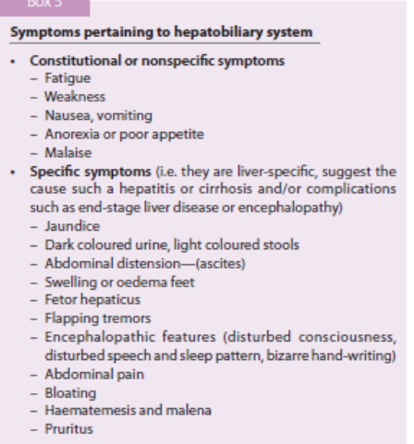
GIT and hepatobiliary symptoms

Slide 12
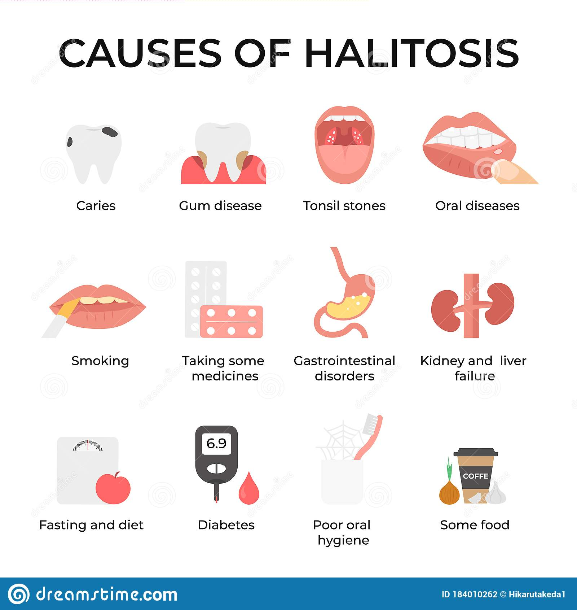
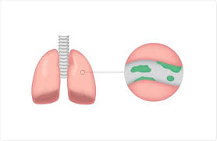
is a frequent or persistent unpleasant odour to the breath.
Gingivitis dental abscess,
Acute tonsilitis
Necrotic oral /nasopharyngeal cancer
Bronchiectasis
Disulfiram
Pharyngeal pouch, GORD, Abdominal sepsis
onions, garlic, spices

Slide 13

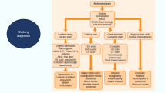


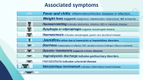

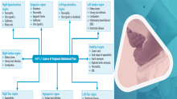



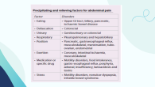
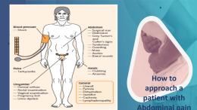



Abdominal pain
5
4
Predisposing Factors
Associated symptoms
Precipitating and relieving factors
6
3
More GIT symptoms
7
Radiation of pain
RT shoulder: hepatobiliary diseases and diaph,.pleurisy
Lf shoulder; Spleen, colonic
Mid-back: pancreatic, gastric
Flank: kidney
Groin: urteric
2
Examination finding
1
Site
Mid-line pain: poorly
localized: visceral pain. D
Para umbilicus: intestinal diseases, e.g. acute intestinal obstruction.
Somatic pain: localizied to organ
8
Working Diagnosis
Notes:
Pain Abdomen

Slide 14
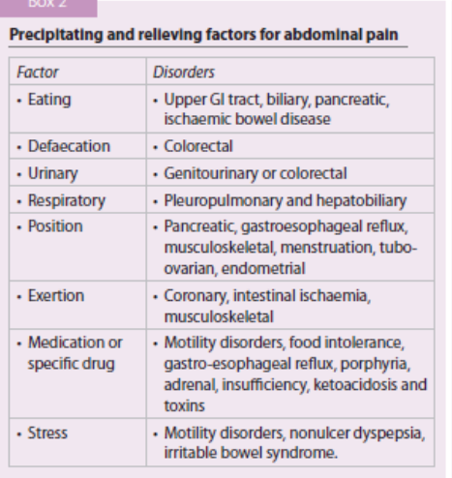

Slide 15
Associated symptoms
Fever and chills: inflammatory/infective diseases or infarction.
Weight loss suggests malignancy, malabsorption, tuberculosis, IBD ischaemia.
Nausea/vomiting indicates obstruction, infection, IBD or metabolic disease.
Dysphagia or odynophagia suggests oesophageal disease
Haematemesis indicates oesophageal, gastric and duodenal disease
Dysuria / haematuria suggests urinary diseases
Vaginal/penile discharge indicates genitourinary disorders.
Hematochezia indicates colorectal disease
Skin/joint/eye involvement indicates inflammatory bowel disease.
Jaundice is either due to haemolytic or hepatobiliary disorders.
Diarrhoea : malabsorption or infection, IBD, secretory tumours (Zollinger- Ellison’s syndrome).

Slide 16
Predisposing Factors
Family history
ischaemic colitis.
Diabetes mellitus
connective tissue diseases
Depression
polyposis, IBD
pancreatitis
disorders of motility, ketoacidosis,
motility disorders and functional disorder
Hypertension, smoking,
old age, atherosclerosis
motility disorders and serositis;
Notes:
zz predispose to
zz predisposes to
predispose to
while may predispose to, e.g. irritable bowel syndrome.

Slide 17
Other GIT symptoms
Hiccup (hiccough)
It is a spasmodic contractions of diaphragm. Results in spasmodic breathing with the glottis is closed.
Causes of hiccup include gastric irritations, aerophagy, carbonated drinks, rapid eating, spicy foods, renal failure, alcohol, stroke, multiple sclerosis, brain tumours
Other symptoms
Dyspepsia/Flatulence
Heart Burn
Melaena
the term applied to symptoms of
bloating and belching without abdominal pain.
GI tract diseases
Drugs and alcohol
Functional
Psychogenic
SWALLOWED BLOOD
Oesophageal varices
BLEEDING DISORDERS / drugs
OTHER CAUSES OF DARK STOOLS
• Iron therapy
• Bismuth preparations
• Liquorice
• Charcoal biscuits
• Red wine (large quantities)
Notes:
Heart Burn
It is a burning pain or discomfort in retrosternal area, that usually occurs after meals
•The patient may experience a sour taste coming up into his mouth
• It is particularly associated with gastroesophageal reflux disease
• Mechanism: regurgitation of gastric contents into the oesophagus
• Aggravating factors:
▪ Stooping, bending or lying supine
▪ Fatty meals, coffee, alcohol, chocolates
• Relieving factors: antacids, anti-ulcer drugs
• Causes of heartburn: gastroesophageal reflux disease (GERD), acute gastritis,
oesophagitis, pregnancy
• Causes of GERD: obesity (increased intra-abdominal pressure which overwhels lower oesophageal sphinctor) , lower oesophageal sphincter pressure
(leads to inappropriate lower oesophageal sphinctor), decreased oesophageal peristalsis, gastric acid hypersecretion, delayed gastric emptying, overeating,
certain foods (cafeine, fatty, or spicy foods), hiatus hernia (protrusion (herniation) of the cardia and/or fundus into the thorax).
Melaena is the passage of altered blood PR. A melaena stool is black
and tarry and has a characteristic smell. The blood is degraded by
hydrochloric acid and intestinal enzymes high in the gastrointestinal
tract. Melaena is unlikely to occur if bleeding comes from lower
than the jejunum, although occasionally melaena may result from a
bleeding Meckel’s diverticulum.
CAUSES
SWALLOWED BLOOD
• Epistaxis
• Haemoptysis
OESOPHAGUS
• Reflux oesophagitis
• Oesophageal varices
• Oesophageal carcinoma
STOMACH
• Peptic ulceration
• Acute gastric erosions
• Mallory–Weiss syndrome
• Carcinoma
• Leiomyoma (gastro-intestinal stromal tumour – GIST)
• Hereditary haemorrhagic telangiectasia
• Vascular malformations
DUODENUM
• Peptic ulceration
• Duodenal diverticulae
• Aortoduodenal fistulae
• Invasive pancreatic tumours
• Haemobilia
SMALL INTESTINE
• Leiomyoma (gastro-intestinal stromal tumour – GIST)
• Meckel’s diverticulum
BLEEDING DISORDERS
• Liver disease-associated
Thrombocytopenia
• Haemophilia
DRUGS
• Anticoagulants
• Aspirin
• NSAIDs
• Steroids
OTHERS
• Uraemia
• Connective tissue disorders
Hiccup (hiccough)
• Hiccup:
▪ It is a spasmodic contractions of diaphragm
▪ Results in spasmodic breathing with the glottis is closed
▪ Accompanied by a characteristic sound (hic)
• Usually it is a self-limited benign condition, lasting for a few minutes,
but may be intractable (lasting for weeks or even months), and may
indicate serious conditions
• Causes of hiccup include gastric irritations, aerophagy, carbonated
drinks, rapid eating, spicy foods, renal failure, alcohol, stroke, multiple
sclerosis, brain tumours

Slide 18


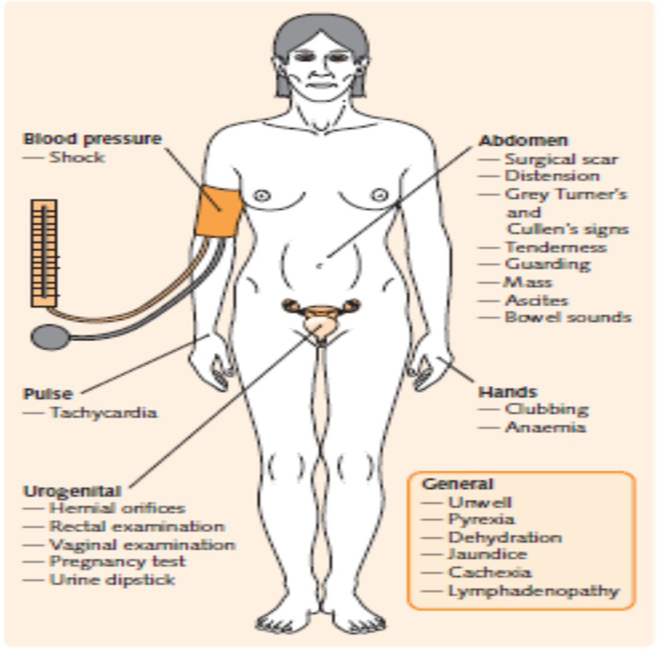

constant or variable? Is it ‘colicky’
Gradual / sudden
previous episodes
How to approach a patient with Abdominal pain
Notes:
What is the site of pain?
• How severe is it?
• Is it continuous or intermittent?
• Does it radiate to any site or direction?
• What is duration of pain?
• Are there any pain-free intervals, if yes, what is their duration?
• Is pain related to meal?
• Does it disturb sleep at night?
• What are the aggravating factors?
• What are relieving factors (e.g. food, vomiting or antacid)?
Appetite
• Is it increased or decreased?
• If reduced, is appetite poor or the patient is afraid of taking food due to pain?

Slide 19
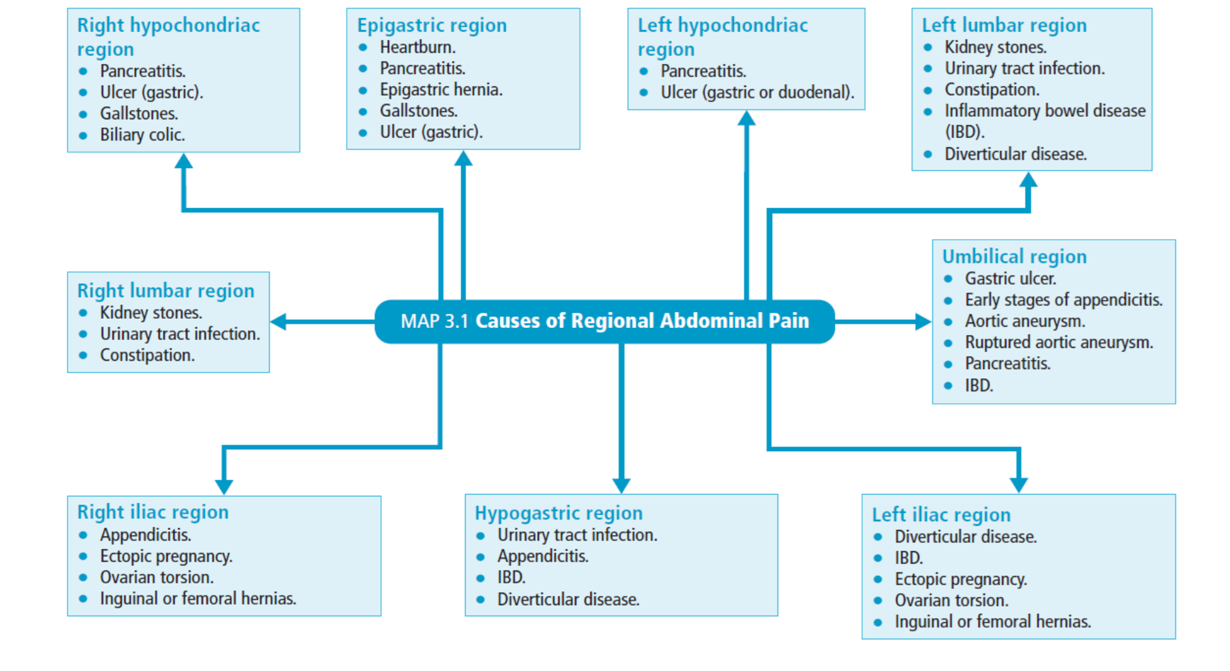

Slide 20
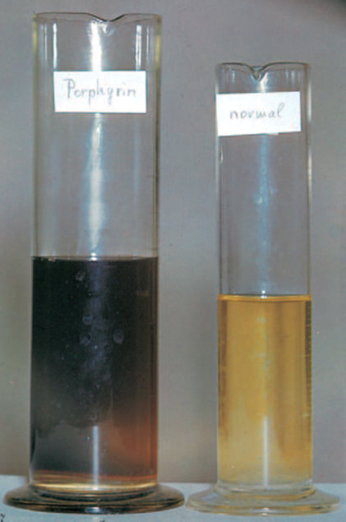
Medical causes of abdominal pain
Porphyrias: Acute Intermittent Porphyria.
Lead Poisoning.
Metabolic and Endocrine Diseases.
Diabetic precoma
Pheochromocytoma
Addison disease
Familiar hyperlipidemia
Inferior MI
Polycythemia, congenital spherocytosis
Sic;le cell disease

Slide 21
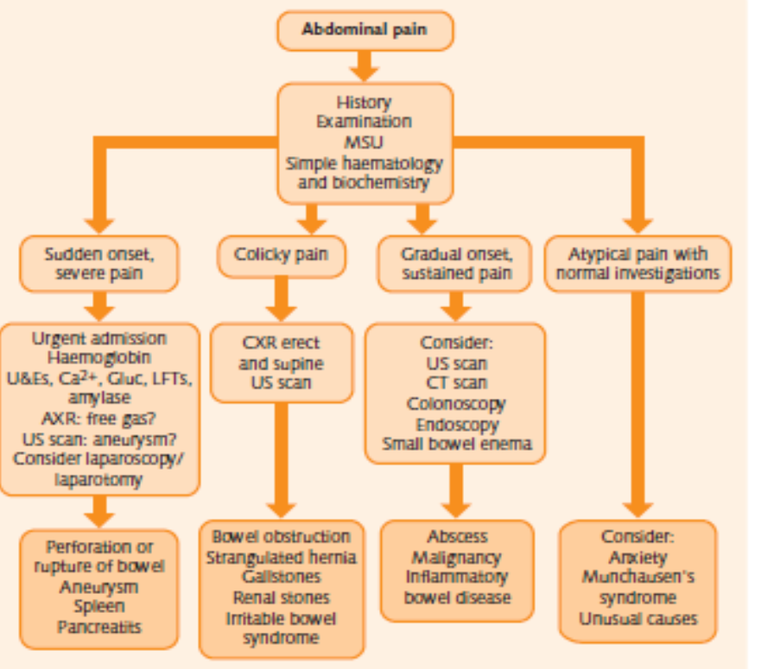
Working diagnosis

Slide 22

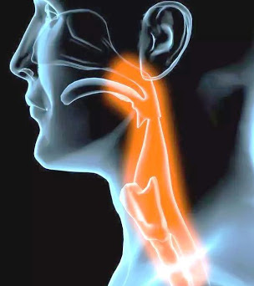
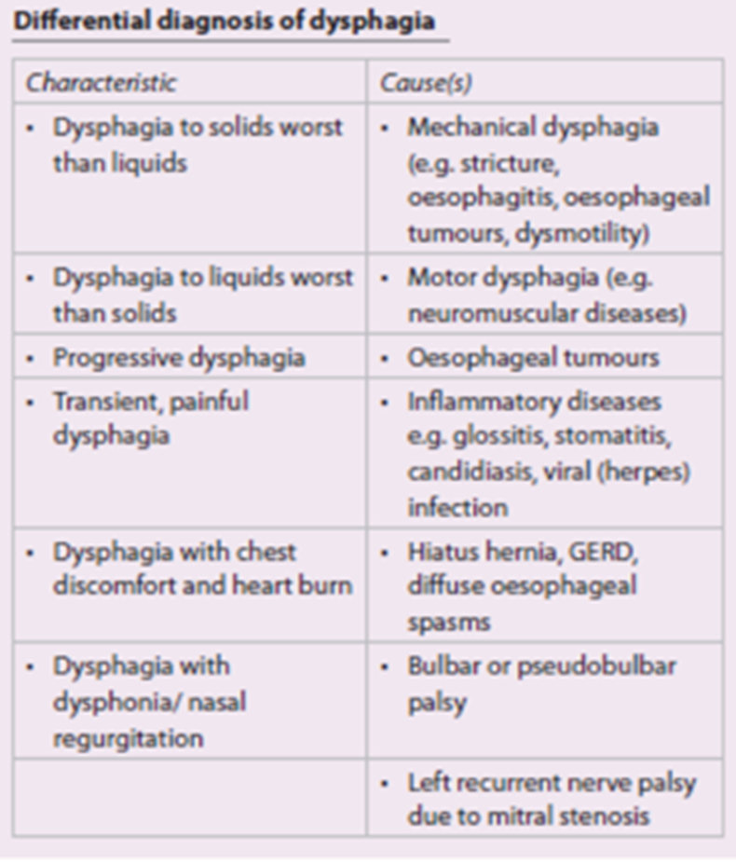
Dysphagia

Slide 23
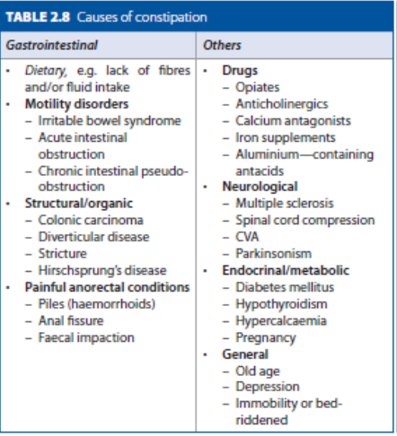
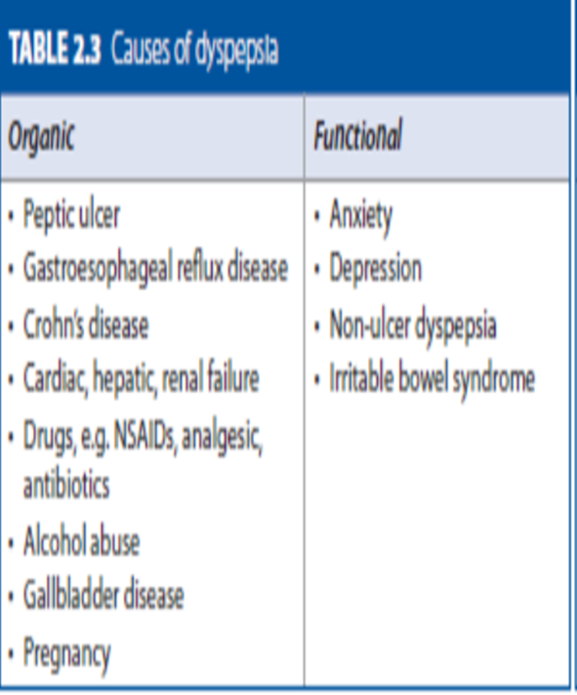
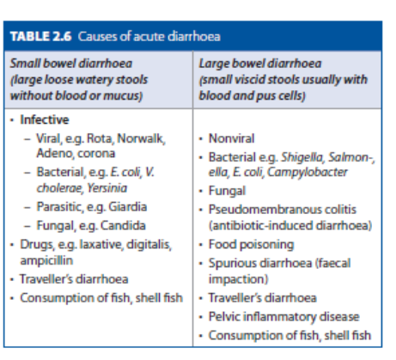
Other GIT symptoms

Slide 24
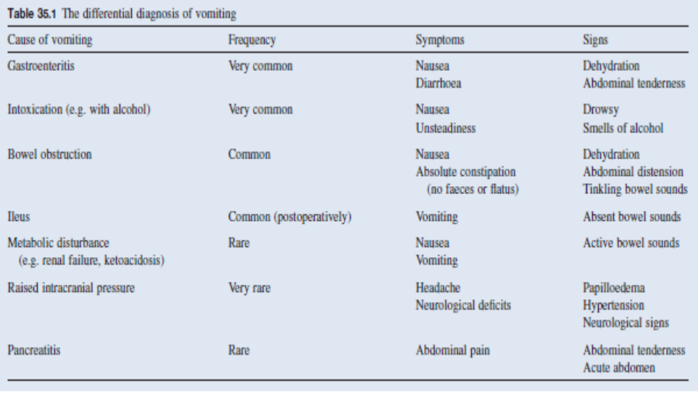
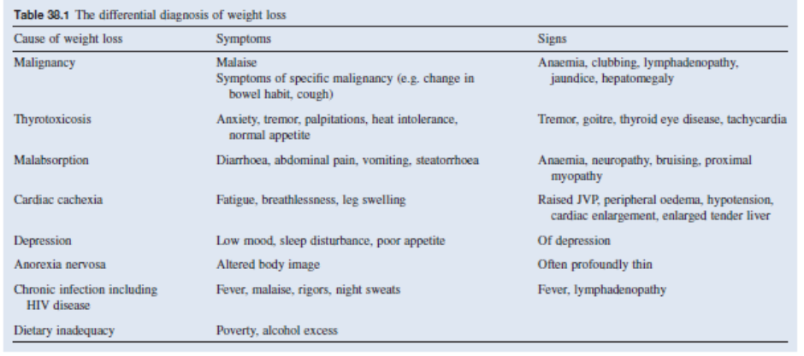
Vomiting & weight loss

Slide 25
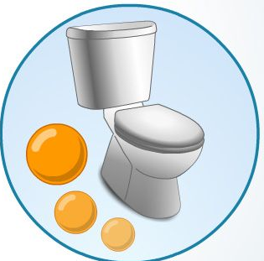
Steatorrhoea
Pass Pale bulky, sticky and greasy offensive stool that floats and is often difficult to flush away
Notes:
LIPASE DEFICIENCY
• Impaired secretion – chronic pancreatitis
• Inactivation – excess gastric acid
BILE DEFICIENCY
• Underproduction – liver disease
• Obstruction – obstructive jaundice
• Increased degradation – bacterial overgrowth
MUCOSAL DISEASE
• Coeliac disease
• Ileal resection
• Crohn’s disease
IMPAIRED FAT TRANSPORT
• Abetalipoproteinaemia
LYMPHATIC DEFICIENCY
• Lymphoma
• Whipple’s disease

Slide 26
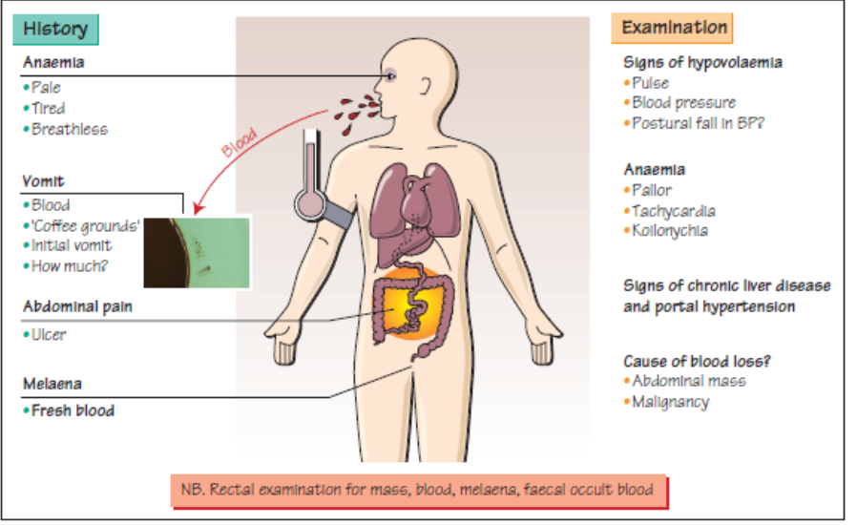

Slide 27

Physical Examination

Slide 28
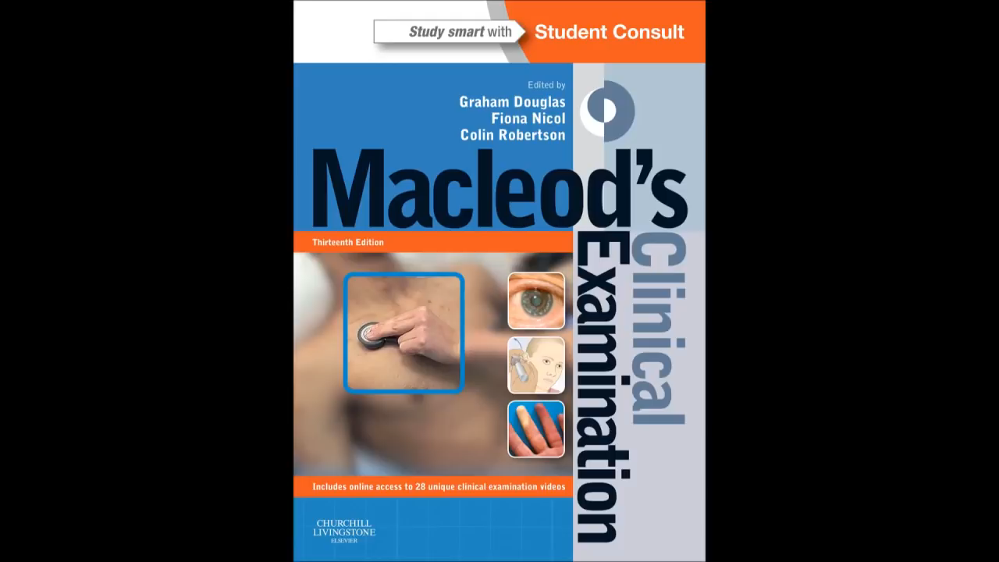

Slide 29
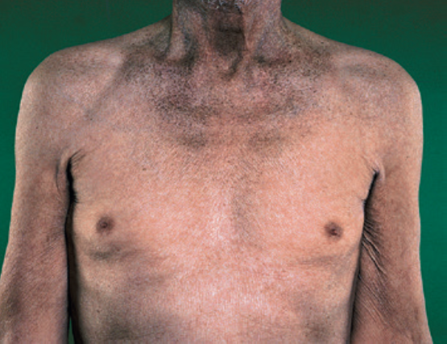
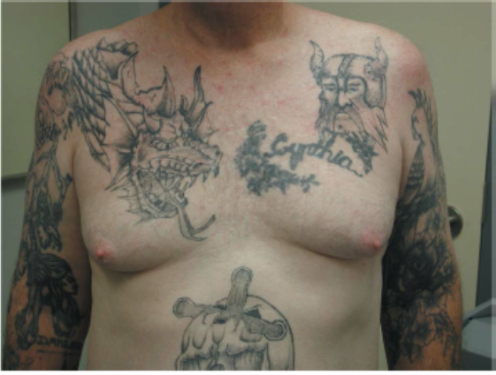
Examination: General inspection
Look at the patient
Position
Is the patient well or unwell, comfortable or in pain, moving easily or lying motionless? e.g. peritonitis?
Writhing in agony, e.g. ureteric or biliary colic?
Pulse, temperature, respiration
Is the patient flushed, suggesting pyrexia?
Pulse and temperature are raised in inflammatory conditions, with bowel infarction.
An increased respiratory rate : pneumonia referring pain to the abdomen.
Is the patient thin or obese?
Is there pallor, jaundice or lymphadenopathy?
Look for systemic features of illness (fever, tachycardia, hypotension,
postural hypotension, tachypnoea, dehydration and
hypovolaemia).
Look for signs of chronic liver disease (spider naevi, gynaecomastia, bruising, parotid hypertrophy, palmar erythema, leuconychia,
Dupuytren’s contracture, excoriations and a metabolic flap
[asterixis]).
Notes:
Cervical lymphadenopathy
Associated with mesenteric adenitis.

Slide 30
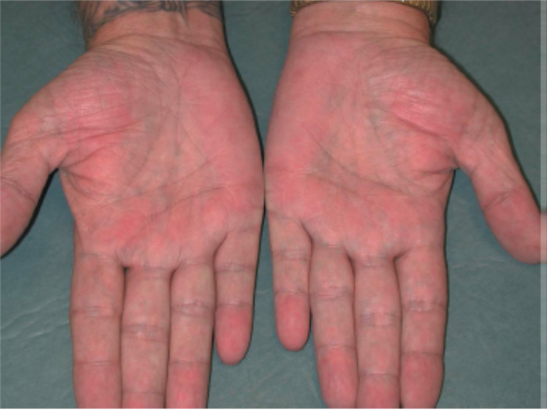
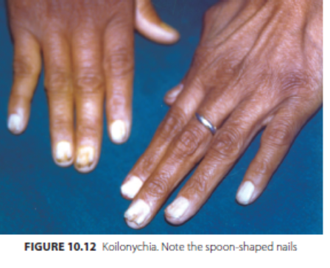
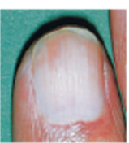
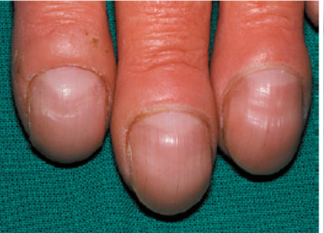
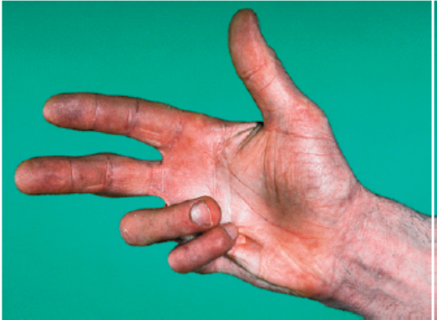
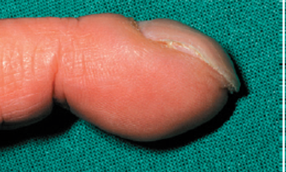
Hand Examination
Palmar erythema
Koilonychia
Metabolic flap (asterixis)?
Leukonychia
Causes of Clubbing
Congenital or familial (5–10%)
Acquired
• Thoracic (~70%):
• Lung cancer
• Chronic suppurative conditions: pulmonary tuberculosis, bronchiectasis, lung abscess, empyema, cystic fibrosis, Mesothelioma, Pulmonary fibrosis
• Cardiovascular: • Cyanotic congenital heart disease , Infective endocarditis, Av shunts, Atrial myxoma
•Gastrointestinal: Cirrhosis, Inflammatory bowel disease
•Others: Thyrotoxicosis (thyroid acropachy)
Dupuytren’s contracture

Slide 31
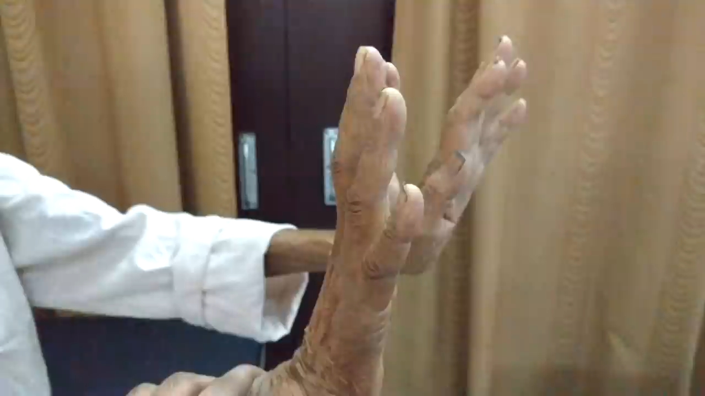
Asterix

Slide 32
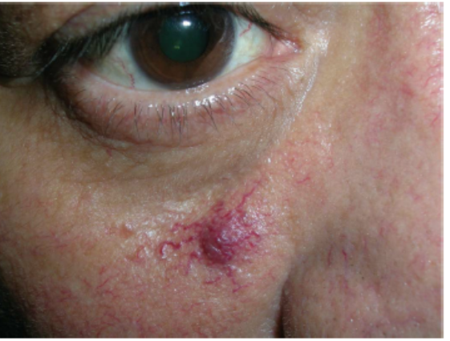
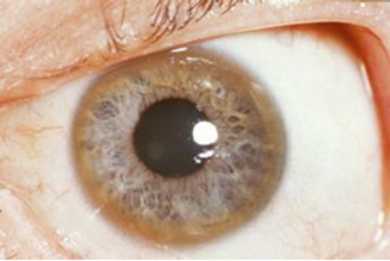
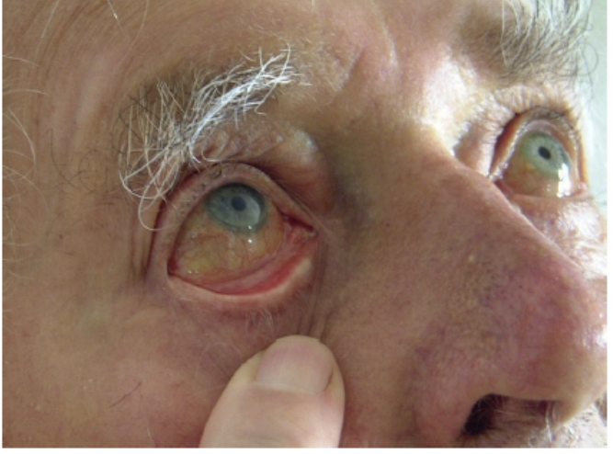
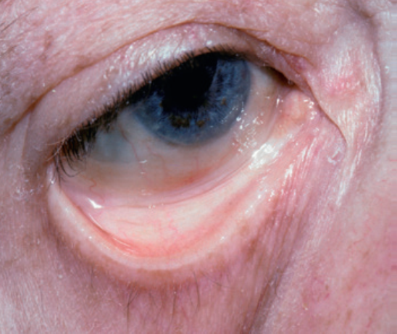
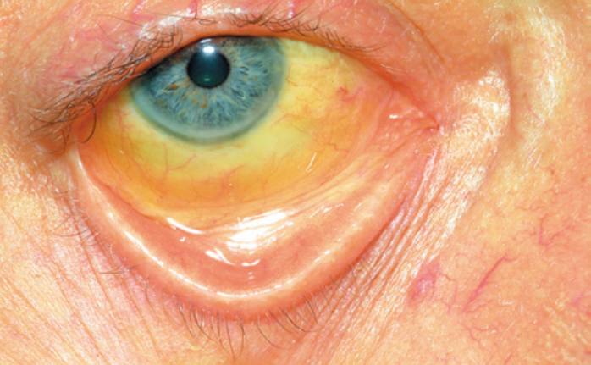
EYE Examination
Spider angioma on the face
Kayser- Fleisher Ring
Anaemia

Slide 33
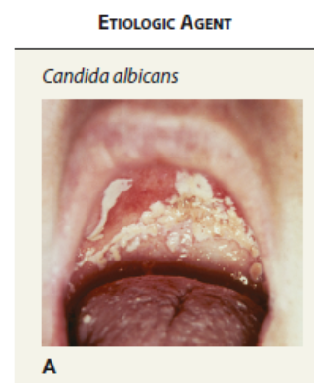
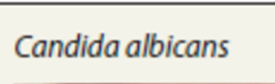
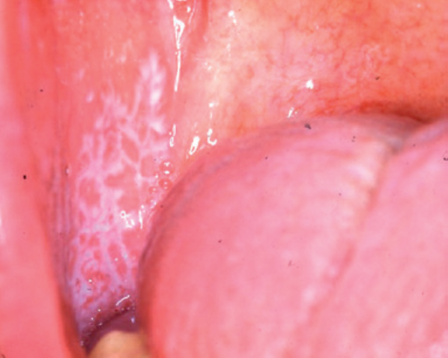
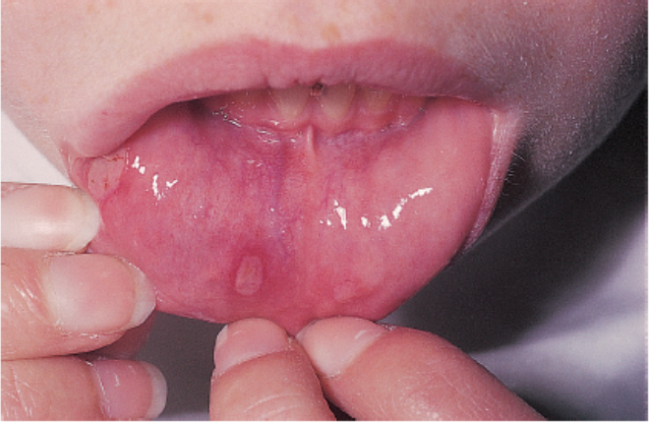

Mouth Examination
Examine the mouth and tongue
Angular stomatitis,
Aphthous ulcers,
Telangiectasia
Lichen planus
Causes of mouth ulcers
Aphthous
Crohn’s disease
Infective:
Bacterial, syphilis,
viral: herpes simplex
Fungal: candidiasis
Neoplastic: squamous cell carcinoma
Skin disease-associated: lichen planus
Connective tissue disease: SLE
Other: Behçet’s syndrome, Reiter’s disease
Aphthous Ulcers
Telangiectasia

Slide 34


Tongue
Causes of dryness of the tongue
Mouth breathers
Dehydration
Vitamin A deficiency (xerosis)
Anticholinergics
Sjögren’s syndrome (Sicca syndrome)

Slide 35



Slide 36
Lymphadenopathy
Look for supraclavicular and other lymphadenopathy (Virchow’s
node or Troissier’s sign – left supraclavicular lymphadenopathy due to spread from abdominal carcinoma).

Slide 37


•

Slide 38

Focused Abdominal Examination

Slide 39






Turner sign
Cullen sign
Notes:
Examine the abdomen
Ensure patient is warm, comfortable and there is sufficient exposure
of the abdomen. The patient should be lying flat with the head supported.
Relax the patient.
Inspect the abdomen
• Is it distended, asymmetrical, are there masses, scars, visible peristalsis,
stoma?
• Ask the patient to cough, take a deep breath and look carefully.

Slide 40


Caput medusae

Slide 41



Slide 42


Slide 43



Slide 44


Palpation o this patient’s abdominal wall (A) during the
course o an abdominal examination resulted in abdominal wall pitting
edema as exemplif ed by the examiner’s hand imprint
Notes:
Palpate the abdomen
• Ask if they have any pain or tenderness: be particularly careful if
they have. Look at the patient’s face whilst examining for any tenderness
or pain. Palpate lightly with fingertips ± ulnar border of index
finger and then more deeply. Palpate all areas of the abdomen. Any
masses or other abnormalities should be assessed in great detail for
size, position, shape, consistency, location, edge, mobility with respiration
and pulsatility.
• Is there any tenderness? If so, define the area with care.
• Any rigidity?
• Is there rebound tenderness? (pain on quick removal of examining
hand – some clinicians prefer to use percussion to minimize pain).
• Is there guarding?

Slide 45




Percussion
Notes:
Percussion: Liver span
The liver span is estimated by percussion.
Remember that it is easier to hear the change from resonance to dullness – so proceed with percussion from areas of resonance to areas of dullness.
Upper border: In the midclavicular line start percussing in the chest moving down towards the abdomen about ½ to 1 cm at a time. Note where the percussion notes change from resonate to dull.
Lower border: In the midclavicular line begin percussion below the unbillicus and proceed upward until dullness is encounter.
The distance between the two areas where dullness is first encountered is the liver span.
Liver span is normally 6 to 12 cm in the midclavicular line.
Is there ascites?
Abdominal distension, flank dullness with shifting dullness?

Slide 46





Ascites

Slide 47


Hepatomegaly
Examine the liver
Is it enlarged? Is it palpable below the right costal margin?
Palpate with ulnar border and pulp of index finger during gentle respiration.
Begin in the right iliac fossa.
Measure. Define the upper extent by percussion.
Is the liver smoothly enlarged, tender, pulsatile, hard or irregular (suggesting tumour)? Is there a bruit?

Slide 48


Examine the spleen
Examine the spleen
• Is the spleen enlarged? Is it palpable below the left costal margin?
Begin in right iliac fossa and palpate towards left costal margin.
Measure. Define the upper extent by percussion. Is it tender? Bruit?
Does it move with respiration?
• Are there any other signs of portal hypertension e.g. ascites, caput
medusae, distended veins (determine direction of flow)?

Slide 49


Examining the patient with lymphadenopathy and/
or splenomegaly.

Slide 50



Examine the kidneys
Examine the kidneys
Are the kidneys palpable? Ballottable? Smoothly or irregularly
enlarged (consider polycystic kidney disease), bruits?

Slide 51

Auscultation
Bowel sounds
Healthy persons may have no bowel sounds for several minutes (silent intestinal contractions). Bowel sounds are exaggerated (borborygmus), and increased in rate in mechanical intestinal. Absent (paralytic ileus),
Venous hum : soft systolic murmur
the collaterals of the portal hypertension: large volume of blood flows in umbilical and paraumbilical veins in falciparum ligament (portosystemic shunt)
Hepatic bruit: Heard over the liver, usually due to hepatocellular carcinoma, or vascular hepatic tumours
Aortic bruit: Just above the umbilicus
Renal bruit: Occurs in renal artery stenosis due to turbulent flow through a narrowed vessel
Succussion splash: Excess fluid in the gut, e.g. from pyloric stenosis, or advanced intestinal obstruction, may splash when the abdomen is shaken, or the patient rolled from side to side
Notes:
Auscultate
Auscultate for bowel sounds (absent/present, normal/abnormal, hyperactive,
high-pitched, tinkling [suggesting obstruction]).

Slide 52
Eruptive xanthomas
p e rip he ral e d ema in the le t
pretibial area o the same patient

Slide 53


Slide 54

Hematemesis

Slide 55


Weight Loss

Slide 56

Conclusions
It is very important to be able to take a focus history from patient with GIT Symptoms
Abdominal pain is very important symproms which need a detail histiory to rule out surgical causes of acute abdomen

Slide 57

?
Do you have any

Slide 58
Thanks!
References
Macleod’s Clinical Examination: 15 edition
Page: 106-125

